Slide 1
MGMT 203 Aerodynamics from a Management Standpoint
Module 2

Slide 2
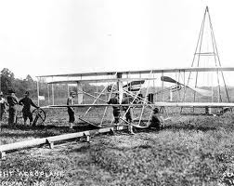
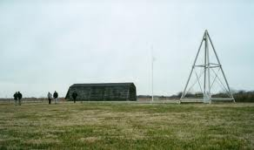
THIS DAY IN AVIATION
September 7
1904 — The Wright Brothers first use their weight-and-derrick-assisted take-off device in order to make themselves independent of the wind and weather.
When the heavy weight is released, the rope pulls the aircraft, which sits on a flatbed truck, over the launching track, thus assisting its take-off.

Slide 3
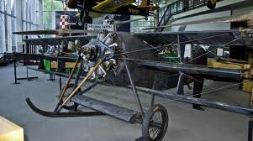
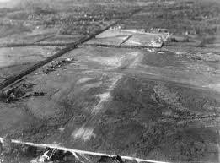
THIS DAY IN AVIATION
September 7
1909 — The United States Army's first “Aerodrome,” an airfield or airport, is established in College Park, Maryland.

Slide 4
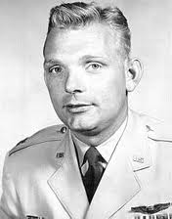
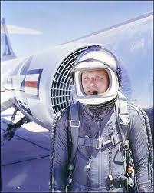
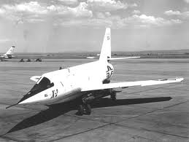
THIS DAY IN AVIATION
September 7
1956 — New manned flight altitude record of 125,200 feet set by Capt. I.C. Kincheloe. (Bell X-2)

Slide 5
Questions / Comments

Slide 6
Learning Objectives – Module 2 (8/29/16 – 9/11/16) Aerodynamics from a Management Standpoint
Management of Aeronautical Science
Upon successful completion of this module, you will be able to:
Locate the major components of an aircraft.
Demonstrate the two physics principles that affect flight – Newton’s Laws of Motion and Force and Bernoulli’s Principle of Pressure.
Describe how the four forces influence aircraft stability and flight maneuvers.
Monday

Slide 7
Learning Objectives – Module 2 (8/29/16 – 9/11/16) Aerodynamics from a Management Standpoint
Management of Aeronautical Science
Upon successful completion of this module, you will be able to:
Develop a working knowledge of aerodynamic terms.
Describe the aircraft design and certification requirements.
Examine Airworthiness Requirements (14 CFR), Type Certification Data Sheets, Airworthiness Directives, and Advisory Circulars
Explore management considerations such as the Minimum Equipment List (MEL), Deferred Maintenance Items (DMIs), and other management considerations.
Explore the methods used by management to improve fuel efficiency of aircraft.
Tuesday
Wednesday

Slide 8
Questions / Comments

Slide 9
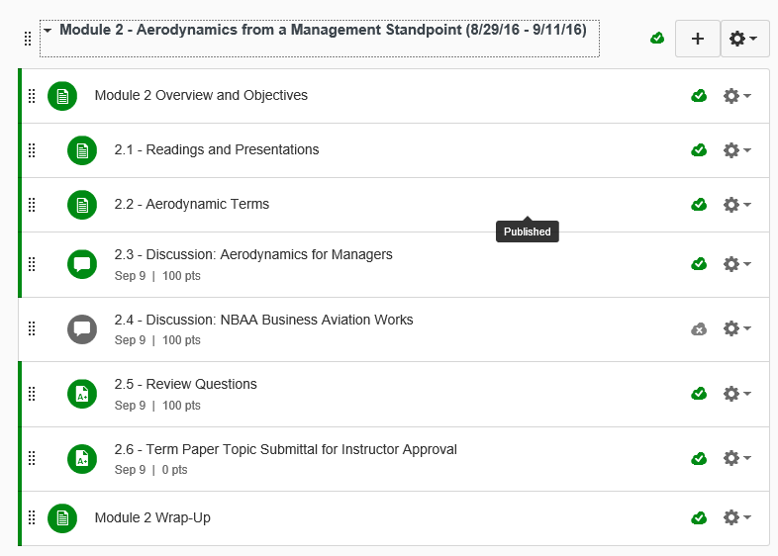

Slide 10
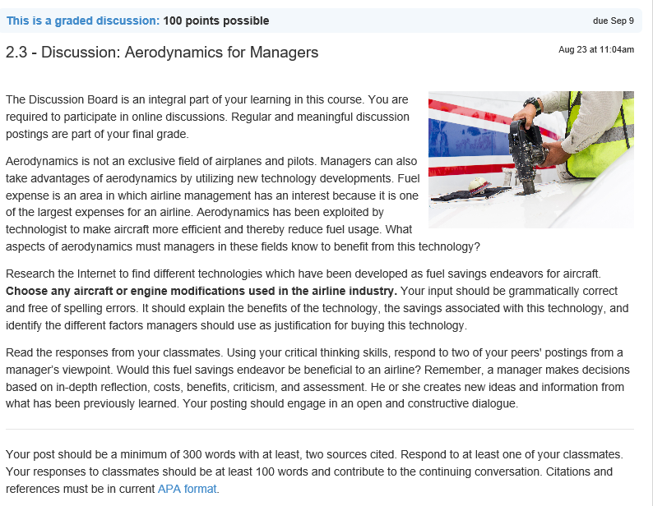
Discussion: Aerodynamics for Managers: Wed Sep 7

Slide 11
Module 2 Review Questions (Due Fri Sep 9)
Spend quality time responding to the following questions in your own words.
1. In managing your flying business, a key requirement is to develop an aircraft use policy. Describe what an aircraft use policy is and what should be included.
2. You are tasked by your CEO to perform an analysis for purchasing a used aircraft. What FAA document will provide the specifications or data on the aircraft and was a result of the aircraft airworthiness certificate? What specifically would this data sheet provide?
3. Describe the substructural members of the semi-monologue fuselage.
4. Describe the four aerodynamic forces acting on an aircraft in flight. What is equilibrium?
5. Describe what a Minimum Equipment List (MEL) is, when can an aircraft not depart a station, and name the four columns associated with the MEL document.
6. The CEO stated she wants a review of the 14 CFR parts for Airworthiness Standards for fixed wing aircraft, engines, and propellers. Please provide a list of those standards as a starting outline for a maintenance policy and procedures book.

Slide 12
Assignments Due – Module 2 (8/29/16 – 9/11/16)
Management of Aeronautical Science
Review Module 2 Instructions for the following assignments:
Discussion Board Due (Aerodynamics for Managers)
(Due - Wed Sep 7) – 2 part (Post and Respond)
Review Questions – Aerodynamics from a Management Standpoint
(Due - Fri Sep 9) – 6 Questions

Slide 13
September 2016
Sunday | Monday | Tuesday | Wednesday | Thursday | Friday | Saturday
28 | 29 Module 2 Intro Aircraft Components | 30 Module 2 Aircraft Design and Certification | 31 Module 2 MEL and DMI Progress Reports Due | 1 Beaufort County Airport (ILT) | 2 Flightline Friday Progress Reports Sent Home | 3
4 | 5 HOLIDAY Labor Day | 6 Module 2 Aircraft Components | 7 Module 2 Aircraft Components Discussion Due | 8 Beaufort County Airport (ILT) | 9 Review Questions Due Flightline Friday | 10
11 | 12 Module 3 Propulsion and Aircraft Performance | 13 Module 3 | 14 Module 3 | 15 Beaufort County Airport (ILT) | 16 Flightline Friday | 17
18 | 19 Module 3 | 20 Module 3 | 21 Module 3 Discussion Due Progress Reports Due | 22 Beaufort County Airport (ILT) | 23 Review Questions Due Progress Reports Sent Home | 24

Slide 14
Questions / Comments

Slide 15
MGMT 203 Aerodynamics from a Management Standpoint
Module 2

Slide 16
Questions / Comments

