Slide 1
MGMT 203 Aerodynamics from a Management Standpoint
Module 2

Slide 2
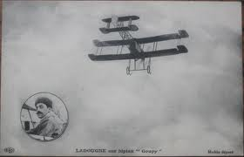
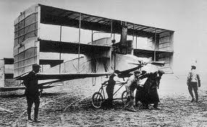
THIS DAY IN AVIATION
September 5
1908 — The first flight of a full-size triplane, the French “Goupy,” is made.
Built by Ambroise Goupy, it has three sets of wings; each stacked above the others and is powered by 50-hp Renault engine.

Slide 3
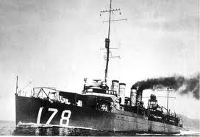
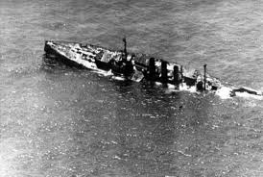
THIS DAY IN AVIATION
September 5
1923 — Two condemned naval vessels sunk by Army bombing tests.

Slide 4
Questions / Comments

Slide 5
September 2017
Sunday | Monday | Tuesday | Wednesday | Thursday | Friday | Saturday
27 | 28 Module 1 Intro Aeronautical Science | 29 Module 1 Aeronautical Science | 30 Module 1 Aeronautical Science Review Questions Due | 31 Module 1 Aeronautical Science | 1 Review Questions Due Flightline Friday | 2
3 | 4 HOLIDAY | 5 Module 2 Intro Aerodynamics from a Management Perspective | 6 Module 2 Aerodynamics from a Management Perspective | 7 Module 2 Aerodynamics from a Management Perspective | 8 Flightline Friday Progress Reports Sent Home | 9
10 | 11 Module 2 Aerodynamics from a Management Perspective | 12 Module 2 Aerodynamics from a Management Perspective | 13 Module 2 Aerodynamics from a Management Perspective Review Questions Due | 14 Beaufort County Airport (ILT) | 15 Review Questions Due Flightline Friday | 16
17 | 18 Module 3 Intro Propulsion and Aircraft Performance | 19 Module 3 Propulsion and Aircraft Performance | 20 Module 3 Propulsion and Aircraft Performance | 21 Module 3 Propulsion and Aircraft Performance | 22 Flightline Friday Progress Reports Sent Home | 23

Slide 6
Learning Objectives – Module 2 (9/5/17 – 9/15/17) Aerodynamics from a Management Standpoint
Management of Aeronautical Science
Upon successful completion of this module, you will be able to:
Locate the major components of an aircraft.
Demonstrate the two physics principles that affect flight – Newton’s Laws of Motion and Force and Bernoulli’s Principle of Pressure.
Describe how the four forces influence aircraft stability and flight maneuvers.

Slide 7
Learning Objectives – Module 2 (9/5/17 – 9/15/17) Aerodynamics from a Management Standpoint
Management of Aeronautical Science
Upon successful completion of this module, you will be able to:
Develop a working knowledge of aerodynamic terms.
Describe the aircraft design and certification requirements.
Examine Airworthiness Requirements (14 CFR), Type Certification Data Sheets, Airworthiness Directives, and Advisory Circulars
Explore management considerations such as the Minimum Equipment List (MEL), Deferred Maintenance Items (DMIs), and other management considerations.
Explore the methods used by management to improve fuel efficiency of aircraft.

Slide 8
Questions / Comments

Slide 9
Readings
The Pilot’s Handbook of Aeronautical Knowledge provides a basic overview of aeronautical management.
Chapter 3 – Aircraft Construction
Chapter 4 – Principles of Flight
Chapter 5 – Aerodynamics of Flight
Title 14 Code of Federal Regulations (CFR) - federal regulations to gain more information about your future career.
Please review 14 CFR Parts:
13, 21, 23, 25, 26, 27, 29, 33, 35, 39, 61, and 121.

Slide 10
Readings
The textbook will provide you with an excellent knowledge base for managing an aerospace company.
Please pay attention to the management areas because you will have a term paper assignment on managing a company or agency that will be due for module 8.
Chapter 3: Getting Started

Slide 11
Discussion: NBAA Business Aviation Works
Business aviation plays a vital role to companies, customers, economy, creating jobs, and provide another transportation opportunity for areas not supported by the airlines.
View the video.
Post a brief synopsis of the video and how it pertains to our MGMT 203 course.
What are some main points that you found interesting.
Describe key points could you use if you were a manager of a business or corporate flight department.
https://www.youtube.com/watch?v=sjx_1ePTZcE
Your post should be a minimum of 300 words with at least, two sources cited.
Respond to at least one of your classmates.
Your responses to classmates should be at least 100 words

Slide 12
Module 2 Review Questions (Due Fri Sep 15)
Spend quality time responding to the following questions in your own words.
1. In managing your flying business, a key requirement is to develop an aircraft use policy. Describe what an aircraft use policy is and what should be included.
2. You are tasked by your CEO to perform an analysis for purchasing a used aircraft. What FAA document will provide the specifications or data on the aircraft and was a result of the aircraft airworthiness certificate? What specifically would this data sheet provide?
3. Describe the substructural members of the semi-monologue fuselage.
4. Describe the four aerodynamic forces acting on an aircraft in flight. What is equilibrium?
5. Describe what a Minimum Equipment List (MEL) is, when can an aircraft not depart a station, and name the four columns associated with the MEL document.
6. The CEO stated she wants a review of the 14 CFR parts for Airworthiness Standards for fixed wing aircraft, engines, and propellers. Please provide a list of those standards as a starting outline for a maintenance policy and procedures book.

Slide 13
Term Paper Topics
Your Final Term Paper must be at least 12 pages and consist of the following:
A title page
Main text (10 pages)
Reference page (current APA format)
The paper should include some of the headings below as appropriate:
Introduction
Description of the Company or Agency (Basically what business are you in)
Operation Description
Equipment or Aircraft
Maintenance Requirements
Manager’s Roles and Responsibilities
Staff Qualifications, Certifications, and Responsibilities
Human Factors
Quality Requirements
Regulations and Laws
Safety
Security
Environmental Responsibilities
Other Management Factors Considered
References (current APA format)
Aircraft Manufacturing Management
- Chris Corbett
Fire and Crash Rescue Management
- Trent Thompson
Helicopter Operations Management
- Casey Bradford

Slide 14
Assignments Due – Module 2 (9/5/17 – 9/15/17)
Management of Aeronautical Science
Review Module 2 Instructions for the following assignments:
Discussion Board Due (NBAA Business Aviation Works)
(Due - Wed Sep 13) – 2 part (Post and Respond)
Review Questions – Aerodynamics from a Management Standpoint
(Due - Fri Sep 15) – 6 Questions

Slide 15
Questions / Comments

Slide 16
MGMT 203 Aerodynamics from a Management Standpoint
Module 2

Slide 17
Purpose of this Course
This course provides a management perspective of the course learning objectives.
The intent of the course is not a pilot, maintainer, air traffic controller, safety inspector, security agent, or weather forecaster specifics.

Slide 18
Managers’ Perspective
Understand the basics of
Design of aircraft, engines, and propellers
Certification Requirements
Airworthiness Requirements (14 CFR)
Type Certification Data Sheets
Aircraft structures
Four aerodynamic forces
Five major stresses on an aircraft

Slide 19
Managers’ Perspective
Understand the basics of
Newton’s Laws
Bernoulli's Principle
Airworthiness Directives
Advisory Circulars
Management Considerations
In this course, we will make reference to Title # CFR Part # as # CFR Part #
Example: 14 CFR Part #

Slide 20
Aircraft Structures
There are three types of metal fuselage structures.
Monocoque Construction
Called single-shell construction.
Consider a soda can construction.
Semi-monocoque construction
Substructure reinforces the skin.
Longerons, Stringers, Frames, Bulkheads
Very common design.
Reinforced Shell
Skin reinforced by a complete framework of structural members.
Sometimes tubular steel was used.

Slide 21
Aircraft Structures
Semi-monocoque substructure members include
Longerons
Take primary bending loads
Lengthwise member
Nose to tail
Stringer
Smaller and lighter than longeron
Nose to tail
Bulkhead or Bulkhead
Oval shaped
Give form to and maintain the shape of structure
Vertical structural member
Formers and Frames
Smaller than bulkheads
Oval
Vertical structural member
Skin attachments

Slide 22
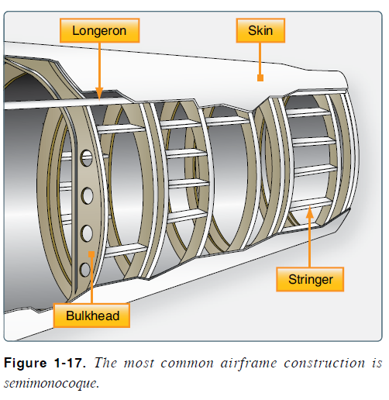
Aircraft Structures

Slide 23
Wing Design and Structure
Designed to produce lift.
The wing design depends on a number of factors.
Size
Weight
Use of aircraft or mission
Desired speed in flight and landing
Desired rate of climb
2 types of wing design.
External bracing
Bi-Plane
Cantilever
Used by most civilian and military aircraft.
No external bracing.
Contains ailerons, flaps, spoilers, and slats.

Slide 24
Wing Structure
Structural Members of Wing
Spar
Wing tip to wing tip.
Principle structural member of wing.
Stringers or stiffeners
Wing tip to wing tip.
Different shapes.
Ribs
Give wing its shape.
Run leading edge to trailing edge.
Transmit loads from stringers to skin.

Slide 25
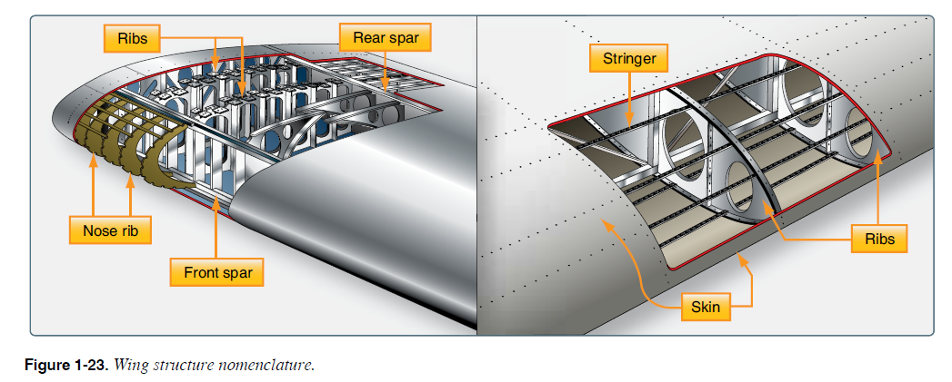
Wing Structure

Slide 26
Winglets
NASA Scientist, Richard Whitcomb
Overcomes the wing tip vortex problems (drag reduction).
Improves wing efficiency and fuel economy.
3 ways manufacturers use to eliminate wing tip vortex.
Wing tip tanks
Dropped wing tips
Winglets
Many aircraft wings are being modified for efficiencies that can be gained.

Slide 27
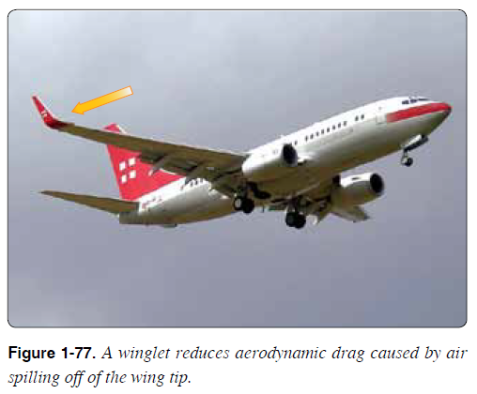
Winglets

Slide 28
Empennage Structure
Tail section.
Horizontal stabilizer (with elevators).
Vertical stabilizer (with rudder).
Similar to wing structural members.
Gives stability to aircraft.
T-Tail arrangement prevents turbulence over horizontal stabilizer and elevators.

Slide 29
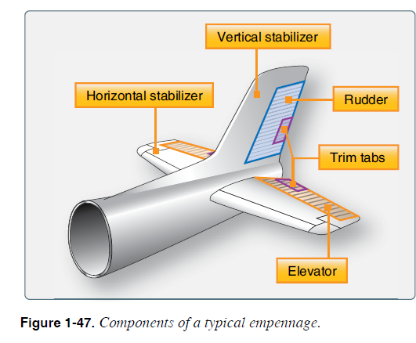
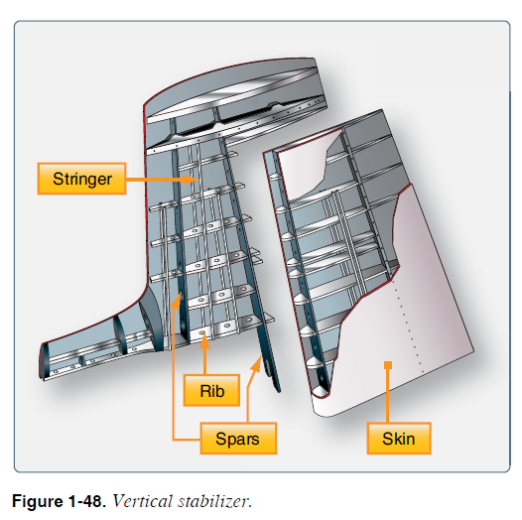
Empennage Structure

Slide 30
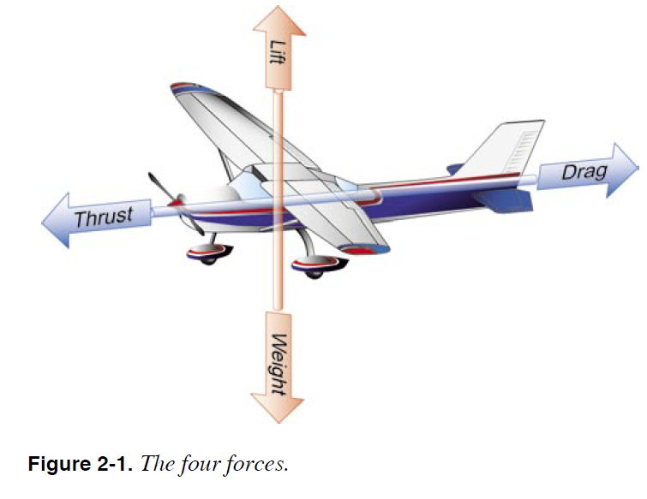
Four Aerodynamic Forces

Slide 31
Four Aerodynamic Forces
Lift
Upward force
Lift opposed by weight or gravity
Weight
Tends to draw an object toward earth (caused by gravity)
Thrust
Forward force
Force which overcomes drag
Drag
Backward deterrent force
Drag opposed by thrust
When all four forces are balanced (equilibrium) the aircraft is flying straight and level.

Slide 32
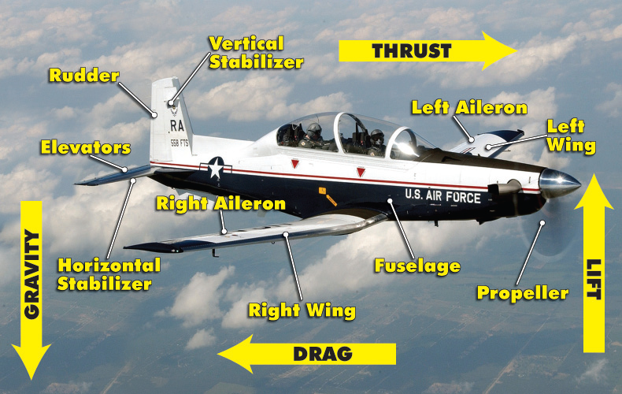

Slide 33
Questions / Comments

