Slide 1


MGMT 203
Propulsion and Aircraft Performance Management Perspective
Module 3

Slide 2
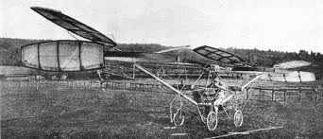
THIS DAY IN AVIATION
September 19
1907 — The first piloted helicopter rises at Douai in France.
Piloted by Volumard, it rises only about 2 feet and is steadied by men on the ground.
It does not constitute free, vertical flight.

Slide 3
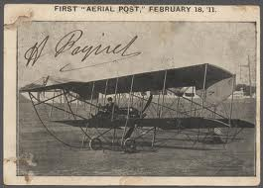
THIS DAY IN AVIATION
September 19
1911 — One of the first aerial photography experiments was made from an airplane.

Slide 4
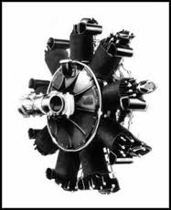
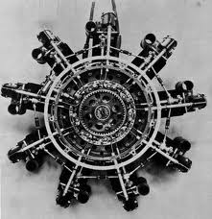
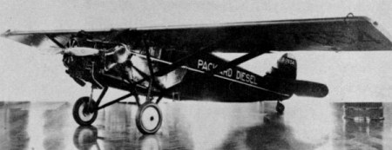
THIS DAY IN AVIATION
September 19
1928 — The first diesel engine to power a heavier-than-air aircraft is flight tested in Utica, Michigan.

Slide 5

Questions / Comments

Slide 6
Learning Objectives – Module 3 (9/18/17 – 9/29/17)
Propulsion and Aircraft Performance Management Perspective
Management of Aeronautical Science
Upon successful completion of this module, you will be able to:
  Define aircraft performance terms and life cycles costs.
  Describe the Aircraft Flight Manual (AFM) and Pilot’s Operating Handbook.
  Describe three classifications of reciprocating engines.
  Describe a turbofan engine that has a dual spool axial flow compressor.
  Examine the different types of systems used for reciprocating and turbine engines.
  Critique why a turboprop engine is used and its three sections.
  Describe a propeller and how thrust is produced.

Slide 7
Learning Objectives – Module 3 (9/18/17 – 9/29/17)
Propulsion and Aircraft Performance Management Perspective
Management of Aeronautical Science
Upon successful completion of this module, you will be able to:
  Describe where you can find weight and balance limitations specified.
  Analyze aircraft payloads for overweight conditions and proper loading of an airplane.
  Describe the two types of plans that are used in the business flight department.
  Compose a list of business flight department records. Consider operations and maintenance.

Slide 8
Questions / Comments

Slide 9
Readings
The Pilot’s Handbook of Aeronautical Knowledge
  Chapter 7 - Aircraft Systems, Powerplants (pages 7-1 to 7-24)
  Chapter 10 - Weight and Balance
  Chapter 11 - Aircraft Performance
Title 14 Code of Federal Regulations (CFR) - Please review 14 CFR Parts:
  33, 91, 121, 125, and 135.
Textbook – Business and Corporate Aviation Management
  Chapter 4: Running the Business

Slide 10
Discussion: Interviewing with Northern Air Cargo for a Management Position Wed Sep 27
You are interviewing for a management position at Northern Air Cargo (Links to an external site.)Links to an external site.(NAC), a general airfreight service that operates throughout Alaska. As part of your preparation for the interview, you thoroughly check out their website. You also found out that the interviewers are likely to discuss any of these topics:
Aircraft Performance
Turbofan engines
Air cargo and freight operations
Hazardous materials
Safety culture
Routes and Locations
Problems with weight and balance
Repairs and modifications
Maintenance scheduling vs. flight schedules
PART I: Choose one of the Interview Topics from above and discuss how they relate to the safe and efficient management of Northern Air Cargo operations. Consider that you are interviewing with Northern Air Cargo and have been asked the following question: "As the next Manager of Aviation Operations at Northern Air Cargo how will you safely, effectively, and efficiently address (enter topic here)?"
PART II: Be sure to read the responses from your classmates logically. Remember, a manager's role is to provide proper thorough oversight and direction to a group that is trying to accomplish a certain task.
Your post should be a minimum of 300 words with at least, two sources cited.
Respond to at least one of your classmates.
Your responses to classmates should be at least 100 words

Slide 11
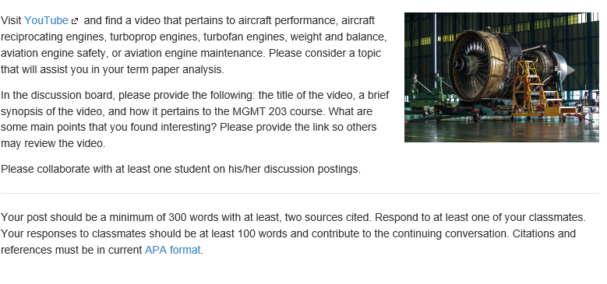
Discussion: YouTube Video: Wed Sep 27

Slide 12
Module 3 Review Questions
(Due Fri Sep 29)
Spend quality time responding to the following questions in your own words.
1. Defend the importance of the Aircraft Flight Manual (AFM) and Pilot’s Operating Handbook.
2. Name the four stages or the Life Cycle Costs and describe which stage is the highest and why.
3. Describe the three classifications of reciprocating engines. Please give examples of each type.
4. Describe two types of plans that are used in a business or corporate aviation flight department.
5. Describe why a turboprop is used in aviation today. What are the three main sections of a turboprop engine?

Slide 13
Term Paper Topics
Your Final Term Paper must be at least 12 pages and consist of the following:
A title page
Main text (10 pages)
Reference page (current APA format)
The paper should include some of the headings below as appropriate:
Introduction
Description of the Company or Agency (Basically what business are you in)
Operation Description
Equipment or Aircraft
Maintenance Requirements
Manager’s Roles and Responsibilities
Staff Qualifications, Certifications, and Responsibilities
Human Factors
Quality Requirements
Regulations and Laws
Safety
Security
Environmental Responsibilities
Other Management Factors Considered
References (current APA format)
Aircraft Manufacturing Management
- Chris Corbett
Fire and Crash Rescue Management
- Trent Thompson
Helicopter Operations Management
- Casey Bradford

Slide 14
Assignments Due – Module 3
(9/18/17 – 9/29/17)
Management of Aeronautical Science
Review Module 3 Instructions for the following assignments:
Discussion Board Due (Interviewing with Northern Air Cargo for a Management Position)
  (Due - Wed Sep 27) – 2 part (Post and Respond)
Discussion Board Due (YouTube Video)
  (Due - Wed Sep 27) – 2 part (Post and Respond)
Review Questions – Propulsion and Aircraft Performance Management Perspective
  (Due - Fri Sep 29) – 5 Questions

Slide 15
September / October 2017
Sunday | Monday | Tuesday | Wednesday | Thursday | Friday | Saturday
17 | 18 Module 3 Intro Propulsion and Aircraft Performance | 19 Module 3 Propulsion and Aircraft Performance | 20 Module 3 Propulsion and Aircraft Performance | 21 Module 3 Propulsion and Aircraft Performance | 22 Flightline Friday Progress Reports Sent Home | 23
24 | 25 Module 3 Propulsion and Aircraft Performance | 26 Module 3 Propulsion and Aircraft Performance | 27 Module 3 Propulsion and Aircraft Performance Discussion Due | 28 Beaufort County Airport (ILT) | 29 Flightline Friday Review Questions Due | 30
1 | 2 Module 4 Intro Aircraft Systems and Maintenance | 3 Module 4 Aircraft Systems and Maintenance | 4 Module 4 Aircraft Systems and Maintenance | 5 Module 4 Aircraft Systems and Maintenance | 6 Flightline Friday | 7
8 | 9 Module 4 Aircraft Systems and Maintenance | 10 Module 4 Aircraft Systems and Maintenance | 11 Module 4 Aircraft Systems and Maintenance Discussion Due | 12 Beaufort County Airport (ILT) | 13 Flightline Friday Review Questions Due Progress Reports Sent Home | 14

Slide 16
Questions / Comments

Slide 17
MGMT 203
Propulsion and Aircraft Performance Management Perspective
Module 3

Slide 18
Propulsion
Let’s explore the very basics of the types of engines and their systems

Slide 19
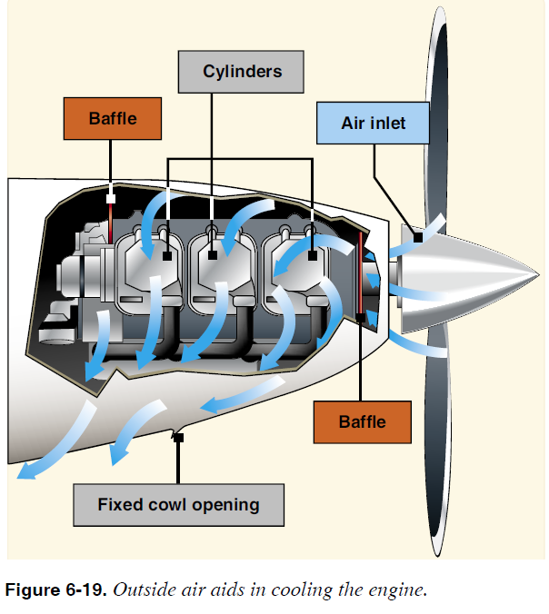
Reciprocating Engines
Internal combustion engine
Converts chemical energy to heat energy to mechanical energy to drive propeller.
Reciprocating action of pistons inside cylinders
3 ways to classify reciprocating engines
  Cylinder arrangement
  Cooling system type
  Lubricating system type

Slide 20
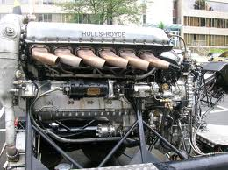
Reciprocating Engines
  Cylinder arrangement
    Inline
      Even number of cylinders or all cylinders in a row.
    V Type
      Cylinders arranged in 2 rows or banks forming the letter "V" with an angle.
      Even number of cylinders.

Slide 21
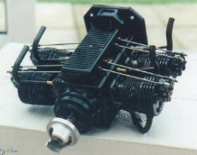
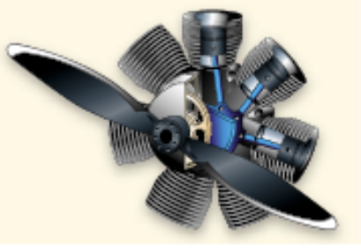
Reciprocating Engines
  Cylinder arrangement
    Opposed or O Type Engines
      2 banks of cylinders directly opposite each other.
      Vertical or horizontally mounted.
      Most widely used in general aviation (GA).
    Radial Engines
      Consists of a row, or rows of cylinders arranged radially about a central crankcase.
      Odd number of cylinders 5, 7, or 9 per row.
      May have dual rows (9 cylinders in front and 9 in the back).
      Greatest drag of all cylinder arrangements.

Slide 22
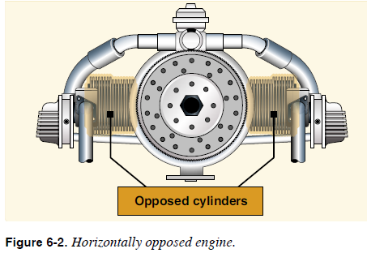
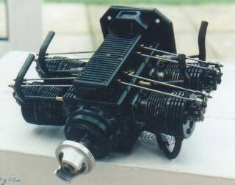
Reciprocating Engines
FAA. (2008). FAA-H-8083-25 Pilot's Handbook of Aeronautical Knowledge.
p. 6-2

Slide 23
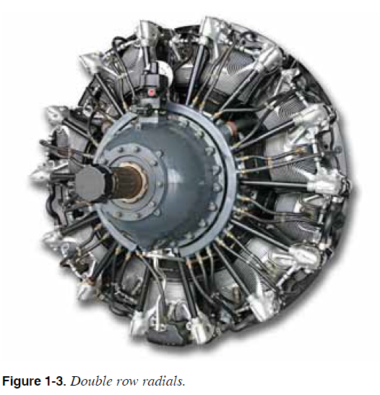
Reciprocating Engines
FAA (2012). FAA-H-8083-32 Aviation Maintenance Technician Handbook – Powerplant.
p. 1-5

Slide 24
Reciprocating Engines
Cooling system type
  Air cooled (fins around the cylinder)
    Very common
  Liquid cooled (radiator)
Lubricating system type
  Wet sump system
    Entire oil supply is carried in engine.
    Example car engine.
  Dry sump system
    Independent oil system.
    Separate tank and tubing or hose to engine oil pump.

Slide 25
Reciprocating Engines
Most of the reciprocating engines used today are 4 stroke engines.
5 events of a 4 stroke engine in the order of occurrence.
  Intake
  Compression
  Ignition
  Power
  Exhaust

Slide 26
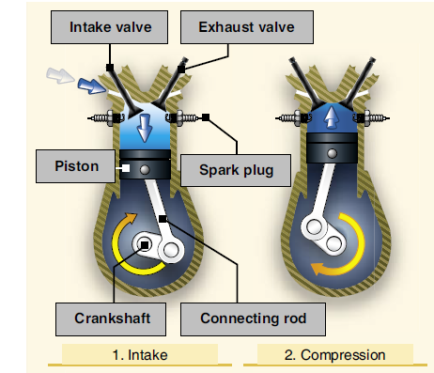
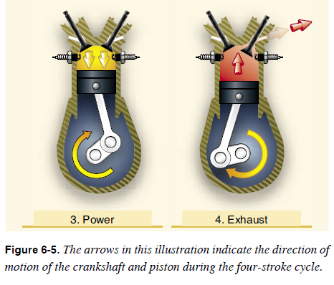
Reciprocating Engines
FAA. (2008). FAA-H-8083-25 Pilot's Handbook of Aeronautical Knowledge. p. 6-4

Slide 27
Reciprocating Engine Components
Crankcase Section
  Foundation of engine
  One piece or multi-piece construction
Cylinder
  Two main parts of a cylinder are
    Cylinder head
      Intake and exhaust valves
      2 spark plugs
    Cylinder barrel
      Connected to cylinder head and crankcase
Pistons move up and down in the cylinder
  Has compression rings and oil ring

Slide 28
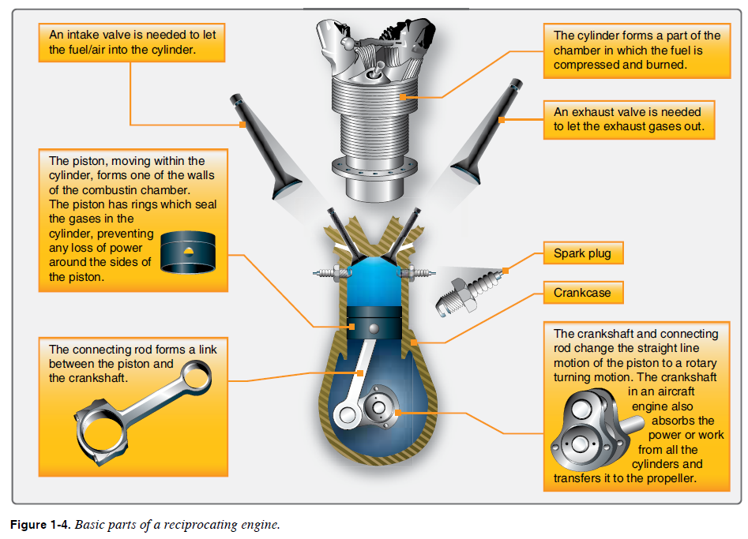
Reciprocating Engines
FAA (2012). FAA-H-8083-32 Aviation Maintenance Technician Handbook – Powerplant. p. 1-6

Slide 29
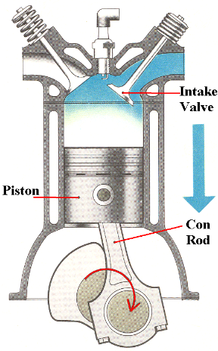
Powerplants
Reciprocating Engines
1. The intake stroke begins as the piston starts its downward travel.
  When this happens, the intake valve opens and the fuel/air mixture is drawn into the cylinder.
  SUCK, SQUEEZE, BANG, BLOW.

Slide 30
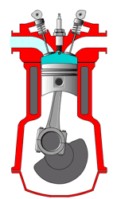
Powerplants
Reciprocating Engines
2. The compression stroke begins when the intake valve closes and the piston starts moving back to the top of the cylinder.
  This phase of the cycle is used to obtain a much greater power output from the fuel/air mixture once it is ignited.
  SUCK, SQUEEZE, BANG, BLOW.

Slide 31
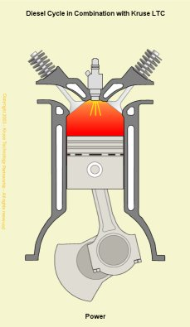
Powerplants
Reciprocating Engines
3. The power stroke begins when the fuel/air mixture is ignited.
  This causes a tremendous pressure increase in the cylinder, and forces the piston downward away from the cylinder head, creating the power that turns the crankshaft.
  SUCK, SQUEEZE, BANG, BLOW.

Slide 32
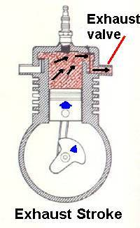
Powerplants
Reciprocating Engines
4. The exhaust stroke is used to purge the cylinder of burned gases.
  It begins when the exhaust valve opens and the piston starts to move toward the cylinder head once again.
  SUCK, SQUEEZE, BANG, BLOW.

Slide 33
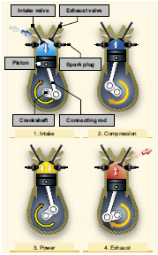
Powerplants
Reciprocating Engines
The four-stroke cycle takes place several hundred times each minute.
In a four-cylinder engine, each cylinder operates on a different stroke.

Slide 34
Powerplants
Reciprocating Engines
Continuous rotation of a crankshaft is maintained by the precise timing of the power strokes in each cylinder.
Continuous operation of the engine depends on auxiliary systems, including the induction, ignition, fuel, oil, cooling, and exhaust systems.

Slide 35
Powerplants
Reciprocating Engines
The intake/exhaust valves, spark plugs, and pistons are located in the cylinders.
The crankshaft and connecting rods are located in the crankcase.
The magnetos are normally located on the engine accessory housing.

Slide 36
Reciprocating Engine Systems
Intake system
  Must allow the proper amount of clean air to enter the engine at all operating conditions.
  Normally aspirated (nonsupercharged).
  May be supercharged.
    Supercharger driven by engine
    Turbocharger (driven by exhaust gases).
  Carburetor heat system prevents ice from forming.
    Alternate air valve is used to select heat or no heat.
    14 CFR Part 23 each reciprocating engine air induction system must have a means to remove and eliminate ice.

Slide 37
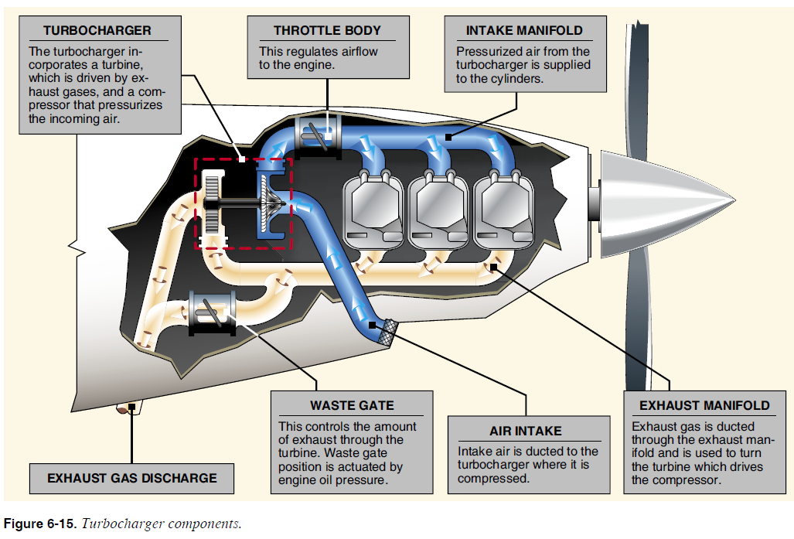
Reciprocating Engines Systems
FAA. (2008). FAA-H-8083-25 Pilot's Handbook of Aeronautical Knowledge. p. 6-13

Slide 38
Reciprocating Engines Systems
Exhaust System
  Dispose of exhaust gases away from engine and aircraft.
  Exhaust pipes
  Mufflers
  Cracks are most common exhaust system problem.
Cooling
  Air cooled (fins around the cylinder)
  Liquid cooled (radiator)

Slide 39
Reciprocating Engines Systems
FAA. (2008). FAA-H-8083-25 Pilot's Handbook of Aeronautical
Knowledge. p. 6-17

Slide 40
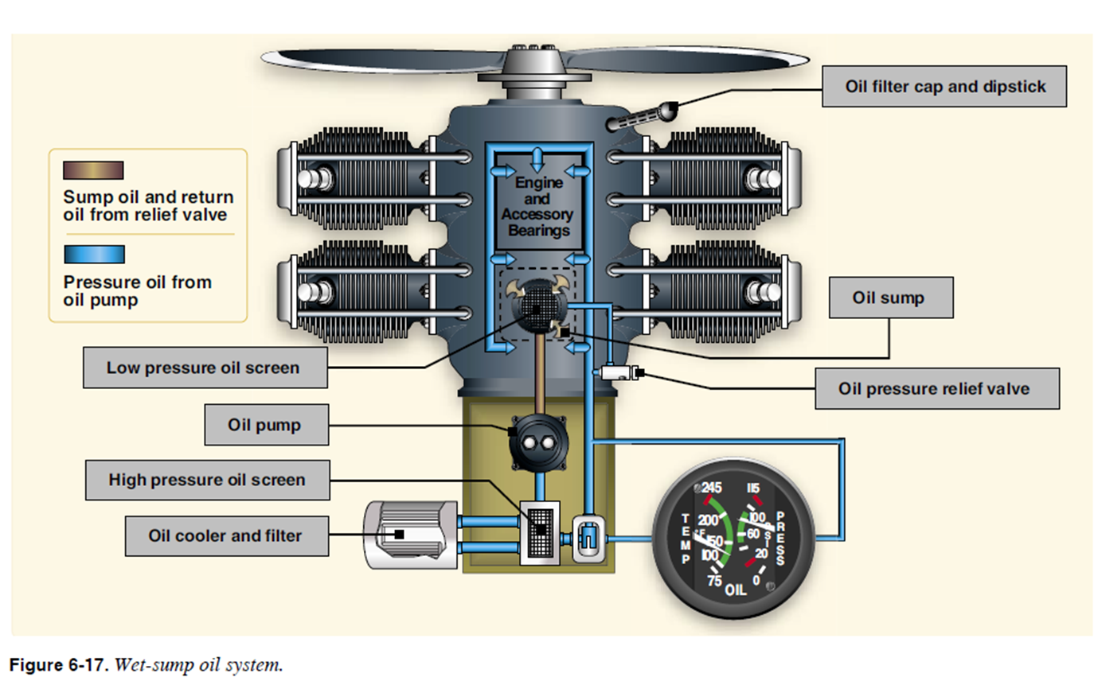
Reciprocating Engines Systems
Engine oil system
  Function
    Lubricates (reduces friction)
    Cools (oil absorbs heat and carries it away)
    Seal and cushions shock
    Cleans
    Protects against corrosion
  Components
    Oil tank (may have a Reserve Oil Tank)
    Filter
    Oil pumps (main and scavenge)
    Oil cooler and control valve
      Airflow controls (oil cooler flap)

Slide 41

Reciprocating Engines Systems
FAA. (2008). FAA-H-8083-25 Pilot's Handbook of Aeronautical Knowledge. p. 6-16

Slide 42
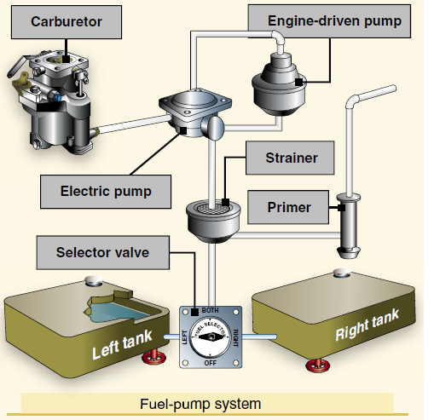
Reciprocating Engines Systems
Fuel Feed Systems
  Fuel comes from the aircraft fuel supply system.
  Different types of fuel are used depending upon engine.
  Supply fuel to carburetor under all altitudes, attitudes, and temperatures.
  Components
    Low pressure filter
    Engine driven fuel pump
    High pressure filter
    Fuel metering system (Throttle)
      Float carburetor, pressure carburetor, or fuel injection system.
    Mixture Control System (Flight deck controlled)
      Mixture control and fuel shutoff .

Slide 43
Reciprocating Engines Systems
FAA. (2008). FAA-H-8083-25 Pilot's Handbook of Aeronautical Knowledge. p. 6-25

Slide 44
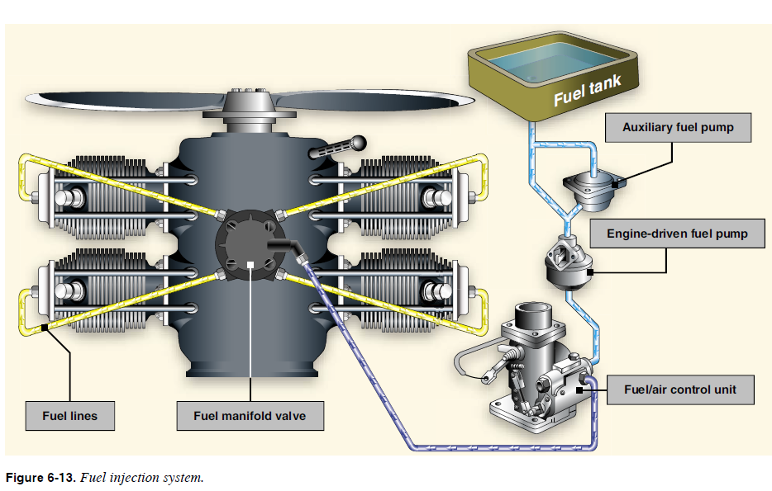
Reciprocating Engines Systems
FAA. (2008). FAA-H-8083-25 Pilot's Handbook of Aeronautical Knowledge. p. 6-11

Slide 45
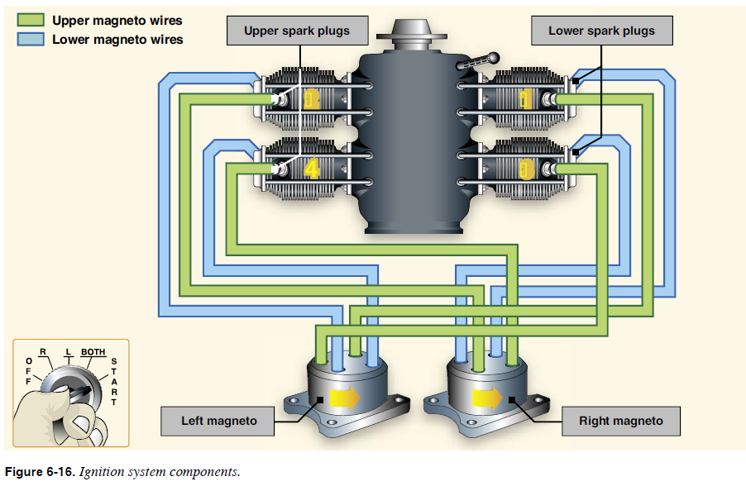
Reciprocating Engines Systems
Engine Ignition Systems
  Dual type ignition system
    Two independent systems = if one system fails, engine will operate on the other ignition system.
  Components
    Ignition Switch in flight deck
      Controls left or right ignition systems, both, or shutoff.
    Magnetos (2 separate or dual in one magneto housing)
      Self‑contained magneto which supplies the electrical energy for the ignition system.
      Once engine starts, magnetos do not need an aircraft battery.
    Coils – step up electricity (step up transformer)
      May be located inside magneto or separate for each spark plug.
    Distributor – distributes spark to spark plugs.
    Spark plugs – two plugs per cylinder.

Slide 46
Reciprocating Engines Systems
FAA. (2008). FAA-H-8083-25 Pilot's Handbook of Aeronautical Knowledge. p. 6-15

Slide 47
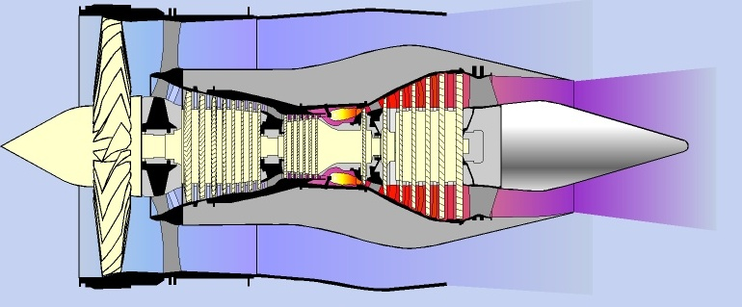
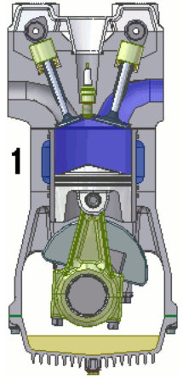
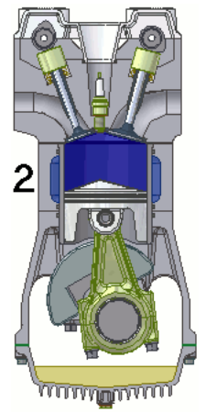
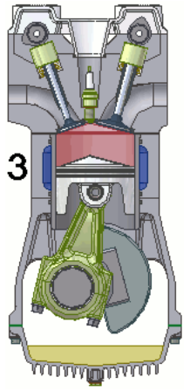
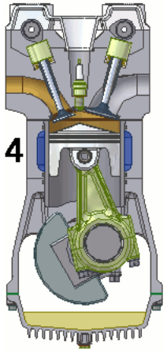
Engine Operation Similarity
Reciprocating and turbine engines have same four operations
Intake
Compression
Ignition
Expansion
Notes:
Each of the stages in a jet engine are similar to the operations of a reciprocating engine.

Slide 48
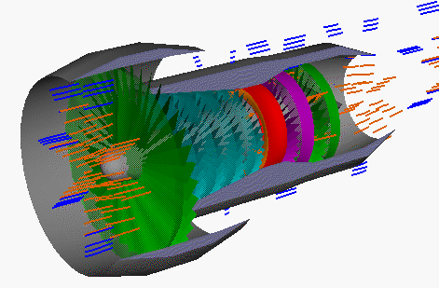
Turbofan
Modern military and commercial aircraft
Combines best of high and low speed and altitude performance
Two airstreams
  Center core of air sent through process similar to basic turbojet
  Some air passes around this center turbojet
  Ratio of two streams is bypass ratio
Notes:
An interactive engine presentation can be found at GE Aviation’s education website: http://www.geae.com/education/index.html . Select Engines 101.
An animated journey through a jet engine can be found at the Rolls Royce education website: http://www.rolls-royce.com/cr/education/resources/how_things_work/index.jsp
Select Take a Journey Through a Jet Engine.
A turbofan engine is the most modern variation of the basic gas turbine engine. As with other gas turbines, there is a core engine. In the turbofan engine, the core engine is surrounded by a fan in the front and an additional turbine at the rear. The fan and fan turbine are composed of many blades, like the core compressor and core turbine, and are connected by an additional shaft also called turbomachinery. As with the core compressor and turbine, some of the fan blades turn with the shaft and some blades remain stationary. The fan shaft passes through the core shaft for mechanical reasons. This type of arrangement is called a two spool engine; one “spool" for the fan, one "spool" for the core. Some advanced engines have additional spools for sections of the compressor which provide for even higher compressor efficiency.
How does a turbofan engine work? The incoming air is captured by the engine inlet. Some of the incoming air, colored blue on the figure, passes through the fan and continues on into the core compressor and then into the burner, where it is mixed with fuel and combustion occurs. The hot exhaust passes through the core and fan turbines and then out the nozzle, as in a basic turbojet.
More information is available at NASA’s website: http://www.grc.nasa.gov/WWW/K-12/airplane/turbfan.html

Slide 49
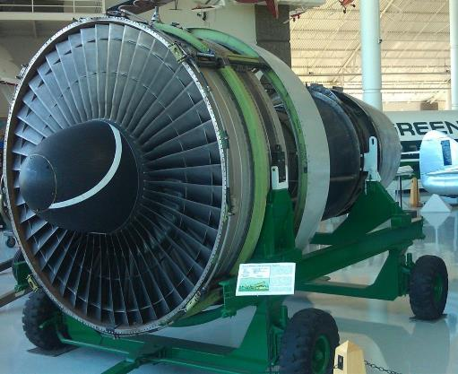
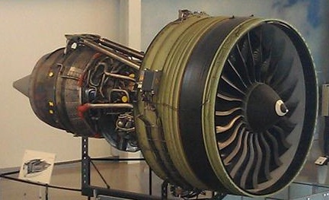
Turbofan
Boeing 777 Engine
Boeing 767 Engine
Notes:
Ask students what the purpose might be for the white stripe on the engine cone. The answer is to indicate to personnel whether the engine is turning or static.

Slide 50
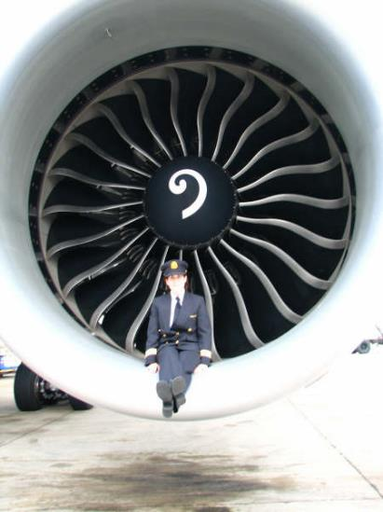
Turbofan Engine Size
Boeing 777 Engine Intake
Notes:
The image shows the scale of a turbofan engine.

Slide 51
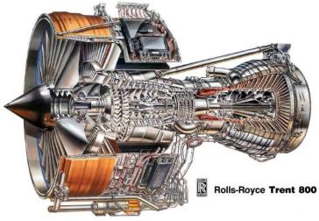
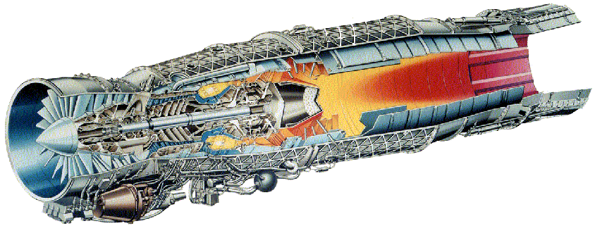
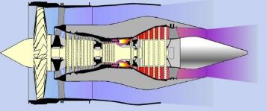

Turbofan Bypass Ratios
High bypass ratio turbofan
for civilian aircraft
Low bypass ratio turbofan
for military aircraft
Notes:
The images on the left are an example of a high bypass ratio turbofan for civilian aircraft. It is a Rolls Royce Trent 800 turbofan engine.
The images on the right are an example of a low bypass ratio turbofan for military aircraft. It is a Rolls Royce EJ200 turbofan engine. The military aircraft’s flight speed and jet velocity are both higher than for a civilian airliner, but jet velocity is still less than a turbojet (V_{flight} < V_{jet} < V_{turbojet}).

Slide 52
Turbofan Operation
Core
compressor
Core turbine
PRESSURE
LPT 1
Bypass
Spare
pressure
Accelerate,
slow down,
accelerate,
slow down,
at each stage
LPT 2
LPT 3
LPT 4
Very fast core jet
Core

Slide 53
Turbofan Systems
Intake
  Must provide a uniform and steady flow.
  Any inefficiencies in the duct results as losses throughout the engine.
  Amount of air passing through an engine is dependent upon 3 factors.
    RPM
    Aircraft forward speed
    Ambient air density

Slide 54
Turbofan Systems
Exhaust
  Located directly behind the turbine section.
  Tailpipe or exhaust duct
    Collects or straightens the gas flow.
    Increase velocity of gases to increase thrust.

Slide 55
Turbofan System
Oil system
  Functions (Same as reciprocating engine)
    Lubricates (reduces friction)
    Cools (oil absorbs heat and carries it away)
    Seal and cushions shock
    Cleans
    Protects against corrosion
  Types Of Oil Systems
    Wet Sump
      Oil stored within engine
    Dry Sump System
      Separate oil tank
      Most common

Slide 56
Turbofan System
Oil system
  Oil Tank
  Pumps
    Supply oil under pressure to engine.
    Two basic types of pumps:
      Pressure = forces oil to engine bearings and gears.
      Scavenge = draws oil from bearings and gears returns oil to tank.
  Filters
  Oil coolers
    Turbine engines that depend solely on lube oil for bearing cooling have an oil cooler.
    2 types
      Air-oil
      Fuel-oil

Slide 57
Turbofan System
Fuel feed system
  Fuel delivered from the aircraft fuel supply system.
  Vary fuel flow to combustion chambers injectors by movement of throttle and metering from a fuel control.
  Components
    Fuel shutoff valve (emergency system)
    Low pressure filter
    Fuel pump
    Fuel heater
    Fuel control (meters fuel to injectors)
      May also have another shutoff valve
    Fuel manifold and injectors

Slide 58
Turbofan System
Ignition System
  Operates during engine start only
  After engine is started - ignition off
  Some aircraft have a continuous ignition system
    Has a low power discharge to one of the ignitor plugs.
    Selected in flight especially during turbulence.
  Requires a high voltage, high energy ignition system
  Trouble free when compared to a reciprocating engine
    Does not use a magneto like the reciprocating engine.
  Components
    Ignition exciter
    2 Spark Ignitors
    Crossover tubes are used for the other combustion chamber cans
      6 cans = 2 igniters

Slide 59
Turbofan Systems
Thrust Reversers (TRs)
  Actuated by engine throttles.
  Satisfy minimum braking requirements on landing.
    Assists Main Landing Gear (MLG) brakes.
  2 basic types
    Mechanical blockage
      Reverse the flow of exhaust gases to help slow the aircraft down.
      Aircraft must be on ground to actuate TRs.
    Aerodynamic blockage
      Use fan discharge to slow the aircraft down.
      Some aircraft use as flight speed brakes.

Slide 60
Turboprop Engine
Provides both the high speed and high altitude of a turbojet with takeoff advantages of a reciprocating engine.
At all flight operations (alpha range) constant speed
A turboprop propeller accounts for 75% - 85% of total thrust output.
3 main sections of a turboprop engine
  Gas Turbine Section (Core sections)
    Single axial flow compressor
  Reduction Gear Box
  Torquemeter

Slide 61
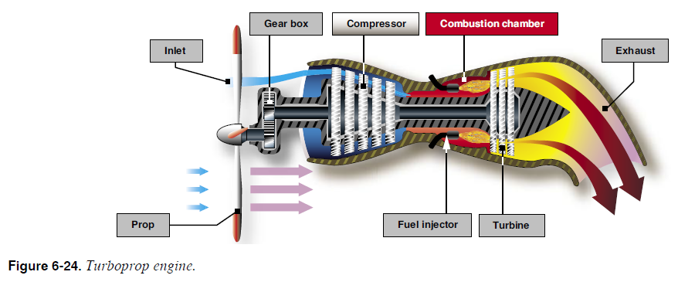
Turboprop Engine
Flying, p. 6-21

Slide 62
Turboprop Engine
Reduction Gear Box (RGB)
  Reduces engine speed to one that the propeller can operate safely and efficiently.
  RGB connects to propeller.
Torquemeter
  Connects engine to RGB.
  Measures torque or horsepower that engine applies to RGB.

Slide 63
Turboprop Engine
Negative Torque System (NTS)
  Negative torque is developed when propeller drive the engine.
  Function is to increase propeller blade angle; therefore, engine drives the propeller.
Safety Coupling
  Connected between torquemeter and RGB.
  Backs up the NTS.
  Decouples the engine from the RGB whenever negative torque exceeds the coupling setting.

Slide 64
Turboprop Systems
Systems are identical to turbofan except for the following.
  Oil system
    Dry sump system
    Gravity feed system to engine and reduction gearbox (RGB).
    Scavenge pumps return oil from RGB and engine to oil tank.
  Fuel system
    Coordinator system
      Fuel control
      Propeller
  Propeller
    No Thrust Reversers like Turbofan engine.
    Propeller reverse system slows the aircraft on the ground with main landing gear brakes.

Slide 65
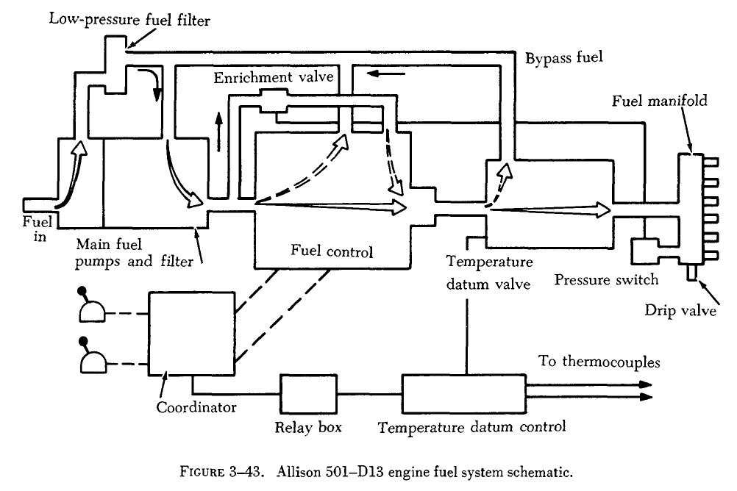
Turboprop Fuel System
FAA. (1976). AC 65-12A Airframe and powerplant mechanics powerplant handbook
(Cancelled). p. 150

Slide 66
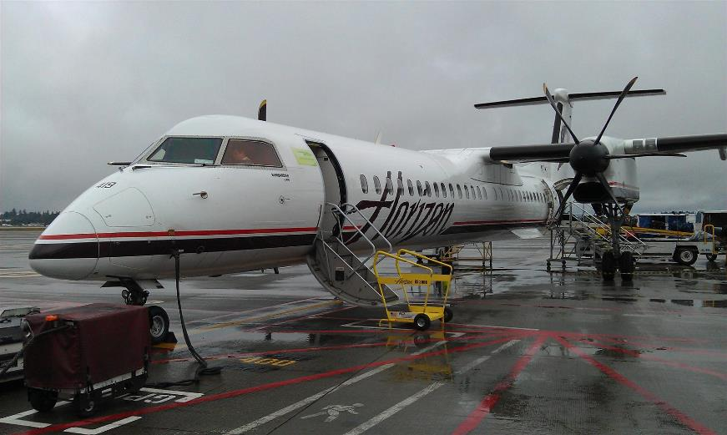
Turboprop Example

Slide 67
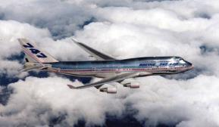
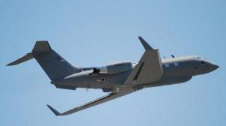
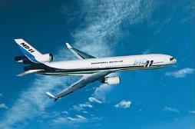
Engine Placement
Engine arrangements
Under wing
  Engine weight close to lift generation
  Reduces wing structure
Rear-fuselage
Mixed under wing and rear fuselage

Slide 68
Propellers (Prop)
Converts torque of engine into thrust (or HP into thrust).
Each blade is essentially a rotating airfoil.
Produces thrust due to low psi on the forward side and a high psi on the aft side of the blade.
Thrust produced is a result of
  Prop shape
  Angle of Attack (AOA)

Slide 69
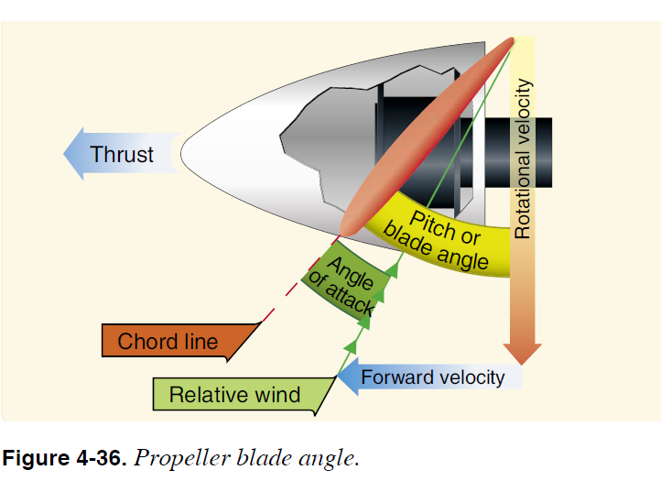
Propellers (Prop)
FAA. (2008). FAA-H-8083-25 Pilot's Handbook of Aeronautical Knowledge. p. 4-24

Slide 70
Propellers (Prop)
Types of propellers
  Fixed Pitch Prop
    Blade pitch or angle is built into the prop and cannot be
    changed.
    Can be wood or metal construction.
  Ground Adjustable Prop
    Operated as a fixed pitch prop in flight.
    Ground adjustable blade angle when prop isn't rotating on the ground.
  Controllable Pitch Prop
    Permits a change in blade angle or pitch while prop is rotating.
    May be a 2 pitch or variable pitch.

Slide 71
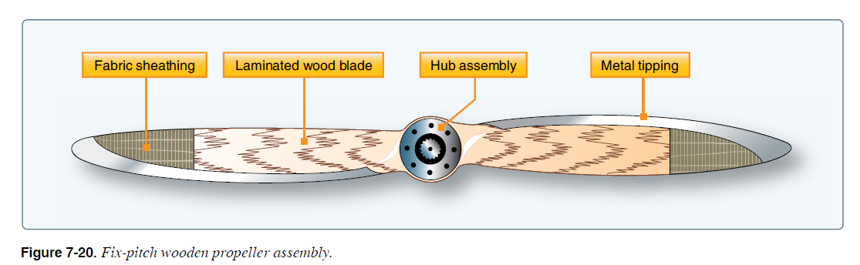
Propellers (Prop)
FAA. (2012). FAA-H-8083-32 Aviation Maintenance Technician Handbook – Powerplant, Volume 2. p. 7-12

Slide 72
Propellers (Prop)
Types of propellers
  Constant Speed Prop
    Blade angle varied to maintain constant RPM
      Turboprop 100% RPM in flight (alpha) range
    Provides maximum efficiency by adjusting blade angles for most flight conditions.
    Governors
      Called constant speed control unit
      RPM sensing device
      Geared to engine
    Set by cockpit control (prop control)
      Sometimes called a condition lever
    Propeller oil system

Slide 73
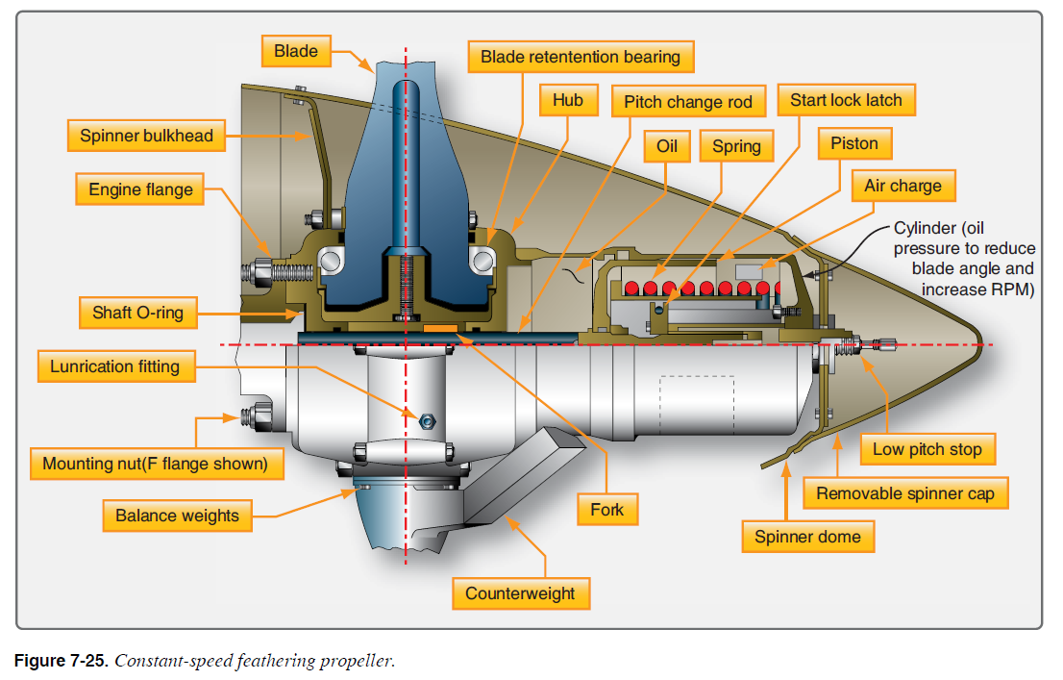
Propellers (Prop)
FAA. (2012). FAA-H-8083-32 Aviation Maintenance Technician Handbook – Powerplant, Volume 2. p. 7-16

Slide 74
Propellers (Prop)
Types of propellers
  Feathering
    Reduce prop drag to a minimum under engine failure conditions.
      Rotate blades to approximately 90 degree angle.
    Most multi-engine aircraft use constant speed feathering props.
  Reversing
    Produces a high negative thrust at low speed by using engine power.
    Reduces ground roll after landing.
    Controlled by the throttle.
    A touchdown circuit (wheels on ground) prevents inadvertent movement to reverse in flight.

Slide 75
Propellers (Prop)
Prop Synchronization
  Over 1 engine aircraft.
  Provides a means of controlling and synchronizing engine RPM to reduce vibration.
  Not used during Takeoff .

Slide 76
Questions / Comments

