Slide 1
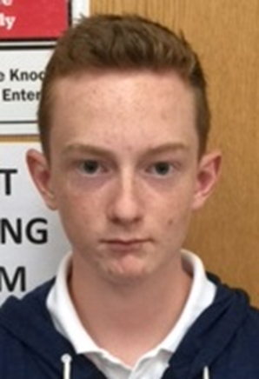
Gordon “Flash” Hetrick
Hair: Red
Eye Color: Blue
WT: 120 HT: 69”
DOB: 03/03/2000
Zach “Z” Langford
Hair: Blonde
Eye Color: Blue
WT: 130 HT: 68”
DOB: 01/20/2000

Slide 2
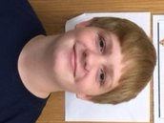
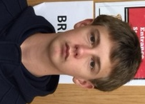
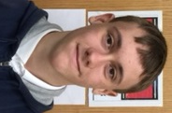
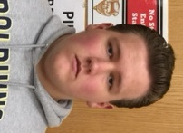
Brandon ”Mr. Young” Young
Hair: Blonde
Eye Color: Blue
WT: 130 HT: 63”
DOB: 02/25/2000
Andrew “Andy” Makowski
Hair: Brown
Eye Color: Hazel
WT: 110 HT: 66”
DOB: 12/26/1999
1
Ray ”Joker” Ayres
Daniel “D” Johnson
Hair: Brown
Eye Color: Blue
WT: 225 HT: 72”
DOB: 02/16/2000
Hair: Brown
Eye Color: Brown
WT: 136 HT: 69”
DOB: 08/07/1999

