Slide 1
MGMT 203 Aircraft Systems and Maintenance – Importance to Management
Module 4

Slide 2
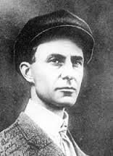
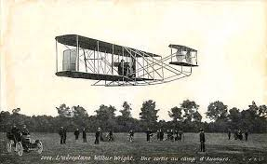
THIS DAY IN AVIATION
October 6
1908 — Wilbur Wright and a French writer make the first passenger flight of over one hour.

Slide 3
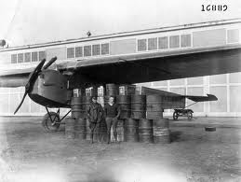
THIS DAY IN AVIATION
October 6
1922 — Lieutenants John Macready and O.G. Kelly set a new world flight endurance record, staying aloft in their Fokker T-2 monoplane for a total of 35 hours, 18 minutes and 30 seconds.

Slide 4
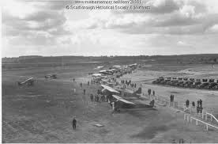
THIS DAY IN AVIATION
October 6
1928 — Air Meet at Wilmington, Delaware.

Slide 5
Questions / Comments

Slide 6
Learning Objectives – Module 4 (10/2/17 – 10/13/17) Aircraft Systems and Maintenance – Importance to Management
Management of Aeronautical Science
Upon successful completion of this module, you will be able to:
1. For a typical aircraft, describe the functions of the flight controls.
2. Examine the components of a typical airframe system such as fuel, landing gear and brakes, oxygen systems, air conditioning systems, pressurization systems, hydraulic systems, deice and anti-ice systems, electrical, and autopilot systems.
3. Explain the formation of shock waves on an aircraft wing.
4. Describe fly by wire primary flight controls and the advantages of this technology.

Slide 7
Learning Objectives – Module 4 (10/2/17 – 10/13/17) Aircraft Systems and Maintenance – Importance to Management
Management of Aeronautical Science
Upon successful completion of this module, you will be able to:
5. Describe the three areas that most maintenance procedures are based upon.
6. Examine the scope and detail of the 100 hour and annual inspection.
7. Describe the recording and approval of Major Repairs and Alterations.
8. Differentiate between the four options to the inspection program for large turbine powered multi-engine aircraft.
9. Discuss the Continuing Analysis and Surveillance System (CASS) of an air carrier maintenance program.
10. Critique the make or buy decision and outsourcing maintenance.
11. Explain the three primary airline maintenance processes.
12. Examine quality requirements for an airline maintenance program.

Slide 8
Questions / Comments

Slide 9
Readings
The Pilot’s Handbook of Aeronautical Knowledge
Chapter 6 – Flight Controls
Chapter 7 – Aircraft Systems
Chapter 8 – Flight Instruments
Title 14 Code of Federal Regulations (CFR) - Please review 14 CFR Parts:
21, 39, 43, 91, 119, and 145.
Textbook – Business and Corporate Aviation Management
Chapter 7: Maintenance

Slide 10
Discussion: Aircraft Systems: Wed Oct 11
Your post should be a minimum of 300 words with at least, two sources cited. Respond to at least two of your classmates. Your responses to classmates should be at least 100 words and contribute to the continuing conversation.

Slide 11
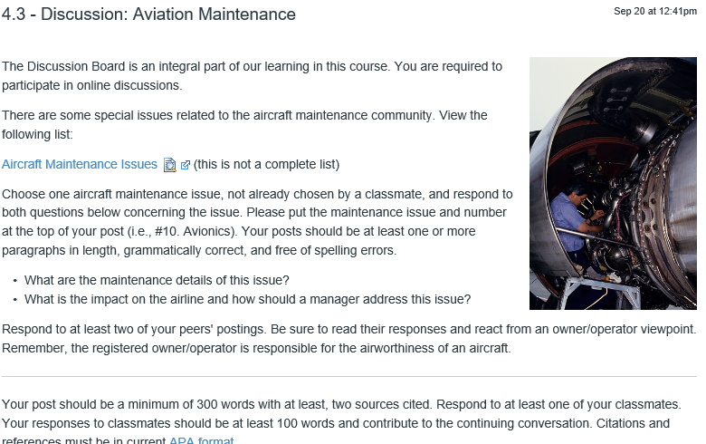
Discussion: Aviation Maintenance: Wed Oct 11

Slide 12
Module 4 Review Questions (Due Fri Oct 13)
Spend quality time responding to the following questions in your own words.
1. Describe the primary flight controls, their movement about each axis, and location.
2. Explain the formation of the wing airfoil normal shock wave during high-speed flight.
3. Examine the scope and detail of the 100 hour and annual inspection. Who has the authority to sign off on each inspection?
4. Differentiate between the four options of the inspection program for large turbine powered, multi-engine aircraft.
5. What is the make or buy decision? Critique both sides for aviation maintenance.

Slide 13
Term Paper Topics
Your Final Term Paper must be at least 12 pages and consist of the following:
A title page
Main text (10 pages)
Reference page (current APA format)
The paper should include some of the headings below as appropriate:
Introduction
Description of the Company or Agency (Basically what business are you in)
Operation Description
Equipment or Aircraft
Maintenance Requirements
Manager’s Roles and Responsibilities
Staff Qualifications, Certifications, and Responsibilities
Human Factors
Quality Requirements
Regulations and Laws
Safety
Security
Environmental Responsibilities
Other Management Factors Considered
References (current APA format)
Aircraft Manufacturing Management
- Chris Corbett
Fire and Crash Rescue Management
- Trent Thompson
Helicopter Operations Management
- Casey Bradford

Slide 14
Assignments Due – Module 4 (10/2/17 – 10/13/17)
Management of Aeronautical Science
Review Module 4 Instructions for the following assignments:
Discussion Board Due (Aircraft Systems)
(Due - Wed Oct 11) – 2 part (Post and Respond)
Discussion Board Due (Aviation Maintenance)
(Due - Wed Oct 11) – 2 part (Post and Respond)
Review Questions – Aircraft Systems and Maintenance – Importance to Management
(Due - Fri Oct 13) – 5 Questions

Slide 15
September / October 2017
Sunday | Monday | Tuesday | Wednesday | Thursday | Friday | Saturday
17 | 18 Module 3 Intro Propulsion and Aircraft Performance | 19 Module 3 Propulsion and Aircraft Performance | 20 Module 3 Propulsion and Aircraft Performance | 21 Module 3 Propulsion and Aircraft Performance | 22 Flightline Friday Progress Reports Sent Home | 23
24 | 25 Module 3 Propulsion and Aircraft Performance | 26 Module 3 Propulsion and Aircraft Performance | 27 Module 3 Propulsion and Aircraft Performance Discussion Due | 28 Beaufort County Airport (ILT) | 29 Flightline Friday Review Questions Due | 30
1 | 2 Module 4 Intro Aircraft Systems and Maintenance | 3 Module 4 Aircraft Systems and Maintenance | 4 Module 4 Aircraft Systems and Maintenance | 5 Module 4 Aircraft Systems and Maintenance | 6 Flightline Friday | 7
8 | 9 Module 4 Aircraft Systems and Maintenance | 10 Module 4 Aircraft Systems and Maintenance | 11 Module 4 Aircraft Systems and Maintenance Discussion Due | 12 Beaufort County Airport (ILT) | 13 Flightline Friday Review Questions Due Progress Reports Sent Home | 14

Slide 16
Questions / Comments

Slide 17
MGMT 203 Aircraft Systems and Maintenance – Importance to Management
Module 4

Slide 18
Maintenance
Understand management perspective of aviation maintenance

Slide 19
AC 120-16F Air Carrier Maintenance Program
Explains the meaning, scope, and content of the maintenance program.
10 Elements of the air carrier program
Airworthiness responsibility
Air carrier maintenance manual
Air carrier maintenance organization
Accomplishment and approval of maintenance and alterations
Maintenance schedule
Required Item Inspection (RII)
Usually 2 A&Ps will sign off the maintenance task
Maintenance recordkeeping system
Contract maintenance
Personnel training
Continuing Analysis And Surveillance System (CASS)

Slide 20
Airline Maintenance Checks
Airlines undergo periodic checks from simple, routine examinations to detailed inspections.
Specifically stated by airline in their procedures.
The information below is an example only
A Check
The shortest and simplest work
Performed every 300 hours of operation

Slide 21
Airline Maintenance Checks
B- Check
Incorporates "A" check requirements
Often is 600-hour intervals or every 6 months
More detailed examinations
May require some disassembly of airframe over the one-to two-day process
C- Check
Performed every two to three years
Includes all elements of “A" and "B" checks
Some disassembly
Detailed aircraft & engine examinations
Often lasts a week or longer

Slide 22
Airline Maintenance Checks
D-Check
Every 6 years
Requires complete structural and systems examination and testing including engine removals.
Several weeks to months depending upon aircraft condition.
Equivalent to Military Depot level maintenance.

Slide 23
Make or Buy Decision
Make is company does their own maintenance
Buy is company outsources or contracts out
Called 3rd party maintenance
Maintenance, Repair, and Operations facilities
Consider 4 key areas for make or buy decisions
Comparative costs
Labor relations
Quality of work
Flexibility

Slide 24
3rd Party Maintenance
Contracting out decision
Most 3rd party facilities are well established and expanding
Services performed
Modifications
Overhauls
Letter checks
Especially C & D (Heavy maintenance)
Corrosion control and painting
Avionics upgrades
Cargo conversions
Maintenance away from company base or line stations

Slide 25
14 CFR Part 145 Repair Stations
Considered 3rd party maintenance
Discussed previously in course
Repairman certified under Part 65
Many different types and classifications of repair stations

Slide 26
3rd Party Types of Contracts
Maintenance Labor only agreement
Labor and parts agreements
Preventive maintenance
Complete maintenance management
Complete major repair, modification, and alterations

Slide 27
Maintenance Costs
Some examples
Maintenance personnel and support
Spare/repair parts
Test and support equipment maintenance
Maintenance training
Maintenance facilities
Technical data changes
Technical manuals/data
Transportation and handling

Slide 28
Managers’ Perspective
Understand the basics of
Maintenance Management Considerations
Minimum Equipment List (MEL)
Deferred Maintenance Items (DMI)
Maintenance personnel duty time limitations
Physical fatigue can lead to mistakes, incidents, and accidents.
See 14 CFR Part 121 for air carrier maintenance personnel.

Slide 29
Maintenance Planning and Controlling
Maintenance planning is coordinated with the flight department or operations.
Scheduling is very important to verify the following are available
Parts
Personnel for shifts
Special equipment (jacks, engine change equipment, etc.)
Inspection work cards, types, and frequencies
Airworthiness Directives (ADs)
Life limiting or time change parts
Corrections of deferred maintenance items (parts and processes)
Corrosion control and painting

Slide 30
Inventory
Aircraft-on-ground (AOG) waiting parts is another critical management responsibility.
4 Categories of Inventory
Raw materials
Work in Progress (WIP)
Finished goods
Parts, components, engines, etc.
Maintenance, Repair, and Operating (MRO) Stock
Bench stock
Bolts, washers, nuts, gaskets, and rivets, etc.

Slide 31
Inventory Costs
Unlimited inventory
Financial drain on the company
Minimum inventory
Aircraft grounded
Parts canned (removed) from another aircraft
Growth of deferred maintenance items (DMI)

Slide 32
Inventory Costs
Inventory Carrying or Holding Costs
Considered warehousing and material handling.
Costs of maintaining and handling materials and inventory for a specific period of time.
Ordering Costs
Considered purchasing and transportation costs
Costs of placing and receiving an order
Total Costs
= carrying costs + ordering costs

Slide 33
Quality
Conformance to customer requirements
Conformance to specifications or standards
Airlines
14 CFR Part 121.373 requires the operator to provide a system of continuous analysis and surveillance.
Repair Stations require a quality program under 14 CFR Part 145.

Slide 34
Quality Control
Process of
Measure actual performance
Compare it with specifications
Take action if difference
Consists of
Inspection
Acceptance
Reporting or Feedback
Evaluation of personnel and procedures

Slide 35
Quality Assurance (QA)
Oriented to prevent quality problems
Emphasis on feedback and corrective actions
Evaluates such functions as
Reliability reports
Audits
Component tear-down reports
Inspection procedures and results
Tool calibration program
Cause of any recurring discrepancy
Investigation of FAA write-ups

Slide 36
ISO 9001:2008
ISO = equal or uniform
International Organization for Standardization (IOS)
Headquartered in Geneva
Requires quality manual, process, procedures and work instructions.
New spec is ISO 9001:2015
ISO 9001:2008 is still being used

Slide 37
ISO 9001:2008
Provides guidance for an effective quality management system (QMS)
Company must manage the process
Process control
Top management support
Documentation is a key factor
Continuous improvement

Slide 38
AS9100 Aerospace Standard
Aerospace Industry Specification
Follows requirements of ISO 9001 by requiring specific requirements for the aerospace industry quality and safety.
Released in 1999 by Society of Automotive Engineers (SAE) and European Association of Aerospace Industries.

Slide 39
Questions / Comments

