Slide 1
MGMT 203 Aircraft Systems and Maintenance – Importance to Management
Module 4

Slide 2
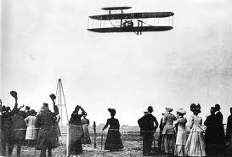
THIS DAY IN AVIATION
October 4
1909 — More than a million New Yorkers watch as Wilbur Wright makes a flight along the Hudson River.

Slide 3
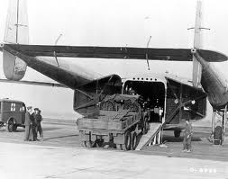
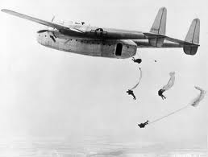
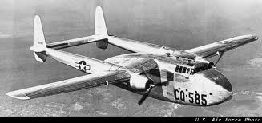
THIS DAY IN AVIATION
October 4
1942 — An entire field artillery battery is dropped from a Fairchild C-82 “Packet” by parachute.

Slide 4
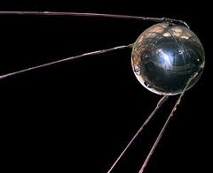
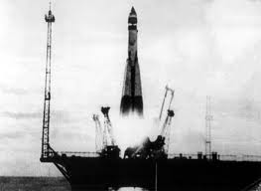
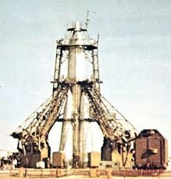
THIS DAY IN AVIATION
October 4
1957 — Russia launches the first Earth satellite. The 184-lb. “Sputnik” attains an orbital velocity of 5 miles per second.

Slide 5
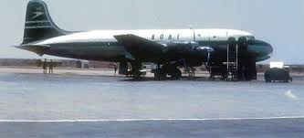
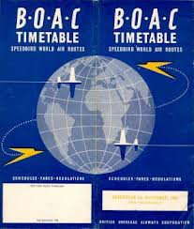
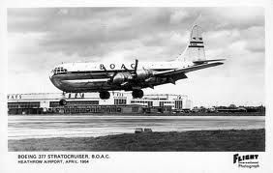
THIS DAY IN AVIATION
October 4
1958 — Britain's national overseas airline BOAC becomes the first carrier to fly the Atlantic route by jet airliner.

Slide 6
Questions / Comments

Slide 7
Learning Objectives – Module 4 (10/2/17 – 10/13/17) Aircraft Systems and Maintenance – Importance to Management
Management of Aeronautical Science
Upon successful completion of this module, you will be able to:
1. For a typical aircraft, describe the functions of the flight controls.
2. Examine the components of a typical airframe system such as fuel, landing gear and brakes, oxygen systems, air conditioning systems, pressurization systems, hydraulic systems, deice and anti-ice systems, electrical, and autopilot systems.
3. Explain the formation of shock waves on an aircraft wing.
4. Describe fly by wire primary flight controls and the advantages of this technology.

Slide 8
Learning Objectives – Module 4 (10/2/17 – 10/13/17) Aircraft Systems and Maintenance – Importance to Management
Management of Aeronautical Science
Upon successful completion of this module, you will be able to:
5. Describe the three areas that most maintenance procedures are based upon.
6. Examine the scope and detail of the 100 hour and annual inspection.
7. Describe the recording and approval of Major Repairs and Alterations.
8. Differentiate between the four options to the inspection program for large turbine powered multi-engine aircraft.
9. Discuss the Continuing Analysis and Surveillance System (CASS) of an air carrier maintenance program.
10. Critique the make or buy decision and outsourcing maintenance.
11. Explain the three primary airline maintenance processes.
12. Examine quality requirements for an airline maintenance program.

Slide 9
Questions / Comments

Slide 10
Readings
The Pilot’s Handbook of Aeronautical Knowledge
Chapter 6 – Flight Controls
Chapter 7 – Aircraft Systems
Chapter 8 – Flight Instruments
Title 14 Code of Federal Regulations (CFR) - Please review 14 CFR Parts:
21, 39, 43, 91, 119, and 145.
Textbook – Business and Corporate Aviation Management
Chapter 7: Maintenance

Slide 11
Discussion: Aircraft Systems: Wed Oct 11
Your post should be a minimum of 300 words with at least, two sources cited. Respond to at least two of your classmates. Your responses to classmates should be at least 100 words and contribute to the continuing conversation.

Slide 12
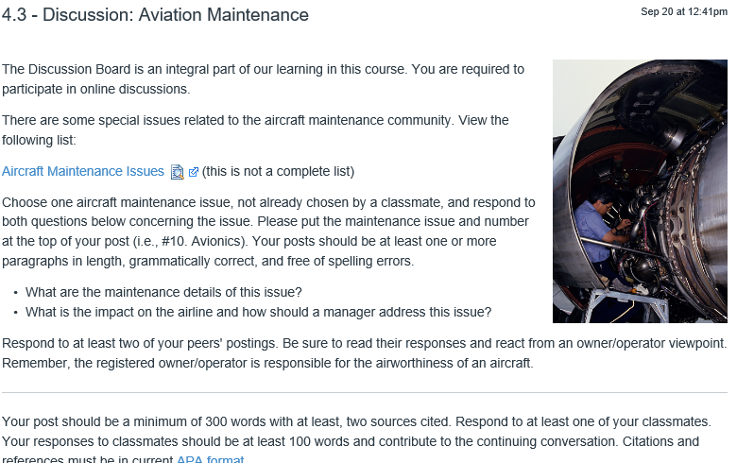
Discussion: Aviation Maintenance: Wed Oct 11

Slide 13
Module 4 Review Questions (Due Fri Oct 13)
Spend quality time responding to the following questions in your own words.
1. Describe the primary flight controls, their movement about each axis, and location.
2. Explain the formation of the wing airfoil normal shock wave during high-speed flight.
3. Examine the scope and detail of the 100 hour and annual inspection. Who has the authority to sign off on each inspection?
4. Differentiate between the four options of the inspection program for large turbine powered, multi-engine aircraft.
5. What is the make or buy decision? Critique both sides for aviation maintenance.

Slide 14
Term Paper Topics
Your Final Term Paper must be at least 12 pages and consist of the following:
A title page
Main text (10 pages)
Reference page (current APA format)
The paper should include some of the headings below as appropriate:
Introduction
Description of the Company or Agency (Basically what business are you in)
Operation Description
Equipment or Aircraft
Maintenance Requirements
Manager’s Roles and Responsibilities
Staff Qualifications, Certifications, and Responsibilities
Human Factors
Quality Requirements
Regulations and Laws
Safety
Security
Environmental Responsibilities
Other Management Factors Considered
References (current APA format)
Aircraft Manufacturing Management
- Chris Corbett
Fire and Crash Rescue Management
- Trent Thompson
Helicopter Operations Management
- Casey Bradford

Slide 15
Assignments Due – Module 4 (10/2/17 – 10/13/17)
Management of Aeronautical Science
Review Module 4 Instructions for the following assignments:
Discussion Board Due (Aircraft Systems)
(Due - Wed Oct 11) – 2 part (Post and Respond)
Discussion Board Due (Aviation Maintenance)
(Due - Wed Oct 11) – 2 part (Post and Respond)
Review Questions – Aircraft Systems and Maintenance – Importance to Management
(Due - Fri Oct 13) – 5 Questions

Slide 16
September / October 2017
Sunday | Monday | Tuesday | Wednesday | Thursday | Friday | Saturday
17 | 18 Module 3 Intro Propulsion and Aircraft Performance | 19 Module 3 Propulsion and Aircraft Performance | 20 Module 3 Propulsion and Aircraft Performance | 21 Module 3 Propulsion and Aircraft Performance | 22 Flightline Friday Progress Reports Sent Home | 23
24 | 25 Module 3 Propulsion and Aircraft Performance | 26 Module 3 Propulsion and Aircraft Performance | 27 Module 3 Propulsion and Aircraft Performance Discussion Due | 28 Beaufort County Airport (ILT) | 29 Flightline Friday Review Questions Due | 30
1 | 2 Module 4 Intro Aircraft Systems and Maintenance | 3 Module 4 Aircraft Systems and Maintenance | 4 Module 4 Aircraft Systems and Maintenance | 5 Module 4 Aircraft Systems and Maintenance | 6 Flightline Friday | 7
8 | 9 Module 4 Aircraft Systems and Maintenance | 10 Module 4 Aircraft Systems and Maintenance | 11 Module 4 Aircraft Systems and Maintenance Discussion Due | 12 Beaufort County Airport (ILT) | 13 Flightline Friday Review Questions Due Progress Reports Sent Home | 14

Slide 17
Questions / Comments

Slide 18
MGMT 203 Aircraft Systems and Maintenance – Importance to Management
Module 4

Slide 19
Maintenance
Understand management perspective of aviation maintenance

Slide 20
Maintenance
Maintenance is a must when considering aircraft designs or modifications.
Modifications to existing aircraft are being accomplished in lieu of aircraft redesign and development.
Avionics modification
Aging fleet problems
High cycle aircraft can result in initial fatigue cracking of the complete airline fleet .
Most aircraft designs include redundancy
Backup systems
Prevents effects of failure on safety

Slide 21
Maintenance Practices
Good and reliable maintenance assures an item stays as reliable as initially designed.
Reliability = safety
Good maintenance practices provide
Reliability and safety
Insure customer satisfaction
Insures equipment utilization
Increases confidence in the public's eyes

Slide 22
Maintenance Procedures
Most maintenance procedures are based on
Hours or Time
Cycles
Landing gear retractions and extensions
Engine starts and operation
Chronological time/calendar
Accomplished in accordance with Title 14 CFR(s) and manufacturers’ procedures.
Adequate inspection is a must

Slide 23
Title 14 CFR Requirements
Aircraft, rotorcraft, engine, and propeller Airworthiness Regulations and 14 CFR Part 39: Airworthiness Directives (AD) (previously discussed)
14 CFR Part 21 Certification Procedures for Product and Parts
Provides requirements for replacement parts and approvals
Part 21.303 replacement and modification parts require all replacement parts used on an aircraft must be produced under a Parts Manufacturer Approval (PMA).
4 exceptions
Parts approved under a type or production certificate.
Parts produced by an owner or operator for maintaining or altering his own product.
Parts produced under a Technical Standard Order (TSO).
Standard parts such as fasteners, safety wire, etc.

Slide 24
Title 14 CFR Part 43
Title: Maintenance, Preventive Maintenance, Rebuilding, and Alteration.
Aircraft having a U.S. Airworthiness Certificate
Includes airframe, engines, and propellers
Logbook Entries for inspections and repairs
Appendix A: Lists
Major repairs
Major alterations
Preventive maintenance

Slide 25
Title 14 CFR Part 43
Appendix B Recording of Major Repairs and Major Alterations
FAA Form 337
Person performing repair completes form
Form completed by the A&P
Approved by person with an Inspection Authorization (IA)
Appendix D Scope and Detail of Annual and 100 hour
Describes the inspection requirements

Slide 26
Title 14 CFR Part 43
Appendix E Altimeter System Test and Inspection
Appendix F ATC Transponder Tests and Inspections
Note
Aircraft manufacturer may perform alterations, maintenance, and inspections.
If special tools or testers are required by aircraft manufacturer you must use them.

Slide 27
Title 14 CFR Part 91
Title: General Operations and Flight Rules
Has maintenance requirements
Includes the requirements for maintenance, inspection, and record keeping.
General Aviation Inspections
Each aircraft must undergo an annual inspection once during each 12 calendar months.
Inspector Authorization (IA)
Scope and detail in Part 43
In addition to above requirement aircraft that are used for hire must be inspected each 100 hours of operation.
A&P
Scope and detail in Part 43

Slide 28
Title 14 CFR Part 91
Progressive Inspection
An alternative to the 100 hour/annual inspection
Breaks up and change the 100 hour/annual inspection into smaller/shorter inspections for compliance at a different hourly or calendar time basis.
Complete inspection must be accomplished in 12 calendar months.
Supervisory requirement
IA
Certified repair station
Aircraft manufacturer

Slide 29
Title 14 CFR Part 91.409
Large Turbine Powered Multi-engine Aircraft
Provides 4 options to the inspection program
Continuous Airworthiness Program Part 121 (airlines or air carrier)
Air Taxi Operator Program (Part 135) Aircraft with more than 10 passenger seats.
Manufacturer's Inspection Program
Owner-Operator Developed Inspection Program approved by FAA.

Slide 30
Preflight Inspections
Requirements can be found in
Approved Flight Manual
Pilot's Operating Handbook
Maintenance Manual
Additional inspection requirements
Mandatory inspections
14 CFR Part 91 - Pilot is responsible for deter­mining the airworthiness of the aircraft before flight
Pilot must conduct inspection
14 CFR Part 135 and Part 121 have requirements for inspection
Check company procedures
For an example maintenance personnel may perform an in-depth preflight
Flight crew may perform a preflight walk around visual and check of equipment

Slide 31
Special Inspections
Detailed in aircraft maintenance manuals
3 common types
Hard or overweight landing inspection
Severe turbulence inspection
Lightning strike inspection

Slide 32
14 CFR Part 121 Airlines Maintenance
Title: Certification and Operations: Domestic, Flag, and Supplemental Air Carriers and Commercial Operators of Large Aircraft.
Continuous Airworthiness Program (airlines or air carrier)
FAA approves the air carrier's maintenance program and any changes to the program
Time limitations
Inspections
Overhauls
Effectiveness of preventive maintenance

Slide 33
14 CFR Parts 121 Airlines Maintenance
Part 121.131 Manual Requirements
Often called Air Carrier Manual.
For use and guidance of flight and ground operations personnel.
Both operational specification and manual are laws to follow after accepted by FAA.
Part 121.135 Provides detailed requirements for manual contents.
Part 135 also has a manual requirement

Slide 34
14 CFR Part 121 Operator's Maintenance Manual
Part of the air carrier manual or may be a separate manual.
Define the continuous airworthiness maintenance program.
Prescribes the authorizations, methods, standards, and procedures of maintenance.
Has 3 general categories
Policies and Procedures.
Detailed Instructions for accomplishment of the scheduled inspection program.
Technical manuals for maintenance standards and methods.
Part 121 and 119 specifies the time limitations for overhaul, inspections, and checks set forth in the operations specifications.

Slide 35
14 CFR Part 119 Operations Specification (OpSpec)
Issued to air carriers
Lists authorizations and specifications
Legally binding and has 8 broad categories
General
Enroute authorizations and limitations
Airport authorizations and limitations
Maintenance
Weight and Balance
Schedules
Equipment interchange
Aircraft leasing

Slide 36
Airlines Maintenance
3 Primary Maintenance Processes
Hard Time (HT) (Time Changes)
Overhaul time limits or part life limit.
Dates back to the origin of aviation.
On-Condition Maintenance (OC)
Repetitive inspections or tests must be accomplished, at specific intervals.
Requires periodic inspected for serviceability.
Condition Monitoring (CM)
Depends upon data collection and analysis.
Analysis of failures to improve performance.

Slide 37
5 Types of Maintenance
Inspection
Scheduled Maintenance
Tasks performed at specific intervals
Routine and non-routine
Unscheduled Maintenance
Basically a discrepancy and corrective action process
Maintenance or flight crew discrepancies
Major Repair and Overhaul
Sometimes called Depot Repair
Shop operations
Preventive Maintenance
Directed to the prevention of failure
Proactive in nature
Required Item Inspection (RII)
2 A&Ps must sign maintenance documents

Slide 38
Questions / Comments

