Slide 1
MGMT 203 Aircraft Systems and Maintenance – Importance to Management
Module 4

Slide 2
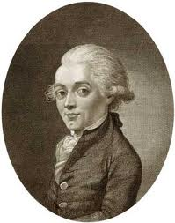
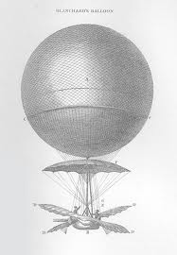
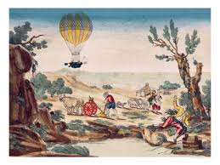
THIS DAY IN AVIATION
October 3
1785 — Jean-Pierre Blanchard makes the first manned balloon ascent in Germany.

Slide 3
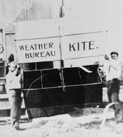
THIS DAY IN AVIATION
October 3
1907 — A record altitude of 23,110 feet is set by a United States Weather Bureau meteorological kite.

Slide 4
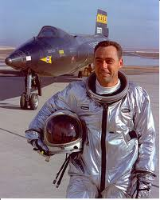
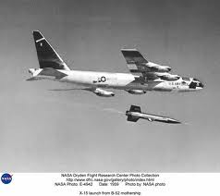
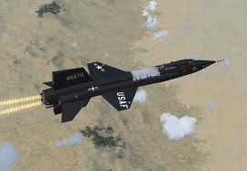
THIS DAY IN AVIATION
October 3
1967 — Major William J. Knight pilots the North American Aviation X-15 to a speed record of 4,534 mph.

Slide 5
Questions / Comments

Slide 6
Learning Objectives – Module 4 (10/2/17 – 10/13/17) Aircraft Systems and Maintenance – Importance to Management
Management of Aeronautical Science
Upon successful completion of this module, you will be able to:
1. For a typical aircraft, describe the functions of the flight controls.
2. Examine the components of a typical airframe system such as fuel, landing gear and brakes, oxygen systems, air conditioning systems, pressurization systems, hydraulic systems, deice and anti-ice systems, electrical, and autopilot systems.
3. Explain the formation of shock waves on an aircraft wing.
4. Describe fly by wire primary flight controls and the advantages of this technology.

Slide 7
Learning Objectives – Module 4 (10/2/17 – 10/13/17) Aircraft Systems and Maintenance – Importance to Management
Management of Aeronautical Science
Upon successful completion of this module, you will be able to:
5. Describe the three areas that most maintenance procedures are based upon.
6. Examine the scope and detail of the 100 hour and annual inspection.
7. Describe the recording and approval of Major Repairs and Alterations.
8. Differentiate between the four options to the inspection program for large turbine powered multi-engine aircraft.
9. Discuss the Continuing Analysis and Surveillance System (CASS) of an air carrier maintenance program.
10. Critique the make or buy decision and outsourcing maintenance.
11. Explain the three primary airline maintenance processes.
12. Examine quality requirements for an airline maintenance program.

Slide 8
Questions / Comments

Slide 9
Readings
The Pilot’s Handbook of Aeronautical Knowledge
Chapter 6 – Flight Controls
Chapter 7 – Aircraft Systems
Chapter 8 – Flight Instruments
Title 14 Code of Federal Regulations (CFR) - Please review 14 CFR Parts:
21, 39, 43, 91, 119, and 145.
Textbook – Business and Corporate Aviation Management
Chapter 7: Maintenance

Slide 10
Discussion: Aircraft Systems: Wed Oct 11
Your post should be a minimum of 300 words with at least, two sources cited. Respond to at least two of your classmates. Your responses to classmates should be at least 100 words and contribute to the continuing conversation.

Slide 11
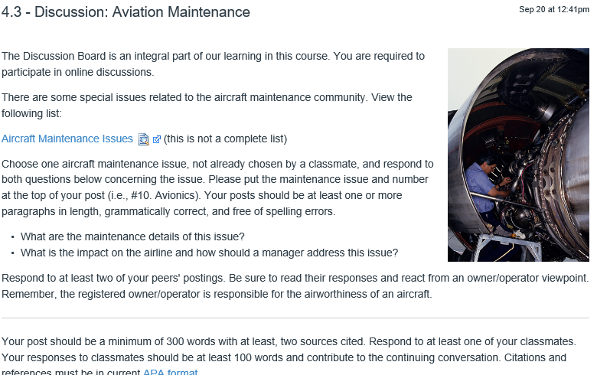
Discussion: Aviation Maintenance: Wed Oct 11

Slide 12
Module 4 Review Questions (Due Fri Oct 13)
Spend quality time responding to the following questions in your own words.
1. Describe the primary flight controls, their movement about each axis, and location.
2. Explain the formation of the wing airfoil normal shock wave during high-speed flight.
3. Examine the scope and detail of the 100 hour and annual inspection. Who has the authority to sign off on each inspection?
4. Differentiate between the four options of the inspection program for large turbine powered, multi-engine aircraft.
5. What is the make or buy decision? Critique both sides for aviation maintenance.

Slide 13
Term Paper Topics
Your Final Term Paper must be at least 12 pages and consist of the following:
A title page
Main text (10 pages)
Reference page (current APA format)
The paper should include some of the headings below as appropriate:
Introduction
Description of the Company or Agency (Basically what business are you in)
Operation Description
Equipment or Aircraft
Maintenance Requirements
Manager’s Roles and Responsibilities
Staff Qualifications, Certifications, and Responsibilities
Human Factors
Quality Requirements
Regulations and Laws
Safety
Security
Environmental Responsibilities
Other Management Factors Considered
References (current APA format)
Aircraft Manufacturing Management
- Chris Corbett
Fire and Crash Rescue Management
- Trent Thompson
Helicopter Operations Management
- Casey Bradford

Slide 14
Assignments Due – Module 4 (10/2/17 – 10/13/17)
Management of Aeronautical Science
Review Module 4 Instructions for the following assignments:
Discussion Board Due (Aircraft Systems)
(Due - Wed Oct 11) – 2 part (Post and Respond)
Discussion Board Due (Aviation Maintenance)
(Due - Wed Oct 11) – 2 part (Post and Respond)
Review Questions – Aircraft Systems and Maintenance – Importance to Management
(Due - Fri Oct 13) – 5 Questions

Slide 15
September / October 2017
Sunday | Monday | Tuesday | Wednesday | Thursday | Friday | Saturday
17 | 18 Module 3 Intro Propulsion and Aircraft Performance | 19 Module 3 Propulsion and Aircraft Performance | 20 Module 3 Propulsion and Aircraft Performance | 21 Module 3 Propulsion and Aircraft Performance | 22 Flightline Friday Progress Reports Sent Home | 23
24 | 25 Module 3 Propulsion and Aircraft Performance | 26 Module 3 Propulsion and Aircraft Performance | 27 Module 3 Propulsion and Aircraft Performance Discussion Due | 28 Beaufort County Airport (ILT) | 29 Flightline Friday Review Questions Due | 30
1 | 2 Module 4 Intro Aircraft Systems and Maintenance | 3 Module 4 Aircraft Systems and Maintenance | 4 Module 4 Aircraft Systems and Maintenance | 5 Module 4 Aircraft Systems and Maintenance | 6 Flightline Friday | 7
8 | 9 Module 4 Aircraft Systems and Maintenance | 10 Module 4 Aircraft Systems and Maintenance | 11 Module 4 Aircraft Systems and Maintenance Discussion Due | 12 Beaufort County Airport (ILT) | 13 Flightline Friday Review Questions Due Progress Reports Sent Home | 14

Slide 16
Questions / Comments

Slide 17
MGMT 203 Aircraft Systems and Maintenance – Importance to Management
Module 4

Slide 18
High Speed Flight
4 areas of flight
Below 0.75 Mach = Subsonic
0.75 to 1.2 Mach = Transonic
1.2 to 5 Mach = Supersonic
Above 5 Mach = Hypersonic
Speed of sound varies with changes in temperature of the air as speed of sound is a function of temperature.

Slide 19
High Speed Flight
Shock Wave Formation (Fixed wing aircraft)
Depends upon airfoil design and wind tunnel testing at different parameters.
Always forms on the top of the wing first because air stream is accelerated here first.
Called Critical Mach Number
At flight speed of Mach 0.77, a normal shock wave develops on top of wing.
Drag results aft of the shock wave
Boundary layer separation
At flight speed Mach 0.82, top of wing shock wave moves toward trailing edge and a normal shock wave develops on bottom of wing.

Slide 20
High Speed Flight
Shock Wave Formation (Fixed wing aircraft)
At flight speed Mach 0.95, normal shock waves move to trailing edge.
At flight speed Mach 1.05, a shock wave is formed at the leading edge and is called a bow wave.

Slide 21
Airfoil Shock Waves
Normal Shock Wave forms
turbulence or possible separation
M = .77
Notes:
From Bill Teeple SFTY 330 Course

Slide 22
Airfoil Shock Waves
Normal Shock Wave
turbulence or possible separation
Normal Shock Wave forms
M = .82
Notes:
From Bill Teeple SFTY 330 Course

Slide 23
Airfoil Shock Waves
Normal Shock Wave
Supersonic airflow
turbulence
Supersonic airflow
M = .95
Normal Shock Wave
Notes:
From Bill Teeple SFTY 330 Course

Slide 24
Airfoil Shock Waves
Bow
Wave
starts
to
form
Normal Shock Wave
Supersonic airflow
turbulence
Supersonic airflow
M = 1.05
Normal Shock Wave
Notes:
From Bill Teeple SFTY 330 Course

Slide 25
Airfoil Shock Waves
Bow
Wave
compresses
Normal Shock Wave
Supersonic airflow
turbulence
Supersonic airflow
M = above 1.05
Normal Shock Wave
Notes:
From Bill Teeple SFTY 330 Course

Slide 26
Questions / Comments

