Slide 1
MGMT 203 Human Factors and Crew Resource Management
Module 6

Slide 2
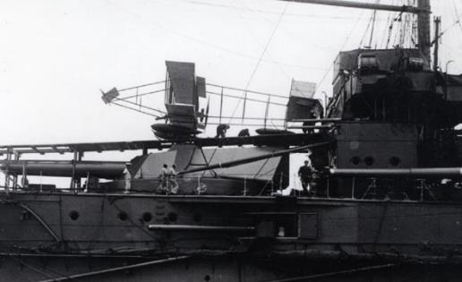
THIS DAY IN AVIATION
October 31
1921 — United States Navy hydroairplane is launched from catapult.

Slide 3
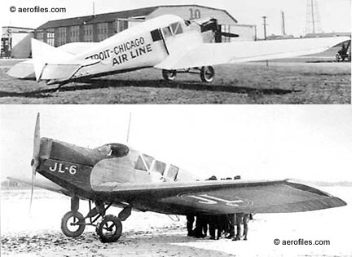
THIS DAY IN AVIATION
October 31
1921 — American Legion Flying Meet, during National Convention at Kansas City, Missouri, has 100 planes participating. Curtiss and Larsen J.L-6 planes with passengers fly from New York prior to the events.

Slide 4
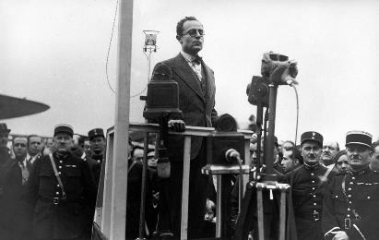
THIS DAY IN AVIATION
October 31
1933 — France's air minister Pierre Cot formally inaugurates the country's national airline, Air France.

Slide 5
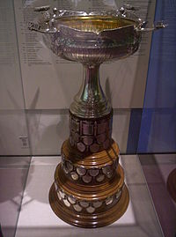
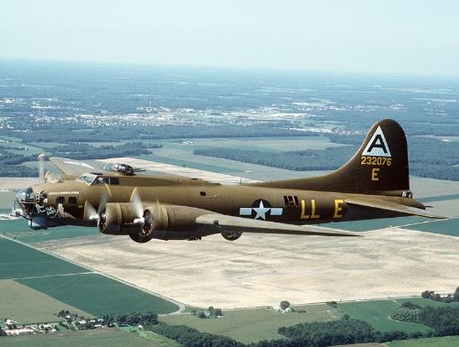
THIS DAY IN AVIATION
October 31
1939 — The Mackay Army Trophy for 1938 is presented to the 2nd Bombardment Group, Langley Field, Virginia by the Secretary of War, Harry H. Woodring.
The trophy was won as a result of the efficient and successful completion of the flight of six Boeing B-17 “Flying Fortresses” from Langley Field, Virginia, to Buenos Aires, Argentina, and return during February, 1938.

Slide 6
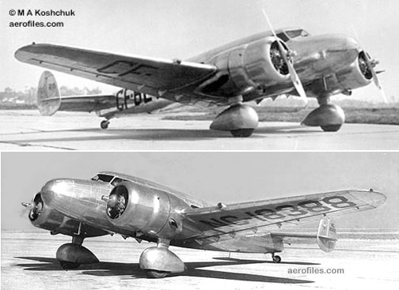
THIS DAY IN AVIATION
October 31
1939 — Comdr. Humberto Gallino and Capt. Victor Gallino, Peruvian brothers, land on Puna Island, Ecuador, in the Gulf of Guayaquil off Ecuador , after flying approximately 3,300 miles, from New York, which they left on 29 October in a Barkley-Grow monoplane , powered by 2 Pratt & Whitney “Wasp Junior” engines.
Lack of fuel forced the plane to land short of Lima, Peru, its goal.

Slide 7
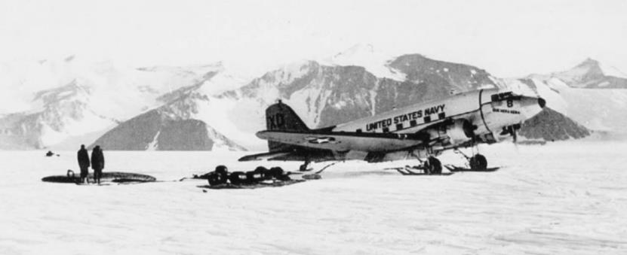
THIS DAY IN AVIATION
October 31
1956 — The US Navy R4D-5 “Skytrain” Que Sera Sera, commanded by Rear Admiral George Dufek, becomes the first airplane to make a landing at the South Pole.

Slide 8
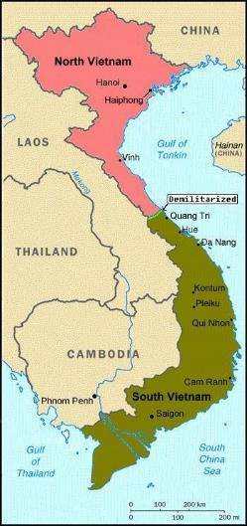
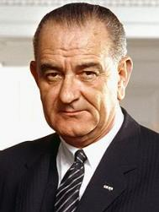
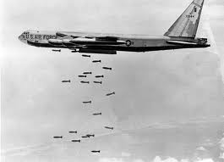
THIS DAY IN AVIATION
October 31
1968 — President Johnson orders a halt to bombing of North Vietnam.

Slide 9
Questions / Comments

Slide 10
October 2017
Sunday | Monday | Tuesday | Wednesday | Thursday | Friday | Saturday
15 | 16 Module 5 Intro Aviation Safety and Security | 17 Module 5 Aviation Safety and Security | 18 Module 5 Aviation Safety and Security | 19 Module 5 Aviation Safety and Security | 20 Flightline Friday | 21
22 | 23 Module 5 Aviation Safety and Security | 24 Module 5 Aviation Safety and Security | 25 Module 5 Aviation Safety and Security Discussions Due | 26 Beaufort County Airport (ILT) | 27 Mighty 8th Review Questions Due | 28
29 | 30 Module 6 Intro Human Factors and CRM | 31 Module 6 Human Factors and CRM | 1 Module 6 Human Factors and CRM | 2 Module 6 Human Factors and CRM | 3 Flightline Friday | 4
5 | 6 Module 6 Human Factors and CRM | 7 Module 6 Human Factors and CRM | 8 Module 6 Human Factors and CRM Discussion Due | 9 Beaufort County Airport (ILT) | 10 Flightline Friday Review Questions Due | 11

Slide 11
Learning Objectives – Module 6 (10/30/17 – 11/10/17) Human Factors and Crew Resource Management
Management of Aeronautical Science
Upon successful completion of this module, you will be able to:
Explain the aeromedical factors that are essential features in the lives of aviation professionals.
Classify the principles of the Aeronautical Decision Making (ADM) model include DECIDE.
Describe human factors design considerations that must be considered in flight deck design.
Describe the evolving concepts of Crew Resource Management.
Differentiate among the topics that are typically included in current CRM programs.
Analyze CRM performance marker clusters for their applicability to different crew situations.
Describe the goals associated with Maintenance Resource Management (MRM).
Discuss the principles of Dr. James Reason's Swiss Cheese Model.
Explain the Sterile Flight Deck or Cockpit rule and why is it important.
Discuss human factors design considerations.

Slide 12
Readings
Refer to Readings on ERAU Website Mod 6
FAA AC 120-51E Crew Resource Management Training
Pilots Handbook of Aeronautical Knowledge
Chapter 17 – Aeromedical Factors
Chapter 2 – Aeronautical Decision Making
Title 14 Code of Federal Regulations (CFR) - Please review 14 CFR Parts:
121 and 135.
Textbook – Business and Corporate Aviation Management
Chapter 6: Operations

Slide 13
6.3a - NTSB Case Study (Part 1) Wed Nov 8

Slide 14
6.3b - NTSB Case Study (Part 2) Wed Nov 8

Slide 15
Module 6 Review Questions (Due Fri Nov 10)
Spend quality time responding to the following questions in your own words.
Explain the aeromedical factors that are essential features in the lives of aviation professionals.
Classify the principles of the Aeronautical Decision Making (ADM) model and DECIDE (Detect, Estimate, Choose, Identify, Do, Evaluate) model .
Describe human factors design considerations that must be considered in flight deck design. What is the importance of this concept ?
What are the evolving concepts of Crew Resource Management (CRM)?
Describe the goals associated with Maintenance Resource Management (MRM).

Slide 16
Term Paper Topics
Your Final Term Paper must be at least 12 pages and consist of the following:
A title page
Main text (10 pages)
Reference page (current APA format)
The paper should include some of the headings below as appropriate:
Introduction
Description of the Company or Agency (Basically what business are you in)
Operation Description
Equipment or Aircraft
Maintenance Requirements
Manager’s Roles and Responsibilities
Staff Qualifications, Certifications, and Responsibilities
Human Factors
Quality Requirements
Regulations and Laws
Safety
Security
Environmental Responsibilities
Other Management Factors Considered
References (current APA format)
DUE Friday Dec 8, 2017
Aircraft Manufacturing Management
- Chris Corbett
Fire and Crash Rescue Management
- Trent Thompson
Helicopter Operations Management
- Casey Bradford

Slide 17
Assignments Due – Module 6 (10/30/17 – 11/10/17)
Management of Aeronautical Science
Review Module 6 Instructions for the following assignments:
Discussion Board Due (NTSB Case Study 1 and 2)
(Due – Wed Nov 8) – 2 part (Post and Respond)
Review Questions – Human Factors and CRM
(Due – Fri Nov 10) – 5 Questions

Slide 18
Questions / Comments

Slide 19
Crew Resource Management (CRM)
Initially called Cockpit Resource Management.
Issues were identified by flight deck voice recorders (incident and accident investigation).
Enhance pilots skills and interactive training with other team members.
Principles are expanding and new concepts are explored.
14 CFR Part 135 and Part 121 covers Crew Resource Management training.

Slide 20
Crew Resource Management (CRM)
Applied to any activity involving a team, equipment, and a dynamic situation.
Allows individual to improve teamwork.
Concentrates on crewmember attitudes and behaviors.
Provides an opportunity for individuals to examine their behaviors.

Slide 21
AC 120-51E Crew Resource Management Training
Guidelines for developing, implementing, reinforcing, and CRM training
Flight crewmembers
Other personnel essential to flight safety
Application of crew team management concepts in decision making.
Back to basics: Excellent communication, group decision making, leadership, and task or resource management.
Common use of Line Oriented Flight Training schedules (LOFT) for integration.

Slide 22
AC 120-51E Crew Resource Management Training
Review Behavioral Markers under each Cluster
Communications Processes and Decision Behavior Cluster
Briefings: safety and security
Inquiry/Advocacy/Assertion
Crew self-critique regarding decisions and actions
Communications and Decisions
Other considerations
Conflict resolution
Interpersonal communication
External factors and barriers

Slide 23
AC 120-51E Crew Resource Management Training
Review Behavioral Markers under each Cluster
Team Building and Maintenance Cluster
Leadership Followership/Concern for Tasks
Interpersonal Relationships/Group Climate
Workload Management and Situational Awareness Cluster
Preparation/Planning/Vigilance
Workload Distribution/Distractions Avoided
(AC 120-51, 2004, Appendix 1, pp. 1-5)

Slide 24
The Dirty Dozen Leading to Maintenance Errors
Identified by a study performed by Transport Canada
1. Lack of Communication
2. Lack of Teamwork
3. Lack of Assertiveness
4. Complacency
5. Fatigue
6. Stress
7. Lack of Resources

Slide 25
The Dirty Dozen Leading to Maintenance Errors
8. Lack of Awareness
9. Lack of Knowledge
10. Pressure
11. Distraction
12. Norms
(Sheehan, 2013, p. 282)

Slide 26
Maintenance Resource Management (MRM)
Developed to address teamwork deficiencies in aviation maintenance.
Dirty dozen provided stimulus for training that was required.
Problem resolution based on open and honest communication among all maintenance stakeholders.
14 CFR Part 121 and Part 135 - Maintenance training program.

Slide 27
Maintenance Resource Management (MRM)
Stresses teamwork and a philosophy toward error-free maintenance performance.
Create a positive safety culture throughout the organization.
Goal is to integrate maintenance technical skills, interpersonal skills, and human factors knowledge into excellent maintenance performance.
Detailed information in AC 120-72 Maintenance Resource Management Training.
27
Notes:
27

Slide 28
Maintenance Resource Management (MRM)
Similar to CRM with same themes
Open communications
Issue with shift change briefings
Teamwork
Situational Awareness
Paying attention to detail
Problem solving and troubleshooting
Safety first (Team based safety behavior)
Task allocation
28
Notes:
28

Slide 29
Reason’s Swiss Cheese Model
Dr. James Reason's Model of Accident Causation.
Focus is on understanding incidents and accidents and their contributing factors.
Traces the root causes of accidents to higher management levels.
Used in all types of accidents.
If the holes align, the result is an accident.

Slide 30
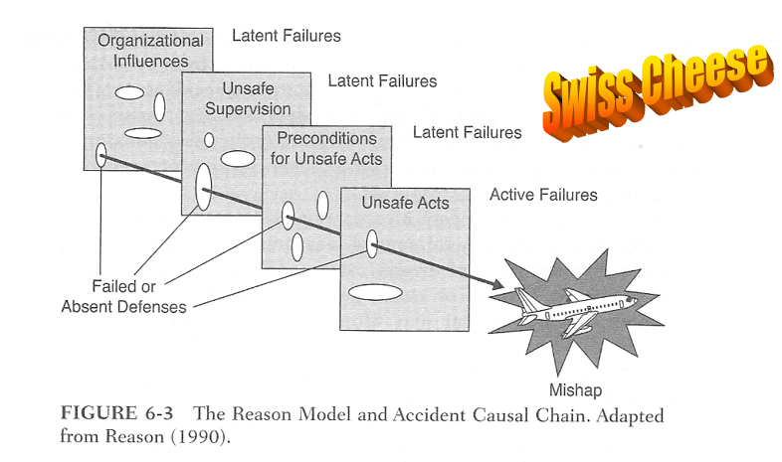
Reason’s Swiss Cheese Model
Rodrigues & Cusick. (2012). Commercial Aviation Safety. p. 142

Slide 31
Questions / Comments

