Slide 1
MGMT 203 Human Factors and Crew Resource Management
Module 6

Slide 2
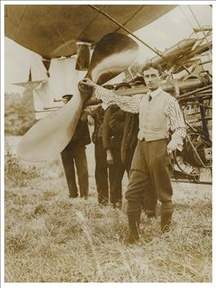
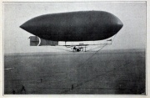
THIS DAY IN AVIATION
November 4
1910 — The first dirigible to fly from England to France is the British non-rigid airship City of Cardiff, built by E.T. Willows.

Slide 3
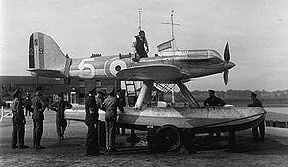
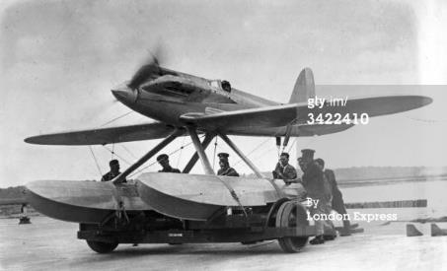
THIS DAY IN AVIATION
November 4
1928 — Lt. D'Arcy Greig in Supermarine-Napier S-5 monoplane flies at a speed of 319.57 mph.
His record is not official because it does not beat by 5 mph that of 318.624 made by the Bernardi in Italy.

Slide 4
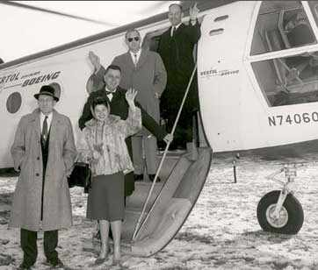
THIS DAY IN AVIATION
November 4
1949 — Civil Aeronautics Board reports the airline financial improvement during first six months of 1949 — $10,649,000 operating profit as compared to a $3,966,000 dollar loss in 1948 — results from increased non-mail revenues.

Slide 5
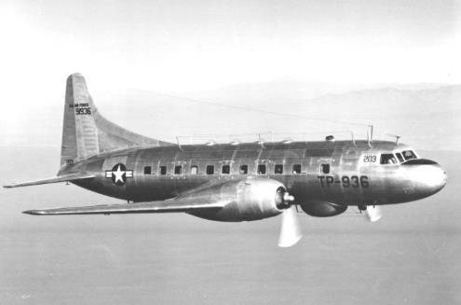
THIS DAY IN AVIATION
November 4
1949 — Consolidated Vultee receives $5-million United States Air Force contract for twelve T-29 trainers.

Slide 6
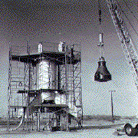
THIS DAY IN AVIATION
November 4
1959 — Second Project Mercury “Little Joe” firing to test the capsules escape rocket system is a complete success.

Slide 7
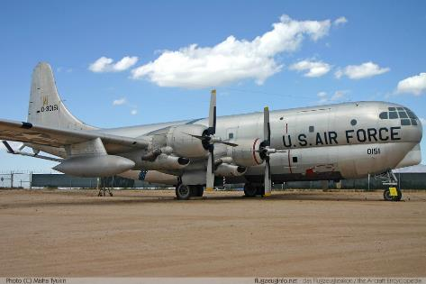
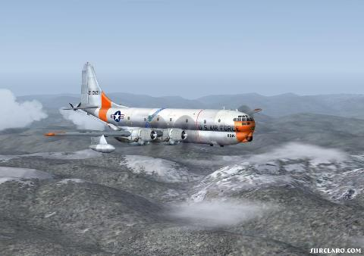
THIS DAY IN AVIATION
November 4
1960 — The United States Air Force revealed use of a converted Boeing C-97 “Stratofreighter“ as an airborne command post.

Slide 8
Questions / Comments

Slide 9
Learning Objectives – Module 6 (10/31/16 – 11/6/16) Human Factors and Crew Resource Management
Management of Aeronautical Science
Upon successful completion of this module, you will be able to:
Explain the aeromedical factors that are essential features in the lives of aviation professionals.
Classify the principles of the Aeronautical Decision Making (ADM) model include DECIDE.
Describe human factors design considerations that must be considered in flight deck design.
Describe the evolving concepts of Crew Resource Management.
Differentiate among the topics that are typically included in current CRM programs.
Analyze CRM performance marker clusters for their applicability to different crew situations.
Describe the goals associated with Maintenance Resource Management (MRM).
Discuss the principles of Dr. James Reason's Swiss Cheese Model.
Explain the Sterile Flight Deck or Cockpit rule and why is it important.
Discuss human factors design considerations.
Mon/Tues/Wed

Slide 10
Questions / Comments

Slide 11
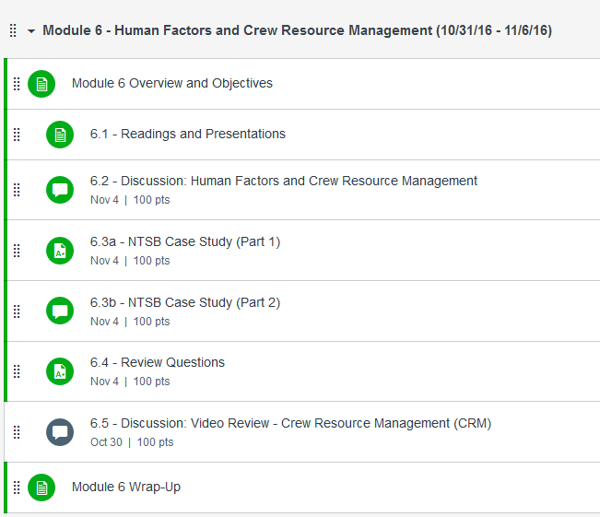

Slide 12
October 2016
SUNDAY | MONDAY | TUESDAY | WEDNESDAY | THURSDAY | FRIDAY | SATURDAY
16 | 17 Module 4 Aircraft Systems / Maintenance | 18 Module 4 Aircraft Systems / Maintenance Discussion Due Review Questions Due | 19 Module 5 Intro Aviation Safety and Security | 20 Module 5 Aviation Safety and Security | 21 Module 5 Aviation Safety and Security Flightline Friday | 22
23 | 24 Module 5 Aviation Safety and Security | 25 Module 5 Aviation Safety and Security | 26 Module 5 Aviation Safety and Security Discussion Due Review Questions Due | 27 Beaufort County Airport (ILT) | 28 Mighty 8th Museum | 29
30 | 31 Module 6 Intro Human Factors and Crew Resource Management | 1 Module 6 Human Factors and Crew Resource Management | 2 Module 6 Human Factors and Crew Resource Management | 3 Beaufort County Airport (ILT) | 4 FLIGHTLINE FRIDAY Discussion Due Review Questions Due | 5

Slide 13
6.3a - NTSB Case Study (Part 1) Fri Nov 4

Slide 14
6.3b - NTSB Case Study (Part 2) Fri Nov 4

Slide 15
Module 6 Review Questions (Due Fri Nov 4)
Spend quality time responding to the following questions in your own words.
Explain the aeromedical factors that are essential features in the lives of aviation professionals.
Classify the principles of the Aeronautical Decision Making (ADM) model and DECIDE (Detect, Estimate, Choose, Identify, Do, Evaluate) model .
Describe human factors design considerations that must be considered in flight deck design. What is the importance of this concept ?
What are the evolving concepts of Crew Resource Management (CRM)?
Describe the goals associated with Maintenance Resource Management (MRM).

Slide 16
Assignments Due – Module 6 (10/31/16 – 11/06/16)
Management of Aeronautical Science
Review Module 6 Instructions for the following assignments:
Discussion Board Due (NTSB Case Study 1 and 2)
(Due – Fri Nov 4) – 2 part (Post and Respond)
Review Questions – Human Factors and CRM
(Due – Fri Nov 4) – 5 Questions

Slide 17
Questions / Comments

Slide 18
Human Factors
Understand the basics of
Human Factors
Aeronautical Decision Making (ADM)
Human Factors Design Considerations
Crew Resource Management (CRM)
Maintenance Resource Management (MRM)
In this course, we will make reference to Title # CFR Part # as # CFR Part #
Example: 14 CFR Part #

Slide 19
Crew Resource Management (CRM)
Applied to any activity involving a team, equipment, and a dynamic situation.
Allows individual to improve teamwork.
Concentrates on crewmember attitudes and behaviors.
Provides an opportunity for individuals to examine their behaviors.

Slide 20
AC 120-51E Crew Resource Management Training
Guidelines for developing, implementing, reinforcing, and CRM training
Flight crewmembers
Other personnel essential to flight safety
Application of crew team management concepts in decision making.
Back to basics: Excellent communication, group decision making, leadership, and task or resource management.
Common use of Line Oriented Flight Training schedules (LOFT) for integration.

Slide 21
The Dirty Dozen Leading to Maintenance Errors
Identified by a study performed by Transport Canada
1. Lack of Communication
2. Lack of Teamwork
3. Lack of Assertiveness
4. Complacency
5. Fatigue
6. Stress
7. Lack of Resources

Slide 22
The Dirty Dozen Leading to Maintenance Errors
8. Lack of Awareness
9. Lack of Knowledge
10. Pressure
11. Distraction
12. Norms
(Sheehan, 2013, p. 282)

Slide 23
Maintenance Resource Management (MRM)
Stresses teamwork and a philosophy toward error-free maintenance performance.
Create a positive safety culture throughout the organization.
Goal is to integrate maintenance technical skills, interpersonal skills, and human factors knowledge into excellent maintenance performance.
Detailed information in AC 120-72 Maintenance Resource Management Training.
23
Notes:
23

Slide 24
Maintenance Resource Management (MRM)
Similar to CRM with same themes
Open communications
Issue with shift change briefings
Teamwork
Situational Awareness
Paying attention to detail
Problem solving and troubleshooting
Safety first (Team based safety behavior)
Task allocation
24
Notes:
24

Slide 25
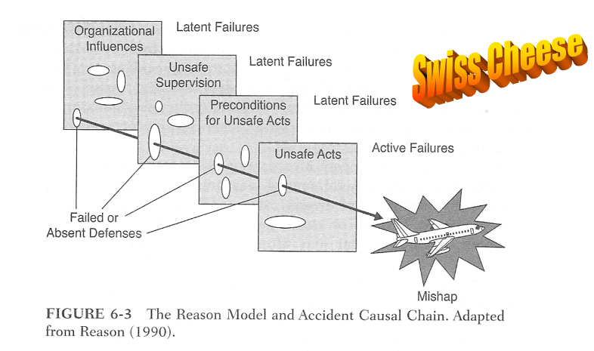
Reason’s Swiss Cheese Model
Rodrigues & Cusick. (2012). Commercial Aviation Safety. p. 142

