Slide 1
MGMT 203 Aviation National and International Laws and Regulations, and Environmental Issues
Module 8

Slide 2
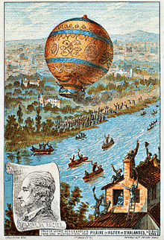
THIS DAY IN AVIATION
November 21
1783 — The first free or untethered human flight takes place when Jean Francois Pilatre de Rozier flies as high as 500 feet and travels 5 miles over Paris in a Montgolfier hot-air balloon.

Slide 3
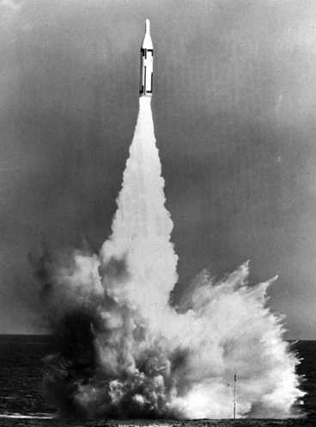
THIS DAY IN AVIATION
November 21
1957 — The first of several ballistic missile bases to be erected at Francis E. Warren AFB, Wyoming.

Slide 4
Questions / Comments

Slide 5
Learning Objectives – Module 8 (11/21/16 – 12/4/16) Aviation National and International Laws and Regulations, and Environmental Issues
Management of Aeronautical Science
Upon successful completion of this module, you will be able to:
Describe 14 CFR Part 13 from a management perspective.
Explain the framework of FAA Laws and Regulations that regulate the aviation industry.
Describe why the Federal Register is important to research.
Explain the impact of environmental issues and laws in the aviation industry.
Explain the framework of National Laws and Regulations that regulate air commerce.
Explain the framework of International Laws and Regulations that regulate air commerce.
Discuss the Material Safety Data Sheet (MSDS) or Safety Data Sheet.
Mon/Tues/Wed

Slide 6
Questions / Comments

Slide 7
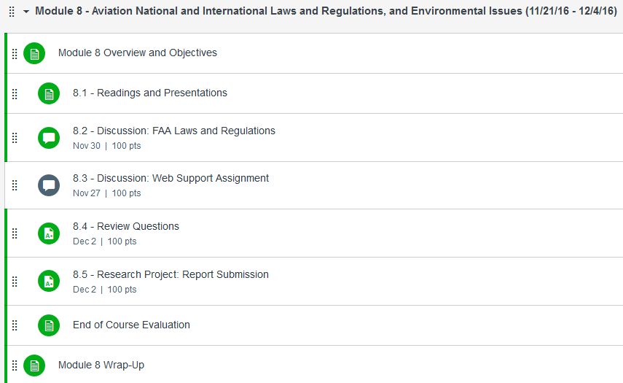

Slide 8
November 2016
SUNDAY | MONDAY | TUESDAY | WEDNESDAY | THURSDAY | FRIDAY | SATURDAY
6 | 7 Module 7 Intro Airports, Airspace, and Air Traffic Control Management | 8 NO SCHOOL Election Day | 9 Module 7 Airports, Airspace, and Air Traffic Control Management | 10 Beaufort County Airport (ILT) | 11 Flightline Friday | 12
13 | 14 Module 7 Airports, Airspace, and Air Traffic Control Management | 15 Module 7 Airports, Airspace, and Air Traffic Control Management | 16 Module 7 Airports, Airspace, and Air Traffic Control Management Discussion Due | 17 MCAS Air Station (ILT) | 18 Flightline Friday Review Questions Due | 19
20 | 21 Module 8 Intro Aviation National and International Laws and Regulations, and Environmental Issues | 22 Module 8 Aviation National and International Laws and Regulations, and Environmental Issues | 23 | 24 NO SCHOOL Thanksgiving | 25 NO SCHOOL | 26

Slide 9
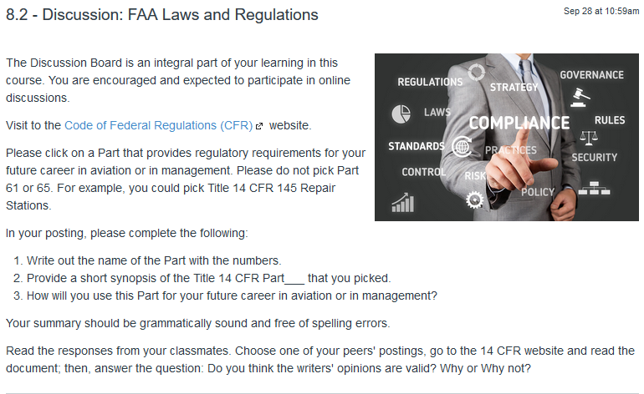
8.2 – Discussion: FAA Laws and Regulations Wed Nov 30

Slide 10
8.5 – Research Project: Report Submission Fri Dec 2
The term paper will consist of a topic related to management of an aerospace company or agency. Your textbook for the course provides excellent information on the operation of Business and Corporate Aviation. There are many subtitles in the textbook to assist you. Also, the activities, module readings, and discussions will provide concepts to consider.
Submit your paper on your approved topic in current APA format. Your Final Term Paper must be at least 12 pages and consist of the following:
A title page
Main text (10 pages)
Reference page (current APA format)
The main text titles should include
Introduction
Description of the Company or Agency (Basically what business are you in)
Operation Description
Equipment or Aircraft
Maintenance Requirements
Manager’s Roles and Responsibilities
Staff Qualifications, Certifications, and Responsibilities
Human Factors
Quality Requirements
Regulations and Laws
Safety
Security
Environmental Responsibilities
Other Management Factors Considered
References (current APA format)

Slide 11
8.5 – Research Project: Report Submission Fri Dec 2
The term paper will consist of a topic related to management of an aerospace company or agency.
TOPIC NAME
Airport Management Ray Ayres
NASA (Ops) Jonathan Buck
Aircraft Manufacturing Management Matt Hurtt

Slide 12
Module 8 Review Questions (Due Fri Dec 2)
Spend quality time responding to the following questions in your own words.
Describe Title 14 CFR Part 13, Investigative and Enforcement Procedures and how it relates to management of your aviation company.
Explain the framework of FAA Laws and Regulations that regulate the aviation industry. Consider 14 CFR from a management perspective. Where can a manager look for proposed rules, request for comments, and final rules to federal laws and regulations?
Analyze the responsibilities required based on Federal Aviation Act of 1958.
Describe two aviation emission requirements that pertain to the Clean Air Act of 1970 and its amendments. What Title 14 CFR part covers emissions? Managers must be able to research the 14 CFR for specific guidance.
Describe the Material Safety Data Sheet (MSDS) or Safety Data Sheet (SDS) from a manager's perspective.

Slide 13
Assignments Due – Module 8 (11/21/16 – 12/4/16)
Management of Aeronautical Science
Review Module 8 Instructions for the following assignments:
Discussion Board Due (FAA Laws and Regs)
(Due – Wed Nov 30) – 2 part (Post and Respond)
Final Paper Due (Student Topic of Choice)
(Due – Fri Dec 2) – (Min 12 pgs – 10 pgs Body)
Review Questions – FAA Laws and Regulations
(Due – Fri Dec 2) – 5 Questions

Slide 14
Questions / Comments

Slide 15
Managers’ Perspective
Understand the basics of
National Laws and Regulations
FAA Laws and Regulations
Regulations were covered in the previous course modules
International Laws and Regulations
Environmental Issues

Slide 16
National Laws and Regulations
Contract Act of 1925 (Kelly Act)
Government awards contracts for moving airmail to the private sector
Air Commerce Act of 1926
Promote commercial aviation
Designate air routes and develop rules for operating in airspace system
License pilots and mechanics
License of aircraft

Slide 17
National Laws and Regulations
Watres Act of 1930
Also called McNary-Watres Act
Postmaster General Walter Brown allowed the Post Office to enter long-term contracts.
Rates based on volume or space
Allowed consolidation of routes
In 1934, airmail service returned to U.S. Army because of contracting scandals.
Air Mail Act of 1934
Passage of the act, resulted in return of airmail service again to the private sector.

Slide 18
National Laws and Regulations
Civil Aeronautics Act of 1938
Creation of an Civil Aeronautics Authority (CAA)
Created two separate agencies
Civil Aeronautics Board (CAB)
Economic regulation of the air carriers
Civil Aeronautics Administration (CAA)
Safe operation of the aviation and airways
Safety regulation enforcement

Slide 19
National Laws and Regulations
Federal Aviation Act of 1958
Established Federal Aviation Agency (FAA)
Responsibilities include
Aviation safety and rule making
Air Traffic Control
Airport certification
Certifies aircraft, engines, and propellers
Certification of airmen
Retained Civil Aeronautics Board (CAB)

Slide 20
National Laws and Regulations
U.S. Department of Transportation (DOT) 1967
Change from Federal Aviation Agency to Federal Aviation Administration (FAA)
Federal Aviation Regulations (FAR)
Now Title 14 CFR Part
Established National Transportation Safety Board (NTSB) under DOT
Responsible for investigating all modes of transportation
In 1974 Congress established as an independent agency

Slide 21
Code of Federal Regulations
Title 14 Code of Federal Regulations (CFR)
http://www.ecfr.gov/cgi-bin/text-idx?tpl=/ecfrbrowse/Title14/14tab_02.tpl
The FAA website provides documents (airworthiness directives, regulations, handbooks, advisory circulars, etc.)
http://www.faa.gov/
Title 14 CFR(s) are laws that must be complied with
Includes Airworthiness Directives (ADs)
Title 14 CFR Part 13 has enforcement procedures

Slide 22
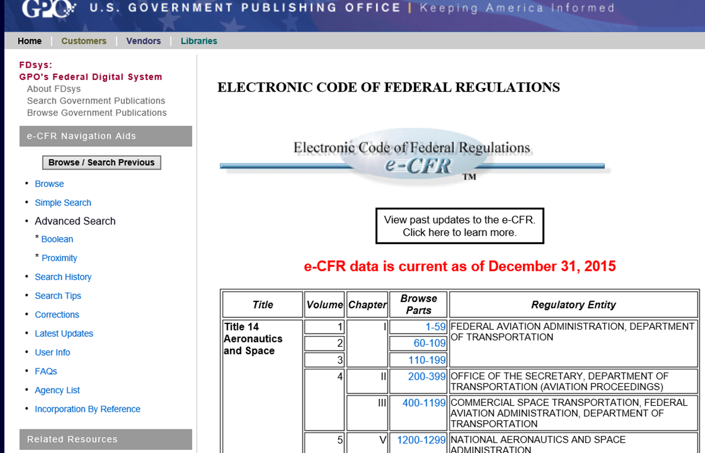
CFR Web site

Slide 23
Questions / Comments

Slide 24
Airport and Airway Funding and Development (From 1970)
Airport and Airway Development Act of 1970
Federal government aid for development
Established Airport Development Aid Program (ADAP)
Airport and Airway Revenue Act of 1970
Airport and Airway Development Act Amendments of 1976
Airport and Airway Improvement Act of 1982
Establish National Plan of Integrated Airport Systems (NPIAS) by 1984
Airport and Airway Safety and Capacity Expansion Act of 1987

Slide 25
Airport and Airway Funding and Development
Aviation Safety and Capacity Expansion Act of 1990
Passenger Facility Charge (PFC) program
Military Airport Program
Conversion of selected military airfields to civil aviation
Airport and Airway Safety, Capacity, Noise Improvement, and Inter­modal Transportation Act of 1992
Federal Aviation Administration Authorization Act of 1994
Federal Aviation Administration Reauthorization Act of 1996

Slide 26
Air Cargo Deregulation 1977
Cargo carriers
May operate on any domestic route
Can enter and exit market segments
No more government regulation or approval of rates
Price determined by what markets would accept
Growth of express package carriers
Hub and Spoke networks

Slide 27
Airline Deregulation Act of 1978
Complete elimination of restrictions on routes and services.
No more regulation of rates.
Phase out of Civil Aeronautics Board (CAB) with termination in Dec 1984.

Slide 28
Aircraft Noise and Capacity Act of 1990
Established policy on noise
Previous act was Aviation Safety and Noise Abatement Act of 1979
Restriction on operation of aircraft stage 2
Title 14 CFR Part 36 Noise Standards: Aircraft Type and Airworthiness
Specifies stages for aircraft
Currently operating at Stage 4
Noise abatement
Title 14 CFR Part 150 Noise Control Compatibility Planning Program
Airport noise levels and abatement

Slide 29
Hazardous Material Transportation Uniform Act of 1990
Required Department of Transportation to establish training standards of all U.S. employees who handle hazardous materials.
Training completion date of April 1993.

Slide 30
General Aviation (GA) Revitalization Act of 1994
Provided relief against GA product liability lawsuits due to accidents.
Prior to the act, general aviation production lines were shutdown.
Limitation is 18 years from date of manufacture.

Slide 31
Aviation and Transportation Security Act of 2001
Established a series of milestones toward achieving secure air travel.
Result of September 11, 2001 events
Established Transportation Security Administration (TSA)
Under Department of Transportation (DOT)
Transportation Security Regulations (TSR) in Title 49 CFR(s).

Slide 32
Homeland Security Act of 2002
Secure the United States from terrorist attacks and security vulnerability
Established U.S. Department of Homeland Security
There are many organizations under DHS
Three main
Coast Guard
Customs Service
Transportation Security Administration (TSA)
Moved from Department of Transportation to DHS in March 2003

Slide 33
National Environmental Policy Act of 1970
Established President’s Counsel on Environmental Quality
Requires
Environmental Assessments (EAs)
A written analysis to determine if a federal action would affect the environment.
Environmental Impact Statements (EISs)
Document required of federal agencies for major projects or legislative proposals.
President Nixon’s executive order created Environmental Protection Agency (EPA)
Abate and control pollution by integrating
Research
Monitoring
Standard-setting
Enforcement
http://www.epa.gov/

Slide 34
Environmental Laws
The Clean Air Act of 1970
Amended in 1990
Aviation requirements
Exhaust emissions of smoke from aircraft engines
Venting of fuel emissions into the atmosphere
Noise Control Act of 1972
Resource Conservation & Recovery Act (RCRA) 1976
Gave EPA authority to control hazardous waste from "cradle to grave"
Governs all phases of the waste from generation to disposal
Aviation sources of hazardous wastes
Painting
Corrosion control
Chemical cleaning
Plating
Toxic metals
Spills

Slide 35
Environmental Laws
Toxic Substances Control Act 1976
Gave EPA authority to track industrial chemicals produced or imported into the United States.
Consider aircraft manufacturing and assembly processes.
Clean Water Act 1977
Wastewater standards for industry.
Water quality standards for surface waters.
Quiet Communities Act of 1978
Established a nationwide Quiet Communities Program.
Specific decibel limits for civil aircraft.
Tightening noise emission standards.

Slide 36
Environmental Laws
Comprehensive Environmental Response, Compensation, & Liability Act (CERCLA) 1980.
Gave federal authority to respond directly to releases or potential releases of hazardous chemicals.
Provided for individual liability
Fines and clean up
Tax on chemical industries (Super fund)
Superfund Amendments and Reauthorization Act of 1986.

Slide 37
Environmental Laws
Emergency Planning & Community Right-to-Know Act (EPCRA) 1986.
Helped local communities protect public health, safety, and the environment from chemical hazards.
Each state was required to appoint a State Emergency Response Commission (SERC).
Consider Aircraft Rescue & Fire Fighting (ARFF) and airport fires unrelated to aircraft.
Oil Pollution Act (OPA) of 1990
Applies to aviation fueling and storage operations
Fuel farms

Slide 38
International

Slide 39
International Laws and Regulations
Warsaw Convention of 1929
Airlines performing international transportation.
Protection from catastrophic loss.
Regulates liability for persons, luggage, or products transported.
Specified terms and conditions.

Slide 40
International Laws and Regulations
Chicago Convention of 1944
Established International Civil Aviation Organization (ICAO)
Organization under United Nations.
Oversight of civil aviation of member states.
Flight over territories of contracting states (countries).
Authorizations required for scheduled air service.
Must comply with rules and regulations of the member state and airways.

Slide 41
International Laws and Regulations
Tokyo Convention of 1963
Called Convention on Offenses and Certain Other Acts Committed on Board Aircraft.
Aircraft registered in state will have jurisdiction over offender.
Gave powers to aircraft commander or pilot in charge.

Slide 42
International Laws and Regulations
Montreal Convention of 1999
Called Warsaw convention.
Complete convention name was Convention for the Suppression of Unlawful Acts against the Safety of Civil Aviation.
Specified international states legal responsibility.
Restrict any unlawful actions at airports.

Slide 43
International Laws and Regulations
Cape Town Treaty on International Interests of 2001
Held in South Africa
Registration of aircraft security interests (liens)
Standardize financial transactions
Aircraft Equipment Protocol
Aircraft and engines (propellers)

Slide 44
Questions / Comments

Slide 45
References
Federal Aviation Administration (FAA). (2008). FAA-H-8083-25 Pilot's handbook of aeronautical knowledge. Oklahoma City OK: United States Department of Transportation.
Rodrigues, C. C. & Cusick, S. K., (2012). Commercial aviation safety. New York, NY: McGraw-Hill.
Sheehan, J. J. (2013). Business and corporate aviation management (2nd. ed.). New York, NY: McGraw-Hill Education.
Wells, A. T., & Young, S. B. (2004). Airport planning and management. New York: NY. McGraw-Hill.

