Slide 1
MGMT 203 Human Factors and Crew Resource Management
Module 6

Slide 2
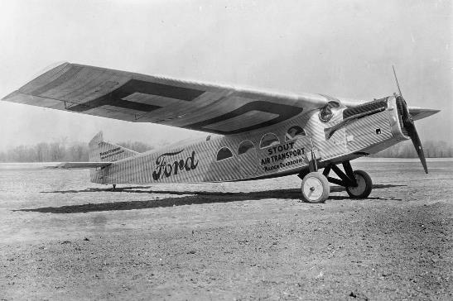
THIS DAY IN AVIATION
November 1
1928 — Stout Air Services starts six times weekly passenger service between Detroit and Chicago, 252 miles.

Slide 3
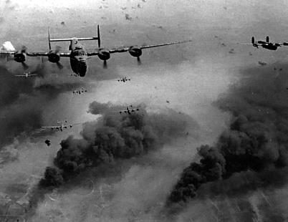
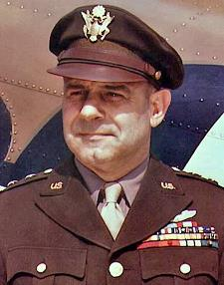
THIS DAY IN AVIATION
November 1
1943 — The Fifteenth Air Force (15th AF) was in Tunis, Tunisia as part of the United States Army Air Forces in the World War II Mediterranean Theater of Operations as a strategic air force and commenced combat operations the day after it was formed.
The first commander was General Jimmy Doolittle.

Slide 4
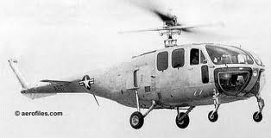
THIS DAY IN AVIATION
November 1
1949 — The Bell Aircraft Corporation announces its 12-passenger helicopter with all-metal fuselage, engineered to use either a 600 or 800-hp engine to cruise at more than 100-mph.

Slide 5
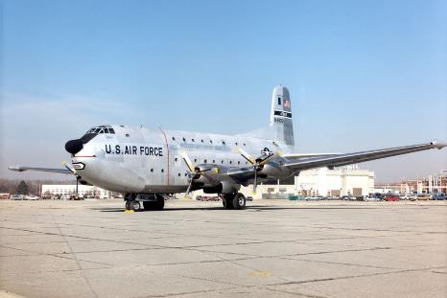
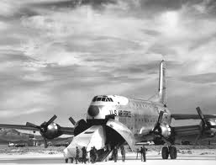
THIS DAY IN AVIATION
November 1
1949 — The Douglas C-124 “Globemaster II” United States Air Force heavy transport, goes on the pre-flight line.
The aircraft weighs 175,000 pounds and features a built-in ramp and clamshell doors.

Slide 6
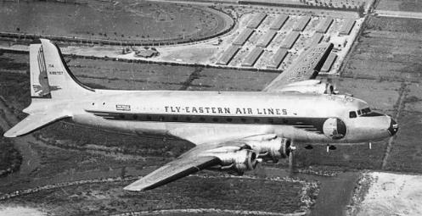
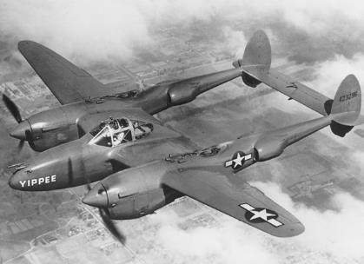
THIS DAY IN AVIATION
November 1
1949 — An Eastern Air Lines Douglas DC-4 and a military Lockheed P-38 “Lightning” crash at Washington National Airport, killing 55 persons.

Slide 7
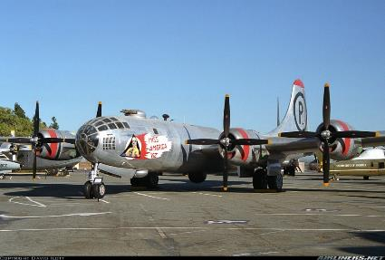
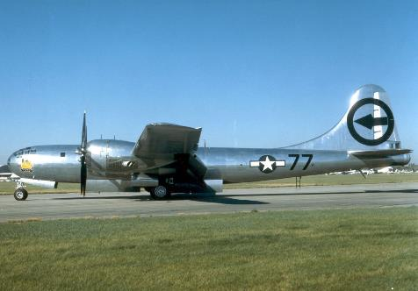
THIS DAY IN AVIATION
November 1
1954 — The United States Air Force retires its last Boeing B-29 “Superfortress” from service.

Slide 8
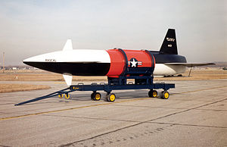
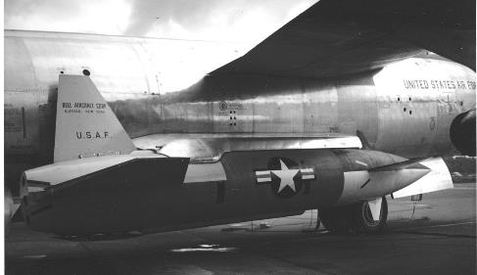
THIS DAY IN AVIATION
November 1
1957 — The Bell GAM-63 “Rascal” air-to-surface guided missile officially becomes operational with the Strategic Air Command at Pinecastle AFB, Florida.

Slide 9
Questions / Comments

Slide 10
October/November 2017
Sunday | Monday | Tuesday | Wednesday | Thursday | Friday | Saturday
15 | 16 Module 5 Intro Aviation Safety and Security | 17 Module 5 Aviation Safety and Security | 18 Module 5 Aviation Safety and Security | 19 Module 5 Aviation Safety and Security | 20 Flightline Friday | 21
22 | 23 Module 5 Aviation Safety and Security | 24 Module 5 Aviation Safety and Security | 25 Module 5 Aviation Safety and Security Discussions Due | 26 Beaufort County Airport (ILT) | 27 Mighty 8th Review Questions Due | 28
29 | 30 Module 6 Intro Human Factors and CRM | 31 Module 6 Human Factors and CRM | 1 Module 6 Human Factors and CRM | 2 Module 6 Human Factors and CRM | 3 Flightline Friday | 4
5 | 6 Module 6 Human Factors and CRM | 7 Module 6 Human Factors and CRM | 8 Module 6 Human Factors and CRM Discussion Due | 9 Beaufort County Airport (ILT) | 10 Flightline Friday Review Questions Due | 11

Slide 11
Learning Objectives – Module 6 (10/30/17 – 11/10/17) Human Factors and Crew Resource Management
Management of Aeronautical Science
Upon successful completion of this module, you will be able to:
Explain the aeromedical factors that are essential features in the lives of aviation professionals.
Classify the principles of the Aeronautical Decision Making (ADM) model include DECIDE.
Describe human factors design considerations that must be considered in flight deck design.
Describe the evolving concepts of Crew Resource Management.
Differentiate among the topics that are typically included in current CRM programs.
Analyze CRM performance marker clusters for their applicability to different crew situations.
Describe the goals associated with Maintenance Resource Management (MRM).
Discuss the principles of Dr. James Reason's Swiss Cheese Model.
Explain the Sterile Flight Deck or Cockpit rule and why is it important.
Discuss human factors design considerations.

Slide 12
Readings
Refer to Readings on ERAU Website Mod 6
FAA AC 120-51E Crew Resource Management Training
Pilots Handbook of Aeronautical Knowledge
Chapter 17 – Aeromedical Factors
Chapter 2 – Aeronautical Decision Making
Title 14 Code of Federal Regulations (CFR) - Please review 14 CFR Parts:
121 and 135.
Textbook – Business and Corporate Aviation Management
Chapter 6: Operations

Slide 13
6.3a - NTSB Case Study (Part 1) Wed Nov 8

Slide 14
6.3b - NTSB Case Study (Part 2) Wed Nov 8

Slide 15
Module 6 Review Questions (Due Fri Nov 10)
Spend quality time responding to the following questions in your own words.
Explain the aeromedical factors that are essential features in the lives of aviation professionals.
Classify the principles of the Aeronautical Decision Making (ADM) model and DECIDE (Detect, Estimate, Choose, Identify, Do, Evaluate) model .
Describe human factors design considerations that must be considered in flight deck design. What is the importance of this concept ?
What are the evolving concepts of Crew Resource Management (CRM)?
Describe the goals associated with Maintenance Resource Management (MRM).

Slide 16
Term Paper Topics
Your Final Term Paper must be at least 12 pages and consist of the following:
A title page
Main text (10 pages)
Reference page (current APA format)
The paper should include some of the headings below as appropriate:
Introduction
Description of the Company or Agency (Basically what business are you in)
Operation Description
Equipment or Aircraft
Maintenance Requirements
Manager’s Roles and Responsibilities
Staff Qualifications, Certifications, and Responsibilities
Human Factors
Quality Requirements
Regulations and Laws
Safety
Security
Environmental Responsibilities
Other Management Factors Considered
References (current APA format)
DUE Friday Dec 8, 2017
Aircraft Manufacturing Management
- Chris Corbett
Fire and Crash Rescue Management
- Trent Thompson
Helicopter Operations Management
- Casey Bradford

Slide 17
Assignments Due – Module 6 (10/30/17 – 11/10/17)
Management of Aeronautical Science
Review Module 6 Instructions for the following assignments:
Discussion Board Due (NTSB Case Study 1 and 2)
(Due – Wed Nov 8) – 2 part (Post and Respond)
Review Questions – Human Factors and CRM
(Due – Fri Nov 10) – 5 Questions

Slide 18
Questions / Comments

