Slide 1
MGMT 203 Airports, Airspace, and Air Traffic Control Management
Module 7

Slide 2
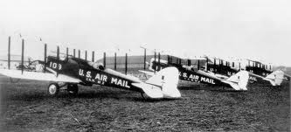
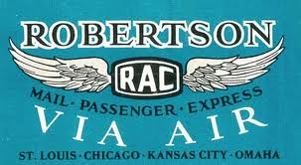
THIS DAY IN AVIATION
November 15
1928 — Robertson Aircraft Corporation starts daily passenger service between St. Louis and Kansas City, 235 miles.

Slide 3
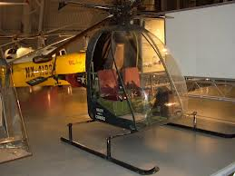
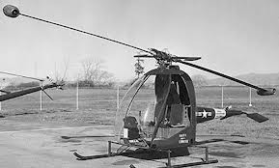
THIS DAY IN AVIATION
November 15
1947 — The world's first ram-jet helicopter is test flown by McDonald Aviation.

Slide 4
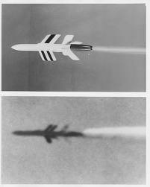
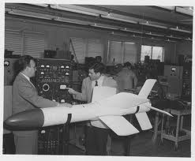
THIS DAY IN AVIATION
November 15
1949 — Ryan Aeronautical Company releases details of the first air-to-air missile, the Ryan XAAM-A-1 "Firebird," a ten-foot, target-seeking, rocket-powered air-to-air missile.

Slide 5
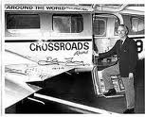
THIS DAY IN AVIATION
November 15
1965 — The first flight around the world over flying both Poles is made by U.S. airline Flying Tiger Line Captain J.L. Martin.

Slide 6
Questions / Comments

Slide 7
Learning Objectives – Module 7 (11/13/17 – 11/21/17) Airports, Airspace, and Air Traffic Control Management
Management of Aeronautical Science
Upon successful completion of this module, you will be able to:
Explain the impact of airport design, development, operations, and funding sources on airport systems.
Explain the purpose of an airport.
Describe Air Traffic Control Towers (ATCTs) and their purpose.
Compare air traffic control systems between en route, terminal, tower, and flight service functions.
Demonstrate an understanding of the Title 14 CFR Parts that are used to operate airports.
Explain the purpose of the Air Traffic System Command Center (ATCSCC) and location.
Outline the basic structure of the national airspace system, and describe the impact of the FAA's National Airspace System Plan (NASP).
Describe the Flight Service Station (FSS) and its services.
Describe the requirements for a reliever airport classification.
Critique the Airport Certification Manual.
Describe the Airport Emergency Plan (AEP) requirements.
Mon/Tues/Wed

Slide 8
Readings
Refer to Readings on ERAU Website Mod 7
Pilots Handbook of Aeronautical Knowledge
Chapter 14 – Airport Operations
Chapter 15 – Airspace
Title 14 Code of Federal Regulations (CFR) - Please review 14 CFR Parts:
36, 71, 73, 139, and 150.
Textbook – Business and Corporate Aviation Management
Chapter 5: Flight Department

Slide 9
November 2017
SUNDAY | MONDAY | TUESDAY | WEDNESDAY | THURSDAY | FRIDAY | SATURDAY
5 | 6 Module 6 Human Factors and CRM | 7 Module 6 Human Factors and CRM | 8 Module 6 Human Factors and CRM Discussion Due | 9 Module 6 Human Factors and CRM | 10 Flightline Friday Review Questions Due | 11
12 | 13 Module 7 Intro Airports, Airspace, and Air Traffic Control Management | 14 Module 7 Airports, Airspace, and Air Traffic Control Management | 15 Module 7 Airports, Airspace, and Air Traffic Control Management | 16 Module 7 Airports, Airspace, and Air Traffic Control Management | 17 Beaufort County Airport (ILT) Flightline Friday | 18
19 | 20 Module 7 Airports, Airspace, and Air Traffic Control Management Discussion Due | 21 Module 7 Airports, Airspace, and Air Traffic Control Management Review Questions Due | 22 NO SCHOOL | 23 NO SCHOOL Thanksgiving | 24 NO SCHOOL | 25

Slide 10
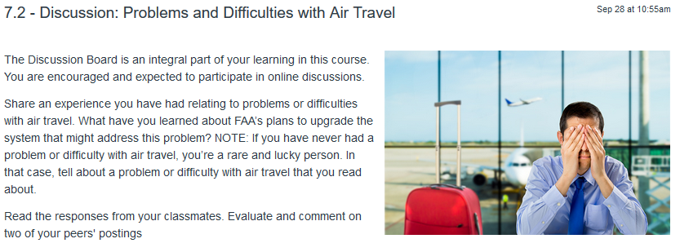
7.2 – Discussion: Problems and Difficulties with Air Travel Mon Nov 20

Slide 11
7.4 – Discussion: Video Analysis: FAA Gate to Gate – NextGen Explained Mon Nov 20

Slide 12
Module 7 Review Questions (Due Tues Nov 21)
Spend quality time responding to the following questions in your own words.
Explain the purpose of an airport.
Describe Air Traffic Control Towers (ATCTs) and their purpose.
Demonstrate an understanding of the Title 14 CFR Parts that are used to operate airports. Please state at least five parts we discussed in the course.
Describe the Flight Service Station (FSS) and the services it can provide.
Describe the requirements for a reliever airport classification.

Slide 13
Term Paper Topics
Your Final Term Paper must be at least 12 pages and consist of the following:
A title page
Main text (10 pages)
Reference page (current APA format)
The paper should include some of the headings below as appropriate:
Introduction
Description of the Company or Agency (Basically what business are you in)
Operation Description
Equipment or Aircraft
Maintenance Requirements
Manager’s Roles and Responsibilities
Staff Qualifications, Certifications, and Responsibilities
Human Factors
Quality Requirements
Regulations and Laws
Safety
Security
Environmental Responsibilities
Other Management Factors Considered
References (current APA format)
DUE Friday Dec 8, 2017
Aircraft Manufacturing Management
- Chris Corbett
Fire and Crash Rescue Management
- Trent Thompson
Helicopter Operations Management
- Casey Bradford

Slide 14
Assignments Due – Module 7 (11/13/17 – 11/21/17)
Management of Aeronautical Science
Review Module 7 Instructions for the following assignments:
Discussion Board Due (Problems with Air Travel)
(Due – Mon Nov 20) – 2 part (Post and Respond)
Discussion Board Due (Video Analysis)
(Due – Mon Nov 20) – 2 part (Post and Respond)
Review Questions – Airports, Airspace and ATC
(Due – Tues Nov 21) – 5 Questions

Slide 15
Questions / Comments

Slide 16
Air Traffic Control

Slide 17
Air Traffic Control (ATC)
Promote the safe, orderly, and expeditious flow of air traffic.
Determined by controlled airspace classification
Will discuss classes in airspace slides.

Slide 18
Air Traffic Control System
Operated by FAA
Includes
Majority of air traf­fic control towers
Visual and electronic navigational aids
At and near airports
Rules and procedures that govern civil aviation and airport operations.
Provides airport improve­ment and expansion funding.

Slide 19
Air Traffic Control System Command Center (ATCSCC)
Top level of Air Traffic Control System
Manages air traffic and every aircraft within the continental United States.
Balances demand with system capacity within the National Airspace System (NAS).
Maximizes overall operation
Authority to declare ground holds to avoid congestion.
Currently located in Warrenton, VA

Slide 20
Air Route Traffic Control Centers (ARTCCs)
Monitor enroute aircraft and aircraft in high-altitude cruise.

Slide 21
Terminal Radar Approach Control (TRACON) Facilities
Regional air traffic control centers.
Control the movement of air traffic in altitudes un­der 18,000 Mean Sea Level (MSL).
Controller hands over a landing aircraft within 5 miles of an airport and below 2,500 feet to airport terminal air traffic controllers.

Slide 22
Air Traffic Control Towers (ATCTs)
Terminal facility.
Provide services to aircraft operating in the vicinity of an airport or on movement area.
Authorizes aircraft to land or takeoff or to transit the Class D airspace area.
May provide approach control services.
Majority of towers are managed by FAA.
Some are contract managed with restrictions.

Slide 23
Flight Service Station (FSS)
Air traffic facility
Provide many services
Pilot briefing
Assistance in emergency situations
Provide Notices to Airmen (NOTAM)
Weather information and observations
Receive and process Instrument Flight Rules (IFR) flight plans
Monitor NAVAIDs
Airport advisories

Slide 24
Other ATC Facilities
Automated Flight Service Stations (AFSS)
Subcontracted to the Lockheed Martin Flight Services
FAA oversight
Provides information and services to pilots
Communicate clearances from ATC as required
Do not give ATC instructions, clearances, or separation
Ground Control
Control aircraft during taxi to and from runways.
May have Surface Movement Radar (SMR) to monitor aircraft and vehicles movement on the ground.
Automated Flight Service.

Slide 25
Flight Plan
Provides aircraft intended flight information
Filed with Flight Service Station or an Air Traffic Control facility
Orally or written
Receive and process Instrument Flight Rules (IFR) flight plans
Also special Visual Flight Rule (VFR) procedures
May file, activate, close, or change a flight plan

Slide 26
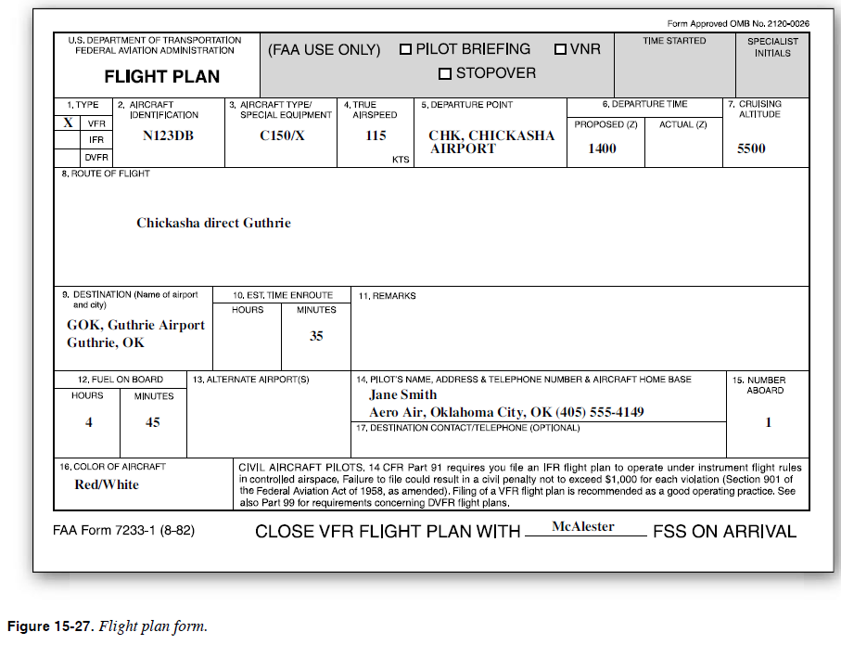
Flight Plan
FAA. (2008). FAA-H-8083-25 Pilot's Handbook of Aeronautical Knowledge. p. 15-21

Slide 27
Questions / Comments

