Slide 1
MGMT 203 Airports, Airspace, and Air Traffic Control Management
Module 7

Slide 2
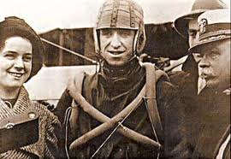
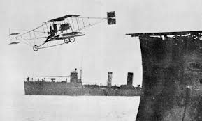
THIS DAY IN AVIATION
November 14
1910 — The birth of the aircraft carrier occurs when Eugene Ely takes off from the cruiser USS Birmingham in Virginia, on a Curtiss biplane.
The warship has an 83-foot platform built over the foredeck for the take-off.

Slide 3
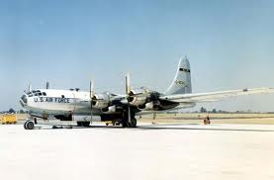
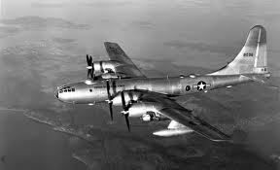
THIS DAY IN AVIATION
November 14
1949 — Boeing Airplane Company begins delivery to the United States Air Force of B-50D's equipped with droppable fuel tanks.

Slide 4
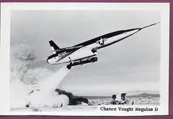
THIS DAY IN AVIATION
November 14
1957 — Chance Vought “Regulus II” completes successful rocket-boosted flight test by United States Navy.

Slide 5
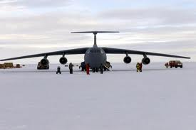
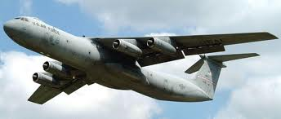
THIS DAY IN AVIATION
November 14
1966 — A Lockheed C-141 “Starlifter” became the first jet aircraft to land in Antarctica.

Slide 6
Questions / Comments

Slide 7
Learning Objectives – Module 7 (11/13/17 – 11/21/17) Airports, Airspace, and Air Traffic Control Management
Management of Aeronautical Science
Upon successful completion of this module, you will be able to:
Explain the impact of airport design, development, operations, and funding sources on airport systems.
Explain the purpose of an airport.
Describe Air Traffic Control Towers (ATCTs) and their purpose.
Compare air traffic control systems between en route, terminal, tower, and flight service functions.
Demonstrate an understanding of the Title 14 CFR Parts that are used to operate airports.
Explain the purpose of the Air Traffic System Command Center (ATCSCC) and location.
Outline the basic structure of the national airspace system, and describe the impact of the FAA's National Airspace System Plan (NASP).
Describe the Flight Service Station (FSS) and its services.
Describe the requirements for a reliever airport classification.
Critique the Airport Certification Manual.
Describe the Airport Emergency Plan (AEP) requirements.
Mon/Tues/Wed

Slide 8
Readings
Refer to Readings on ERAU Website Mod 7
Pilots Handbook of Aeronautical Knowledge
Chapter 14 – Airport Operations
Chapter 15 – Airspace
Title 14 Code of Federal Regulations (CFR) - Please review 14 CFR Parts:
36, 71, 73, 139, and 150.
Textbook – Business and Corporate Aviation Management
Chapter 5: Flight Department

Slide 9
November 2017
SUNDAY | MONDAY | TUESDAY | WEDNESDAY | THURSDAY | FRIDAY | SATURDAY
5 | 6 Module 6 Human Factors and CRM | 7 Module 6 Human Factors and CRM | 8 Module 6 Human Factors and CRM Discussion Due | 9 Module 6 Human Factors and CRM | 10 Flightline Friday Review Questions Due | 11
12 | 13 Module 7 Intro Airports, Airspace, and Air Traffic Control Management | 14 Module 7 Airports, Airspace, and Air Traffic Control Management | 15 Module 7 Airports, Airspace, and Air Traffic Control Management | 16 Beaufort County Airport (ILT) | 17 Flightline Friday | 18
19 | 20 Module 7 Airports, Airspace, and Air Traffic Control Management Discussion Due | 21 Module 7 Airports, Airspace, and Air Traffic Control Management Review Questions Due | 22 NO SCHOOL | 23 NO SCHOOL Thanksgiving | 24 NO SCHOOL | 25

Slide 10
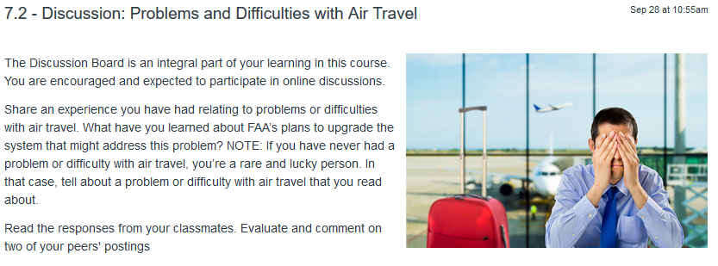
7.2 – Discussion: Problems and Difficulties with Air Travel Mon Nov 20

Slide 11
7.4 – Discussion: Video Analysis: FAA Gate to Gate – NextGen Explained Mon Nov 20

Slide 12
Module 7 Review Questions (Due Tues Nov 21)
Spend quality time responding to the following questions in your own words.
Explain the purpose of an airport.
Describe Air Traffic Control Towers (ATCTs) and their purpose.
Demonstrate an understanding of the Title 14 CFR Parts that are used to operate airports. Please state at least five parts we discussed in the course.
Describe the Flight Service Station (FSS) and the services it can provide.
Describe the requirements for a reliever airport classification.

Slide 13
Term Paper Topics
Your Final Term Paper must be at least 12 pages and consist of the following:
A title page
Main text (10 pages)
Reference page (current APA format)
The paper should include some of the headings below as appropriate:
Introduction
Description of the Company or Agency (Basically what business are you in)
Operation Description
Equipment or Aircraft
Maintenance Requirements
Manager’s Roles and Responsibilities
Staff Qualifications, Certifications, and Responsibilities
Human Factors
Quality Requirements
Regulations and Laws
Safety
Security
Environmental Responsibilities
Other Management Factors Considered
References (current APA format)
DUE Friday Dec 8, 2017
Aircraft Manufacturing Management
- Chris Corbett
Fire and Crash Rescue Management
- Trent Thompson
Helicopter Operations Management
- Casey Bradford

Slide 14
Assignments Due – Module 7 (11/13/17 – 11/21/17)
Management of Aeronautical Science
Review Module 7 Instructions for the following assignments:
Discussion Board Due (Problems with Air Travel)
(Due – Mon Nov 20) – 2 part (Post and Respond)
Discussion Board Due (Video Analysis)
(Due – Mon Nov 20) – 2 part (Post and Respond)
Review Questions – Airports, Airspace and ATC
(Due – Tues Nov 21) – 5 Questions

Slide 15
Questions / Comments

Slide 16
Airports

Slide 17
Airport Markings
Used for control and communications
Ground markings and lights
Runway markings
Painted white and white lights at night
Taxiway markings
Painted yellow
Blue lights
Vehicle roadway markings
Boundary markings for non-movement areas
Have many types of lights that are dependent upon airport complexity but are standardized.

Slide 18
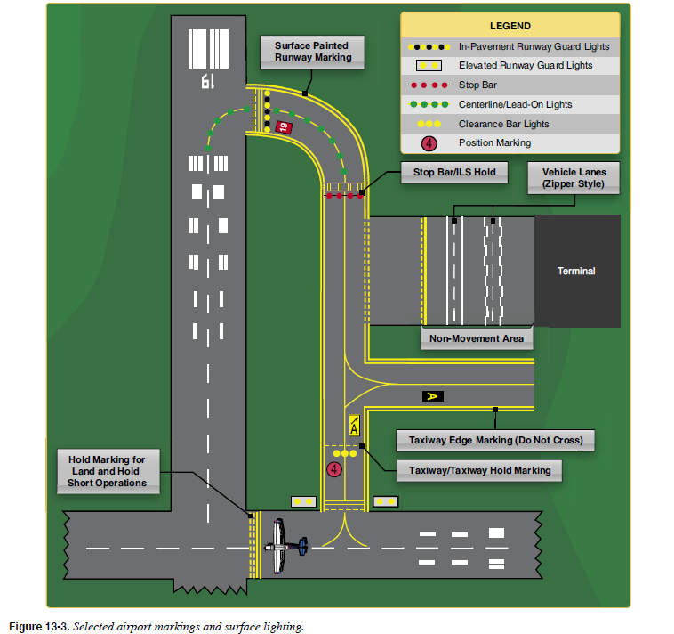
Airport Markings
FAA. (2008). FAA-H-8083-25
Pilot's Handbook of Aeronautical Knowledge.
p. 13-5

Slide 19
Airport Signs
Used for control and communication
Complexity of airport determines the amount of signs for communication.
Types
Mandatory instruction signs
Runway, critical area, or prohibited area
Example is white letters on red background
Runway holding position
· Location signs
Taxiway or runway location
Direction signs
Black letters on yellow background = Provide directions

Slide 20
Airport Signs
Types
Destination signs
Yellow background with black letters and arrows
Terminal
Parking area
Cargo terminal
Information signs
Yellow background with black letters
Frequencies and noise abatement requirements
Runway distance remaining signs
Black background with white numbers indicating thousands of feet
(FAA, pp. 13-4 - 13-6, 2008)

Slide 21
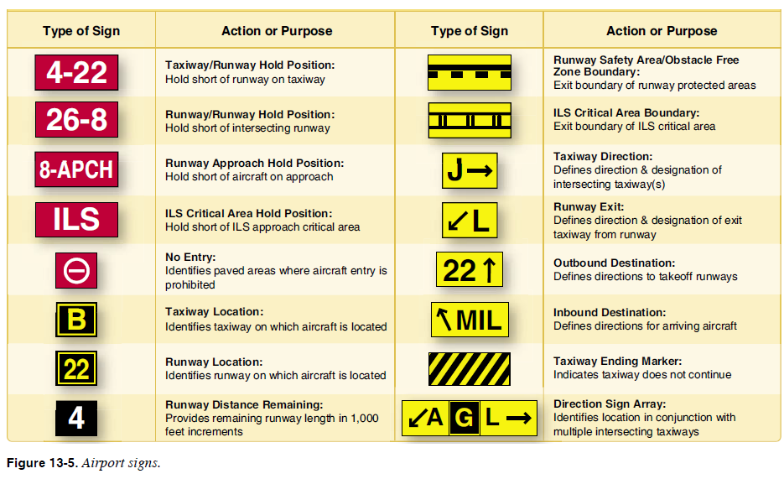
Airport Signs
FAA. (2008). FAA-H-8083-25 Pilot's Handbook of Aeronautical Knowledge. p. 13-6

Slide 22
Aircraft Rescue and Firefighting (ARFF)
Crash, Fire, and Rescue (CFR)
FAA changed from CFR to ARFF in 14 CFR Part 139
Different equipment and apparatus
ARFF Vehicles
Hoses and Nozzles
Accessories
Personal Protective Equipment (PPE)
Extinguishing agents
Water
Foam
Dry Chemicals
Rescue tools and equipment

Slide 23
Aircraft Rescue and Firefighting (ARFF)
14 CFR Part 139 designates the airport ARFF index
The length of aircraft from nose to tail that depart the airport on an average of five departures per day.
Determine the type and number of ARFF equipment required.
ARFF index
A: Aircraft less that 90 feet in length
B: Aircraft more than 90 feet but less than 126 feet in length
C: Aircraft more than 126 feet but less than 159 feet in length
D: Aircraft more than 159 feet but less than 200 feet in length
E: Aircraft greater than 200 feet in length

Slide 24
Noise Abatement and Control
Title 14 CFR Part 150 Noise Control Compatibility Planning Program.
AC 150/5020-1 Noise Control and Compatibility Planning for Air­ports.
Title 14 CFR Part 36 Noise Standards: Aircraft Type and Airworthiness.
Airport neighbors noise complaints are common especially during 11 pm to 7 am timeframe.
This can be a constraint for maintenance
Airport may have procedures in place to climb as soon as possible to prevent excessive noise.

Slide 25
Bird and Wildlife Hazard Management
Birds and other wildlife strikes are common in the vicinity of airport.
There have been reports that indicate aircraft damage and in some cases loss of life.
14 CFR Part 139 requires airport operators to have policies and procedures for identification, correction and control, and prevention of these hazards.

Slide 26
ICAO Airport
U.S. airports serving international operations
Article 68 of the Convention on International Civil Aviation.
AC 150/5000-16 Lists all U.S. international airports, designated airports.
Airports served by scheduled and nonscheduled international air transport and international general aviation flights.

Slide 27
Airport Safety Self-Inspection
Title 14 CFR Part 139 Certification of Airports
AC 150/5200-18B
Responsibility of the airport owner or operator.
Used to prevent injury and aircraft/ airport damage.
Multiple inspection frequencies.
Inspection results must be documented and kept
Follow up and feedback are necessary

Slide 28
Management Perspective
Communicate, communicate, and communicate.
Know the airport rules and regulations.
Understand the meaning of signs, lights, and and markings.
Situational awareness in a must for safe operations.
Vehicle Control Plan is necessary for safe operations especially on the air-side of the airport.

Slide 29
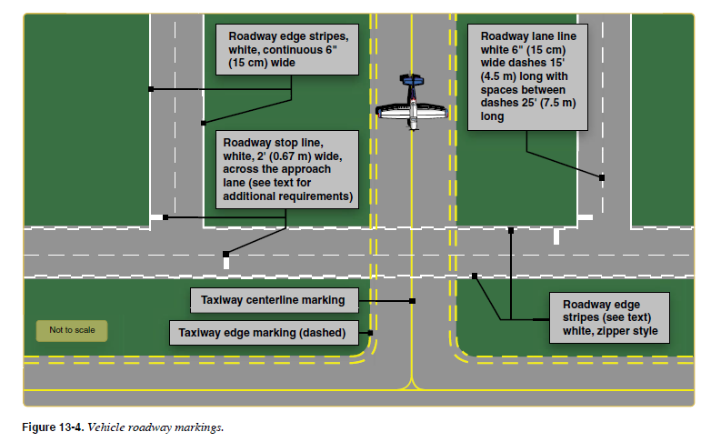
Vehicle Control
FAA. (2008). FAA-H-8083-25 Pilot's Handbook of Aeronautical Knowledge. p. 13-5

Slide 30
Questions / Comments

Slide 31
Air Traffic Control

Slide 32
Air Traffic Control (ATC)
Promote the safe, orderly, and expeditious flow of air traffic.
Determined by controlled airspace classification
Will discuss classes in airspace slides.

Slide 33
Air Traffic Control System
Operated by FAA
Includes
Majority of air traf­fic control towers
Visual and electronic navigational aids
At and near airports
Rules and procedures that govern civil aviation and airport operations.
Provides airport improve­ment and expansion funding.

Slide 34
Air Traffic Control System Command Center (ATCSCC)
Top level of Air Traffic Control System
Manages air traffic and every aircraft within the continental United States.
Balances demand with system capacity within the National Airspace System (NAS).
Maximizes overall operation
Authority to declare ground holds to avoid congestion.
Currently located in Warrenton, VA

Slide 35
Air Route Traffic Control Centers (ARTCCs)
Monitor enroute aircraft and aircraft in high-altitude cruise.

Slide 36
Terminal Radar Approach Control (TRACON) Facilities
Regional air traffic control centers.
Control the movement of air traffic in altitudes un­der 18,000 Mean Sea Level (MSL).
Controller hands over a landing aircraft within 5 miles of an airport and below 2,500 feet to airport terminal air traffic controllers.

Slide 37
Air Traffic Control Towers (ATCTs)
Terminal facility.
Provide services to aircraft operating in the vicinity of an airport or on movement area.
Authorizes aircraft to land or takeoff or to transit the Class D airspace area.
May provide approach control services.
Majority of towers are managed by FAA.
Some are contract managed with restrictions.

Slide 38
Flight Service Station (FSS)
Air traffic facility
Provide many services
Pilot briefing
Assistance in emergency situations
Provide Notices to Airmen (NOTAM)
Weather information and observations
Receive and process Instrument Flight Rules (IFR) flight plans
Monitor NAVAIDs
Airport advisories

Slide 39
Other ATC Facilities
Automated Flight Service Stations (AFSS)
Subcontracted to the Lockheed Martin Flight Services
FAA oversight
Provides information and services to pilots
Communicate clearances from ATC as required
Do not give ATC instructions, clearances, or separation
Ground Control
Control aircraft during taxi to and from runways.
May have Surface Movement Radar (SMR) to monitor aircraft and vehicles movement on the ground.
Automated Flight Service.

Slide 40
Flight Plan
Provides aircraft intended flight information
Filed with Flight Service Station or an Air Traffic Control facility
Orally or written
Receive and process Instrument Flight Rules (IFR) flight plans
Also special Visual Flight Rule (VFR) procedures
May file, activate, close, or change a flight plan

Slide 41
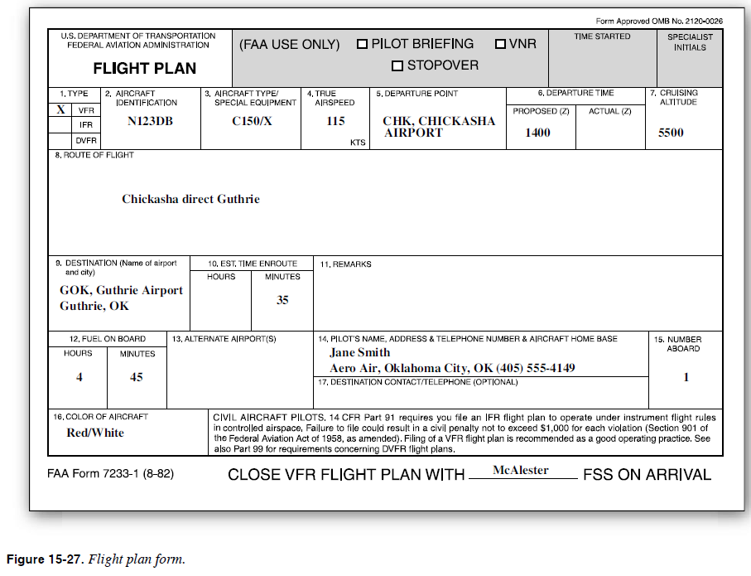
Flight Plan
FAA. (2008). FAA-H-8083-25 Pilot's Handbook of Aeronautical Knowledge. p. 15-21

Slide 42
Airspace

Slide 43
Controlled Airspace
Airspace where aircraft may be sub­ject to air traffic control
Considered boundaries above earth’s surface or a specific portion if airspace
There are different classes of controlled airspace
14 CFR Part 71 Designation of Class A, B, C, D, and E Airspace Areas; Air Traffic Routes; and Reporting Requirements.

Slide 44
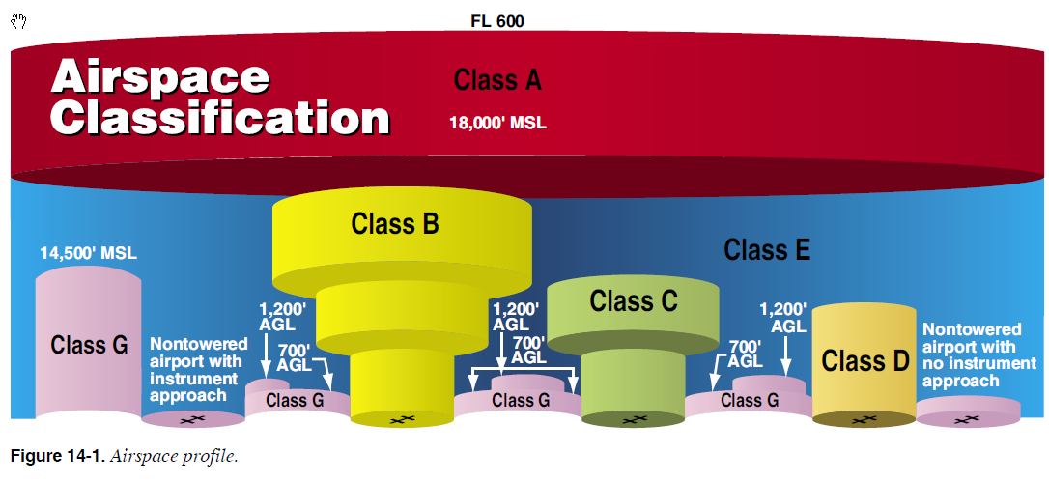
Controlled Airspace
FAA. (2008). Pilot's Handbook of Aeronautical Knowledge, p. 14-2

Slide 45
Controlled Airspace
Class A Airspace
Positive control airspace
Airspace located throughout the United States beginning at an altitude of 18,000 feet Mean Sea Level (MSL) up to 60,000 MSL.
Conducted under IFR

Slide 46
Controlled Airspace
Class B Airspace
Terminal radar service areas.
Airspace surrounding the nation's busiest airports.
Must have ATC clearance to operate in the area.

Slide 47
Controlled Airspace
Class C Airspace
Airport radar service areas.
Airspace surrounding airports of moderately high levels of IFR operations or passenger enplanements.
Must establish two-way radio communications with the ATC facility prior to entering the airspace and maintain that communication in the airspace.

Slide 48
Controlled Airspace
Class D Airspace
Control zones
Airspace surrounding those airports not in Class B or Class C airspace but do have an air traffic control tower in op­eration.
Must establish two-way radio communications with the ATC facility prior to entering the airspace and maintain that communication in the airspace.

Slide 49
Controlled Airspace
Class E airspace
General controlled airspace
Airspace that generally ex­ists in the absence of Class A, B, C, or D airspace extending from the sur­face to 18,000 feet MSL within 5 miles or airports without control towers but with instrument approach procedures.

Slide 50
Controlled Airspace
Class G airspace
Uncontrolled airspace
Airspace in the absence of Class A, B, C, D, or E airspace
Maintain visual flight rules (VFR) minimums

Slide 51
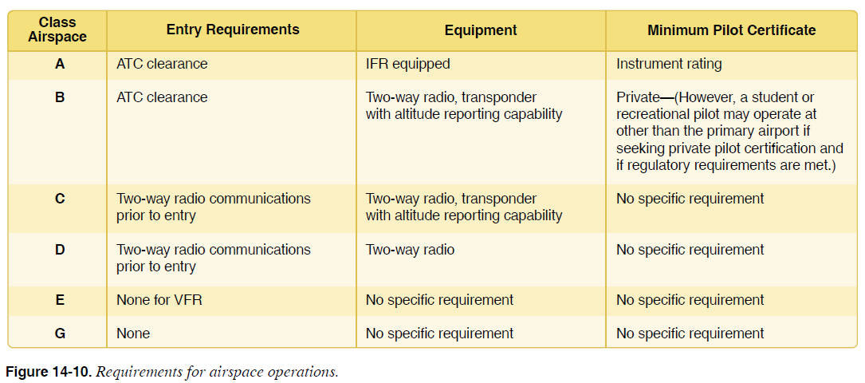
Class Airspace
FAA. (2008). Pilot's Handbook of Aeronautical Knowledge, p. 14-9

Slide 52
Special Use Airspace
Prohibited areas (White House)
Restricted areas (artillery fire)
Military operations areas (MOA)
Alert areas (high volume pilot training)
Warning areas (hazardous flight activity)
Controlled firings areas (rocket firing)
Title 14 CFR Part 73—Special Use Airspace provides information on restricted and prohibited areas

Slide 53
Temporary Flight Restrictions (TFR)
Airspace areas restricted for a specific period of time
TFR issued for
National security
9/11
Potential terrorist activity
Military operations
Hazards or disasters
Accidents
Space launch and recovery operations

Slide 54
Notice to Airmen (NOTAM)
Contains information identifying any condition or change in any facility, service, hazards, or procedures with flight operations.
Reductions in capability.
Another notification is the Airport/Facility Directory.
Title 14 CFR Part 139 Certification of Airports.

Slide 55
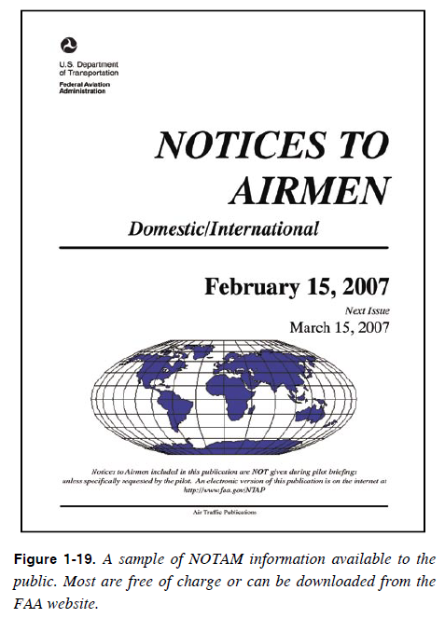
Notice to Airmen (NOTAM)
FAA. (2008). FAA-H-8083-25 Pilot's
Handbook of Aeronautical
Knowledge. p. 1-12

Slide 56
National Airspace System (NAS)
Consists of organization of airports, facilities, airspace, and air traffic control.
Integration of equipment, processes and procedures, and systems.
Provides a safe and systematic flying environment.
Consist of United States civil aviation system.
Consider the classes of controlled airspace.

Slide 57
National Airspace System Plan (NASP)
Specifies development projects required to improve public airports to meet the demands of civil aviation.
Includes strategic goals for NAS
Specifies NAS modernization
Communication
Navigation
Surveillance
Weather Automation Systems
Avionics
Operations
Free Flight (NextGen)

Slide 58
Free Flight (NextGen)
ATC and National Airspace System (NAS) modernization.
Global Positioning System (GPS) navigation that allows direct routes between airports.
ATC controllers monitor and perform surveillance
Consists of
Aeronautical data link systems communication
Controller-to-pilot data link
GPS navigation system
Traffic Alert and Collision Avoidance System (TCAS)
Automated Dependent Surveillance (ADS)
Weather
Integrated Terminal Weather System (ITWS)
Weather and Radar Processor
Enroute enhancements

Slide 59
NAS Capital Investment Plan (CIP)
Appendix B For Fiscal Years 2014 to 2018.
Provides metrics (measures) to link to Department of Transportation and Federal Aviation Administration strategic plans.
Contains budget line items for specific programs and schedules.
Next Generation Air Transportation System (NextGen)
Runway Incursion Reduction Program, etc.

Slide 60
Questions / Comments

