Slide 1
Warm-Up – 9/9 – 10 minutes
Utilizing your notes and past knowledge answer the following questions:
What type of aircraft led to gaining control of the air?
Describe the first type of bullet deflection used on propellers.
What influence did the invention of the interrupting gear have on the use of fighter aircraft?
Describe the problems associated with the wing mounted machine guns?
Describe the first all metal, low wing monoplane.

Slide 2
Questions / Comments

Slide 3
Warm-Up – 9/9 – 10 minutes
Utilizing your notes and past knowledge answer the following questions:
What type of aircraft led to gaining control of the air?
Describe the first type of bullet deflection used on propellers.
What influence did the invention of the interrupting gear have on the use of fighter aircraft?
Describe the problems associated with the wing mounted machine guns?
Describe the first all metal, low wing monoplane.

Slide 4
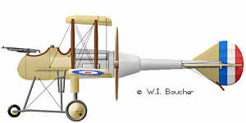
Introduction
As more and more bombing raids took place, clear need for control of the air was needed.
Fighter or pursuit aircraft were needed to drive off bombers.

Slide 5
Warm-Up – 9/9 – 10 minutes
Utilizing your notes and past knowledge answer the following questions:
What type of aircraft led to gaining control of the air?
Describe the first type of bullet deflection used on propellers.
What influence did the invention of the interrupting gear have on the use of fighter aircraft?
Describe the problems associated with the wing mounted machine guns?
Describe the first all metal, low wing monoplane.

Slide 6
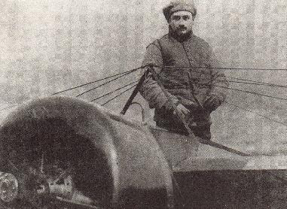
Fighter Development
1915 – French pilot – Roland Garros
Mounted an automatic rifle on aircraft
Fired through the propeller
To keep from shooting off propeller, the rear of the propeller was armored with steel plates

Slide 7
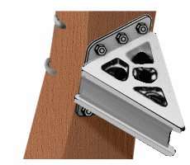
The Steel Deflector Plate Fix
Angled metal guards on the propeller in line with the path of the bullets
The guard is a "V" shaped piece of steel
"U" shaped bullet "gutter" intended to direct the deflected path of the bullet striking it away from the propeller.
sending a ricocheting bullet back into the pilot.
bullet striking the plate could create fractures in the propeller causing it to fail.

Slide 8
Warm-Up – 9/9 – 10 minutes
Utilizing your notes and past knowledge answer the following questions:
What type of aircraft led to gaining control of the air?
Describe the first type of bullet deflection used on propellers.
What influence did the invention of the interrupting gear have on the use of fighter aircraft?
Describe the problems associated with the wing mounted machine guns?
Describe the first all metal, low wing monoplane.

Slide 9
Fighter Development
Germans captured Garros and his plane
Dutch – airplane designer – Anthony Fokker improved on design
Fokker designed a machine gun that fired through a spinning propeller
This gave Germans total control over the skies for over a year

Slide 10
Warm-Up – 9/9 – 10 minutes
Utilizing your notes and past knowledge answer the following questions:
What type of aircraft led to gaining control of the air?
Describe the first type of bullet deflection used on propellers.
What influence did the invention of the interrupting gear have on the use of fighter aircraft?
Describe the problems associated with the wing mounted machine guns?
Describe the first all metal, low wing monoplane.

Slide 11
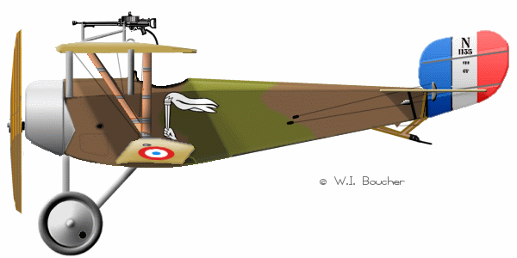
Fighter Development
Allies tried to mount a gun to the top of the wing but was ineffective due to increased drag

Slide 12
The Wing-Mounted Gun Solution:
Fire above the path of the propeller:
Fitted with either drum or clip ammunition feed systems
Two issues:
Unreliable and prone to jamming
difficult task of reloading ammunition or clearing a round from a jammed gun while flying

Slide 13
Warm-Up – 9/9 – 10 minutes
Utilizing your notes and past knowledge answer the following questions:
What type of aircraft led to gaining control of the air?
Describe the first type of bullet deflection used on propellers.
What influence did the invention of the interrupting gear have on the use of fighter aircraft?
Describe the problems associated with the wing mounted machine guns?
Describe the first all metal, low wing monoplane.

Slide 14
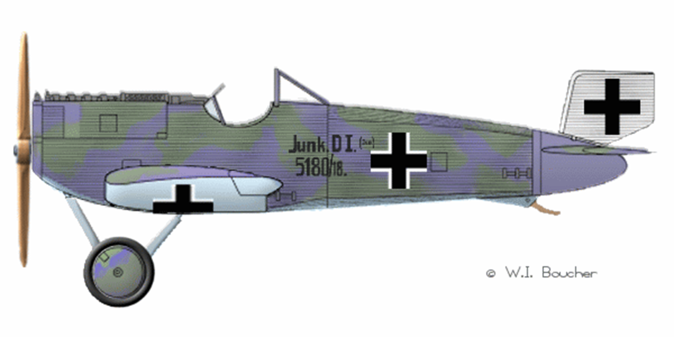
Fighter Development
May 1918
German designer Hugo Junkers built world’s first all metal, low-wing monoplane fighter called the Junkers D1
Arrived too late to make a difference in the war but was the fighter of the future

Slide 15
Questions / Comments

Slide 16
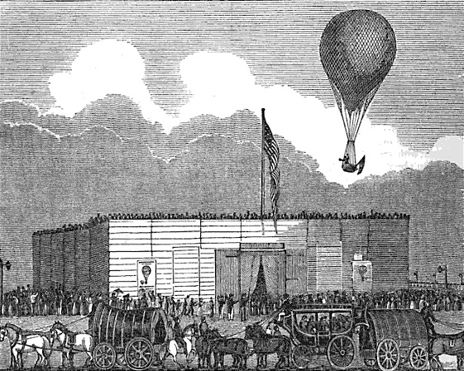
THIS DAY IN AVIATION
September 9
1830 — Charles Durant, America's first great balloonist, makes his first United States ascent at Castle Garden, New York.
He stays in the air for two hours, landing at South Amboy, New Jersey.
His skill and enthusiasm inspire a passion for ballooning in America.

Slide 17
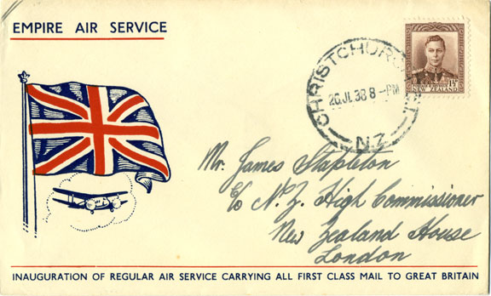
THIS DAY IN AVIATION
September 9
1911 — The first mail carried by air in the United Kingdom is delivered.
The mail contains messages for King George V and other members of the British Royal family.

Slide 18
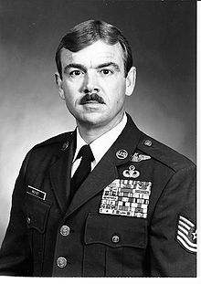
THIS DAY IN AVIATION
September 9
1967 — Sgt. Duane D. Hackney became the first living enlisted man to receive the Air Force Cross.

Slide 19
Questions / Comments

Slide 20
September 2016
Sunday | Monday | Tuesday | Wednesday | Thursday | Friday | Saturday
 | 29 Chapter 2 Intro | 30 Chapter 2 Curtiss | 31 Chapter 2 Vin Fiz Progress Rpts Due | 1 Chapter 2 Progress in Europe | 2 NO SCHOOL STORM | 3
4 | 5 NO SCHOOL HOLIDAY | 6 Chapter 2 QUIZ Progress Rpts Sent Home | 7 Chapter 2 WWI Preparing for War Fighter Development | 8 Chapter 2 WWI Fighter Aces Lafayette Escadrille | 9 WWI TEST FltLine Friday “FlyBoys” | 10
11 | 12 Chapter 3 The Golden Age | 13 Chapter 3 The Golden Age | 14 Chapter 3 The Golden Age | 15 Chapter 3 The Golden Age | 16 Chapter 3 QUIZ | 17
18 | 19 Chapter 3 The Golden Age | 20 Chapter 3 The Golden Age | 21 Chapter 3 The Golden Age Progress Rpts Due | 22 Chapter 3 The Golden Age | 23 Progress Rpts Sent Home | 24
27 | 28 | 29 | 30

Slide 21
Questions / Comments

Slide 22
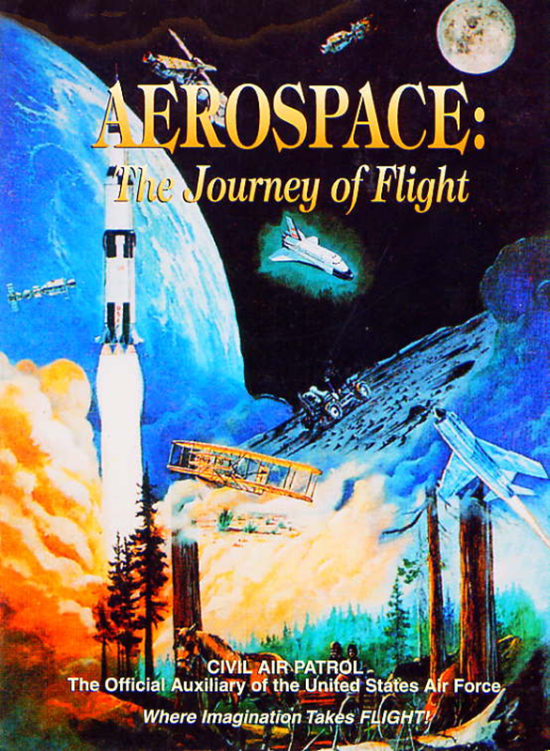
Chapter 2
The Adolescence of Air Power
1904-1919
Test Review

Slide 23
Questions / Comments

Slide 24
Chapter 2
The Adolescence of Air Power
1904-1919
Test

Slide 25
Questions / Comments

Slide 26
Flyboys

