Slide 1
Warm-Up – 9/8 – 10 minutes
Utilizing your notes and past knowledge answer the following questions:
What was the sentiment of the U.S. public regarding aviation between 1904-1919?
List the seven requirements President Roosevelt stated the Wright Brothers must meet before the U.S. government would contract for aircraft.
Why was Glenn Curtiss known as the “Fastest Man on Earth?”
Identify the members of the AEA.
Describe the prize and the rules established for the challenge of the flight across the country.

Slide 2
Questions / Comments

Slide 3
Warm-Up – 9/8 – 10 minutes
Utilizing your notes and past knowledge answer the following questions:
What was the sentiment of the U.S. public regarding aviation between 1904-1919?
List the seven requirements President Roosevelt stated the Wright Brothers must meet before the U.S. government would contract for aircraft.
Why was Glenn Curtiss known as the “Fastest Man on Earth?”
Identify the members of the AEA.
Describe the prize and the rules established for the challenge of the flight across the country.

Slide 4
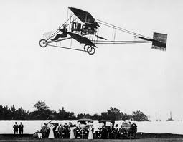
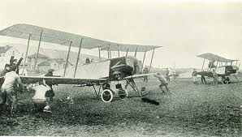
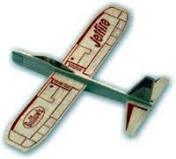
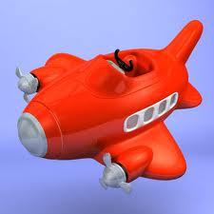
Introduction
1904-1919 people were getting interested in flying but didn’t realize the uses of airplanes.
Some thought of them as just toys or novelties.

Slide 5
Warm-Up – 9/8 – 10 minutes
Utilizing your notes and past knowledge answer the following questions:
What was the sentiment of the U.S. public regarding aviation between 1904-1919?
List the seven requirements President Roosevelt stated the Wright Brothers must meet before the U.S. government would contract for aircraft.
Why was Glenn Curtiss known as the “Fastest Man on Earth?”
Identify the members of the AEA.
Describe the prize and the rules established for the challenge of the flight across the country.

Slide 6
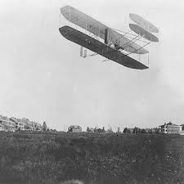
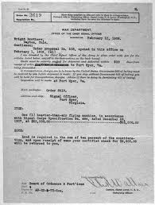
Developments in the United States
Seven requirements:
Carry a pilot
Carry a passenger
125 mile range
Fly at least 36 mph under perfect control
Take off and land in a war zone
Disassembled for transport by wagon
Reassembled in 1 hour
Contract called for Wrights to train 2 pilots for Army

Slide 7
Warm-Up – 9/8 – 10 minutes
Utilizing your notes and past knowledge answer the following questions:
What was the sentiment of the U.S. public regarding aviation between 1904-1919?
List the seven requirements President Roosevelt stated the Wright Brothers must meet before the U.S. government would contract for aircraft.
Why was Glenn Curtiss known as the “Fastest Man on Earth?”
Identify the members of the AEA.
Describe the prize and the rules established for the challenge of the flight across the country.

Slide 8
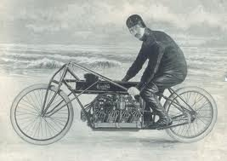
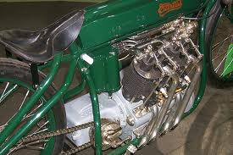
Developments in the U.S.
In 1907, Curtiss became known as the “Fastest Man on Earth”
Raced a motorcycle 136.3mph.
His engines were light and powerful – which caught the interest of Thomas Baldwin – a balloonist.

Slide 9
Warm-Up – 9/8 – 10 minutes
Utilizing your notes and past knowledge answer the following questions:
What was the sentiment of the U.S. public regarding aviation between 1904-1919?
List the seven requirements President Roosevelt stated the Wright Brothers must meet before the U.S. government would contract for aircraft.
Why was Glenn Curtiss known as the “Fastest Man on Earth?”
Identify the members of the AEA.
Describe the prize and the rules established for the challenge of the flight across the country.

Slide 10
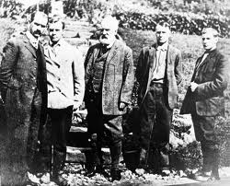
Aerial Experiment Association
Alexander Graham Bell asked Curtiss to join him to help design and develop aircraft and further developments in the aviation industry. (Goal of AEA)
The AEA was formed by Bell, Curtiss, Lt Thomas Selfridge, Baldwin and JohnMcCurdy.

Slide 11
Warm-Up – 9/8 – 10 minutes
Utilizing your notes and past knowledge answer the following questions:
What was the sentiment of the U.S. public regarding aviation between 1904-1919?
List the seven requirements President Roosevelt stated the Wright Brothers must meet before the U.S. government would contract for aircraft.
Why was Glenn Curtiss known as the “Fastest Man on Earth?”
Identify the members of the AEA.
Describe the prize and the rules established for the challenge of the flight across the country.

Slide 12
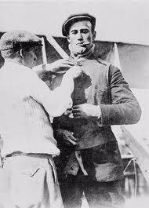
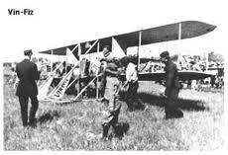
Developments in the U.S.
1911 – William Randolph Hearst – offered $50,000 for flight across U.S.
Must be completed in 30 days
Pilot Calbraith Perry Rodgers persuaded soft drink company “Vin Fiz” to sponsor trip.
The aircraft was a 1911 Wright Flyer Model D at is called the “Vin Fiz Flyer”

Slide 13
Questions / Comments

Slide 14
September 2015
Sunday | Monday | Tuesday | Wednesday | Thursday | Friday | Saturday
 | 31 Chapter 2 Intro | 1 Chapter 2 Curtiss | 2 Chapter 2 Vin Fiz Progress Rpts Due | 3 Chapter 2 Progress in Europe | 4 Chapter 2 QUIZ Progress Rpts Sent Home | 5
6 | 7 NO SCHOOL HOLIDAY | 8 Chapter 2 WWI Preparing for War | 9 Chapter 2 WWI Fighter Development | 10 Chapter 2 WWI Fighter Aces Lafayette Escadrille | 11 WWI TEST FltLine Friday “FlyBoys” | 12
13 | 14 Chapter 3 IThe Golden Age | 15 Chapter 3 The Golden Age | 16 Chapter 3 The Golden Age | 17 Chapter 3 The Golden Age | 18 Chapter 3 QUIZ | 19
20 | 21 | 22 | 23 Progress Rpts Due | 24 | 25 Progress Rpts Sent Home | 26
27 | 28 | 29 | 30

Slide 15
Questions / Comments

Slide 16
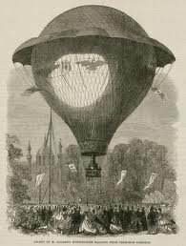
THIS DAY IN AVIATION
September 8
1856 — The first Canadians to fly are A.E. Kierzkowski and A.X. Rambau, who fly in Eugene Godard's balloon.

Slide 17
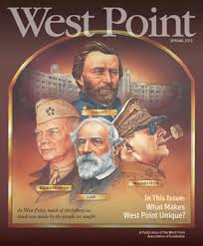
THIS DAY IN AVIATION
September 8
1928 — Seventy-six of the 260 graduates at West Point choose Air Corps as their branch of service and are assigned to Brooks Field, Texas, for primary flying training.

Slide 18
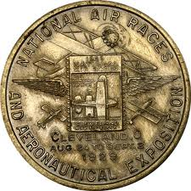
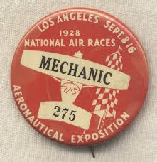
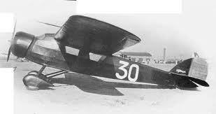
THIS DAY IN AVIATION
September 8 - 16
1928 — An average of 28,000 persons a day attend the National Air Races and Exposition at Los Angeles California.

Slide 19
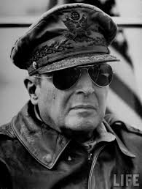
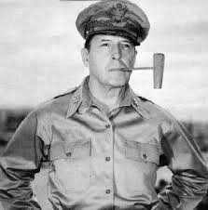
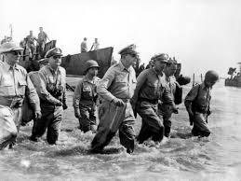
THIS DAY IN AVIATION
September 8
1945 — General MacArthur enters Tokyo.

Slide 20
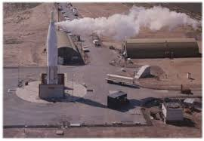
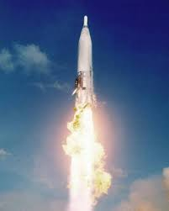
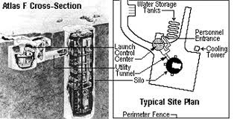
THIS DAY IN AVIATION
September 8
1962 — First “Atlas-F” operational missile squadron installed at Schilling AFB, Kansas.

Slide 21
Questions / Comments

Slide 22
AVIATION ACES
1A
Pilots (A – 93 & above)
1A
Co-Pilots (B – 85 – 92)
Appleby, Chris
Kidd, Bryson
Ballard, Dylan
Clay, Ethan
Dunlap, Kaleb
Geilman, Joseph
Hales, Messiah
Lincoln, Christian
Mcintyre, Bradley
Robinson, Jamel
Segura, Miguel
Topp, Caleb
High Shooter (Score)
98%

Slide 23
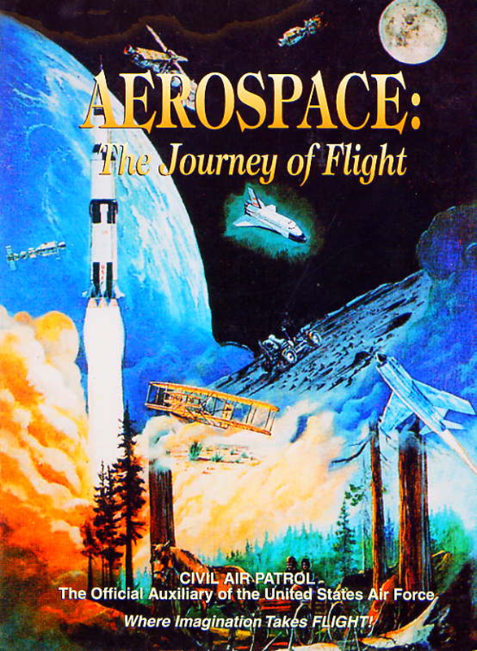
Chapter 2
The Adolescence of Air Power
1904-1919

Slide 24
Today’s Mission Requirements
Mission:
Describe the state of the US Aviation military industry at the start and end of World War I?
What was the military role of the airplane in World War I?
How did that influence the way the war was fought?
How were airships (dirigibles and zeppelins) used during the war?
How did their use influence aircraft development?
EQ:
Describe significant aviation events occurring between 1904-1919 and their impact on future aviation development.

Slide 25
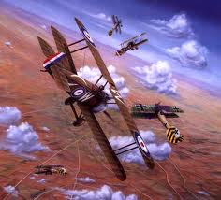
Preparing for War
1912 – all modern countries formed a military flying service

Slide 26
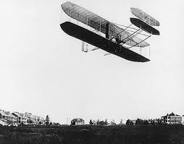
Preparing for War
1908 – US Army purchased a Wright Flyer
Three years it was the entire “Air Force”
1911 – US Congress bought 5 more planes
By end of 1913 – US had 19 aircraft and 29 pilots

Slide 27
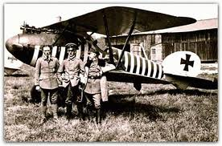
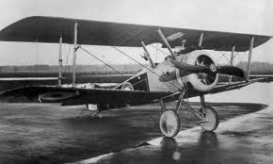
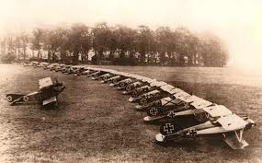
Preparing for War
1914 – start of WWI
Germany had 200 aircraft
Britain and France had over 450
More importantly they had the industry to make more aircraft

Slide 28
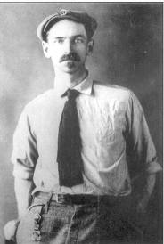
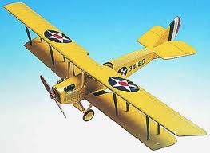
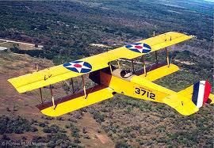
Preparing for War
US did not enter WWI until 1917
Did not have a single combat-worthy aircraft
Curtiss Aircraft was the ONLY company in the US

Slide 29
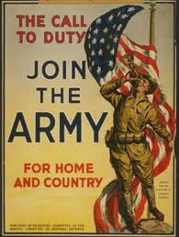
Preparing for War
1917 – Congress appropriated $64 million to build aircraft – stated:
“darken the skies over Europe with US aircraft”
Promised 263 American squadrons with 22,625 aircraft

Slide 30
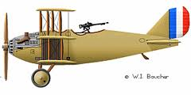
Preparing for War
End of War – Nov 1918
There were only 45 American squadrons
Flying British and French aircraft
Not a single American combat-designed aircraft flew in WWI

Slide 31
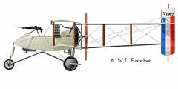
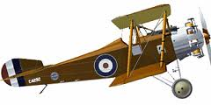
Military Role of the Airplane
Start of 1914
Avg plane speed 70 – 80 mph
Could fly no higher than 10,000 ft
When the war ended (Nov 1918)
Avg plane speed was 140-150 mph
Could fly up to 24,000 ft

Slide 32
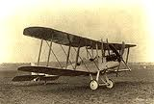
Military Role of the Airplane
Airplane was first used for observation
This use changed the battlefield forever

Slide 33
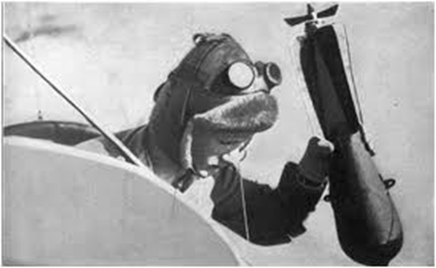
Military Role of the Airplane
Evolved to use as a bomber
With pilot or observer carrying bombs in lap

Slide 34
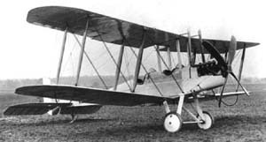
British BE-2

Slide 35
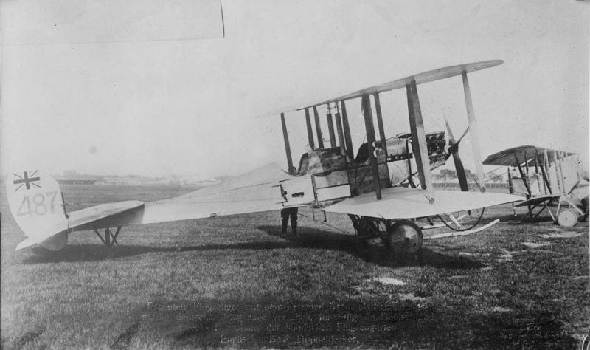
British BE-2

Slide 36
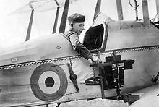

Slide 37
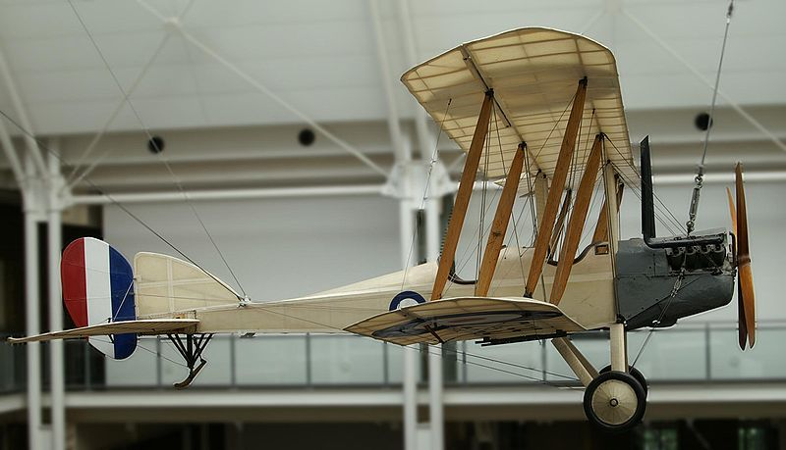
British BE-2

Slide 38
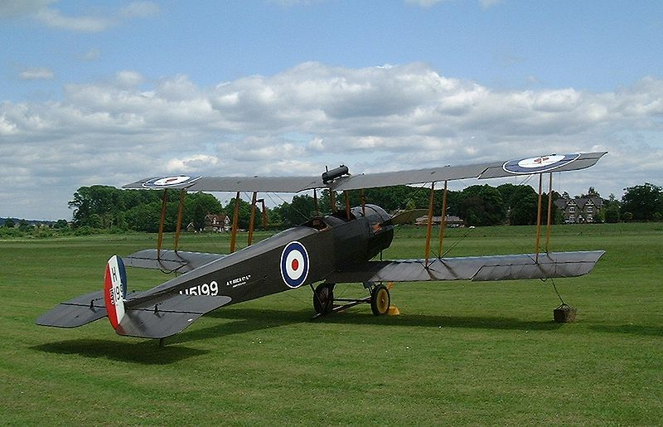
British Avro 504

Slide 39
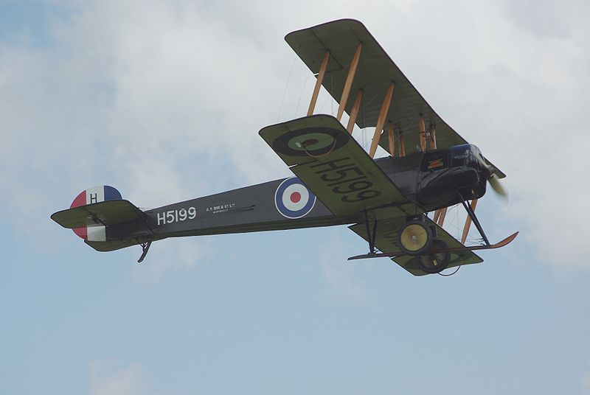
British Avro 504

Slide 40
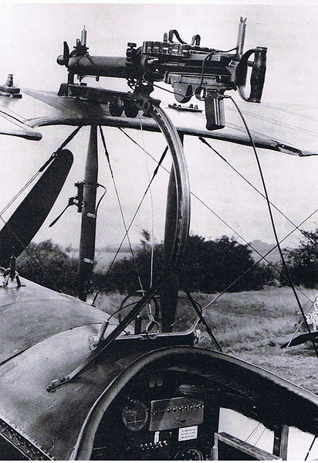
Foster Mounted Lewis Gun
Specifications
Weight | 28 pounds
Length | 50.5 inches
Barrel length | 26.5 inches
Width | 4.5 inches
Cartridge | .303 British .30-06 Springfield 7.92x57mm Mauser
Action | Gas operated
Rate of fire | 500–600 rounds/min
Muzzle velocity | 2,440 feet per second
Effective range | 880 yards
Maximum range | 3,500 yards
Feed system | 47 or 97-round drum magazine
Sights | Blade and Tangent Leaf

Slide 41
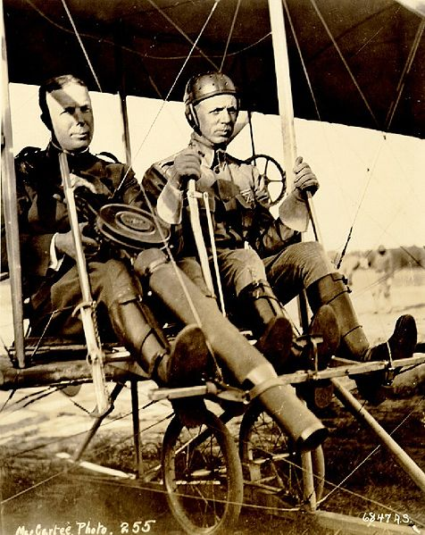
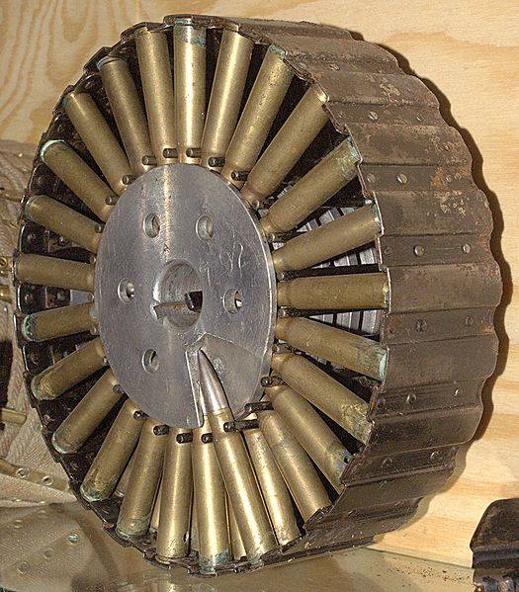
Pan magazine as used on a 7.92×57mm Lewis Gun
Captain Charles Chandler (with Lewis Gun) and Lt. Roy Kirtland seated in a Wright Model B Flyer, 1912, after the first successful firing of a machine-gun from an airplane.

Slide 42
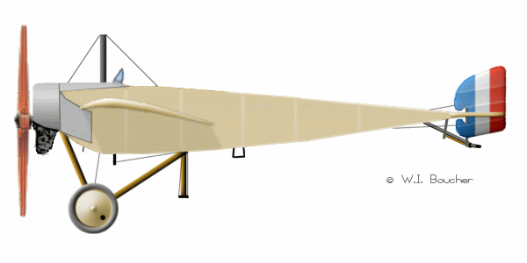
French Morane

Slide 43
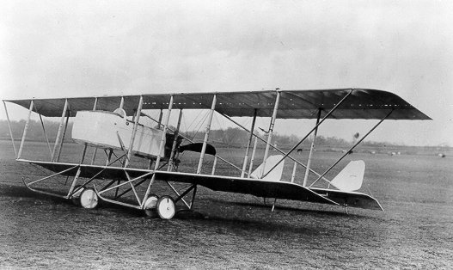
French Farman

Slide 44
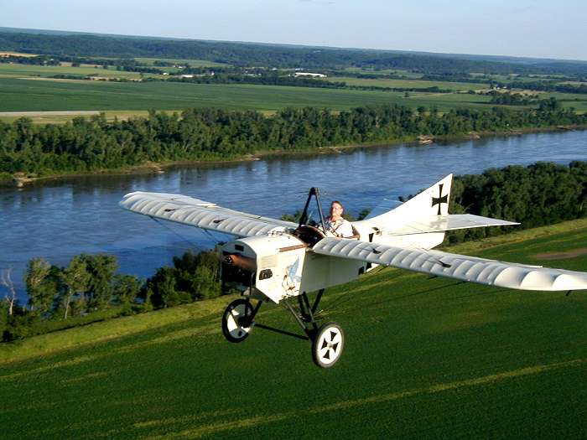
German Taube

Slide 45
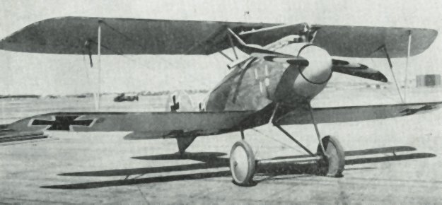
German Albatros

Slide 46
German Albatros – Crashed

Slide 47
Military Role of the Airplane
First Long Range Strategic Bombing raid
Three (3) British Avro 504s bombed a Zeppelin storage shed in southern Germany
Little damage but caused Germans to form their first bombing squadron
1915 – Germans were raiding behind allied lines in France
Later began bombing London using dirigibles and airplanes

Slide 48
Europe in World War I
Beginning of World War I
Germany had 20 dirigibles
Produced 88 more during the war
Germany used them as strategic bombers against French and English cities

Slide 49
Europe in World War I
They were accurate bombers
Highly flammable
Because they were vulnerable to anti-aircraft fire from ground and air
Mainly flown at night
1916 – Germany created a replacement – twin-engine bomber the Gotha IV
This caused British fighters to be called back from war in France
To help protect British cities from the dirigibles

Slide 50
German Gotha IV
Type: Heavy Bomber
First Flight: January 30, 1915
Number Built: 20
Length: 39 ft 4 in
Wingspan: 66 ft 7 in
Height: 12 ft 10 in
Empty Weight: 3,970 lb
Max Takeoff Weight: 6,539 lb
Engines: 2× Benz Bz.III inline engine, 150 hp each
Maximum Speed: 80 mph
Rate of Climb: 140 ft/min
Crew: 3
Armament:
Guns: 3 × 7.92 mm Parabellum MG14 machine guns

Slide 51
Questions / Comments

Slide 52
Today’s Mission Requirements
Mission:
Describe the state of the US Aviation military industry at the start and end of World War I?
What was the military role of the airplane in World War I?
How did that influence the way the war was fought?
How were airships (dirigibles and zeppelins) used during the war?
How did their use influence aircraft development?
EQ:
Describe significant aviation events occurring between 1904-1919 and their impact on future aviation development.

Slide 53
Preparing for War
1908 – US Army purchased a Wright Flyer
Three years it was the entire “Air Force”
1911 – US Congress bought 5 more planes
By end of 1913 – US had 19 aircraft and 29 pilots

Slide 54
Preparing for War
1914 – start of WWI
Germany had 200 aircraft
Britain and France had over 450
More importantly they had the industry to make more aircraft

Slide 55
Preparing for War
US did not enter WWI until 1917
Did not have a single combat-worthy aircraft
Curtiss Aircraft was the ONLY company in the US

Slide 56
Preparing for War
1917 – Congress appropriated $64 million to build aircraft – stated:
“darken the skies over Europe with US aircraft”
Promised 263 American squadrons with 22,625 aircraft

Slide 57
Preparing for War
End of War – Nov 1918
There were only 45 American squadrons
Flying British and French aircraft
Not a single American combat-designed aircraft flew in WWI

Slide 58
Today’s Mission Requirements
Mission:
Describe the state of the US Aviation military industry at the start and end of World War I?
What was the military role of the airplane in World War I?
How did that influence the way the war was fought?
How were airships (dirigibles and zeppelins) used during the war?
How did their use influence aircraft development?
EQ:
Describe significant aviation events occurring between 1904-1919 and their impact on future aviation development.

Slide 59
Military Role of the Airplane
Airplane was first used for observation
This use changed the battlefield forever

Slide 60
Military Role of the Airplane
Evolved to use as a bomber
With pilot or observer carrying bombs in lap

Slide 61
Today’s Mission Requirements
Mission:
Describe the state of the US Aviation military industry at the start and end of World War I?
What was the military role of the airplane in World War I?
How did that influence the way the war was fought?
How were airships (dirigibles and zeppelins) used during the war?
How did their use influence aircraft development?
EQ:
Describe significant aviation events occurring between 1904-1919 and their impact on future aviation development.

Slide 62
Military Role of the Airplane
First Long Range Strategic Bombing raid
Three (3) British Avro 504s bombed a Zeppelin storage shed in southern Germany
Little damage but caused Germans to form their first bombing squadron
1915 – Germans were raiding behind allied lines in France
Later began bombing London using dirigibles and airplanes

Slide 63
Today’s Mission Requirements
Mission:
Describe the state of the US Aviation military industry at the start and end of World War I?
What was the military role of the airplane in World War I?
How did that influence the way the war was fought?
How were airships (dirigibles and zeppelins) used during the war?
How did their use influence aircraft development?
EQ:
Describe significant aviation events occurring between 1904-1919 and their impact on future aviation development.

Slide 64
Europe in World War I
Beginning of World War I
Germany had 20 dirigibles
Produced 88 more during the war
Germany used them as strategic bombers against French and English cities

Slide 65
Today’s Mission Requirements
Mission:
Describe the state of the US Aviation military industry at the start and end of World War I?
What was the military role of the airplane in World War I?
How did that influence the way the war was fought?
How were airships (dirigibles and zeppelins) used during the war?
How did their use influence aircraft development?
EQ:
Describe significant aviation events occurring between 1904-1919 and their impact on future aviation development.

Slide 66
Europe in World War I
They were accurate bombers
Highly flammable
Because they were vulnerable to anti-aircraft fire from ground and air
Mainly flown at night
1916 – Germany created a replacement – twin-engine bomber the Gotha IV
This caused British fighters to be called back from war in France
To help protect British cities from the dirigibles

Slide 67
Questions / Comments

Slide 68
Model Building Grading Rubic
Each Group MUST follow all directions
STOP! - If you are unsure
SAFETY at ALL Times
Accuracy and Authenticity will be judged
Each Group Member is responsible to produce a 2 page paper on the model.
Aircraft Specifications
Aircraft contribution to Aviation development
Significant Aviation Pioneers associated with aircraft (pilots, inventors etc.)
The Group will provide a Presentation on the model.
5to 7 slides (Title slide; Body; Summary Slide)

Slide 69
Questions / Comments

Slide 70
Lesson Closure - 3 – 2 - 1
3. List 3 things you learned today.
2. List 2 things you have questions about today’s lesson.
1. Create (1) quiz question with answer about today’s lesson.

Slide 71
Questions / Comments

Slide 73
Safety Rules – Safety Monitor Brief
Must Use Safety Glasses
Use of Cutting tools is Dangerous – AT ALL TIMES
Must Use Cutting Mats
Extended breathing of adhesives and paint fumes can be dangerous
All Areas will remain clean and organized
Plane Captains will insure All Areas will be cleaned and all items put back in proper locations 10minutes prior to class ending
Class safety monitor will insure areas are clean and safe at all times

Slide 74
SAFETY FIRST.
SAFETY ALWAYS.

Slide 75
Questions / Comments

Slide 77
Today’s Mission Requirements
Standards Addressed:
Technological Literacy
Students will develop an understanding of the:
Characteristics and scope of technology.
Core concepts of technology.
Relationships among technologies and the connections between technology and the other fields of study.
English Language Arts
Students will:
Conduct research and gather, evaluate and synthesize data and communicate their discoveries to their audience.
Use a variety of technological and informational resources to create and communicate knowledge.

Slide 78
October 2014
Sunday | Monday | Tuesday | Wednesday | Thursday | Friday | Saturday
 | 29 Chapter 2 QUIZ Progress in Europe Model Building | 30 | 1 Flying Vertical Commercial Flying Model Building | 2 | 3 Chapter 2 QUIZ FltLine Friday Model Building | 4
5 | 6 | 7 Preparing for War WWI – Role of the Airplane Model Building | 8 | 9 Europe in WWI Fighter Development Model Building | 10 | 11
12 | 13 Chapter 2 QUIZ Fighter Aces US in WWI Model Building | 14 | 15 US in WWI Ind 2 pg paper Presentation / Models Due | 16 | 18 Chapter 2 TEST FltLine Friday “FlyBoys” | 18
19 | 20 1st Quarter Grades Due | 21 | 22 | 23 | 24 No School Parent/Teacher Conf. | 25
26 | 27 | 28 | 29 | 30 | 31

