Slide 1
Warm-Up – 9/7 – 10 minutes
Utilizing your notes and past knowledge answer the following questions:
What key or menu item would I select to check if my Aery glider would fly?
What should you do to the leading edges of the wings and the stabilizers to aid in flight?
Why is it important for the wing to be centered on the fuselage?
Why is it important for the stabilizer to be centered on the fuselage?
What is the best method for gluing on the wings and stabilizer?

Slide 2
Questions / Comments

Slide 3
Warm-Up – 9/7 – 10 minutes
Utilizing your notes and past knowledge answer the following questions:
What key or menu item would I select to check if my Aery glider would fly?
What should you do to the leading edges of the wings and the stabilizers to aid in flight?
Why is it important for the wing to be centered on the fuselage?
Why is it important for the stabilizer to be centered on the fuselage?
What is the best method for gluing on the wings and stabilizer?

Slide 4
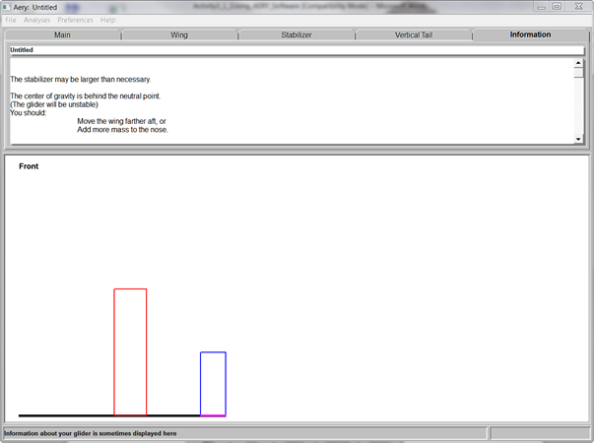
Will it Fly? Analysis
Press F3 or under Analysis
Once you get an AERY number
AND it is stable
Raise Hand

Slide 5
Warm-Up – 9/7 – 10 minutes
Utilizing your notes and past knowledge answer the following questions:
What key or menu item would I select to check if my Aery glider would fly?
What should you do to the leading edges of the wings and the stabilizers to aid in flight?
Why is it important for the wing to be centered on the fuselage?
Why is it important for the stabilizer to be centered on the fuselage?
What is the best method for gluing on the wings and stabilizer?

Slide 6
Shaping the Wing Profile
Leading edge should have minimal rounding
Trailing edge needs taper on top only
Use sanding block and edge of a solid surface for uniform sanding

Slide 7
Warm-Up – 9/7 – 10 minutes
Utilizing your notes and past knowledge answer the following questions:
What key or menu item would I select to check if my Aery glider would fly?
What should you do to the leading edges of the wings and the stabilizers to aid in flight?
Why is it important for the wing to be centered on the fuselage?
Why is it important for the stabilizer to be centered on the fuselage?
What is the best method for gluing on the wings and stabilizer?

Slide 8
Adding the Wing
Center the wing on the fuselage
Glue it on straight and square to the fuselage . . . this is critical

Slide 9
Balance the Glider
Place pencil on table top and put glider on top of it with center of gravity directly over pencil
Add clay to nose until glider balances at the center of gravity

Slide 10
Balance the Glider
Hold glider on fingertips placed at nose and tail
Add clay to wingtips until glider balances at fuselage

Slide 11
Warm-Up – 9/7 – 10 minutes
Utilizing your notes and past knowledge answer the following questions:
What key or menu item would I select to check if my Aery glider would fly?
What should you do to the leading edges of the wings and the stabilizers to aid in flight?
Why is it important for the wing to be centered on the fuselage?
Why is it important for the stabilizer to be centered on the fuselage?
What is the best method for gluing on the wings and stabilizer?

Slide 12
Adding the Stabilizer
Center the stabilizer on the fuselage
Glue it on straight and square to the fuselage . . . this is critical

Slide 13
Warm-Up – 9/7 – 10 minutes
Utilizing your notes and past knowledge answer the following questions:
What key or menu item would I select to check if my Aery glider would fly?
What should you do to the leading edges of the wings and the stabilizers to aid in flight?
Why is it important for the wing to be centered on the fuselage?
Why is it important for the stabilizer to be centered on the fuselage?
What is the best method for gluing on the wings and stabilizer?

Slide 14
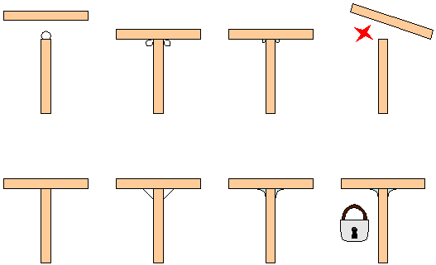
Making a Strong Bond
Avoid typical novice method of applying excessive glue on an edge and sticking material together
Light bond with reinforcing fillets increases the glue surface area and bond strength

Slide 15
Questions / Comments

Slide 16
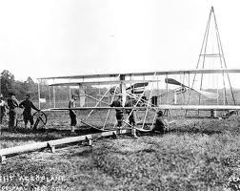
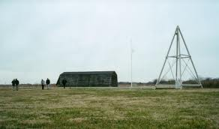
THIS DAY IN AVIATION
September 7
1904 — The Wright Brothers first use their weight-and-derrick-assisted take-off device in order to make themselves independent of the wind and weather.
When the heavy weight is released, the rope pulls the aircraft, which sits on a flatbed truck, over the launching track, thus assisting its take-off.

Slide 17
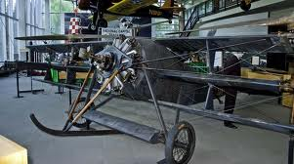
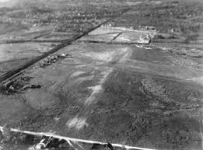
THIS DAY IN AVIATION
September 7
1909 — The United States Army's first “Aerodrome,” an airfield or airport, is established in College Park, Maryland.

Slide 18
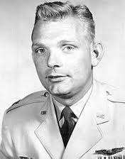
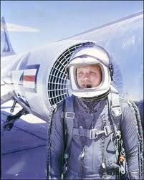
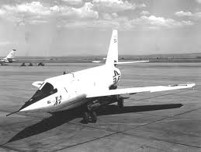
THIS DAY IN AVIATION
September 7
1956 — New manned flight altitude record of 125,200 feet set by Capt. I.C. Kincheloe. (Bell X-2)

Slide 19
Questions / Comments

Slide 20
September 2017
Sunday | Monday | Tuesday | Wednesday | Thursday | Friday | Saturday
 | 4 HOLIDAY | 5 AERY Software Balsa Glider Construction | 6 AERY Software Balsa Glider Construction | 7 Balsa Glider Construction | 8 Glider Challenge Flight Line Friday Progress Reports | 9
10 | 11 Chapter 2 Development of Aviation in U.S. | 12 Chapter 2 Glenn Curtiss | 13 Chapter 2 Vin Fiz | 14 Chapter 2 Progress in Europe | 15 Chapter 2 Quiz Flight Line Friday | 16
17 | 18 Chapter 2 WWI Preparing for War Fighter Development | 19 Chapter 2 WWI Fighter Aces Lafayette Escadrille | 20 Chapter 2 WWI | 21 Chapter 2 WWI | 22 Chapter 2 Test Flight Line Friday | 23
24 | 25 Chapter 3 The Golden Age | 26 Chapter 3 The Golden Age | 27 Chapter 3 The Golden Age | 28 Chapter 3 The Golden Age | 29 Chapter 3 Quiz Flight Line Friday | 30

Slide 21
Questions / Comments

Slide 23
Will it Fly? Analysis
Press F3 or under Analysis
Once you get an AERY number
AND it is stable
Raise Hand

Slide 24
Building on a Single Sheet
90 cm
or
36 inch
Fuselage
Wing
Horizontal
Stabilizer
Vertical
Tail
7.5 cm
or
3 inch
Leave extra space at these locations if material allows
Notice the grain direction: Always spanwise!
NOTE: Fuselage can be no LONGER than 35 cm or 12 inch
Can be no WIDER than 2.5 cm or 1 inch

Slide 25
Questions / Comments

Slide 26
Balsa Glider Construction

Slide 27
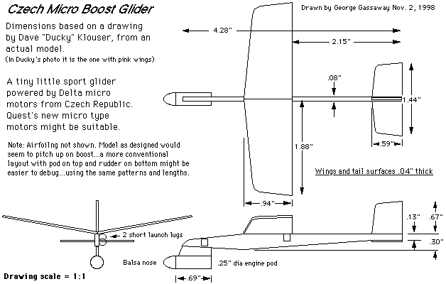
Familiarize Yourself with the Plan
Components
Dimensions
Materials
Outlines vs. cuts

Slide 28
Building on a Single Sheet
Wing
Horizontal
Stabilizer
Vertical
Tail
Leave extra space at these locations if material allows
Notice the grain direction: Always spanwise!

Slide 29
Marking the Fuselage
Cut for Length
Wing
Location
Center
of
Gravity
Horizontal
Stabilizer
Vertical
Tail
Neutral
Point

Slide 30
Cut Out Pieces
Cut the wing
Cut out stabilizers
Sand leading and trailing edges with minimal rounding

Slide 31
Shaping the Wing Profile
Leading edge should have minimal rounding
Trailing edge needs taper on top only
Use sanding block and edge of a solid surface for uniform sanding

Slide 32
Adding the Wing
Center the wing on the fuselage
Glue it on straight and square to the fuselage . . . this is critical

Slide 33
Making a Strong Bond
Avoid typical novice method of applying excessive glue on an edge and sticking material together
Light bond with reinforcing fillets increases the glue surface area and bond strength

Slide 34
Add Horizontal Stabilizer
One piece stabilizer
Stronger
Only possible if mounted somewhere away from vertical stabilizer
Two piece stabilizer
Weaker
Mount anywhere else

Slide 35
Check Alignment
Hold stabilizer on wedge
Ensure from front or back that stabilizer is parallel to wing
If not, sand wedge slightly and recheck

Slide 36
Vertical Stabilizer Side Mount
Requires tail at a completely different location on fuselage from horizontal stabilizer
Glue onto side of fuselage flush with bottom edge and front edge even with vertical tail mark
Front
Back
VT
Side of Fuselage
VT
VT
Top View

Slide 37
Vertical Stabilizer Top Mount
Can be used no matter where tail is located
Draw line down center of fuselage top starting at vertical tail mark
Glue on vertical tail straight and square
Front
Back
VT
Side of Fuselage
VT
Top View
VT
VT

Slide 38
Balance the Glider
Place pencil on table top and put glider on top of it with center of gravity directly over pencil
Add clay to nose until glider balances at the center of gravity

Slide 39
Balance the Glider
Hold glider on fingertips placed at nose and tail
Add clay to wingtips until glider balances at fuselage

Slide 40
SAFETY FIRST.
SAFETY ALWAYS.

Slide 41
Safety Rules – Safety Monitor Brief
Must Use Safety Glasses
Use of Cutting tools is Dangerous – AT ALL TIMES
Must Use Cutting Mats
Extended breathing of adhesives and paint fumes can be dangerous
All Areas will remain clean and organized
Plane Captains will insure All Areas will be cleaned and all items put back in proper locations 10minutes prior to class ending
Class safety monitor will insure areas are clean and safe at all times

Slide 42
Questions / Comments

