Slide 1
Warm-Up – 9/2 – 10 minutes
Utilizing your notes and past knowledge answer the following questions:
Describe the contributions by Robert Esnault-Pelterie to aviation.
Describe the contributions by Alberto Santos-Dumont to aviation.
Describe the contributions by Louis Bleriot to aviation.
Describe the aviation achievements at the First International Air meet.
Identify Henri Farman’s contributions to aviation.

Slide 2
Questions / Comments

Slide 3
Warm-Up – 9/2 – 10 minutes
Utilizing your notes and past knowledge answer the following questions:
Describe the contributions by Robert Esnault-Pelterie to aviation.
Describe the contributions by Alberto Santos-Dumont to aviation.
Describe the contributions by Louis Bleriot to aviation.
Describe the aviation achievements at the First International Air meet.
Identify Henri Farman’s contributions to aviation.

Slide 4
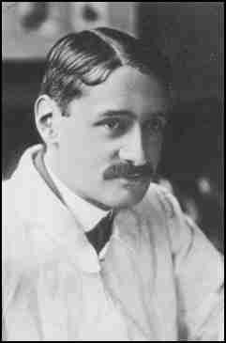
Progress in Europe
Wing Warping
Clumsy method to control an airplane
Frenchman – Robert Esnault-Pelterie built a Wright-style glider in 1904 and used ailerons to replace the wing-warping technique developed by the Wright brothers.
Utilized a hand operated wheel to control the ailerons
Inventor of the joystick and first fully enclosed fuselage airplane

Slide 5
Warm-Up – 9/2 – 10 minutes
Utilizing your notes and past knowledge answer the following questions:
Describe the contributions by Robert Esnault-Pelterie to aviation.
Describe the contributions by Alberto Santos-Dumont to aviation.
Describe the contributions by Louis Bleriot to aviation.
Describe the aviation achievements at the First International Air meet.
Identify Henri Farman’s contributions to aviation.

Slide 6
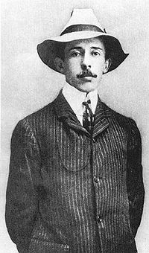
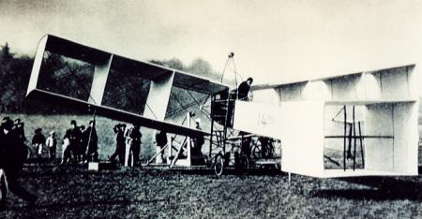
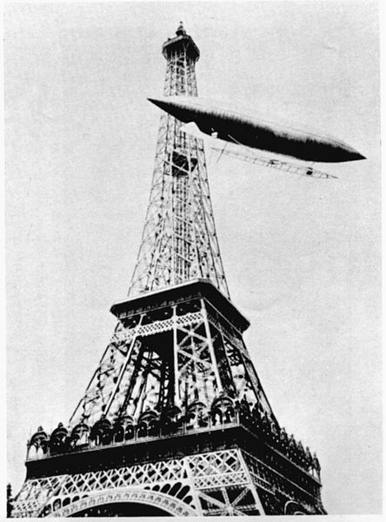
Progress in Europe
Alberto Santos-Dumount
Flew first powered airplane in Europe
14-bis biplane – Paris, France Oct 23, 1906
for a distance 197ft at a height of 10ft
Two weeks later flew for 722ft

Slide 7
Warm-Up – 9/2 – 10 minutes
Utilizing your notes and past knowledge answer the following questions:
Describe the contributions by Robert Esnault-Pelterie to aviation.
Describe the contributions by Alberto Santos-Dumont to aviation.
Describe the contributions by Louis Bleriot to aviation.
Describe the aviation achievements at the First International Air meet.
Identify Henri Farman’s contributions to aviation.

Slide 8
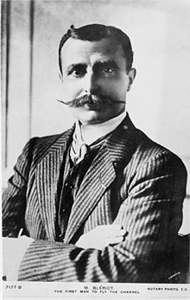
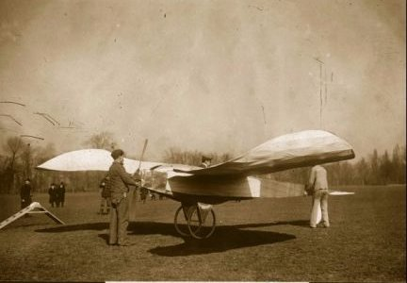
Progress in Europe
Louis Bleriot
Flew first powered monoplane 1907
The Blériot V canard monoplane

Slide 9
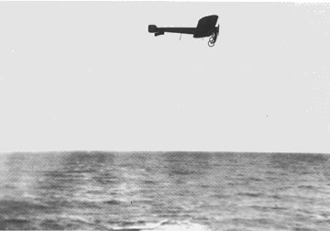
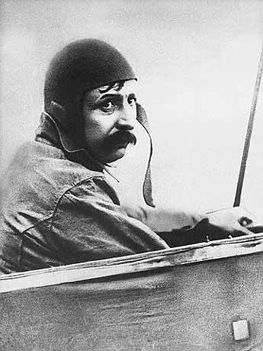
Progress in Europe
Louis Blériot took off in his model XI on July 25, 1909 to fly across the English Channel.
25 –hp engine
Built 11 planes before the trip – had almost 50 crashes but refused to give up

Slide 10
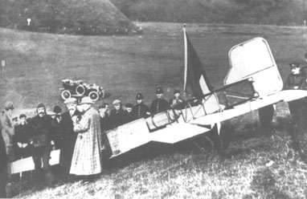
Progress in Europe
Blériot was an instant celebrity when he landed in Dover after crossing the English Channel.
25 miles - 37 minutes
No compass

Slide 11
Warm-Up – 9/2 – 10 minutes
Utilizing your notes and past knowledge answer the following questions:
Describe the contributions by Robert Esnault-Pelterie to aviation.
Describe the contributions by Alberto Santos-Dumont to aviation.
Describe the contributions by Louis Bleriot to aviation.
Describe the aviation achievements at the First International Air meet.
Identify Henri Farman’s contributions to aviation.

Slide 12
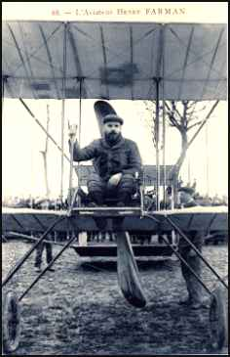
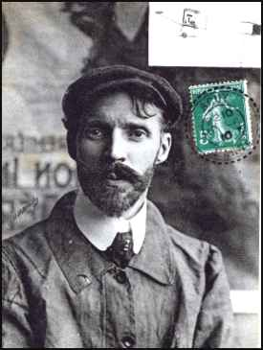
Progress in Europe
1909 – First International Air meet held in Rheims, France
Many speed and endurance records were broken
Louis Bleriot - - fastest lap – 47.8 mph
Henri Farman stayed in the air 3 hrs, 4 minutes and 56 seconds
Flying 111 miles

Slide 13
Warm-Up – 9/2 – 10 minutes
Utilizing your notes and past knowledge answer the following questions:
Describe the contributions by Robert Esnault-Pelterie to aviation.
Describe the contributions by Alberto Santos-Dumont to aviation.
Describe the contributions by Louis Bleriot to aviation.
Describe the aviation achievements at the First International Air meet.
Identify Henri Farman’s contributions to aviation.

Slide 14
Progress in Europe
1909 – First International Air meet held in Rheims, France
Many speed and endurance records were broken
Louis Bleriot - - fastest lap – 47.8 mph
Henri Farman stayed in the air 3 hrs, 4 minutes and 56 seconds
Flying 111 miles

Slide 15
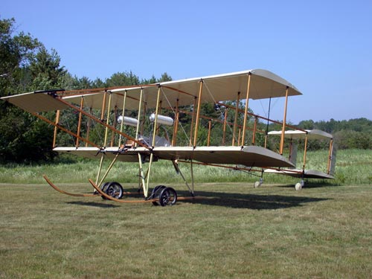
Henri Farman III
Powered by a 50-horsepower Gnôme engine,
It had full ailerons and twin rudders for control
Sprung wheels on the skids to soften the landing.

Slide 16
Questions / Comments

Slide 17
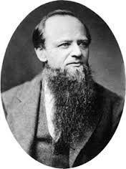
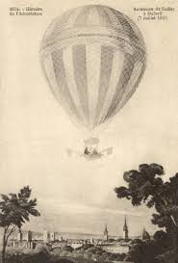
THIS DAY IN AVIATION
September 2
1858 — Samuel King introduces the first drag-line in America.
It is a long rope attached to the basket, which helps to stabilize altitude by dragging on the ground when the balloon is flying very low.

Slide 18
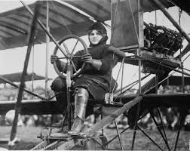
THIS DAY IN AVIATION
September 2
1910 — Blanche Scott, the first woman pilot in the United States, makes a solo flight at Lake Keuka, Hammondsport.

Slide 19
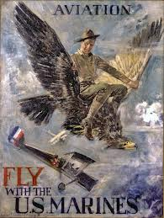
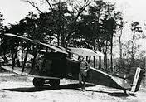
THIS DAY IN AVIATION
September 2
1921 — United States Marine Corps planes locate entire hidden “Moon Shine” village on Atlantic Coast.

Slide 20
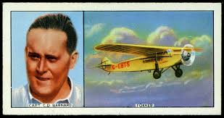
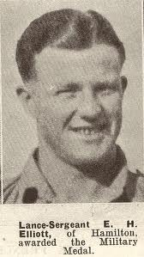
THIS DAY IN AVIATION
September 2
1928 — Capt. C.D. Barnard, and Flight Officer E.H. Elliott, flying a Fokker monoplane, powered by a Jupiter engine, fly from Karachi, India to London in 4½ Days.

Slide 21
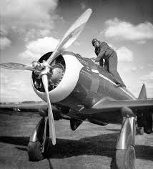
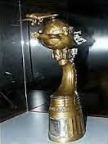
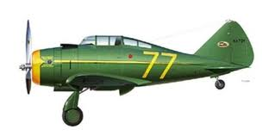
THIS DAY IN AVIATION
September 2
1939 — Frank Fuller, Jr., wins the Bendix Trophy Race with an elapsed time from Burbank, California, to Bendix, New Jersey, in 9 hours, 2 minutes, 5 seconds.
By setting records between Burbank and Cleveland, Ohio and between Burbank and Bendix, New Jersey, he wins $12,500.
His average speed was 217 mph. He flew a “Wasp” powered Seversky Racer.

Slide 22
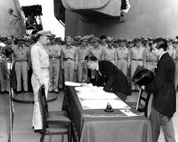
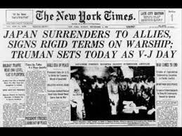
THIS DAY IN AVIATION
September 2
1945 — The Japanese sign the surrender documents aboard the battleship USS Missouri anchored in Tokyo Bay.
The V-J, Victory over the Pacific, is formally declared.

Slide 23
Questions / Comments

Slide 24
August 2016
Sunday | Monday | Tuesday | Wednesday | Thursday | Friday | Saturday
14 | 15 Welcome to Aviation | 16 Parts of an Aircraft Forces of Flight | 17 Flight Control Surfaces | 18 Aircraft Review | 19 Flight Line Friday Quiz | 20
21 | 22 Quiz Review Chapter 1 Intro | 23 Chapter 1 Developing the Airplane | 24 Chapter 1 Wright Brothers | 25 Chapter 1 Wright Brothers | 26 Flight Line Friday Chapter 1 Test | 27
28 | 29 Chapter 2 Development of Aviation in U.S. | 30 Chapter 2 Curtiss | 31 Chapter 2 Vin Fiz Progress Rpts Due | 1 Chapter 2 Progress in Europe | 2 Chapter 2 QUIZ Progress Rpts Sent Home

Slide 25
Questions / Comments

Slide 26
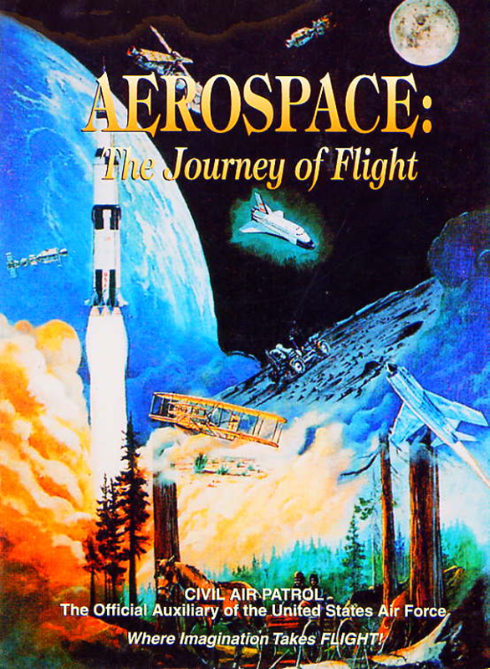
Chapter 2
The Adolescence of Air Power
1904-1919

Slide 27
Today’s Mission Requirements
Mission:
Describe the first multiengine aircraft and the reasons for its development.
Describe the first four engine aircraft.
Describe the Gnome and the Le Rhone engine.
Describe the early inventors of the helicopter and the major control problem they faced.
Describe the first regularly scheduled airline service.
EQ:
Describe significant aviation events occurring between 1904-1919 and their impact on future aviation development.

Slide 28
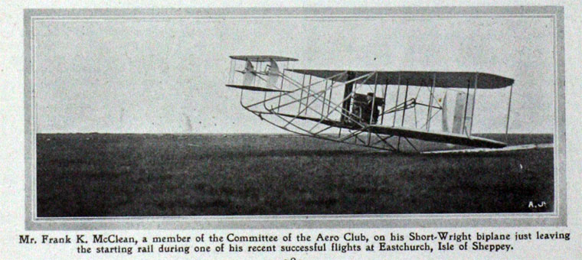
Progress in Europe
1911 – Short Brothers developed the first multiengine aircraft – called the “Triple Twin”

Slide 29
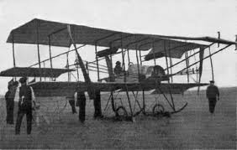
Progress in Europe
“Triple Twin”
Had two engines and three propellers

Slide 30
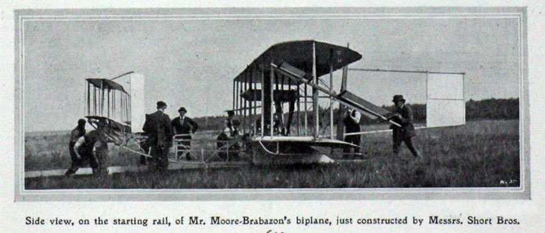
Progress in Europe
Reasons for multi-engine aircraft
Increased power
Reliability ( if 1 fails enough power to safe landing)

Slide 31
Progress in Europe
May 13, 1913 – First four engine aircraft
The LeGrand
Built and flown by Igor Sikorsky
Wingspan of 92 ft
Four 100-hp engines
16 wheels for landing gear
Fully enclosed cockpit
Passenger cabin with portholes for windows

Slide 32
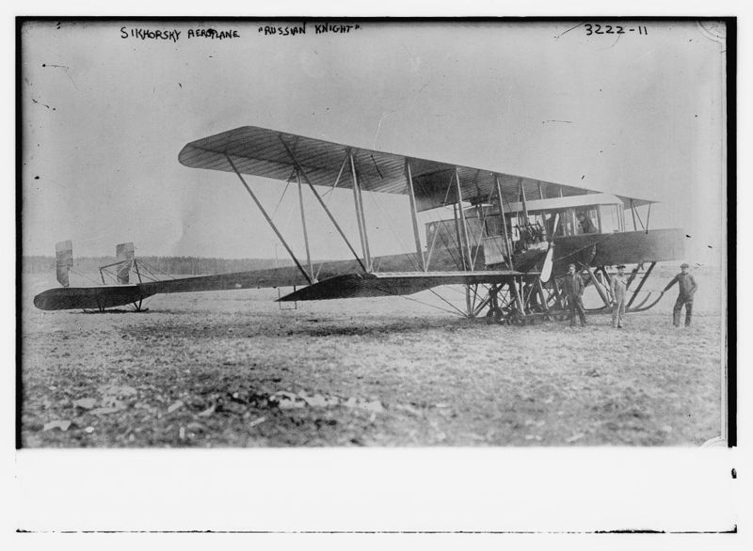

Slide 33
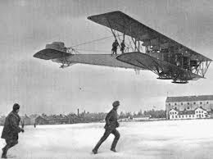
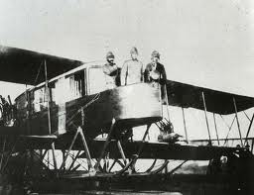

Slide 34
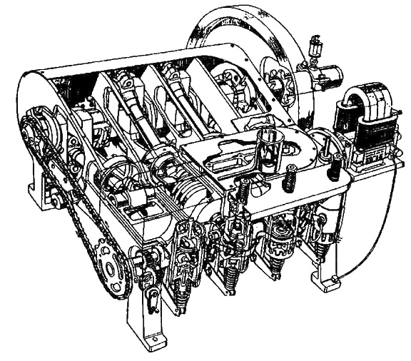
Progress in Europe
Engines at that time were
Manufactured from steel, cast iron, and brass
Water-cooled
10 lbs for every 1 horsepower
Required large heavy structure to support weight of engine
1903 Wright Engine

Slide 35
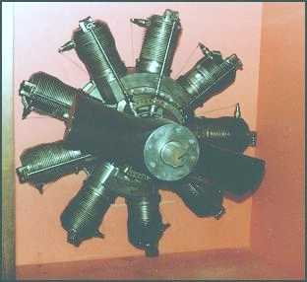
Gnome
Engine

Slide 36
Progress in Europe
Gnome
Cylinders had cooling fins to help bleed the heat into the air
When stationary the engine/propeller spun around the fixed crankshaft
Opposite of modern radial engines
Called rotary engines

Slide 37
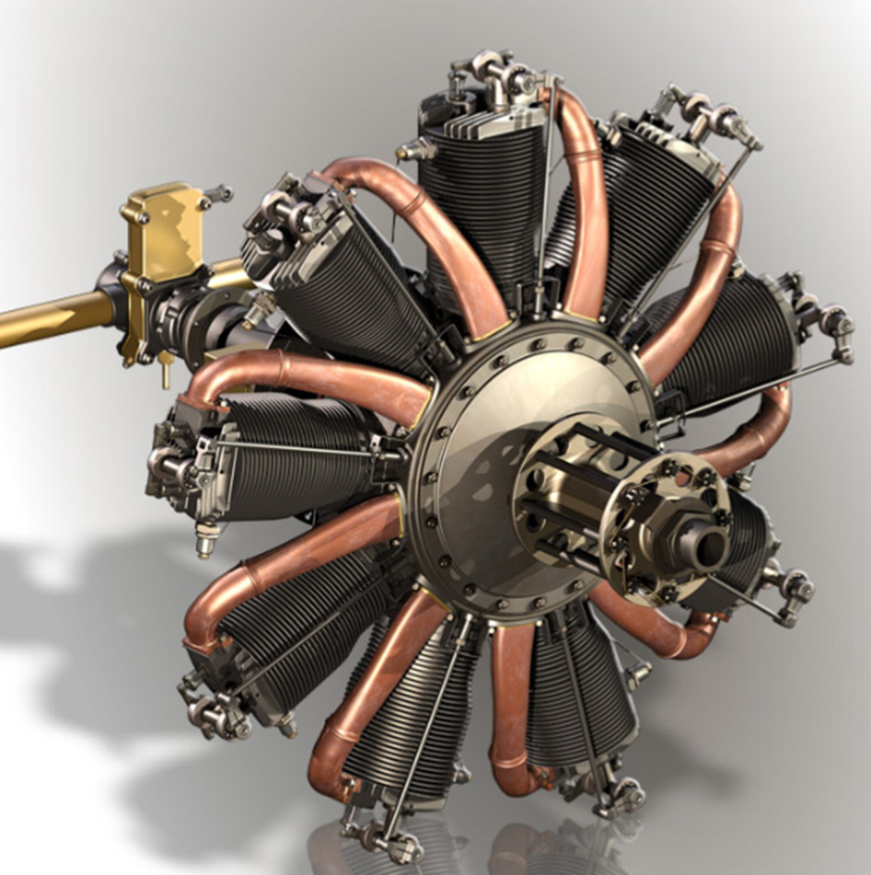
Progress in Europe
Gnome / Le Rhone
Many World War I aircraft used the engines
Sopwith Camel
Sopwith Pup

Slide 38
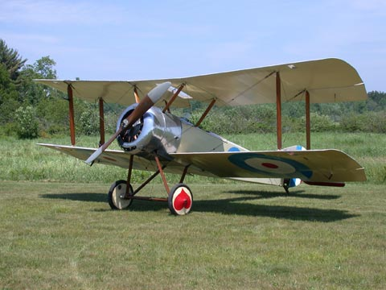
Sopwith Pup

Slide 39
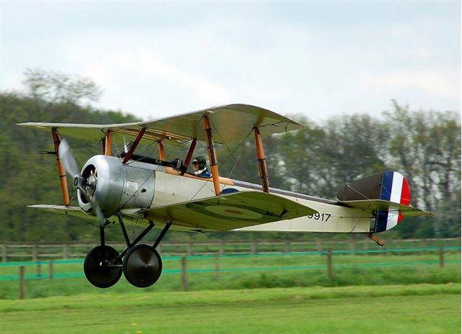
Sopwith Camel

Slide 40
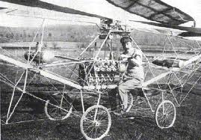
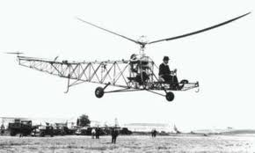
How to
Fly a
Helicopter

Slide 41
Moving Up – Vertical Flying
Heavier-than-aircraft –
Lift is produced by the wings
To sustain lift
Wings must be moving through the air
Fixed wing aircraft forward motion causes wings to move through air and create lift
Helicopters
Main rotor moves through air and made up of a number of blades
Blades are like wings
As they move through the air they create lift
Hence the term – rotary wing

Slide 42
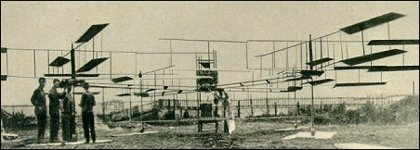
Louis Breguet - 1907
Lifted off ground but was held by four assistants

Slide 43
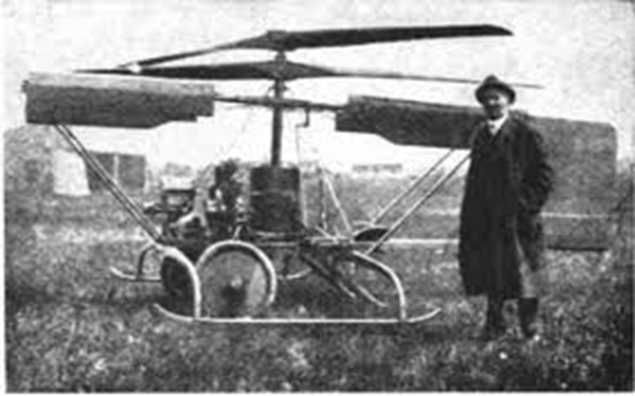
Helicopter Development
Plagued by control problems
Counteracting the torque of the main rotor
When the helicopter was turning the aircraft went in the opposite direction

Slide 44
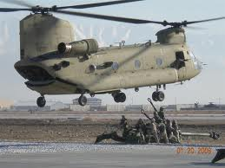
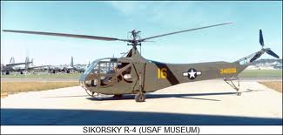
Helicopter Development
To counteract it - two rotors were added rotating in opposite directions
Another is to put a small rotor on the tail boom which provided thrust to counteract the torque of the main rotor.
Took 30 years to solve it – just prior to World War II

Slide 45
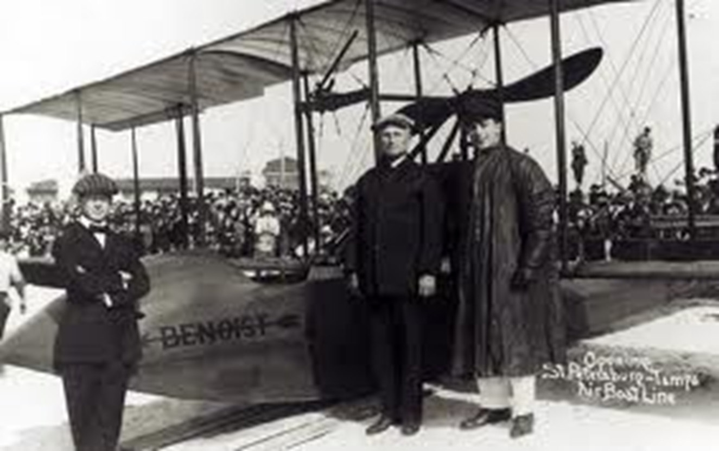
Commercial Flying
Jan 1, 1914 – first regularly scheduled air service using a heavier-than-aircraft in US

Slide 46
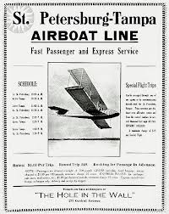
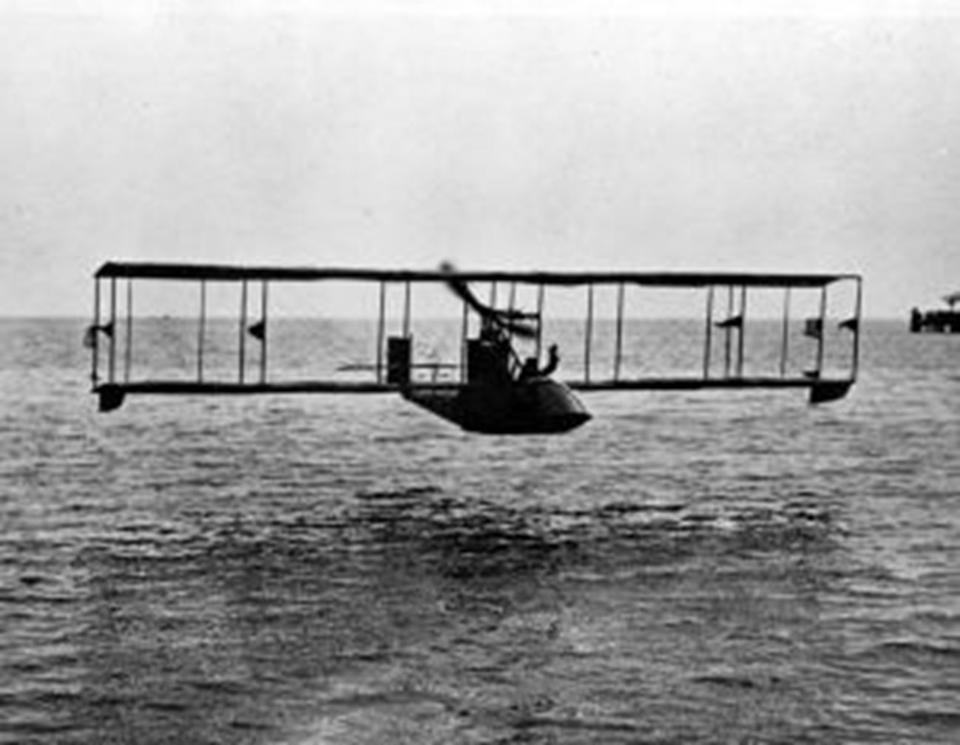
Commercial Flying
Airline – “St. Petersburg – Tampa Airboat Line”
Twin-engine Benoist XIV – flying boat
Carried 2 passengers

Slide 47
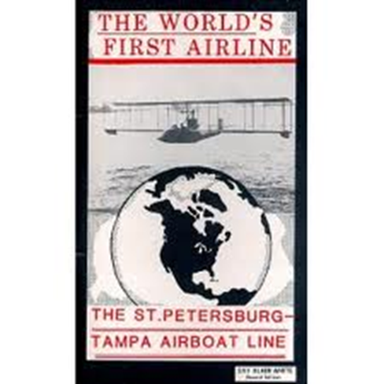
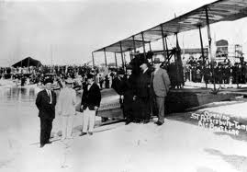
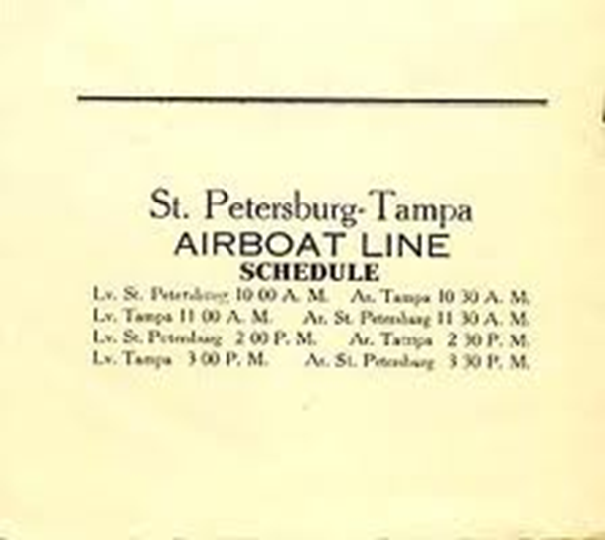
Commercial Flying
22 mile flight cost $5 took 20 minutes
Flew twice a day for 5 months
Carried a total of 1,200 passengers

Slide 48
Questions / Comments

Slide 49
SAFETY FIRST.
SAFETY ALWAYS.

Slide 50
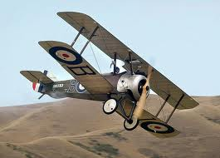
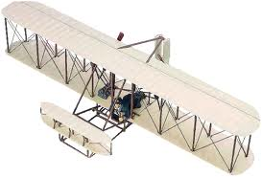

Slide 51
Safety Rules – Safety Monitor Brief
Must Use Safety Glasses
Use of Cutting tools is Dangerous – AT ALL TIMES
Must Use Cutting Mats
Extended breathing of adhesives and paint fumes can be dangerous
May use vinyl gloves

Slide 52
Safety Rules – Safety Monitor Brief
Do not wash paint brushes in sink
Do not pour paint or thinner down drain
Only use paint thinner to clean brushes
May use Acetone to remove Super Glue or glue
Only use spray paint outside and on cardboard to avoid overspray.
Must use dust mask when using spray paint.

Slide 53
Safety Rules – Safety Monitor Brief
Be sure to read all model instructions.
All Areas will remain clean and organized
Plane Captains will insure All Areas will be cleaned and all items put back in proper locations 10minutes prior to class ending
Class safety monitor will insure areas are clean and safe at all times
Class Leader insure hangar is clean before class dismissed

Slide 54
SAFETY FIRST.
SAFETY ALWAYS.

Slide 55
Today’s Mission Requirements
Mission:
Describe the first multiengine aircraft and the reasons for its development.
Describe the first four engine aircraft.
Describe the Gnome and the Le Rhone engine.
Describe the early inventors of the helicopter and the major control problem they faced.
Describe the first regularly scheduled airline service.
EQ:
Describe significant aviation events occurring between 1904-1919 and their impact on future aviation development.

Slide 56
Progress in Europe
1911 – Short Brothers developed the first multiengine aircraft

Slide 57
Progress in Europe
Reasons for multi-engine aircraft
Increased power
Reliability ( if 1 fails enough power to safe landing)

Slide 58
Today’s Mission Requirements
Mission:
Describe the first multiengine aircraft and the reasons for its development.
Describe the first four engine aircraft.
Describe the Gnome and the Le Rhone engine.
Describe the early inventors of the helicopter and the major control problem they faced.
Describe the first regularly scheduled airline service.
EQ:
Describe significant aviation events occurring between 1904-1919 and their impact on future aviation development.

Slide 60
Progress in Europe
May 13, 1913 – First four engine aircraft
The LeGrand
Built and flown by Igor Sikorsky
Wingspan of 92 ft
Four 100-hp engines
16 wheels for landing gear
Fully enclosed cockpit
Passenger cabin with portholes for windows

Slide 61
Today’s Mission Requirements
Mission:
Describe the first multiengine aircraft and the reasons for its development.
Describe the first four engine aircraft.
Describe the Gnome and the Le Rhone engine.
Describe the early inventors of the helicopter and the major control problem they faced.
Describe the first regularly scheduled airline service.
EQ:
Describe significant aviation events occurring between 1904-1919 and their impact on future aviation development.

Slide 62
Progress in Europe
Gnome
Cylinders had cooling fins to help bleed the heat into the air
When stationary the engine/propeller spun around the fixed crankshaft
Opposite of modern radial engines
Called rotary engines

Slide 63
Today’s Mission Requirements
Mission:
Describe the first multiengine aircraft and the reasons for its development.
Describe the first four engine aircraft.
Describe the Gnome and the Le Rhone engine.
Describe the early inventors of the helicopter and the major control problem they faced.
Describe the first regularly scheduled airline service.
EQ:
Describe significant aviation events occurring between 1904-1919 and their impact on future aviation development.

Slide 64
Helicopter Development
Plagued by control problems
Counteracting the torque of the main rotor
When the helicopter was turning the aircraft went in the opposite direction

Slide 65
Helicopter Development
To counteract it - two rotors were added rotating in opposite directions
Another is to put a small rotor on the tail boom which provided thrust to counteract the torque of the main rotor.
Took 30 years to solve it – just prior to World War II

Slide 66
Today’s Mission Requirements
Mission:
Describe the first multiengine aircraft and the reasons for its development.
Describe the first four engine aircraft.
Describe the Gnome and the Le Rhone engine.
Describe the early inventors of the helicopter and the major control problem they faced.
Describe the first regularly scheduled airline service.
EQ:
Describe significant aviation events occurring between 1904-1919 and their impact on future aviation development.

Slide 67
Commercial Flying
Jan 1, 1914 – first regularly scheduled air service using a heavier-than-aircraft in US

Slide 68
Commercial Flying
Airline – “St. Petersburg – Tampa Airboat Line”
Twin-engine Benoist XIV – flying boat
Carried 2 passengers

Slide 69
Commercial Flying
22 mile flight cost $5 took 20 minutes
Flew twice a day for 5 months
Carried a total of 1,200 passengers

Slide 70
Questions / Comments

Slide 71
Model Building Grading Rubic
Each Group MUST follow all directions
STOP! - If you are unsure
SAFETY at ALL Times
Accuracy and Authenticity will be judged
Each Group Member is responsible to produce a 2 page paper on the model.
Aircraft Specifications
Aircraft contribution to Aviation development
Significant Aviation Pioneers associated with aircraft (pilots, inventors etc.)
The Group will provide a Presentation on the model.
5to 7 slides (Title slide; Body; Summary Slide)

Slide 72
Questions / Comments

Slide 73
Lesson Closure - 3 – 2 - 1
3. List 3 things you learned today.
2. List 2 things you have questions about today’s lesson.
1. Create (1) quiz question with answer about today’s lesson.

Slide 74
Questions / Comments

Slide 76
Safety Rules – Safety Monitor Brief
Must Use Safety Glasses
Use of Cutting tools is Dangerous – AT ALL TIMES
Must Use Cutting Mats
Extended breathing of adhesives and paint fumes can be dangerous
All Areas will remain clean and organized
Plane Captains will insure All Areas will be cleaned and all items put back in proper locations 10minutes prior to class ending
Class safety monitor will insure areas are clean and safe at all times

Slide 77
SAFETY FIRST.
SAFETY ALWAYS.

Slide 78
Questions / Comments

Slide 79
Video of the Day
Blimps, Ballooning and the Great Airships
http://www.youtube.com/watch?v=OegHOkVmOdI

Slide 80
Video of the Day
From Earth to the Moon
http://www.youtube.com/watch?v=YWGE6czA16U&feature=related

Slide 81
Video of the Day
Samuel Pierpont Langley
http://www.youtube.com/watch?v=V4ml4LJ4joo
http://www.youtube.com/watch?v=M-5DeIvOJ7Y&feature=related
Zeppelin
http://www.youtube.com/watch?v=QWpwZn0pKl4&feature=related

Slide 83
In Class Discussion
1. There were two Wright brothers. What were their names?
2. What did they name this invention?
3. How many people witnessed this occurrence?
4. How much did these inventions cost to build?
5. Where did this happen?
6. How did the brothers learn about how to make their invention?

Slide 84
Chapter 2 Quiz
20 Minutes

Slide 85
Bonus Question:
What was the two purposes
the AEA was formed?

Slide 86
October 2014
Sunday | Monday | Tuesday | Wednesday | Thursday | Friday | Saturday
 | 29 | 30 Progress in Europe Model Building | 1 | 2 Flying Vertical Commercial Flying Model Building | 3 | 4
5 | 6 Chapter 2 QUIZ Preparing for War WWI – Role of the Airplane Model Building | 7 | 8 Europe in WWI Fighter Development Model Building | 9 | 10 FltLine Friday Model Building | 11
12 | 13 | 14 Chapter 2 QUIZ Fighter Aces US in WWI Model Building | 15 | 16 US in WWI Ind 2 pg paper Presentation / Models Due | 18 | 18
19 | 20 Chapter 2 TEST 1st Quarter Grades Due | 21 | 22 FltLine Friday “FlyBoys” | 23 | 24 No School Parent/Teacher Conf. | 25
26 | 27 | 28 | 29 | 30 | 31

Slide 87
Today’s Mission Requirements
Standards Addressed:
Technological Literacy
Students will develop an understanding of the:
Characteristics and scope of technology.
Core concepts of technology.
Relationships among technologies and the connections between technology and the other fields of study.
English Language Arts
Students will:
Conduct research and gather, evaluate and synthesize data and communicate their discoveries to their audience.
Use a variety of technological and informational resources to create and communicate knowledge.

