Slide 1
Warm-Up – 9/22 – 10 minutes
Utilizing your notes and past knowledge answer the following questions:
Describe the contributions by Robert Esnault-Pelterie to aviation.
Describe the contributions by Alberto Santos-Dumont to aviation.
Describe the contributions by Louis Bleriot to aviation.
Describe the aviation achievements at the First International Air meet.
Identify Henri Farman’s contributions to aviation.

Slide 2
Questions / Comments

Slide 3
Warm-Up – 9/22 – 10 minutes
Utilizing your notes and past knowledge answer the following questions:
Describe the contributions by Robert Esnault-Pelterie to aviation.
Describe the contributions by Alberto Santos-Dumont to aviation.
Describe the contributions by Louis Bleriot to aviation.
Describe the aviation achievements at the First International Air meet.
Identify Henri Farman’s contributions to aviation.

Slide 4
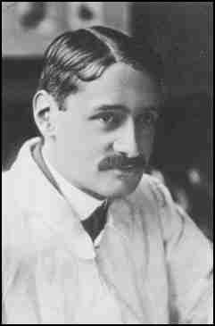
Progress in Europe
Wing Warping
Clumsy method to control an airplane
Frenchman – Robert Esnault-Pelterie built a Wright-style glider in 1904 and used ailerons to replace the wing-warping technique developed by the Wright brothers.
Utilized a hand operated wheel to control the ailerons
Inventor of the joystick and first fully enclosed fuselage airplane

Slide 5
Warm-Up – 9/22 – 10 minutes
Utilizing your notes and past knowledge answer the following questions:
Describe the contributions by Robert Esnault-Pelterie to aviation.
Describe the contributions by Alberto Santos-Dumont to aviation.
Describe the contributions by Louis Bleriot to aviation.
Describe the aviation achievements at the First International Air meet.
Identify Henri Farman’s contributions to aviation.

Slide 6
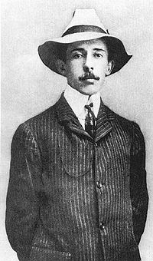
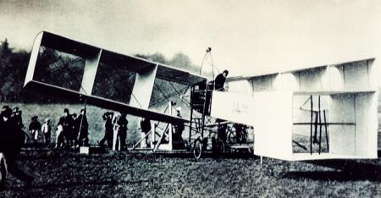
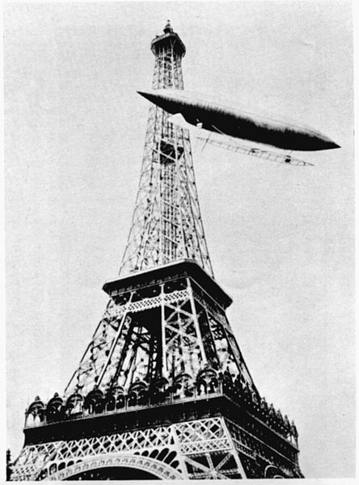
Progress in Europe
Alberto Santos-Dumount
Flew first powered airplane in Europe
14-bis biplane – Paris, France Oct 23, 1906
for a distance 197ft at a height of 10ft
Two weeks later flew for 722ft

Slide 7
Warm-Up – 9/22 – 10 minutes
Utilizing your notes and past knowledge answer the following questions:
Describe the contributions by Robert Esnault-Pelterie to aviation.
Describe the contributions by Alberto Santos-Dumont to aviation.
Describe the contributions by Louis Bleriot to aviation.
Describe the aviation achievements at the First International Air meet.
Identify Henri Farman’s contributions to aviation.

Slide 8
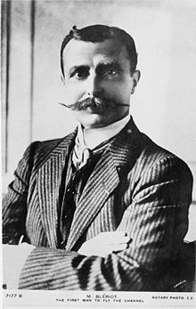
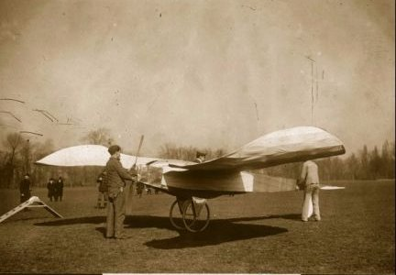
Progress in Europe
Louis Bleriot
Flew first powered monoplane 1907
The Blériot V canard monoplane

Slide 9
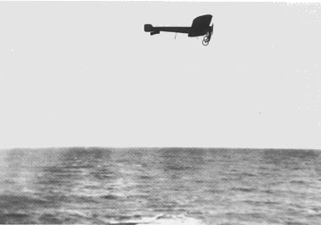
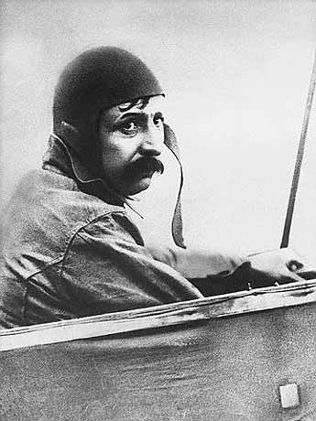
Progress in Europe
Louis Blériot took off in his model XI on July 25, 1909 to fly across the English Channel.
25 –hp engine
Built 11 planes before the trip – had almost 50 crashes but refused to give up

Slide 10
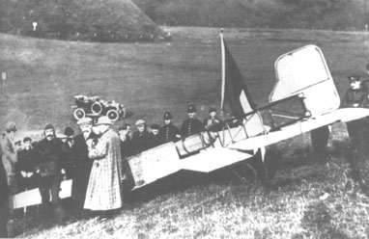
Progress in Europe
Blériot was an instant celebrity when he landed in Dover after crossing the English Channel.
25 miles - 37 minutes
No compass

Slide 11
Warm-Up – 9/22 – 10 minutes
Utilizing your notes and past knowledge answer the following questions:
Describe the contributions by Robert Esnault-Pelterie to aviation.
Describe the contributions by Alberto Santos-Dumont to aviation.
Describe the contributions by Louis Bleriot to aviation.
Describe the aviation achievements at the First International Air meet.
Identify Henri Farman’s contributions to aviation.

Slide 12
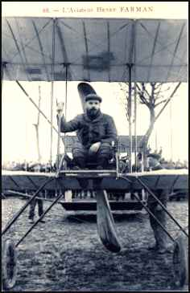
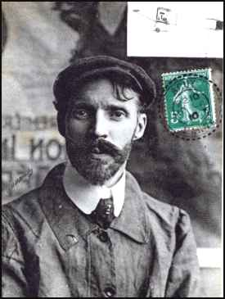
Progress in Europe
1909 – First International Air meet held in Rheims, France
Many speed and endurance records were broken
Louis Bleriot - - fastest lap – 47.8 mph
Henri Farman stayed in the air 3 hrs, 4 minutes and 56 seconds
Flying 111 miles

Slide 13
Warm-Up – 9/22 – 10 minutes
Utilizing your notes and past knowledge answer the following questions:
Describe the contributions by Robert Esnault-Pelterie to aviation.
Describe the contributions by Alberto Santos-Dumont to aviation.
Describe the contributions by Louis Bleriot to aviation.
Describe the aviation achievements at the First International Air meet.
Identify Henri Farman’s contributions to aviation.

Slide 14
Progress in Europe
1909 – First International Air meet held in Rheims, France
Many speed and endurance records were broken
Louis Bleriot - - fastest lap – 47.8 mph
Henri Farman stayed in the air 3 hrs, 4 minutes and 56 seconds
Flying 111 miles

Slide 15
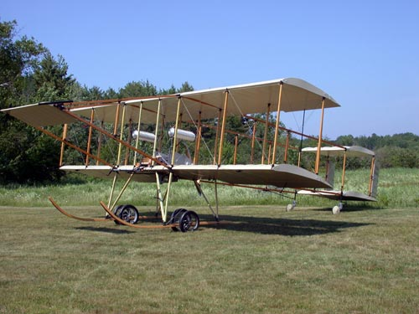
Henri Farman III
Powered by a 50-horsepower Gnôme engine,
It had full ailerons and twin rudders for control
Sprung wheels on the skids to soften the landing.

Slide 16
Questions / Comments

Slide 17
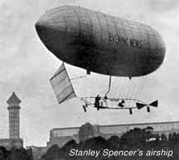
THIS DAY IN AVIATION
September 22
1902 — Stanley Spencer becomes the first Englishman to fly in a powered airship over England.
The 75-foot-long dirigible is powered by a 3-hp water-cooled engine and makes a flight of 30 miles.

Slide 18
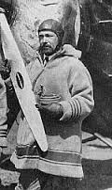
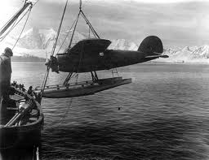
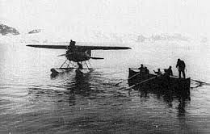
THIS DAY IN AVIATION
September 22
1928 — Wilkins Antarctic Expedition sails from New York.

Slide 19
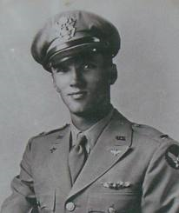
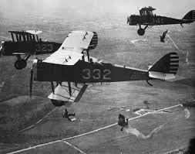
THIS DAY IN AVIATION
September 22
1928 — The number of lives saved by parachute jumps passes the 100 mark when Lieutenant Roger V. Williams jumps at San Diego, California.

Slide 20
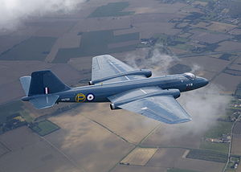
THIS DAY IN AVIATION
September 22
1950 — First non-stop flight of Atlantic made by jet aircraft.
English Electric Canberra

Slide 21
Questions / Comments

Slide 22
September 2017
Sunday | Monday | Tuesday | Wednesday | Thursday | Friday | Saturday
10 | 11 NO SCHOOL | 12 NO SCHOOL | 13 AERY Software Balsa Glider Construction | 14 Balsa Glider Construction | 15 Glider Challenge Flight Line Friday Progress Reports | 16
17 | 18 Chapter 2 Development of Aviation in U.S. | 19 Chapter 2 Glenn Curtiss | 20 Chapter 2 Vin Fiz | 21 Chapter 2 Progress in Europe | 22 Chapter 2 Quiz Flight Line Friday | 23
24 | 25 Chapter 2 WWI Preparing for War Fighter Development | 26 Chapter 2 WWI Fighter Aces Lafayette Escadrille | 27 Chapter 2 WWI | 28 Chapter 2 WWI | 29 Chapter 2 Test Flight Line Friday | 30
1 | 2 Chapter 3 The Golden Age | 3 Chapter 3 The Golden Age | 4 Chapter 3 The Golden Age | 5 Chapter 3 The Golden Age | 6 Chapter 3 Quiz Flight Line Friday | 7

Slide 23
Questions / Comments

Slide 24
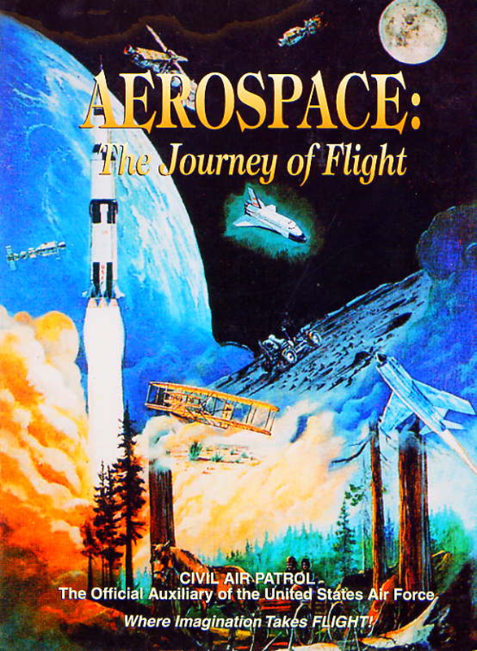
Chapter 2
The Adolescence of Air Power
1904-1919

Slide 25
Today’s Mission Requirements
Mission:
Describe the first multiengine aircraft and the reasons for its development.
Describe the first four engine aircraft.
Describe the Gnome and the Le Rhone engine.
Describe the early inventors of the helicopter and the major control problem they faced.
Describe the first regularly scheduled airline service.
EQ:
Describe significant aviation events occurring between 1904-1919 and their impact on future aviation development.

Slide 26
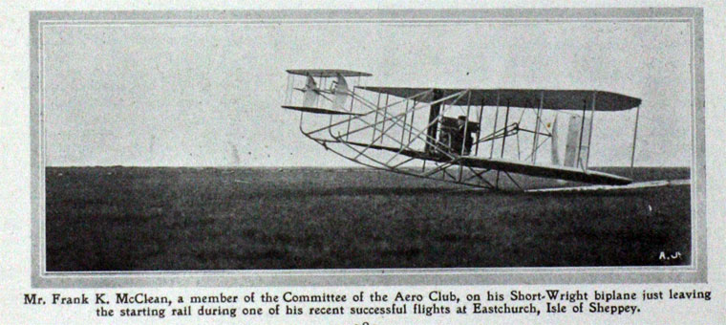
Progress in Europe
1911 – Short Brothers developed the first multiengine aircraft – called the “Triple Twin”

Slide 27
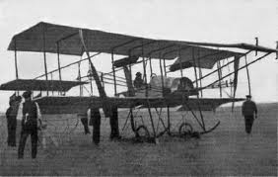
Progress in Europe
“Triple Twin”
Had two engines and three propellers

Slide 28
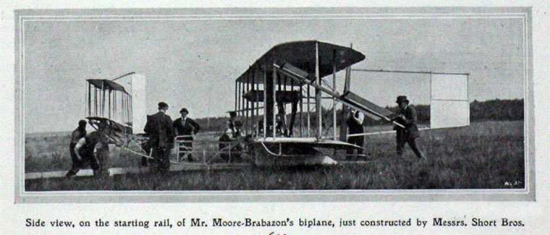
Progress in Europe
Reasons for multi-engine aircraft
Increased power
Reliability ( if 1 fails enough power to safe landing)

Slide 29
Progress in Europe
May 13, 1913 – First four engine aircraft
The LeGrand
Built and flown by Igor Sikorsky
Wingspan of 92 ft
Four 100-hp engines
16 wheels for landing gear
Fully enclosed cockpit
Passenger cabin with portholes for windows

Slide 30
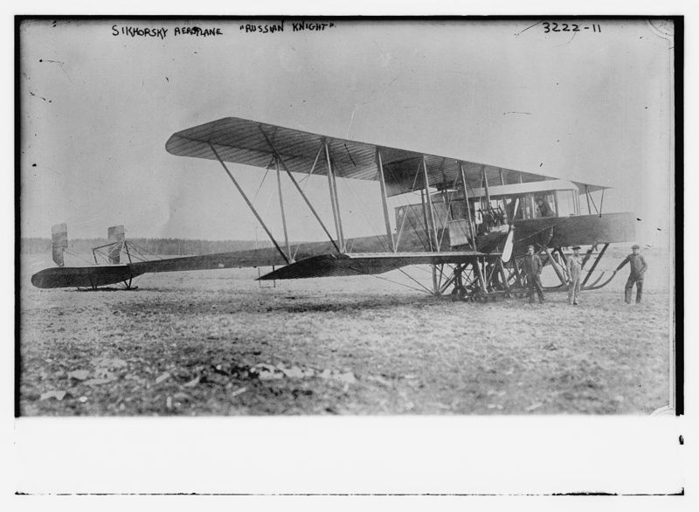

Slide 31
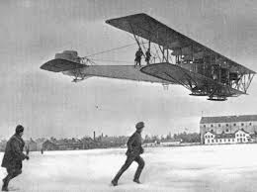
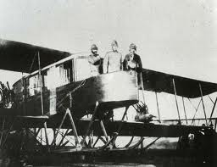

Slide 32
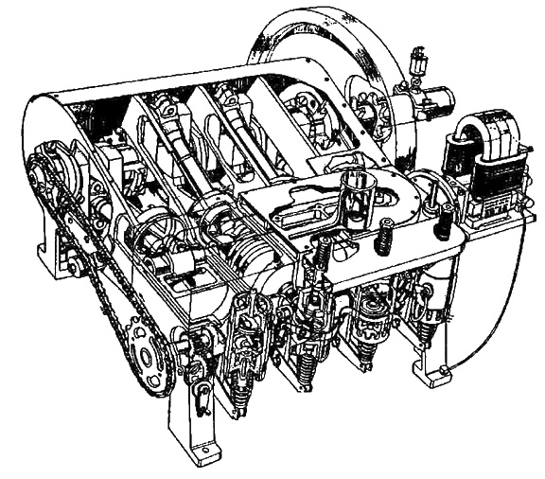
Progress in Europe
Engines at that time were
Manufactured from steel, cast iron, and brass
Water-cooled
10 lbs for every 1 horsepower
Required large heavy structure to support weight of engine
1903 Wright Engine

Slide 33
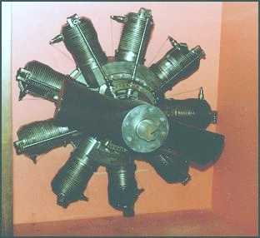
Gnome
Engine

Slide 34
Progress in Europe
Gnome
Cylinders had cooling fins to help bleed the heat into the air
When stationary the engine/propeller spun around the fixed crankshaft
Opposite of modern radial engines
Called rotary engines

Slide 35
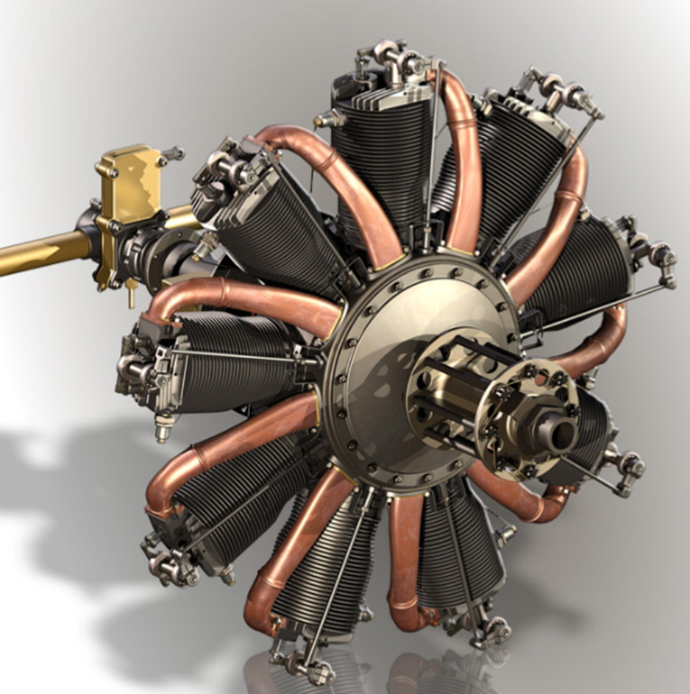
Progress in Europe
Gnome / Le Rhone
Many World War I aircraft used the engines
Sopwith Camel
Sopwith Pup

Slide 36
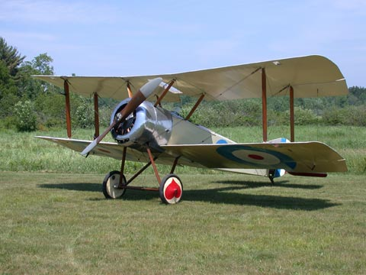
Sopwith Pup

Slide 37
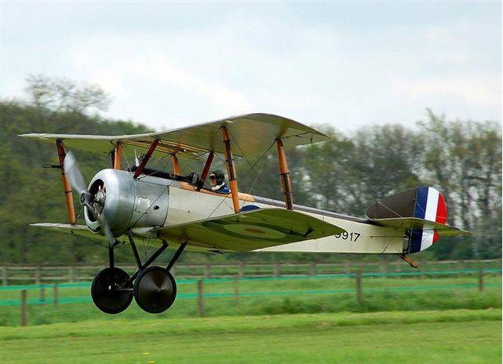
Sopwith Camel

Slide 38
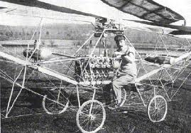
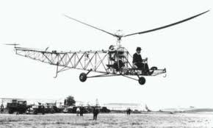
How to
Fly a
Helicopter

Slide 39
Moving Up – Vertical Flying
Heavier-than-aircraft –
Lift is produced by the wings
To sustain lift
Wings must be moving through the air
Fixed wing aircraft forward motion causes wings to move through air and create lift
Helicopters
Main rotor moves through air and made up of a number of blades
Blades are like wings
As they move through the air they create lift
Hence the term – rotary wing

Slide 40
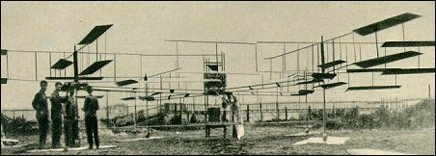
Louis Breguet - 1907
Lifted off ground but was held by four assistants

Slide 41
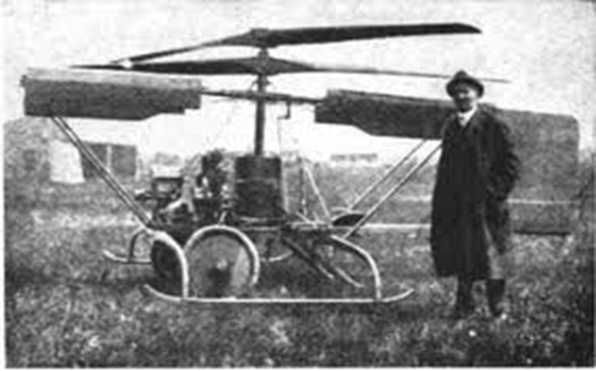
Helicopter Development
Plagued by control problems
Counteracting the torque of the main rotor
When the helicopter was turning the aircraft went in the opposite direction

Slide 42
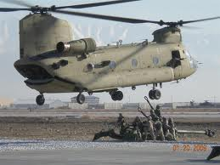
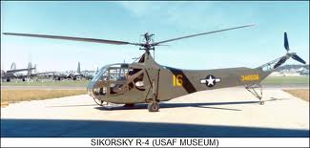
Helicopter Development
To counteract it - two rotors were added rotating in opposite directions
Another is to put a small rotor on the tail boom which provided thrust to counteract the torque of the main rotor.
Took 30 years to solve it – just prior to World War II

Slide 43
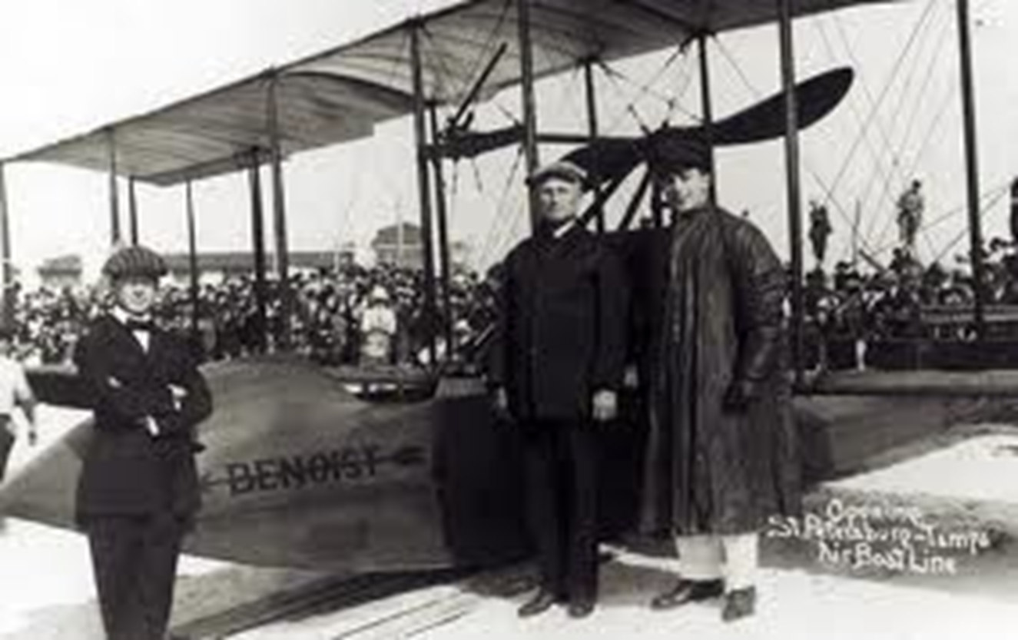
Commercial Flying
Jan 1, 1914 – first regularly scheduled air service using a heavier-than-aircraft in US

Slide 44
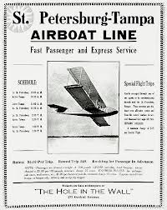
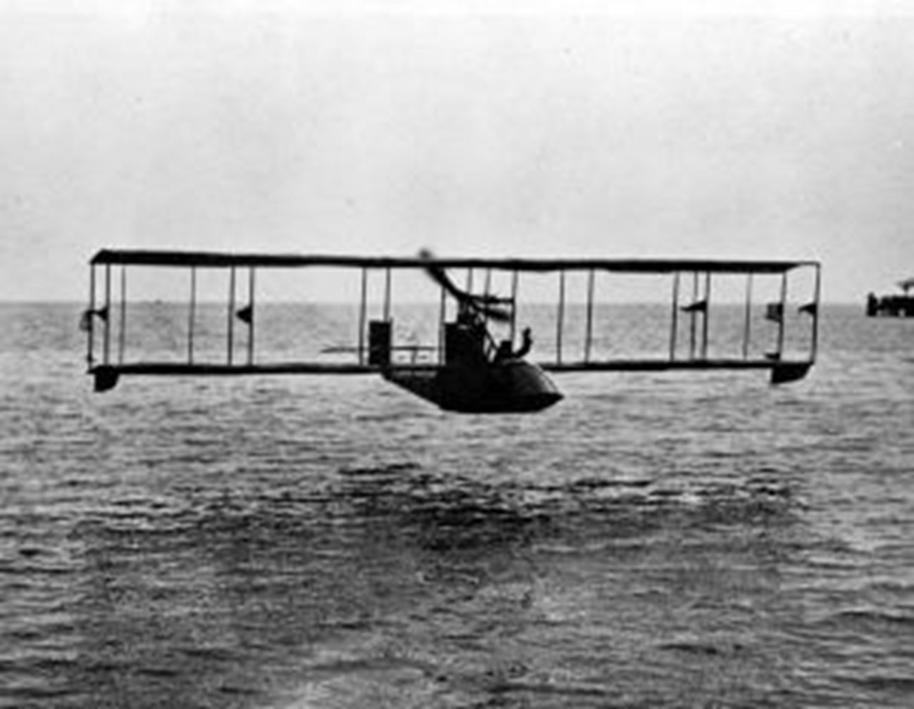
Commercial Flying
Airline – “St. Petersburg – Tampa Airboat Line”
Twin-engine Benoist XIV – flying boat
Carried 2 passengers

Slide 45
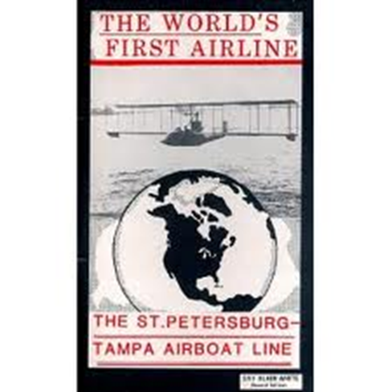
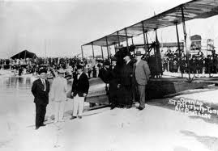
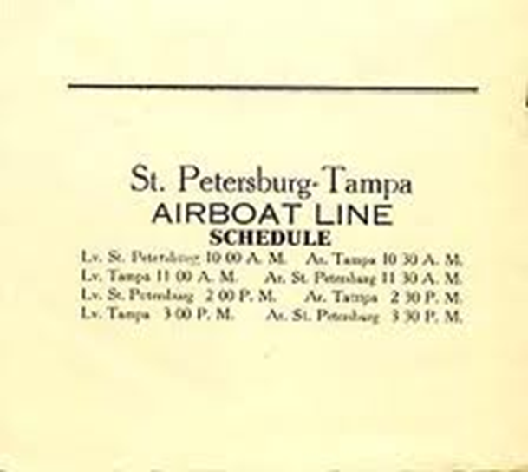
Commercial Flying
22 mile flight cost $5 took 20 minutes
Flew twice a day for 5 months
Carried a total of 1,200 passengers

Slide 46
Questions / Comments

Slide 47
SAFETY FIRST.
SAFETY ALWAYS.

Slide 48
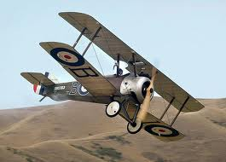
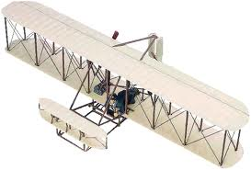
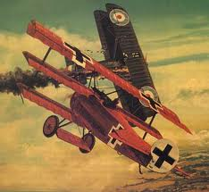

Slide 49
Safety Rules – Safety Monitor Brief
Must Use Safety Glasses
Use of Cutting tools is Dangerous – AT ALL TIMES
Must Use Cutting Mats
Extended breathing of adhesives and paint fumes can be dangerous
May use vinyl gloves

Slide 50
Safety Rules – Safety Monitor Brief
Do not wash paint brushes in sink
Do not pour paint or thinner down drain
Only use paint thinner to clean brushes
May use Acetone to remove Super Glue or glue
Only use spray paint outside and on cardboard to avoid overspray.
Must use dust mask when using spray paint.

Slide 51
Safety Rules – Safety Monitor Brief
Be sure to read all model instructions.
All Areas will remain clean and organized
Plane Captains will insure All Areas will be cleaned and all items put back in proper locations 10minutes prior to class ending
Class safety monitor will insure areas are clean and safe at all times
Class Leader insure hangar is clean before class dismissed

Slide 52
SAFETY FIRST.
SAFETY ALWAYS.

Slide 53
Today’s Mission Requirements
Mission:
Describe the first multiengine aircraft and the reasons for its development.
Describe the first four engine aircraft.
Describe the Gnome and the Le Rhone engine.
Describe the early inventors of the helicopter and the major control problem they faced.
Describe the first regularly scheduled airline service.
EQ:
Describe significant aviation events occurring between 1904-1919 and their impact on future aviation development.

Slide 54
Progress in Europe
1911 – Short Brothers developed the first multiengine aircraft

Slide 55
Progress in Europe
Reasons for multi-engine aircraft
Increased power
Reliability ( if 1 fails enough power to safe landing)

Slide 56
Today’s Mission Requirements
Mission:
Describe the first multiengine aircraft and the reasons for its development.
Describe the first four engine aircraft.
Describe the Gnome and the Le Rhone engine.
Describe the early inventors of the helicopter and the major control problem they faced.
Describe the first regularly scheduled airline service.
EQ:
Describe significant aviation events occurring between 1904-1919 and their impact on future aviation development.

Slide 58
Progress in Europe
May 13, 1913 – First four engine aircraft
The LeGrand
Built and flown by Igor Sikorsky
Wingspan of 92 ft
Four 100-hp engines
16 wheels for landing gear
Fully enclosed cockpit
Passenger cabin with portholes for windows

Slide 59
Today’s Mission Requirements
Mission:
Describe the first multiengine aircraft and the reasons for its development.
Describe the first four engine aircraft.
Describe the Gnome and the Le Rhone engine.
Describe the early inventors of the helicopter and the major control problem they faced.
Describe the first regularly scheduled airline service.
EQ:
Describe significant aviation events occurring between 1904-1919 and their impact on future aviation development.

Slide 60
Progress in Europe
Gnome
Cylinders had cooling fins to help bleed the heat into the air
When stationary the engine/propeller spun around the fixed crankshaft
Opposite of modern radial engines
Called rotary engines

Slide 61
Today’s Mission Requirements
Mission:
Describe the first multiengine aircraft and the reasons for its development.
Describe the first four engine aircraft.
Describe the Gnome and the Le Rhone engine.
Describe the early inventors of the helicopter and the major control problem they faced.
Describe the first regularly scheduled airline service.
EQ:
Describe significant aviation events occurring between 1904-1919 and their impact on future aviation development.

Slide 62
Helicopter Development
Plagued by control problems
Counteracting the torque of the main rotor
When the helicopter was turning the aircraft went in the opposite direction

Slide 63
Helicopter Development
To counteract it - two rotors were added rotating in opposite directions
Another is to put a small rotor on the tail boom which provided thrust to counteract the torque of the main rotor.
Took 30 years to solve it – just prior to World War II

Slide 64
Today’s Mission Requirements
Mission:
Describe the first multiengine aircraft and the reasons for its development.
Describe the first four engine aircraft.
Describe the Gnome and the Le Rhone engine.
Describe the early inventors of the helicopter and the major control problem they faced.
Describe the first regularly scheduled airline service.
EQ:
Describe significant aviation events occurring between 1904-1919 and their impact on future aviation development.

Slide 65
Commercial Flying
Jan 1, 1914 – first regularly scheduled air service using a heavier-than-aircraft in US

Slide 66
Commercial Flying
Airline – “St. Petersburg – Tampa Airboat Line”
Twin-engine Benoist XIV – flying boat
Carried 2 passengers

Slide 67
Commercial Flying
22 mile flight cost $5 took 20 minutes
Flew twice a day for 5 months
Carried a total of 1,200 passengers

Slide 68
Questions / Comments

Slide 69
Model Building Grading Rubic
Each Group MUST follow all directions
STOP! - If you are unsure
SAFETY at ALL Times
Accuracy and Authenticity will be judged
Each Group Member is responsible to produce a 2 page paper on the model.
Aircraft Specifications
Aircraft contribution to Aviation development
Significant Aviation Pioneers associated with aircraft (pilots, inventors etc.)
The Group will provide a Presentation on the model.
5to 7 slides (Title slide; Body; Summary Slide)

Slide 70
Questions / Comments

Slide 71
Lesson Closure - 3 – 2 - 1
3. List 3 things you learned today.
2. List 2 things you have questions about today’s lesson.
1. Create (1) quiz question with answer about today’s lesson.

Slide 72
Questions / Comments

Slide 74
Safety Rules – Safety Monitor Brief
Must Use Safety Glasses
Use of Cutting tools is Dangerous – AT ALL TIMES
Must Use Cutting Mats
Extended breathing of adhesives and paint fumes can be dangerous
All Areas will remain clean and organized
Plane Captains will insure All Areas will be cleaned and all items put back in proper locations 10minutes prior to class ending
Class safety monitor will insure areas are clean and safe at all times

Slide 75
SAFETY FIRST.
SAFETY ALWAYS.

Slide 76
Questions / Comments

Slide 77
Video of the Day
Blimps, Ballooning and the Great Airships
http://www.youtube.com/watch?v=OegHOkVmOdI

Slide 78
Video of the Day
From Earth to the Moon
http://www.youtube.com/watch?v=YWGE6czA16U&feature=related

Slide 79
Video of the Day
Samuel Pierpont Langley
http://www.youtube.com/watch?v=V4ml4LJ4joo
http://www.youtube.com/watch?v=M-5DeIvOJ7Y&feature=related
Zeppelin
http://www.youtube.com/watch?v=QWpwZn0pKl4&feature=related

Slide 80
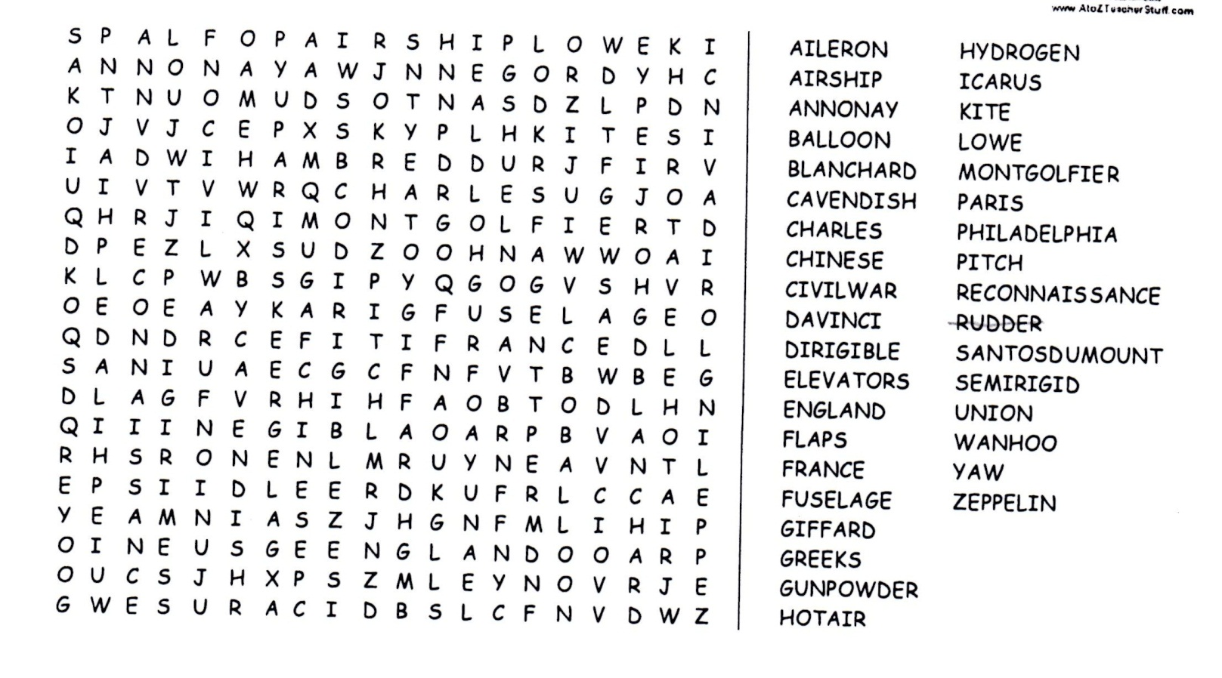

Slide 81
In Class Discussion
1. There were two Wright brothers. What were their names?
2. What did they name this invention?
3. How many people witnessed this occurrence?
4. How much did these inventions cost to build?
5. Where did this happen?
6. How did the brothers learn about how to make their invention?

Slide 82
Chapter 2 Quiz
20 Minutes

Slide 83
Bonus Question:
What was the two purposes
the AEA was formed?

Slide 84
October 2014
Sunday | Monday | Tuesday | Wednesday | Thursday | Friday | Saturday
 | 29 | 30 Progress in Europe Model Building | 1 | 2 Flying Vertical Commercial Flying Model Building | 3 | 4
5 | 6 Chapter 2 QUIZ Preparing for War WWI – Role of the Airplane Model Building | 7 | 8 Europe in WWI Fighter Development Model Building | 9 | 10 FltLine Friday Model Building | 11
12 | 13 | 14 Chapter 2 QUIZ Fighter Aces US in WWI Model Building | 15 | 16 US in WWI Ind 2 pg paper Presentation / Models Due | 18 | 18
19 | 20 Chapter 2 TEST 1st Quarter Grades Due | 21 | 22 FltLine Friday “FlyBoys” | 23 | 24 No School Parent/Teacher Conf. | 25
26 | 27 | 28 | 29 | 30 | 31

Slide 85
Today’s Mission Requirements
Standards Addressed:
Technological Literacy
Students will develop an understanding of the:
Characteristics and scope of technology.
Core concepts of technology.
Relationships among technologies and the connections between technology and the other fields of study.
English Language Arts
Students will:
Conduct research and gather, evaluate and synthesize data and communicate their discoveries to their audience.
Use a variety of technological and informational resources to create and communicate knowledge.

