Slide 1
Warm-Up – 9/21 – 10 minutes
Utilizing your notes and past knowledge answer the following questions:
Describe the prize and the rules established for the challenge of the flight across the country.
Identify the type and the name of the aircraft used in the cross country flight.
Describe the planned course of the flight from coast to coast.
Describe the distance, speed and the time the cross country trip took to complete.
Describe Harriet Quimby and her significance to aviation. (hint: two firsts)

Slide 2
Questions / Comments

Slide 3
Warm-Up – 9/21 – 10 minutes
Utilizing your notes and past knowledge answer the following questions:
Describe the prize and the rules established for the challenge of the flight across the country.
Identify the type and the name of the aircraft used in the cross country flight.
Describe the planned course of the flight from coast to coast.
Describe the distance, speed and the time the cross country trip took to complete.
Describe Harriet Quimby and her significance to aviation. (two firsts)

Slide 4
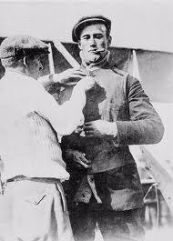
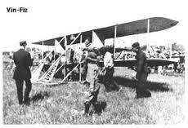
Developments in the U.S.
1911 – William Randolph Hearst – offered $50,000 for flight across U.S.
Must be completed in 30 days
Pilot Calbraith Perry Rodgers persuaded soft drink company “Vin Fiz” to sponsor trip.
The aircraft was a 1911 Wright Flyer Model D at is called the “Vin Fiz Flyer”

Slide 5
Warm-Up – 9/21 – 10 minutes
Utilizing your notes and past knowledge answer the following questions:
Describe the prize and the rules established for the challenge of the flight across the country.
Identify the type and the name of the aircraft used in the cross country flight.
Describe the planned course of the flight from coast to coast.
Describe the distance, speed and the time the cross country trip took to complete.
Describe Harriet Quimby and her significance to aviation. (two firsts)

Slide 6
Developments in the U.S.
1911 – William Randolph Hearst – offered $50,000 for flight across U.S.
Must be completed in 30 days
Pilot Calbraith Perry Rodgers persuaded soft drink company “Vin Fiz” to sponsor trip.
The aircraft was a 1911 Wright Flyer Model D called the “Vin Fiz Flyer”

Slide 7
Warm-Up – 9/21 – 10 minutes
Utilizing your notes and past knowledge answer the following questions:
Describe the prize and the rules established for the challenge of the flight across the country.
Identify the type and the name of the aircraft used in the cross country flight.
Describe the planned course of the flight from coast to coast.
Describe the distance, speed and the time the cross country trip took to complete.
Describe Harriet Quimby and her significance to aviation. (two firsts)

Slide 8
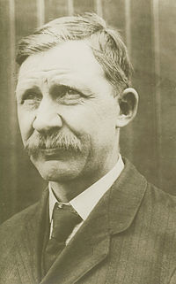
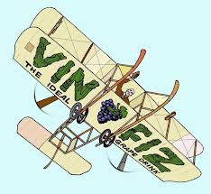
Developments in the U.S.
Wright Brothers mechanic, Charlie Taylor takes on job.
Trip was planned from:
New York to Chicago
Kansas City to San Antonio / El Paso
Yuma to Pasadena, CA
Trip was to cover more than 3,390 miles

Slide 9
Warm-Up – 9/21 – 10 minutes
Utilizing your notes and past knowledge answer the following questions:
Describe the prize and the rules established for the challenge of the flight across the country.
Identify the type and the name of the aircraft used in the cross country flight.
Describe the planned course of the flight from coast to coast.
Describe the distance, speed and the time the cross country trip took to complete.
Describe Harriet Quimby and her significance to aviation. (two firsts)

Slide 10
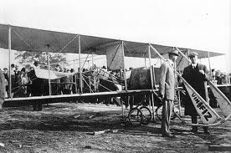
Development in the U.S.
Rodgers actual trip
4,251 miles
Longest flight 133 miles
Average speed 52 mph
Flight lasted 49 days
Did NOT receive prize but made the first airplane crossing of the United States

Slide 11
Warm-Up – 9/21 – 10 minutes
Utilizing your notes and past knowledge answer the following questions:
Describe the prize and the rules established for the challenge of the flight across the country.
Identify the type and the name of the aircraft used in the cross country flight.
Describe the planned course of the flight from coast to coast.
Describe the distance, speed and the time the cross country trip took to complete.
Describe Harriet Quimby and her significance to aviation. (two firsts)

Slide 12
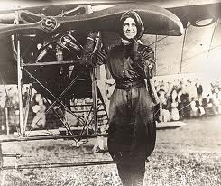
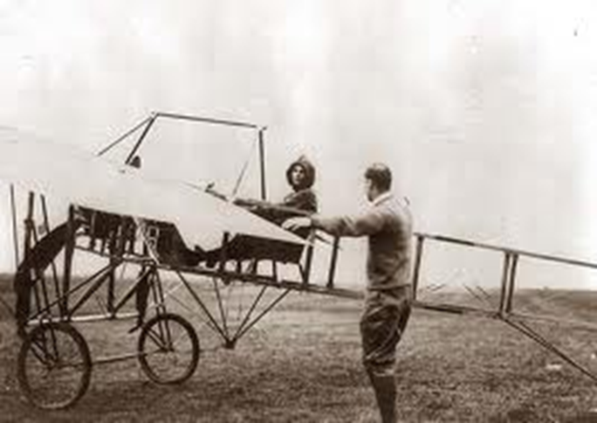
Development in the U.S.
Harriet Quimby in Aug 1911 became America’s first licensed pilot
She used her writing talents to urge country to give more attention to commercial aviation and aeronautical development

Slide 13
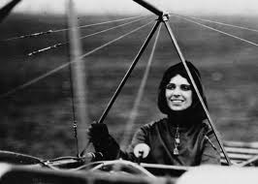
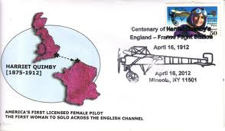
Development in the U.S.
She became first woman to fly solo across English Channel
Making the flight in 30 minutes

Slide 14
Questions / Comments

Slide 15
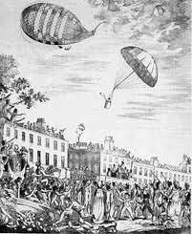
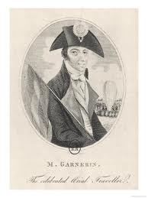
THIS DAY IN AVIATION
September 21
1802 — Frenchman Andre-Jacques Garnerin makes the first parachute descent in England, jumping from a balloon over London.

Slide 16
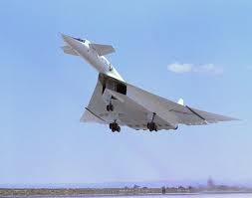
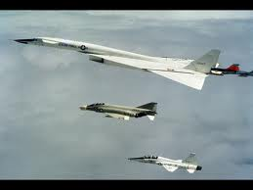
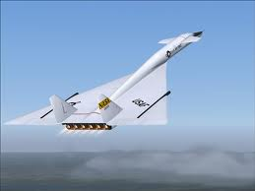
THIS DAY IN AVIATION
September 21
1964 — The North American XB-70A “Valkyrie” makes his first flight.

Slide 17
Questions / Comments

Slide 18
September 2017
Sunday | Monday | Tuesday | Wednesday | Thursday | Friday | Saturday
10 | 11 NO SCHOOL | 12 NO SCHOOL | 13 AERY Software Balsa Glider Construction | 14 Balsa Glider Construction | 15 Glider Challenge Flight Line Friday Progress Reports | 16
17 | 18 Chapter 2 Development of Aviation in U.S. | 19 Chapter 2 Glenn Curtiss | 20 Chapter 2 Vin Fiz | 21 Chapter 2 Progress in Europe | 22 Chapter 2 Quiz Flight Line Friday | 23
24 | 25 Chapter 2 WWI Preparing for War Fighter Development | 26 Chapter 2 WWI Fighter Aces Lafayette Escadrille | 27 Chapter 2 WWI | 28 Chapter 2 WWI | 29 Chapter 2 Test Flight Line Friday | 30
1 | 2 Chapter 3 The Golden Age | 3 Chapter 3 The Golden Age | 4 Chapter 3 The Golden Age | 5 Chapter 3 The Golden Age | 6 Chapter 3 Quiz Flight Line Friday | 7

Slide 19
Questions / Comments

Slide 20
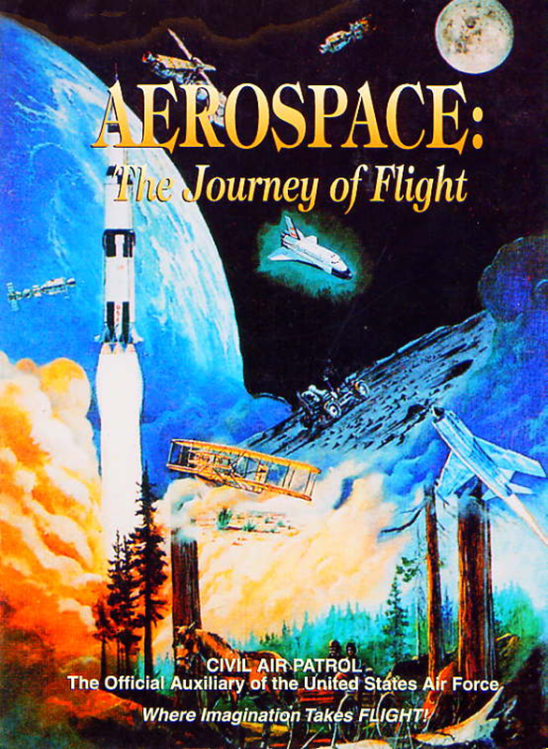
Chapter 2
The Adolescence of Air Power
1904-1919

Slide 21
Today’s Mission Requirements
Mission:
Describe the contributions by Robert Esnault-Pelterie to aviation.
Describe the contributions by Alberto Santos-Dumont to aviation.
Describe the contributions by Louis Bleriot to aviation.
Describe the aviation achievements at the First International Air meet.
Identify Henri Farman’s contributions to aviation.
EQ:
Describe significant aviation events occurring between 1904-1919 and their impact on future aviation development.

Slide 22
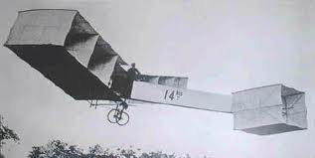
14 bis
Plane

Slide 23
Introduction
The US was slowly warming to the idea of aviation and use of aircraft but the progress in Europe was far advanced in comparison.

Slide 24
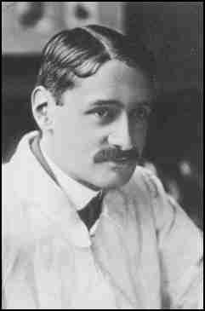
Progress in Europe
Wing Warping
Clumsy method to control an airplane
Frenchman – Robert Esnault-Pelterie (REP) built a Wright-style glider in 1904 and used ailerons to replace the wing-warping technique developed by the Wright brothers.
Utilized a hand operated wheel to control the ailerons
Inventor of the joystick and first fully enclosed fuselage airplane

Slide 25
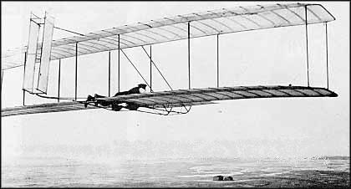
Progress in Europe
France, October, 1904, Robert Esnault Pelterie, invented a new device comprising of two separate horizontal surfaces which are mounted forward of the wings.

Slide 26
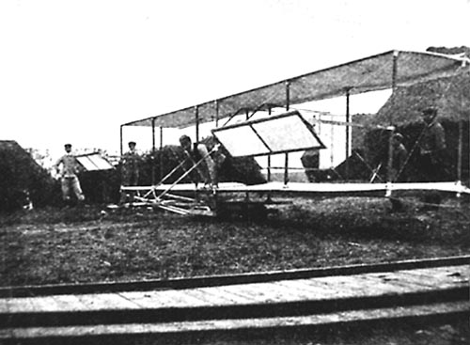
Progress in Europe

Slide 27
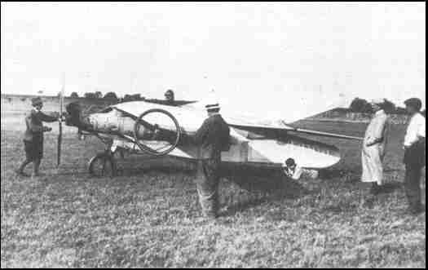
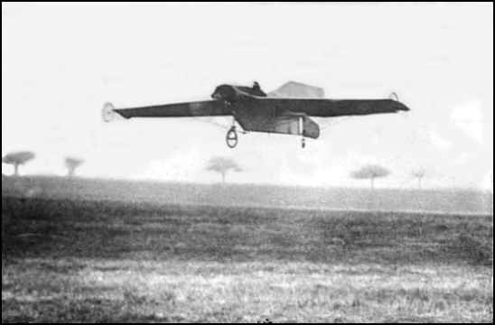
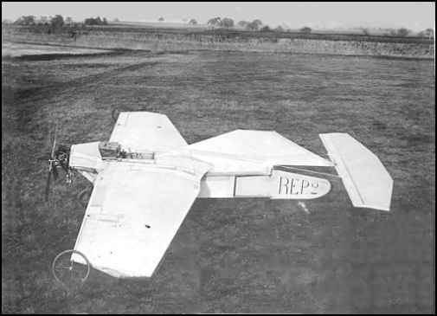
Progress in Europe
Robert Esnault-Pelterie - Monoplane (REP)

Slide 28
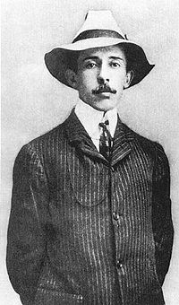
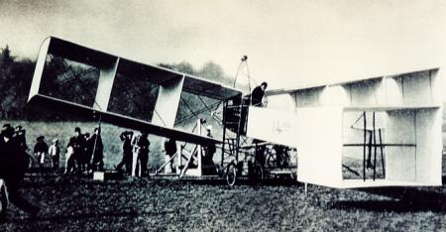
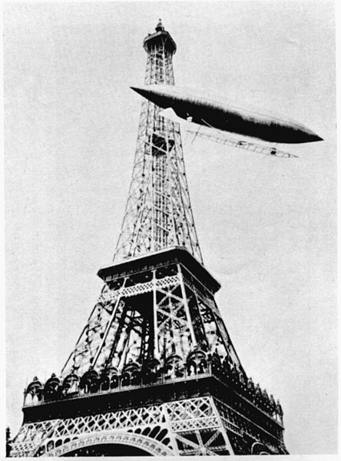
Progress in Europe
Alberto Santos-Dumount
Flew first powered airplane in Europe
14-bis biplane – Paris, France Oct 23, 1906
for a distance 197ft at a height of 10ft
Two weeks later flew for 722ft

Slide 29
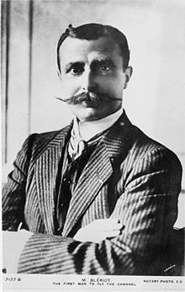
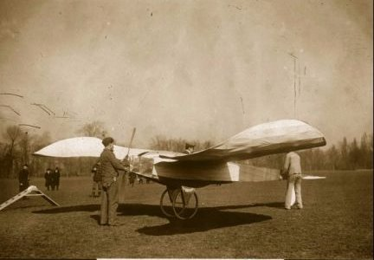
Progress in Europe
Louis Bleriot
Flew first powered monoplane 1907
The Blériot V canard monoplane

Slide 30
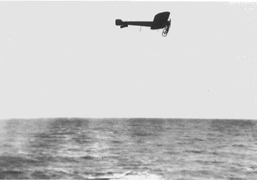
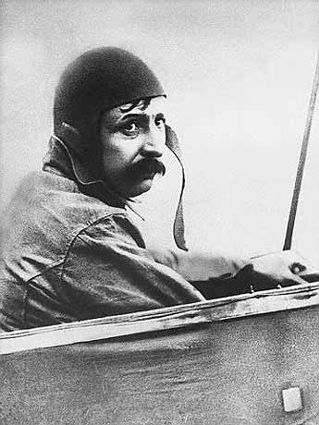
Progress in Europe
Louis Blériot took off in his Model XI on July 25, 1909 to fly across the English Channel.
25 –hp engine
Built 11 planes before the trip – had almost 50 crashes but refused to give up

Slide 31
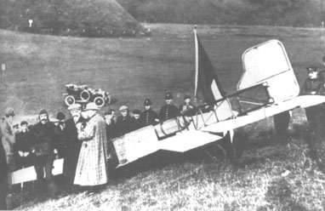
Progress in Europe
Blériot was an instant celebrity when he landed in Dover after crossing the English Channel.
25 miles - 37 minutes
No compass

Slide 32
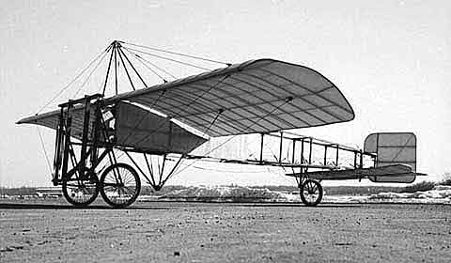
Bleriot XI

Slide 33
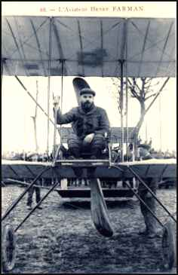
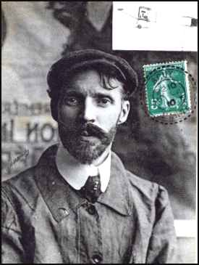
Progress in Europe
1909 – First International Air meet held in Rheims, France
Many speed and endurance records were broken
Louis Bleriot - - fastest lap – 47.8 mph
Henri Farman stayed in the air 3 hrs, 4 minutes and 56 seconds
Flying 111 miles

Slide 34
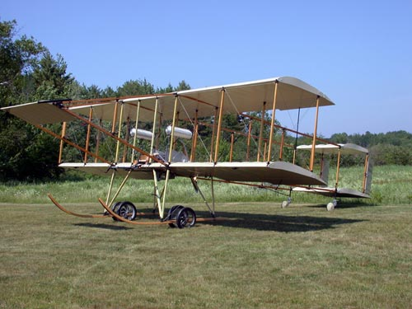
Henri Farman III
Powered by a 50-horsepower Gnôme engine,
It had full ailerons and twin rudders for control
Sprung wheels on the skids to soften the landing.

Slide 35
Questions / Comments

Slide 36
Today’s Mission Requirements
Mission:
Describe the contributions by Robert Esnault-Pelterie to aviation.
Describe the contributions by Alberto Santos-Dumont to aviation.
Describe the contributions by Louis Bleriot to aviation.
Describe the aviation achievements at the First International Air meet.
Identify Henri Farman’s contributions to aviation.
EQ:
Describe significant aviation events occurring between 1904-1919 and their impact on future aviation development.

Slide 37
Progress in Europe
Wing Warping
Clumsy method to control an airplane
Frenchman – Robert Esnault-Pelterie built a Wright-style glider in 1904 and used ailerons to replace the wing-warping technique developed by the Wright brothers.
Utilized a hand operated wheel to control the ailerons
Inventor of the joystick and first fully enclosed fuselage airplane

Slide 38
Today’s Mission Requirements
Mission:
Describe the contributions by Robert Esnault-Pelterie to aviation.
Describe the contributions by Alberto Santos-Dumont to aviation.
Describe the contributions by Louis Bleriot to aviation.
Describe the aviation achievements at the First International Air meet.
Identify Henri Farman’s contributions to aviation.
EQ:
Describe significant aviation events occurring between 1904-1919 and their impact on future aviation development.

Slide 39
Progress in Europe
Alberto Santos-Dumount
Flew first powered airplane in Europe
14-bis biplane – Paris, France Oct 23, 1906
for a distance 197ft at a height of 10ft
Two weeks later flew for 722ft

Slide 40
Today’s Mission Requirements
Mission:
Describe the contributions by Robert Esnault-Pelterie to aviation.
Describe the contributions by Alberto Santos-Dumont to aviation.
Describe the contributions by Louis Bleriot to aviation.
Describe the aviation achievements at the First International Air meet.
Identify Henri Farman’s contributions to aviation.
EQ:
Describe significant aviation events occurring between 1904-1919 and their impact on future aviation development.

Slide 41
Progress in Europe
Louis Bleriot
Flew first powered monoplane 1907
The Blériot V canard monoplane

Slide 42
Progress in Europe
Louis Blériot took off in his model XI on July 25, 1909 to fly across the English Channel.
25 –hp engine
Built 11 planes before the trip – had almost 50 crashes but refused to give up

Slide 43
Progress in Europe
Blériot was an instant celebrity when he landed in Dover after crossing the English Channel.
25 miles - 37 minutes
No compass

Slide 44
Today’s Mission Requirements
Mission:
Describe the contributions by Robert Esnault-Pelterie to aviation.
Describe the contributions by Alberto Santos-Dumont to aviation.
Describe the contributions by Louis Bleriot to aviation.
Describe the aviation achievements at the First International Air meet.
Identify Henri Farman’s contributions to aviation.
EQ:
Describe significant aviation events occurring between 1904-1919 and their impact on future aviation development.

Slide 45
Progress in Europe
1909 – First International Air meet held in Rheims, France
Many speed and endurance records were broken
Louis Bleriot - - fastest lap – 47.8 mph
Henri Farman stayed in the air 3 hrs, 4 minutes and 56 seconds
Flying 111 miles

Slide 46
Today’s Mission Requirements
Mission:
Describe the contributions by Robert Esnault-Pelterie to aviation.
Describe the contributions by Alberto Santos-Dumont to aviation.
Describe the contributions by Louis Bleriot to aviation.
Describe the aviation achievements at the First International Air meet.
Identify Henri Farman’s contributions to aviation.
EQ:
Describe significant aviation events occurring between 1904-1919 and their impact on future aviation development.

Slide 47
Progress in Europe
1909 – First International Air meet held in Rheims, France
Many speed and endurance records were broken
Louis Bleriot - - fastest lap – 47.8 mph
Henri Farman stayed in the air 3 hrs, 4 minutes and 56 seconds
Flying 111 miles

Slide 48
Henri Farman III
Powered by a 50-horsepower Gnôme engine,
It had full ailerons and twin rudders for control
Sprung wheels on the skids to soften the landing.

Slide 49
Questions / Comments

Slide 50
Today’s Mission Requirements
Mission:
Describe the first multiengine aircraft and the reasons for its development.
Describe the first four engine aircraft.
Describe the Gnome and the Le Rhone engine.
Describe the early inventors of the helicopter and the major control problem they faced.
Describe the first regularly scheduled airline service.
EQ:
Describe significant aviation events occurring between 1904-1919 and their impact on future aviation development.

Slide 51
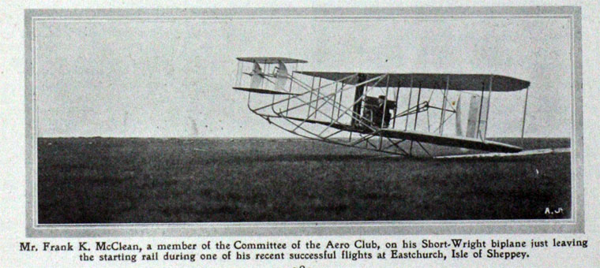
Progress in Europe
1911 – Short Brothers developed the first multiengine aircraft – called the “Triple Twin”

Slide 52
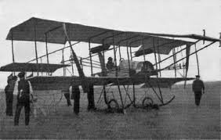
Progress in Europe
“Triple Twin”
Had two engines and three propellers

Slide 53
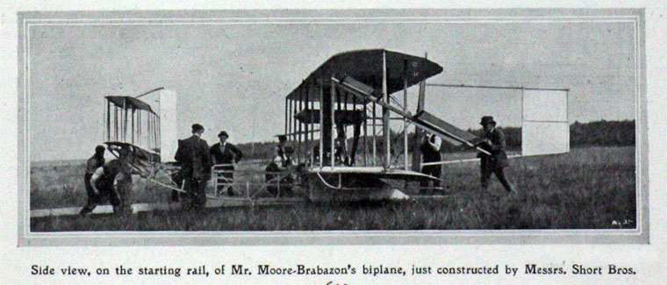
Progress in Europe
Reasons for multi-engine aircraft
Increased power
Reliability ( if 1 fails enough power to safe landing)

Slide 54
Progress in Europe
May 13, 1913 – First four engine aircraft
The LeGrand
Built and flown by Igor Sikorsky
Wingspan of 92 ft
Four 100-hp engines
16 wheels for landing gear
Fully enclosed cockpit
Passenger cabin with portholes for windows

Slide 55
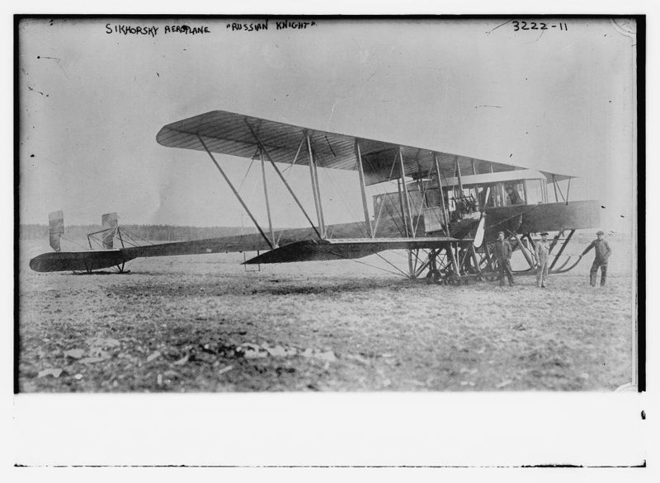

Slide 56
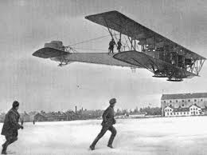
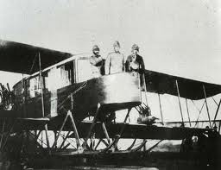

Slide 57
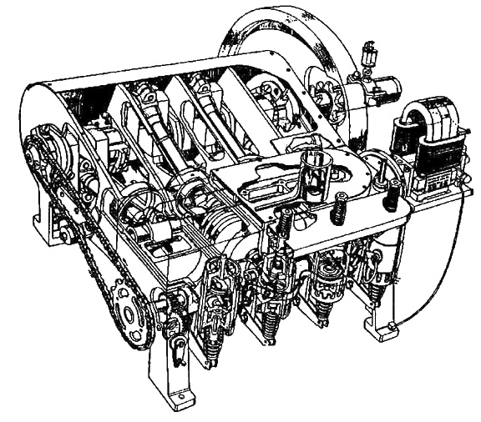
Progress in Europe
Engines at that time were
Manufactured from steel, cast iron, and brass
Water-cooled
10 lbs for every 1 horsepower
Required large heavy structure to support weight of engine
1903 Wright Engine

Slide 58
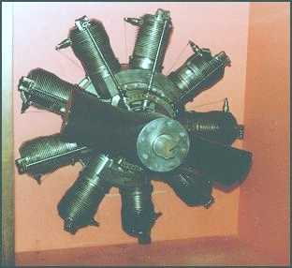
Gnome
Engine

Slide 59
Progress in Europe
Gnome
Cylinders had cooling fins to help bleed the heat into the air
When stationary the engine/propeller spun around the fixed crankshaft
Opposite of modern radial engines
Called rotary engines

Slide 60
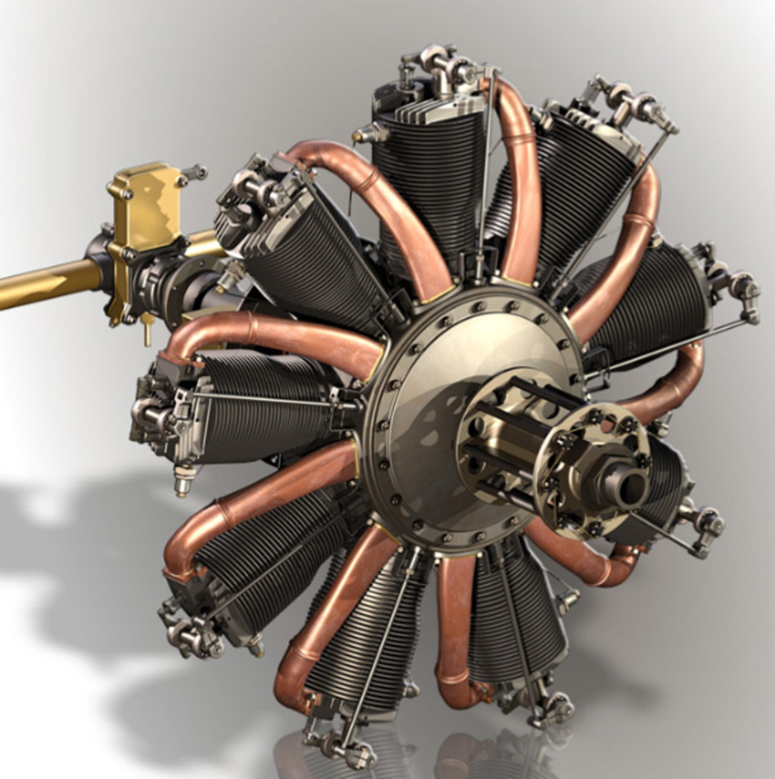
Progress in Europe
Gnome / Le Rhone
Many World War I aircraft used the engines
Sopwith Camel
Sopwith Pup

Slide 61
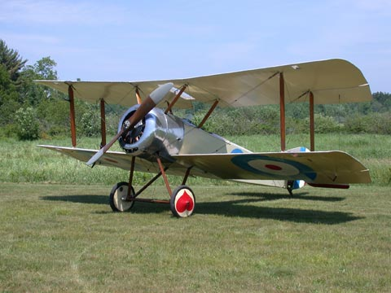
Sopwith Pup

Slide 62
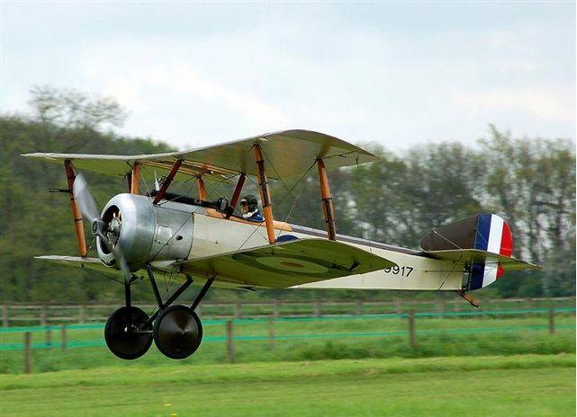
Sopwith Camel

Slide 63
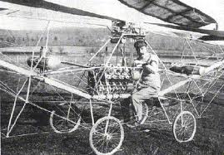
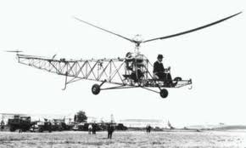
How to
Fly a
Helicopter

Slide 64
Moving Up – Vertical Flying
Heavier-than-aircraft –
Lift is produced by the wings
To sustain lift
Wings must be moving through the air
Fixed wing aircraft forward motion causes wings to move through air and create lift
Helicopters
Main rotor moves through air and made up of a number of blades
Blades are like wings
As they move through the air they create lift
Hence the term – rotary wing

Slide 65
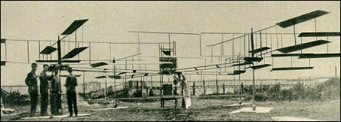
Louis Breguet - 1907
Lifted off ground but was held by four assistants

Slide 66
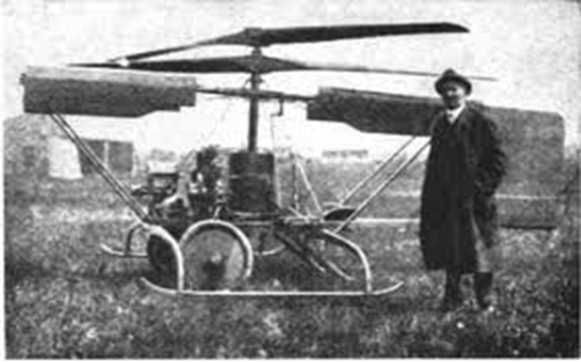
Helicopter Development
Plagued by control problems
Counteracting the torque of the main rotor
When the helicopter was turning the aircraft went in the opposite direction

Slide 67
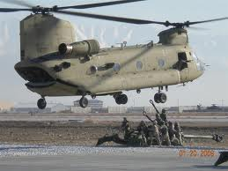
Helicopter Development
To counteract it - two rotors were added rotating in opposite directions
Another is to put a small rotor on the tail boom which provided thrust to counteract the torque of the main rotor.
Took 30 years to solve it – just prior to World War II

Slide 68
Commercial Flying
Jan 1, 1914 – first regularly scheduled air service using a heavier-than-aircraft in US

Slide 69
Commercial Flying
Airline – “St. Petersburg – Tampa Airboat Line”
Twin-engine Benoist XIV – flying boat
Carried 2 passengers

Slide 70
Commercial Flying
22 mile flight cost $5 took 20 minutes
Flew twice a day for 5 months
Carried a total of 1,200 passengers

Slide 71
Questions / Comments

Slide 72
SAFETY FIRST.
SAFETY ALWAYS.

Slide 74
Safety Rules – Safety Monitor Brief
Must Use Safety Glasses
Use of Cutting tools is Dangerous – AT ALL TIMES
Must Use Cutting Mats
Extended breathing of adhesives and paint fumes can be dangerous
May use vinyl gloves

Slide 75
Safety Rules – Safety Monitor Brief
Do not wash paint brushes in sink
Do not pour paint or thinner down drain
Only use paint thinner to clean brushes
May use Acetone to remove Super Glue or glue
Only use spray paint outside and on cardboard to avoid overspray.
Must use dust mask when using spray paint.

Slide 76
Safety Rules – Safety Monitor Brief
Be sure to read all model instructions.
All Areas will remain clean and organized
Plane Captains will insure All Areas will be cleaned and all items put back in proper locations 10minutes prior to class ending
Class safety monitor will insure areas are clean and safe at all times
Class Leader insure hangar is clean before class dismissed

Slide 77
SAFETY FIRST.
SAFETY ALWAYS.

Slide 78
Model Building Grading Rubic
Each Group MUST follow all directions
STOP! - If you are unsure
SAFETY at ALL Times
Accuracy and Authenticity will be judged
Each Group Member is responsible to produce a 2 page paper on the model.
Aircraft Specifications
Aircraft contribution to Aviation development
Significant Aviation Pioneers associated with aircraft (pilots, inventors etc.)
The Group will provide a Presentation on the model.
5to 7 slides (Title slide; Body; Summary Slide)

Slide 79
Safety Rules – Safety Monitor Brief
Must Use Safety Glasses
Use of Cutting tools is Dangerous – AT ALL TIMES
Must Use Cutting Mats
Extended breathing of adhesives and paint fumes can be dangerous
All Areas will remain clean and organized
Plane Captains will insure All Areas will be cleaned and all items put back in proper locations 10minutes prior to class ending
Class safety monitor will insure areas are clean and safe at all times

Slide 80
SAFETY FIRST.
SAFETY ALWAYS.

Slide 81
Questions / Comments

Slide 82
Lesson Closure - 3 – 2 - 1
3. List 3 things you learned today.
2. List 2 things you have questions about today’s lesson.
1. Create (1) quiz question with answer about today’s lesson.

Slide 83
Questions / Comments

Slide 84
1st Quarter Requirements (Report Cards due Oct 14)
All students will complete the following:
Take notes - All in class quizzes and tests
Each day is worth 10pts - (4 day week 15pts)
Build models – Involved and productive
Each day is worth 10pts - (4 day week 10pts)
If only notes (no time for building models)
Each day is worth 20pts - (4 day week 25pts)
Student will receive zero points for all incomplete work – NO make-up / extra credit

