Slide 1
Warm-Up – 9/15 – 10 minutes
Utilizing your notes and past knowledge answer the following questions:
Describe the 20 year period from 1919-1939.
Describe the change in aircraft during this period.
Describe the four stages of the first Atlantic Ocean crossing.
Describe the challenges associated with the first attempts to cross the Atlantic Ocean.
Describe the first nonstop crossing of the Atlantic by Alcock and Brown.

Slide 2

Questions / Comments

Slide 3
Warm-Up – 9/15 – 10 minutes
Utilizing your notes and past knowledge answer the following questions:
Describe the 20 year period from 1919-1939.
Describe the change in aircraft during this period.
Describe the four stages of the first Atlantic Ocean crossing.
Describe the challenges associated with the first attempts to cross the Atlantic Ocean.
Describe the first nonstop crossing of the Atlantic by Alcock and Brown.

Slide 4
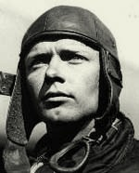
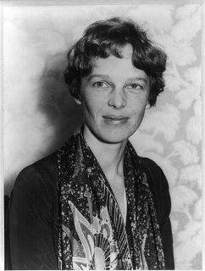
Introduction
The 20-year period between the end of World War I and the beginning of World War II has been called the Golden Age of Aviation.
During this period, there were many exciting and dramatic exploits by daring aviators from many lands.
Charles Lindbergh
Amelia Earhart

Slide 5
Warm-Up – 9/15 – 10 minutes
Utilizing your notes and past knowledge answer the following questions:
Describe the 20 year period from 1919-1939.
Describe the change in aircraft during this period.
Describe the four stages of the first Atlantic Ocean crossing.
Describe the challenges associated with the first attempts to cross the Atlantic Ocean.
Describe the first nonstop crossing of the Atlantic by Alcock and Brown.

Slide 6
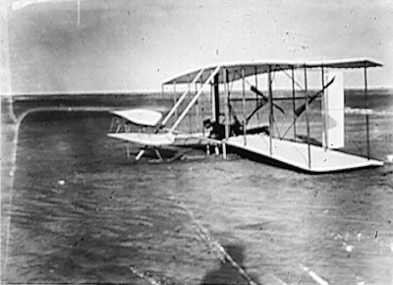
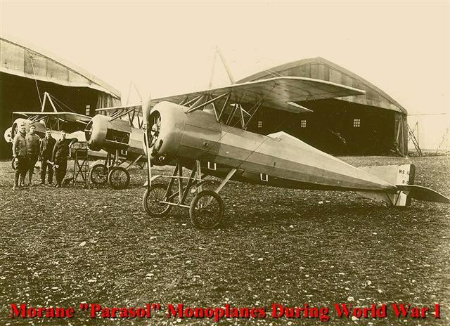
Introduction
The airplane changed from a slow, wood-framed, fabric-covered biplane to a fast, sleek, all-metal monoplane.

Slide 7
Warm-Up – 9/15 – 10 minutes
Utilizing your notes and past knowledge answer the following questions:
Describe the 20 year period from 1919-1939.
Describe the change in aircraft during this period.
Describe the four stages of the first Atlantic Ocean crossing.
Describe the challenges associated with the first attempts to cross the Atlantic Ocean.
Describe the first nonstop crossing of the Atlantic by Alcock and Brown.

Slide 8
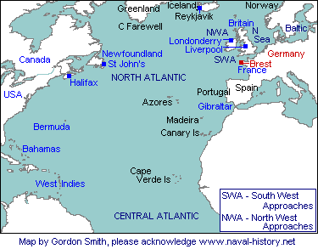
Flying the Atlantic
The flight was to be made in 4 stages
  Rockaway, NY to Trepassey, Newfoundland
  To the Azores
  To Lisbon, Portugal
  To Plymouth, England

Slide 9
Warm-Up – 9/15 – 10 minutes
Utilizing your notes and past knowledge answer the following questions:
Describe the 20 year period from 1919-1939.
Describe the change in aircraft during this period.
Describe the four stages of the first Atlantic Ocean crossing.
Describe the challenges associated with the first attempts to cross the Atlantic Ocean.
Describe the first nonstop crossing of the Atlantic by Alcock and Brown.

Slide 10
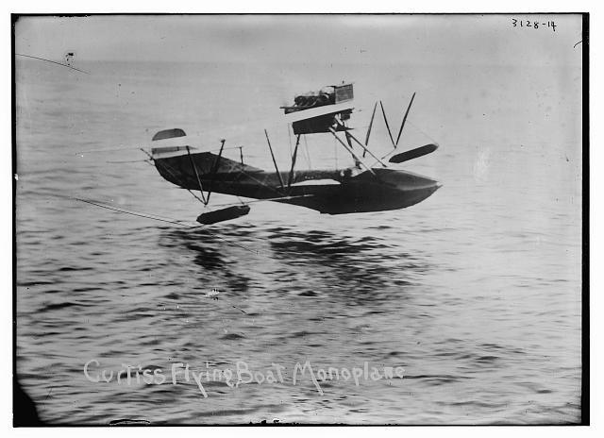
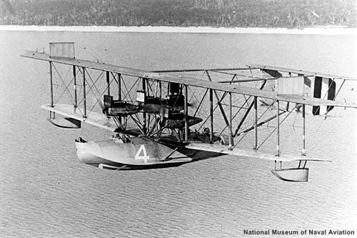
Flying the Atlantic
NC-1 and NC-3 landed in the water to check their navigation
12 ft waves prevented NC-3 from taking off – so he taxied for 3 days and arrived in the Azores
The plane was so badly damaged that it was unable to fly

Slide 11
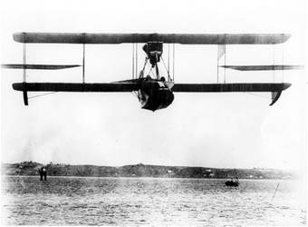
Flying the Atlantic
NC-1 came down after flying 850 miles – damaged on landing in the water and began to break up
Steamship rescued the crew and naval destroyer tried to tow the plane but it broke up and sank
NC-4 kept flying and landed in Azores harbor 15 hrs and 18 minutes after leaving Newfoundland

Slide 12
Warm-Up – 9/15 – 10 minutes
Utilizing your notes and past knowledge answer the following questions:
Describe the 20 year period from 1919-1939.
Describe the change in aircraft during this period.
Describe the four stages of the first Atlantic Ocean crossing.
Describe the challenges associated with the first attempts to cross the Atlantic Ocean.
Describe the first nonstop crossing of the Atlantic by Alcock and Brown.

Slide 13
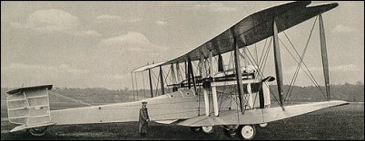
Flying the Atlantic
Two weeks later the first non-stop crossing of the Atlantic was made in a Vickers-Vimy IV
Captain John Alcock & Lt Arthur Brown
  Departed St. John’s Newfoundland
  Arrived Clifden, Ireland
  16 hrs and 12 minutes
  1,880 miles avg speed 2 miles a minute
Won prize of $50,000 by London Daily Mail
Remarkable advance from 1903 to 1919

Slide 14
Questions / Comments

Slide 15
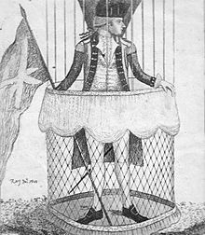
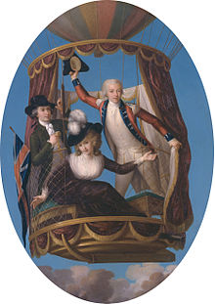
THIS DAY IN AVIATION
September 15
1784 — Italian diplomat, Vincenzo Lunardi, makes the first ascent in a hydrogen balloon in Britain.

Slide 16
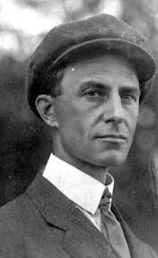
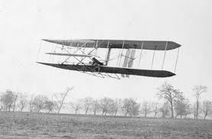
THIS DAY IN AVIATION
September 15
1904 — Wilbur Wright in the airplane “Flyer II” makes his first controlled half-circle while in flight.

Slide 17
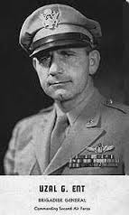
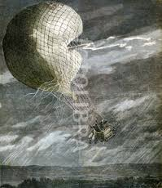
THIS DAY IN AVIATION
September 15
1928 — Lt. Uzal G. Ent, Air Corps, awarded Distinguished Flying Cross for heroic conduct in National Elimination Balloon Race on May 30, when Lieutenant Everet, pilot of his balloon, was struck by lightning.
Ent remained with him in the burning balloon rather than assure his own safety by jumping with a parachute.

Slide 18
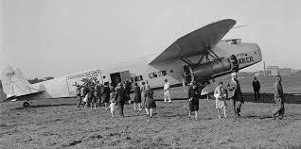
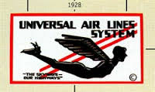
THIS DAY IN AVIATION
September 15
1928 — Universal Air Lines starts daily passenger service between Chicago and Cleveland , 313 miles.

Slide 19
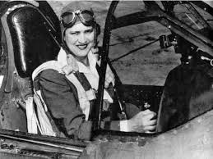
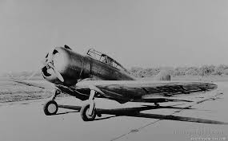
THIS DAY IN AVIATION
September 15
1939 — Jacqueline Cochran, in a Seversky monoplane, powered by a 700-hp Pratt & Whitney “Wasp” engine, sets a new international speed record of 305.926 mph for 1,000 km on Burbank, San Francisco, Burbank course.

Slide 20
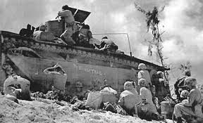
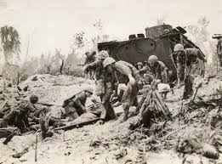
THIS DAY IN AVIATION
September 15
1944 — United States Marines amphibious landing on Peleliu launched the Battle of Peleliu.

Slide 21
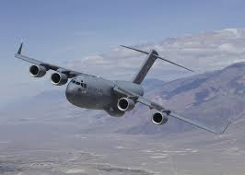
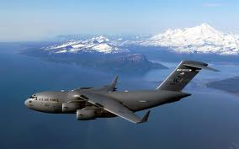
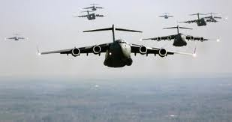
THIS DAY IN AVIATION
September 15
1991 — McDonald Douglas C-17 “Globemaster III” makes first flight.

Slide 22
Questions / Comments

Slide 23
September 2015
Sunday | Monday | Tuesday | Wednesday | Thursday | Friday | Saturday
 | 31 Chapter 2 Intro | 1 Chapter 2 Curtiss | 2 Chapter 2 Vin Fiz Progress Rpts Due | 3 Chapter 2 Progress in Europe | 4 Chapter 2 QUIZ Progress Rpts Sent Home | 5
6 | 7 NO SCHOOL HOLIDAY | 8 Chapter 2 WWI Preparing for War | 9 Chapter 2 WWI Fighter Development | 10 Chapter 2 WWI Fighter Aces Lafayette Escadrille | 11 WWI TEST FltLine Friday “FlyBoys” | 12
13 | 14 Chapter 3 The Golden Age | 15 Chapter 3 The Golden Age | 16 Chapter 3 The Golden Age | 17 Chapter 3 The Golden Age | 18 Chapter 3 QUIZ | 19
20 | 21 Chapter 3 The Golden Age | 22 Chapter 3 The Golden Age | 23 Progress Rpts Due | 24 Chapter 3 The Golden Age | 25 Progress Rpts Sent Home | 26
27 | 28 | 29 | 30

Slide 24
Questions / Comments

Slide 25
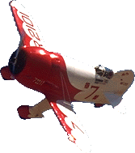
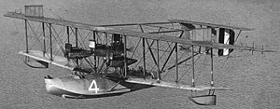
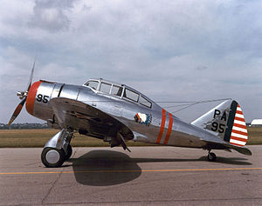
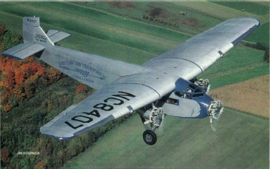
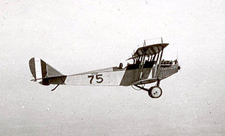
The Golden Age
“Barnstormers”
Air Mail Speeds Up Delivery
Army Air Power Develops
Investing in Air Power
1919 - 1939

Slide 26
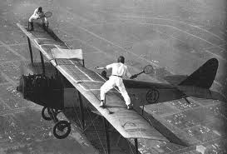
Video of the Day
Barnstormers

Slide 27
Today’s Mission Requirements
Mission:
Describe what happened to America’s air power shortly after the end of WWI.
What was the impact on military aviation when WWI ended?
Describe the cost and use of the Curtiss JN-4 “Jenny” after the war.
Who was the first licensed black female pilot?
Describe the impact “barnstormers” had on aviation development
EQ:
  What were some of the technological improvements that influenced aviation during this timeframe (1919-1939)?

Slide 28
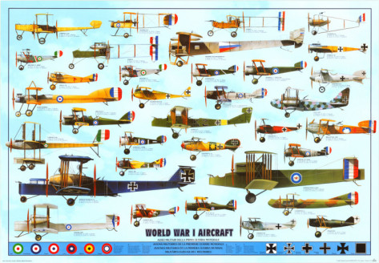
Investing in Air Power
France, Germany, Italy, England and the United States all built great aviation industries by the end of WWI.

Slide 29
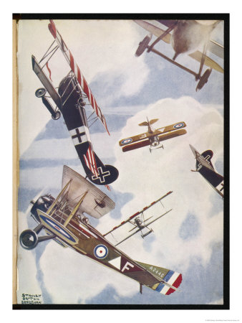
Investing in Air Power
177,000 aircraft were in service by the end of the war.
  France – 67,982
  Germany – 47,637
  Italy – 20,000
  U.S. – 15,000

Slide 30
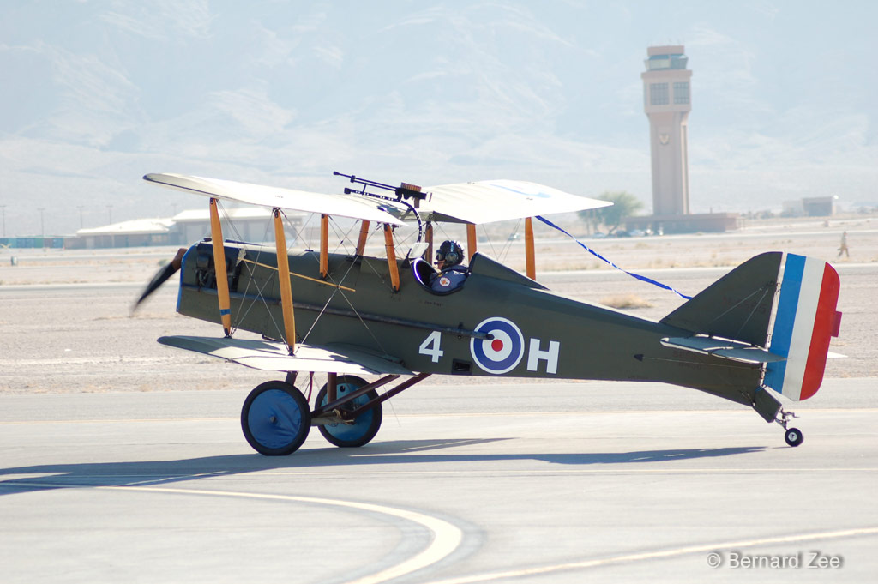
Investing in Air Power
British production beginning of war about 20 per month to 3,500 per month by war’s end

Slide 31
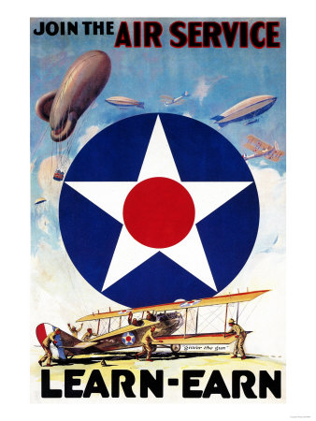
Investing in Air Power
America’s front-line strength
  750 combat aircraft
  800 pilots
  Approx 3,000 training aircraft
  Total 9,500 men in Air Service
That all changed when the war ended.

Slide 32

Investing in Air Power
x
Within 3 days of the war ending, the U.S. government canceled $100 million in airplane contracts.
Within 3 months, 175,000 factory workers had been laid off.

Slide 33

Investing in Air Power
Military aviation was cut by 95 percent.
Military airfields were closed
Pilots and other aviation personnel were unemployed
Aviation in the U.S. almost died – except for two groups of people
  Barnstormers and Army aviators

Slide 34



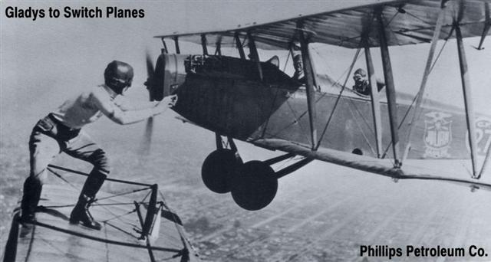
The “Barnstormers”

Slide 35
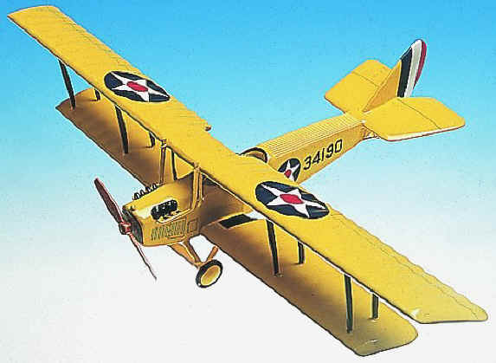
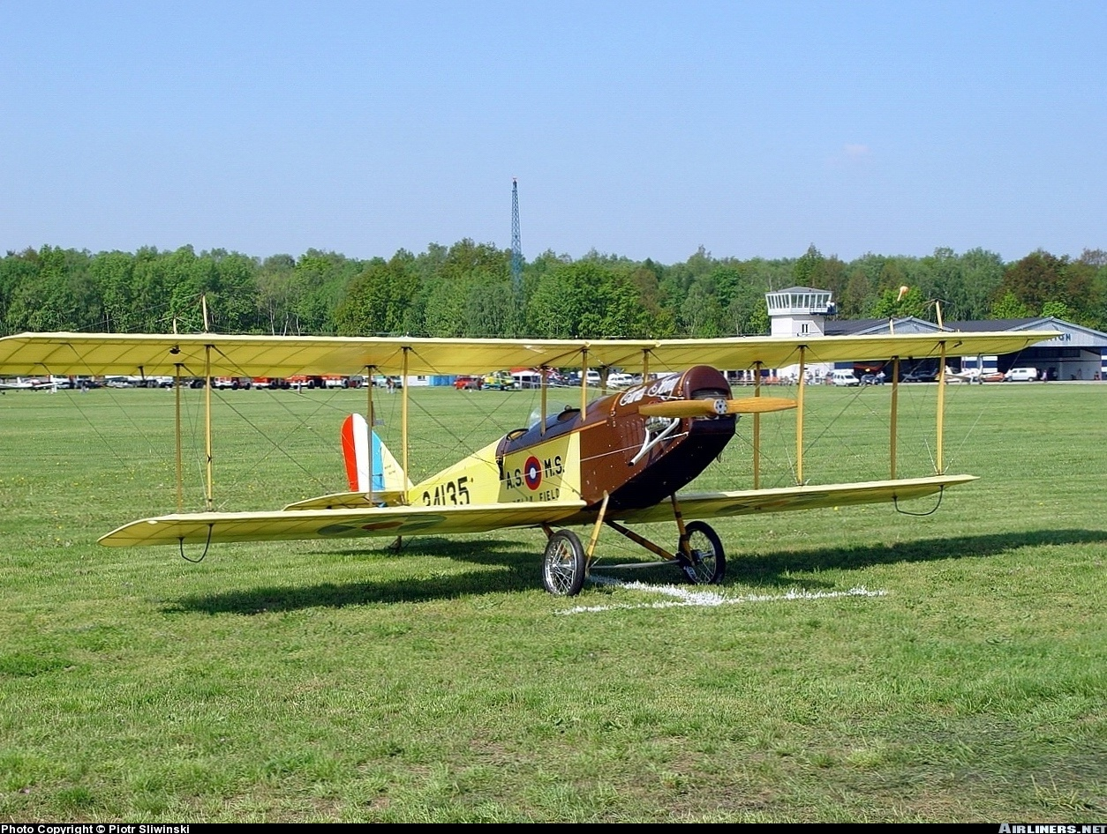
Barnstormers
Ex-military pilots who flew war-surplus planes Curtiss JN-4 “Jenny”
Gov’t paid $5000 but sold for as little as $200

Slide 36
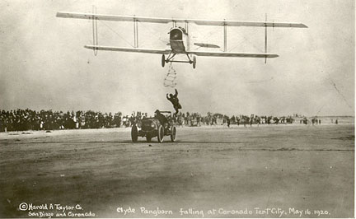
Barnstormers
They flew over small towns, then landed on nearby farms, and took people for rides

Slide 37
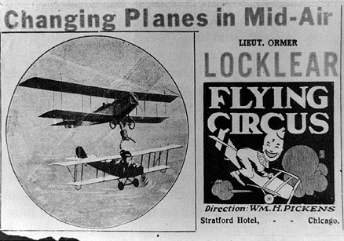
Barnstormers
They put on exhibitions and wing-walking demonstrations – Groups were known as “Flying Circus”

Slide 38
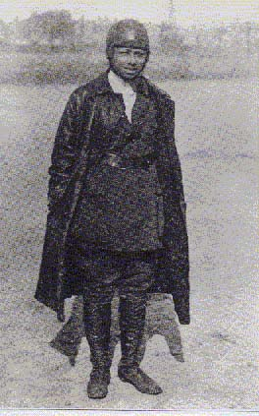
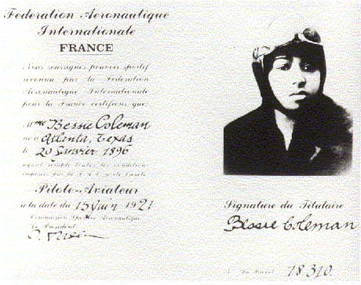
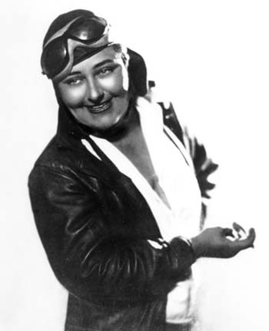
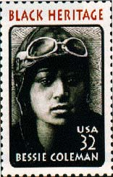
Barnstormers
Some of the barnstormers were women pilots
Bessie Coleman
1st licensed black female pilot
Pancho Barnes
Speed queen of the "Golden Era of Airplane Racing"

Slide 39

Barnstormers
When WWI ended, most people had never seen an airplane.
The Barnstormers helped create interest in fliers and flying.
This interest sparked people to improve aircraft design, safety, and achievement.

Slide 40
Questions / Comments

Slide 41
Today’s Mission Requirements
Mission:
Describe what happened to America’s air power shortly after the end of WWI.
What was the impact on military aviation when WWI ended?
Describe the cost and use of the Curtiss JN-4 “Jenny” after the war.
Who was the first licensed black female pilot?
Describe the impact “barnstormers” had on aviation development
EQ:
  What were some of the technological improvements that influenced aviation during this timeframe (1919-1939)?

Slide 42
Investing in Air Power
x
Within 3 days of the war ending, the U.S. government canceled $100 million in airplane contracts.
Within 3 months, 175,000 factory workers had been laid off.

Slide 43
Today’s Mission Requirements
Mission:
Describe the what happened to America’s air power shortly after the end of WWI.
What was the impact on military aviation when WWI ended?
Describe the cost and use of the Curtiss JN-4 “Jenny” after the war.
Who was the first licensed black female pilot?
Describe the impact “barnstormers” had on aviation development
EQ:
  What were some of the technological improvements that influenced aviation during this timeframe (1919-1939)?

Slide 44
Investing in Air Power
Military aviation was cut by 95 percent.
Military airfields were closed
Pilots and other aviation personnel were unemployed
Aviation in the U.S. almost died – except for two groups of people
  Barnstormers and Army aviators

Slide 45
Today’s Mission Requirements
Mission:
Describe the what happened to America’s air power shortly after the end of WWI.
What was the impact on military aviation when WWI ended?
Describe the cost and use of the Curtiss JN-4 “Jenny” after the war.
Who was the first licensed black female pilot?
Describe the impact “barnstormers” had on aviation development
EQ:
  What were some of the technological improvements that influenced aviation during this timeframe (1919-1939)?

Slide 46
Barnstormers
Ex-military pilots who flew war-surplus planes Curtiss JN-4 “Jenny”
Gov’t paid $5000 but sold for as little as $200

Slide 47
Today’s Mission Requirements
Mission:
Describe the what happened to America’s air power shortly after the end of WWI.
What was the impact on military aviation when WWI ended?
Describe the cost and use of the Curtiss JN-4 “Jenny” after the war.
Who was the first licensed black female pilot?
Describe the impact “barnstormers” had on aviation development
EQ:
  What were some of the technological improvements that influenced aviation during this timeframe (1919-1939)?

Slide 48
Barnstormers
Some of the barnstormers were women pilots
Bessie Coleman
1st licensed black female pilot
Pancho Barnes
Speed queen of the "Golden Era of Airplane Racing"

Slide 49
Today’s Mission Requirements
Mission:
Describe the what happened to America’s air power shortly after the end of WWI.
What was the impact on military aviation when WWI ended?
Describe the cost and use of the Curtiss JN-4 “Jenny” after the war.
Who was the first licensed black female pilot?
Describe the impact “barnstormers” had on aviation development
EQ:
  What were some of the technological improvements that influenced aviation during this timeframe (1919-1939)?

Slide 50
Barnstormers
When WWI ended, most people had never seen an airplane.
The Barnstormers helped create interest in fliers and flying.
This interest sparked people to improve aircraft design, safety, and achievement.

Slide 51
Lesson Closure- Finish these Statements
2. Something from today's lesson that I want to find out more about is ...
1. One thing I learned today was ...
3. Something I found difficult to understand today was ...
4. I really enjoyed today's lesson because ...

