Slide 1
Warm-Up – 10/2 – 10 minutes
Utilizing your notes and past knowledge answer the following questions:
Describe the state of the US Aviation military industry at the start and end of World War I?
What was the military role of the airplane in World War I?
What was the nickname given to the first bombers of WWI?
What type of aircraft led to gaining control of the air?
What was the first type of bullet deflection used on propellers?

Slide 2
Questions / Comments

Slide 3
Warm-Up – 10/2 – 10 minutes
Utilizing your notes and past knowledge answer the following questions:
Describe the state of the US Aviation military industry at the start and end of World War I?
What was the military role of the airplane in World War I?
What was the nickname given to the first bombers of WWI?
What type of aircraft led to gaining control of the air?
What was the first type of bullet deflection used on propellers?

Slide 4
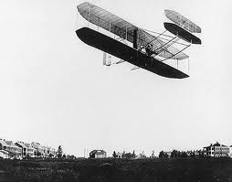
Preparing for War
1908 – US Army purchased a Wright Flyer
Three years it was the entire “Air Force”
1911 – US Congress bought 5 more planes
By end of 1913 – US had 19 aircraft and 29 pilots

Slide 5
Warm-Up – 10/2 – 10 minutes
Utilizing your notes and past knowledge answer the following questions:
Describe the state of the US Aviation military industry at the start and end of World War I?
What was the military role of the airplane in World War I?
What was the nickname given to the first bombers of WWI?
What type of aircraft led to gaining control of the air?
What was the first type of bullet deflection used on propellers?

Slide 6
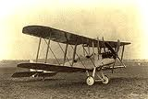
Military Role of the Airplane
Airplane was first used for observation
This use changed the battlefield forever

Slide 7
Warm-Up – 10/2 – 10 minutes
Utilizing your notes and past knowledge answer the following questions:
Describe the state of the US Aviation military industry at the start and end of World War I?
What was the military role of the airplane in World War I?
What was the nickname given to the first bombers of WWI?
What type of aircraft led to gaining control of the air?
What was the first type of bullet deflection used on propellers?

Slide 8
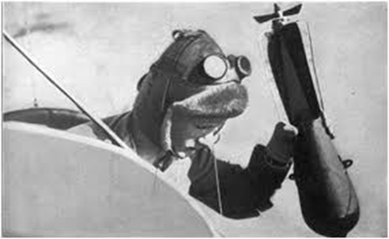
Military Role of the Airplane
Evolved to use as a bomber
With pilot or observer carrying bombs in lap

Slide 9
Warm-Up – 10/2 – 10 minutes
Utilizing your notes and past knowledge answer the following questions:
Describe the state of the US Aviation military industry at the start and end of World War I?
What was the military role of the airplane in World War I?
What was the nickname given to the first bombers of WWI?
What type of aircraft led to gaining control of the air?
What was the first type of bullet deflection used on propellers?

Slide 10
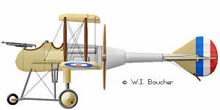
Introduction
As more and more bombing raids took place, clear need for control of the air was needed.
Fighter or pursuit aircraft were needed to drive off bombers.

Slide 11
Warm-Up – 10/2 – 10 minutes
Utilizing your notes and past knowledge answer the following questions:
Describe the state of the US Aviation military industry at the start and end of World War I?
What was the military role of the airplane in World War I?
What was the nickname given to the first bombers of WWI?
What type of aircraft led to gaining control of the air?
What was the first type of bullet deflection used on propellers?

Slide 12
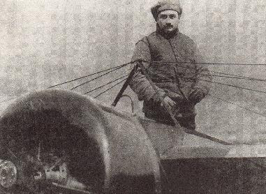
Fighter Development
1915 – French pilot – Roland Garros
Mounted an automatic rifle on aircraft
Fired through the propeller
To keep from shooting off propeller, the rear of the propeller was armored with steel plates

Slide 13
Questions / Comments

Slide 14
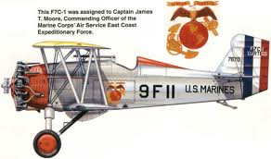
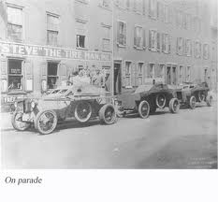
THIS DAY IN AVIATION
October 2
1921 — US Marine Corps planes complete five days of maneuvers with the East Coast Expeditionary Forces at Wilderness Run, Virginia.
They made 204 flights, with total distance flown of 10,500 miles.

Slide 15
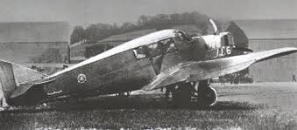
THIS DAY IN AVIATION
October 2
1921 — A Larsen J.L.-6 armored monoplane with 30 machine guns, was exhibited at Bolling Field, Washington, D.C.

Slide 16
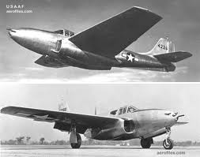
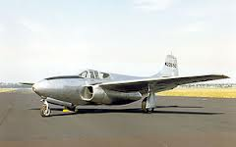
THIS DAY IN AVIATION
October 2
1942 — The Bell P-59A made the first flight of a United States turbojet aircraft.

Slide 17
Questions / Comments

Slide 18
September/October 2017
Sunday | Monday | Tuesday | Wednesday | Thursday | Friday | Saturday
10 | 11 NO SCHOOL | 12 NO SCHOOL | 13 AERY Software Balsa Glider Construction | 14 Balsa Glider Construction | 15 Glider Challenge Flight Line Friday Progress Reports | 16
17 | 18 Chapter 2 Development of Aviation in U.S. | 19 Chapter 2 Glenn Curtiss | 20 Chapter 2 Vin Fiz | 21 Chapter 2 Progress in Europe | 22 Chapter 2 Quiz Flight Line Friday | 23
24 | 25 Chapter 2 Helicopter Commercial Air Travel | 26 Chapter 2 WWI Preparing for War Fighter Development | 27 Chapter 2 WWI Fighter Aces | 28 Chapter 2 WWI Lafayette Escadrille Chapter 2 Test Flyboys | 29 Flyboys Flight Line Friday | 30
1 | 2 Chapter 3 The Golden Age | 3 Chapter 3 The Golden Age | 4 Chapter 3 The Golden Age | 5 Chapter 3 The Golden Age | 6 Chapter 3 Quiz Flight Line Friday | 7

Slide 19
Questions / Comments

Slide 20
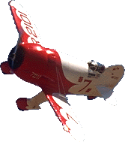
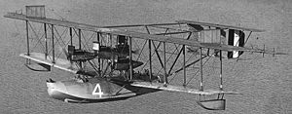
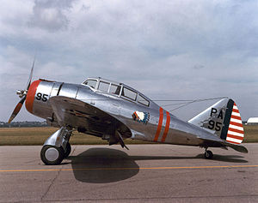
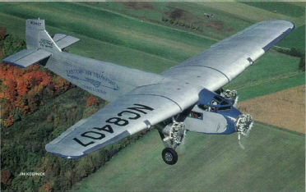
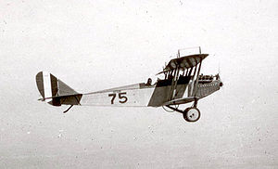
The Golden Age
“Barnstormers”
Air Mail Speeds Up Delivery
Army Air Power Develops
Investing in Air Power
1919 - 1939

Slide 21
Today’s Mission Requirements
Mission:
Describe the 20 year period from 1919-1939.
Describe the change in aircraft during this period.
Describe the four stages of the first Atlantic Ocean crossing.
Describe the challenges associated with the first attempts to cross the Atlantic Ocean.
Describe the first nonstop crossing of the Atlantic by Alcock and Brown.
EQ:
What were some of the technological improvements that influenced aviation during this timeframe (1919-1939)?

Slide 22
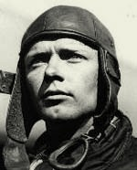
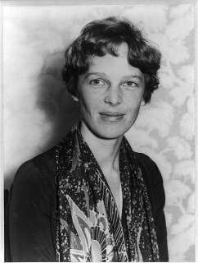
Introduction
The 20-year period between the end of World War I and the beginning of World War II has been called the Golden Age of Aviation.
During this period, there were many exciting and dramatic exploits by daring aviators from many lands.
Charles Lindbergh
Amelia Earhart

Slide 23
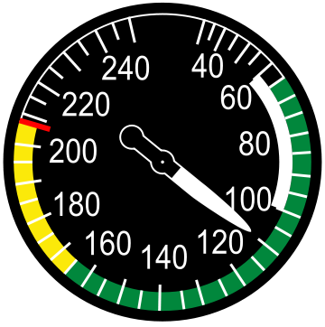
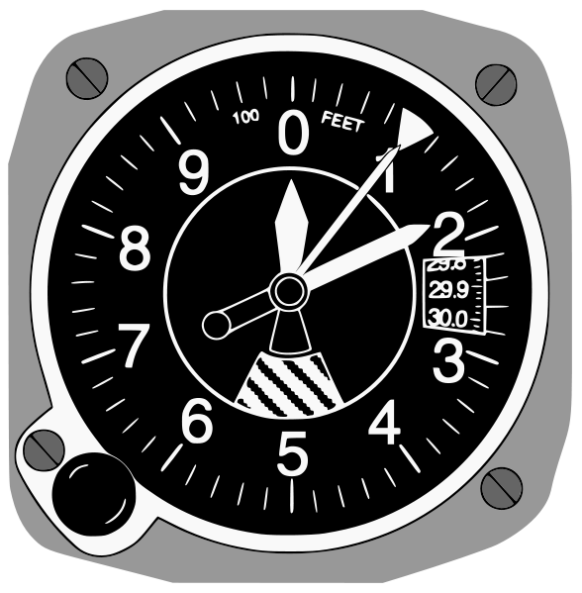
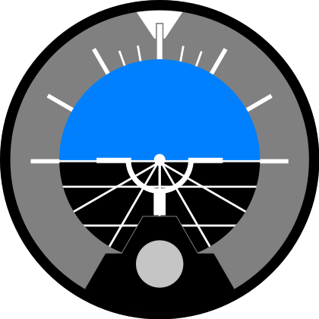
Introduction
New speed and altitude records were set and broken again and again.
There were oceans and continents to cross and each accomplishment led to someone who wanted to do it better and faster.

Slide 24
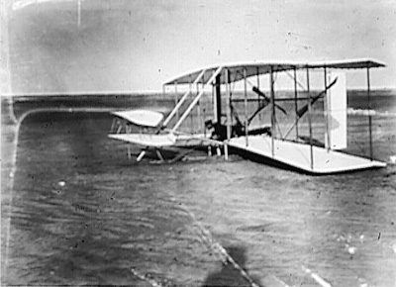
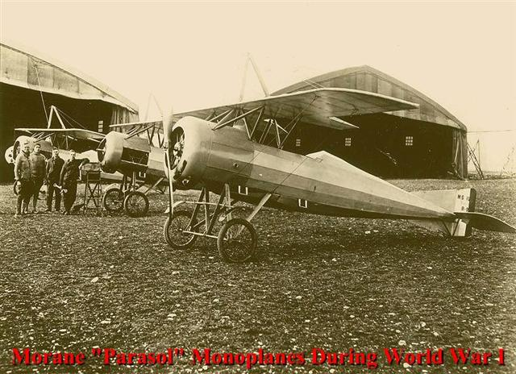
Introduction
The airplane changed from a slow, wood-framed, fabric-covered biplane to a fast, sleek, all-metal monoplane.

Slide 25
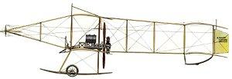
Technological Advances of Aircraft – WWI
Farman Biplane: 1913
Designed by French aviator Henri Farman, the Farman biplanes were employed in the early stages of WWI by the French military.

Slide 26
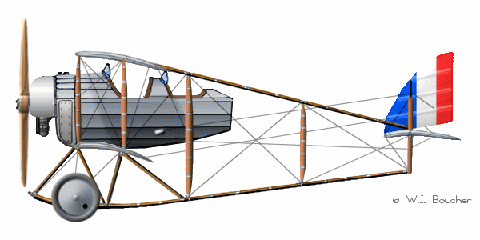
Caudron G.III - 1914
The French Caudron G.III was a two seat, single-engine tractor biplane built in 1913 for reconnaissance missions.

Slide 27
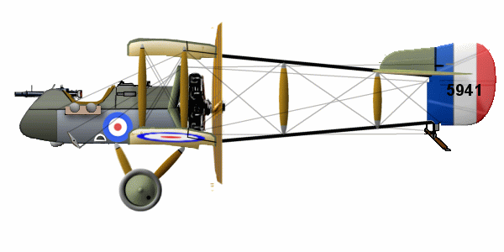
De Havilland D.H.2: 1915
The D.H.2 had good maneuverability with an excellent rate of climb. Mounting the engine to the rear of the fuselage permitted the use of a fixed, forward-firing machine gun before the advent of the synchronous machine gun.

Slide 28
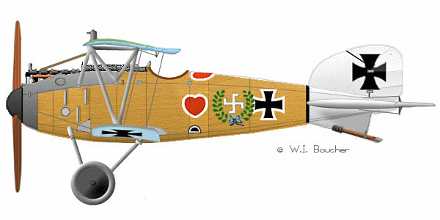
Albatros D.III - 1916
The German Albatros D.III was a sesquiplane semi-monocoque, plywood skinned fightercraft armed with twin 0.312 in (7.92 mm) LMG 08/15 "Spandau" machine guns.

Slide 29
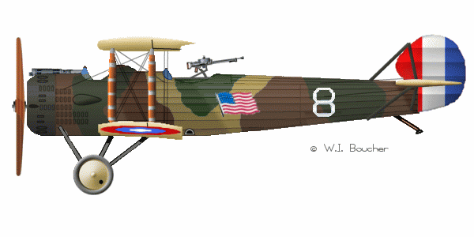
Salmson 2: 1918
The Salmson 2 was a reconnaissance aircraft made by Salmson, it was the main reconnaissance aircraft in use with the French army in 1918

Slide 30
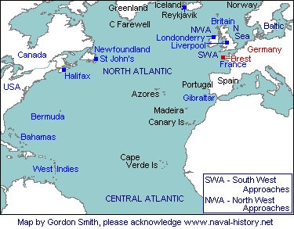
Flying the Atlantic
The first natural barrier to be challenged was the Atlantic Ocean.

Slide 31
Flying the Atlantic
The flight was to be made in 4 stages
Rockaway, NY to Trepassey, Newfoundland
To the Azores
To Lisbon, Portugal
To Plymouth, England

Slide 32
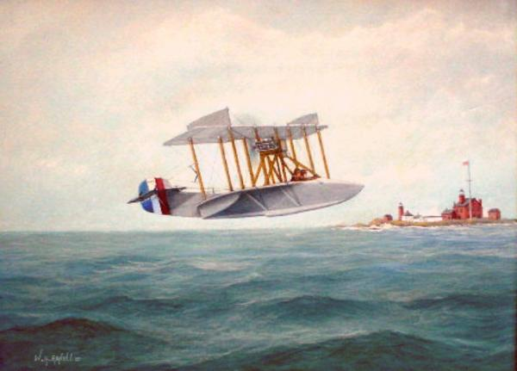
Flying the Atlantic
The attempt was to be made in 1919 by the United States Navy flying three new Curtiss flying boats (NC-1, NC-3, and NC-4)

Slide 33
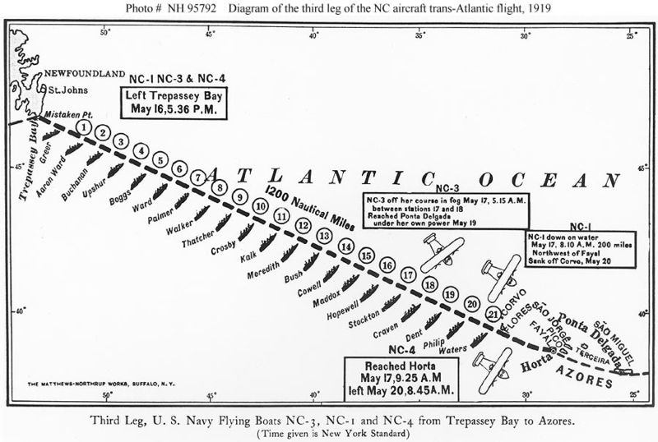
Flying the Atlantic
The journey began May 1919 and all three aircraft made it safely to Trepassey, Newfoundland
The next stage was critical for it was to cover over 1200 miles over water.
Naval vessels were stretched 50 miles apart along the route (should it ditch no more than 25 miles apart)

Slide 35
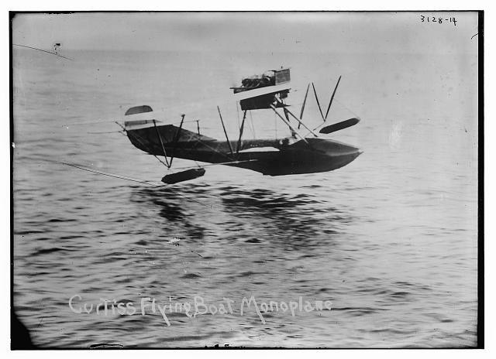
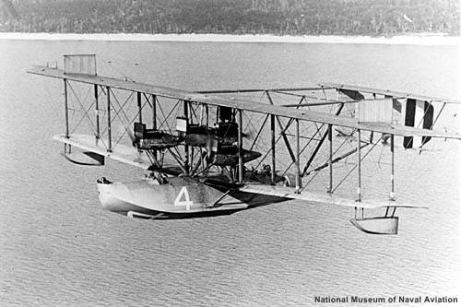
Flying the Atlantic
NC-1 and NC-3 landed in the water to check their navigation
12 ft waves prevented NC-3 from taking off – so he taxied for 3 days and arrived in the Azores
The plane was so badly damaged that it was unable to fly

Slide 37
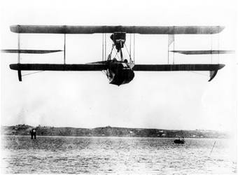
Flying the Atlantic
NC-1 came down after flying 850 miles – damaged on landing in the water and began to break up
Steamship rescued the crew and naval destroyer tried to tow the plane but it broke up and sank
NC-4 kept flying and landed in Azores harbor 15 hrs and 18 minutes after leaving Newfoundland

Slide 39
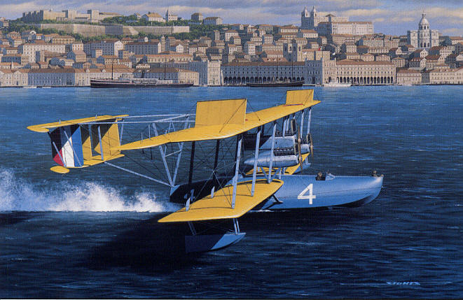
Flying the Atlantic
NC-4 and crew flown on to Lisbon, Portugal several days later and made the journey in 9 hrs and 43 minutes
Total time from Newfoundland was 26 hrs 45 minutes

Slide 40
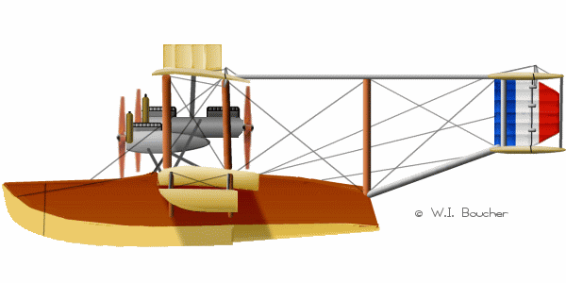
Flying the Atlantic
Few days later flew up to Spain due to engine trouble and then on to Plymouth, England and landed near where the Mayflower had moored 300 years before.

Slide 41
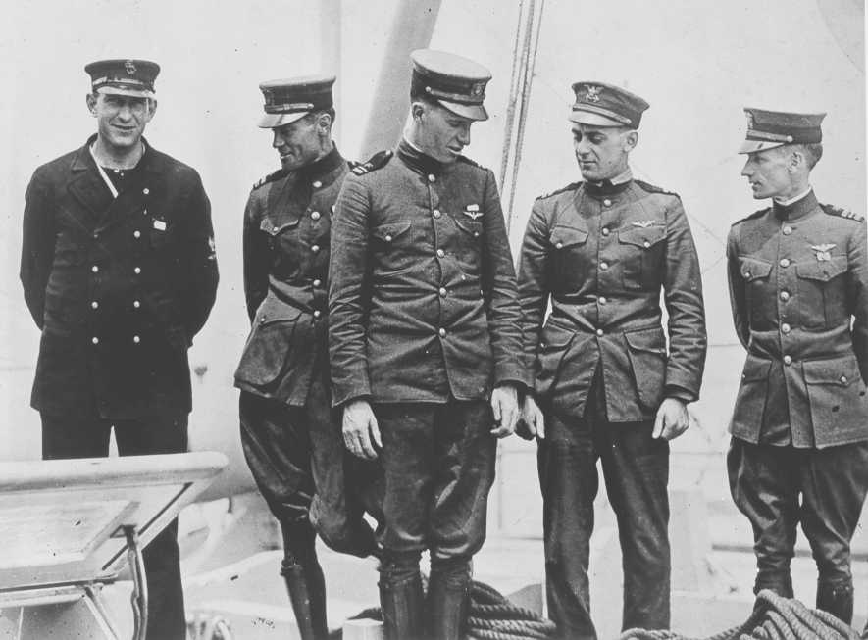
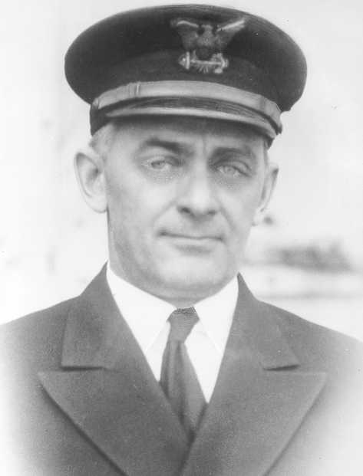
Flying the Atlantic
CDR Elmer Stone USCG
Total distance and time from Rockaway, NY:
3,936 miles
52 hrs and 31 minutes
This marked the first transatlantic crossing

Slide 42
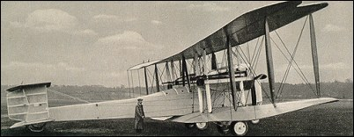
Flying the Atlantic
Two weeks later the first non-stop crossing of the Atlantic was made in a Vickers-Vimy IV
Captain John Alcock & Lt Arthur Brown
Departed St. John’s Newfoundland
Arrived Clifden, Ireland
16 hrs and 12 minutes
1,880 miles avg speed 2 miles a minute
Won prize of $50,000 by London Daily Mail
Remarkable advance from 1903 to 1919

Slide 43
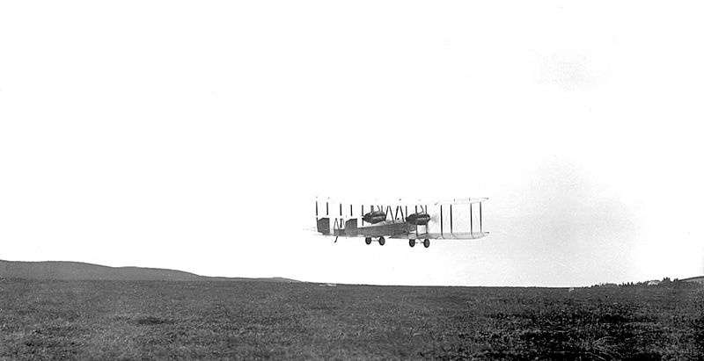
Alcock and Brown takeoff from St. John's, Newfoundland in 1919.

Slide 44
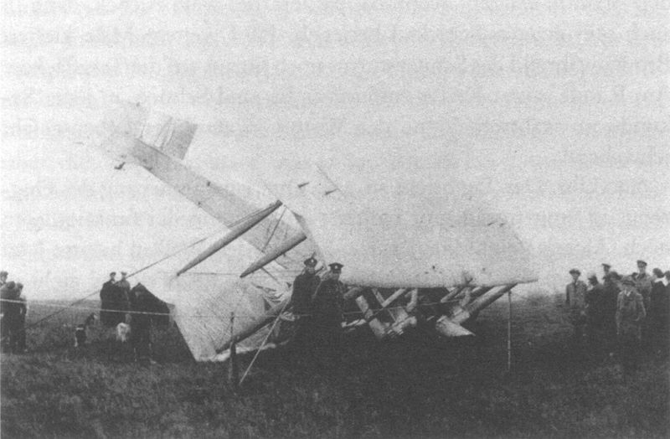
Crash landed County Galway, Ireland

Slide 45
Questions / Comments

Slide 46
SAFETY FIRST.
SAFETY ALWAYS.

Slide 47
Safety Rules – Safety Monitor Brief
Must Use Safety Glasses
Use of Cutting tools is Dangerous – AT ALL TIMES
Must Use Cutting Mats
Extended breathing of adhesives and paint fumes can be dangerous
All Areas will remain clean and organized
Plane Captains will insure All Areas will be cleaned and all items put back in proper locations 10minutes prior to class ending
Class safety monitor will insure areas are clean and safe at all times

Slide 48
SAFETY FIRST.
SAFETY ALWAYS.

Slide 49
Questions / Comments

Slide 50
Lesson Closure- Finish these Statements
2. Something from today's lesson that I want to find out more about is ...
1. One thing I learned today was ...
3. Something I found difficult to understand today was ...
4. I really enjoyed today's lesson because ...

