Slide 1
Warm-Up – 1/30 – 10 minutes
Utilizing your notes and past knowledge answer the following questions:
What is the maximum length of the fuselage when designing the glider in the Aery software program?
What is the width of the fuselage when designing the glider in the Aery software program?
What is the overall dimensions of the balsa wood?
What key or menu item would I select to check if my Aery glider would fly?
Besides the fuselage, what are the other three aircraft parts you must design?

Slide 2
Questions / Comments

Slide 3
Warm-Up – 1/30 – 10 minutes
Utilizing your notes and past knowledge answer the following questions:
What is the maximum length of the fuselage when designing the glider in the Aery software program?
What is the width of the fuselage when designing the glider in the Aery software program?
What is the overall dimensions of the balsa wood?
What key or menu item would I select to check if my Aery glider would fly?
Besides the fuselage, what are the other three aircraft parts you must design?

Slide 4
Building on a Single Sheet
90 cm
or
36 inch
Fuselage
Wing
Horizontal
Stabilizer
Vertical
Tail
7.5 cm
or
3 inch
Leave extra space at these locations if material allows
Notice the grain direction: Always spanwise!
NOTE: Fuselage can be no LONGER than 35 cm or 12 inch
Can be no WIDER than 2.5 cm or 1 inch

Slide 5
Warm-Up – 1/30 – 10 minutes
Utilizing your notes and past knowledge answer the following questions:
What is the maximum length of the fuselage when designing the glider in the Aery software program?
What is the width of the fuselage when designing the glider in the Aery software program?
What is the overall dimensions of the balsa wood?
What key or menu item would I select to check if my Aery glider would fly?
Besides the fuselage, what are the other three aircraft parts you must design?

Slide 6
Building on a Single Sheet
90 cm
or
36 inch
Fuselage
Wing
Horizontal
Stabilizer
Vertical
Tail
7.5 cm
or
3 inch
Leave extra space at these locations if material allows
Notice the grain direction: Always spanwise!
NOTE: Fuselage can be no LONGER than 35 cm or 12 inch
Can be no WIDER than 2.5 cm or 1 inch

Slide 7
Warm-Up – 1/30 – 10 minutes
Utilizing your notes and past knowledge answer the following questions:
What is the maximum length of the fuselage when designing the glider in the Aery software program?
What is the width of the fuselage when designing the glider in the Aery software program?
What is the overall dimensions of the balsa wood?
What key or menu item would I select to check if my Aery glider would fly?
Besides the fuselage, what are the other three aircraft parts you must design?

Slide 8
Building on a Single Sheet
90 cm
or
36 inch
Fuselage
Wing
Horizontal
Stabilizer
Vertical
Tail
7.5 cm
or
3 inch
Leave extra space at these locations if material allows
Notice the grain direction: Always spanwise!
NOTE: Fuselage can be no LONGER than 35 cm or 12 inch
Can be no WIDER than 2.5 cm or 1 inch

Slide 9
Warm-Up – 1/30 – 10 minutes
Utilizing your notes and past knowledge answer the following questions:
What is the maximum length of the fuselage when designing the glider in the Aery software program?
What is the width of the fuselage when designing the glider in the Aery software program?
What is the overall dimensions of the balsa wood?
What key or menu item would I select to check if my Aery glider would fly?
Besides the fuselage, what are the other three aircraft parts you must design?

Slide 10
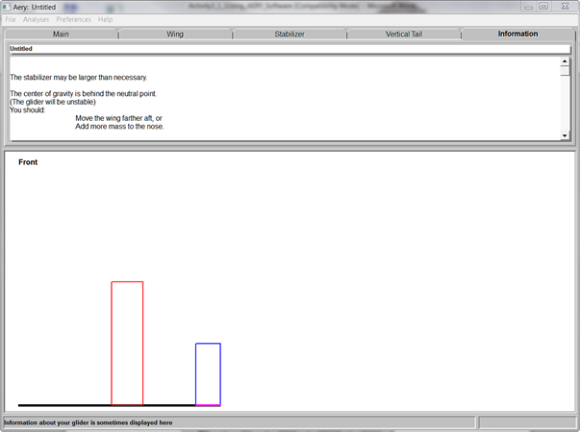
Will it Fly? Analysis
Press F3 or under Analysis
Once you get an AERY number
AND it is stable
Raise Hand

Slide 11
Warm-Up – 1/30 – 10 minutes
Utilizing your notes and past knowledge answer the following questions:
What is the maximum length of the fuselage when designing the glider in the Aery software program?
What is the width of the fuselage when designing the glider in the Aery software program?
What is the overall dimensions of the balsa wood?
What key or menu item would I select to check if my Aery glider would fly?
Besides the fuselage, what are the other three aircraft parts you must design?

Slide 12
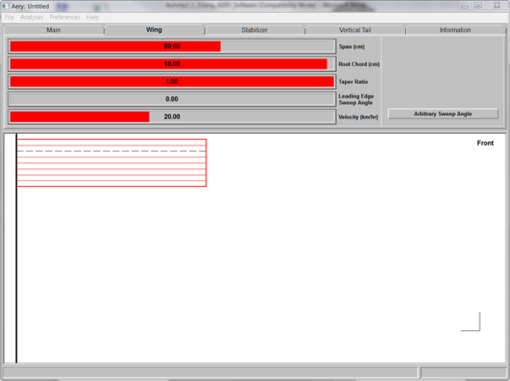
Wing Design Tab

Slide 13
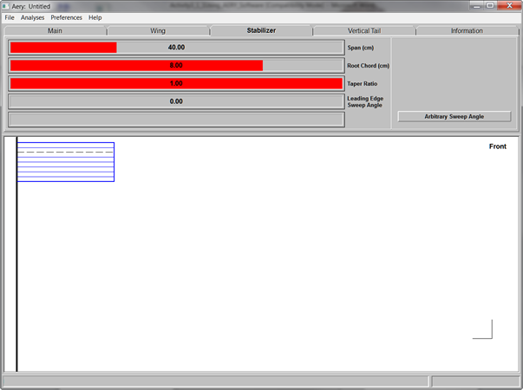
Stabilizer (Horizontal) Design Tab

Slide 14
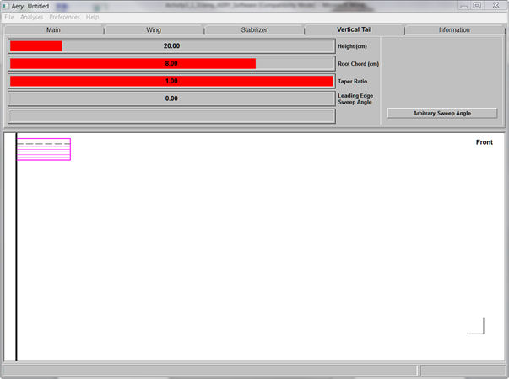
Vertical Tail Design Tab

Slide 15
Questions / Comments

Slide 16
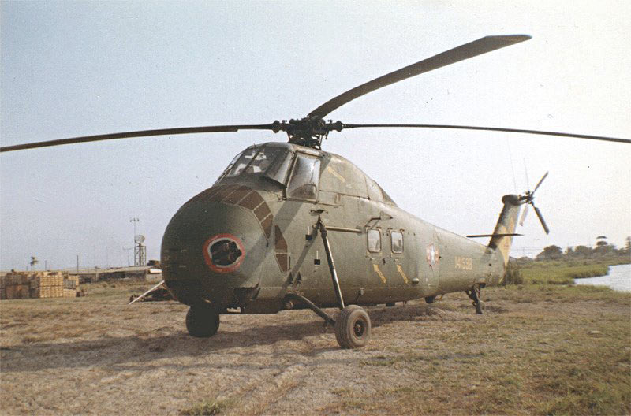
THIS DAY IN AVIATION
January 30
1957 — Sikorsky's HSS-1 (Model S-58) piston-engined helicopter, developed for anti-submarine operations, makes its first flight.

Slide 17
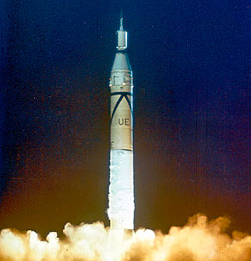
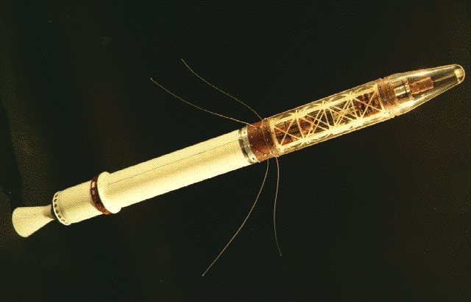
THIS DAY IN AVIATION
January 30
1958 — First United States satellite, “Explorer 1,” launched into orbit.

Slide 18
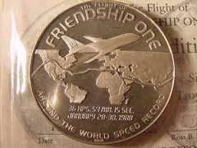
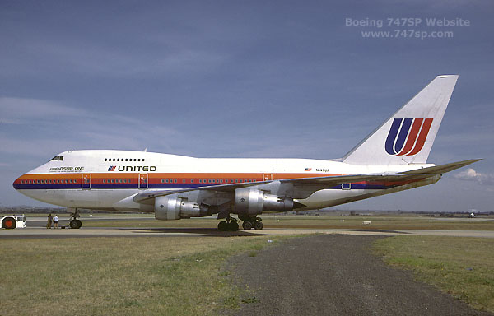
THIS DAY IN AVIATION
January 30
1988 — Boeing's long-range 747SP “Friendship One” returns to Seattle to set a round-the-world record of 36 hours 54 minutes 15 seconds.

Slide 19
Questions / Comments

Slide 20
January 2018
Sunday | Monday | Tuesday | Wednesday | Thursday | Friday | Saturday
 | 1 | 2 | 3 | 4 | 5 | 6
7 | 8 Welcome to Aviation | 9 Parts of an Aircraft Forces of Flight | 10 Flight Control Surfaces Syllabus Due | 11 Aircraft Review | 12 Flight Line Friday Quiz | 13
14 | 15 HOLIDAY | 16 Quiz Review Chapter 1 Intro | 17 Chapter 1 Developing the Airplane | 18 Chapter 1 Wright Brothers | 19 Flight Line Friday Chapter 1 Test | 20
21 | 22 Chapter 2 Development of Aviation in U.S. | 23 Chapter 2 Curtiss | 24 Chapter 2 Vin Fiz Progress Rpts Due | 25 Chapter 2 Progress in Europe | 26 Chapter 2 QUIZ Progress Rpts Sent Home | 27
28 | 29 AERY Software Balsa Glider Construction | 30 Balsa Glider Construction | 31 Balsa Glider Construction | 1 Balsa Glider Construction | 2 Glider Challenge Flight Line Friday | 3

Slide 21
Questions / Comments

Slide 23
Today’s Mission Requirements
Mission:
It is expected that students will:
Describe the requirements for a glider to remain stable in flight.
Design and construct a glider that meets the design requirements provided by the instructor.
EQ:
What factors affect lift and drag?

Slide 24
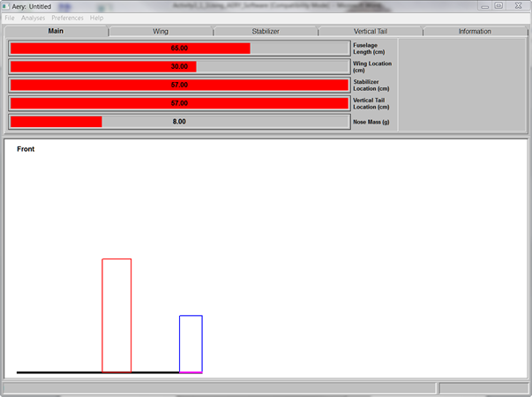
Main Interface Tab

Slide 25
Wing Design Tab

Slide 26
Stabilizer (Horizontal) Design Tab

Slide 27
Vertical Tail Design Tab

Slide 28
Will it Fly? Analysis
Press F3 or under Analysis
Once you get an AERY number
AND it is stable
Raise Hand

Slide 29
Building on a Single Sheet
90 cm
or
36 inch
Fuselage
Wing
Horizontal
Stabilizer
Vertical
Tail
7.5 cm
or
3 inch
Leave extra space at these locations if material allows
Notice the grain direction: Always spanwise!
NOTE: Fuselage can be no LONGER than 35 cm or 12 inch
Can be no WIDER than 2.5 cm or 1 inch

Slide 30
Once it is Stable
Print your plans
Exit to Lab room
Safety Glasses
Model Kit – for Knife
Go to table with cutting board
Ruler
Balsa wood

Slide 31
Aery Software Activity Worksheet
Login to Computer
Go to website – petrucciaviation.weebly.com
Intro to Aviation
Class Materials
Classroom Worksheets
Aery Glider Software
Go to Search bar – bottom of computer
Type in AERY
Launch software

Slide 32
Questions / Comments

Slide 33
Balsa Glider Construction

Slide 34
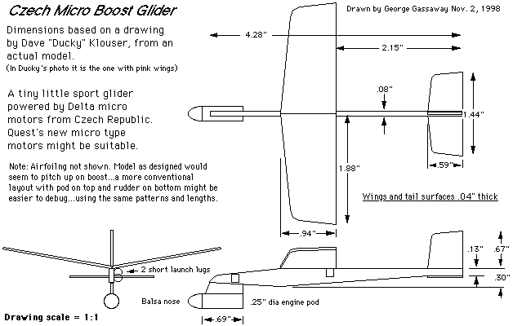
Familiarize Yourself with the Plan
Components
Dimensions
Materials
Outlines vs. cuts

Slide 35
Building on a Single Sheet
Wing
Horizontal
Stabilizer
Vertical
Tail
Leave extra space at these locations if material allows
Notice the grain direction: Always spanwise!

Slide 36
Marking the Fuselage
Cut for Length
Wing
Location
Center
of
Gravity
Horizontal
Stabilizer
Vertical
Tail
Neutral
Point

Slide 37
Cut Out Pieces
Cut the wing
Cut out stabilizers
Sand leading and trailing edges with minimal rounding

Slide 38
Shaping the Wing Profile
Leading edge should have minimal rounding
Trailing edge needs taper on top only
Use sanding block and edge of a solid surface for uniform sanding

Slide 39
Adding the Wing
Center the wing on the fuselage
Glue it on straight and square to the fuselage . . . this is critical

Slide 40
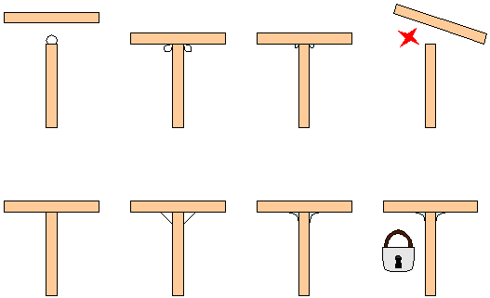
Making a Strong Bond
Avoid typical novice method of applying excessive glue on an edge and sticking material together
Light bond with reinforcing fillets increases the glue surface area and bond strength

Slide 41
Add Horizontal Stabilizer
One piece stabilizer
Stronger
Only possible if mounted somewhere away from vertical stabilizer
Two piece stabilizer
Weaker
Mount anywhere else

Slide 42
Check Alignment
Hold stabilizer on wedge
Ensure from front or back that stabilizer is parallel to wing
If not, sand wedge slightly and recheck

Slide 43
Vertical Stabilizer Side Mount
Requires tail at a completely different location on fuselage from horizontal stabilizer
Glue onto side of fuselage flush with bottom edge and front edge even with vertical tail mark
Front
Back
VT
Side of Fuselage
VT
VT
Top View

Slide 44
Vertical Stabilizer Top Mount
Can be used no matter where tail is located
Draw line down center of fuselage top starting at vertical tail mark
Glue on vertical tail straight and square
Front
Back
VT
Side of Fuselage
VT
Top View
VT
VT

Slide 45
Balance the Glider
Place pencil on table top and put glider on top of it with center of gravity directly over pencil
Add clay to nose until glider balances at the center of gravity

Slide 46
Balance the Glider
Hold glider on fingertips placed at nose and tail
Add clay to wingtips until glider balances at fuselage

Slide 47
SAFETY FIRST.
SAFETY ALWAYS.

Slide 48
Safety Rules – Safety Monitor Brief
Must Use Safety Glasses
Use of Cutting tools is Dangerous – AT ALL TIMES
Must Use Cutting Mats
Extended breathing of adhesives and paint fumes can be dangerous
All Areas will remain clean and organized
Plane Captains will insure All Areas will be cleaned and all items put back in proper locations 10minutes prior to class ending
Class safety monitor will insure areas are clean and safe at all times

Slide 49
Questions / Comments

