Slide 1
Warm-Up – 1/24 – 10 minutes
Utilizing your notes and past knowledge answer the following questions:
Why was Glenn Curtiss known as the “Fastest Man on Earth?”
What was the contribution of Curtiss to the U.S. Army aviation?
Identify the members of the AEA.
Describe the goals of the AEA.
Describe the significant aviation advances in 1910 and the impact.

Slide 2
Questions / Comments

Slide 3
Warm-Up – 1/24 – 10 minutes
Utilizing your notes and past knowledge answer the following questions:
Why was Glenn Curtiss known as the “Fastest Man on Earth?”
What was the contribution of Curtiss to the U.S. Army aviation?
Identify the members of the AEA.
Describe the goals of the AEA.
Describe the significant aviation advances in 1910 and the impact.

Slide 4
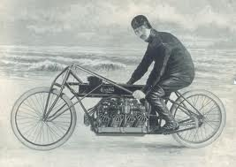
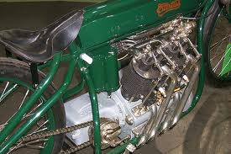
Developments in the U.S.
In 1907, Curtiss became known as the “Fastest Man on Earth”
Raced a motorcycle 136.3mph.
His engines were light and powerful – which caught the interest of Thomas Baldwin – a balloonist.

Slide 5
Warm-Up – 1/24 – 10 minutes
Utilizing your notes and past knowledge answer the following questions:
Why was Glenn Curtiss known as the “Fastest Man on Earth?”
What was the contribution of Curtiss to the U.S. Army aviation?
Identify the members of the AEA.
Describe the goals of the AEA.
Describe the significant aviation advances in 1910 and the impact.

Slide 6
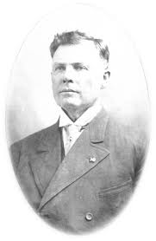
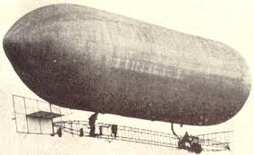
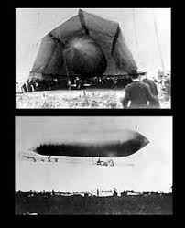
Developments in the U.S.
Baldwin’s airship with the Curtiss engine became the first powered dirigible in the U.S.
Another of Curtiss engines was used to power the first U.S. Army aircraft the dirigible – SC-1

Slide 7
Warm-Up – 1/24 – 10 minutes
Utilizing your notes and past knowledge answer the following questions:
Why was Glenn Curtiss known as the “Fastest Man on Earth?”
What was the contribution of Curtiss to the U.S. Army aviation?
Identify the members of the AEA.
Describe the goals of the AEA.
Describe the significant aviation advances in 1910 and the impact.

Slide 8
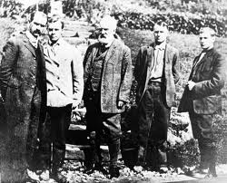
Aerial Experiment Association
Alexander Graham Bell asked Curtiss to join him to help design and develop aircraft and further developments in the aviation industry. (Goal of AEA)
The AEA was formed by Bell, Curtiss, Lt Thomas Selfridge, Baldwin and JohnMcCurdy.

Slide 9
Warm-Up – 1/24 – 10 minutes
Utilizing your notes and past knowledge answer the following questions:
Why was Glenn Curtiss known as the “Fastest Man on Earth?”
What was the contribution of Curtiss to the U.S. Army aviation?
Identify the members of the AEA.
Describe the goals of the AEA.
Describe the significant aviation advances in 1910 and the impact.

Slide 10
Aerial Experiment Association
Alexander Graham Bell asked Curtiss to join him to help design and develop aircraft and further developments in the aviation industry. (Goal of AEA)
The AEA was formed by Bell, Curtiss, Lt Thomas Selfridge, Baldwin and JohnMcCurdy.

Slide 11
Warm-Up – 1/24 – 10 minutes
Utilizing your notes and past knowledge answer the following questions:
Why was Glenn Curtiss known as the “Fastest Man on Earth?”
What was the contribution of Curtiss to the U.S. Army aviation?
Identify the members of the AEA.
Describe the goals of the AEA.
Describe the significant aviation advances in 1910 and the impact.

Slide 12
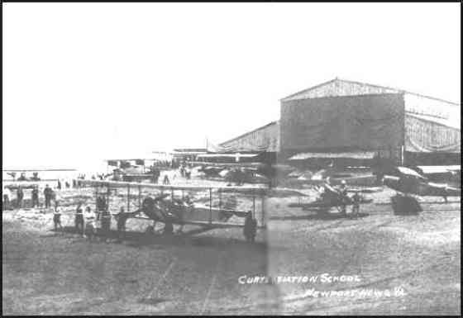
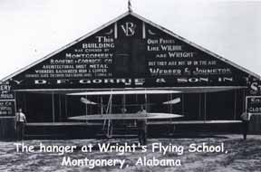
Significant Aviation Advances 1910 and their impact
Wright Brothers and Curtiss both opened flight schools

Slide 13
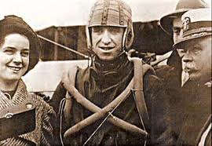
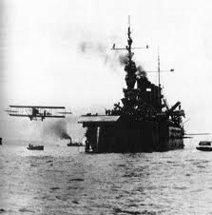
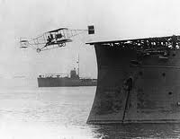
Significant Aviation Advances 1910 and their impact
Eugene Ely makes first flight from deck of USS Birmingham (Hudson Flier) – Hampton Roads, VA

Slide 14
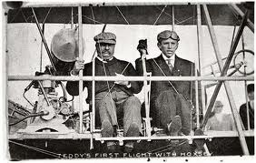
Significant Aviation Advances 1910 and their impact
President Roosevelt became first president to fly (St. Louis, Missouri)

Slide 15
Questions / Comments

Slide 16
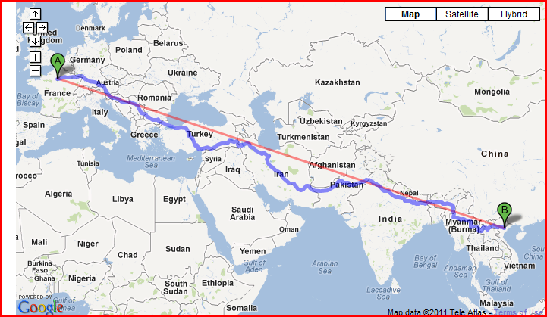
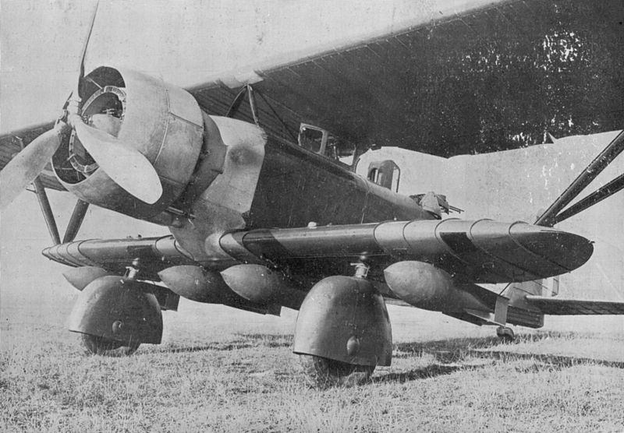
THIS DAY IN AVIATION
January 24
In 1932... French pilots Paul Condos and Henri Robida land in Paris after flying from Hanoi in French Indochina in a record time of 3 days 4 hours.

Slide 17
Questions / Comments

Slide 18
January 2018
Sunday | Monday | Tuesday | Wednesday | Thursday | Friday | Saturday
 | 1 | 2 | 3 | 4 | 5 | 6
7 | 8 Welcome to Aviation | 9 Parts of an Aircraft Forces of Flight | 10 Flight Control Surfaces Syllabus Due | 11 Aircraft Review | 12 Flight Line Friday Quiz | 13
14 | 15 HOLIDAY | 16 Quiz Review Chapter 1 Intro | 17 Chapter 1 Developing the Airplane | 18 Chapter 1 Wright Brothers | 19 Flight Line Friday Chapter 1 Test | 20
21 | 22 Chapter 2 Development of Aviation in U.S. | 23 Chapter 2 Curtiss | 24 Chapter 2 Vin Fiz Progress Rpts Due | 25 Chapter 2 Progress in Europe | 26 Chapter 2 QUIZ Progress Rpts Sent Home | 27
28 | 29 | 30 | 31

Slide 19
3A - Missing Assignments
How Wings Work Worksheet
Syllabus Slip
Aircraft Parts Word Search
Apache
Bulldog
Big Red
Ryder
Black Hawk
Big Red
Due NLT Today

Slide 20
Questions / Comments

Slide 21
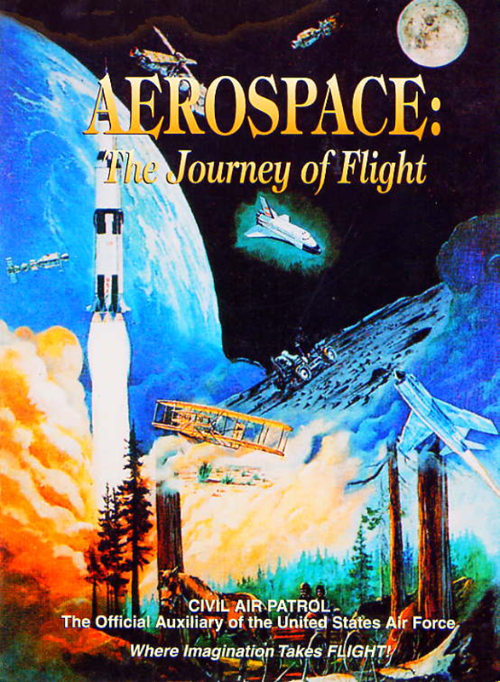
Chapter 2
The Adolescence of Air Power
1904-1919

Slide 22
Today’s Mission Requirements
Mission:
Describe the prize and the rules established for the challenge of the flight across the country.
Identify the type and the name of the aircraft.
Describe the planned course of the flight from coast to coast.
Describe the distance, speed and the time the trip.
Describe Harriet Quimby and her significance to aviation.
EQ:
Describe significant aviation events occurring between 1904-1919 and their impact on future aviation development.

Slide 23
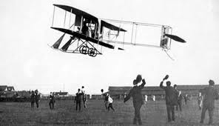
Vin Fiz
Flyer

Slide 24
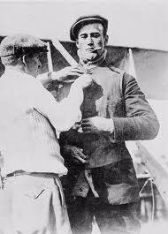
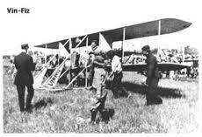
Developments in the U.S.
1911 – William Randolph Hearst – offered $50,000 for flight across U.S.
Must be completed in 30 days
Pilot Calbraith Perry Rodgers persuaded soft drink company “Vin Fiz” to sponsor trip.
The aircraft was a 1911 Wright Flyer Model D called the “Vin Fiz Flyer”

Slide 25
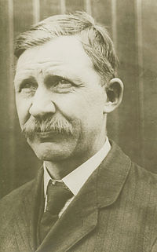
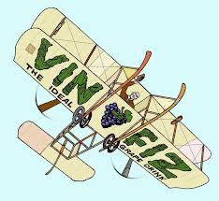
Developments in the U.S.
Wright Brothers mechanic, Charlie Taylor takes on job as mechanic.
Trip was planned from:
New York to Chicago
Kansas City to San Antonio / El Paso
Yuma to Pasadena, CA
Trip was to cover more than 3,390 miles

Slide 26
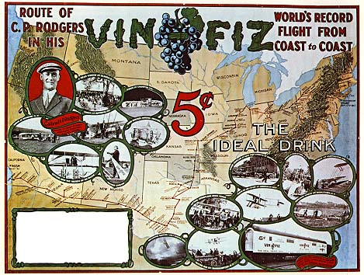

Slide 27
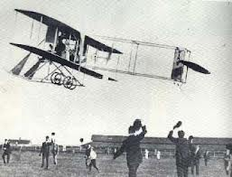
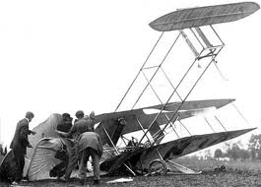
Developments in the U.S.
Due to 40 hp engine – Rodgers knew he could not make it over Rocky Mountains
He started from Long Island, NY
Made over 68 landings
Some severe
Only parts to make entire trip were rudder and 1 strut

Slide 28
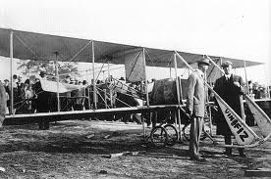
Development in the U.S.
Rodgers actual trip
4,251 miles
Longest flight 133 miles
Average speed 52 mph
Flight lasted 49 days
Did NOT receive prize but made the first airplane crossing of the United States

Slide 29
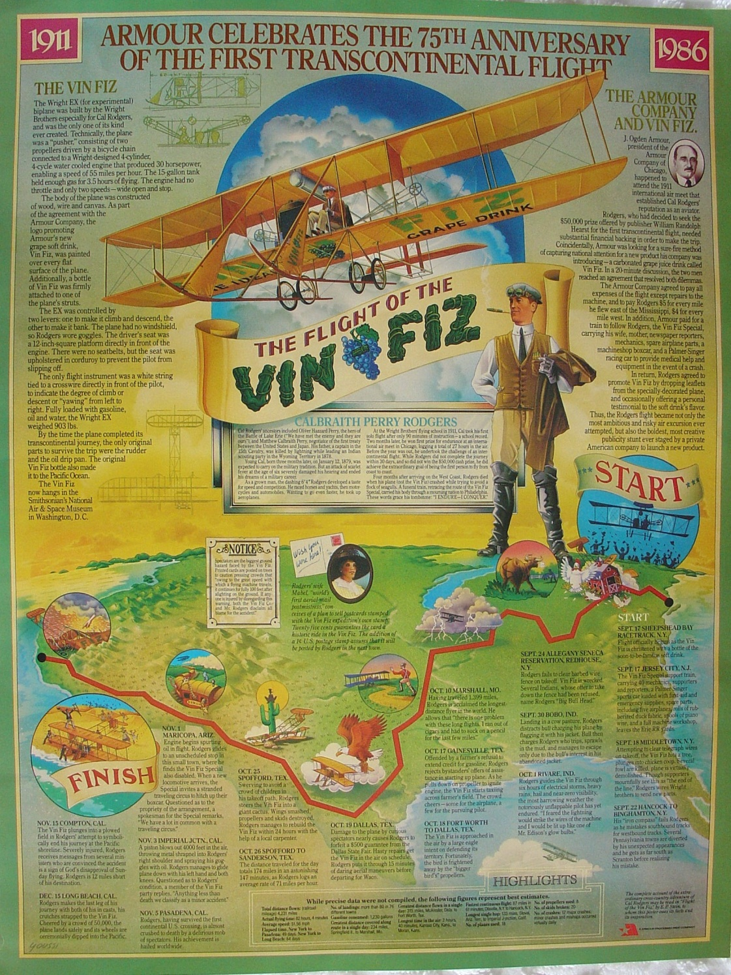
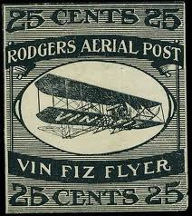

Slide 30
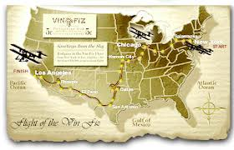
Development in the U.S.
Significance of trip
No landing fields
No advance weather information
No special instruments
Supplies
facilities

Slide 31
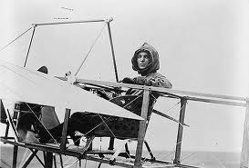
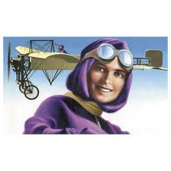
Harriet
Quimby

Slide 32
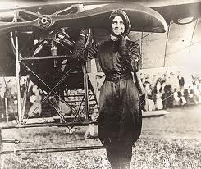
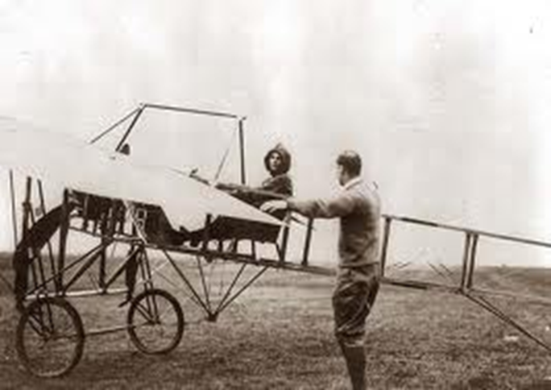
Development in the U.S.
Harriet Quimby in Aug 1911 became America’s first licensed pilot
She used her writing talents to urge country to give more attention to commercial aviation and aeronautical development

Slide 33
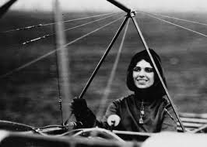
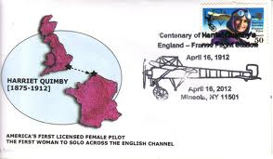
Development in the U.S.
She became first woman to fly solo across English Channel
Making the flight in 30 minutes

Slide 34
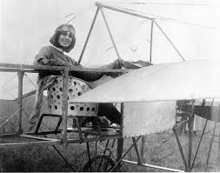
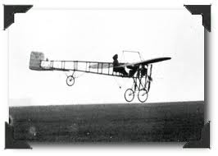
Development in the U.S.
June 1912
Flying at the Harvard-Boston Aviation Meet over Boston Harbor
Lost control of Bleriot monoplane
She and her passenger fell to their deaths

Slide 35
Questions / Comments

Slide 36
Today’s Mission Requirements
Mission:
Describe the prize and the rules established for the challenge of the flight across the country.
Identify the type and the name of the aircraft.
Describe the planned course of the flight from coast to coast.
Describe the distance, speed and the time the trip.
Describe Harriet Quimby and her significance to aviation.
EQ:
Describe significant aviation events occurring between 1904-1919 and their impact on future aviation development.

Slide 37
Developments in the U.S.
1911 – William Randolph Hearst – offered $50,000 for flight across U.S.
Must be completed in 30 days
Pilot Calbraith Perry Rodgers persuaded soft drink company “Vin Fiz” to sponsor trip.
The aircraft was a 1911 Wright Flyer Model D at is called the “Vin Fiz Flyer”

Slide 38
Today’s Mission Requirements
Mission:
Describe the prize and the rules established for the challenge of the flight across the country.
Identify the type and the name of the aircraft.
Describe the planned course of the flight from coast to coast.
Describe the distance, speed and the time the trip.
Describe Harriet Quimby and her significance to aviation.
EQ:
Describe significant aviation events occurring between 1904-1919 and their impact on future aviation development.

Slide 39
Developments in the U.S.
1911 – William Randolph Hearst – offered $50,000 for flight across U.S.
Must be completed in 30 days
Pilot Calbraith Perry Rodgers persuaded soft drink company “Vin Fiz” to sponsor trip.
The aircraft was a 1911 Wright Flyer Model D called the “Vin Fiz Flyer”

Slide 40
Today’s Mission Requirements
Mission:
Describe the prize and the rules established for the challenge of the flight across the country.
Identify the type and the name of the aircraft.
Describe the planned course of the flight from coast to coast.
Describe the distance, speed and the time the trip.
Describe Harriet Quimby and her significance to aviation.
EQ:
Describe significant aviation events occurring between 1904-1919 and their impact on future aviation development.

Slide 41
Developments in the U.S.
Wright Brothers mechanic, Charlie Taylor takes on job.
Trip was planned from:
New York to Chicago
Kansas City to San Antonio / El Paso
Yuma to Pasadena, CA
Trip was to cover more than 3,390 miles

Slide 42
Today’s Mission Requirements
Mission:
Describe the prize and the rules established for the challenge of the flight across the country.
Identify the type and the name of the aircraft.
Describe the planned course of the flight from coast to coast.
Describe the distance, speed and the time the trip.
Describe Harriet Quimby and her significance to aviation.
EQ:
Describe significant aviation events occurring between 1904-1919 and their impact on future aviation development.

Slide 43
Development in the U.S.
Rodgers actual trip
4,251 miles
Longest flight 133 miles
Average speed 52 mph
Flight lasted 49 days
Did NOT receive prize but made the first airplane crossing of the United States

Slide 44
Today’s Mission Requirements
Mission:
Describe the prize and the rules established for the challenge of the flight across the country.
Identify the type and the name of the aircraft.
Describe the planned course of the flight from coast to coast.
Describe the distance, speed and the time the trip.
Describe Harriet Quimby and her significance to aviation.
EQ:
Describe significant aviation events occurring between 1904-1919 and their impact on future aviation development.

Slide 45
Development in the U.S.
Harriet Quimby in Aug 1911 became America’s first licensed pilot
She used her writing talents to urge country to give more attention to commercial aviation and aeronautical development

Slide 46
Development in the U.S.
She became first woman to fly solo across English Channel
Making the flight in 30 minutes

Slide 47
Questions / Comments

Slide 48
SAFETY FIRST.
SAFETY ALWAYS.

Slide 49
Model Building Grading Rubic
Each Group MUST follow all directions
STOP! - If you are unsure
SAFETY at ALL Times
Accuracy and Authenticity will be judged
Each Group Member is responsible to produce a 2 page paper on the model.
Aircraft Specifications
Aircraft contribution to Aviation development
Significant Aviation Pioneers associated with aircraft (pilots, inventors etc.)
The Group will provide a Presentation on the model.
5to 7 slides (Title slide; Body; Summary Slide)

Slide 50
Safety Rules – Safety Monitor Brief
Must Use Safety Glasses
Use of Cutting tools is Dangerous – AT ALL TIMES
Must Use Cutting Mats
Extended breathing of adhesives and paint fumes can be dangerous
May use vinyl gloves

Slide 51
Safety Rules – Safety Monitor Brief
Do not wash paint brushes in sink
Do not pour paint or thinner down drain
Only use paint thinner to clean brushes
May use Acetone to remove Super Glue or glue
Only use spray paint outside and on cardboard to avoid overspray.

Slide 52
SAFETY FIRST.
SAFETY ALWAYS.

Slide 53
Safety Rules – Safety Monitor Brief
Be sure to read all model instructions.
All Areas will remain clean and organized
Plane Captains will insure All Areas will be cleaned and all items put back in proper locations 10minutes prior to class ending
Class safety monitor will insure areas are clean and safe at all times
Class Leader insure hangar is clean before class dismissed

Slide 54
SAFETY FIRST.
SAFETY ALWAYS.

Slide 55
Questions / Comments

Slide 56
Lesson Closure - 3 – 2 - 1
3. List 3 things you learned today.
2. List 2 things you have questions about today’s lesson.
1. Create (1) quiz question with answer about today’s lesson.

Slide 57
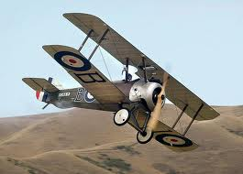
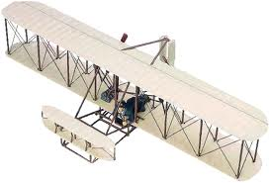
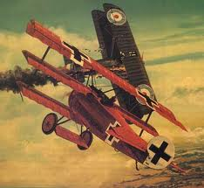

Slide 58
Questions / Comments

Slide 59
Safety Rules – Safety Monitor Brief
Must Use Safety Glasses
Use of Cutting tools is Dangerous – AT ALL TIMES
Must Use Cutting Mats
Extended breathing of adhesives and paint fumes can be dangerous
All Areas will remain clean and organized
Plane Captains will insure All Areas will be cleaned and all items put back in proper locations 10minutes prior to class ending
Class safety monitor will insure areas are clean and safe at all times

Slide 60
Questions / Comments

Slide 62
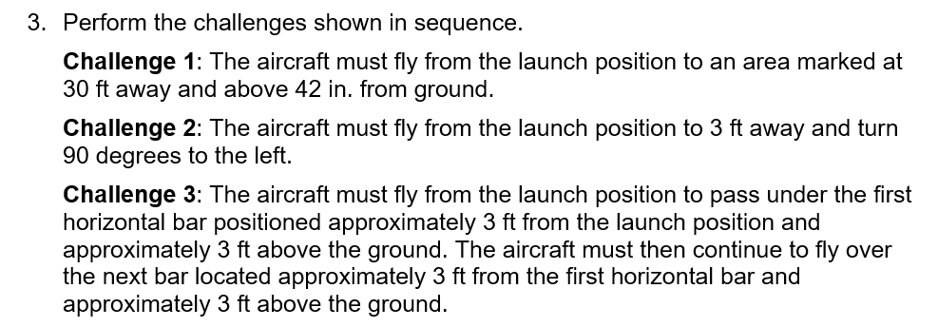

Slide 63
