Slide 1
Warm-Up – 1/12 – 10 minutes
Utilizing your notes and past knowledge answer the following questions:
What are the three axes of flight?
What flight control surface(s) are used to roll an aircraft?
What flight control surface(s) is used to pitch an aircraft?
What flight control surface(s) is used to yaw an aircraft?
What are the four forces of flight?

Slide 2
Questions / Comments

Slide 3
Warm-Up – 1/12 – 10 minutes
Utilizing your notes and past knowledge answer the following questions:
What are the three axes of flight?
What flight control surface(s) are used to roll an aircraft?
What flight control surface(s) is used to pitch an aircraft?
What flight control surface(s) is used to yaw an aircraft?
What are the four forces of flight?

Slide 4
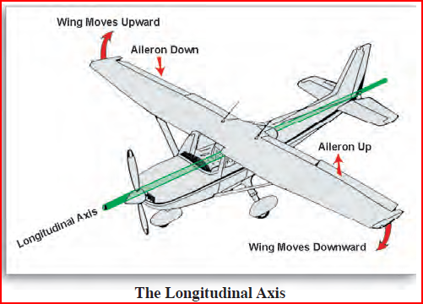
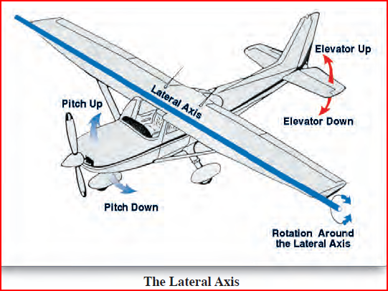
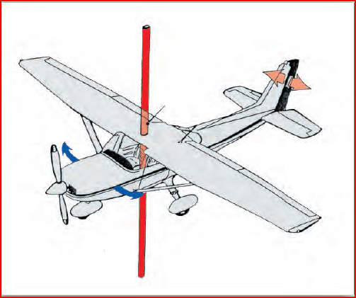
The Axes of Flight
The axes of flight are:
Longitudinal (Roll)
Axis from tip of nose to tip of tail – ROLL
Lateral (Pitch)
Axis from one wingtip to other wingtip – PITCH
Vertical (Yaw)
Axis vertically through meeting point of the longitudinal and lateral axes. – YAW

Slide 5
Warm-Up – 1/12 – 10 minutes
Utilizing your notes and past knowledge answer the following questions:
What are the three axes of flight?
What flight control surface(s) are used to roll an aircraft?
What flight control surface(s) is used to pitch an aircraft?
What flight control surface(s) is used to yaw an aircraft?
What are the four forces of flight?

Slide 6
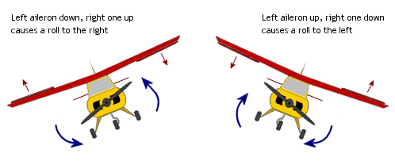
Ailerons
Are hinged, horizontal surfaces attached to the back (trailing edge), outer edges of the wings of the plane.
Used to turn the plane. (ROLL) – Longitudinal Axis
As one aileron rises, the opposite aileron lowers, raising one wing and lowering the other, tilting (or banking) the plane toward the lower aileron.

Slide 7
Warm-Up – 1/12 – 10 minutes
Utilizing your notes and past knowledge answer the following questions:
What are the three axes of flight?
What flight control surface(s) are used to roll an aircraft?
What flight control surface(s) is used to pitch an aircraft?
What flight control surface(s) is used to yaw an aircraft?
What are the four forces of flight?

Slide 8
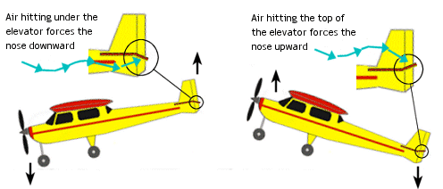
Elevators
Are hinged, horizontal surfaces attached to the trailing edge of the horizontal stabilizer.
Control the plane’s movement upward or downward. (PITCH) – Lateral Axis
When the elevators are raised, the tail is forced downward, the wings are forced upward, and the plane climbs.

Slide 9
Warm-Up – 1/12 – 10 minutes
Utilizing your notes and past knowledge answer the following questions:
What are the three axes of flight?
What flight control surface(s) are used to roll an aircraft?
What flight control surface(s) is used to pitch an aircraft?
What flight control surface(s) is used to yaw an aircraft?
What are the four forces of flight?

Slide 10
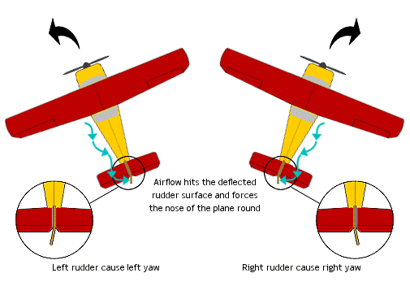
Rudder
A hinged, vertical surface attached to the trailing edge of the vertical stabilizer (tail of the plane).
Helps the plane enter and recover from turns by swinging the tail to the left or right. (YAW) – Vertical Axis

Slide 11
Warm-Up – 1/12 – 10 minutes
Utilizing your notes and past knowledge answer the following questions:
What are the three axes of flight?
What flight control surface(s) are used to roll an aircraft?
What flight control surface(s) is used to pitch an aircraft?
What flight control surface(s) is used to yaw an aircraft?
What are the four forces of flight?

Slide 12
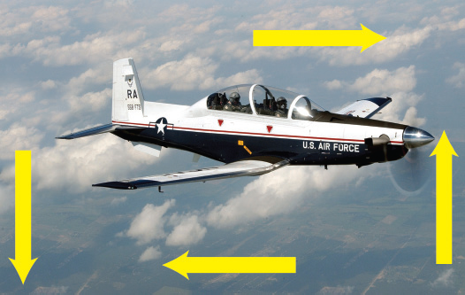
THRUST
GRAVITY
LIFT
DRAG

Slide 13
Questions / Comments

Slide 14
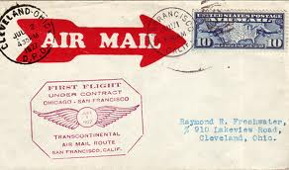
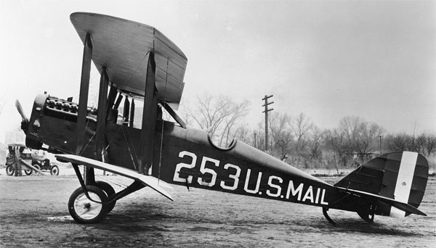
THIS DAY IN AVIATION
January 12
1929 — The first United States Air Mail stamped envelopes are available for sale.

Slide 15
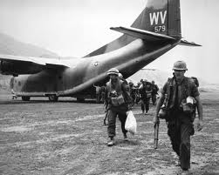
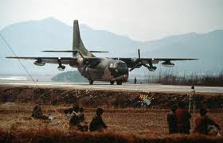
THIS DAY IN AVIATION
January 12
1962 — The USAF begins “Operation Ranch Hand” in Vietnam, C-123s spray defoliants.

Slide 16
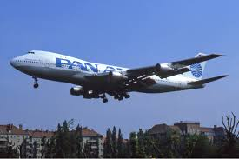
THIS DAY IN AVIATION
January 12
1970 — Pan Am Boeing 747, on a proving flight from New York, is the first wide-bodied airliner to make a landing at Heathrow Airport in London.

Slide 17
Questions / Comments

Slide 18
January 2018
Sunday | Monday | Tuesday | Wednesday | Thursday | Friday | Saturday
 | 1 | 2 | 3 | 4 | 5 | 6
7 | 8 Welcome to Aviation | 9 Parts of an Aircraft Forces of Flight | 10 Flight Control Surfaces Syllabus Due | 11 Aircraft Review | 12 Flight Line Friday Quiz | 13
14 | 15 HOLIDAY | 16 Quiz Review Chapter 1 Intro | 17 Chapter 1 Developing the Airplane | 18 Chapter 1 Wright Brothers | 19 Flight Line Friday Chapter 1 Test | 20
21 | 22 Chapter 2 Development of Aviation in U.S. | 23 Chapter 2 Curtiss | 24 Chapter 2 Vin Fiz Progress Rpts Due | 25 Chapter 2 Progress in Europe | 26 Chapter 2 QUIZ Progress Rpts Sent Home | 27
28 | 29 | 30 | 31

Slide 19
Questions / Comments

Slide 20
Quick Review

Slide 21
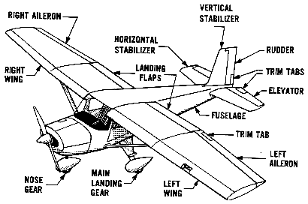
Basic Airplane and its Parts
EMPENNAGE

Slide 22
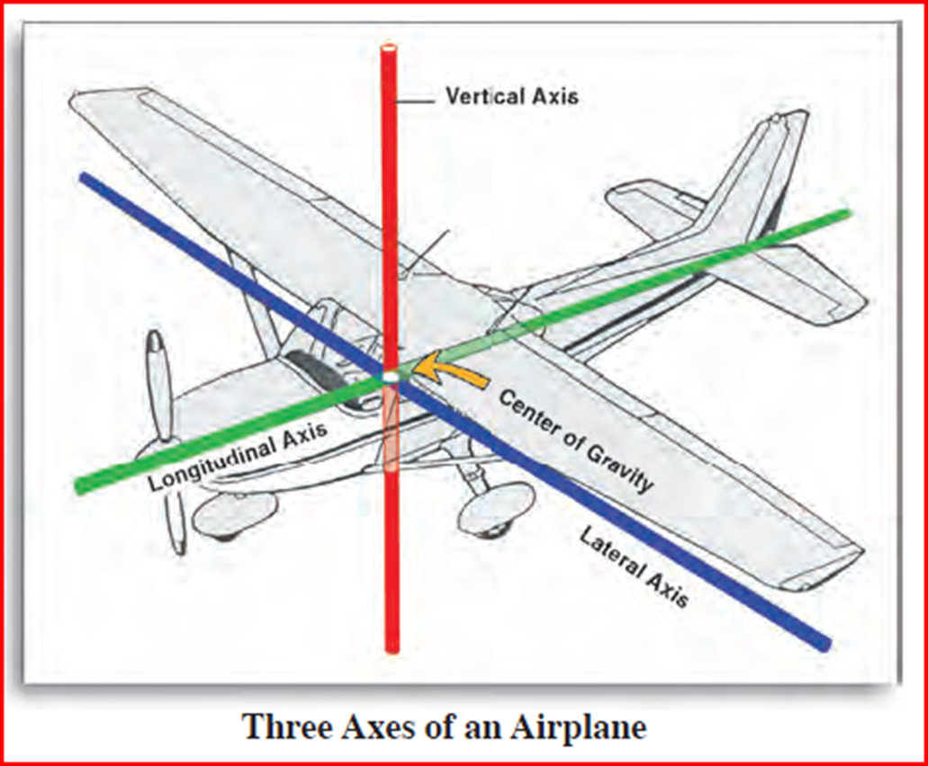

Slide 23
The Axes of Flight
The axes of flight are:
Longitudinal (Roll)
Axis from tip of nose to tip of tail – ROLL
Lateral (Pitch)
Axis from one wingtip to other wingtip – PITCH
Vertical (Yaw)
Axis vertically through meeting point of the longitudinal and lateral axes. – YAW

Slide 24
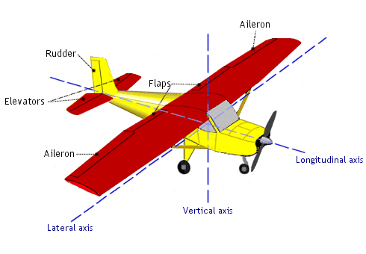
Flight Control Surfaces

Slide 25
Flight Control Surfaces
Action: | Axis: | Controlled by:
Roll | Longitudinal | Ailerons
Pitch | Lateral | Elevators
Yaw | Vertical | Rudder

Slide 26
Flight Control Surfaces
Action: | Axis: | Controlled by:
Roll | Longitudinal | Ailerons
Pitch | Lateral | Elevators
Yaw | Vertical | Rudder

Slide 27
Flight Control Surfaces
Action: | Axis: | Controlled by:
Roll | Longitudinal | Ailerons
Pitch | Lateral | Elevators
Yaw | Vertical | Rudder

Slide 28
Flight Control Surfaces
Action: | Axis: | Controlled by:
Roll | Longitudinal | Ailerons
Pitch | Lateral | Elevators
Yaw | Vertical | Rudder

Slide 29
Flight Control Surfaces
Action: | Axis: | Controlled by:
Roll | Longitudinal | Ailerons
Pitch | Lateral | Elevators
Yaw | Vertical | Rudder

Slide 30
Flight Control Surfaces
Action: | Axis: | Controlled by:
Roll | Longitudinal | Ailerons
Pitch | Lateral | Elevators
Yaw | Vertical | Rudder

Slide 31
Flight Control Surfaces
Action: | Axis: | Controlled by:
Roll | Longitudinal | Ailerons
Pitch | Lateral | Elevators
Yaw | Vertical | Rudder

Slide 32
Flight Control Surfaces
Action: | Axis: | Controlled by:
Roll | Longitudinal | Ailerons
Pitch | Lateral | Elevators
Yaw | Vertical | Rudder

Slide 33
Flight Control Surfaces
Action: | Axis: | Controlled by:
Roll | Longitudinal | Ailerons
Pitch | Lateral | Elevators
Yaw | Vertical | Rudder

Slide 34
Flight Control Surfaces
Action: | Axis: | Controlled by:
Roll | Longitudinal | Ailerons
Pitch | Lateral | Elevators
Yaw | Vertical | Rudder

Slide 35
Flight Control Surfaces
Action: | Axis: | Controlled by:
Roll | Longitudinal | Ailerons
Pitch | Lateral | Elevators
Yaw | Vertical | Rudder

Slide 36
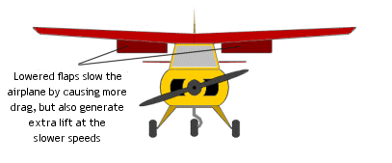
Flaps

Slide 37
THRUST
GRAVITY
LIFT
DRAG

Slide 38
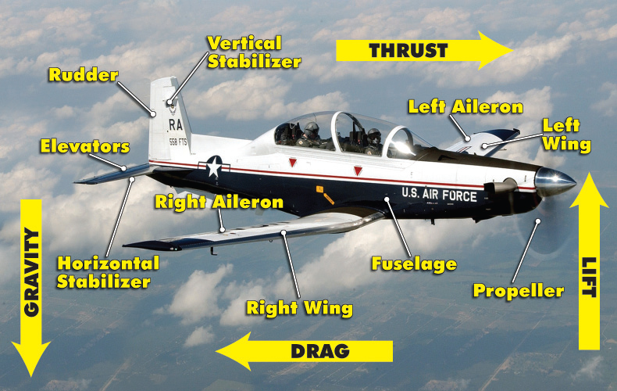

Slide 39
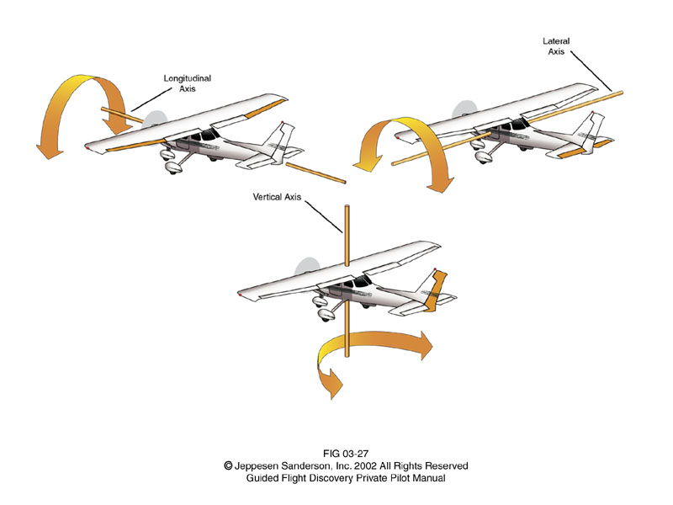
Aircraft Motion and Control
Axis | Motion | Stabilized by | Control | Pilot Control
Longitudinal | Roll | Wings | Aileron | Yoke twist left or right
Lateral | Pitch | Horizontal stabilizer | Elevator | Yoke forward or aft
Vertical | Yaw | Vertical stabilizer | Rudder | Rudder pedals
Roll
Lateral
Axis
Pitch
Longitudinal
Axis
Yaw
Vertical
Axis

Slide 40
STICK / YOKE | FLT CONTROL (UP / DOWN) (LEFT / RIGHT) | AIRCRAFT ACTION
MOVE RIGHT | RIGHT AILERON UP LEFT AILERON DOWN | ROLL RIGHT / LEFT
MOVE LEFT | RIGHT AILERON DOWN LEFT AILERON UP | ROLL RIGHT / LEFT
MOVE FORWARD | ELEVATORS DOWN | PITCH UP / DOWN
MOVE BACK | ELEVATORS UP | PITCH UP / DOWN
RIGHT PEDAL FWD | RUDDER RIGHT | YAW RIGHT / LEFT
LEFT PEDAL FWD | RUDDER LEFT | YAW RIGHT / LEFT

Slide 41
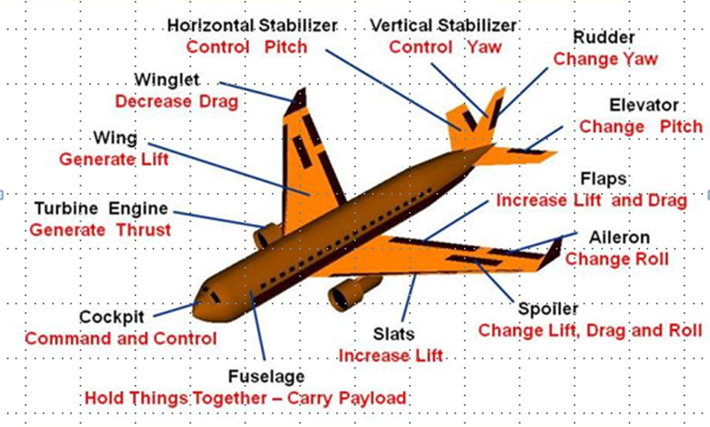
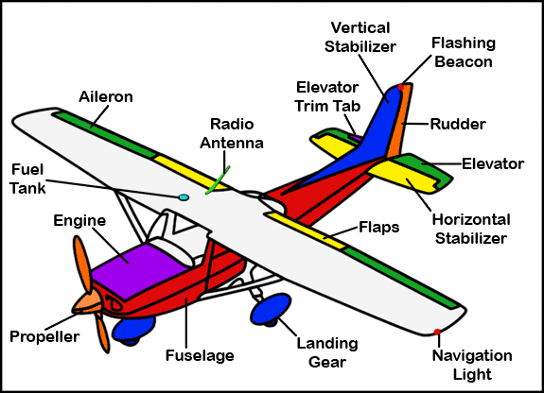
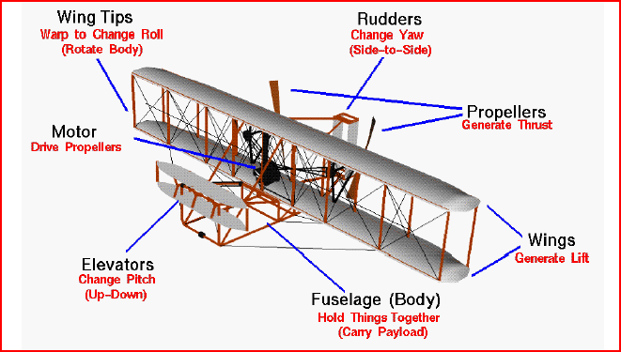
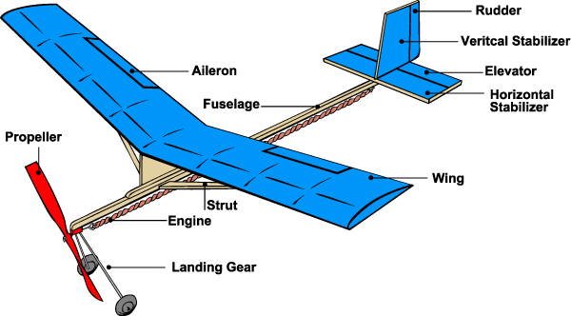
Aircraft in Motion

Slide 42
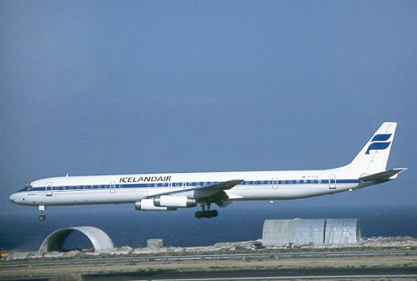
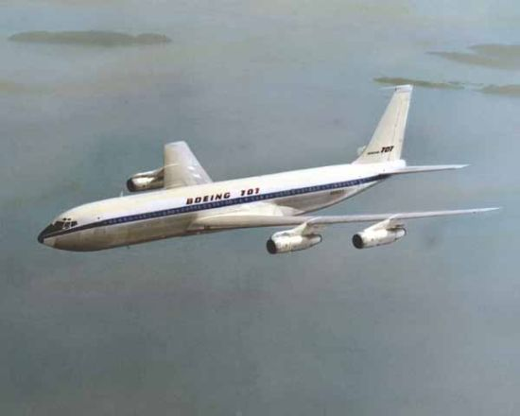
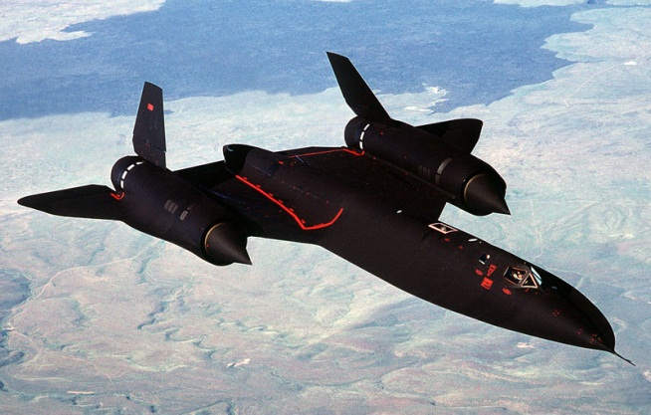
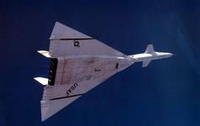
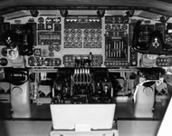
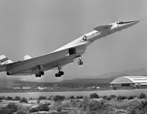
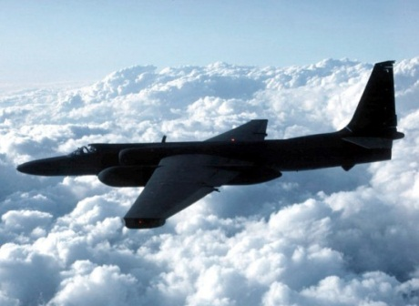
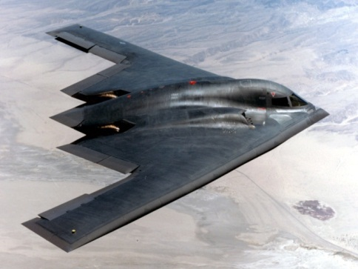
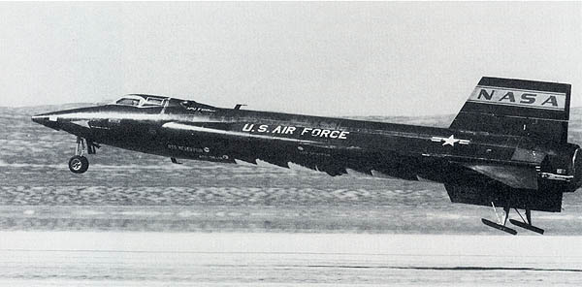
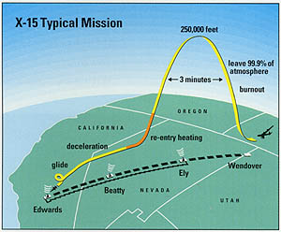
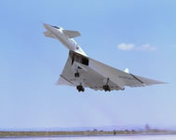
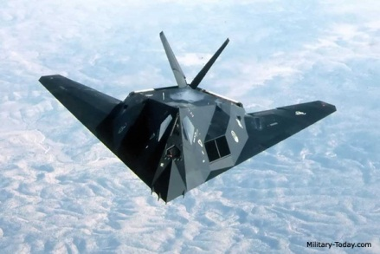
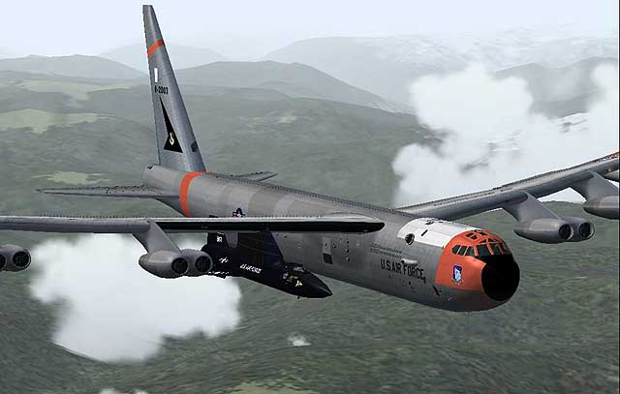
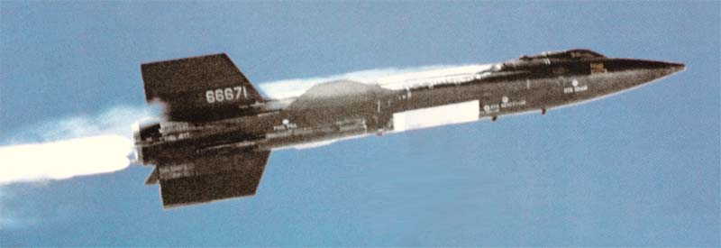
Aircraft Parts
Axis of Flight
and
Flight Control Surfaces
Quiz

Slide 43
SAFETY FIRST.
SAFETY ALWAYS.

Slide 44
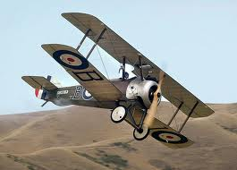
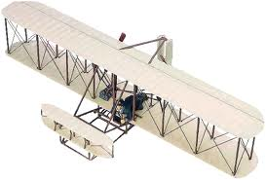
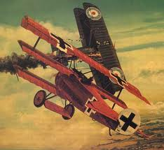

Slide 45
Safety Rules – Safety Monitor Brief
Must Use Safety Glasses
Use of Cutting tools is Dangerous – AT ALL TIMES
Must Use Cutting Mats
Extended breathing of adhesives and paint fumes can be dangerous
May use vinyl gloves

Slide 46
Safety Rules – Safety Monitor Brief
Do not wash paint brushes in sink
Do not pour paint or thinner down drain
Only use paint thinner to clean brushes
May use Acetone to remove Super Glue or glue
Only use spray paint outside and on cardboard to avoid overspray.
Must use dust mask when using spray paint.

Slide 47
Safety Rules – Safety Monitor Brief
Be sure to read all model instructions.
All Areas will remain clean and organized
Plane Captains will insure All Areas will be cleaned and all items put back in proper locations 10minutes prior to class ending
Class safety monitor will insure areas are clean and safe at all times
Class Leader insure hangar is clean before class dismissed

Slide 48
SAFETY FIRST.
SAFETY ALWAYS.

Slide 49
Model Building Grading Rubic
Each Group MUST follow all directions
STOP! - If you are unsure
SAFETY at ALL Times
Accuracy and Authenticity will be judged
Each Group Member is responsible to produce a 2 page paper on the model.
Aircraft Specifications
Aircraft contribution to Aviation development
Significant Aviation Pioneers associated with aircraft (pilots, inventors etc.)
The Group will provide a Presentation on the model.
5to 7 slides (Title slide; Body; Summary Slide)
Group will grade team members

Slide 50
Questions / Comments

Slide 51
MODEL SAFETY
QUIZ
SAFETY ALWAYS.

Slide 52
SAFETY FIRST.
SAFETY ALWAYS.

Slide 53
Questions / Comments

Slide 54
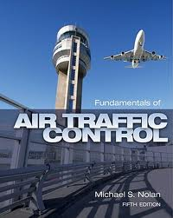
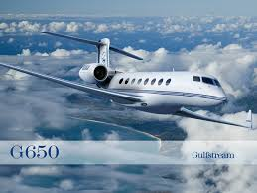

Slide 55
