Slide 1
Warm-Up – 2/1 – 10 minutes
Utilizing your notes and past knowledge answer the following questions:
What must be worn at all times when working in the lab?
What must be placed on the work tables prior to using the knives?
What are the five items which must be marked on the fuselage?
Why is it critical for the wing and stabilizer to be centered on the fuselage?
Once the Center of Gravity (COG) is determined, what is placed on the nose to assist in balanced flight?

Slide 2
Questions / Comments

Slide 3
Warm-Up – 2/1 – 10 minutes
Utilizing your notes and past knowledge answer the following questions:
What must be worn at all times when working in the lab?
What must be placed on the work tables prior to using the knives?
What are the five items which must be marked on the fuselage?
Why is it critical for the wing and stabilizer to be centered on the fuselage?
Once the Center of Gravity (COG) is determined, what is placed on the nose to assist in balanced flight?

Slide 4
Safety Rules – Safety Monitor Brief
Must Use Safety Glasses
Use of Cutting tools is Dangerous – AT ALL TIMES
Must Use Cutting Mats
Extended breathing of adhesives and paint fumes can be dangerous
All Areas will remain clean and organized
Plane Captains will insure All Areas will be cleaned and all items put back in proper locations 10minutes prior to class ending
Class safety monitor will insure areas are clean and safe at all times

Slide 5
Warm-Up – 2/1 – 10 minutes
Utilizing your notes and past knowledge answer the following questions:
What must be worn at all times when working in the lab?
What must be placed on the work tables prior to using the knives?
What are the five items which must be marked on the fuselage?
Why is it critical for the wing and stabilizer to be centered on the fuselage?
Once the Center of Gravity (COG) is determined, what is placed on the nose to assist in balanced flight?

Slide 6
Safety Rules – Safety Monitor Brief
Must Use Safety Glasses
Use of Cutting tools is Dangerous – AT ALL TIMES
Must Use Cutting Mats
Extended breathing of adhesives and paint fumes can be dangerous
All Areas will remain clean and organized
Plane Captains will insure All Areas will be cleaned and all items put back in proper locations 10minutes prior to class ending
Class safety monitor will insure areas are clean and safe at all times

Slide 7
Warm-Up – 2/1 – 10 minutes
Utilizing your notes and past knowledge answer the following questions:
What must be worn at all times when working in the lab?
What must be placed on the work tables prior to using the knives?
What are the five items which must be marked on the fuselage?
Why is it critical for the wing and stabilizer to be centered on the fuselage?
Once the Center of Gravity (COG) is determined, what is placed on the nose to assist in balanced flight?

Slide 8
Marking the Fuselage
Cut for Length
Wing
Location
Center
of
Gravity
Horizontal
Stabilizer
Vertical
Tail
Neutral
Point

Slide 9
Warm-Up – 2/1 – 10 minutes
Utilizing your notes and past knowledge answer the following questions:
What must be worn at all times when working in the lab?
What must be placed on the work tables prior to using the knives?
What are the five items which must be marked on the fuselage?
Why is it critical for the wing and stabilizer to be centered on the fuselage?
Once the Center of Gravity (COG) is determined, what is placed on the nose to assist in balanced flight?

Slide 10
Adding the Wing
Center the wing on the fuselage
Glue it on straight and square to the fuselage . . . this is critical

Slide 11
Warm-Up – 2/1 – 10 minutes
Utilizing your notes and past knowledge answer the following questions:
What must be worn at all times when working in the lab?
What must be placed on the work tables prior to using the knives?
What are the five items which must be marked on the fuselage?
Why is it critical for the wing and stabilizer to be centered on the fuselage?
Once the Center of Gravity (COG) is determined, what is placed on the nose to assist in balanced flight?

Slide 12
Balance the Glider
Place pencil on table top and put glider on top of it with center of gravity directly over pencil
Add clay to nose until glider balances at the center of gravity

Slide 13
Questions / Comments

Slide 14
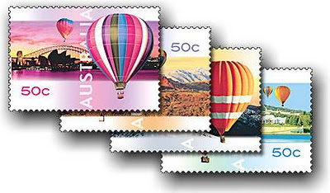
THIS DAY IN AVIATION
February 1
In 1851... Englishman William Dean makes the first balloon ascent in Australia, flying the Australasia for about 7 miles over Melbourne.

Slide 15
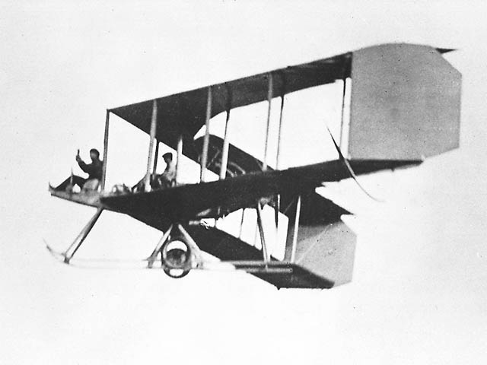
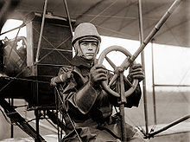
THIS DAY IN AVIATION
February 1
In 1911... Burgess and Curtiss become the US's first licensed aircraft manufacturer.

Slide 16
THIS DAY IN AVIATION
February 1
In 1929... The aviation and space operations of Boeing and Pratt & Whitney are merged to form the United Aircraft & Transport Corp.
This united business interests in all aspects of aviation—a combination of aircraft engine and airframe manufacturer and airline business, to serve all aviation markets, both civil aviation (cargo, passenger, private, air mail) and military aviation.

Slide 17
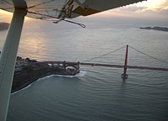
THIS DAY IN AVIATION
February 1
In 1930... San Francisco's first air ferry service starts to operate, cutting journey time across the Bay to 6 minutes. The ferry flies from San Francisco to Alameda, and from Oakland to Vallejo.

Slide 18
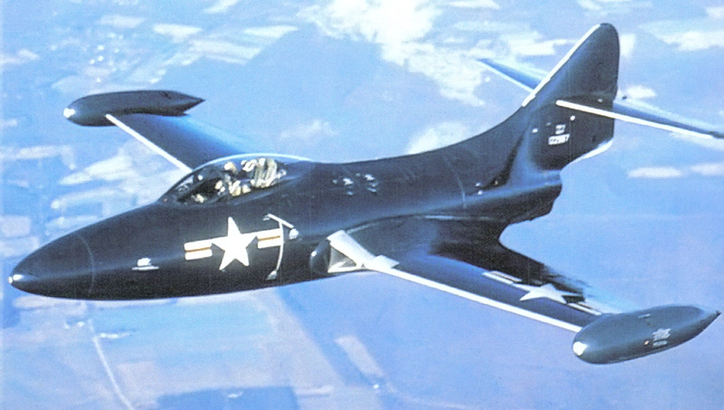
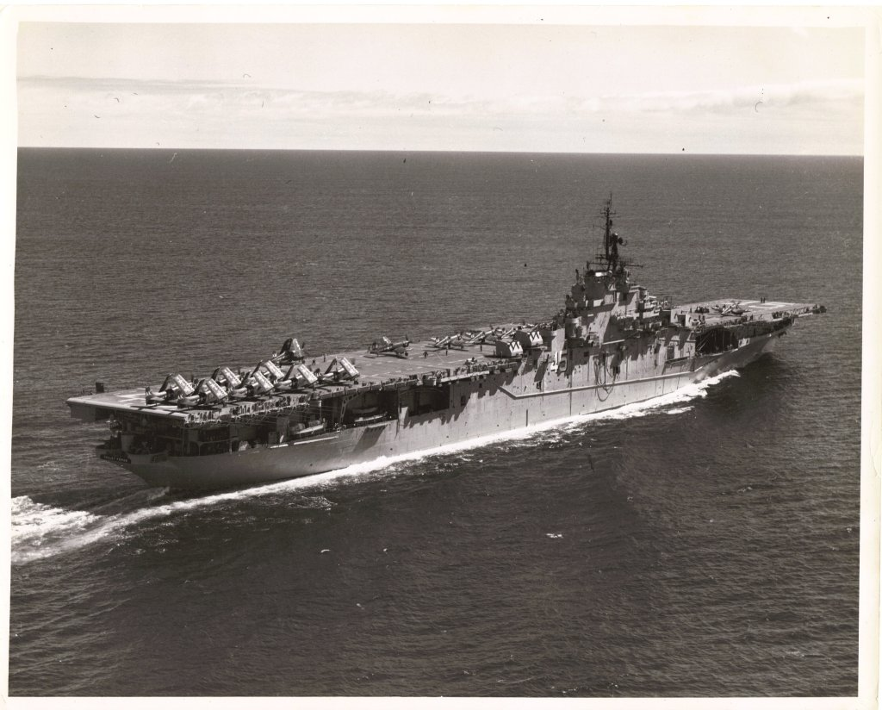
THIS DAY IN AVIATION
February 1
In 1950... Eight Grumman F9F Panthers land on the USS Valley Forge to complete the first aircraft carrier night landing trials by jets.

Slide 19
Questions / Comments

Slide 20
January/February 2018
Sunday | Monday | Tuesday | Wednesday | Thursday | Friday | Saturday
 | 1 | 2 | 3 | 4 | 5 | 6
7 | 8 Welcome to Aviation | 9 Parts of an Aircraft Forces of Flight | 10 Flight Control Surfaces Syllabus Due | 11 Aircraft Review | 12 Flight Line Friday Quiz | 13
14 | 15 HOLIDAY | 16 Quiz Review Chapter 1 Intro | 17 Chapter 1 Developing the Airplane | 18 Chapter 1 Wright Brothers | 19 Flight Line Friday Chapter 1 Test | 20
21 | 22 Chapter 2 Development of Aviation in U.S. | 23 Chapter 2 Curtiss | 24 Chapter 2 Vin Fiz Progress Rpts Due | 25 Chapter 2 Progress in Europe | 26 Chapter 2 QUIZ Progress Rpts Sent Home | 27
28 | 29 AERY Software Balsa Glider Construction | 30 Balsa Glider Construction | 31 Balsa Glider Construction | 1 Balsa Glider Construction | 2 Glider Challenge Flight Line Friday | 3

Slide 21
Questions / Comments

Slide 23
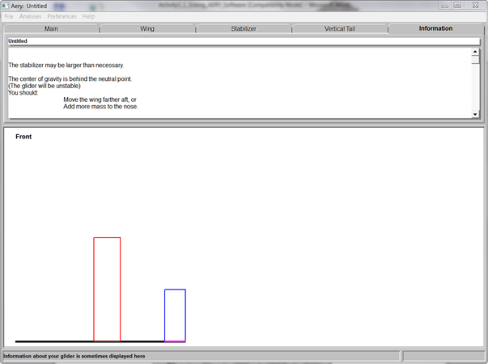
Will it Fly? Analysis
Press F3 or under Analysis
Once you get an AERY number
AND it is stable
Raise Hand

Slide 24
Building on a Single Sheet
90 cm
or
36 inch
Fuselage
Wing
Horizontal
Stabilizer
Vertical
Tail
7.5 cm
or
3 inch
Leave extra space at these locations if material allows
Notice the grain direction: Always spanwise!
NOTE: Fuselage can be no LONGER than 35 cm or 12 inch
Can be no WIDER than 2.5 cm or 1 inch

Slide 25
Aery Glider Worksheet Reflection Questions

Slide 26
Questions / Comments

Slide 27
SAFETY FIRST.
SAFETY ALWAYS.

Slide 28
Safety Rules – Safety Monitor Brief
Must Use Safety Glasses
Use of Cutting tools is Dangerous – AT ALL TIMES
Must Use Cutting Mats
Extended breathing of adhesives and paint fumes can be dangerous
All Areas will remain clean and organized
Plane Captains will insure All Areas will be cleaned and all items put back in proper locations 10minutes prior to class ending
Class safety monitor will insure areas are clean and safe at all times

Slide 29
Questions / Comments

