Slide 1
Warm-Up – 8/31 – 10 minutes
Utilizing your notes and past knowledge answer the following questions:
Why was Glenn Curtiss known as the “Fastest Man on Earth?”
What was the contribution of Curtiss to the U.S. Army aviation?
Identify the members of the AEA.
Describe the goals of the AEA.
Describe the significant aviation advances in 1910 and the impact.

Slide 2
Questions / Comments

Slide 3
Warm-Up – 8/31 – 10 minutes
Utilizing your notes and past knowledge answer the following questions:
Why was Glenn Curtiss known as the “Fastest Man on Earth?”
What was the contribution of Curtiss to the U.S. Army aviation?
Identify the members of the AEA.
Describe the goals of the AEA.
Describe the significant aviation advances in 1910 and the impact.

Slide 4
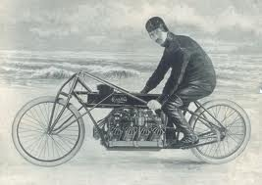
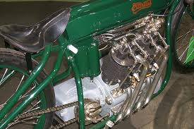
Developments in the U.S.
In 1907, Curtiss became known as the “Fastest Man on Earth”
Raced a motorcycle 136.3mph.
His engines were light and powerful – which caught the interest of Thomas Baldwin – a balloonist.

Slide 5
Warm-Up – 8/31 – 10 minutes
Utilizing your notes and past knowledge answer the following questions:
Why was Glenn Curtiss known as the “Fastest Man on Earth?”
What was the contribution of Curtiss to the U.S. Army aviation?
Identify the members of the AEA.
Describe the goals of the AEA.
Describe the significant aviation advances in 1910 and the impact.

Slide 6
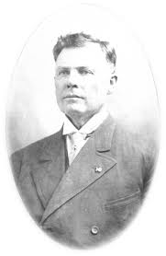
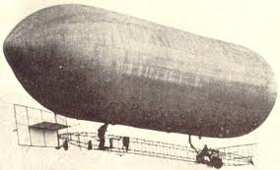
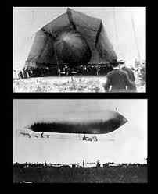
Developments in the U.S.
Baldwin’s airship with the Curtiss engine became the first powered dirigible in the U.S.
Another of Curtiss engines was used to power the first U.S. Army aircraft the dirigible – SC-1

Slide 7
Warm-Up – 8/31 – 10 minutes
Utilizing your notes and past knowledge answer the following questions:
Why was Glenn Curtiss known as the “Fastest Man on Earth?”
What was the contribution of Curtiss to the U.S. Army aviation?
Identify the members of the AEA.
Describe the goals of the AEA.
Describe the significant aviation advances in 1910 and the impact.

Slide 8
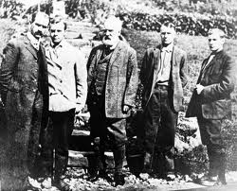
Aerial Experiment Association
Alexander Graham Bell asked Curtiss to join him to help design and develop aircraft and further developments in the aviation industry. (Goal of AEA)
The AEA was formed by Bell, Curtiss, Lt Thomas Selfridge, Baldwin and JohnMcCurdy.

Slide 9
Warm-Up – 8/31 – 10 minutes
Utilizing your notes and past knowledge answer the following questions:
Why was Glenn Curtiss known as the “Fastest Man on Earth?”
What was the contribution of Curtiss to the U.S. Army aviation?
Identify the members of the AEA.
Describe the goals of the AEA.
Describe the significant aviation advances in 1910 and the impact.

Slide 10
Aerial Experiment Association
Alexander Graham Bell asked Curtiss to join him to help design and develop aircraft and further developments in the aviation industry. (Goal of AEA)
The AEA was formed by Bell, Curtiss, Lt Thomas Selfridge, Baldwin and JohnMcCurdy.

Slide 11
Warm-Up – 8/31 – 10 minutes
Utilizing your notes and past knowledge answer the following questions:
Why was Glenn Curtiss known as the “Fastest Man on Earth?”
What was the contribution of Curtiss to the U.S. Army aviation?
Identify the members of the AEA.
Describe the goals of the AEA.
Describe the significant aviation advances in 1910 and the impact.

Slide 12
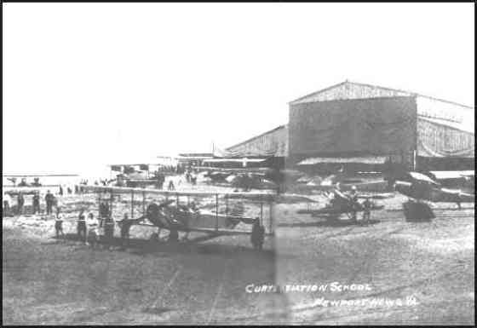
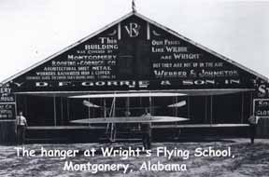
Significant Aviation Advances 1910 and their impact
Wright Brothers and Curtiss both opened flight schools

Slide 13
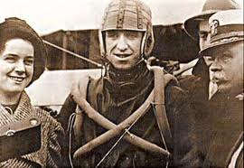
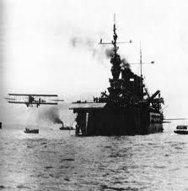
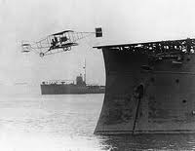
Significant Aviation Advances 1910 and their impact
Eugene Ely makes first flight from deck of USS Birmingham (Hudson Flier) – Hampton Roads, VA

Slide 14
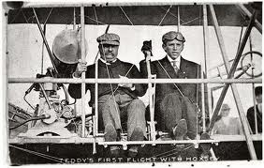
Significant Aviation Advances 1910 and their impact
President Roosevelt became first president to fly (St. Louis, Missouri)

Slide 15
Questions / Comments

Slide 16
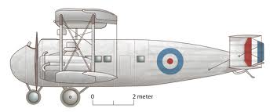
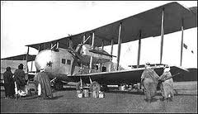
THIS DAY IN AVIATION
August 31
1921 — The first production Vickers “Vernon,” the first troop carrier designed for the British RAF (Royal Air Force), is delivered by the British manufacturer.

Slide 17
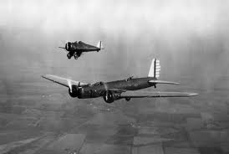
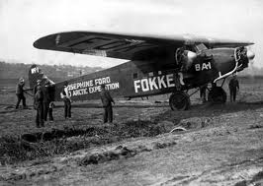
THIS DAY IN AVIATION
August 31
1932 — Air Corps pilots flew 5 miles above the Earth's surface to photograph an eclipse of the Sun.

Slide 18
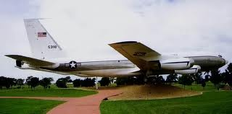
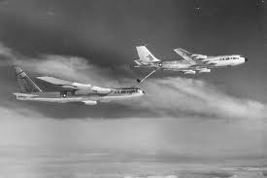
THIS DAY IN AVIATION
August 31
1956 — The first Boeing KC-135A (55-3118) makes its first flight and is taken over by the USAF on January 31, 1957.

Slide 19
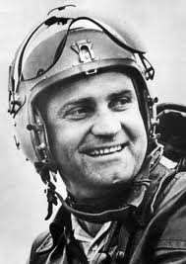
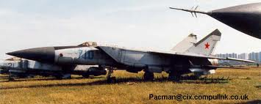
THIS DAY IN AVIATION
August 31
1977 — Soviet test pilot Alexander Fedotov claims a new world height record for manned aircraft when he climbs to a height of 37,650 m (123,523 ft.) flying the Mikoyan E-266M.

Slide 20
Questions / Comments

Slide 21
August 2016
Sunday | Monday | Tuesday | Wednesday | Thursday | Friday | Saturday
14 | 15 Welcome to Aviation | 16 Parts of an Aircraft Forces of Flight | 17 Flight Control Surfaces | 18 Aircraft Review | 19 Flight Line Friday Quiz | 20
21 | 22 Quiz Review Chapter 1 Intro | 23 Chapter 1 Developing the Airplane | 24 Chapter 1 Wright Brothers | 25 Chapter 1 Wright Brothers | 26 Flight Line Friday Chapter 1 Test | 27
28 | 29 Chapter 2 Development of Aviation in U.S. | 30 Chapter 2 Curtiss | 31 Chapter 2 Vin Fiz Progress Rpts Due | 1 Chapter 2 Progress in Europe | 2 Chapter 2 QUIZ Progress Rpts Sent Home

Slide 22
Questions / Comments

Slide 23
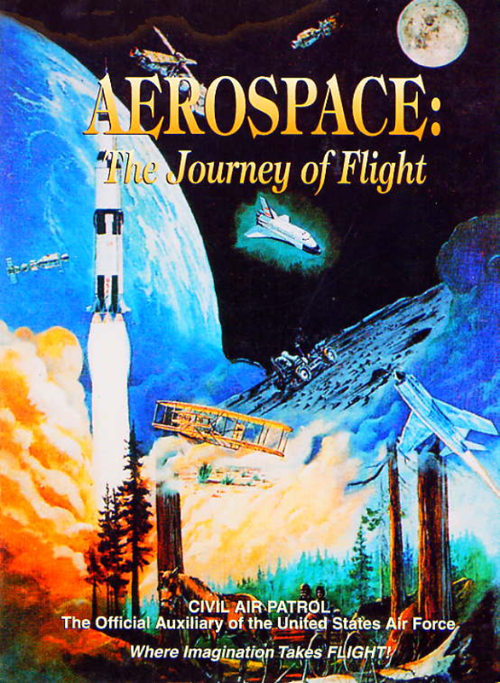
Chapter 2
The Adolescence of Air Power
1904-1919

Slide 24
Today’s Mission Requirements
Mission:
Describe the prize and the rules established for the challenge of the flight across the country.
Identify the type and the name of the aircraft.
Describe the planned course of the flight from coast to coast.
Describe the distance, speed and the time the trip.
Describe Harriet Quimby and her significance to aviation.
EQ:
Describe significant aviation events occurring between 1904-1919 and their impact on future aviation development.

Slide 25
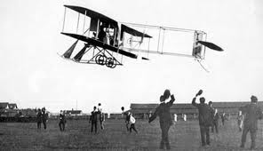
Vin Fiz
Flyer

Slide 26
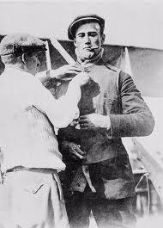
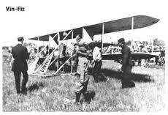
Developments in the U.S.
1911 – William Randolph Hearst – offered $50,000 for flight across U.S.
Must be completed in 30 days
Pilot Calbraith Perry Rodgers persuaded soft drink company “Vin Fiz” to sponsor trip.
The aircraft was a 1911 Wright Flyer Model D called the “Vin Fiz Flyer”

Slide 27
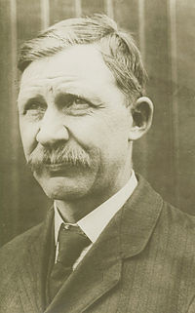
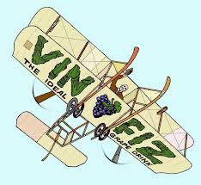
Developments in the U.S.
Wright Brothers mechanic, Charlie Taylor takes on job as mechanic.
Trip was planned from:
New York to Chicago
Kansas City to San Antonio / El Paso
Yuma to Pasadena, CA
Trip was to cover more than 3,390 miles

Slide 28
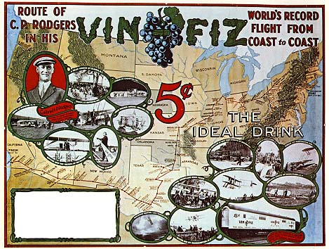

Slide 29
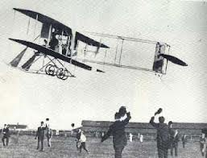
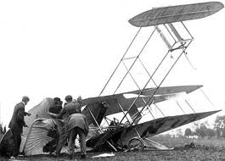
Developments in the U.S.
Due to 40 hp engine – Rodgers knew he could not make it over Rocky Mountains
He started from Long Island, NY
Made over 68 landings
Some severe
Only parts to make entire trip were rudder and 1 strut

Slide 30
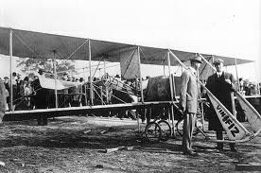
Development in the U.S.
Rodgers actual trip
4,251 miles
Longest flight 133 miles
Average speed 52 mph
Flight lasted 49 days
Did NOT receive prize but made the first airplane crossing of the United States

Slide 31
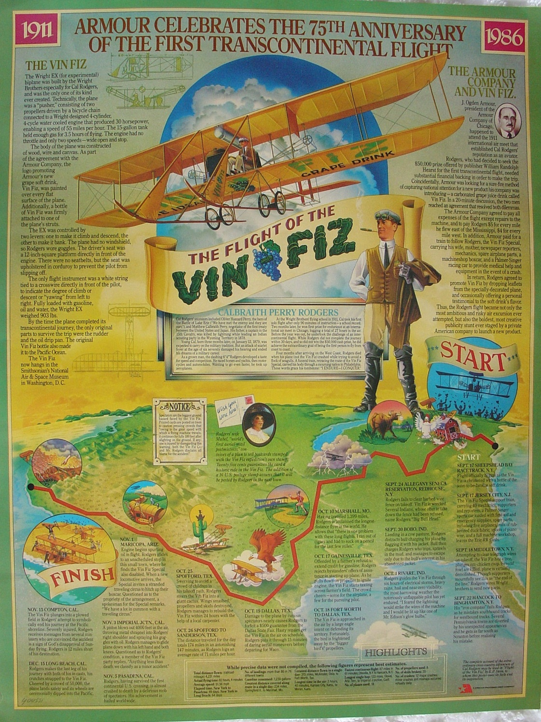
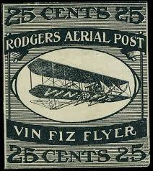

Slide 32
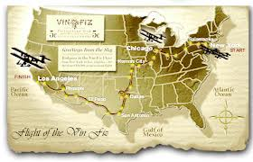
Development in the U.S.
Significance of trip
No landing fields
No advance weather information
No special instruments
Supplies
facilities

Slide 33
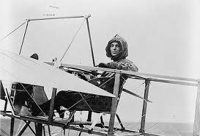
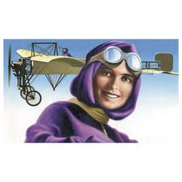
Harriet
Quimby

Slide 34
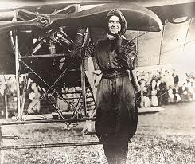
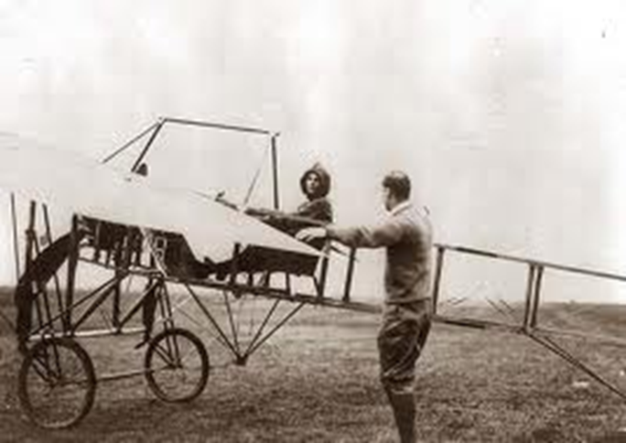
Development in the U.S.
Harriet Quimby in Aug 1911 became America’s first licensed pilot
She used her writing talents to urge country to give more attention to commercial aviation and aeronautical development

Slide 35
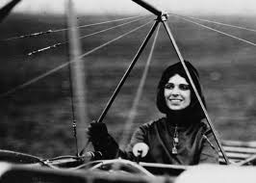
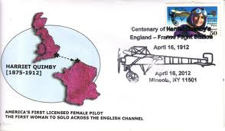
Development in the U.S.
She became first woman to fly solo across English Channel
Making the flight in 30 minutes

Slide 36
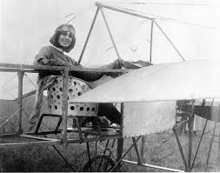
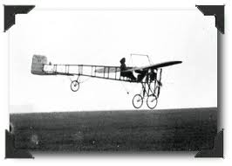
Development in the U.S.
June 1912
Flying at the Harvard-Boston Aviation Meet over Boston Harbor
Lost control of Bleriot monoplane
She and her passenger fell to their deaths

Slide 37
Questions / Comments

Slide 38
Today’s Mission Requirements
Mission:
Describe the prize and the rules established for the challenge of the flight across the country.
Identify the type and the name of the aircraft.
Describe the planned course of the flight from coast to coast.
Describe the distance, speed and the time the trip.
Describe Harriet Quimby and her significance to aviation.
EQ:
Describe significant aviation events occurring between 1904-1919 and their impact on future aviation development.

Slide 39
Developments in the U.S.
1911 – William Randolph Hearst – offered $50,000 for flight across U.S.
Must be completed in 30 days
Pilot Calbraith Perry Rodgers persuaded soft drink company “Vin Fiz” to sponsor trip.
The aircraft was a 1911 Wright Flyer Model D at is called the “Vin Fiz Flyer”

Slide 40
Today’s Mission Requirements
Mission:
Describe the prize and the rules established for the challenge of the flight across the country.
Identify the type and the name of the aircraft.
Describe the planned course of the flight from coast to coast.
Describe the distance, speed and the time the trip.
Describe Harriet Quimby and her significance to aviation.
EQ:
Describe significant aviation events occurring between 1904-1919 and their impact on future aviation development.

Slide 41
Developments in the U.S.
1911 – William Randolph Hearst – offered $50,000 for flight across U.S.
Must be completed in 30 days
Pilot Calbraith Perry Rodgers persuaded soft drink company “Vin Fiz” to sponsor trip.
The aircraft was a 1911 Wright Flyer Model D called the “Vin Fiz Flyer”

Slide 42
Today’s Mission Requirements
Mission:
Describe the prize and the rules established for the challenge of the flight across the country.
Identify the type and the name of the aircraft.
Describe the planned course of the flight from coast to coast.
Describe the distance, speed and the time the trip.
Describe Harriet Quimby and her significance to aviation.
EQ:
Describe significant aviation events occurring between 1904-1919 and their impact on future aviation development.

Slide 43
Developments in the U.S.
Wright Brothers mechanic, Charlie Taylor takes on job.
Trip was planned from:
New York to Chicago
Kansas City to San Antonio / El Paso
Yuma to Pasadena, CA
Trip was to cover more than 3,390 miles

Slide 44
Today’s Mission Requirements
Mission:
Describe the prize and the rules established for the challenge of the flight across the country.
Identify the type and the name of the aircraft.
Describe the planned course of the flight from coast to coast.
Describe the distance, speed and the time the trip.
Describe Harriet Quimby and her significance to aviation.
EQ:
Describe significant aviation events occurring between 1904-1919 and their impact on future aviation development.

Slide 45
Development in the U.S.
Rodgers actual trip
4,251 miles
Longest flight 133 miles
Average speed 52 mph
Flight lasted 49 days
Did NOT receive prize but made the first airplane crossing of the United States

Slide 46
Today’s Mission Requirements
Mission:
Describe the prize and the rules established for the challenge of the flight across the country.
Identify the type and the name of the aircraft.
Describe the planned course of the flight from coast to coast.
Describe the distance, speed and the time the trip.
Describe Harriet Quimby and her significance to aviation.
EQ:
Describe significant aviation events occurring between 1904-1919 and their impact on future aviation development.

Slide 47
Development in the U.S.
Harriet Quimby in Aug 1911 became America’s first licensed pilot
She used her writing talents to urge country to give more attention to commercial aviation and aeronautical development

Slide 48
Development in the U.S.
She became first woman to fly solo across English Channel
Making the flight in 30 minutes

Slide 49
Questions / Comments

Slide 50
SAFETY FIRST.
SAFETY ALWAYS.

Slide 51
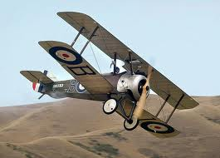
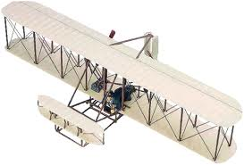
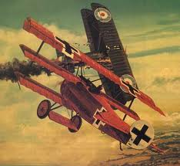

Slide 52
Safety Rules – Safety Monitor Brief
Must Use Safety Glasses
Use of Cutting tools is Dangerous – AT ALL TIMES
Must Use Cutting Mats
Extended breathing of adhesives and paint fumes can be dangerous
May use vinyl gloves

Slide 53
Safety Rules – Safety Monitor Brief
Do not wash paint brushes in sink
Do not pour paint or thinner down drain
Only use paint thinner to clean brushes
May use Acetone to remove Super Glue or glue
Only use spray paint outside and on cardboard to avoid overspray.
Must use dust mask when using spray paint.

Slide 54
Safety Rules – Safety Monitor Brief
Be sure to read all model instructions.
All Areas will remain clean and organized
Plane Captains will insure All Areas will be cleaned and all items put back in proper locations 10minutes prior to class ending
Class safety monitor will insure areas are clean and safe at all times
Class Leader insure hangar is clean before class dismissed

Slide 55
SAFETY FIRST.
SAFETY ALWAYS.

Slide 56
Questions / Comments

Slide 57
Lesson Closure - 3 – 2 - 1
3. List 3 things you learned today.
2. List 2 things you have questions about today’s lesson.
1. Create (1) quiz question with answer about today’s lesson.

Slide 59
Model Building Grading Rubic
Each Group MUST follow all directions
STOP! - If you are unsure
SAFETY at ALL Times
Accuracy and Authenticity will be judged
Each Group Member is responsible to produce a 2 page paper on the model.
Aircraft Specifications
Aircraft contribution to Aviation development
Significant Aviation Pioneers associated with aircraft (pilots, inventors etc.)
The Group will provide a Presentation on the model.
5to 7 slides (Title slide; Body; Summary Slide)

Slide 60
Questions / Comments

Slide 61
SAFETY FIRST.
SAFETY ALWAYS.

Slide 62
Safety Rules – Safety Monitor Brief
Must Use Safety Glasses
Use of Cutting tools is Dangerous – AT ALL TIMES
Must Use Cutting Mats
Extended breathing of adhesives and paint fumes can be dangerous
All Areas will remain clean and organized
Plane Captains will insure All Areas will be cleaned and all items put back in proper locations 10minutes prior to class ending
Class safety monitor will insure areas are clean and safe at all times

Slide 63
Questions / Comments

