Slide 1
Warm-Up – 8/27 – 10 minutes
Utilizing your notes and past knowledge answer the following questions:
During development of the airplane, early pioneers struggled with…?
Who identified the forces of lift, drag, and thrust and built the 1st successful full-sized, manned glider?
Who was known as the “Father of Modern Aviation and is credited with over 2,000 glider flights?
This aviation pioneer was known for his study of aviation history and collection and distribution of aviation information?
Who is credited with making the first “two” attempts launching an aircraft off a barge via a catapult?

Slide 2
Questions / Comments

Slide 3
Warm-Up – 8/27 – 10 minutes
Utilizing your notes and past knowledge answer the following questions:
During development of the airplane, early pioneers struggled with…?
Who identified the forces of lift, drag, and thrust and built the 1st successful full-sized, manned glider?
Who was known as the “Father of Modern Aviation and is credited with over 2,000 glider flights?
This aviation pioneer was known for his study of aviation history and collection and distribution of aviation information?
Who is credited with making the first “two” attempts launching an aircraft off a barge via a catapult?

Slide 4
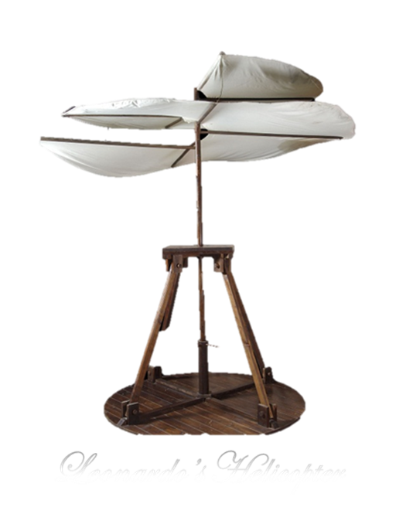
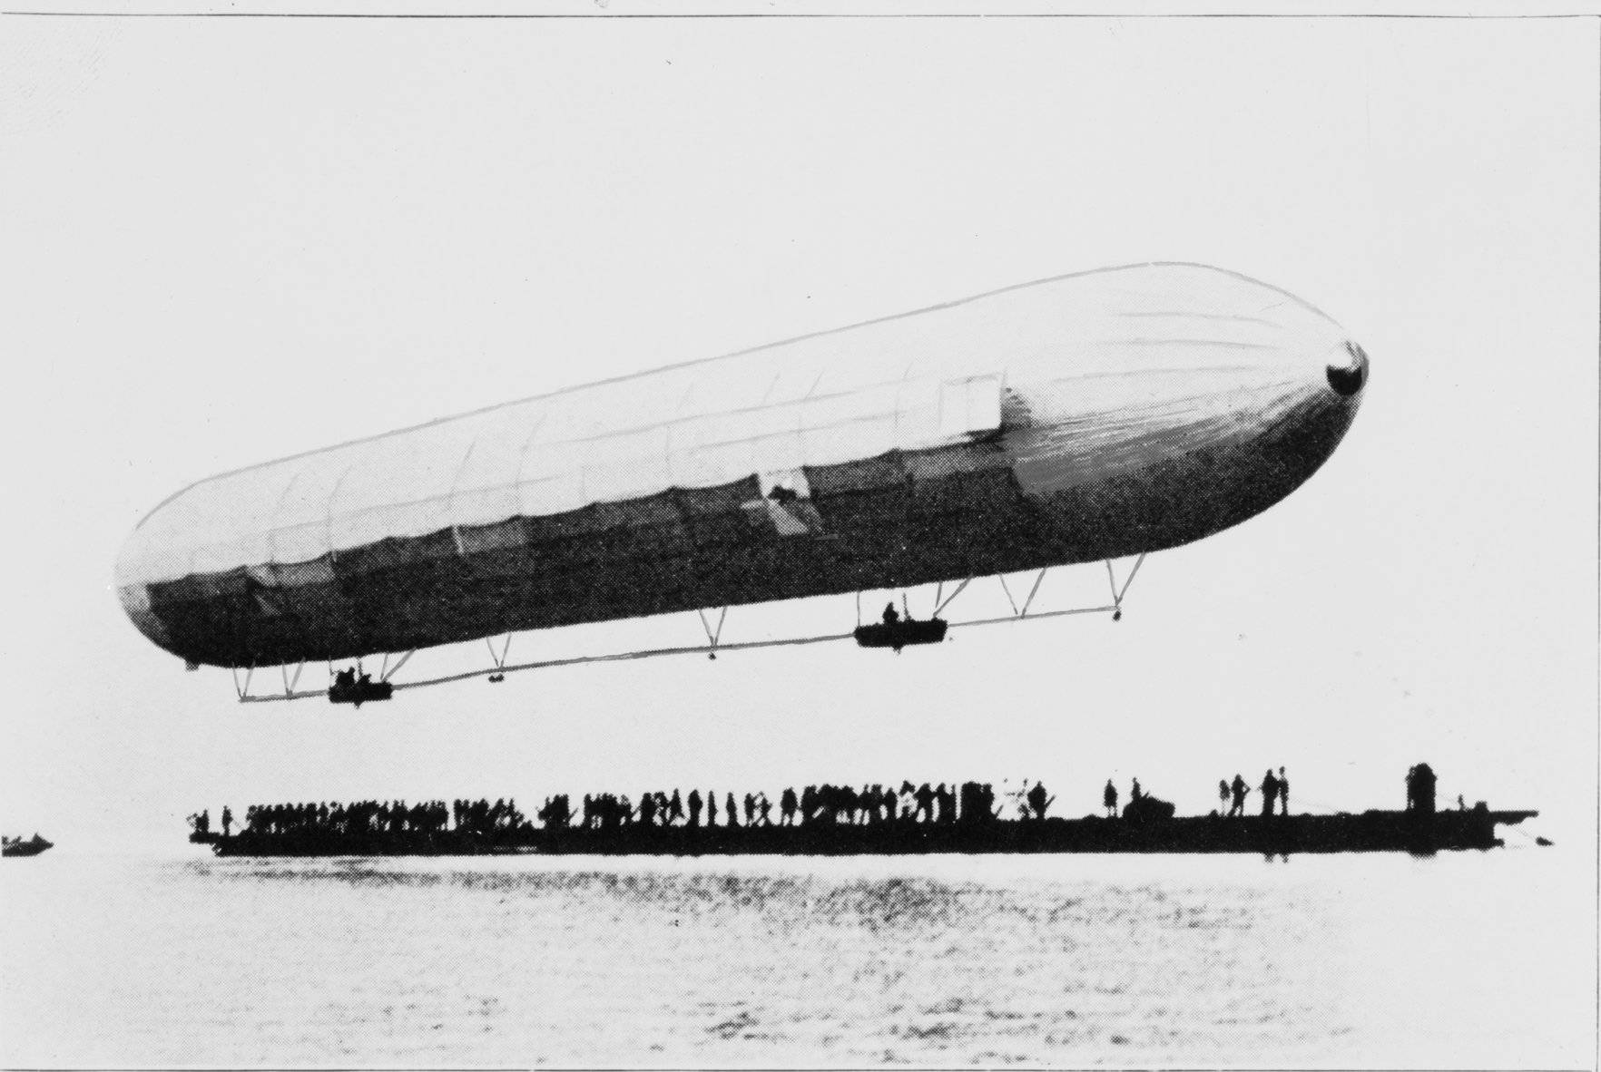
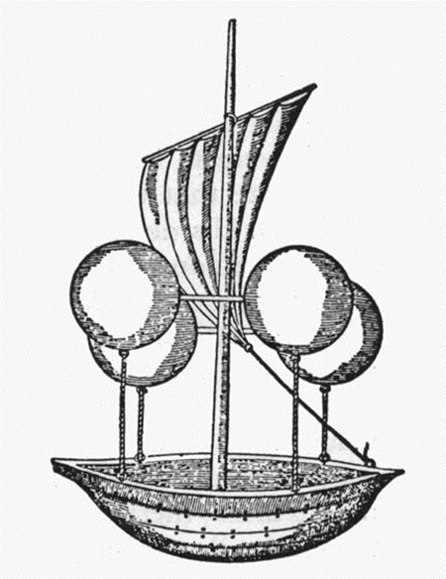
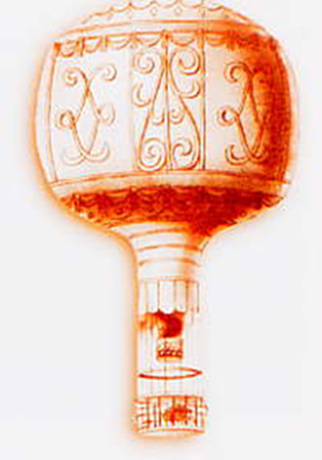
Developing the Airplane
Aviation Pioneers struggled with:
developing lift
sustaining lift
and controlling aircraft

Slide 5
Warm-Up – 8/27 – 10 minutes
Utilizing your notes and past knowledge answer the following questions:
During development of the airplane, early pioneers struggled with…?
Who identified the forces of lift, drag, and thrust and built the 1st successful full-sized, manned glider?
Who was known as the “Father of Modern Aviation and is credited with over 2,000 glider flights?
This aviation pioneer was known for his study of aviation history and collection and distribution of aviation information?
Who is credited with making the first “two” attempts launching an aircraft off a barge via a catapult?

Slide 6
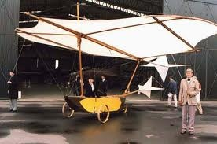
Developing the Airplane
Sir George Cayley was the 1st 19th century airplane pioneer
Built and flew small model gliders
Laid foundation for modern aeronautics with published account of making a surface support a given weight by the application of power to the resistance of air
He identified the forces of lift, drag, and thrust
Built 1st successful full-sized, manned glider

Slide 7
Warm-Up – 8/27 – 10 minutes
Utilizing your notes and past knowledge answer the following questions:
During development of the airplane, early pioneers struggled with…?
Who identified the forces of lift, drag, and thrust and built the 1st successful full-sized, manned glider?
Who was known as the “Father of Modern Aviation and is credited with over 2,000 glider flights?
This aviation pioneer was known for his study of aviation history and collection and distribution of aviation information?
Who is credited with making the first “two” attempts launching an aircraft off a barge via a catapult?

Slide 8
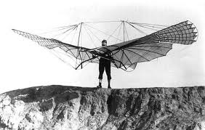
Developing the Airplane
Otto Lilienthal – Father of Modern Aviation
He built single-winged and two-winged gliders
1891-1896, he made over 2,000 glides some over 700 ft
Built an engine to link the wingtips
Built a pilot control system
Wrote a book on aviation and spurred interest around the world

Slide 9
Warm-Up – 8/27 – 10 minutes
Utilizing your notes and past knowledge answer the following questions:
During development of the airplane, early pioneers struggled with…?
Who identified the forces of lift, drag, and thrust and built the 1st successful full-sized, manned glider?
Who was known as the “Father of Modern Aviation and is credited with over 2,000 glider flights?
This aviation pioneer was known for his study of aviation history and collection and distribution of aviation information?
Who is credited with making the first “two” attempts launching an aircraft off a barge via a catapult?

Slide 10
Developing the Airplane
Octave Chanute
Read Lilienthal’s works and improved upon them
Designed gliders but was too old to fly them
Known for his study of aviation history and collection and distribution of aviation information

Slide 11
Warm-Up – 8/27 – 10 minutes
Utilizing your notes and past knowledge answer the following questions:
During development of the airplane, early pioneers struggled with…?
Who identified the forces of lift, drag, and thrust and built the 1st successful full-sized, manned glider?
Who was known as the “Father of Modern Aviation and is credited with over 2,000 glider flights?
This aviation pioneer was known for his study of aviation history and collection and distribution of aviation information?
Who is credited with making the first “two” attempts launching an aircraft off a barge via a catapult?

Slide 12
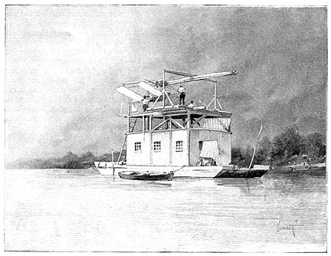
Developing the Airplane
Samuel Pierpont Langley attempted to add power to a glider
1903, the Aerodrome launched by a catapult from a barge anchored in the Potomac River
It fell into the river.
Same thing happened on the next attempt two months later
Both attempts widely covered by the press – the U.S. government dropped its support and Langley gave up project

Slide 13
Questions / Comments

Slide 14
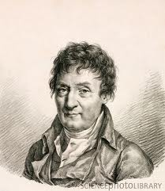
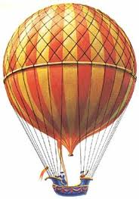
THIS DAY IN AVIATION
August 27
1783 — Jacques Alexandre César Charles flies the first balloon filled with gas rather than fire-heated air using hydrogen produced by pouring 489 lbs. of sulfuric acid on 1,000 lbs. of iron.
The balloon has a diameter of 12 ft.

Slide 15
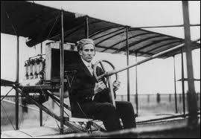
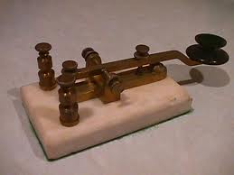
THIS DAY IN AVIATION
August 27
1910 — Radio is first used to send messages between the ground and an airplane when James McCurdy both sends and receives messages from a Curtiss biplane at Sheepshead, New York, using an H.M. Horton wireless set

Slide 16
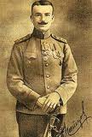
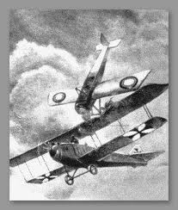
THIS DAY IN AVIATION
August 27
1913 — Lieutenant Petr Nesterov of the Russian Army in Kiev performs the first loop-the-loop.
The complete circle and other intentional acrobatic stunts prove to be valuable experience for the wartime maneuvers needed during aerial battles.

Slide 17
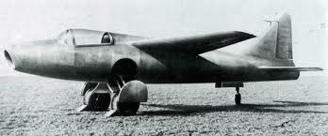
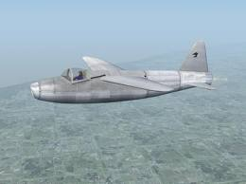
THIS DAY IN AVIATION
August 27
1939 — The first fully jet-propelled aircraft to fly is Germany's Heinkel 178.
A centrifugal flow turbojet engine powers it.

Slide 18
Questions / Comments

Slide 19
August 2015
Sunday | Monday | Tuesday | Wednesday | Thursday | Friday | Saturday
 |  |  |  |  |  | 1
2 | 3 | 4 | 5 | 6 | 7 | 8
9 | 10 | 11 | 12 | 13 | 14 | 15
16 | 17 Welcome to Aviation | 18 Parts of an Aircraft Forces of Flight | 19 Flight Control Surfaces | 20 Aircraft Review | 21 Flight Line Friday Quiz | 22
23 | 24 Quiz Review Chapter 1 Intro | 25 Chapter 1 Developing the Airplane | 26 Flight Line Friday | 27 Chapter 1 Wright Brothers | 28 Chapter 1 Wright Brothers Chapter 1 Test | 29
30 | 31

Slide 20
Questions / Comments

Slide 21
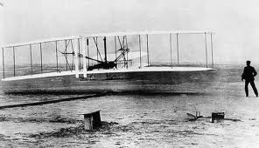
Wright
Brothers
Story

Slide 22
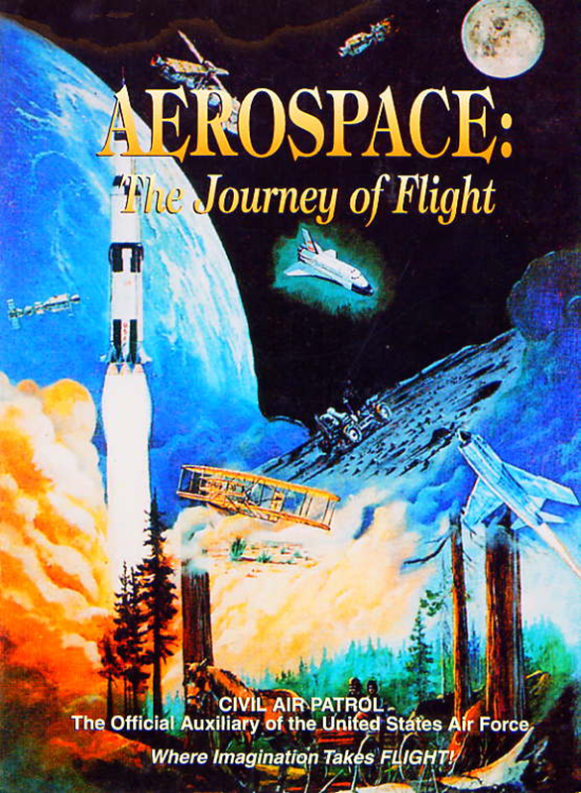
Chapter 1
Introduction to Air Power

Slide 23
Today’s Mission Requirements
Mission:
Identify the significant contributions that advanced air and space power.
Identify the individuals with the contributions they made to developing the airplane.
EQ:
Describe some of the innovations that led to advances in air and space power.

Slide 24
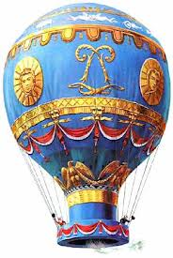
Developing the Airplane
Initial pioneers of aviation struggled with the forces of flight
How to develop Lift to get them in air
How to sustain the lift
How to develop a way to control the aircraft

Slide 25
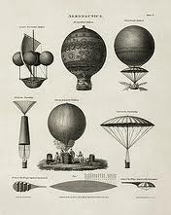
Developing the Airplane
Balloonists solved the first 2 problems by building aircraft lighter than air
(Created lift)
Kept aloft by dumping ballast or maintaining fire to heat the air
(Sustained lift)
So the issue came down to control
An Airplane doesn’t have a balloon to keep aloft – early pioneers had all three problems

Slide 26
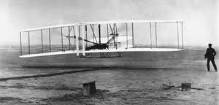
Developing the Airplane
The Wright Brothers – Orville and Wilbur
Approach to flight was to first
develop an aircraft that would fly
Aircraft that could be controlled in flight
And then to add a power plant

Slide 27
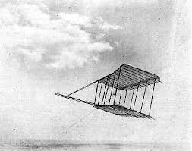
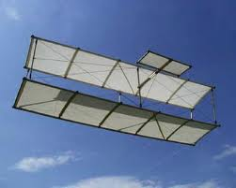
Developing the Airplane
Observed birds and noticed they maneuvered in flight by twisting their wings
Developed the wing-warping technique
Tested on kite – then glider

Slide 28
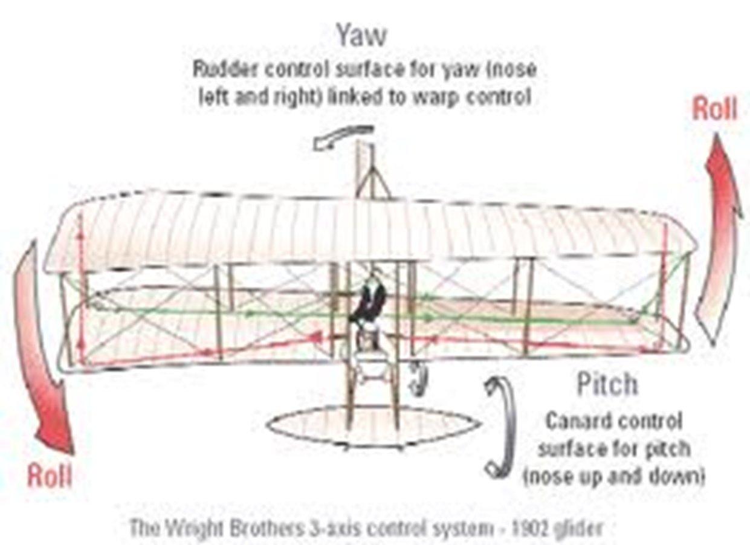

Slide 29
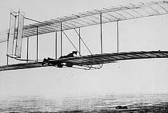
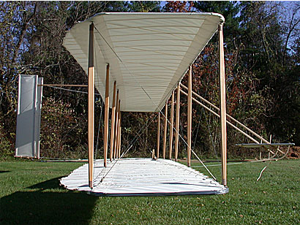
Developing the Airplane
Contacted Weather Bureau for location of sustained wind
Kill Devil Hills, NC
By October 1902, had over 1,000 successful glider flights – had solved all of the major control problems –
just needed a suitable power plant

Slide 30
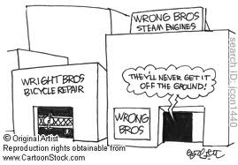

Slide 31
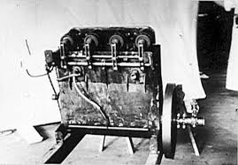
Developing the Airplane
They enlisted mechanic Charlie Taylor who built a water cooled 12 hp engine
Connected via bicycle chains to the sprockets which turned the propellers

Slide 32
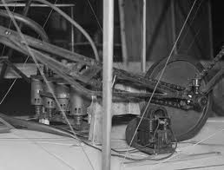

Slide 33
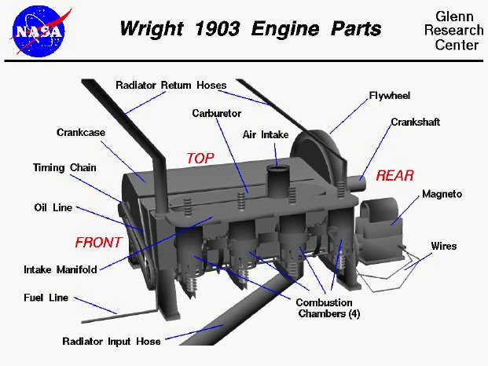

Slide 34
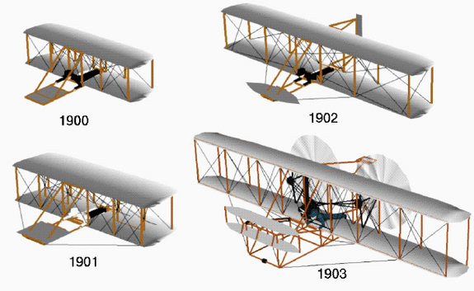
Wright Flyers

Slide 35
Questions / Comments

Slide 36
Today’s Mission Requirements
Mission:
Identify the significant contributions that advanced air and space power.
Identify the individuals with the contributions they made to developing the airplane.
EQ:
Describe some of the innovations that led to advances in air and space power.

Slide 37
Developing the Airplane
The Wright Brothers – Orville and Wilbur
Approach to flight:
was to first develop an aircraft that would fly
Aircraft that could be controlled in flight
And then to add a power plant

Slide 38
Developing the Airplane
Observed birds and noticed they maneuvered in flight by twisting their wings
Developed the wing-warping technique
Tested on kite – then glider

Slide 39
Developing the Airplane
Contacted Weather Bureau for location of sustained wind
Kill Devil Hills, NC
By October 1902, had over 1,000 successful glider flights – had solved all of the major control problems –
just needed a suitable power plant

Slide 40
Today’s Mission Requirements
Mission:
Identify the significant contributions that advanced air and space power.
Identify the individuals with the contributions they made to developing the airplane.
EQ:
Describe some of the innovations that led to advances in air and space power.

Slide 41
Developing the Airplane
They enlisted mechanic Charlie Taylor who built a water cooled 12 hp engine
Connected via bicycle chains to the sprockets which turned the propellers

Slide 42
Lesson Closure - 3 – 2 - 1
3. List 3 things you learned today.
2. List 2 things you have questions about today’s lesson.
1. Create (1) quiz question with answer about today’s lesson.

Slide 43
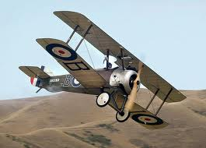
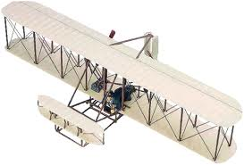
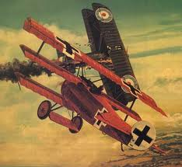

Slide 44
Model Building Grading Rubic
Each Group MUST follow all directions
STOP! - If you are unsure
SAFETY at ALL Times
Accuracy and Authenticity will be judged
Each Group Member is responsible to produce a 2 page paper on the model.
Aircraft Specifications
Aircraft contribution to Aviation development
Significant Aviation Pioneers associated with aircraft (pilots, inventors etc.)
The Group will provide a Presentation on the model.
5to 7 slides (Title slide; Body; Summary Slide)

Slide 45
Questions / Comments

Slide 46
SAFETY FIRST.
SAFETY ALWAYS.

Slide 47
Safety Rules – Safety Monitor Brief
Must Use Safety Glasses
Use of Cutting tools is Dangerous – AT ALL TIMES
Must Use Cutting Mats
Extended breathing of adhesives and paint fumes can be dangerous
All Areas will remain clean and organized
Plane Captains will insure All Areas will be cleaned and all items put back in proper locations 10minutes prior to class ending
Class safety monitor will insure areas are clean and safe at all times

Slide 48
Questions / Comments

