Slide 1
Warm-Up – 8/23 – 10 minutes
Utilizing your notes and past knowledge answer the following questions:
What part of the aircraft is located on the outer portion of the trailing edge of the wing – (it causes an aircraft to roll).
What is the French term for the tail portion of an aircraft?
What are the three basic types of wing placements?
What are the three basic landing gear configurations?
What part of the aircraft is located on the trailing edge of the vertical stabilizer?

Slide 2
Questions / Comments

Slide 3
Warm-Up – 8/23 – 10 minutes
Utilizing your notes and past knowledge answer the following questions:
What part of the aircraft is located on the outer portion of the trailing edge of the wing – (it causes an aircraft to roll).
What is the French term for the tail portion of an aircraft?
What are the three basic types of wing placements?
What are the three basic landing gear configurations?
What part of the aircraft is located on the trailing edge of the vertical stabilizer?

Slide 4
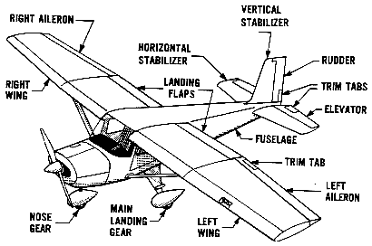
Basic Airplane and its Parts

Slide 5
Warm-Up – 8/23 – 10 minutes
Utilizing your notes and past knowledge answer the following questions:
What part of the aircraft is located on the outer portion of the trailing edge of the wing – (it causes an aircraft to roll).
What is the French term for the tail portion of an aircraft?
What are the three basic types of wing placements?
What are the three basic landing gear configurations?
What part of the aircraft is located on the trailing edge of the vertical stabilizer?

Slide 6
Basic Airplane and its Parts
EMPENNAGE

Slide 7
Warm-Up – 8/23 – 10 minutes
Utilizing your notes and past knowledge answer the following questions:
What part of the aircraft is located on the outer portion of the trailing edge of the wing – (it causes an aircraft to roll).
What is the French term for the tail portion of an aircraft?
What are the three basic types of wing placements?
What are the three basic landing gear configurations?
What part of the aircraft is located on the trailing edge of the vertical stabilizer?

Slide 8
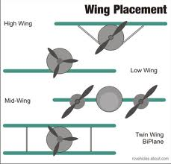

Slide 9
Warm-Up – 8/23 – 10 minutes
Utilizing your notes and past knowledge answer the following questions:
What part of the aircraft is located on the outer portion of the trailing edge of the wing – (it causes an aircraft to roll).
What is the French term for the tail portion of an aircraft?
What are the three basic types of wing placements?
What are the three basic landing gear configurations?
What part of the aircraft is located on the trailing edge of the vertical stabilizer?

Slide 10
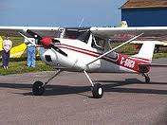
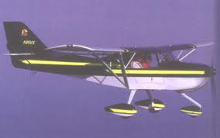
Landing Gear
Three Types
Conventional
2 fwd, 1 rear
Tricycle
Nose wheel and two on the side
Tandem
Two sets wheels one behind the other on the fuselage
AV-8B / B-52– requires outrigger gear

Slide 11
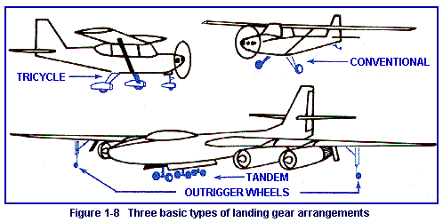

Slide 12
Warm-Up – 8/23 – 10 minutes
Utilizing your notes and past knowledge answer the following questions:
What part of the aircraft is located on the outer portion of the trailing edge of the wing – (it causes an aircraft to roll).
What is the French term for the tail portion of an aircraft?
What are the three basic types of wing placements?
What are the three basic landing gear configurations?
What part of the aircraft is located on the trailing edge of the vertical stabilizer?

Slide 13
Basic Airplane and its Parts

Slide 14
Questions / Comments

Slide 15
August 2017
Sunday | Monday | Tuesday | Wednesday | Thursday | Friday | Saturday
 |  | 1 | 2 | 3 | 4 | 5
6 | 7 | 8 | 9 | 10 | 11 | 12
13 | 14 | 15 | 16 | 17 Welcome to Aviation | 18 Flightline Friday | 19
20 | 21 NO SCHOOL | 22 Parts of an Aircraft Forces of Flight Syllabus Due | 23 Flight Control Surfaces | 24 Aircraft Review | 25 Flight Line Friday Quiz | 26
27 | 28 Chapter 1 Intro to Aviation | 29 Chapter 1 Intro to Aviation | 30 Chapter 1 Intro to Aviation | 31 Chapter 1 Intro to Aviation | 1 Flightline Friday Test | 2
3 | 4 HOLIDAY | 5 | 6

Slide 16
Questions / Comments

Slide 17
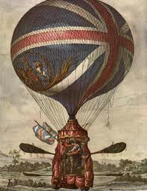
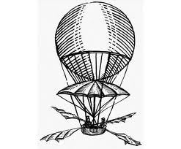
THIS DAY IN AVIATION
August 23
1878 — The British government uses its first military aviation budget (£150) to build and fly their first balloon, the “Pioneer.”

Slide 18
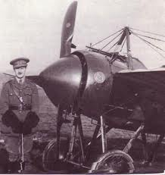
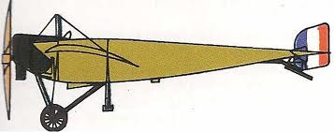
THIS DAY IN AVIATION
August 23
1913 — Léon Letort carries out the first non-stop flight between Paris and Berlin when he flies his Morane-Saulnier monoplane fitted with an 80-hp Le Rhône engine the 560 miles between the two capitals in 8 hours.

Slide 19
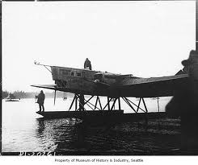
THIS DAY IN AVIATION
August 23
to 31 October 1929 — The Russian aircraft “Land of the Soviets,” is flown on a goodwill tour from Moscow across the North Pacific, entering the United States at Seattle, then on to New York, having covered 13,300 miles in 142 flying hours.

Slide 20
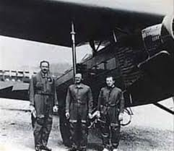
THIS DAY IN AVIATION
August 23
1937 — First wholly automatic landing in history accomplished occurred in the US.

Slide 21
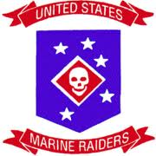
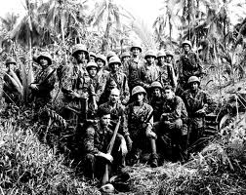
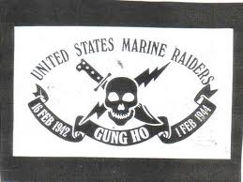
THIS DAY IN AVIATION
August 23
1942 — United States Marine Raiders attack Makin Atoll in the Gilbert Islands.

Slide 22
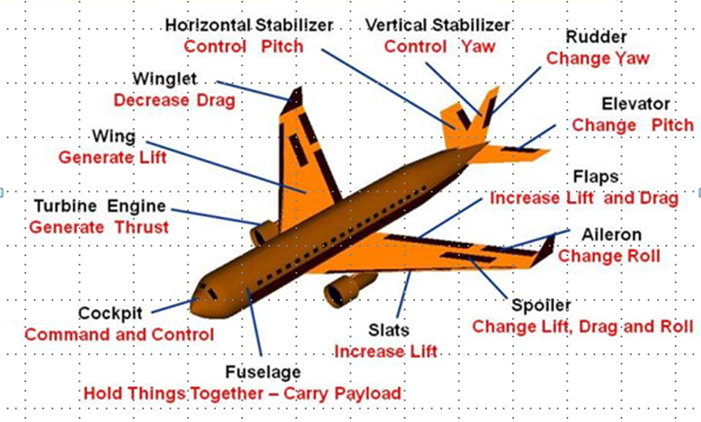
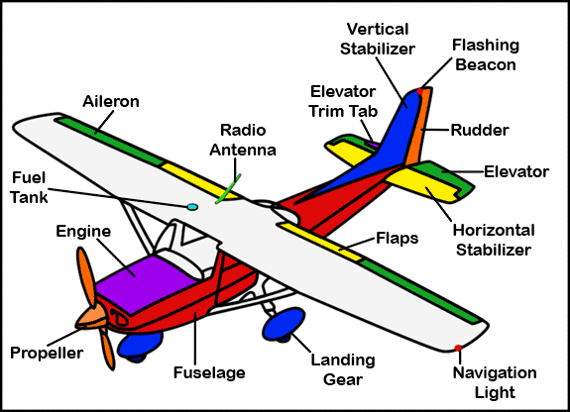
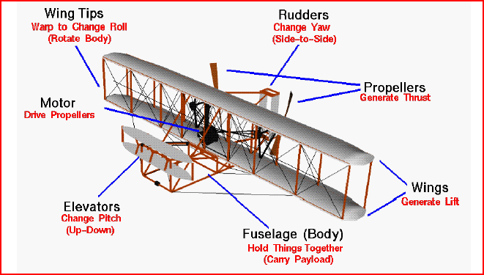
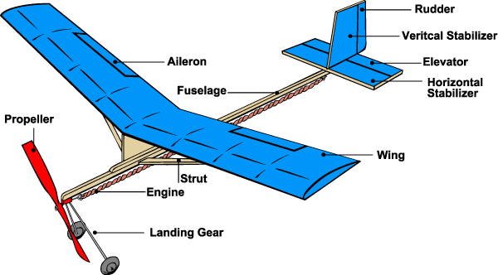
Aircraft in Motion

Slide 23
Today’s Mission Requirements
Mission:
Describe the Forces of Flight.
Identify the flight control surfaces of an aircraft.
Describe the effects of the flight control surfaces on aircraft flight.
EQ:
Describe aircraft components, their function and how the axes of rotation, forces of flight, and flight controls surfaces contribute to understanding flight.

Slide 24
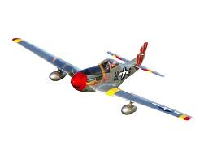
Forces
of
Flight

Slide 25
Four Forces of Flight
Determine whether an airplane rises or falls through the air:
Thrust
Drag
Lift
Gravity (Weight)

Slide 26
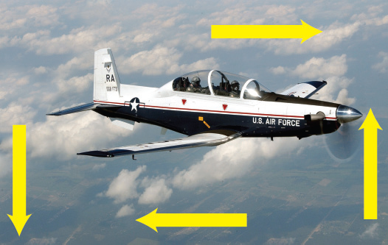

Slide 27
Thrust
The force that pushes or pulls a plane forward through the air.
Propellers, jet engines, tailwinds, and other outside sources – even catapults! – can provide needed thrust.

Slide 28
Drag
The force that resists forward motion and acts against thrust.
Created by friction between the plane and the atmosphere.
If the force of drag is too great, then a plane will move slower and will lose lift.

Slide 29
Lift
The force of lift exceeds the plane’s weight, the plane rises.

Slide 30
Gravity / Weight
Earth’s gravity pulls the plane downward, giving the plane weight.

Slide 31
THRUST
GRAVITY
LIFT
DRAG

Slide 32
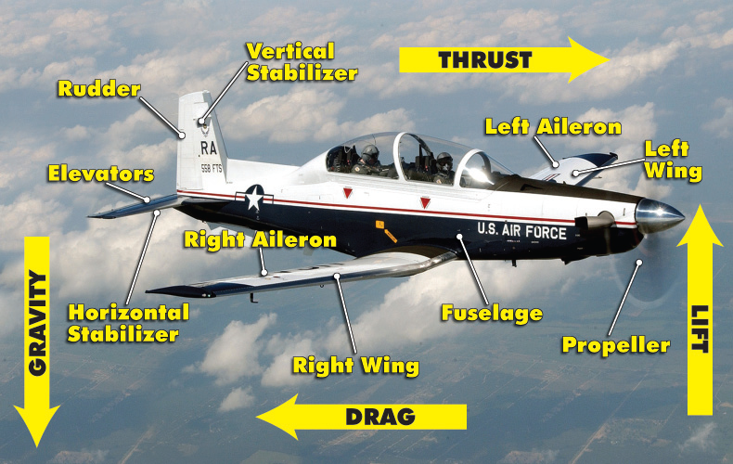

Slide 33
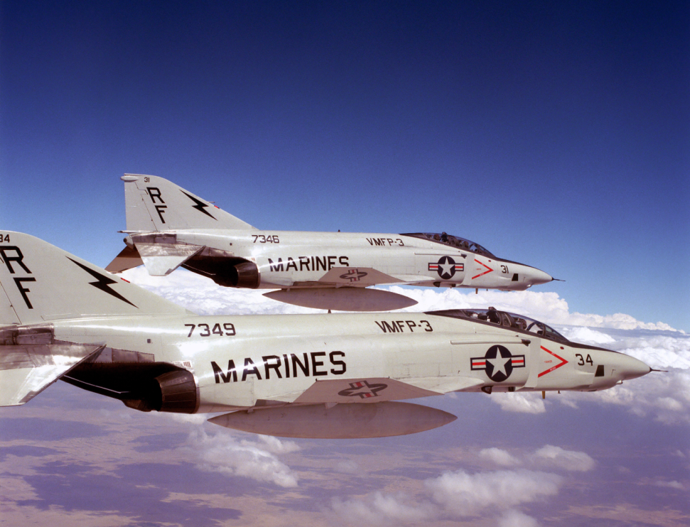
Aircraft
in
Flight

Slide 34
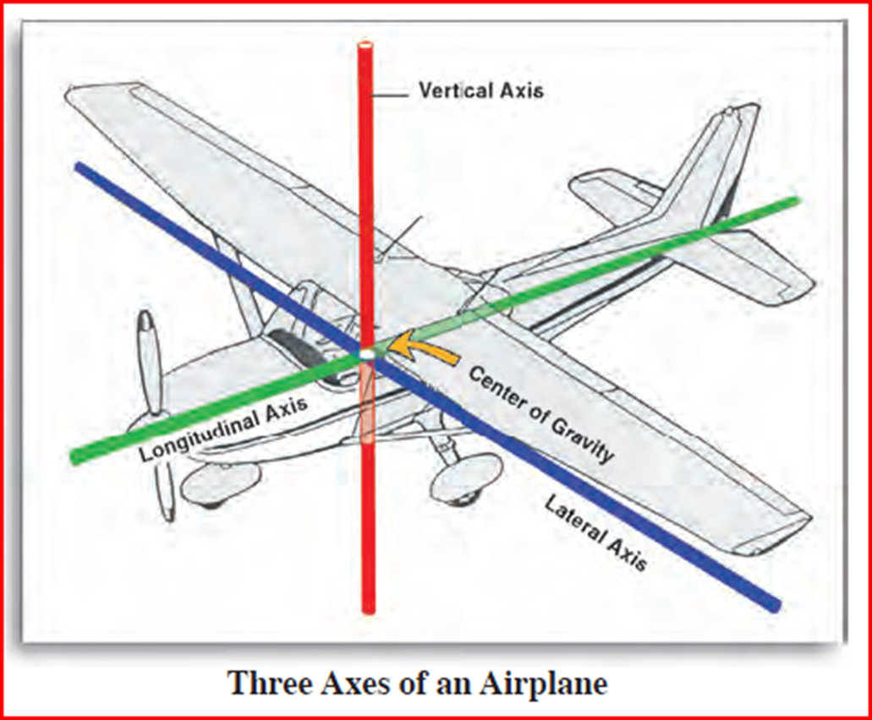

Slide 35
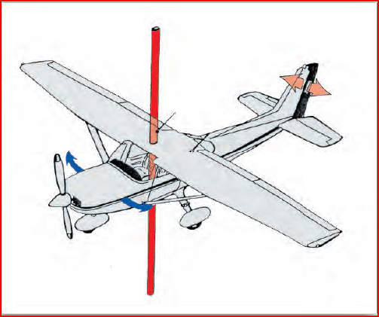
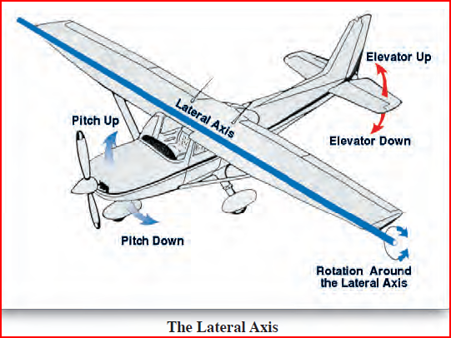
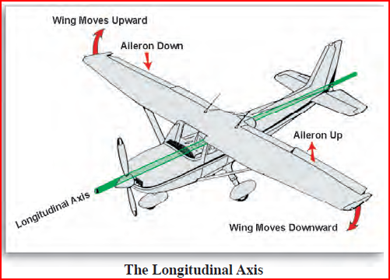
The Axes of Flight
The axes of flight are:
Longitudinal (Roll)
Axis from tip of nose to tip of tail – ROLL
Lateral (Pitch)
Axis from one wingtip to other wingtip – PITCH
Vertical (Yaw)
Axis vertically through meeting point of the longitudinal and lateral axes. – YAW

Slide 36
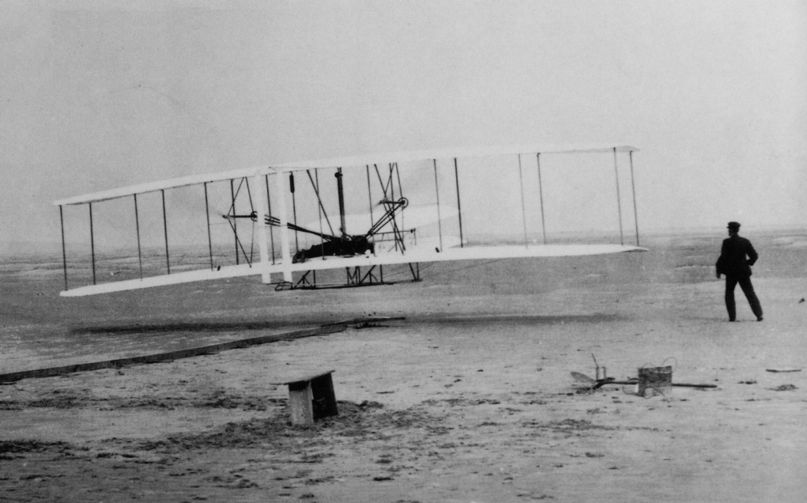
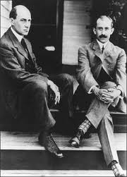
Flight Controls
Wilbur and Orville gave us sustained, controlled, powered heavier than air flight

Slide 37
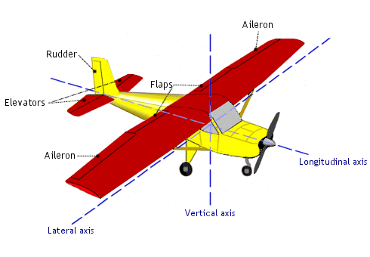
Flight Control Surfaces

Slide 38
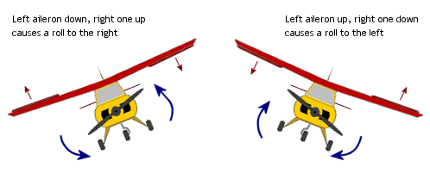
Ailerons
Are hinged, horizontal surfaces attached to the back (trailing edge), outer edges of the wings of the plane.
Used to turn the plane. (ROLL) – Longitudinal Axis
As one aileron rises, the opposite aileron lowers, raising one wing and lowering the other, tilting (or banking) the plane toward the lower aileron.

Slide 39
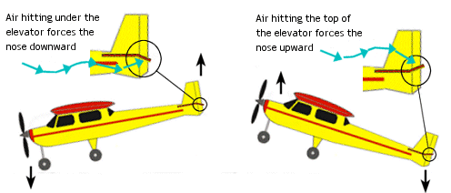
Elevators
Are hinged, horizontal surfaces attached to the trailing edge of the horizontal stabilizer.
Control the plane’s movement upward or downward. (PITCH) – Lateral Axis
When the elevators are raised, the tail is forced downward, the wings are forced upward, and the plane climbs.

Slide 40
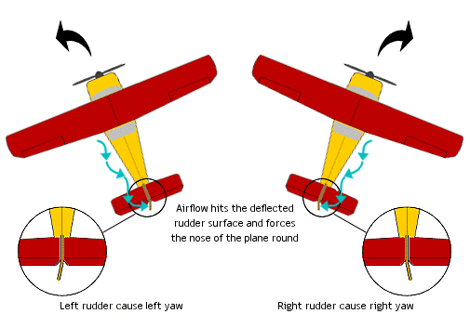
Rudder
A hinged, vertical surface attached to the trailing edge of the vertical stabilizer (tail of the plane).
Helps the plane enter and recover from turns by swinging the tail to the left or right. (YAW) – Vertical Axis

Slide 41
Flight Control Surfaces
Action: | Axis: | Controlled by:
Roll | Longitudinal | Ailerons
Pitch | Lateral | Elevators
Yaw | Vertical | Rudder

Slide 42
Flight Control Surfaces
Action: | Axis: | Controlled by:
Roll | Longitudinal | Ailerons
Pitch | Lateral | Elevators
Yaw | Vertical | Rudder

Slide 43
Flight Control Surfaces
Action: | Axis: | Controlled by:
Roll | Longitudinal | Ailerons
Pitch | Lateral | Elevators
Yaw | Vertical | Rudder

Slide 44
Flight Control Surfaces
Action: | Axis: | Controlled by:
Roll | Longitudinal | Ailerons
Pitch | Lateral | Elevators
Yaw | Vertical | Rudder

Slide 45
Flight Control Surfaces
Action: | Axis: | Controlled by:
Roll | Longitudinal | Ailerons
Pitch | Lateral | Elevators
Yaw | Vertical | Rudder

Slide 46
Flight Control Surfaces
Action: | Axis: | Controlled by:
Roll | Longitudinal | Ailerons
Pitch | Lateral | Elevators
Yaw | Vertical | Rudder

Slide 47
Flight Control Surfaces
Action: | Axis: | Controlled by:
Roll | Longitudinal | Ailerons
Pitch | Lateral | Elevators
Yaw | Vertical | Rudder

Slide 48
Flight Control Surfaces
Action: | Axis: | Controlled by:
Roll | Longitudinal | Ailerons
Pitch | Lateral | Elevators
Yaw | Vertical | Rudder

Slide 49
Flight Control Surfaces
Action: | Axis: | Controlled by:
Roll | Longitudinal | Ailerons
Pitch | Lateral | Elevators
Yaw | Vertical | Rudder

Slide 50
Flight Control Surfaces
Action: | Axis: | Controlled by:
Roll | Longitudinal | Ailerons
Pitch | Lateral | Elevators
Yaw | Vertical | Rudder

Slide 51
Flight Control Surfaces
Action: | Axis: | Controlled by:
Roll | Longitudinal | Ailerons
Pitch | Lateral | Elevators
Yaw | Vertical | Rudder

Slide 52
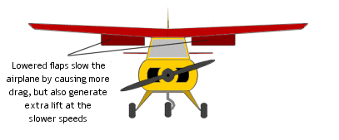
Flaps

Slide 53
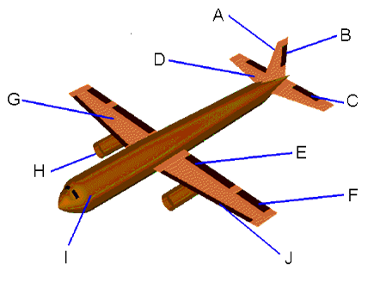
Flight Controls
Flaps
Attached to the trailing edge
Use to slow aircraft and at slow speeds – help create lift

Slide 54
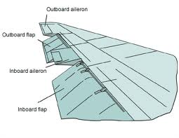

Slide 55
Flight Controls
Slats
Protrusions from the leading edge
Add to lift

Slide 56
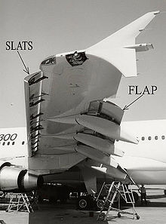

Slide 57
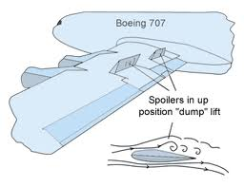
Flight Controls
Spoilers
Work to destroy lift
Located on top of wing

Slide 58
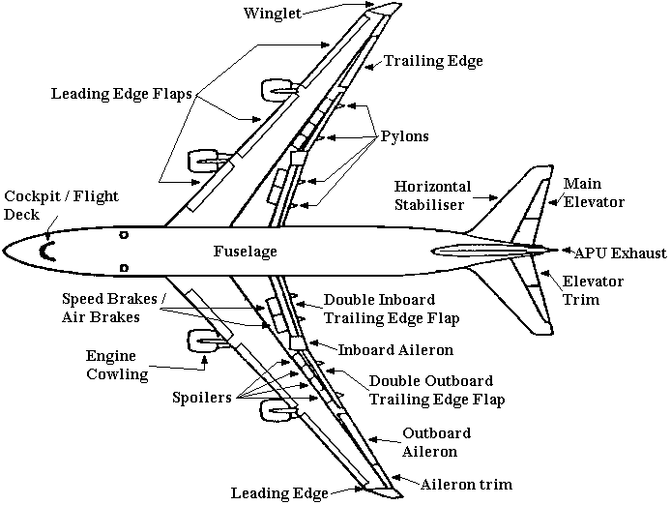

Slide 59
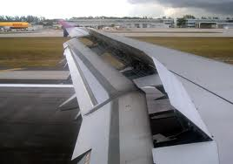

Slide 60
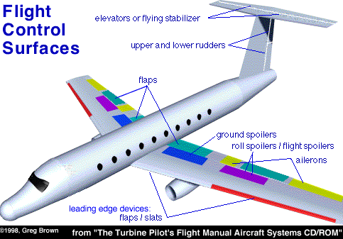

Slide 61
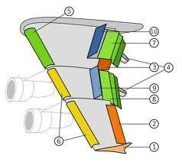

Slide 62
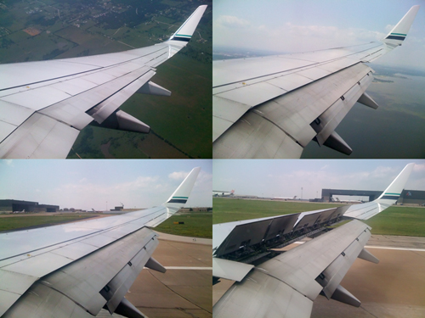

Slide 63
Questions / Comments

Slide 64
Today’s Mission Requirements
Mission:
Describe the Forces of Flight.
Identify the flight control surfaces of an aircraft.
Describe the effects of the flight control surfaces on aircraft flight.
EQ:
Describe aircraft components, their function and how the axes of rotation, forces of flight, and flight controls surfaces contribute to understanding flight.

Slide 65
Flight Control Surfaces

Slide 66
Flight Control Surfaces
Action: | Axis: | Controlled by:
Roll | Longitudinal | Ailerons
Pitch | Lateral | Elevators
Yaw | Vertical | Rudder

Slide 67
Flight Control Surfaces
Action: | Axis: | Controlled by:
Roll | Longitudinal | Ailerons
Pitch | Lateral | Elevators
Yaw | Vertical | Rudder

Slide 68
Flight Control Surfaces
Action: | Axis: | Controlled by:
Roll | Longitudinal | Ailerons
Pitch | Lateral | Elevators
Yaw | Vertical | Rudder

Slide 69
Flight Control Surfaces
Action: | Axis: | Controlled by:
Roll | Longitudinal | Ailerons
Pitch | Lateral | Elevators
Yaw | Vertical | Rudder

Slide 70
Flight Control Surfaces
Action: | Axis: | Controlled by:
Roll | Longitudinal | Ailerons
Pitch | Lateral | Elevators
Yaw | Vertical | Rudder

Slide 71
Flight Control Surfaces
Action: | Axis: | Controlled by:
Roll | Longitudinal | Ailerons
Pitch | Lateral | Elevators
Yaw | Vertical | Rudder

Slide 72
Flight Control Surfaces
Action: | Axis: | Controlled by:
Roll | Longitudinal | Ailerons
Pitch | Lateral | Elevators
Yaw | Vertical | Rudder

Slide 73
Flight Control Surfaces
Action: | Axis: | Controlled by:
Roll | Longitudinal | Ailerons
Pitch | Lateral | Elevators
Yaw | Vertical | Rudder

Slide 74
Flight Control Surfaces
Action: | Axis: | Controlled by:
Roll | Longitudinal | Ailerons
Pitch | Lateral | Elevators
Yaw | Vertical | Rudder

Slide 75
Flight Control Surfaces
Action: | Axis: | Controlled by:
Roll | Longitudinal | Ailerons
Pitch | Lateral | Elevators
Yaw | Vertical | Rudder

Slide 76
Flight Control Surfaces
Action: | Axis: | Controlled by:
Roll | Longitudinal | Ailerons
Pitch | Lateral | Elevators
Yaw | Vertical | Rudder

Slide 77
Questions / Comments

Slide 78
Lab Time

