Slide 1
Warm-Up – 8/22 – 10 minutes
Utilizing your past knowledge answer the following questions:
In the event of an emergency evacuation – what are the classroom procedures?
What is the classroom procedure for cell phone and headphone use?
What are the classroom rules regarding food, gum and drinks?
What is the classroom expectation for note taking and pens / pencils?
What is the phonetic alphabet for the letters:
D, L, N, V, Y, Z

Slide 2
Questions / Comments

Slide 3
Warm-Up – 8/22 – 10 minutes
Utilizing your past knowledge answer the following questions:
In the event of an emergency evacuation – what are the classroom procedures?
What is the classroom procedure for cell phone and headphone use?
What are the classroom rules regarding food, gum and drinks?
What is the classroom expectation for note taking and pens / pencils?
What is the phonetic alphabet for the letters:
D, L, N, V, Y, Z

Slide 4
Emergency Information
In the event of an evacuation:
Orderly – leave bags
Exit classroom
Go straight out doors to grass area
Stay together and out of road
Need to take attendance

Slide 5
Warm-Up – 8/22 – 10 minutes
Utilizing your past knowledge answer the following questions:
In the event of an emergency evacuation – what are the classroom procedures?
What is the classroom procedure for cell phone and headphone use?
What are the classroom rules regarding food, gum and drinks?
What is the classroom expectation for note taking and pens / pencils?
What is the phonetic alphabet for the letters:
D, L, N, V, Y, Z

Slide 6
Class Standards
BE ON TIME!
NO CELL PHONES! No Headphones!
Dress Code
Raise Hand to be heard.
Passes
Bathroom
Nurse
NO OTHERS!
No Heads on desk
Last 10 minutes in seat

Slide 7
Warm-Up – 8/22 – 10 minutes
Utilizing your past knowledge answer the following questions:
In the event of an emergency evacuation – what are the classroom procedures?
What is the classroom procedure for cell phone and headphone use?
What are the classroom rules regarding heads on desk, food, gum and drinks?
What is the classroom expectation for note taking and pens / pencils?
What is the phonetic alphabet for the letters:
D, L, N, V, Y, Z

Slide 8
Class Standards
BE ON TIME!
NO CELL PHONES! No Headphones!
Dress Code
Raise Hand to be heard.
Passes
Bathroom
Nurse
NO OTHERS!
No Heads on desk
No FOOD, Drinks (water only) or Gum!

Slide 9
Warm-Up – 8/22 – 10 minutes
Utilizing your past knowledge answer the following questions:
In the event of an emergency evacuation – what are the classroom procedures?
What is the classroom procedure for cell phone and headphone use?
What are the classroom rules regarding food, gum and drinks?
What is the classroom expectation for note taking and pens / pencils?
What is the phonetic alphabet for the letters:
D, L, N, V, Y, Z

Slide 10
Class Expectations
Come to class prepared
ALL Assignments complete
Notebook
Pen or Pencil
Pencil Sharpening no more than 2 in line
Class Duty Assignments
Plane Captain for each Group
Class Leader - Hangar Cleanup
Admin Assistant
Safety Monitor
Julian Date Calendar
Weather Guesser

Slide 11
Warm-Up – 8/22 – 10 minutes
Utilizing your past knowledge answer the following questions:
In the event of an emergency evacuation – what are the classroom procedures?
What is the classroom procedure for cell phone and headphone use?
What are the classroom rules regarding food, gum and drinks?
What is the classroom expectation for note taking and pens / pencils?
What is the phonetic alphabet for the letters:
D, L, N, V, Y, Z

Slide 12
Phonetic Alphabet
A – Alpha
B – Bravo
C – Charlie
D – Dog
E – Echo
F – Foxtrot
G – Gulf
H – Hotel
I – Indigo
J – Juliet
K – Kilo
L – Lima
M – Mike
N – November
O – Oscar
P – Papa
Q - Quebec
R – Romeo
S – Sierra
T – Tango
U – Uniform
V – Victor
W - Whiskey
X – X-ray
Y – Yankee
Z - Zulu

Slide 13
Questions / Comments

Slide 14
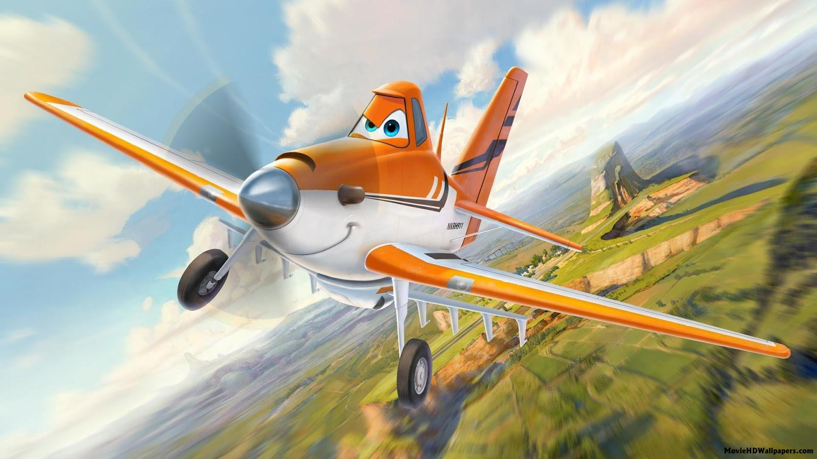
Intro to Aviation Video of the Day

Slide 15
Questions / Comments

Slide 16
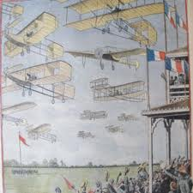
THIS DAY IN AVIATION
August 22
1909 — The first great aviation meeting in Bétheny, France, opens as 23 European airplanes make 87 flights during one week.
The meeting will have a strong influence on the technical and military aspects of flight.

Slide 17
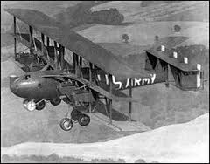
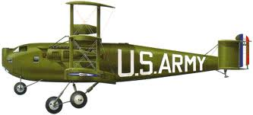
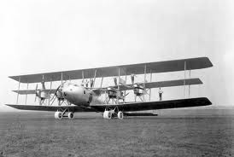
THIS DAY IN AVIATION
August 22
1923 — The Barling bomber made its initial flight.

Slide 18
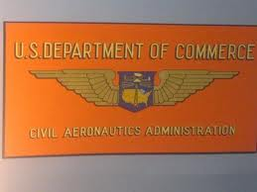
THIS DAY IN AVIATION
August 22
1938 — The Civil Aeronautics Act becomes effective in the United States, coordinating all non-military aviation under the Civil Aeronautics Authority.

Slide 19
Questions / Comments

Slide 20
August 2017
Sunday | Monday | Tuesday | Wednesday | Thursday | Friday | Saturday
 |  | 1 | 2 | 3 | 4 | 5
6 | 7 | 8 | 9 | 10 | 11 | 12
13 | 14 | 15 | 16 | 17 Welcome to Aviation | 18 Flightline Friday | 19
20 | 21 NO SCHOOL | 22 Parts of an Aircraft Forces of Flight Syllabus Due | 23 Flight Control Surfaces | 24 Aircraft Review | 25 Flight Line Friday Quiz | 26
27 | 28 Chapter 1 Intro to Aviation | 29 Chapter 1 Intro to Aviation | 30 Chapter 1 Intro to Aviation | 31 Chapter 1 Intro to Aviation | 1 Flightline Friday Test | 2
3 | 4 HOLIDAY | 5 | 6

Slide 21
Questions / Comments

Slide 22
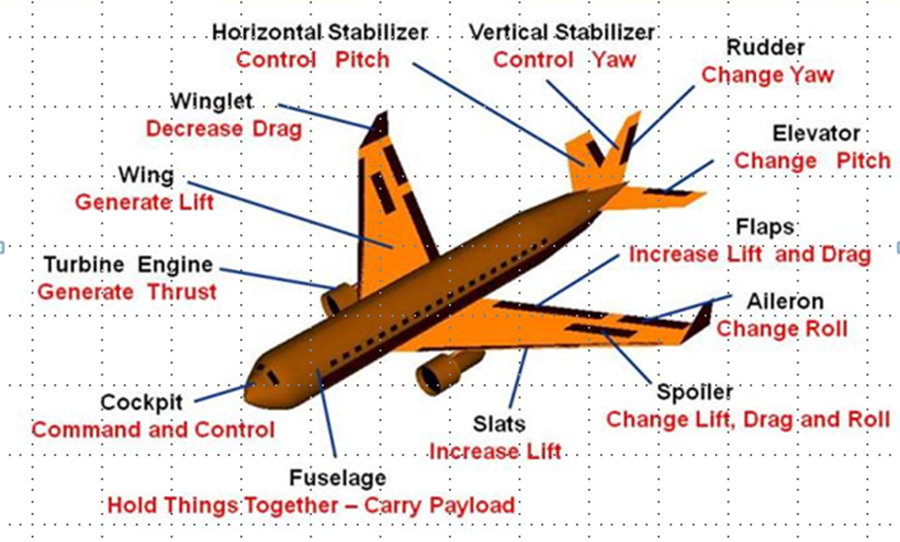
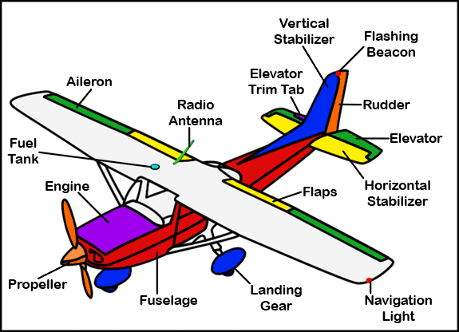
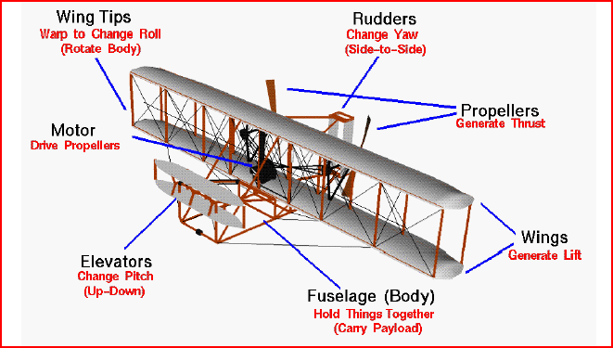
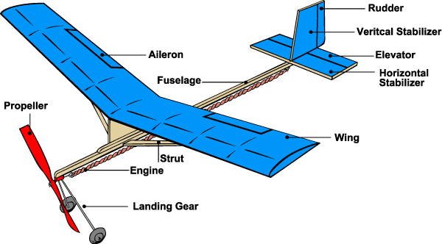
Chapter 8 – Aircraft in Motion

Slide 23
Today’s Mission Requirements
Mission:
Identify the basic parts of a conventional airplane.
Describe the three types of landing gear arrangements.
Describe the Forces of Flight.
EQ:
Describe aircraft components, their function and how the axes of rotation, forces of flight, and flight controls surfaces contribute to understanding flight.

Slide 24
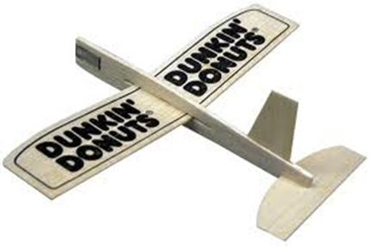

Slide 25
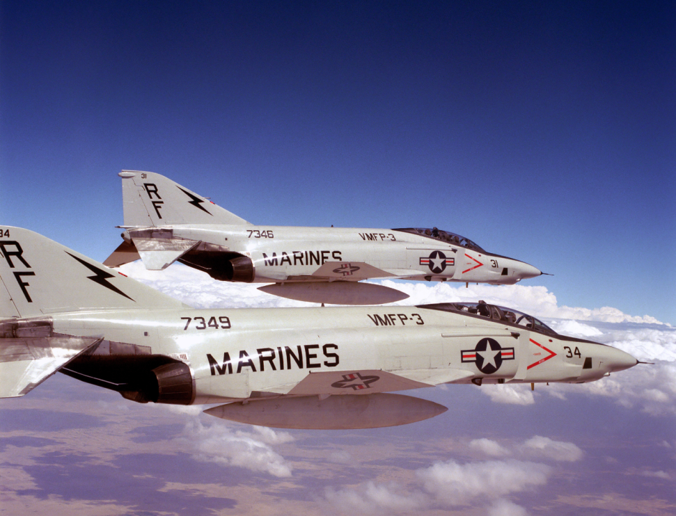
Aircraft
Parts

Slide 26
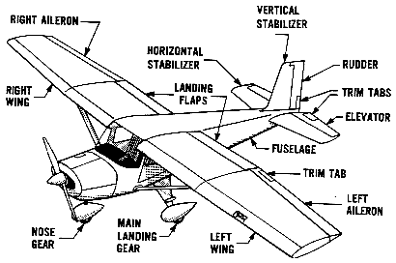
Basic Airplane and its Parts

Slide 27
Basic Airplane and its Parts

Slide 28
Basic Airplane and its Parts

Slide 29
Basic Airplane and its Parts

Slide 30
Basic Airplane and its Parts

Slide 31
Basic Airplane and its Parts

Slide 32
Basic Airplane and its Parts

Slide 33
Basic Airplane and its Parts

Slide 34
Basic Airplane and its Parts

Slide 35
Basic Airplane and its Parts

Slide 36
Basic Airplane and its Parts
EMPENNAGE

Slide 37
Basic Airplane and its Parts

Slide 38
Basic Airplane and its Parts

Slide 39
Basic Airplane and its Parts

Slide 40
Basic Airplane and its Parts

Slide 41
Basic Airplane and its Parts

Slide 42
Basic Airplane and its Parts
EMPENNAGE

Slide 43
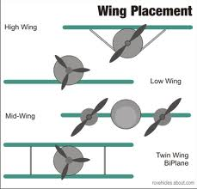

Slide 44
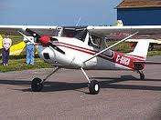
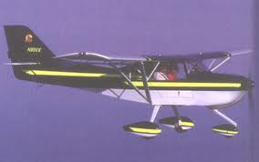
Landing Gear
Three Types
Conventional (“tail dragger”)
2 fwd, 1 rear
Tricycle
Nose wheel and two on the side
Tandem
Two sets wheels one behind the other on the fuselage
AV-8B / B-52– requires outrigger gear

Slide 45
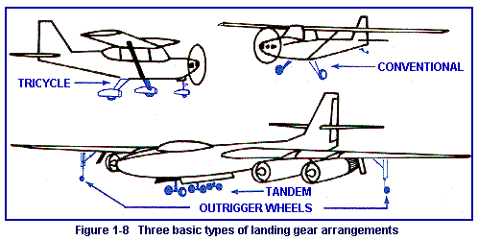

Slide 47
Four Forces of Flight
Determine whether an airplane rises or falls through the air:
Thrust
Drag
Lift
Gravity (Weight)

Slide 48
Questions / Comments

Slide 49
Today’s Mission Requirements
Mission:
Identify the basic parts of a conventional airplane.
Describe the three types of landing gear arrangements.
Describe the Forces of Flight.
EQ:
Describe aircraft components, their function and how the axes of rotation, forces of flight and flight controls surfaces contribute to understanding flight.

Slide 50
Basic Airplane and its Parts

Slide 52
Basic Airplane and its Parts

Slide 53
Basic Airplane and its Parts

Slide 54
Basic Airplane and its Parts

Slide 55
Basic Airplane and its Parts

Slide 56
Basic Airplane and its Parts

Slide 57
Basic Airplane and its Parts

Slide 58
Basic Airplane and its Parts

Slide 59
Basic Airplane and its Parts

Slide 60
Basic Airplane and its Parts

Slide 61
Basic Airplane and its Parts

Slide 62
Basic Airplane and its Parts
EMPENNAGE

Slide 63
Basic Airplane and its Parts

Slide 64
Basic Airplane and its Parts

Slide 65
Basic Airplane and its Parts

Slide 66
Basic Airplane and its Parts

Slide 67
Basic Airplane and its Parts

Slide 68
Basic Airplane and its Parts
EMPENNAGE

Slide 69
Today’s Mission Requirements
Mission:
Identify the basic parts of a conventional airplane.
Describe the three types of landing gear arrangements.
Describe the Forces of Flight.
EQ:
Describe aircraft components, their function and how the axes of rotation, forces of flight and flight controls surfaces contribute to understanding flight.

Slide 70
Landing Gear
Three Types
Conventional (“tail dragger”)
2 fwd, 1 rear
Tricycle
Nose wheel and two on the side
Tandem
Two sets wheels one behind the other on the fuselage
AV-8B / B-52– requires outrigger gear

Slide 72
Today’s Mission Requirements
Mission:
Identify the basic parts of a conventional airplane.
Describe the three types of landing gear arrangements.
Describe the Forces of Flight.
EQ:
Describe aircraft components, their function and how the axes of rotation, forces of flight and flight controls surfaces contribute to understanding flight.

Slide 73
Four Forces of Flight
Determine whether an airplane rises or falls through the air:
Thrust
Drag
Lift
Gravity (Weight)

Slide 74
Questions / Comments

Slide 75
Lab Time

Slide 76
