Slide 1
Warm-Up – 4/23 – 10 minutes
Utilizing your notes and past knowledge answer the following questions:
Describe the electrical system on an aircraft?
Describe compass deviation.
Describe true airspeed versus ground speed?
Describe pilotage?
What are the 18 Great Circles going north to south and are they lines of longitude or latitude?

Slide 2


Questions / Comments

Slide 3
Warm-Up – 4/23 – 10 minutes
Utilizing your notes and past knowledge answer the following questions:
Describe the electrical system on an aircraft?
Describe compass deviation.
Describe true airspeed versus ground speed?
Describe pilotage?
What are the 18 Great Circles going north to south and are they lines of longitude or latitude?

Slide 4
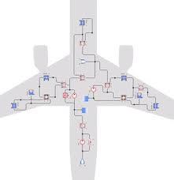
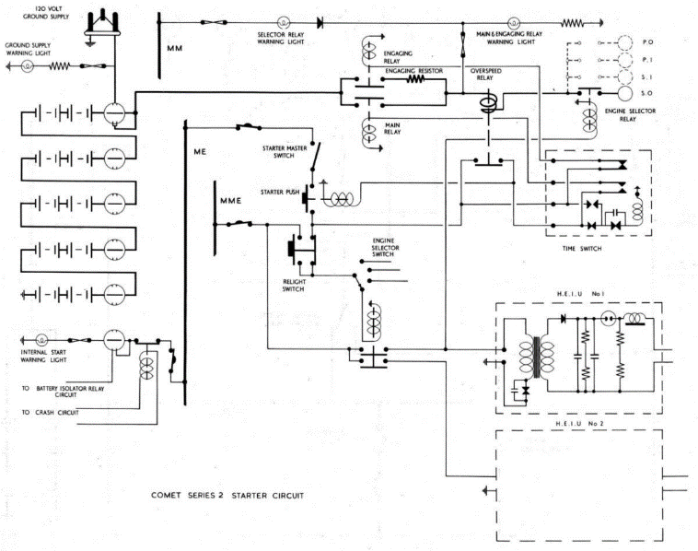
Systems
Hydraulic
    Uses fluid pressure to operate brakes, flight controls, and landing gear
  Electrical
      Generator attached to engine provides electricity to charge battery, start engine, operate radios, and navigation and landing lights

Slide 5
Warm-Up – 4/23 – 10 minutes
Utilizing your notes and past knowledge answer the following questions:
Describe the electrical system on an aircraft?
Describe compass deviation.
Describe true airspeed versus ground speed?
Describe pilotage?
What are the 18 Great Circles going north to south and are they lines of longitude or latitude?

Slide 6
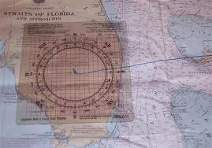
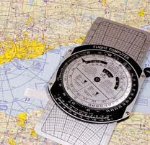
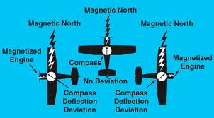
Basic Navigational Practices
True-Course Line
  Line or series of lines a pilot will follow
Magnetic Courses
  Magnetic North different from Geographic north due to changing magnetic fields of earth
Compass Deviation
  Needs to be calibrated due to metals and electrical power within aircraft

Slide 7
Warm-Up – 4/23 – 10 minutes
Utilizing your notes and past knowledge answer the following questions:
Describe the electrical system on an aircraft?
Describe compass deviation.
Describe true airspeed versus ground speed?
Describe pilotage?
What are the 18 Great Circles going north to south and are they lines of longitude or latitude?

Slide 8
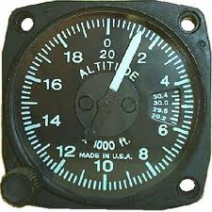
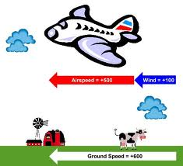
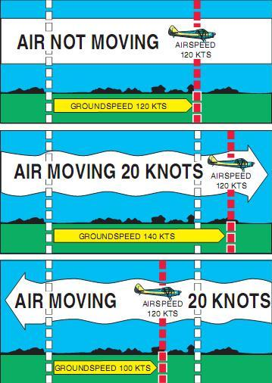
Basic Navigational Practices
Altimeter
  Distance from surface of the Earth
True Airspeed vs Ground Speed
  How fast through air opposed to how fast across surface of Earth

Slide 9
Warm-Up – 4/23 – 10 minutes
Utilizing your notes and past knowledge answer the following questions:
Describe the electrical system on an aircraft?
Describe compass deviation.
Describe true airspeed versus ground speed?
Describe pilotage?
What are the 18 Great Circles going north to south and are they lines of longitude or latitude?

Slide 10
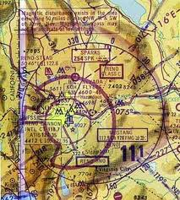
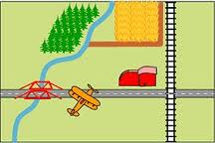
Navigational Techniques
Pilotage
  Navigating via visible landmarks
    Water towers, highways etc..

Slide 11
Warm-Up – 4/23 – 10 minutes
Utilizing your notes and past knowledge answer the following questions:
Describe the electrical system on an aircraft?
Describe compass deviation.
Describe true airspeed versus ground speed?
Describe pilotage?
What are the 18 Great Circles going north to south and are they lines of longitude or latitude?

Slide 12
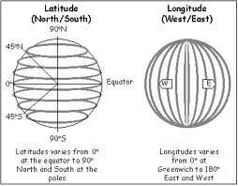
Global Coordinate System
Eighteen primary “great circles” going north-south are called lines of longitude
  20 degrees apart
  Starting point – Prime Meridian – Greenwich, England
Parallel lines having 10 degrees spacing from the equator are called lines of latitude

Slide 13

Questions / Comments

Slide 14
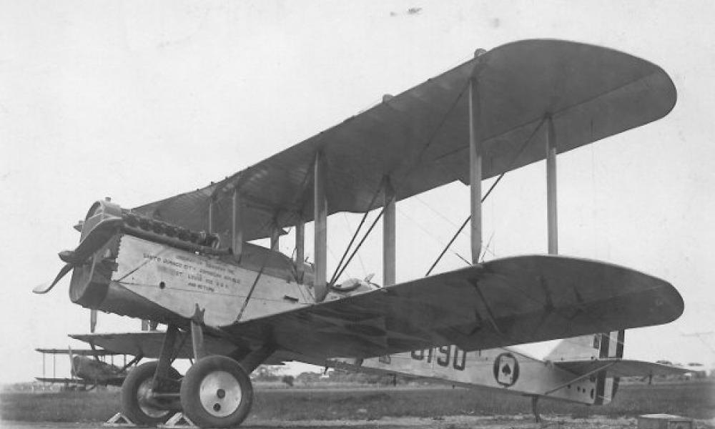
THIS DAY IN AVIATION
April 23
1921 — First Air Squadron, USMC, completes photo mosaic map of Dominican Republic coastline.

Slide 15
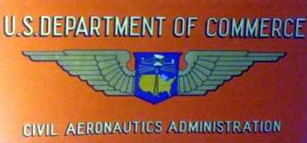
THIS DAY IN AVIATION
April 23
1939 — The United States Civil Aeronautics Authority raises the eligibility age for obtaining a private pilot license to 18 years from the previous 16 years of age.

Slide 16
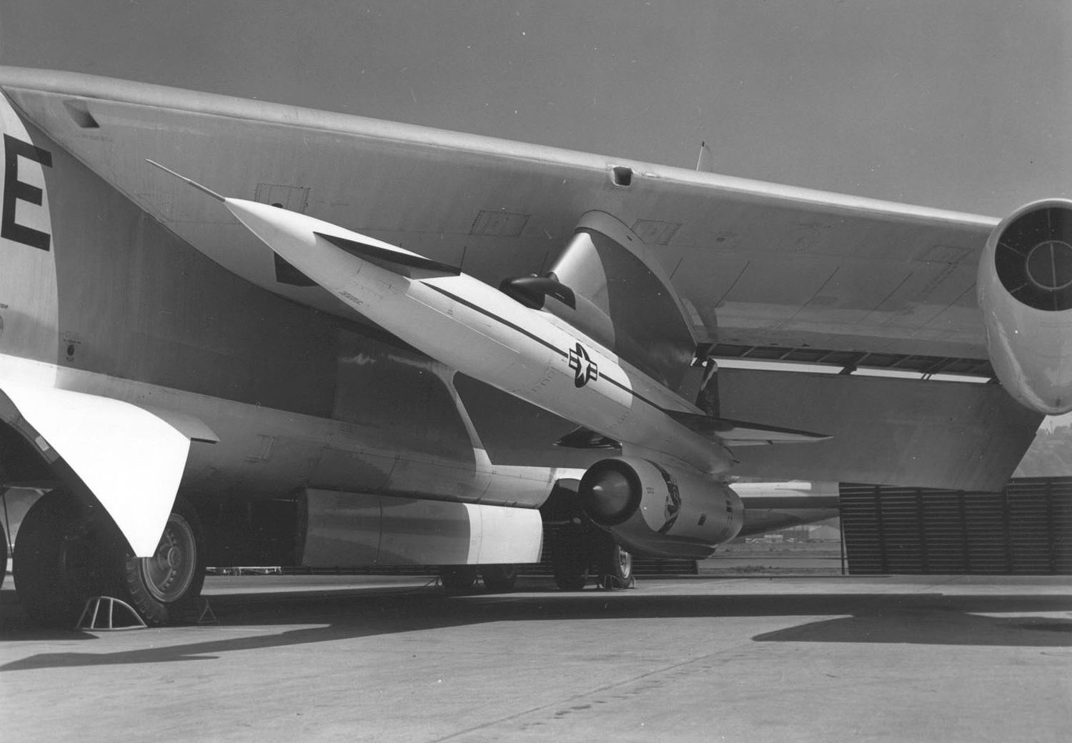
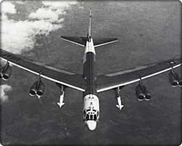
THIS DAY IN AVIATION
April 23
1959 — The North American Aviation GAM-77 “Hound Dog” strategic missile was launched for the first time from a Boeing B-52 “Stratofortress.”

Slide 17
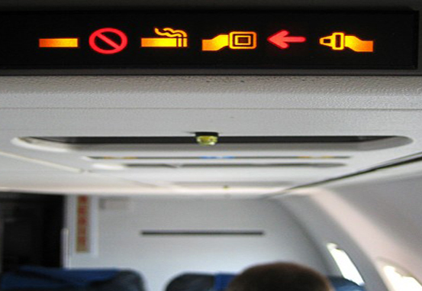

THIS DAY IN AVIATION
April 23
1988 — The United States government's ban on smoking on flights of two hours or less goes into effect.
“No Smoking” signs remain lit on 80% of domestic airline flights.
Flight attendants are to be armed with gum and candy for those in anguish.

Slide 18
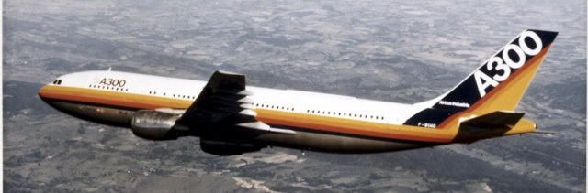
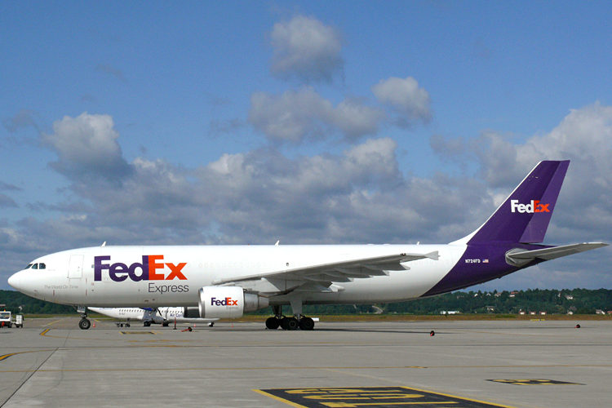
THIS DAY IN AVIATION
April 23
1994 — Airbus delivers the first of 25 Airbus A300-600F dedicated freighters to the specialized package carrier, FedEx.
This all-cargo version can carry up to a maximum payload of 120,855 lb over a range of 1,900 nautical miles.

Slide 19
Questions / Comments

Slide 20
AVIATION ACES
3B
Pilots (A – 90 & above)
3B
Co-Pilots (B – 80 – 89)
Big Bird
O-Cam
Ryder
Top Gun
Apache
Big Red
JD, Bull Dog and French Fry – take Test
High Shooter (96)

Slide 21
April / May 2018
SUNDAY | MONDAY | TUESDAY | WEDNESDAY | THURSDAY | FRIDAY | SATURDAY
15 | 16 Chapter 9 Navigation | 17 Chapter 9 Navigation | 18 Chapter 8 Aircraft in Motion | 19 Chapter 8 Aircraft in Motion | 20 Chapter 8/9 Review Chapter 8/9 Test Flight Line Friday | 21
22 | 23 Chapter 14 Airspace | 24 Chapter 14 Airspace | 25 Chapter 14 Airspace | 26 Chapter 14 Airspace Review and Test | 27 Flight Line Friday | 28
29 | 30 NTSB Accident Investigation | 1 NTSB Accident Investigation | 2 NTSB Accident Investigation | 3 NTSB Accident Investigation Presentations | 4 Flight Line Friday | 5
6 | 7 Chapter 21 Rocket Fundamentals | 8 Chapter 21 Rocket Fundamentals | 9 Chapter 21 Review Chapter 21 Test | 10 Rocket Launch | 11 Patriots Point Field Trip | 12

Slide 22
Questions / Comments

Slide 23

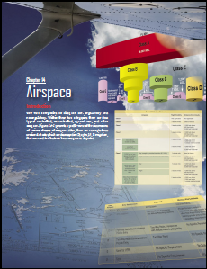
Chapter 14– Airspace
FAA – Pilot’s Handbook of Aeronautical Knowledge

Slide 24
Today’s Mission Requirements
Mission:
Describe the two categories of airspace.
Describe within these two categories the four types of airspace.
Explain the dimensions of various classes of airspace.
EQ:
  Describe the importance of Aeronautical Knowledge for the student pilot learning to fly.

Slide 25
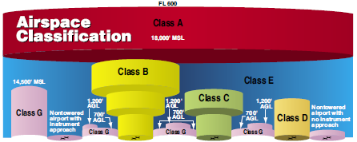
Introduction
The two categories of airspace are: regulatory and Non- regulatory.
Within these two categories there are four types: controlled, uncontrolled, special use, and other airspace.

Slide 26
Controlled Airspace
Controlled airspace is a generic term that covers the different classifications of airspace
Controlled airspace consists of:
  Class A
  Class B
  Class C
  Class D
  Class E

Slide 27
Class A Airspace
Airspace from 18,000 feet mean sea level (MSL) up to and including flight level (FL) 600,
All operation in Class A airspace is conducted under instrument flight rules (IFR).

Slide 28
Class B Airspace
Airspace from the surface to 10,000 feet MSL surrounding the nation’s busiest airports
Class B airspace areas resemble upside-down wedding cakes
ATC clearance is required for all aircraft to operate in the area, and all aircraft that are so cleared receive separation services within the airspace.

Slide 29
Class C Airspace
Surface to 4,000 feet above the airport elevation surrounding those airports that have an operational control tower, are serviced by a radar approach control, and have a certain number of IFR operations or passenger enplanements.
Airspace usually consists of a surface area with a five NM radius, an outer circle with a ten NM radius that extends from 1,200 feet to 4,000 feet above the airport elevation, and an outer area.

Slide 30
Class C Airspace
Each aircraft must establish two-way radio communications with the ATC facility providing air traffic services prior to entering the airspace and thereafter maintain those communications while within the airspace.

Slide 31
Class D Airspace
Surface to 2,500 feet above the airport elevation (charted in MSL) surrounding those airports that have an operational control tower.
Aircraft must establish two-way radio communications with the ATC facility and thereafter maintain those communications while in the airspace.

Slide 32
Class E Airspace
Airspace extends upward from either the surface or a designated altitude to the overlying or adjacent controlled airspace.
Beginning at either 700 or 1,200 feet above ground level (AGL) below 18,000 feet MSL.

Slide 33
Uncontrolled Airspace – Class G
Class G airspace is the portion of the airspace that has not been designated as Class A, B, C, D, or E.
Therefore designated uncontrolled airspace.
Pilots should remember there are visual flight rules (VFR) minimums which apply to Class G airspace.

Slide 34
Questions / Comments

Slide 35
ATC Sector 33 - Challenge
Login to computer
Go to website – Intro to Aviation / Class Materials – ATC Simulation Worksheet
Go to link
  https://www.atcsim.nasa.gov/simulator/sim2/sector33.html
Complete assigned levels
  Tues – 2.1, 2.3
  Wed – 2.6, 3.6
  Thurs – 4.8, 5.6
Complete conclusion questions – Use Snipping Tool to Snip screen shot and post at end of worksheet and turn-in via website with name

Slide 36
Questions / Comments

Slide 37
2nd Quarter Requirements
(3 weeks – May 18)
All students will complete the following:
  Take notes - All in class quizzes and tests
  Private Pilot Syllabus
    Lessons 1 – 5 (Taxiing through Air Traffic Control)
    Must pass written with 80%
    Successfully complete 3 times on small sim
    Successfully complete 1 time on Main sim
  Complete ERAU Aviation 101
    3 quizzes and 1 test
  Student will receive zero points for all incomplete work – NO make-up / extra credit
NOTE: All unfinished Student Pilot and ERAU must be complete prior to starting Private Pilot and last 3 quizzes and test for ERAU.

Slide 38
Special Use Airspace
Designation for airspace in which certain activities must be confined, or where limitations may be imposed on aircraft operations that are not part of those activities.
Special use airspace usually consists of:
  Prohibited areas
  Restricted areas
  Warning areas
  Military operation areas (MOAs)
  Alert areas

Slide 39
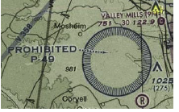
Prohibited Areas
Contain airspace of defined dimensions within which the flight of aircraft is prohibited.
Established for security or other reasons associated with the national welfare.
These areas are depicted on aeronautical charts.

Slide 40
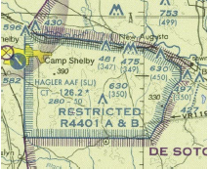
Restricted Areas
Areas where operations are hazardous to nonparticipating aircraft and contain airspace within which the flight of aircraft, while not wholly prohibited, is subject to restrictions.
Restricted areas denote the existence of unusual, often invisible, hazards to aircraft

Slide 41
Restricted Areas
Penetration of restricted areas without authorization from the using or controlling agency may be extremely hazardous to the aircraft and its occupants.
Restricted areas are charted with an “R” followed by a number.

Slide 42
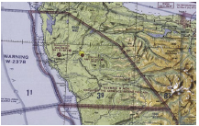
Warning Areas
Similar in nature to restricted areas; however, the United States government does not have sole jurisdiction over the airspace.
Extending from 12 NM outward from the coast of the United States, containing activity that may be hazardous to nonparticipating aircraft.
Airspace is designated with a “W” followed by a number (e.g., W-237).

Slide 43
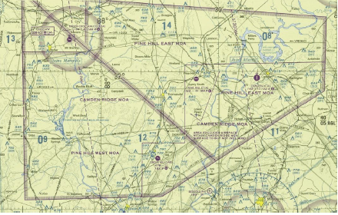
Military Operation Areas (MOAs)
Purpose of separating certain military training activities from IFR traffic.
Whenever an MOA is being used ATC reroutes or restricts nonparticipating IFR traffic.
MOAs are depicted on sectional and en route low altitude charts.

Slide 44
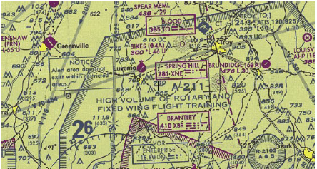
Alert Areas
Depicted on aeronautical charts with an “A” followed by a number (e.g., A-211) to inform nonparticipating pilots of areas that may contain a high volume of pilot training or an unusual type of aerial activity.
Pilots should exercise caution in alert areas.

Slide 45
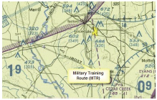
Other Airspace Areas
Military training route (MTR)
Temporary flight restriction (TFR)

Slide 46
Military Training Routes (MTRs)
Routes used by military aircraft to maintain proficiency in tactical flying.
Usually established below 10,000 feet MSL for operations at speeds in excess of 250 knots.

Slide 47
Temporary Flight Restrictions (TFR)
A flight data center (FDC) Notice to Airmen (NOTAM) is issued to designate a TFR.
The NOTAM begins with the phrase “FLIGHT RESTRICTIONS” followed by the location of the temporary restriction, effective time period, area defined in statute miles, and altitudes affected.
The pilot should check the NOTAMs as part of flight planning.

Slide 48
Temporary Flight Restrictions (TFR)
Some of the purposes for establishing a TFR are:
  Protect persons and property in the air or on the surface from an existing or imminent hazard.
  Provide a safe environment for the operation of disaster relief aircraft.
  Protect the President, Vice President, or other public figures.
  Provide a safe environment for space agency operations.

Slide 49
Temporary Flight Restrictions (TFR)
Since the events of September 11, 2001, the use of TFRs has become much more common.
It is a pilot’s responsibility to be aware of TFRs in their proposed area of flight.
One way to check is to visit the FAA website, www.tfr.faa.gov, and verify that there is not a TFR in the area.

Slide 50
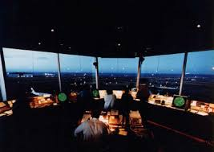
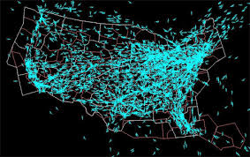
Air Traffic Control and the National Airspace System
The primary purpose of the ATC system is to prevent a collision between aircraft operating in the system and to organize and expedite the flow of traffic

Slide 51
Operating in the Various Types of Airspace
It is important that pilots be familiar with the operational requirements for each of the various types or classes of airspace.

Slide 52
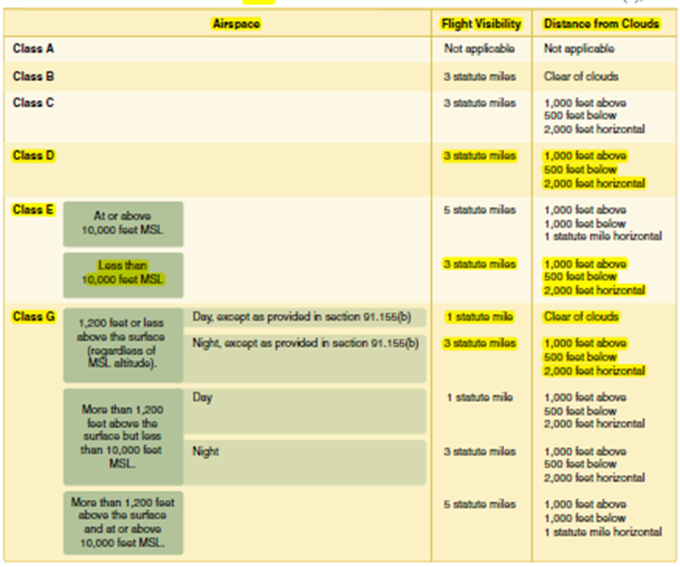
Basic VFR Weather Minimums
No pilot may operate an aircraft under basic VFR when the flight visibility is less, or at a distance from clouds that is less, than that prescribed for the corresponding altitude and class of airspace.
Basic VFR weather minimum.
  1,000' ceiling and 3SM of visibility

Slide 53
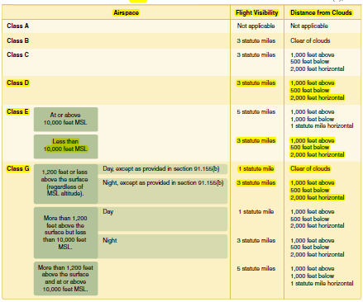
Basic VFR Weather Minimums

Slide 54
Chapter Summary
This chapter introduces the various classifications of airspace and provides information on the requirements to operate in such airspace.

Slide 55
Questions / Comments

