Slide 1
Warm-Up – 9/9 – 10 minutes
Utilizing your notes and past knowledge answer the following questions:
What are the two most popular types of fuselage structures?
What are the three types of wing designs?
What are wing struts attached midway out on the wing called?
What are the principal structural parts of a wing?
When flaps are extended during takeoff what do they provide to the aircraft?

Slide 2
Questions / Comments

Slide 3
Warm-Up – 9/9 – 10 minutes
Utilizing your notes and past knowledge answer the following questions:
What are the two most popular types of fuselage structures?
What are the three types of wing designs?
What are wing struts attached midway out on the wing called?
What are the principal structural parts of a wing?
When flaps are extended during takeoff what do they provide to the aircraft?

Slide 4
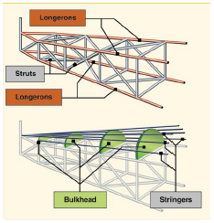
Major Components Fuselage
The most popular types of fuselage structures used in today’s aircraft are the monocoque (French for “single shell”) and semimonocoque.

Slide 5
Warm-Up – 9/9 – 10 minutes
Utilizing your notes and past knowledge answer the following questions:
What are the two most popular types of fuselage structures?
What are the three types of wing designs?
What are wing struts attached midway out on the wing called?
What are the principal structural parts of a wing?
When flaps are extended during takeoff what do they provide to the aircraft?

Slide 6
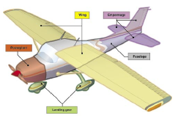
Major Components Wings
Wings may be attached at the top, middle, or lower portion of the fuselage.
These designs are referred to as high-, mid-, and low-wing, respectively.

Slide 7
Warm-Up – 9/9 – 10 minutes
Utilizing your notes and past knowledge answer the following questions:
What are the two most popular types of fuselage structures?
What are the three types of wing designs?
What are wing struts attached midway out on the wing called?
What are the principal structural parts of a wing?
When flaps are extended during takeoff what do they provide to the aircraft?

Slide 8
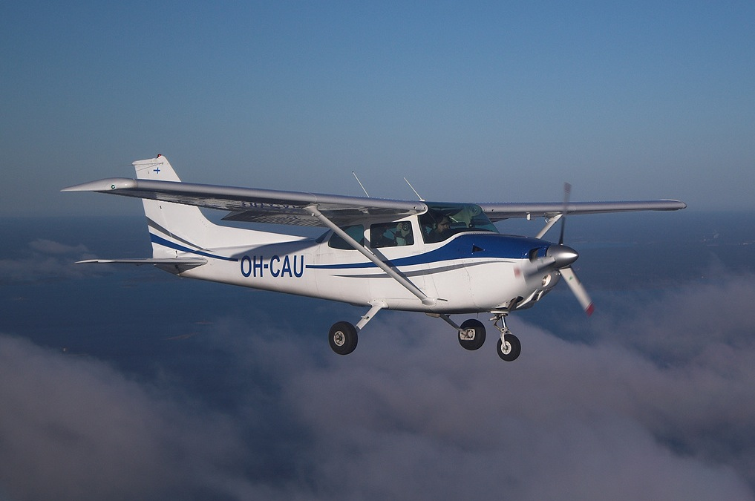
Major Components Wings
Since the wing struts are usually attached approximately halfway out on the wing, this type of wing structure is called semi-cantilever.
A few high-wing and most low-wing airplanes have a full cantilever wing designed to carry the loads without external struts.

Slide 9
Warm-Up – 9/9 – 10 minutes
Utilizing your notes and past knowledge answer the following questions:
What are the two most popular types of fuselage structures?
What are the three types of wing designs?
What are wing struts attached midway out on the wing called?
What are the principal structural parts of a wing?
When flaps are extended during takeoff what do they provide to the aircraft?

Slide 10
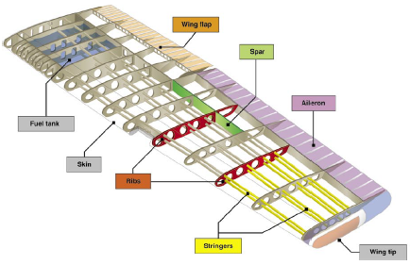
Major Components Wings
The principal structural parts of the wing are spars, ribs, and stringers.
These are reinforced by trusses, I-beams, tubing, or other devices, including the skin.

Slide 11
Warm-Up – 9/9 – 10 minutes
Utilizing your notes and past knowledge answer the following questions:
What are the two most popular types of fuselage structures?
What are the three types of wing designs?
What are wing struts attached midway out on the wing called?
What are the principal structural parts of a wing?
When flaps are extended during takeoff what do they provide to the aircraft?

Slide 12
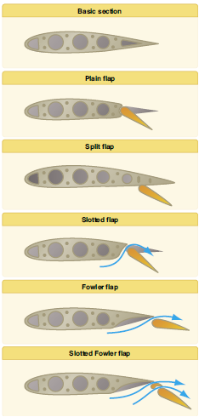
Major Components Wings
The flaps are normally flush with the wing’s surface during cruising flight.
When extended, the flaps move simultaneously downward to increase the lifting force of the wing for takeoffs and landings.

Slide 13
Questions / Comments

Slide 14
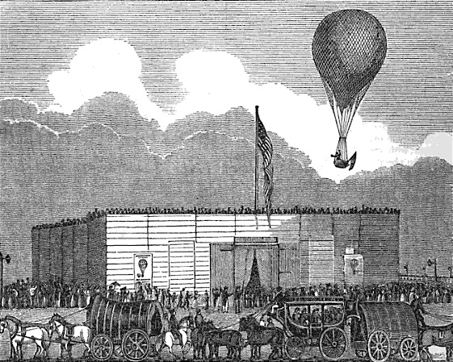
THIS DAY IN AVIATION
September 9
1830 — Charles Durant, America's first great balloonist, makes his first United States ascent at Castle Garden, New York.
He stays in the air for two hours, landing at South Amboy, New Jersey.
His skill and enthusiasm inspire a passion for ballooning in America.

Slide 15
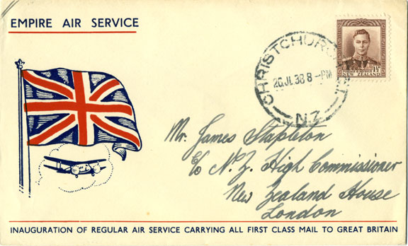
THIS DAY IN AVIATION
September 9
1911 — The first mail carried by air in the United Kingdom is delivered.
The mail contains messages for King George V and other members of the British Royal family.

Slide 16
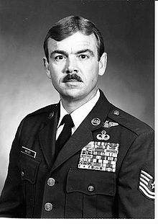
THIS DAY IN AVIATION
September 9
1967 — Sgt. Duane D. Hackney became the first living enlisted man to receive the Air Force Cross.

Slide 17
Questions / Comments

Slide 18
September 2013
Sunday | Monday | Tuesday | Wednesday | Thursday | Friday | Saturday
1 | 2 | 3 Quiz Review Chapter 2 | 4 | 5 Chap 2 Flight Sim Orientation | 6 | 7
8 | 9 Chapter 2 | 10 | 11 Chapter 2 | 12 | 13 Flightline Friday | 14
15 | 16 | 17 Chapter 2 | 18 | 19 Chapter 2 | 20 | 21
22 | 23 Chapter 3 | 24 | 25 Chapter 3 | 26 | 27 Flightline Friday | 28
29 | 30

Slide 19
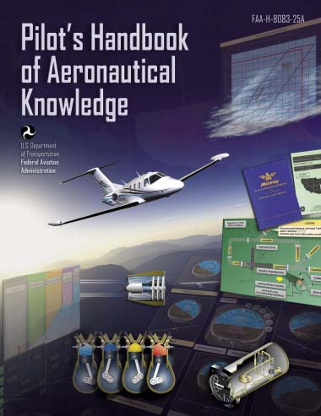
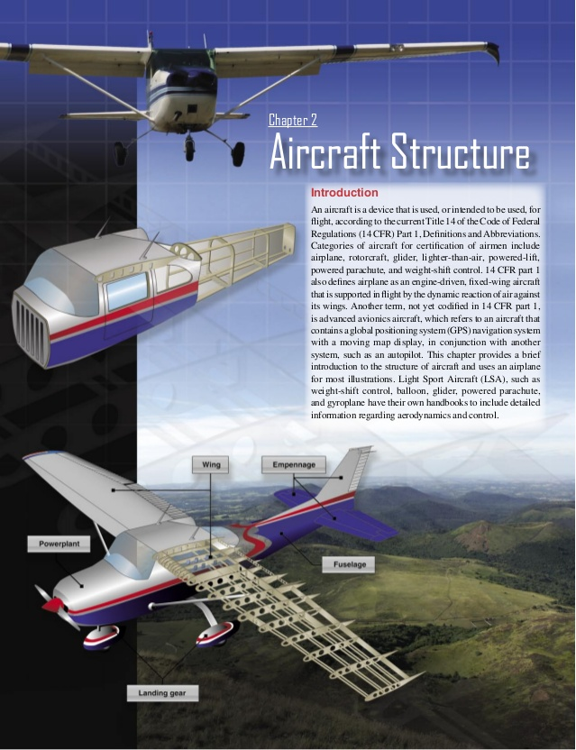
Chapter 2 – Aircraft Structure
FAA – Pilot’s Handbook of Aeronautical Knowledge

Slide 20
Today’s Mission Requirements
Mission:
Describe in writing the major components of an aircraft.
Describe in writing the subcomponents of an aircraft.
Describe in writing types of aircraft construction.
EQ:
Describe the importance of Aeronautical Knowledge for the student pilot learning to fly.

Slide 21
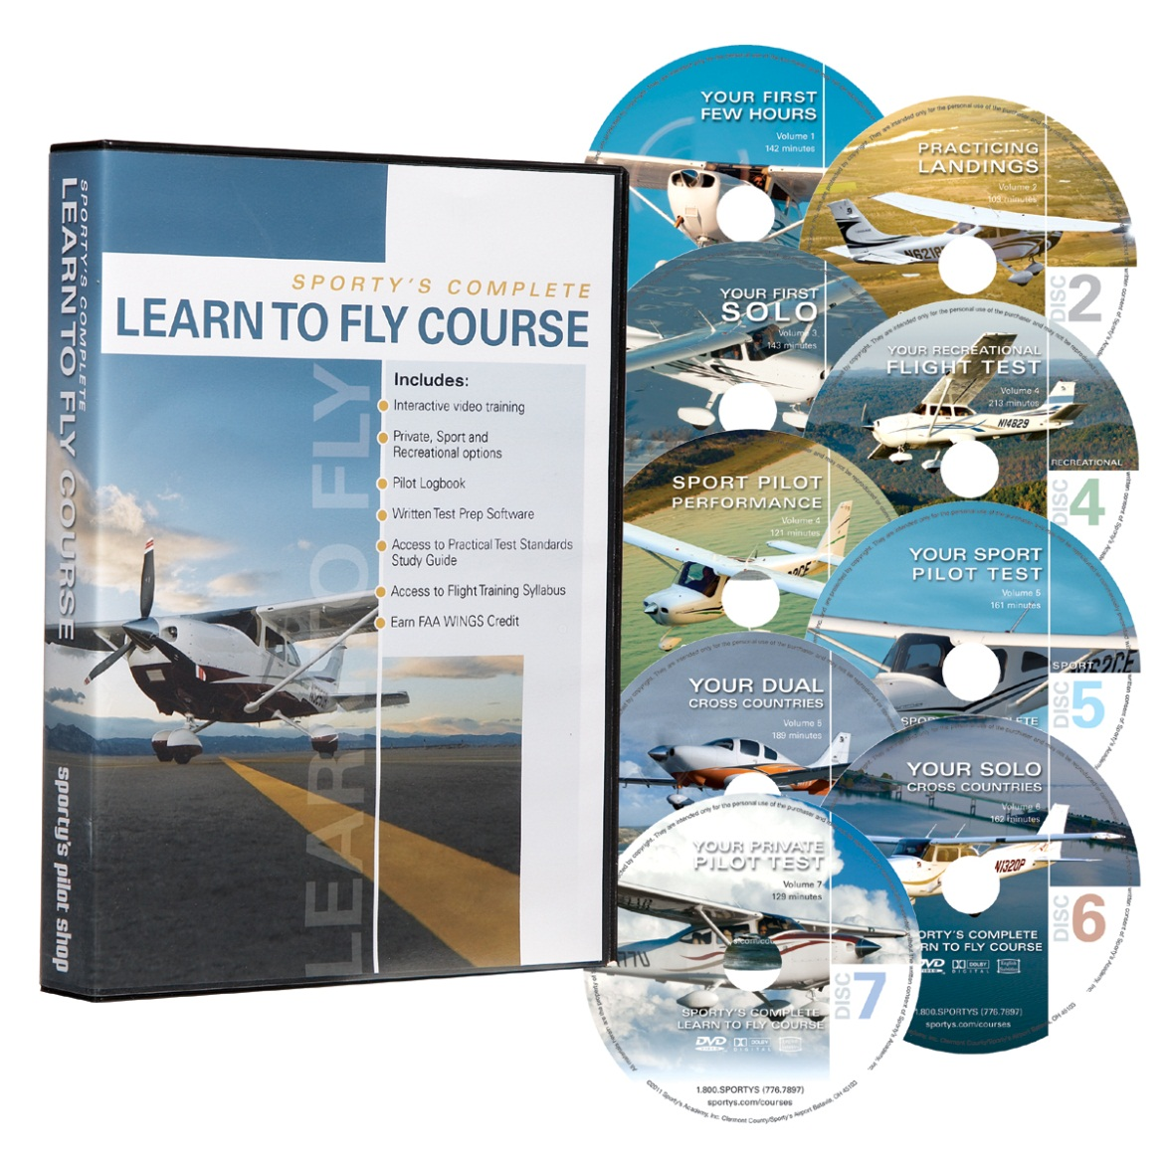
Sporty’ s Learn to Fly

Slide 22
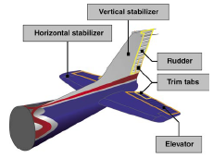
Major Components Empennage
The empennage includes the entire tail group and consists of fixed surfaces such as the vertical stabilizer and the horizontal stabilizer.
The movable surfaces include the rudder, the elevator, and one or more trim tabs.

Slide 23
Major Components Empennage
The rudder is attached to the back of the vertical stabilizer.
During flight, it is used to move the airplane’s nose left and right.

Slide 24
Major Components Empennage
The elevator, which is attached to the back of the horizontal stabilizer, is used to move the nose of the airplane up and down for climbs and descents during flight.

Slide 25
Major Components Empennage
Trim tabs are small, movable portions of the trailing edge of the control surface.
These movable trim tabs, which are controlled from the flight deck, and function to reduce control pressures on the wheel or stick.

Slide 26
Major Components Empennage
Trim tabs may be installed on the ailerons, the rudder, and/or the elevator.

Slide 27
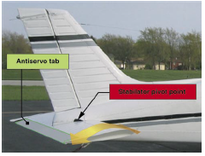
Major Components Empennage
A second type of empennage design incorporates a one-piece horizontal stabilizer that pivots from a central hinge point.
This type of design is called a stabilator, and is moved using the control wheel, just as the elevator is moved.

Slide 28
Major Components Empennage
Stabilators have an antiservo tab extending across their trailing edge.
The antiservo tab moves in the same direction as the trailing edge of the stabilator and helps make the stabilator less sensitive.

Slide 29
Major Components Empennage
The antiservo tab also functions as a trim tab to relieve control pressures and helps maintain the stabilator in the desired position.

Slide 30
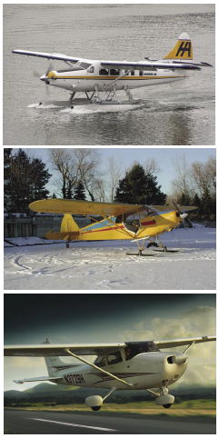
Major Components Landing Gear
The landing gear is the principal support of the airplane when parked, taxiing, taking off, or landing.
The most common type of landing gear consists of wheels, but airplanes can also be equipped with floats for water operations, or skis for landing on snow.

Slide 31
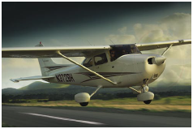
Major Components Landing Gear
Landing gear with a rear mounted wheel is called conventional landing gear.
Airplanes with conventional landing gear are sometimes referred to as tailwheel airplanes.

Slide 32
Major Components Landing Gear
When the third wheel is located on the nose, it is called a nosewheel, and the design is referred to as a tricycle gear.
A steerable nosewheel or tailwheel permits the airplane to be controlled throughout all operations while on the ground.

Slide 33
Major Components Landing Gear
Most aircraft are steered by moving the rudder pedals, whether nosewheel or tailwheel.
Additionally, some aircraft are steered by using differential braking (alternating the application of brakes on one side then the other).

Slide 34
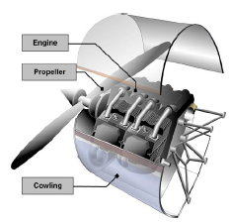
Major Components The Powerplant
The powerplant usually includes both the engine and the propeller.
The primary function of the engine is to provide the power to turn the propeller.

Slide 35
Major Components The Powerplant
It also generates electrical power, provides a vacuum source for some flight instruments, and in most single-engine airplanes, provides a source of heat for the pilot and passengers.

Slide 36
Major Components The Powerplant
The engine is covered by a cowling, or a nacelle, which are both types of covered housings.
The purpose of the cowling or nacelle is to streamline the flow of air around the engine and to help cool the engine by ducting air around the cylinders.

Slide 37
Major Components The Powerplant
The propeller, mounted on the front of the engine, translates the rotating force of the engine into thrust, a forward acting force that helps move the airplane through the air.
The propeller may also be mounted on the rear of the engine as in a pusher-type aircraft.

Slide 38
Major Components The Powerplant
A propeller is a rotating airfoil that produces thrust through aerodynamic action.
A low pressure area is formed at the back of the propeller’s airfoil, and high pressure is produced at the face of the propeller, similar to the way lift is generated by an airfoil used as a lifting surface or wing.

Slide 39
Major Components The Powerplant
This pressure differential pulls air through the propeller, which in turn pulls the airplane forward.

Slide 40
Questions / Comments

Slide 41
Today’s Mission Requirements
Mission:
Describe in writing the major components of an aircraft.
Describe in writing the subcomponents of an aircraft.
Describe in writing types of aircraft construction.
EQ:
Describe the importance of Aeronautical Knowledge for the student pilot learning to fly.

Slide 42
Major Components Empennage
The empennage includes the entire tail group and consists of fixed surfaces such as the vertical stabilizer and the horizontal stabilizer.
The movable surfaces include the rudder, the elevator, and one or more trim tabs.

Slide 43
Major Components Landing Gear
The landing gear is the principal support of the airplane when parked, taxiing, taking off, or landing.
The most common type of landing gear consists of wheels, but airplanes can also be equipped with floats for water operations, or skis for landing on snow.

Slide 44
Major Components The Powerplant
The powerplant usually includes both the engine and the propeller.
The primary function of the engine is to provide the power to turn the propeller.

Slide 45
Questions / Comments

Slide 46
Questions / Comments

