Slide 1
Warm-Up – 9/30 – 10 minutes
Utilizing your notes and past knowledge answer the following questions:
From a pilot’s perspective, what is the direction of the yaw and what do we refer to this type of motion?
How do you counter the effects of adverse yaw?
What must a pilot do to maintain steady altitude during a roll or bank of an aircraft?
In an aircraft with a T-tail configuration during normal flight conditions, what effects are removed from influencing the elevator?
At slow speeds, the elevator on a T-tail aircraft must be moved through a (larger or smaller) number of degrees of travel to raise the nose the same amount as on a conventional aircraft.

Slide 2
Questions / Comments

Slide 3
Warm-Up – 9/30 – 10 minutes
Utilizing your notes and past knowledge answer the following questions:
From a pilot’s perspective, what is the direction of the yaw and what do we refer to this type of motion?
How do you counter the effects of adverse yaw?
What must a pilot do to maintain steady altitude during a roll or bank of an aircraft?
In an aircraft with a T-tail configuration during normal flight conditions, what effects are removed from influencing the elevator?
At slow speeds, the elevator on a T-tail aircraft must be moved through a (larger or smaller) number of degrees of travel to raise the nose the same amount as on a conventional aircraft.

Slide 4
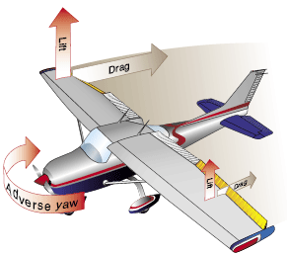
Flight Control Systems Adverse Yaw
This results in the aircraft yawing toward the wing which had experienced an increase in lift (and drag).
From the pilot’s perspective, the yaw is opposite the direction of the bank.

Slide 5
Warm-Up – 9/30 – 10 minutes
Utilizing your notes and past knowledge answer the following questions:
From a pilot’s perspective, what is the direction of the yaw and what do we refer to this type of motion?
How do you counter the effects of adverse yaw?
What must a pilot do to maintain steady altitude during a roll or bank of an aircraft?
In an aircraft with a T-tail configuration during normal flight conditions, what effects are removed from influencing the elevator?
At slow speeds, the elevator on a T-tail aircraft must be moved through a (larger or smaller) number of degrees of travel to raise the nose the same amount as on a conventional aircraft.

Slide 6
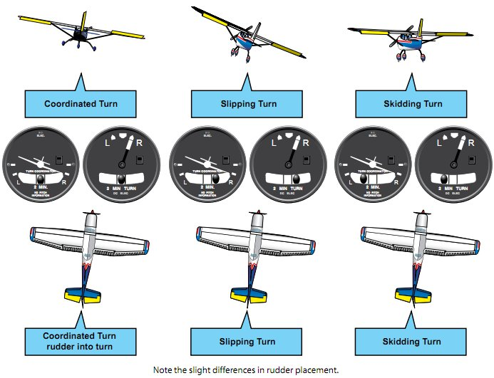
Flight Control Systems Adverse Yaw
Application of rudder is used to counteract adverse yaw.
The amount of rudder control required is greatest at low airspeeds, high angles of attack, and with large aileron deflections.

Slide 7
Warm-Up – 9/30 – 10 minutes
Utilizing your notes and past knowledge answer the following questions:
From a pilot’s perspective, what is the direction of the yaw and what do we refer to this type of motion?
How do you counter the effects of adverse yaw?
What must a pilot do to maintain steady altitude during a roll or bank of an aircraft?
In an aircraft with a T-tail configuration during normal flight conditions, what effects are removed from influencing the elevator?
At slow speeds, the elevator on a T-tail aircraft must be moved through a (larger or smaller) number of degrees of travel to raise the nose the same amount as on a conventional aircraft.

Slide 8
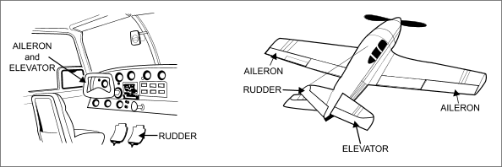
Flight Control Systems Adverse Yaw
Additionally, because more lift is required during a turn than when in straight-and-level flight, the angle of attack (AOA) must be increased by applying elevator back pressure.

Slide 9
Warm-Up – 9/30 – 10 minutes
Utilizing your notes and past knowledge answer the following questions:
From a pilot’s perspective, what is the direction of the yaw and what do we refer to this type of motion?
How do you counter the effects of adverse yaw?
What must a pilot do to maintain steady altitude during a roll or bank of an aircraft?
In an aircraft with a T-tail configuration during normal flight conditions, what effects are removed from influencing the elevator?
At slow speeds, the elevator on a T-tail aircraft must be moved through a (larger or smaller) number of degrees of travel to raise the nose the same amount as on a conventional aircraft.

Slide 10
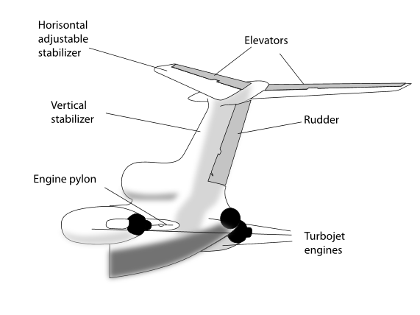
Flight Control Systems T-Tail
In a T-tail configuration, the elevator is above most of the effects of downwash from the propeller as well as airflow around the fuselage and/or wings during normal flight conditions.

Slide 11
Warm-Up – 9/30 – 10 minutes
Utilizing your notes and past knowledge answer the following questions:
From a pilot’s perspective, what is the direction of the yaw and what do we refer to this type of motion?
How do you counter the effects of adverse yaw?
What must a pilot do to maintain steady altitude during a roll or bank of an aircraft?
In an aircraft with a T-tail configuration during normal flight conditions, what effects are removed from influencing the elevator?
At slow speeds, the elevator on a T-tail aircraft must be moved through a (larger or smaller) number of degrees of travel to raise the nose the same amount as on a conventional aircraft.

Slide 12
Flight Control Systems T-Tail
An additional benefit is reduced vibration and noise inside the aircraft.
At slow speeds, the elevator on a T-tail aircraft must be moved through a larger number of degrees of travel to raise the nose a given amount than on a conventional-tail aircraft.

Slide 13
Questions / Comments

Slide 14
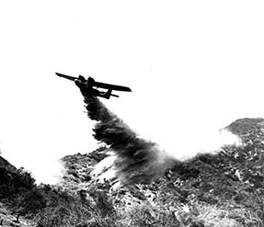
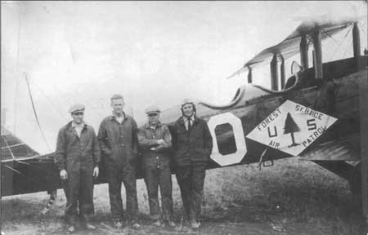
THIS DAY IN AVIATION
September 30
1921 — Forty-seven Army Air Service planes during forest fire season 1921, operating from Pacific Coast bases, discover 832 forest fires in 396 patrols, flying 148,113 miles over area of 7,230,459 square miles National Parks.

Slide 15
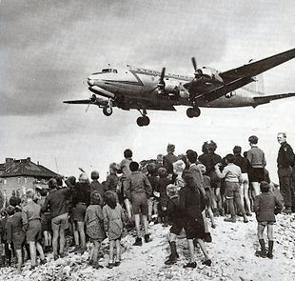
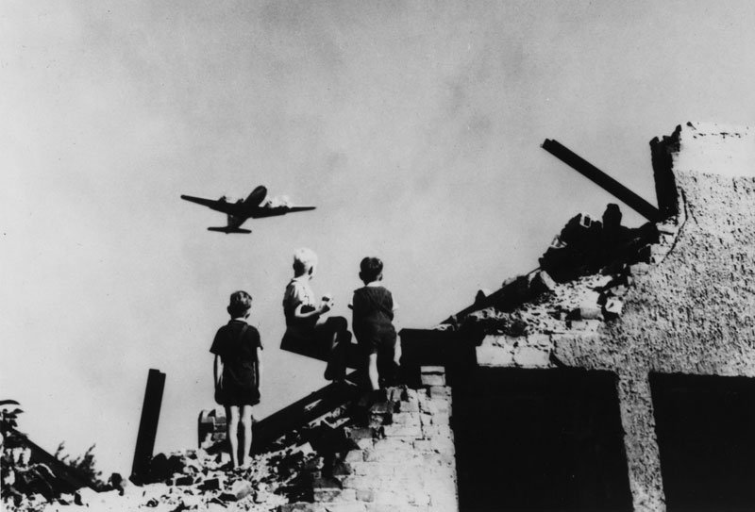
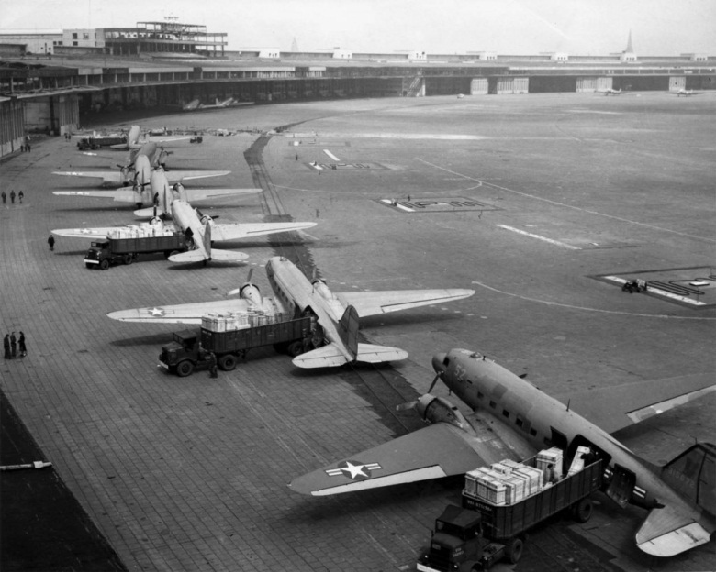
THIS DAY IN AVIATION
September 30
1949 — The Berlin Airlift is officially terminated.

Slide 16
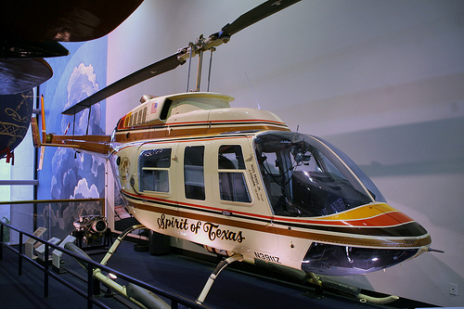
THIS DAY IN AVIATION
September 30
1982 — The first round-the-world flight in a helicopter is completed as the Bell “Long Ranger II,” flown by Americans H. Ross Perot Jr. and Jay Coburn, lands safely.

Slide 17
Questions / Comments

Slide 18
September/October 2015
SUNDAY | MONDAY | TUESDAY | WEDNESDAY | THURSDAY | FRIDAY | SATURDAY
 | 28 Chapter 5 Flight Controls Primary Flight Controls | 29 Chapter 5 Flight Controls Ailerons Adverse Yaw Elevators Stabilators | 30 Chapter 5 Flight Controls Canards Flaps | 1 Chapter 5 Flight Controls Trim Systems Autopilot | 2 Chapter TEST | 3
4 | 5 Chapter 6 Powerplants | 6 Chapter 6 Propellers | 7 Chapter 6 Induction / Carb Systems | 8 Chapter 6 Carb Icing and Heating | 9 Chap 6 Quiz | 10
11 | 12 Chapter 6 Ignition / Oil Systems | 13 Chapter 6 Fuel Systems | 14 Chapter 6 Electrical Systems 1st Quarter Ends Grades Due | 15 Chapter 6 Hydraulic Systems | 16 Chap 6 Quiz | 17
18 | 19 Chapter 7 Flight Instruments | 20 Chapter 7 Flight Instruments Altimeter | 21 Chapter 7 Flight Instruments Vertical Speed Indicator | 22 Chapter 7 Flight Instruments Airspeed Indicator | 23 HALF DAY | 24
25 | 26 | 27 | 28 | 29 | 30 | 31

Slide 19
1st Quarter Requirements (11 Class Meetings – Oct 14)
All students will complete the following:
Take notes - All in class quizzes and tests
Each day is worth 20pts - (4 day week 25pts)
Complete Flight Sim. Tutorials (1 – 5 x3 + 1)
Aircraft Fam. and Student Pilot Syllabus
Lessons 1 – 7 (Straight & Level Flight through First Solo)
Must pass written with 80%
Successfully complete 3 times on small sim
Successfully complete 1 time on Main sim
Complete ERAU Aviation 101
6 quizzes and 2 tests
Student will receive zero points for all incomplete work – NO make-up / extra credit

Slide 20
Questions / Comments

Slide 21
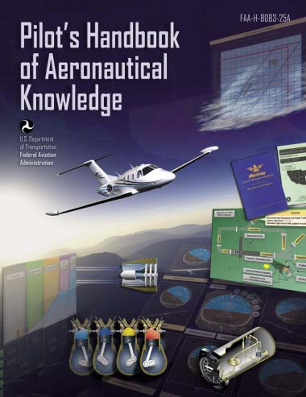
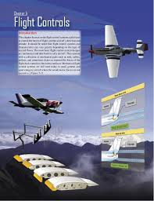
Chapter 5 – Flight Controls
FAA – Pilot’s Handbook of Aeronautical Knowledge

Slide 22
Today’s Mission Requirements
Mission:
Identify in writing the flight control systems a pilot uses to control the forces of flight, and the aircraft’s direction and attitude.
Describe how the flight control systems and characteristics can vary greatly depending on the type of aircraft flown.
Describe in writing the basic flight control system designs.
EQ:
Describe the importance of Aeronautical Knowledge for the student pilot learning to fly.

Slide 23
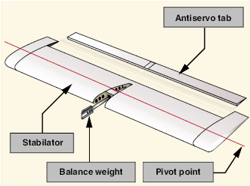
Flight Control Systems Stabilator
A stabilator is a one-piece horizontal stabilizer that pivots from a central hinge point.

Slide 24
Flight Control Systems Stabilator
Because stabilators pivot around a central hinge point, they are extremely sensitive to control inputs and aerodynamic loads.
Antiservo tabs are incorporated on the trailing edge to decrease sensitivity.

Slide 25
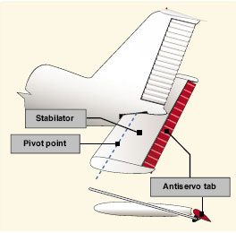
Flight Control Systems Stabilator
They deflect in the same direction as the stabilator.
This results in an increase in the force required to move the stabilator, thus making it less prone to pilot-induced overcontrolling.

Slide 26
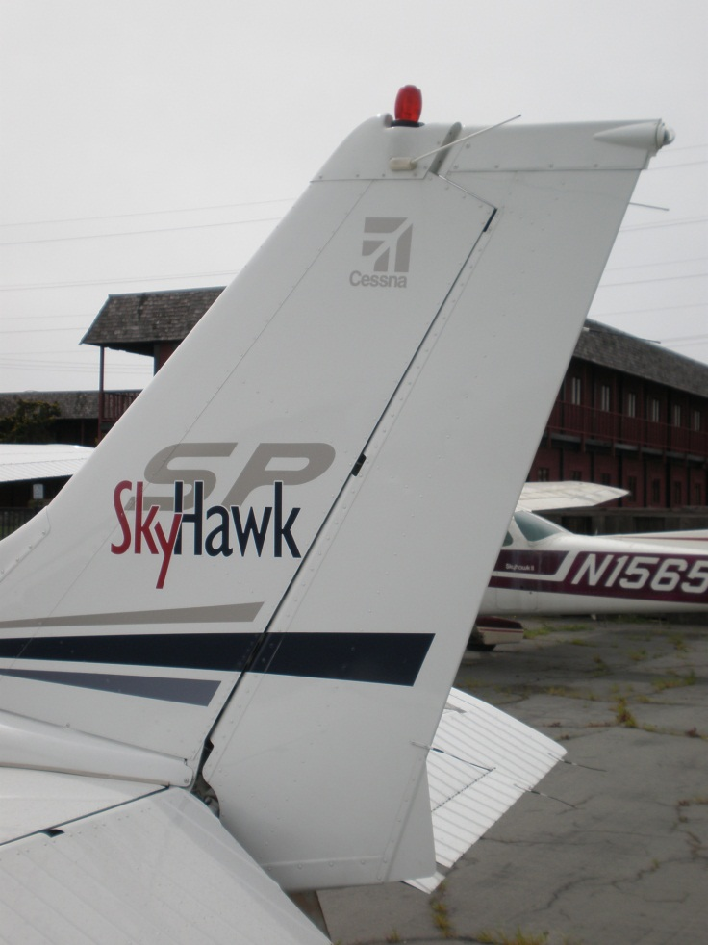
Flight Control Systems Rudder
The rudder controls movement of the aircraft about its vertical axis.
The rudder is a movable surface hinged to a fixed surface, in this case to the vertical stabilizer.

Slide 27
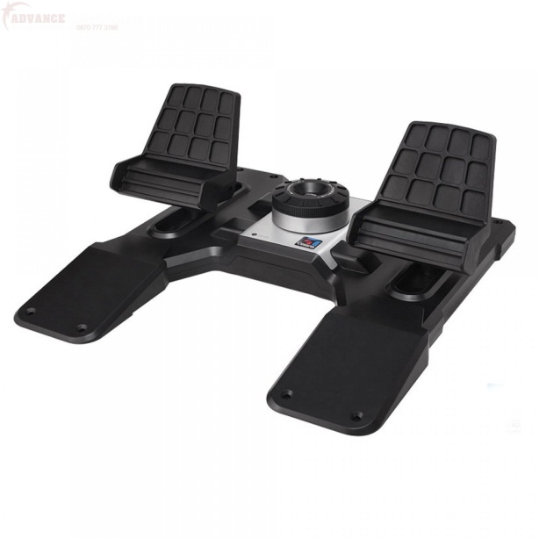
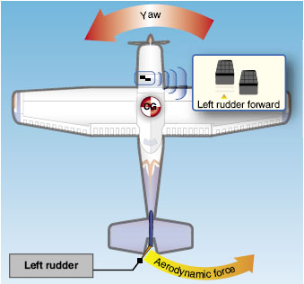
Flight Control Systems Rudder
By pushing the left pedal, the rudder moves left.
This creates a sideward lift that moves the tail to the right and yaws the nose of the airplane to the left.

Slide 28
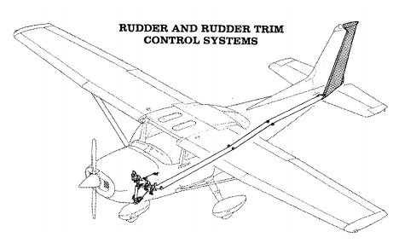
Flight Control Systems Rudder
Rudder effectiveness increases with speed; therefore, large deflections at low speeds and small deflections at high speeds may be required to provide the desired reaction.

Slide 29
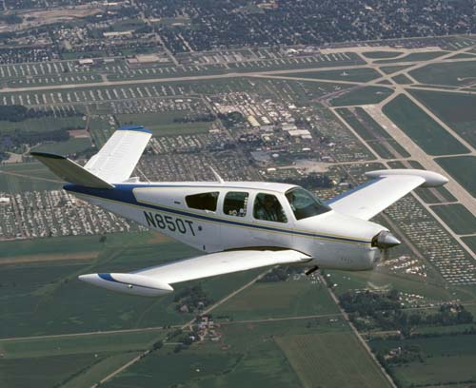
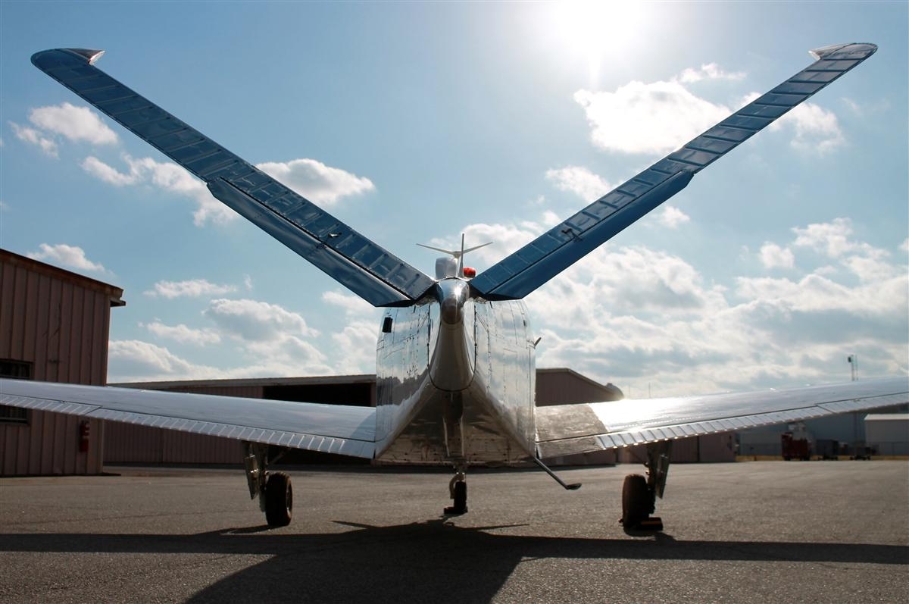
Flight Control Systems V-Tail
The V-tail design utilizes two slanted tail surfaces to perform the same functions as the surfaces of a conventional elevator and rudder configuration.
The fixed surfaces act as both horizontal and vertical stabilizers.

Slide 30
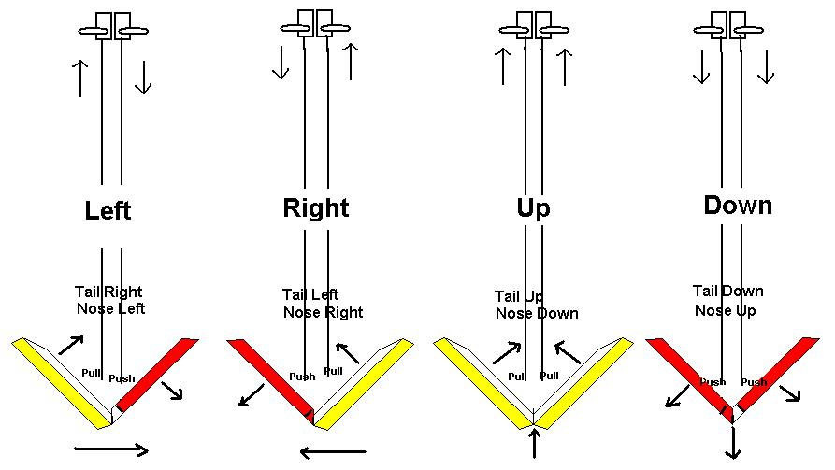
Flight Control Systems V-Tail
The movable surfaces, which are usually called ruddervators, are connected through a special linkage that allows the control wheel to move both surfaces simultaneously.

Slide 31
Flight Control Systems V-Tail
On the other hand, displacement of the rudder pedals moves the surfaces differentially, thereby providing directional control.
A control mixing mechanism moves each surface the appropriate amount.

Slide 32
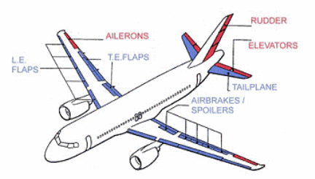
Flight Control Systems Secondary Flight Controls
Secondary flight control systems:
Consist of wing flaps, leading edge devices, spoilers, and trim systems.

Slide 33
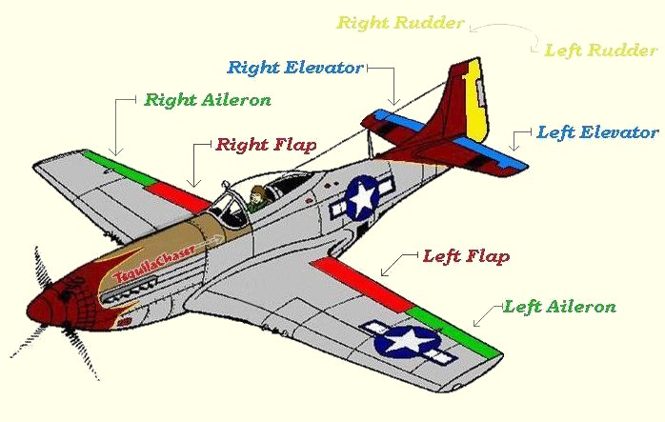
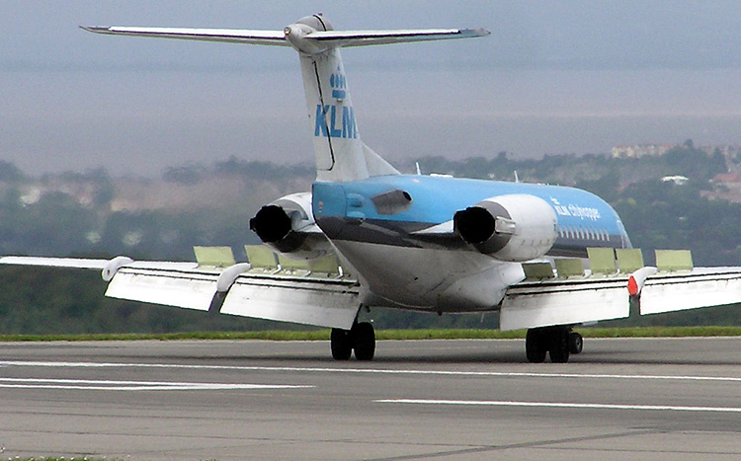
Secondary Flight Controls Flaps
The most common high-lift devices used on aircraft are attached to the trailing edge of the wing, increase both lift and induced drag for any given AOA.

Slide 34
Secondary Flight Controls Flaps
Flaps allow a compromise between high cruising speed and low landing speed, because they may be extended when needed, and retracted into the wing’s structure when not needed.

Slide 35
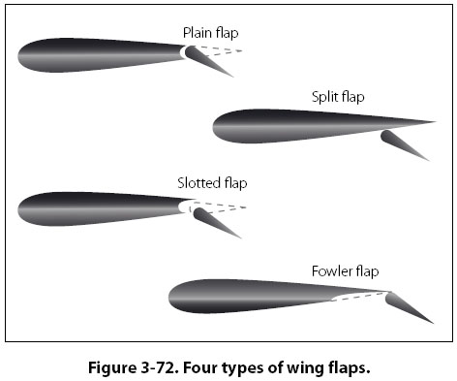
Secondary Flight Controls Flaps
There are four common types of flaps:
plain, split, slotted, and Fowler flaps.

Slide 36
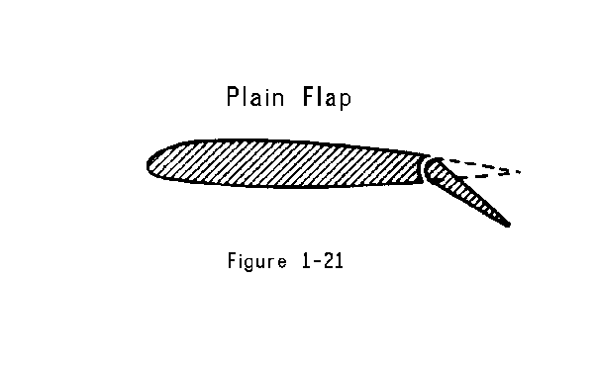
Secondary Flight Controls Flaps
The plain flap is the simplest of the four types.

Slide 37
Secondary Flight Controls Flaps
It increases the airfoil camber, resulting in a significant increase in the coefficient of lift (CL) at a given AOA.
At the same time, it greatly increases drag and moves the center of pressure (CP) aft on the airfoil, resulting in a nose-down pitching moment.

Slide 38
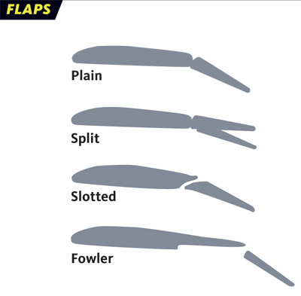
Secondary Flight Controls Flaps
The split flap is deflected from the lower surface of the airfoil and produces a slightly greater increase in lift than the plain flap.
When fully extended, both plain and split flaps produce high drag with little additional lift.

Slide 39
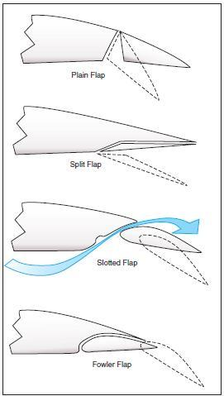
Secondary Flight Controls Flaps
The most popular flap on aircraft today is the slotted flap.
Slotted flaps increase the lift coefficient significantly more than plain or split flaps.

Slide 40
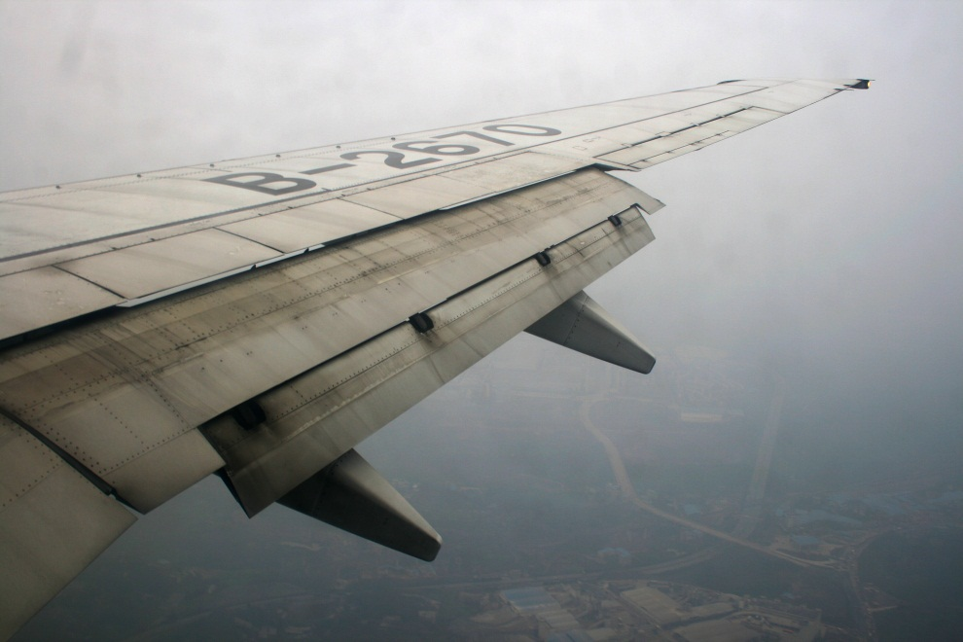
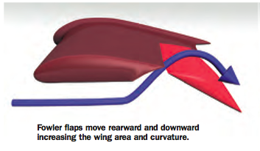
Secondary Flight Controls Flaps
Fowler flaps are a type of slotted flap.
This flap design not only changes the camber of the wing, it also increases the wing area.
Instead of rotating down on a hinge, it slides backwards on tracks.

Slide 41
Questions / Comments

Slide 42
1st Quarter Requirements (11 Class Meetings – Oct 14)
All students will complete the following:
Take notes - All in class quizzes and tests
Each day is worth 20pts - (4 day week 25pts)
Complete Flight Sim. Tutorials (1 – 5 x3 + 1)
Aircraft Fam. and Student Pilot Syllabus
Lessons 1 – 7 (Straight & Level Flight through First Solo)
Must pass written with 80%
Successfully complete 3 times on small sim
Successfully complete 1 time on Main sim
Complete ERAU Aviation 101
6 quizzes and 2 tests
Student will receive zero points for all incomplete work – NO make-up / extra credit

Slide 43
Lesson Closure - 3 – 2 - 1
3. List 3 things you learned today.
2. List 2 things you have questions about today’s lesson.
1. Create (1) quiz question with answer about today’s lesson.

