Slide 1
Warm-Up – 9/3 – 10 minutes
Utilizing your notes and past knowledge answer the following questions:
Private pilot eligibility, aeronautical knowledge, proficiency, and aeronautical requirements can be found in __________.
Describe the three classes of medical certificates and what is the minimum certificate a pilot must possess.
(True / False) A private pilot may be compensated in for services as a pilot.
(True / False) A Private pilot training under 14 CFR part 61, experience requirements include: at least 40 hours of piloting time, including 20 hours of flight with an instructor and 10 hours of solo flight.
What is the minimum score required to pass the FAA knowledge test?

Slide 2
Questions / Comments

Slide 3
Warm-Up – 9/3 – 10 minutes
Utilizing your notes and past knowledge answer the following questions:
Private pilot eligibility, aeronautical knowledge, proficiency, and aeronautical requirements can be found in __________.
Describe the three classes of medical certificates and what is the minimum certificate a pilot must possess.
(True / False) A private pilot may be compensated in for services as a pilot.
(True / False) A Private pilot training under 14 CFR part 61, experience requirements include: at least 40 hours of piloting time, including 20 hours of flight with an instructor and 10 hours of solo flight.
What is the minimum score required to pass the FAA knowledge test?

Slide 4
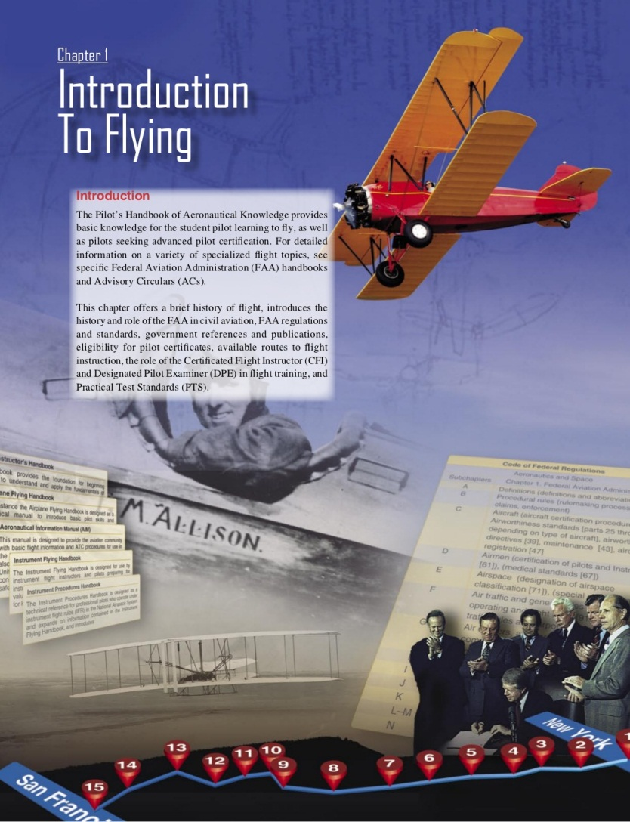
Chapter 1 – Introduction to Flying
FAA – Pilot’s Handbook of Aeronautical Knowledge
14 CFR Part 61 Subpart E

Slide 5
Warm-Up – 9/3 – 10 minutes
Utilizing your notes and past knowledge answer the following questions:
Private pilot eligibility, aeronautical knowledge, proficiency, and aeronautical requirements can be found in __________.
Describe the three classes of medical certificates and what is the minimum certificate a pilot must possess.
(True / False) A private pilot may be compensated in for services as a pilot.
(True / False) A Private pilot training under 14 CFR part 61, experience requirements include: at least 40 hours of piloting time, including 20 hours of flight with an instructor and 10 hours of solo flight.
What is the minimum score required to pass the FAA knowledge test?

Slide 6
Chapter 1 – Introduction to Flying
FAA – Pilot’s Handbook of Aeronautical Knowledge
First class is designed for the airline transport pilot; second class for the commercial pilot; and third class for the student, recreational, and private pilot

Slide 7
Warm-Up – 9/3 – 10 minutes
Utilizing your notes and past knowledge answer the following questions:
Private pilot eligibility, aeronautical knowledge, proficiency, and aeronautical requirements can be found in __________.
Describe the three classes of medical certificates and what is the minimum certificate a pilot must possess.
(True / False) A private pilot may be compensated in for services as a pilot.
(True / False) A Private pilot training under 14 CFR part 61, experience requirements include: at least 40 hours of piloting time, including 20 hours of flight with an instructor and 10 hours of solo flight.
What is the minimum score required to pass the FAA knowledge test?

Slide 8
Chapter 1 – Introduction to Flying
FAA – Pilot’s Handbook of Aeronautical Knowledge
FALSE

Slide 9
Warm-Up – 9/3 – 10 minutes
Utilizing your notes and past knowledge answer the following questions:
Private pilot eligibility, aeronautical knowledge, proficiency, and aeronautical requirements can be found in __________.
Describe the three classes of medical certificates and what is the minimum certificate a pilot must possess.
(True / False) A private pilot may be compensated in for services as a pilot.
(True / False) A Private pilot training under 14 CFR part 61, experience requirements include: at least 40 hours of piloting time, including 20 hours of flight with an instructor and 10 hours of solo flight.
What is the minimum score required to pass the FAA knowledge test?

Slide 10
Chapter 1 – Introduction to Flying
FAA – Pilot’s Handbook of Aeronautical Knowledge
TRUE

Slide 11
Warm-Up – 9/3 – 10 minutes
Utilizing your notes and past knowledge answer the following questions:
Private pilot eligibility, aeronautical knowledge, proficiency, and aeronautical requirements can be found in __________.
Describe the three classes of medical certificates and what is the minimum certificate a pilot must possess.
(True / False) A private pilot may be compensated in for services as a pilot.
(True / False) A Private pilot training under 14 CFR part 61, experience requirements include: at least 40 hours of piloting time, including 20 hours of flight with an instructor and 10 hours of solo flight.
What is the minimum score required to pass the FAA knowledge test?

Slide 12
Chapter 1 – Introduction to Flying
FAA – Pilot’s Handbook of Aeronautical Knowledge
70

Slide 13
Questions / Comments

Slide 14
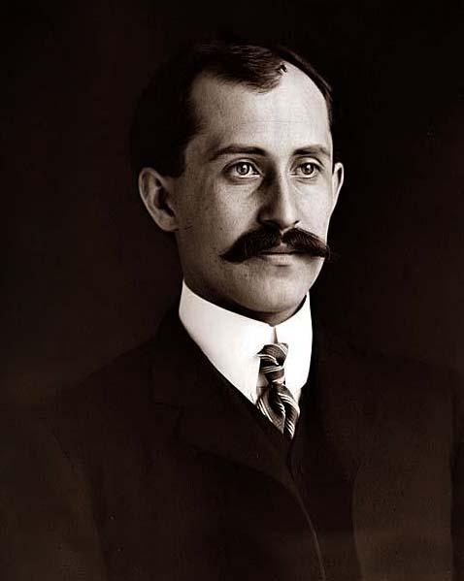
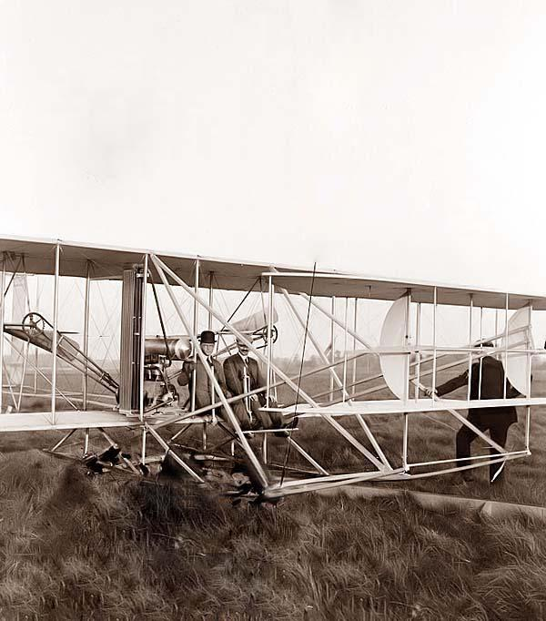
THIS DAY IN AVIATION
September 3
1908 — Orville Wright makes his first flight at Fort Meyer, Virginia, circling the field one-and-one-half times.
During the next two weeks, he conducts a series of 14 long, high, and impressive flights, many of which set new records and are witnessed by government officials.

Slide 15
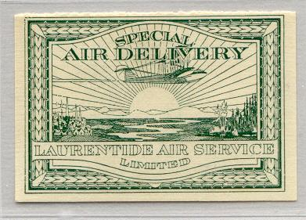
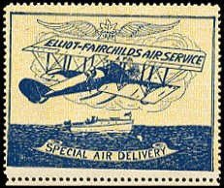
THIS DAY IN AVIATION
September 3
1924 — Regular airmail service in Canada begins with flights between Ontario and Québec.

Slide 16
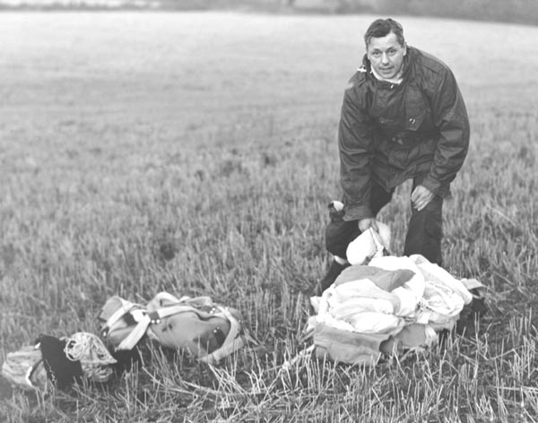
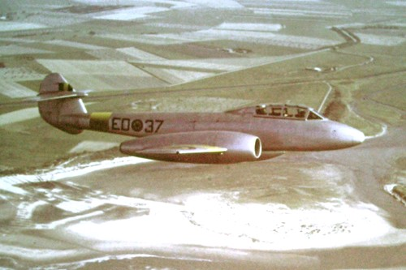
THIS DAY IN AVIATION
September 3
1955 — British Squadron Leader J.S. Fifield in England makes the first successful demonstration of the use of an ejection seat from a moving aircraft while still on the ground.
He ejects from a modified Gloster “Meteor 7” that is traveling 120-mph.

Slide 17
Questions / Comments

Slide 18
AVIATION ACES
2A
Pilots (A – 93 & above)
2A
Co-Pilots (B – 85 – 92)
Alvarez, “ Echo” Miguel
Davis, “ Hawk Eye” Mark
Morgan, “Thunder” Jacob
Sanchez, “El Diablo” Paul
Buchanan, “Olympia” Robert
Hetrick, “Radar” Mark
Jennings, “Force” Michael
Morgan, “Ghost” Landon
Woodruff, “Woody” Michael
High Shooter (Score)

Slide 19
AVIATION ACES
3A
Pilots (A – 93 & above)
3A
Co-Pilots (B – 85 – 92)
Bingham, “Tomater Hater” Jake
Brown, “Bulls eye” Jaylen
Camacho, Big Poppa” Ray
Corlett, “Bird Dog” Marc
Edelen, “Scuffy” Isis
Popp, Jay” Gerald
High Shooter (Score)

Slide 20
September 2013
Sunday | Monday | Tuesday | Wednesday | Thursday | Friday | Saturday
1 | 2 | 3 Quiz Review Chapter 2 | 4 | 5 Chap 2 Flight Sim Orientation | 6 | 7
8 | 9 Chapter 2 | 10 | 11 Chapter 2 | 12 | 13 Flightline Friday | 14
15 | 16 | 17 Chapter 2 | 18 | 19 Chapter 2 | 20 | 21
22 | 23 Chapter 3 | 24 | 25 Chapter 3 | 26 | 27 Flightline Friday | 28
29 | 30

Slide 21
Quiz Answers

Slide 22
GS - Chap 1 Quiz 1
Question #1 (4 points)
During the early years of manned flight, aviation was a free for all because no government body was in place to establish policies or regulate and enforce safety standards.
Your answer:
True

Slide 23
GS - Chap 1 Quiz 1
Question #2 (4 points)
Transcontinental Mail Route spanned from San Francisco to New York.
Your answer:
True

Slide 24
GS - Chap 1 Quiz 1
Question #3 (4 points)
The Air Mail Act charged the Secretary of Commerce with fostering air commerce, issuing and enforcing air traffic rules, licensing pilots, certificating aircraft, establishing airways, and operating and maintaining aids to air navigation.
Your answer:
False
Question #4 (4 points)
__________________ is charged with the investigation of all transportation accidents within the United States.
Your answer:
National Transportation Safety Board (NTSB)
Question #5 (4 points)
Free competition ushered in a new era in passenger air travel with the passage of this law.
Your answer:
The Airline Deregulation Act of 1978

Slide 25
GS - Chap 1 Quiz 1
Question #6 (4 points)
___________________ is empowered by regulations to promote aviation safety and establish safety standards for civil aviation
Your answer:
Federal Aviation Administration
Question #7 (4 points)
FAA regulations are listed under ____________________.
Your answer:
Title 14, Aeronautics and Space
Question #8 (4 points)
______________ pertains to the certification of pilots.
Your answer:
14 CFR part 61

Slide 26
GS - Chap 1 Quiz 1
Question #9 (4 points)
14 CFR part 91 __________________.
Your answer:
provides guidance in the areas of general flight rules, visual flight rules (VFR).
Question #10 (4 points)
Pilot Operating Handbooks (POH) are documents developed by the airplane manufacturer, approved by the FAA, and are specific to a particular make and model aircraft by serial number.
Your answer:
True

Slide 27
GS - Chap 1 Quiz 1
Question #11 (4 points)
Categories of aircraft for which a pilot may be rated are:
Your answer:
Airplane, Rotorcraft, Glider, or Lighter than air
Question #12 (4 points)
A pilot does not have to hold a class rating to operate an aircraft in that class.
Your answer:
False
Question #13 (4 points)
The single-engine land, multi-engine land, single-engine sea and multi-engine sea classes are part of the ____________ category.
Your answer:
airplane

Slide 28
GS - Chap 1 Quiz 1
Question #14 (4 points)
Ultralight pilots should be familiar to the rules specified in _____________.
Your answer:
14 CFR 103
Question #15 (4 points)
Light Sport Aircraft weight may not exceed 1,320 pounds.
Your answer:
True

Slide 29
GS - Chap 1 Quiz 1
Question #16 (4 points)
Private pilot eligibility, aeronautical knowledge, proficiency, and aeronautical requirements can be found in __________.
Your answer:
14 CFR 61 Subpart E
Question #17 (4 points)
As a private pilot you are required to have a flight review every ________ months.
Your answer:
24
Question #18 (4 points)
In order to be a student ___________ pilot you must be 16 years old and hold a current and valid driver’s license as evidence of medical eligibility.
Your answer:
sport

Slide 30
GS - Chap 1 Quiz 1
Question #19 (4 points)
In order to be a student ___________ pilot you must be at least 17 years old, pass the required knowledge test, and possess a third-class medical certificate.
Your answer:
recreation
Question #20 (4 points)
Commercial pilots without an instrument rating are restricted to daytime flight within 50 nautical miles (NM).
Your answer:
True

Slide 31
GS - Chap 1 Quiz 1
Question #21 (4 points)
________________ is a prerequisite for acting as a pilot in command (PIC) of scheduled airline operations.
Your answer:
The Airline Transport Pilot Certificate
Question #22 (4 points)
Medical certificates are designated as first class, second class, or third class. First class is designed for the airline transport pilot; second class for the commercial pilot; and third class for the student, recreational, and private pilot
Your answer:
True
Question #23 (4 points)
A private pilot may be compensated in for services as a pilot.
Your answer:
False

Slide 32
GS - Chap 1 Quiz 1
Question #24 (4 points)
A Private pilot training under 14 CFR part 61, experience requirements include: at least 40 hours of piloting time, including 20 hours of flight with an instructor and 10 hours of solo flight.
Your answer:
True
Question #25 (4 points)
To pass the FAA knowledge test a minimum score of ______ must be attained.
Your answer:
70

Slide 33
Questions / Comments

Slide 34
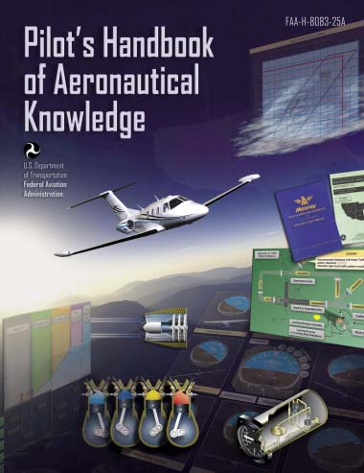
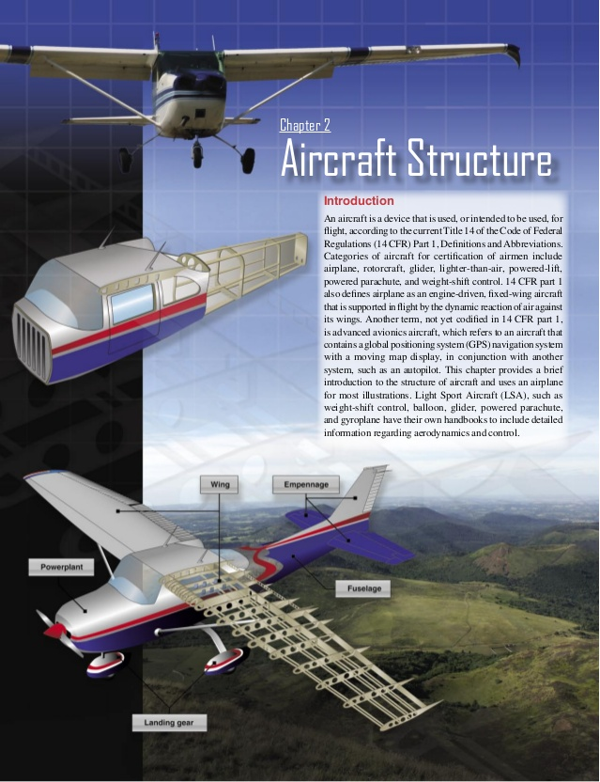
Chapter 2 – Aircraft Structure
FAA – Pilot’s Handbook of Aeronautical Knowledge

Slide 35
Today’s Mission Requirements
Mission:
Identify in writing lift and basic aerodynamics.
Describe the three axis of flight.
Describe in writing CG and its importance.
EQ:
Describe the importance of Aeronautical Knowledge for the student pilot learning to fly.

Slide 36
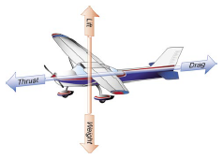
Forces of Flight

Slide 37
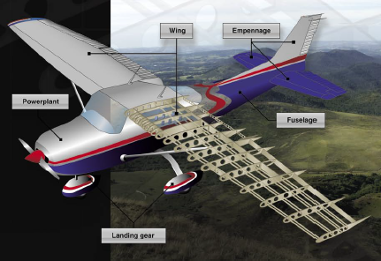
Lift and Basic Aerodynamics
In order to understand the operation of the major components and subcomponents of an aircraft, it is important to understand basic aerodynamic concepts.

Slide 38
Lift and Basic Aerodynamics
Four forces act upon an aircraft in relation to straight-and-level, unaccelerated flight.
These forces are thrust, lift, weight, and drag.

Slide 39
Lift and Basic Aerodynamics
Thrust is the forward force produced by the powerplant/propeller.
It opposes or overcomes the force of drag.
As a general rule, it is said to act parallel to the longitudinal axis.

Slide 40
Lift and Basic Aerodynamics
Drag is a rearward, retarding force, and is caused by disruption of airflow by the wing, fuselage, and other protruding objects.
Drag opposes thrust, and acts rearward parallel to the relative wind.

Slide 41
Lift and Basic Aerodynamics
Weight is the combined load of the airplane itself, the crew, the fuel, and the cargo or baggage.
Weight pulls the airplane downward because of the force of gravity.
It opposes lift, and acts vertically downward through the airplane’s center of gravity (CG).

Slide 42
Lift and Basic Aerodynamics
Lift opposes the downward force of weight, is produced by the dynamic effect of the air acting on the wing, and acts perpendicular to the flightpath through the wing’s center of lift.

Slide 43
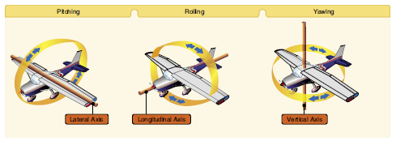
Lift and Basic Aerodynamics
An aircraft moves in three dimensions and is controlled by moving it about one or more of its axes.

Slide 44
Lift and Basic Aerodynamics
The longitudinal or roll axis extends through the aircraft from nose to tail, with the line passing through the CG.

Slide 45
Lift and Basic Aerodynamics
The lateral or pitch axis extends across the aircraft on a line through the wing tips, again passing through the CG.

Slide 46
Lift and Basic Aerodynamics
The vertical, or yaw, axis passes through the aircraft vertically, intersecting the CG.

Slide 47
Lift and Basic Aerodynamics
All control movements cause the aircraft to move around one or more of these axes, and allows for the control of the airplane in flight.

Slide 48
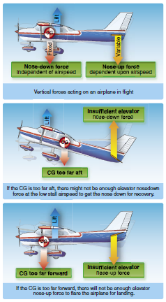
Lift and Basic Aerodynamics
One of the most significant components of aircraft design is CG.
It is the specific point where the mass or weight of an aircraft may be said to center; that is, a point around which, if the aircraft could be suspended or balanced, the aircraft would remain relatively level.

Slide 49
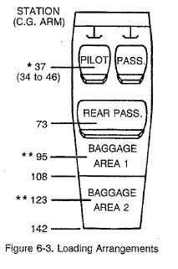

Slide 50
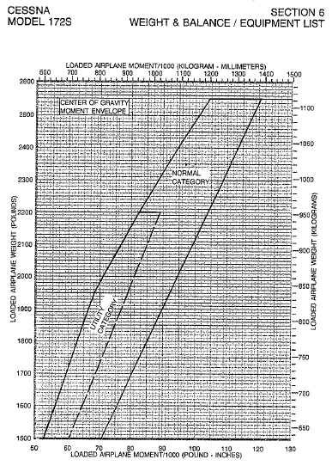

Slide 51
Lift and Basic Aerodynamics
The position of the CG of an aircraft determines the stability of the aircraft in flight.
As the CG moves rearward (towards the tail) the aircraft becomes more and more dynamically unstable.

Slide 52
Lift and Basic Aerodynamics
In aircraft with fuel tanks situated in front of the CG, it is important that the CG is set with the fuel tank empty.
Otherwise, as the fuel is used, the aircraft becomes unstable due to the CG shifting aft or outside the acceptable CG envelop.

Slide 53
Lift and Basic Aerodynamics
The CG is computed during initial design and construction, and is further affected by the installation of onboard equipment, aircraft loading, and other factors.

Slide 55
Questions / Comments

Slide 56
Today’s Mission Requirements
Mission:
Identify in writing lift and basic aerodynamics.
Describe the three axis of flight.
Describe in writing CG and its importance.
EQ:
Describe the importance of Aeronautical Knowledge for the student pilot learning to fly.

Slide 57
Lift and Basic Aerodynamics
Four forces act upon an aircraft in relation to straight-and-level, unaccelerated flight.
These forces are thrust, lift, weight, and drag.

Slide 58
Today’s Mission Requirements
Mission:
Identify in writing lift and basic aerodynamics.
Describe the three axis of flight.
Describe in writing CG and its importance.
EQ:
Describe the importance of Aeronautical Knowledge for the student pilot learning to fly.

Slide 59
Lift and Basic Aerodynamics
An aircraft moves in three dimensions and is controlled by moving it about one or more of its axes.

Slide 60
Today’s Mission Requirements
Mission:
Identify in writing lift and basic aerodynamics.
Describe the three axis of flight.
Describe in writing CG and its importance.
EQ:
Describe the importance of Aeronautical Knowledge for the student pilot learning to fly.

Slide 61
Lift and Basic Aerodynamics
The position of the CG of an aircraft determines the stability of the aircraft in flight.
As the CG moves rearward (towards the tail) the aircraft becomes more and more dynamically unstable.

