Slide 1
Warm-Up – 9/27 – 10 minutes
Utilizing your notes and past knowledge answer the following questions:
Describe why it is difficult for an aircraft to takeoff on hot days at a high altitude.
In “pilot speak,” what is known as a “bad thing?”
Describe chord.
What is known as the most efficient airfoil?
With what flight control surfaces can you change to give an airfoil greater lift at slower flight conditions?

Slide 2
Questions / Comments

Slide 3
Warm-Up – 9/27 – 10 minutes
Utilizing your notes and past knowledge answer the following questions:
Describe why it is difficult for an aircraft to takeoff on hot days at a high altitude.
In “pilot speak,” what is known as a “bad thing?”
Describe chord.
What is known as the most efficient airfoil?
With what flight control surfaces can you change to give an airfoil greater lift at slower flight conditions?

Slide 4
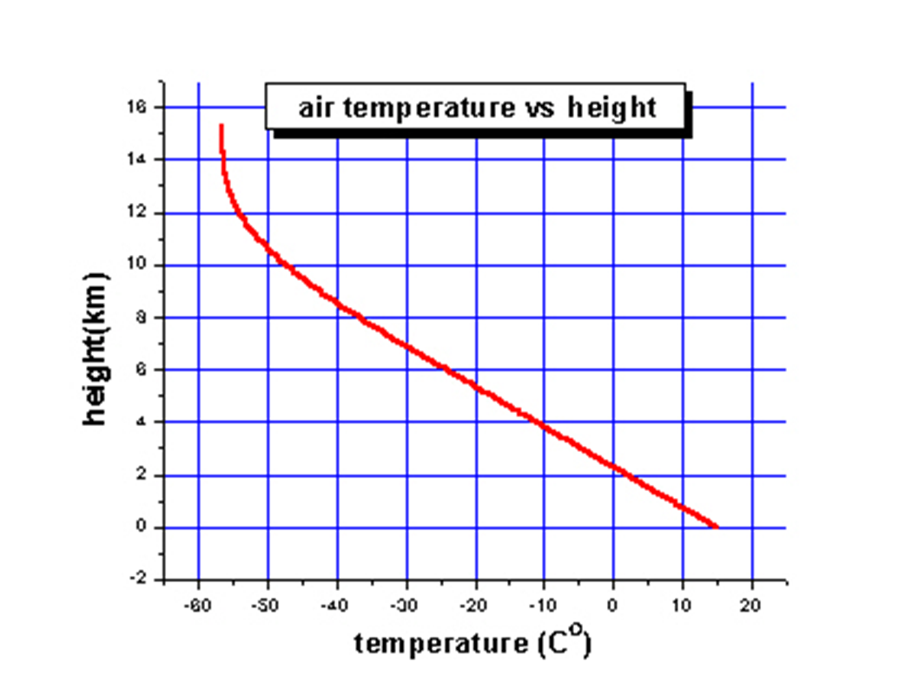
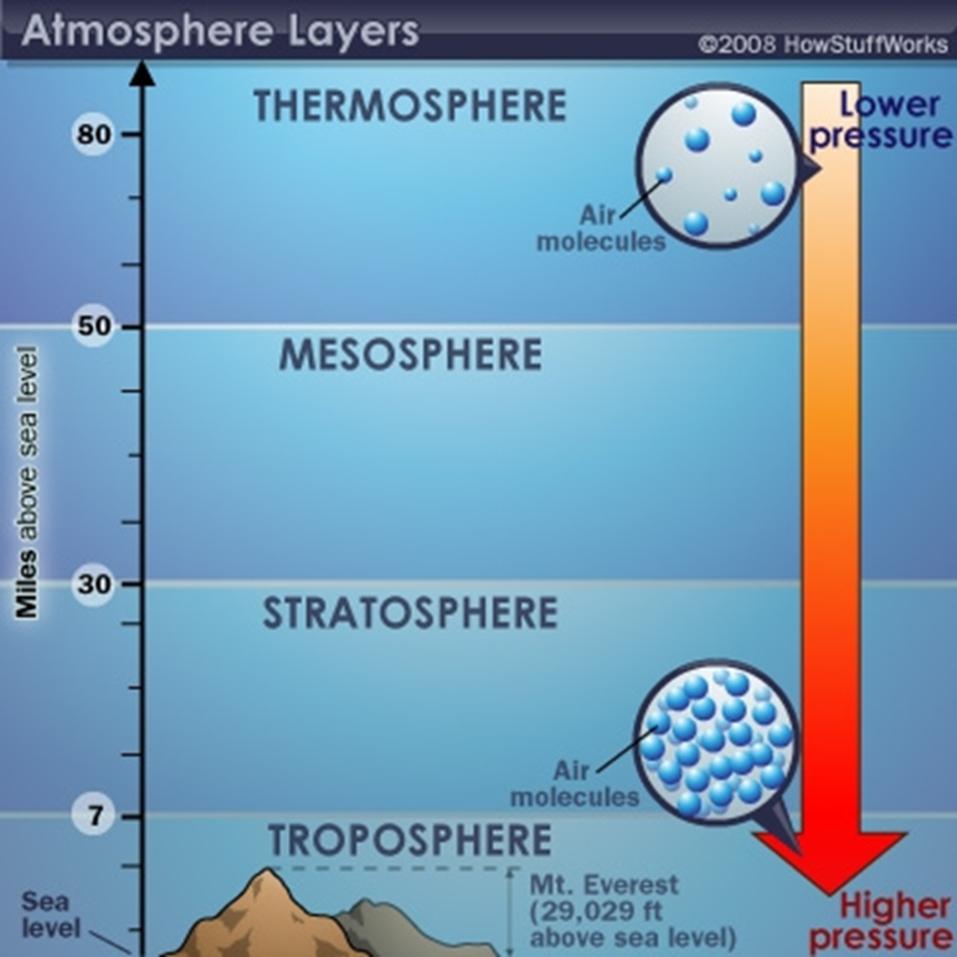
Density
Air at higher altitudes has less pressure – it is also less dense.
Density is also related to temperature.
As air is heated, the molecules move farther apart
Which means there is a decrease in density
On a hot day, aircraft in high altitudes have difficulty taking off – air is too thin

Slide 5
Warm-Up – 9/27 – 10 minutes
Utilizing your notes and past knowledge answer the following questions:
Describe why it is difficult for an aircraft to takeoff on hot days at a high altitude.
In “pilot speak,” what is known as a “bad thing?”
Describe chord.
What is known as the most efficient airfoil?
With what flight control surfaces can you change to give an airfoil greater lift at slower flight conditions?

Slide 6
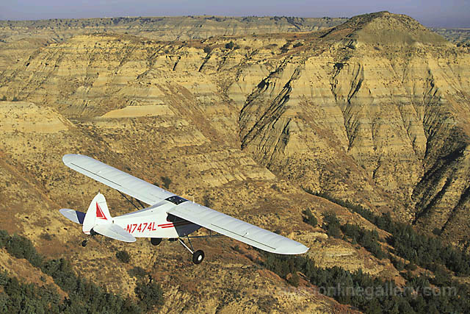
Density Altitude Effect of Humidity on Density
"High, Hot and Heavy is a bad thing!"
High airport elevation, high temperature, high humidity to some degree, and heavy gross weight

Slide 7
Warm-Up – 9/27 – 10 minutes
Utilizing your notes and past knowledge answer the following questions:
Describe why it is difficult for an aircraft to takeoff on hot days at a high altitude.
In “pilot speak,” what is known as a “bad thing?”
Describe chord.
What is known as the most efficient airfoil?
With what flight control surfaces can you change to give an airfoil greater lift at slower flight conditions?

Slide 8
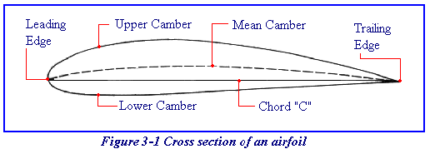
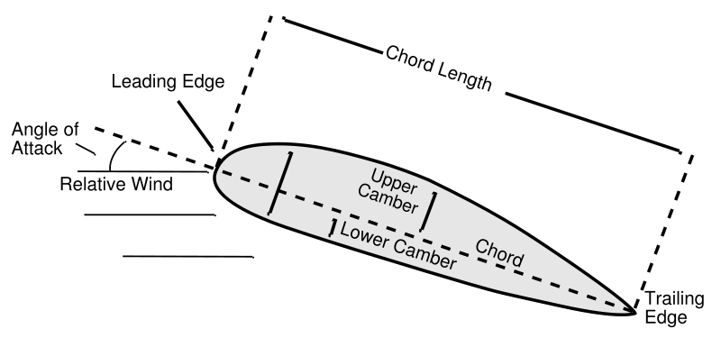
Airfoil – Designs that Capture the Energy of the Wind
Airfoil Design
Chord is an imaginary line that connects the leading with the trailing edge
The Relative Wind is opposite the flight path
Angle of Attack
Is the angle between the chord line and the oncoming relative wind

Slide 9
Warm-Up – 9/27 – 10 minutes
Utilizing your notes and past knowledge answer the following questions:
Describe why it is difficult for an aircraft to takeoff on hot days at a high altitude.
In “pilot speak,” what is known as a “bad thing?”
Describe chord.
What is known as the most efficient airfoil?
With what flight control surfaces can you change to give an airfoil greater lift at slower flight conditions?

Slide 10
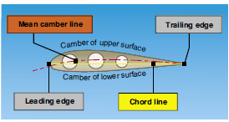
Airfoil Design
The most efficient airfoil for producing the greatest lift is one that has a concave, or “scooped out” lower surface.

Slide 11
Warm-Up – 9/27 – 10 minutes
Utilizing your notes and past knowledge answer the following questions:
Describe why it is difficult for an aircraft to takeoff on hot days at a high altitude.
In “pilot speak,” what is known as a “bad thing?”
Describe chord.
What is known as the most efficient airfoil?
With what flight control surfaces can you change to give an airfoil greater lift at slower flight conditions?

Slide 12
Airfoil Design
Leading edge (Kreuger) flaps and trailing edge (Fowler) flaps, when extended from the basic wing structure, literally change the airfoil shape into the classic concave form, thereby generating much greater lift during slow flight conditions.

Slide 13
Questions / Comments

Slide 14
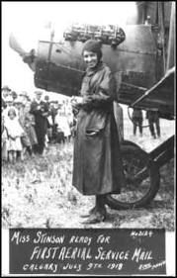
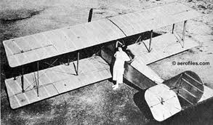
THIS DAY IN AVIATION
September 27
1913 — Katherine Stinson becomes the first woman in the United States to make an official airmail flight.

Slide 15
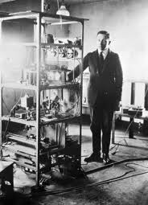
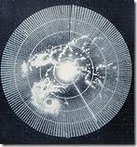
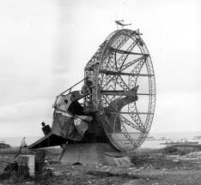
THIS DAY IN AVIATION
September 27
1922 — Dr. Albert Taylor and Leo Young, scientists at the US Naval Aircraft Radio Laboratory, make the first successful detections of objects by “radio observation.”
They use wireless waves to detect objects not visible due to weather or darkness.
This insight leads to the advent of radar.

Slide 16
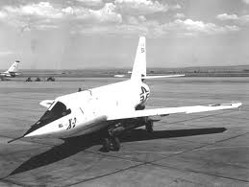
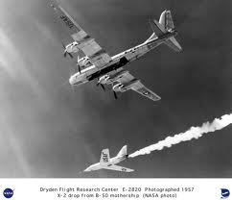
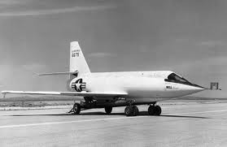
THIS DAY IN AVIATION
September 27
1956 — The first piloted airplane to exceed Mach 3 is the rocket-powered Bell X-2.

Slide 17
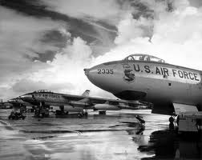
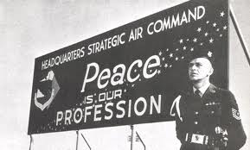
THIS DAY IN AVIATION
September 27
1991 — SAC forces stand down from Alert status.

Slide 18
Questions / Comments

Slide 19
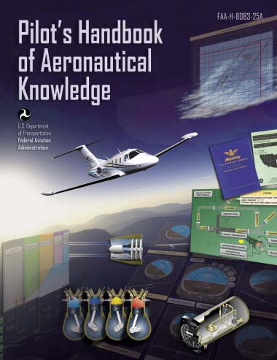
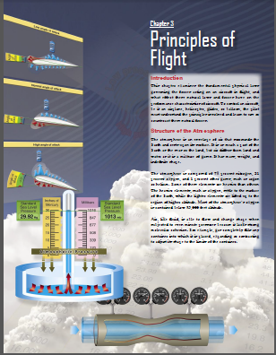
Chapter 3 – Principles of Flight
FAA – Pilot’s Handbook of Aeronautical Knowledge

Slide 20
Today’s Mission Requirements
Mission:
Identify in writing the fundamental physical laws governing the forces acting on an aircraft in flight.
Discuss the layers of the atmosphere, its composition and height.
Describe the atmospheric properties of pressure, temperature, and density
Describe in writing the effect these natural laws and forces have on the performance characteristics of an aircraft.
Describe in writing the means a pilot must understand the principles involved and learn to use or counteract these natural forces.
EQ:
Describe the importance of Aeronautical Knowledge for the student pilot learning to fly.

Slide 21
Questions / Comments

Slide 22
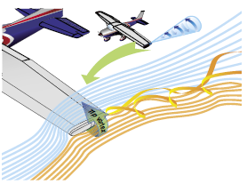
A Third Dimension
The high-pressure area on the bottom of an airfoil pushes around the tip to the low-pressure area on the top.
This action creates a rotating flow called a tip vortex

Slide 23
A Third Dimension
The vortex flows behind the airfoil creating a downwash that extends back to the trailing edge of the airfoil.
This downwash results in an overall reduction in lift for the affected portion of the airfoil.

Slide 24
A Third Dimension
To counteract this action. Winglets can be added to the tip of an airfoil to reduce this flow.
The winglets act as a dam preventing the vortex from forming.
Winglets can be on the top or bottom of the airfoil.

Slide 25
A Third Dimension
Another method of countering the flow is to taper the airfoil tip, reducing the pressure differential and smoothing the airflow around the tip.

Slide 26
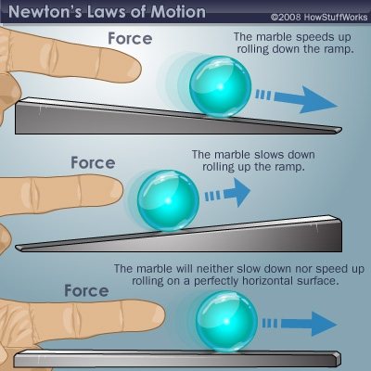
Newton’s Laws of Motion
Newton's three laws of motion are:
Inertia - A body at rest will remain at rest. and a body in motion will remain in motion at the same speed and direction until affected by some external force.
Nothing starts or stops without an outside force to bring about or prevent motion. Hence, the force with which a body offers resistance to change is called the force of inertia.

Slide 27
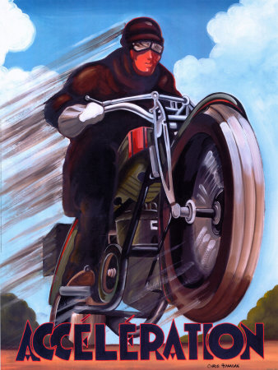
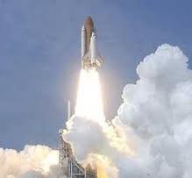
Newton’s Laws of Motion
Newton's three laws of motion are:
Acceleration - The force required to produce a change in motion of a body is directly proportional to its mass and the rate of change in its velocity.
Acceleration refers either to an increase or a decrease in velocity, although Deceleration is commonly used to indicate a decrease.

Slide 28
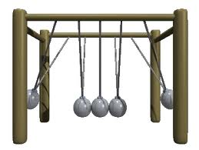
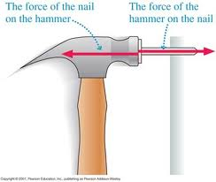
Newton’s Laws of Motion
Newton's three laws of motion are:
Action / Reaction - For every action there is an equal and opposite reaction.
If an interaction occurs between two bodies, equal forces in opposite directions will be imparted to each body.

Slide 29
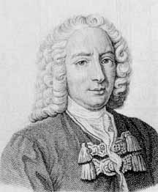
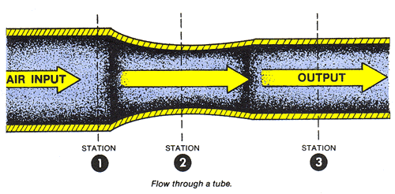
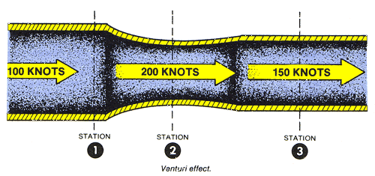
Who is Daniel Bernoulli?
Dutch-born physicist – born in 1738
Discovered a relationship between the pressure and speed of a fluid in motion
Specifically – as velocity of a fluid increases, the pressure decreases

Slide 30
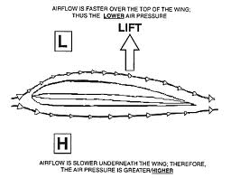
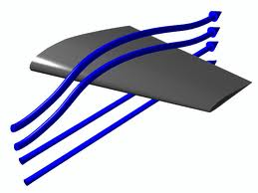
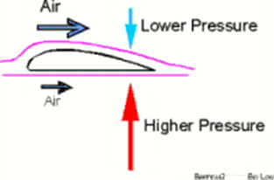
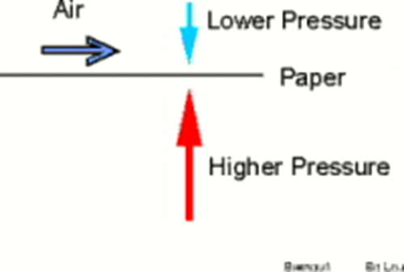
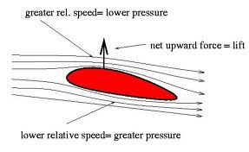
Who is Daniel Bernoulli?
For Lift to occur - The pressure on top of the airfoil must be less than the pressure below.
The airfoil has no choice but to move upward.

Slide 31
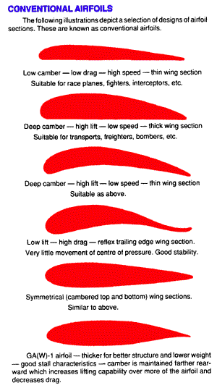
Who is Daniel Bernoulli?
Camber determines the amount of lift an airfoil will produce at a given speed
The thicker or more pronounced the camber – the more lift.
At low speeds its best to have a high-lift airfoil.

Slide 32
Summary
Modern general aviation aircraft have what may be considered high performance characteristics.
Therefore, it is increasingly necessary that pilots appreciate and understand the principles upon which the art of flying is based.

Slide 33
Questions / Comments

Slide 34
Sporty’ s Learn to Fly

Slide 35
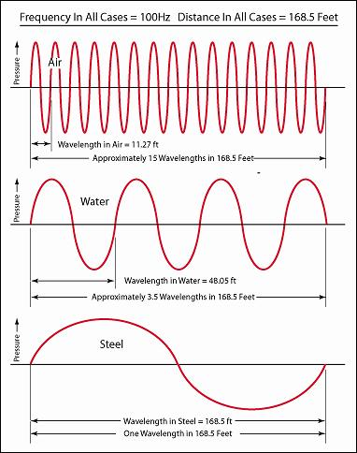
The Speed of Sound in Air
Sound waves travel like ripples in water.
Sound travels in all directions.

Slide 36
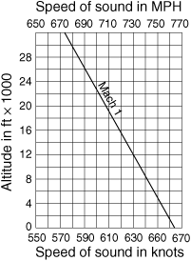
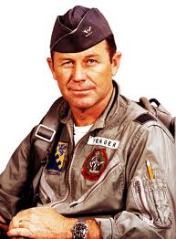
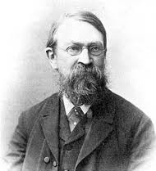
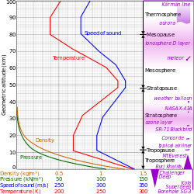
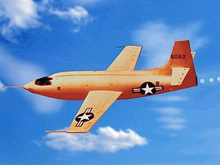
The Speed of Sound in Air
Austrian physicist Ernst Mach determined the mathematical value for the speed of sound
Speed of sound varies with altitude because temperature decreases with an increase in height
Chuck Yeager in the X-1 broke the speed of sound Oct 14, 1947

