Slide 1
Warm-Up – 9/21 – 10 minutes
Utilizing your notes and past knowledge answer the following questions:
CL increases with an increase in AOA, at some point the CL peaks and then begins to drop off. This peak is called ____________.
The wing root reaches its critical AOA _____ making the stall progress _________ toward the wingtip.
By having the wing root stall first, _________ effectiveness is maintained at the wingtips, maintaining __________ of the aircraft.
Describe two methods used to achieve the stalling of the wing root first.
Critical AOA varies from _________depending on the aircraft’s design.

Slide 2
Questions / Comments

Slide 3
Warm-Up – 9/21 – 10 minutes
Utilizing your notes and past knowledge answer the following questions:
CL increases with an increase in AOA, at some point the CL peaks and then begins to drop off. This peak is called ____________.
The wing root reaches its critical AOA _____ making the stall progress _________ toward the wingtip.
By having the wing root stall first, _________ effectiveness is maintained at the wingtips, maintaining __________ of the aircraft.
Describe two methods used to achieve the stalling of the wing root first.
Critical AOA varies from _________depending on the aircraft’s design.

Slide 4
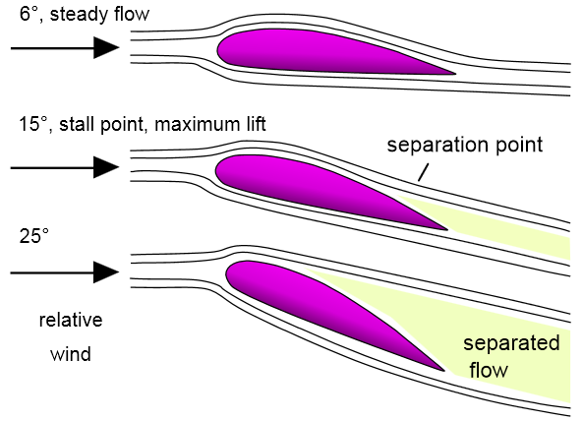
Aerodynamic Forces in Flight Maneuvers Stalls
CL increases with an increase in AOA, at some point the CL peaks and then begins to drop off.
This peak is called the CL-MAX.

Slide 5
Warm-Up – 9/21 – 10 minutes
Utilizing your notes and past knowledge answer the following questions:
CL increases with an increase in AOA, at some point the CL peaks and then begins to drop off. This peak is called ____________.
The wing root reaches its critical AOA _____ making the stall progress _________ toward the wingtip.
By having the wing root stall first, _________ effectiveness is maintained at the wingtips, maintaining __________ of the aircraft.
Describe two methods used to achieve the stalling of the wing root first.
Critical AOA varies from _________depending on the aircraft’s design.

Slide 6
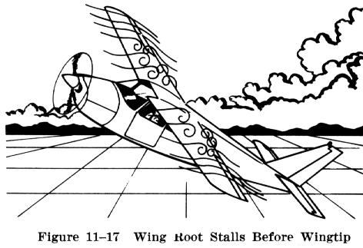
Aerodynamic Forces in Flight Maneuvers Stalls
In most straight-wing aircraft, the wing is designed to stall the wing root first.
The wing root reaches its critical AOA first making the stall progress outward toward the wingtip.

Slide 7
Warm-Up – 9/21 – 10 minutes
Utilizing your notes and past knowledge answer the following questions:
CL increases with an increase in AOA, at some point the CL peaks and then begins to drop off. This peak is called ____________.
The wing root reaches its critical AOA _____ making the stall progress _________ toward the wingtip.
By having the wing root stall first, _________ effectiveness is maintained at the wingtips, maintaining __________ of the aircraft.
Describe two methods used to achieve the stalling of the wing root first.
Critical AOA varies from _________depending on the aircraft’s design.

Slide 8
Aerodynamic Forces in Flight Maneuvers Stalls
By having the wing root stall first, aileron effectiveness is maintained at the wingtips, maintaining controllability of the aircraft.
Various design methods are used to achieve the stalling of the wing root first.

Slide 9
Warm-Up – 9/21 – 10 minutes
Utilizing your notes and past knowledge answer the following questions:
CL increases with an increase in AOA, at some point the CL peaks and then begins to drop off. This peak is called ____________.
The wing root reaches its critical AOA _____ making the stall progress _________ toward the wingtip.
By having the wing root stall first, _________ effectiveness is maintained at the wingtips, maintaining __________ of the aircraft.
Describe two methods used to achieve the stalling of the wing root first.
Critical AOA varies from _________depending on the aircraft’s design.

Slide 10
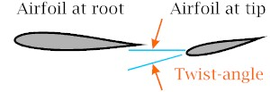
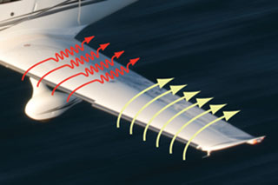
Aerodynamic Forces in Flight Maneuvers Stalls
In one design, the wing is “twisted” to a higher AOA at the wing root.
Installing stall strips on the first 20–25 percent of the wing’s leading edge is another method to introduce a stall prematurely.

Slide 11
Warm-Up – 9/21 – 10 minutes
Utilizing your notes and past knowledge answer the following questions:
CL increases with an increase in AOA, at some point the CL peaks and then begins to drop off. This peak is called ____________.
The wing root reaches its critical AOA _____ making the stall progress _________ toward the wingtip.
By having the wing root stall first, _________ effectiveness is maintained at the wingtips, maintaining __________ of the aircraft.
Describe two methods used to achieve the stalling of the wing root first.
Critical AOA varies from _________depending on the aircraft’s design.

Slide 12
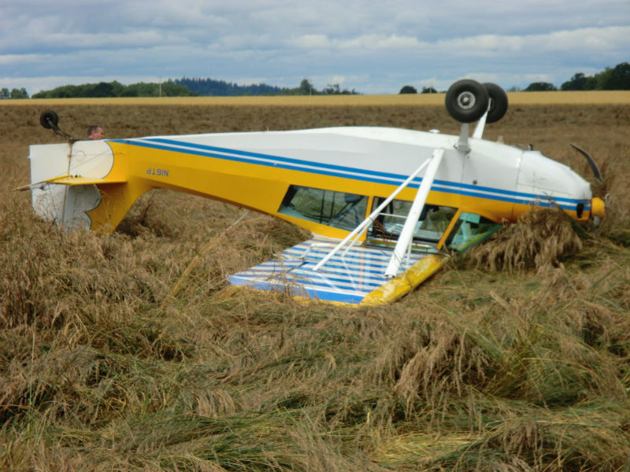
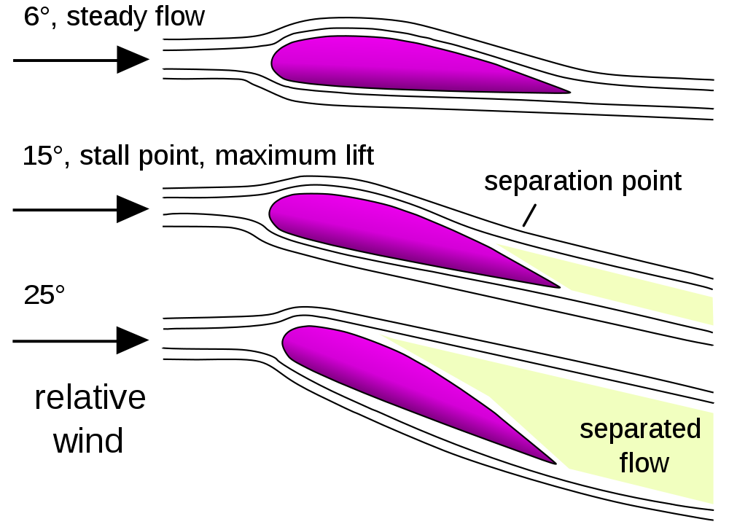
Aerodynamic Forces in Flight Maneuvers Stalls
This critical AOA varies from 16° to 20° depending on the aircraft’s design.
But each aircraft has only one specific AOA where the stall occurs.

Slide 13
Questions / Comments

Slide 14
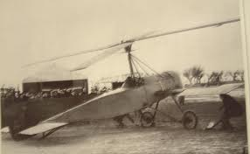
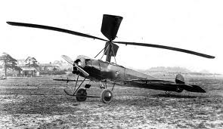
THIS DAY IN AVIATION
September 18
1928 — The first rotating-wing aircraft to fly the English Channel is the Cierva C-8L “Autogyro” flown by its designer, Spaniard, Juan de la Cierva.

Slide 15
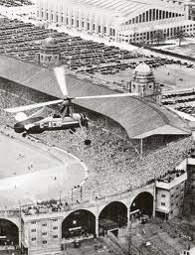
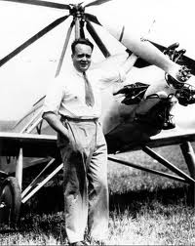
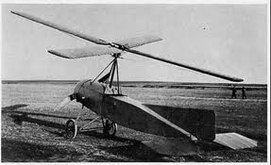
THIS DAY IN AVIATION
September 18
1928 — Juan de la Cierva flies his autogiro from London to Paris.

Slide 16
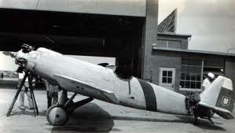
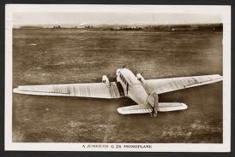
THIS DAY IN AVIATION
September 18
1928 — Swedish pilot, Lindner, and Baron von Huenefeld fly a Junkers monoplane from Berlin to Tokyo, Japan.

Slide 17
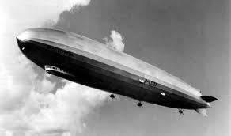
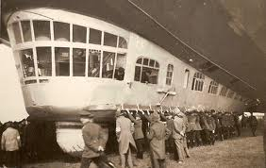
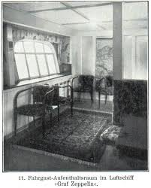
THIS DAY IN AVIATION
September 18
1940 — The first flight of the Zeppelin LZ-127 “Graf Zeppelin” is made.
It is the most successful rigid airship ever built, flown commercially on a regular basis from Europe to South America.
It flies over a million miles and carries some 13,100 passengers before its demise in 1940.

Slide 18
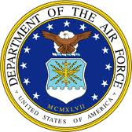
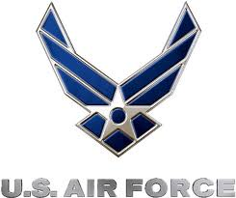
THIS DAY IN AVIATION
September 18
1947 — The United States Air Force becomes an independent service within the unified United States armed forces.
This change recognizes the fact that air power is to be the nation's first line of defense.

Slide 19
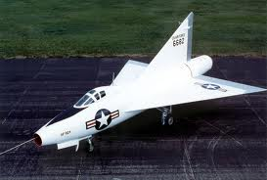
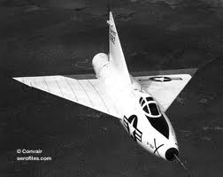
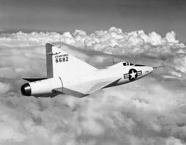
THIS DAY IN AVIATION
September 18
1948 — The first flight of a delta-wing jet airplane is made with the Convair XF-92A.

Slide 20
Questions / Comments

Slide 21
September 2015
Sunday | Monday | Tuesday | Wednesday | Thursday | Friday | Saturday
30 | 31 Chapter 3 Principles of Flight | 1 Chapter 3 Principles of Flight | 2 Chapter 3 Principles of Flight Progress Reports Due | 3 Chapter 3 Principles of Flight | 4 Flightline Friday Progress Reports Sent Home | 5
6 | 7 HOLIDAY | 8 Chapter 4 Principles of Flight | 9 Chapter 4 Principles of Flight | 10 Chapter 4 Principles of Flight | 11 QUIZ Flightline Friday | 12
13 | 14 Chapter 4 Principles of Flight | 15 Chapter 4 Principles of Flight | 16 Chapter 4 Principles of Flight | 17 Chapter 4 Principles of Flight | 18 QUIZ Flightline Friday | 19
20 | 21 | 22 | 23 Progress Reports Due | 24 | 25 Progress Reports Sent Home | 26

Slide 22
1st Quarter Requirements (19 Class Meetings – Oct 14)
All students will complete the following:
Take notes - All in class quizzes and tests
Each day is worth 20pts - (4 day week 25pts)
Complete Flight Sim. Tutorials (1 – 5 x3 + 1)
Aircraft Fam. and Student Pilot Syllabus
Lessons 1 – 7 (Straight & Level Flight through First Solo)
Must pass written with 80%
Successfully complete 3 times on small sim
Successfully complete 1 time on Main sim
Complete ERAU Aviation 101
6 quizzes and 2 tests
Student will receive zero points for all incomplete work – NO make-up / extra credit

Slide 23
Questions / Comments

Slide 24
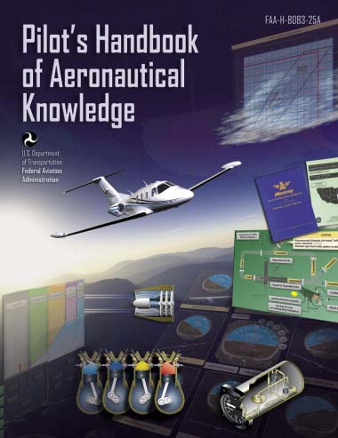
Chapter 4 – Aerodynamics of Flight
FAA – Pilot’s Handbook of Aeronautical Knowledge
Chapter 4
Quiz

Slide 25
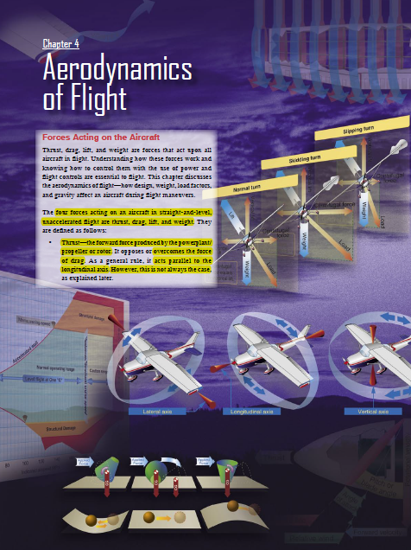
Chapter 4 – Aerodynamics of Flight
FAA – Pilot’s Handbook of Aeronautical Knowledge

Slide 26
Questions / Comments

Slide 27
Lesson Closure - 3 – 2 - 1
3. List 3 things you learned today.
2. List 2 things you have questions about today’s lesson.
1. Create (1) quiz question with answer about today’s lesson.

Slide 28
1st Quarter Requirements (19 Class Meetings – Oct 14)
All students will complete the following:
Take notes - All in class quizzes and tests
Each day is worth 20pts - (4 day week 25pts)
Complete Flight Sim. Tutorials (1 – 5 x3 + 1)
Aircraft Fam. and Student Pilot Syllabus
Lessons 1 – 7 (Straight & Level Flight through First Solo)
Must pass written with 80%
Successfully complete 3 times on small sim
Successfully complete 1 time on Main sim
Complete ERAU Aviation 101
6 quizzes and 2 tests
Student will receive zero points for all incomplete work – NO make-up / extra credit

