Slide 1
Warm-Up – 9/17 – 10 minutes
Utilizing your notes and past knowledge answer the following questions:
What is an advantage of composites that aids in lowering maintenance costs?
What is a potential disadvantage of composites in a hot climate or conditions?
Describe the care maintainers must utilize with paint strippers on composite materials?
What are the three categories of aircraft instruments?
Describe the differences between a 3 satellite and 4 satellite GPS lock-on.

Slide 2
Questions / Comments

Slide 3
Warm-Up – 9/17 – 10 minutes
Utilizing your notes and past knowledge answer the following questions:
What is an advantage of composites that aids in lowering maintenance costs?
What is a potential disadvantage of composites in a hot climate or conditions?
Describe the care maintainers must utilize with paint strippers on composite materials?
What are the three categories of aircraft instruments?
Describe the differences between a 3 satellite and 4 satellite GPS lock-on.

Slide 4
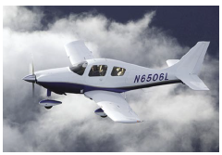
Types of Aircraft Construction Advantages of Construction
Lack of corrosion is a third advantage of composites.
Engineers are no longer as concerned about corrosion from moisture condensation on the hidden areas of the fuselage skins, such as behind insulation blankets.
This should lead to lower long-term maintenance costs for the airlines.

Slide 5
Warm-Up – 9/17 – 10 minutes
Utilizing your notes and past knowledge answer the following questions:
What is an advantage of composites that aids in lowering maintenance costs?
What is a potential disadvantage of composites in a hot climate or conditions?
Describe the care maintainers must utilize with paint strippers on composite materials?
What are the three categories of aircraft instruments?
Describe the differences between a 3 satellite and 4 satellite GPS lock-on.

Slide 6
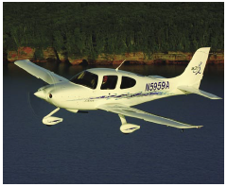
Types of Aircraft Construction Disadvantages of Construction
The potential for heat damage to the resin is another disadvantage of using composites.
While “too hot” depends on the particular resin system chosen, many epoxies begin to weaken over 150° F.

Slide 7
Warm-Up – 9/17 – 10 minutes
Utilizing your notes and past knowledge answer the following questions:
What is an advantage of composites that aids in lowering maintenance costs?
What is a potential disadvantage of composites in a hot climate or conditions?
Describe the care maintainers must utilize with paint strippers on composite materials?
What are the three categories of aircraft instruments?
Describe the differences between a 3 satellite and 4 satellite GPS lock-on.

Slide 8
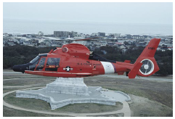
Types of Aircraft Construction Disadvantages of Construction
Chemical paint strippers are very harmful to composites, and must not be used on them.

Slide 9
Warm-Up – 9/17 – 10 minutes
Utilizing your notes and past knowledge answer the following questions:
What is an advantage of composites that aids in lowering maintenance costs?
What is a potential disadvantage of composites in a hot climate or conditions?
Describe the care maintainers must utilize with paint strippers on composite materials?
What are the three categories of aircraft instruments?
Describe the differences between a 3 satellite and 4 satellite GPS lock-on.

Slide 10
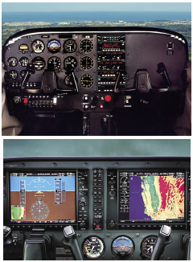
Instrumentation: Moving into the Future
Instrumentation falls into three different categories: performance, control, and navigation.

Slide 11
Warm-Up – 9/17 – 10 minutes
Utilizing your notes and past knowledge answer the following questions:
What is an advantage of composites that aids in lowering maintenance costs?
What is a potential disadvantage of composites in a hot climate or conditions?
Describe the care maintainers must utilize with paint strippers on composite materials?
What are the three categories of aircraft instruments?
Describe the differences between a 3 satellite and 4 satellite GPS lock-on.

Slide 12
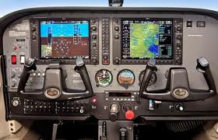
Instrumentation: GPS
A GPS receiver must be locked onto the signal of at least three satellites to calculate a two-dimensional position (latitude and longitude) and track movement.
With four or more satellites in view, the receiver can determine the user’s three-dimensional position (latitude, longitude, and altitude).

Slide 13
Questions / Comments

Slide 14
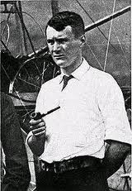
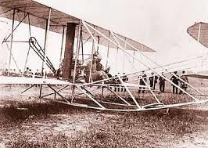
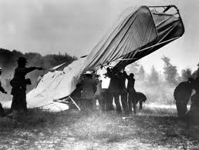
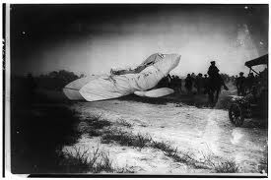
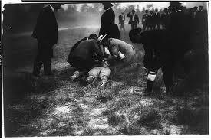
THIS DAY IN AVIATION
September 17
1908 — The first fatality in a powered airplane occurs when Lieutenant Thomas Selfridge is killed while flying with Orville Wright at Fort Meyer, Virginia.

Slide 15
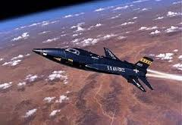
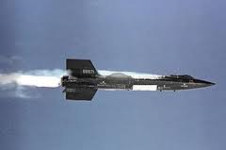
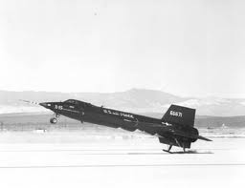
THIS DAY IN AVIATION
September 17
1959 — The North American X-15 rocket plane makes its first powered flight at Edwards Air Force Base in California.

Slide 16
Questions / Comments

Slide 17
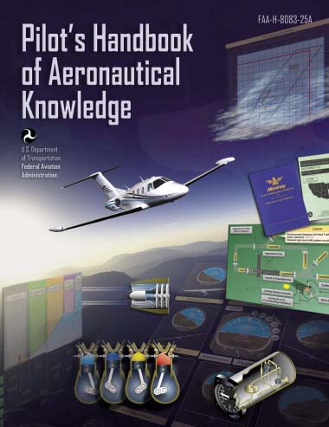
FAA – Pilot’s Handbook of Aeronautical Knowledge
Chapter 1 / 2
Closed Book
Test

Slide 18
Questions / Comments

Slide 19
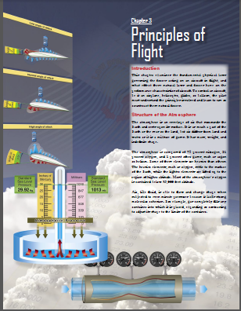
Chapter 3 – Principles of Flight
FAA – Pilot’s Handbook of Aeronautical Knowledge

Slide 20
Today’s Mission Requirements
Mission:
Identify in writing the fundamental physical laws governing the forces acting on an aircraft in flight.
Describe in writing the effect these natural laws and forces have on the performance characteristics of an aircraft.
Describe in writing the means a pilot must understand the principles involved and learn to use or counteract these natural forces.
EQ:
Describe the importance of Aeronautical Knowledge for the student pilot learning to fly.

Slide 21
Sporty’ s Learn to Fly

Slide 22
Introduction
This chapter examines the fundamental physical laws governing the forces acting on an aircraft in flight, and what effect these natural laws and forces have on the performance characteristics of aircraft.

Slide 23
Introduction
To control an aircraft, be it an airplane, helicopter, glider, or balloon, the pilot must understand the principles involved and learn to use or counteract these natural forces.

Slide 24
Structure of the Atmosphere
The atmosphere is composed of 78 percent nitrogen, 21 percent oxygen, and 1 percent other gases, such as argon or helium.

Slide 25
Structure of the Atmosphere
The heavier elements, such as oxygen, settle to the surface of the Earth, while the lighter elements are lifted up to the region of higher altitude.
Most of the atmosphere’s oxygen is contained below 35,000 feet altitude.

Slide 26
Structure of the Atmosphere
Air, like fluid, is able to flow and change shape when subjected to even minute pressures because it lacks strong molecular cohesion.
For example, gas completely fills any container into which it is placed, expanding or contracting to adjust its shape to the limits of the container.

Slide 27
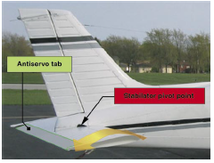
Atmospheric Pressure
Pilots are mainly concerned with atmospheric pressure.

Slide 28
Atmospheric Pressure
It is one of the basic factors in weather changes, helps to lift an aircraft, and actuates some of the important flight instruments.
These instruments are the altimeter, airspeed indicator, vertical speed indicator, and manifold pressure gauge.

Slide 29
Atmospheric Pressure
Air is very light, but it has mass and is affected by the attraction of gravity.
It has weight
It has force
It is a fluid substance
Its effect on bodies within the air is called pressure.

Slide 30
Atmospheric Pressure
Under standard conditions at sea level, the average pressure exerted by the weight of the atmosphere is approximately 14.70 pounds per square inch (psi) of surface, or 1,013.2 millibars (mb).

Slide 31
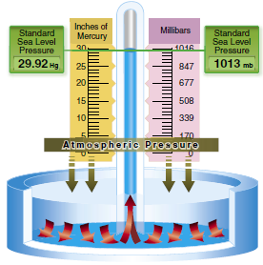
Atmospheric Pressure
The standard atmosphere at sea level is a surface temperature of 59 °F or 15 °C and a surface pressure of 29.92 inches of mercury

Slide 32
Atmospheric Pressure
A standard temperature lapse rate is one in which the temperature decreases at the rate of approximately 3.5 °F or 2 °C per thousand feet up to 36,000 feet which is approximately -65 °F or -55 °C.

Slide 33
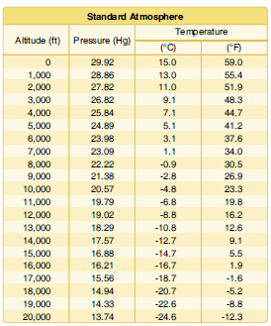
Atmospheric Pressure
Since aircraft performance is compared and evaluated with respect to the standard atmosphere, all aircraft instruments are calibrated for the standard atmosphere.

Slide 34
Pressure Altitude
Pressure altitude is the height above a standard datum plane (SDP), which is a theoretical level where the weight of the atmosphere is 29.92 "Hg as measured by a barometer.
An altimeter is essentially a sensitive barometer calibrated to indicate altitude in the standard atmosphere.

Slide 35
Pressure Altitude
Pressure altitude is important as a basis for determining airplane performance

Slide 36
Pressure Altitude
The pressure altitude can be determined by either of two methods:
1. Setting the barometric scale of the altimeter to 29.92 and reading the indicated altitude.
2. Applying a correction factor to the indicated altitude according to the reported altimeter setting.

Slide 37
Density Altitude
Aircraft operate in a nonstandard atmosphere and the term density altitude is used for correlating aerodynamic performance in the nonstandard atmosphere.
Density altitude is the vertical distance above sea level in the standard atmosphere at which a given density is to be found.

Slide 38
Density Altitude
The density of air has significant effects on the aircraft’s performance because as air becomes less dense, it reduces:
• Power because the engine takes in less air.
• Thrust because a propeller is less efficient in thin air.
• Lift because the thin air exerts less force on the airfoils.

Slide 39
Density Altitude
As the density of the air increases (lower density altitude), aircraft performance increases and conversely as air density decreases (higher density altitude), aircraft performance decreases.
A decrease in air density means a high density altitude; an increase in air density means a lower density altitude.

Slide 40
Density Altitude
Density altitude is used in calculating aircraft performance, because under standard atmospheric conditions, air at each level in the atmosphere not only has a specific density, its pressure altitude and density altitude identify the same level.

Slide 41
Density Altitude
Density altitude is determined by first finding pressure altitude, and then correcting this altitude for nonstandard temperature variations.

Slide 42
Density Altitude
Since density varies directly with pressure, and inversely with temperature, a given pressure altitude may exist for a wide range of temperature by allowing the density to vary.
However, a known density occurs for any one temperature and pressure altitude.

Slide 43
Density Altitude
The density of the air has a pronounced effect on aircraft and engine performance.
Regardless of the actual altitude at which the aircraft is operating, it will perform as though it were operating at an altitude equal to the existing density altitude.

Slide 44
Density Altitude
Air density is affected by changes in altitude, temperature, and humidity.
High density altitude refers to thin air while low density altitude refers to dense air.

Slide 45
Density Altitude
The conditions that result in a high density altitude are high elevations, low atmospheric pressures, high temperatures, high humidity, or some combination of these factors.

Slide 46
Density Altitude
Lower elevations, high atmospheric pressure, low temperatures, and low humidity are more indicative of low density altitude.

Slide 47
Density Altitude Effect of Pressure on Density
Since air is a gas, it can be compressed or expanded.
When air is compressed, a greater amount of air can occupy a given volume.
Conversely, when pressure on a given volume of air is decreased, the air expands and occupies a greater space.

Slide 48
Density Altitude Effect of Pressure on Density
At a lower pressure, the original column of air contains a smaller mass of air.
The density is decreased because density is directly proportional to pressure.

Slide 49
Density Altitude Effect of Pressure on Density
If the pressure is doubled, the density is doubled; if the pressure is lowered, the density is lowered.
This statement is true only at a constant temperature.

Slide 50
Density Altitude Effect of Temperature on Density
Increasing the temperature of a substance decreases its density.
Conversely, decreasing the temperature increases the density.
Thus, the density of air varies inversely with temperature.
This statement is true only at a constant pressure.

Slide 51
Density Altitude Effect of Temperature on Density
In the atmosphere, both temperature and pressure decrease with altitude, and have conflicting effects upon density.
However, the fairly rapid drop in pressure as altitude is increased usually has the dominating effect.
Hence, pilots can expect the density to decrease with altitude.

Slide 52
Density Altitude Effect of Humidity on Density
Humidity may become an important factor in the performance of an aircraft.
Water vapor is lighter than air; consequently, moist air is lighter than dry air.

Slide 53
Density Altitude Effect of Humidity on Density
Therefore, as the water content of the air increases, the air becomes less dense, increasing density altitude and decreasing performance.
It is lightest or least dense when, in a given set of conditions, it contains the maximum amount of water vapor.

Slide 54
Density Altitude Effect of Humidity on Density
Humidity, also called relative humidity, refers to the amount of water vapor contained in the atmosphere, and is expressed as a percentage of the maximum amount of water vapor the air can hold.
This amount varies with temperature. Warm air holds more water vapor, while colder air holds less.

Slide 55
Density Altitude Effect of Humidity on Density
Perfectly dry air that contains no water vapor has a relative humidity of zero percent, while saturated air, which cannot hold any more water vapor, has a relative humidity of 100 percent.

Slide 56
Density Altitude Effect of Humidity on Density
As temperature increases, the air can hold greater amounts of water vapor.
When comparing two separate air masses, the first warm and moist (both qualities tending to lighten the air) and the second cold and dry (both qualities making it heavier), the first must be less dense than the second.

Slide 57
Density Altitude Effect of Humidity on Density
Pressure, temperature, and humidity have a great influence on aircraft performance because of their effect upon density.

Slide 58
Airfoil Design
An airfoil is a structure designed to obtain reaction upon its surface from the air through which it moves or that moves past such a structure.
Air acts in various ways when submitted to different pressures and velocities;

Slide 59
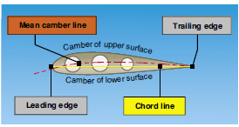
Airfoil Design
Notice that there is a difference in the curvatures (called cambers) of the upper and lower surfaces of the airfoil.
The camber of the upper surface is more pronounced than that of the lower surface, which is usually somewhat flat.

Slide 60
Airfoil Design
A reference line often used in discussing the airfoil is the chord line, a straight line drawn through the profile connecting the extremities of the leading and trailing edges.

Slide 61
Airfoil Design
The distance from this chord line to the upper and lower surfaces of the wing denotes the magnitude of the upper and lower camber at any point.

Slide 62
Airfoil Design
Another reference line, drawn from the leading edge to the trailing edge, is the mean camber line.
This mean line is equidistant at all points from the upper and lower surfaces.

Slide 63
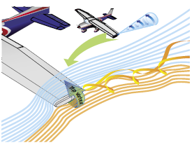
A Third Dimension
The high-pressure area on the bottom of an airfoil pushes around the tip to the low-pressure area on the top.
This action creates a rotating flow called a tip vortex

Slide 64
A Third Dimension
This action creates a rotating flow called a tip vortex.
The vortex flows behind the airfoil creating a downwash that extends back to the trailing edge of the airfoil.
This downwash results in an overall reduction in lift for the affected portion of the airfoil.

Slide 65
A Third Dimension
To counteract this action. Winglets can be added to the tip of an airfoil to reduce this flow.
The winglets act as a dam preventing the vortex from forming.
Winglets can be on the top or bottom of the airfoil.

Slide 66
A Third Dimension
Another method of countering the flow is to taper the airfoil tip, reducing the pressure differential and smoothing the airflow around the tip.

Slide 67
Summary
Modern general aviation aircraft have what may be considered high performance characteristics.
Therefore, it is increasingly necessary that pilots appreciate and understand the principles upon which the art of flying is based.

Slide 68
Questions / Comments

Slide 69
Questions / Comments

