Slide 1
EAA
Young
Eagles
Saturday Oct 5

Slide 2
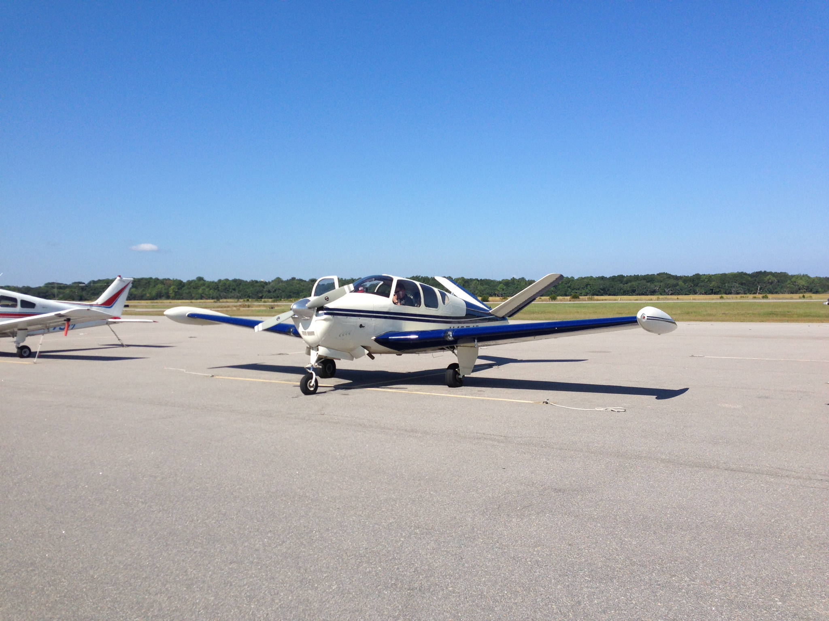

Slide 3
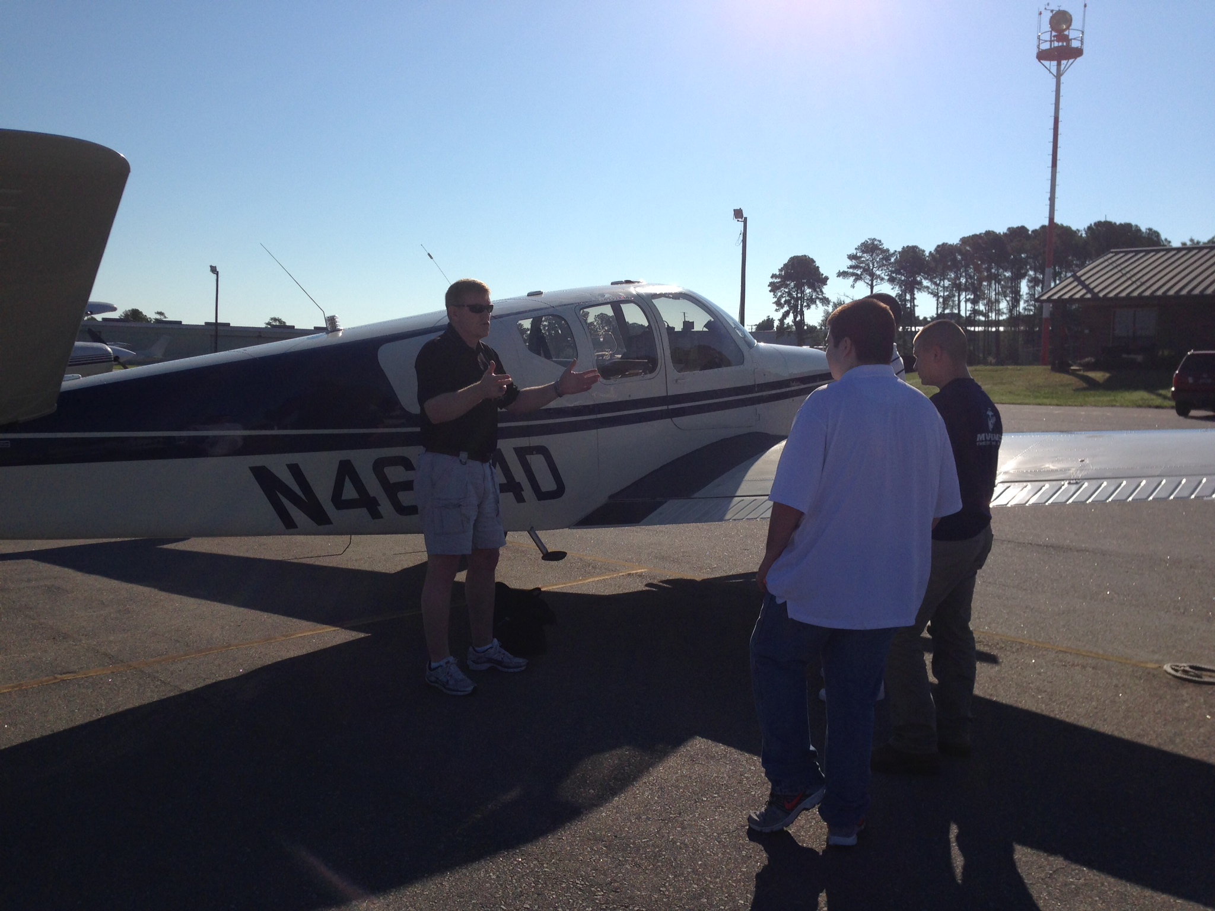

Slide 4
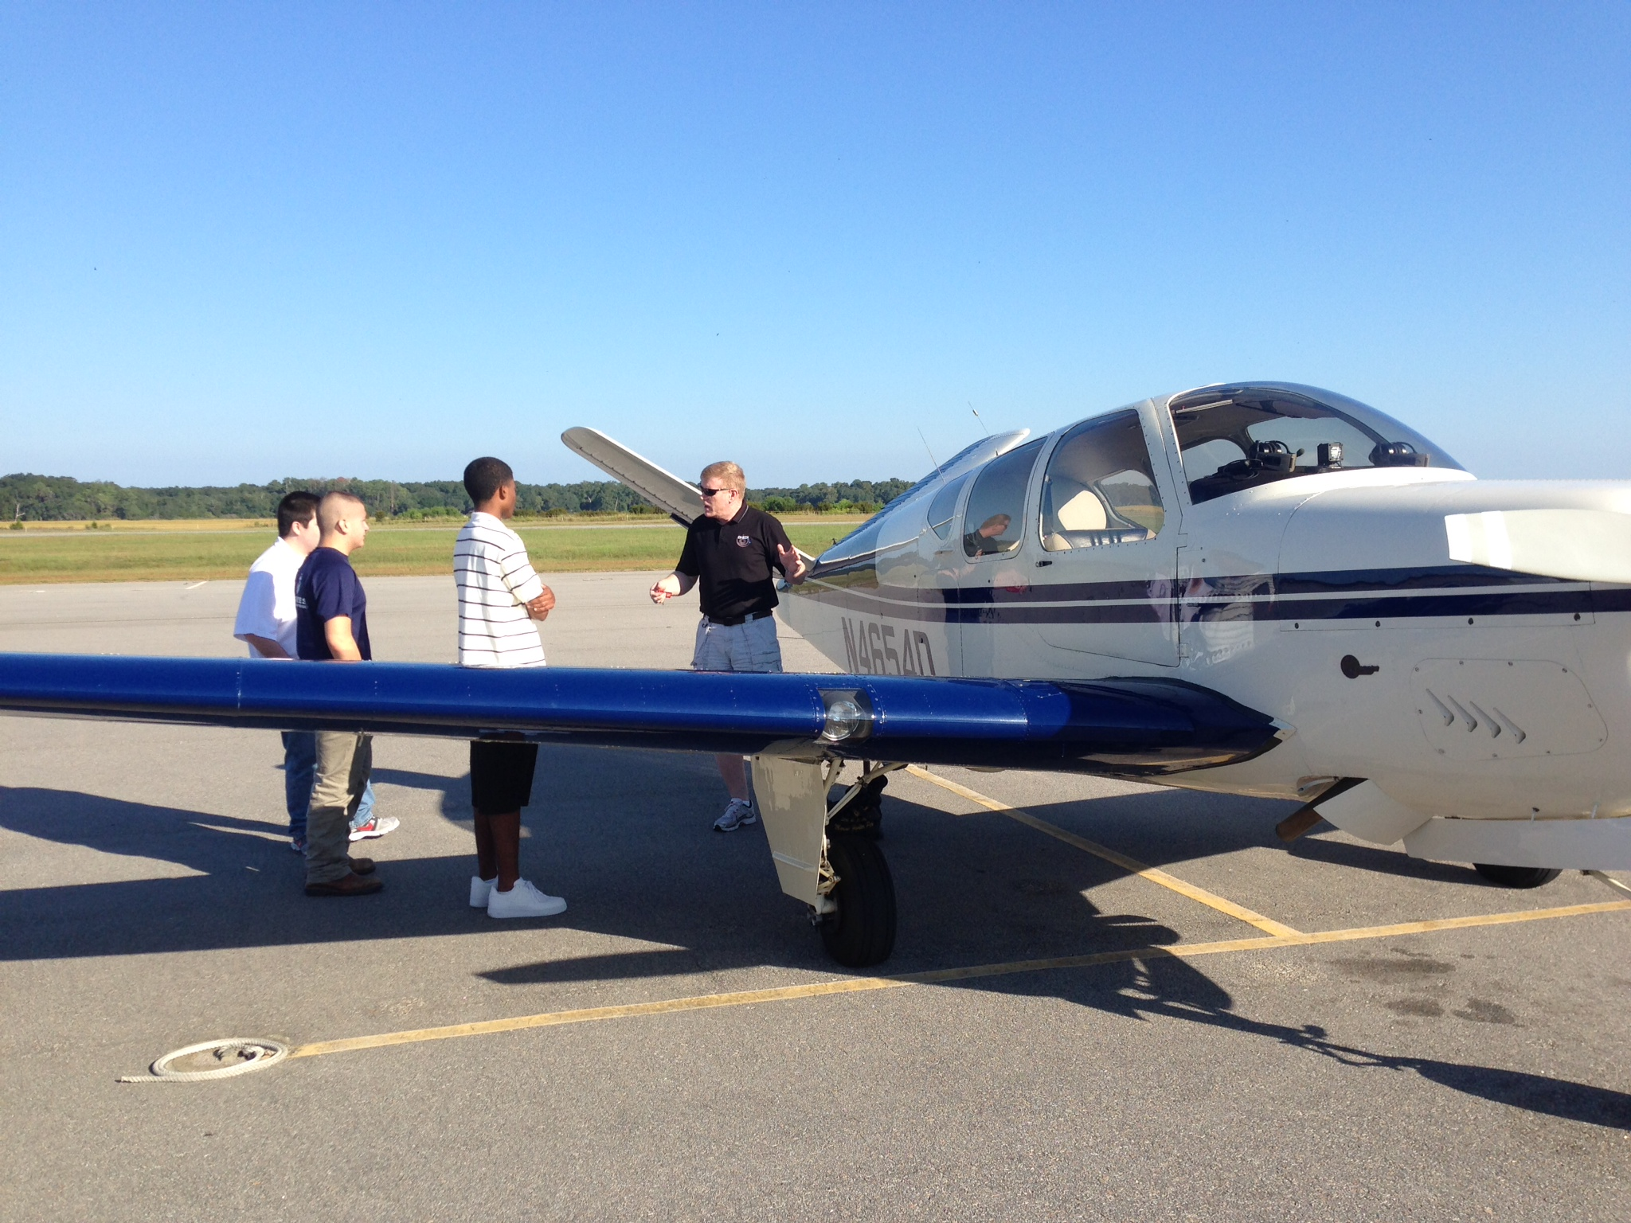

Slide 5
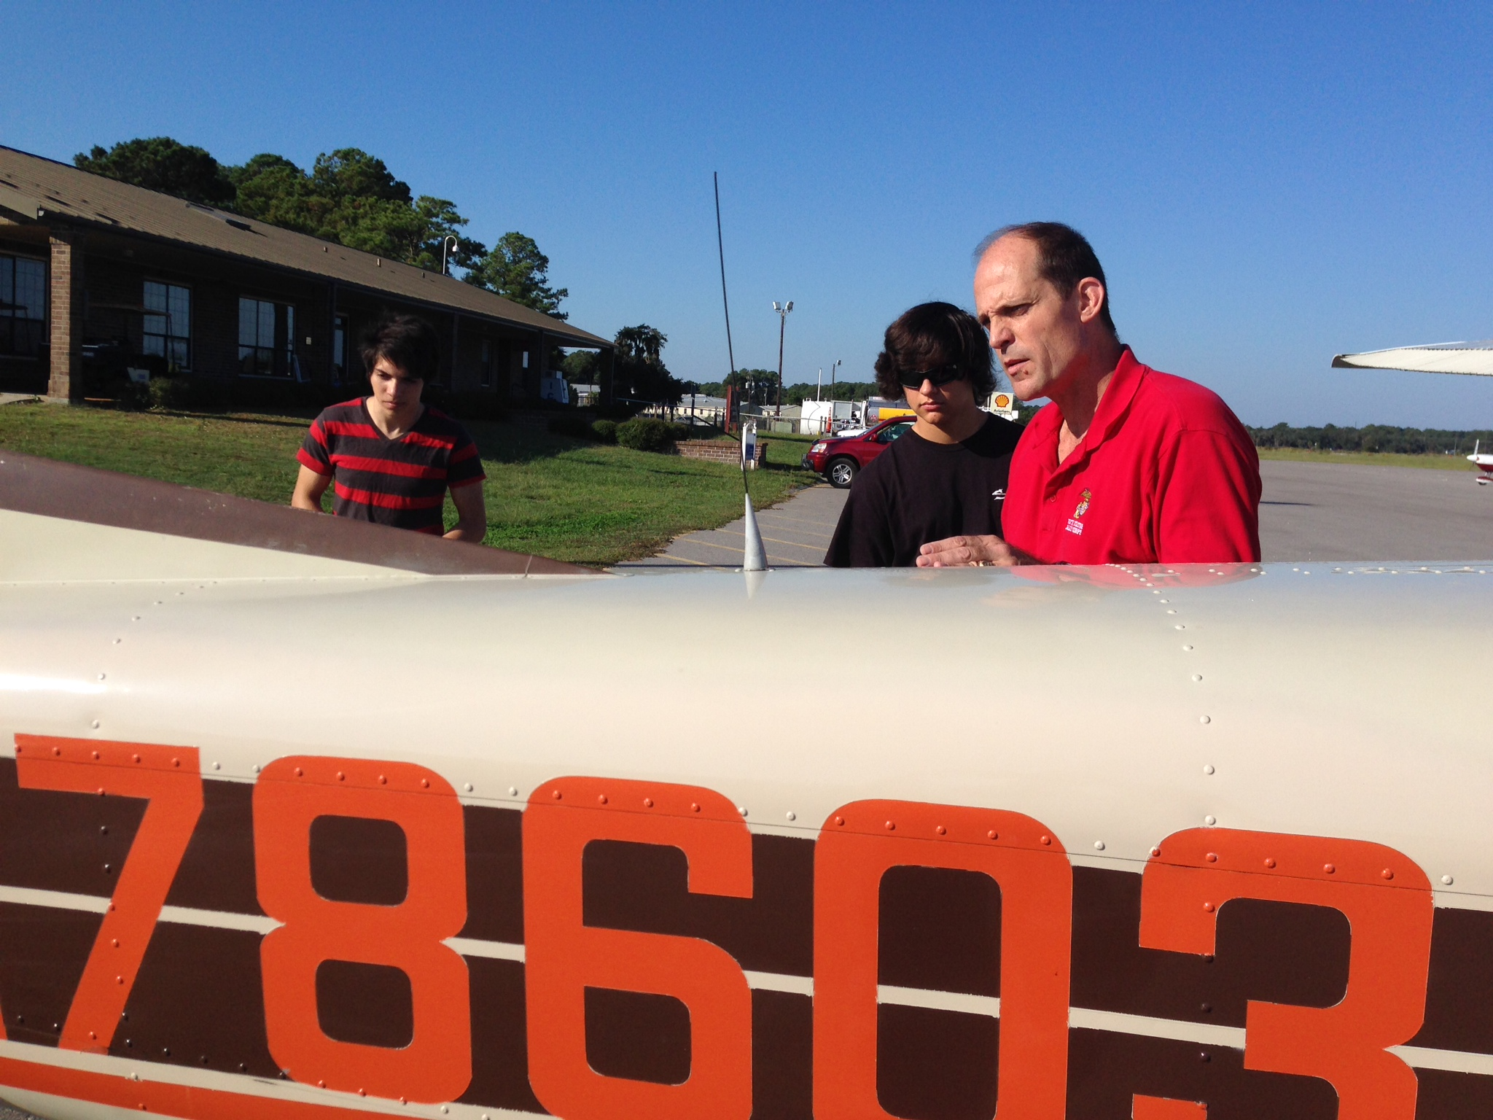

Slide 6
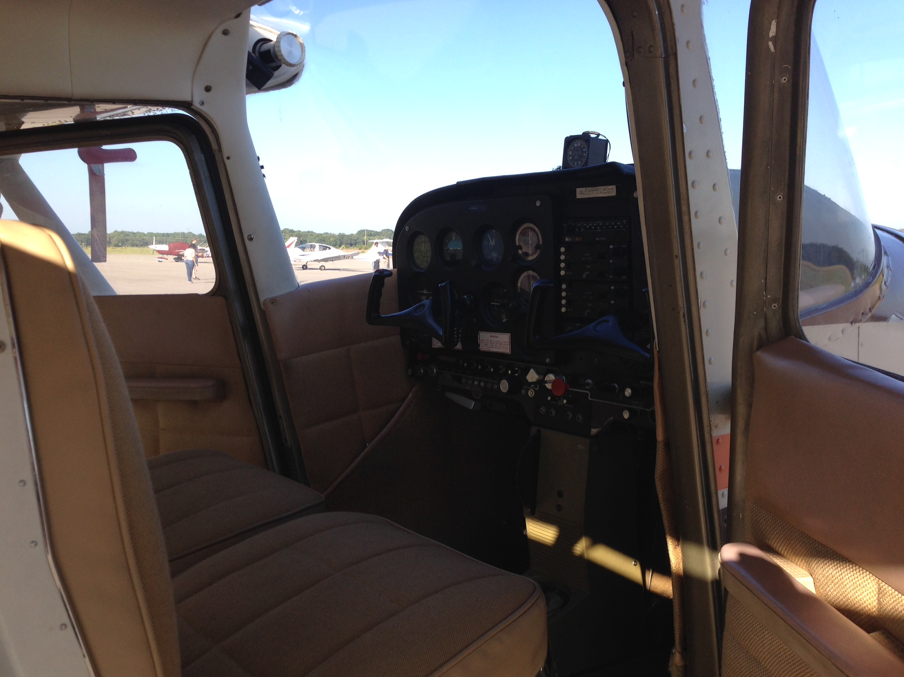

Slide 7
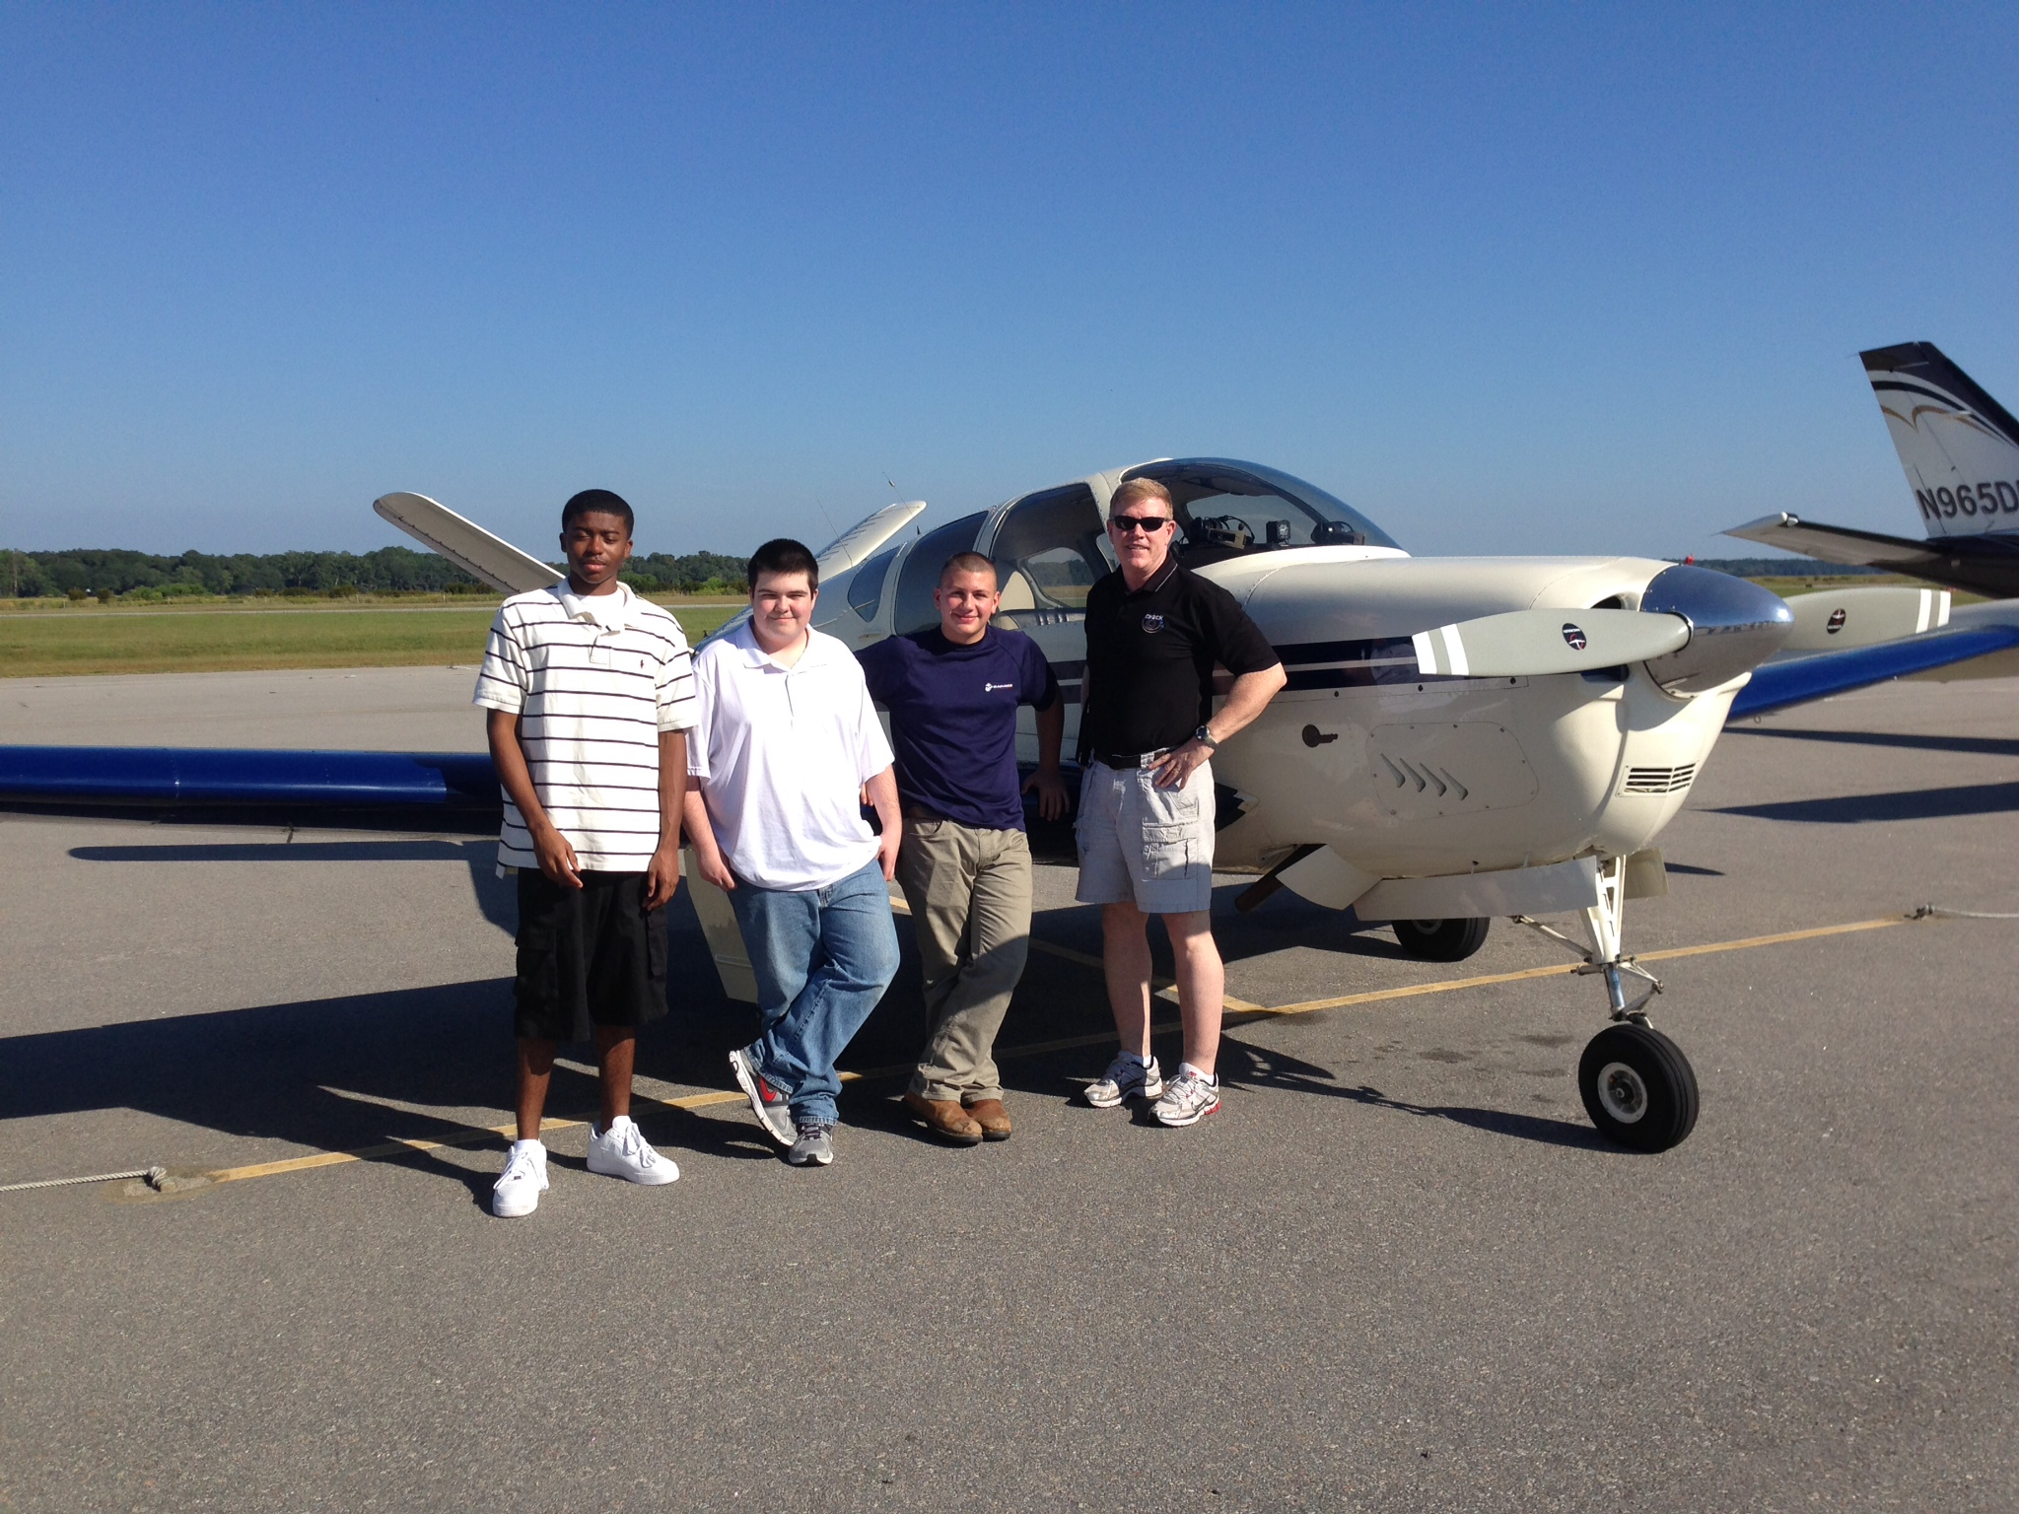

Slide 8
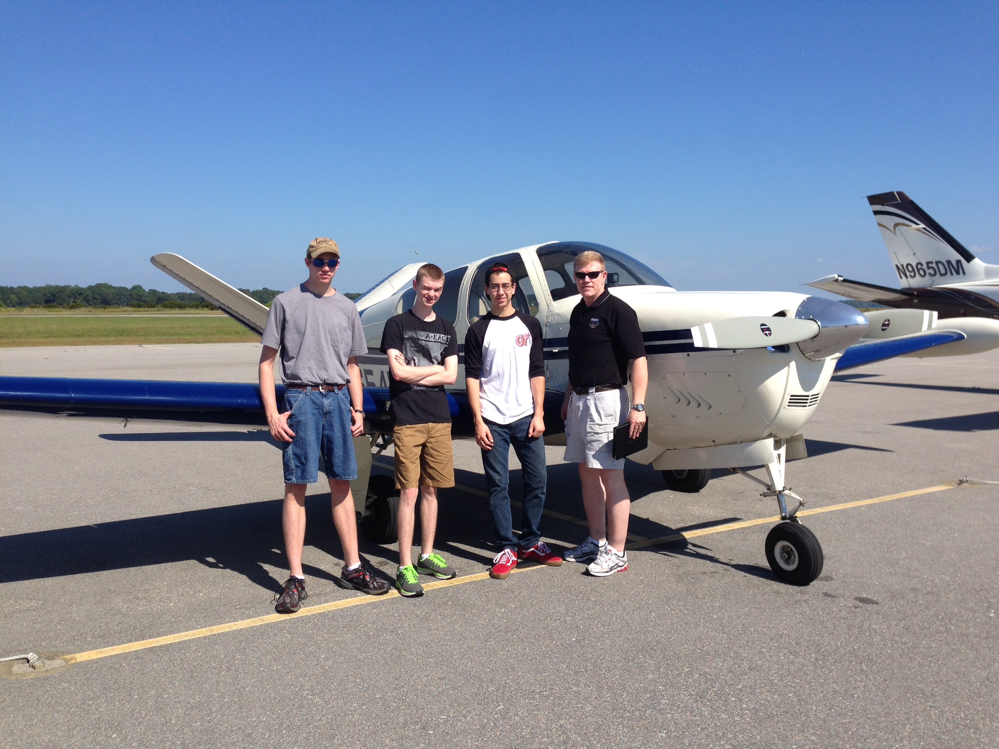

Slide 9
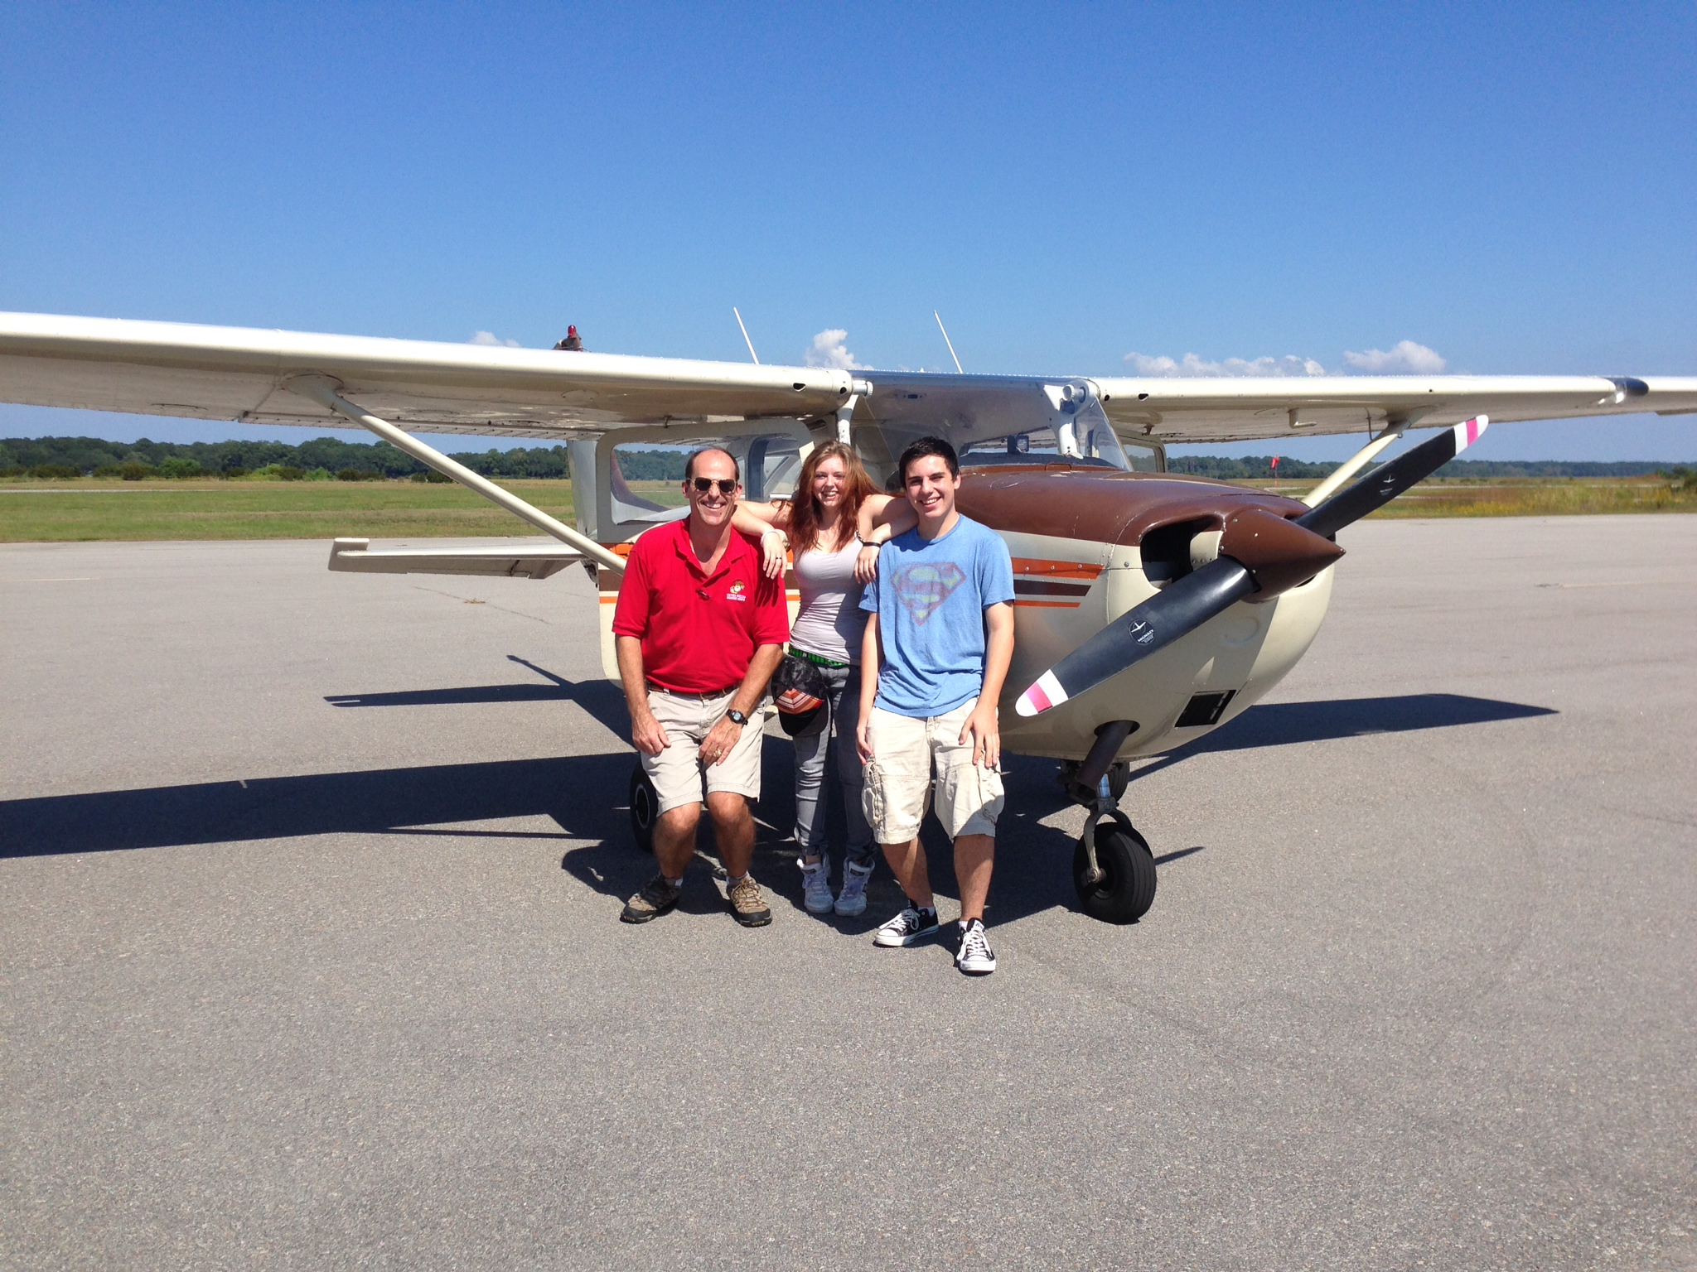

Slide 10
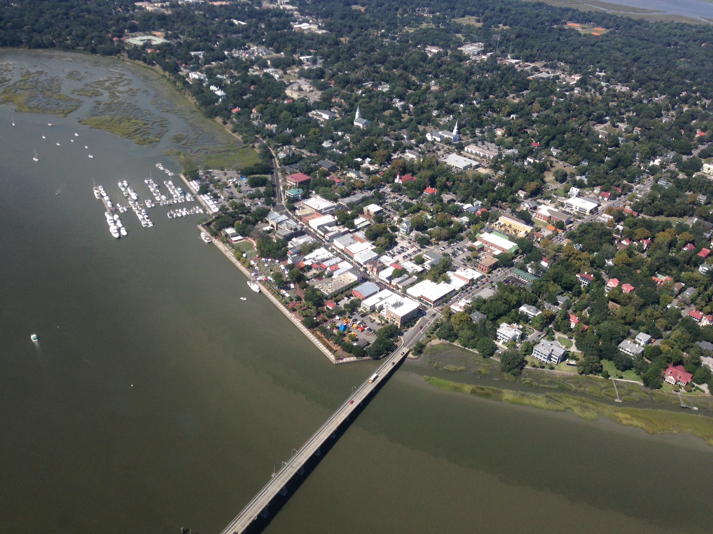

Slide 11
Warm-Up – 10/7 – 10 minutes
Utilizing your notes and past knowledge answer the following questions:
In order for lift to occur with an airfoil, what must the pressure be on top?
What does camber determine for an airfoil?
What type of pressure tends to push around a wingtip?
What is this rotating pressure called?
What are two means in which vortices can be reduced from an airfoil?

Slide 12
Questions / Comments

Slide 13
Warm-Up – 10/7 – 10 minutes
Utilizing your notes and past knowledge answer the following questions:
In order for lift to occur with an airfoil, what must the pressure be on top?
What does camber determine for an airfoil?
What type of pressure tends to push around a wingtip?
What is this rotating pressure called?
What are two means in which vortices can be reduced from an airfoil?

Slide 14
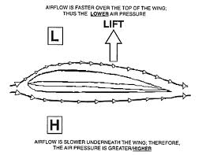
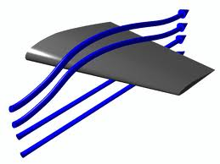
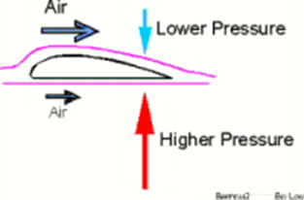
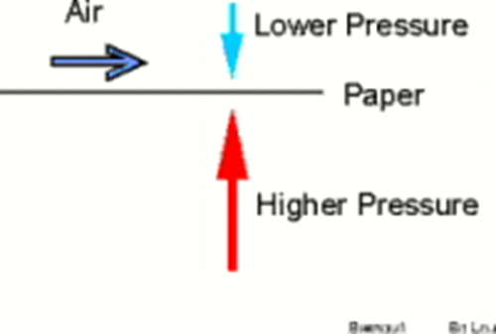
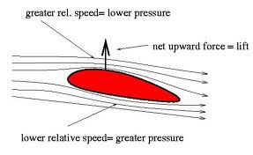
Who is Daniel Bernoulli?
For Lift to occur - The pressure on top of the airfoil must be less than the pressure below.
The airfoil has no choice but to move upward.

Slide 15
Warm-Up – 10/7 – 10 minutes
Utilizing your notes and past knowledge answer the following questions:
In order for lift to occur with an airfoil, what must the pressure be on top?
What does camber determine for an airfoil?
What type of pressure tends to push around a wingtip?
What is this rotating pressure called?
What are two means in which vortices can be reduced from an airfoil?

Slide 16
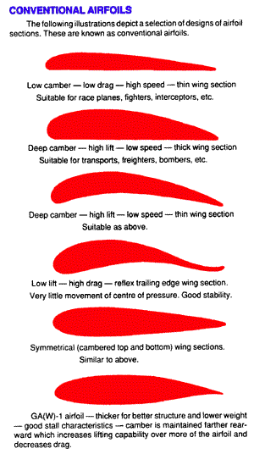
Who is Daniel Bernoulli?
Camber determines the amount of lift an airfoil will produce at a given speed
The thicker or more pronounced the camber – the more lift.
At low speeds its best to have a high-lift airfoil.

Slide 17
Warm-Up – 10/7 – 10 minutes
Utilizing your notes and past knowledge answer the following questions:
In order for lift to occur with an airfoil, what must the pressure be on top?
What does camber determine for an airfoil?
What type of pressure tends to push around a wingtip?
What is this rotating pressure called?
What are two means in which vortices can be reduced from an airfoil?

Slide 18
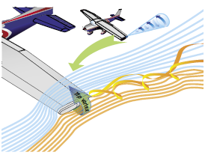
A Third Dimension
The high-pressure area on the bottom of an airfoil pushes around the tip to the low-pressure area on the top.
This action creates a rotating flow called a tip vortex

Slide 19
Warm-Up – 10/7 – 10 minutes
Utilizing your notes and past knowledge answer the following questions:
In order for lift to occur with an airfoil, what must the pressure be on top?
What does camber determine for an airfoil?
What type of pressure tends to push around a wingtip?
What is this rotating pressure called?
What are two means in which vortices can be reduced from an airfoil?

Slide 20
A Third Dimension
The vortex flows behind the airfoil creating a downwash that extends back to the trailing edge of the airfoil.
This downwash results in an overall reduction in lift for the affected portion of the airfoil.

Slide 21
Warm-Up – 10/7 – 10 minutes
Utilizing your notes and past knowledge answer the following questions:
In order for lift to occur with an airfoil, what must the pressure be on top?
What does camber determine for an airfoil?
What type of pressure tends to push around a wingtip?
What is this rotating pressure called?
What are two means in which vortices can be reduced from an airfoil?

Slide 22
A Third Dimension
To counteract this action.
Winglets can be added to the tip of an airfoil to reduce this flow.
The winglets act as a dam preventing the vortex from forming.
Winglets can be on the top or bottom of the airfoil.

Slide 23
Questions / Comments

Slide 24
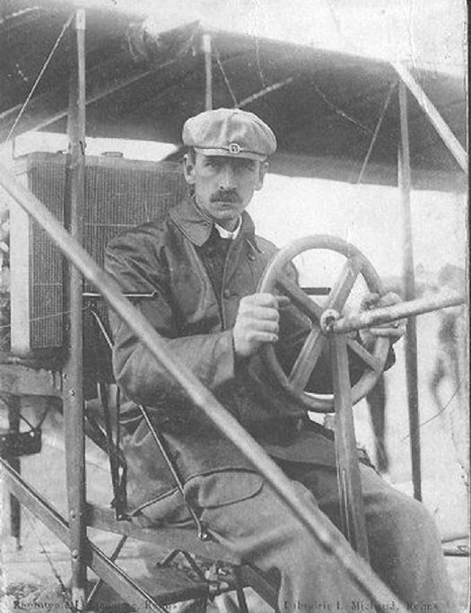
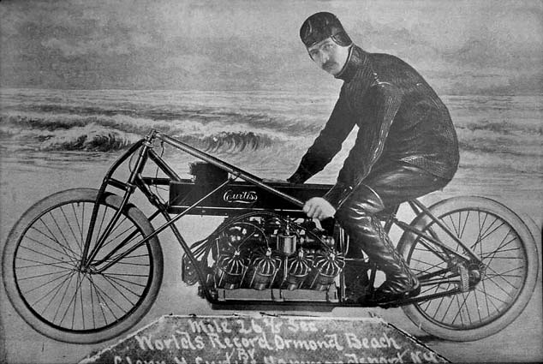
THIS DAY IN AVIATION
October 7
1909 — Glenn Curtiss becomes the first American to hold an FAI airplane certificate.

Slide 25
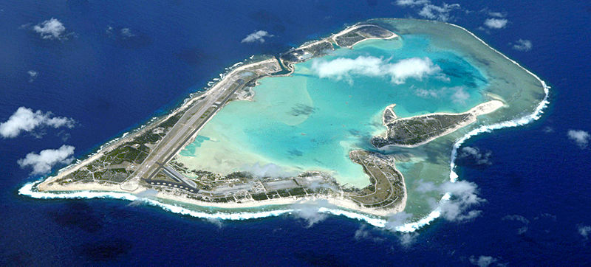
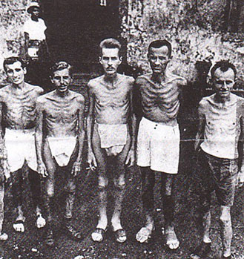
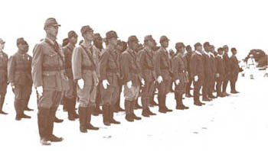
THIS DAY IN AVIATION
October 7
1943 - Japanese execute approximately 100 American POWs on Wake Island.

Slide 26
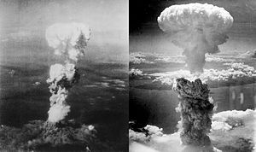
THIS DAY IN AVIATION
October 7
1949 — United States Air Force officials reported immediate availability of atomic bombs if use ordered.

Slide 27
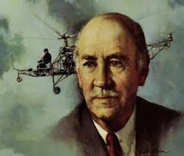
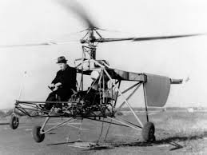
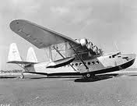
THIS DAY IN AVIATION
October 7
1957 — Igor Sikorsky receives the Annual Meritorious Award of National Business Aircraft Association in recognition of his pioneering in: multi-engine aircraft, trans Ocean flying-boats and helicopters.

Slide 28
Questions / Comments

Slide 29
October 2013
Sunday | Monday | Tuesday | Wednesday | Thursday | Friday | Saturday
 |  | 1 Chapter 3 Lift Theories Wingtip Vortices | 2 | 3 Chapter 3 Test Flight Simulator Syllabus | 4 | 5
6 | 7 Chapter 4 Forces of Flight | 8 | 9 Chapter 4 | 10 | 11 Chapter 4 Quiz FltLine Friday Flight Simulator | 12
13 | 14 | 15 Chapter 4 | 16 | 17 Chapter 4 | 18 | 19
20 | 21 Chapter 4 Quiz 1st Quarter Grades | 22 | 23 | 24 | 25 | 26
27 | 28 | 29 | 30 | 31

Slide 30
Questions / Comments

Slide 31
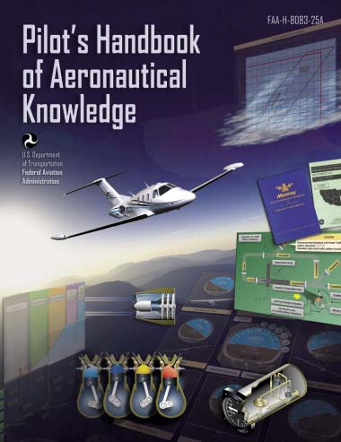
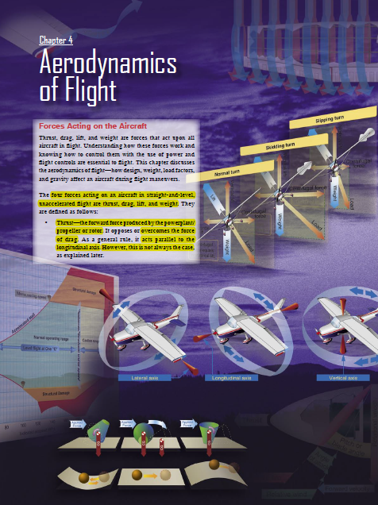
Chapter 4 – Aerodynamics of Flight
FAA – Pilot’s Handbook of Aeronautical Knowledge

Slide 32
Today’s Mission Requirements
Mission:
Identify in writing the forces acting on an aircraft in flight.
Describe how the forces of light work and how to control them with the use of power and flight controls essential to flight.
Describe the aerodynamics of flight.
Describe in writing how design, weight, load factors, and gravity affect an aircraft during flight maneuvers.
EQ:
Describe the importance of Aeronautical Knowledge for the student pilot learning to fly.

Slide 33
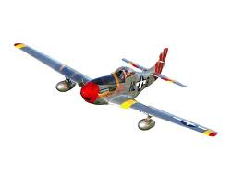
Forces
of
Flight

Slide 34
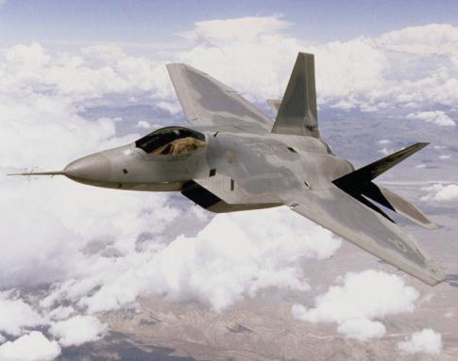
Four Forces of Flight
Determine whether an airplane rises or falls through the air:
Thrust
Drag
Lift
Gravity (Weight)
Lift
Drag
Thrust
Weight

Slide 35
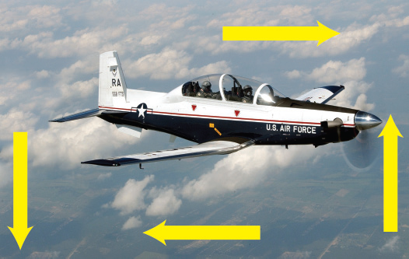

Slide 36
Thrust
The force that pushes or pulls a plane forward through the air.
Propellers, jet engines, tailwinds, and other outside sources – even catapults! – can provide needed thrust.

Slide 37
Drag
The force that resists forward motion and acts against thrust.
Created by friction between the plane and the atmosphere.
If the force of drag is too great, then a plane will move slower and will lose lift.

Slide 38
Lift
The force of lift exceeds the plane’s weight, the plane rises.

Slide 39
Gravity / Weight
Earth’s gravity pulls the plane downward, giving the plane weight.

Slide 40
THRUST
GRAVITY
LIFT
DRAG

Slide 41
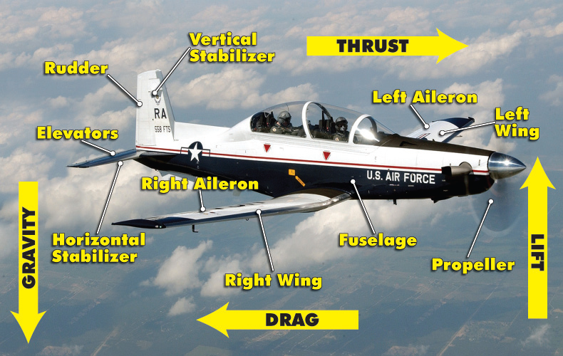

Slide 42
Forces of Flight
Force is what type of quantity?
Vector
What is a vector quantity?
Quantity that has both magnitude and direction
Represented by arrows
Length of arrow is the magnitude
Orientation of arrow is the direction
Force 1
Force 2
What force has a greater magnitude?
Force 1

Slide 43
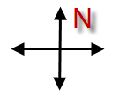
Forces of Flight
Force 1 (75 N)
Force 2 (40 N)
What is the direction of force 1?
East
What is the direction of force 2?
West
If the two forces are applied to an object, what will occur?
Force 2 (40 N)
Force 1 (75 N)

Slide 44
Forces of Flight
When two or more forces are applied to an object, the resulting force is called the resultant force.
Force 2 (45 N)
Force 1 (75 N)
Resultant
(30 N)

Slide 45
Forces of Flight
What is the resultant force?
Force 2 (465 N)
Force 1 (465 N)
Resultant is zero
When opposing forces have the same magnitude and opposite directions, the resultant is zero and the object is in static equilibrium.
Notes:
Static equilibrium means that there is no acceleration. The object stays at rest or continues at its same velocity if already in motion.

Slide 46
Forces of Flight
What forces will the aircraft need to move from position A to position B?
A force applied in the forward direction of movement
B
A
Thrust – Forward-acting force which opposes drag and propels the aircraft through the air
Notes:
Thrust is generated by various types of engines (i.e., propeller, turbine, ramjet, or rocket).

Slide 47
Forces of Flight
Does thrust experience opposition?
B
A
Drag – Acts in the opposite direction of flight, opposes the forward-acting force of thrust, and limits the forward speed of the aircraft

Slide 48
Forces of Flight
What occurs when thrust and drag are equal?
Thrust
Drag
Equilibrium or zero net force, resulting in a constant velocity
How do you increase acceleration?
Increase thrust, decrease drag, or decrease mass
Thrust
Drag
Thrust
Drag

Slide 49
Thrust
Straight-and-level flight may be sustained at a wide range of speeds.
The pilot coordinates angle of attack (AOA)—the acute angle between the chord line of the airfoil and the direction of the relative wind—and thrust in all speed regimes if the aircraft is to be held in level flight.

Slide 50
Thrust
When the airspeed is low, the AOA must be relatively high if the balance between lift and weight is to be maintained.
If thrust decreases and airspeed decreases, lift becomes less than weight and the aircraft starts to descend.

Slide 51
Thrust
To maintain level flight, the pilot can increase the AOA an amount which will generate a lift force again equal to the weight of the aircraft.
While the aircraft will be flying more slowly, it will still maintain level flight if the pilot has properly coordinated thrust and AOA.

Slide 52
Thrust
With the aircraft in a nose-high attitude, there is a vertical component of thrust that helps support it.
During straight-and-level flight when thrust is increased and the airspeed increases, the AOA must be decreased in level flight.
If the AOA were not coordinated (decreased) with an increase of thrust, the aircraft would climb.

Slide 53
Questions / Comments

Slide 54
Today’s Mission Requirements
Mission:
Identify in writing the forces acting on an aircraft in flight.
Describe how the forces of light work and how to control them with the use of power and flight controls essential to flight.
Describe the aerodynamics of flight.
Describe in writing how design, weight, load factors, and gravity affect an aircraft during flight manuevers.
EQ:
Describe the importance of Aeronautical Knowledge for the student pilot learning to fly.

Slide 55
Questions / Comments

