Slide 1
Warm-Up – 10/28 – 10 minutes
Utilizing your notes and past knowledge answer the following questions:
The intensity or strength of the vortices is directly proportional to the ________ of the aircraft.
An aircraft will create wingtip vortices with maximum strength during which stages of flight?
To avoid wake turbulence/wake vortices a pilot should perform this action when taking off behind another aircraft.
What is the distance a pilot should remain behind another aircraft’s flight path?
If a pilot is unsure of the other aircraft’s takeoff or landing point, what time provides a margin of safety that allows wake turbulence dissipation?

Slide 2

Questions / Comments

Slide 3
Warm-Up – 10/28 – 10 minutes
Utilizing your notes and past knowledge answer the following questions:
The intensity or strength of the vortices is directly proportional to the ________ of the aircraft.
An aircraft will create wingtip vortices with maximum strength during which stages of flight?
To avoid wake turbulence/wake vortices a pilot should perform this action when taking off behind another aircraft.
What is the distance a pilot should remain behind another aircraft’s flightpath?
If a pilot is unsure of the other aircraft’s takeoff or landing point, what time provides a margin of safety that allows wake turbulence dissipation?

Slide 4
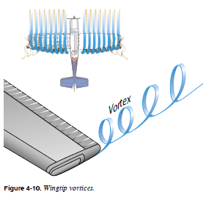
Wingtip Vortices
(Formation of Vortices)
The intensity or strength of the vortices is directly proportional to the weight of the aircraft and inversely proportional to the wingspan and speed of the aircraft

Slide 5
Warm-Up – 10/28 – 10 minutes
Utilizing your notes and past knowledge answer the following questions:
The intensity or strength of the vortices is directly proportional to the ________ of the aircraft.
An aircraft will create wingtip vortices with maximum strength during which stages of flight?
To avoid wake turbulence/wake vortices a pilot should perform this action when taking off behind another aircraft.
What is the distance a pilot should remain behind another aircraft’s flightpath?
If a pilot is unsure of the other aircraft’s takeoff or landing point, what time provides a margin of safety that allows wake turbulence dissipation?

Slide 6
Wingtip Vortices
(Formation of Vortices)
Thus, an aircraft will create wingtip vortices with maximum strength occurring during the takeoff, climb, and landing phases of flight.

Slide 7
Warm-Up – 10/28 – 10 minutes
Utilizing your notes and past knowledge answer the following questions:
The intensity or strength of the vortices is directly proportional to the ________ of the aircraft.
An aircraft will create wingtip vortices with maximum strength during which stages of flight?
To avoid wake turbulence/wake vortices a pilot should perform this action when taking off behind another aircraft.
What is the distance a pilot should remain behind another aircraft’s flightpath?
If a pilot is unsure of the other aircraft’s takeoff or landing point, what time provides a margin of safety that allows wake turbulence dissipation?

Slide 8
Avoiding Wake Turbulence
Avoid flying through another aircraft’s flightpath.
Rotate prior to the point at which the preceding aircraft rotated, when taking off behind another aircraft.

Slide 9
Warm-Up – 10/28 – 10 minutes
Utilizing your notes and past knowledge answer the following questions:
The intensity or strength of the vortices is directly proportional to the ________ of the aircraft.
An aircraft will create wingtip vortices with maximum strength during which stages of flight?
To avoid wake turbulence/wake vortices a pilot should perform this action when taking off behind another aircraft.
What is the distance a pilot should remain behind another aircraft’s flightpath?
If a pilot is unsure of the other aircraft’s takeoff or landing point, what time provides a margin of safety that allows wake turbulence dissipation?

Slide 10
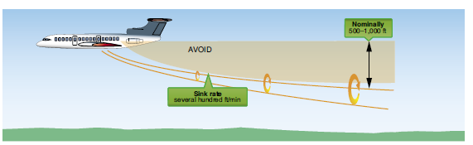
Avoiding Wake Turbulence
Avoid following another aircraft on a similar flightpath at an altitude within 1,000 feet.

Slide 11
Warm-Up – 10/28 – 10 minutes
Utilizing your notes and past knowledge answer the following questions:
The intensity or strength of the vortices is directly proportional to the ________ of the aircraft.
An aircraft will create wingtip vortices with maximum strength during which stages of flight?
To avoid wake turbulence/wake vortices a pilot should perform this action when taking off behind another aircraft.
What is the distance a pilot should remain behind another aircraft’s flightpath?
If a pilot is unsure of the other aircraft’s takeoff or landing point, what time provides a margin of safety that allows wake turbulence dissipation?

Slide 12
Avoiding Wake Turbulence
If a pilot is unsure of the other aircraft’s takeoff or landing point, approximately 3 minutes provides a margin of safety that allows wake turbulence dissipation

Slide 13
Questions / Comments

Slide 14
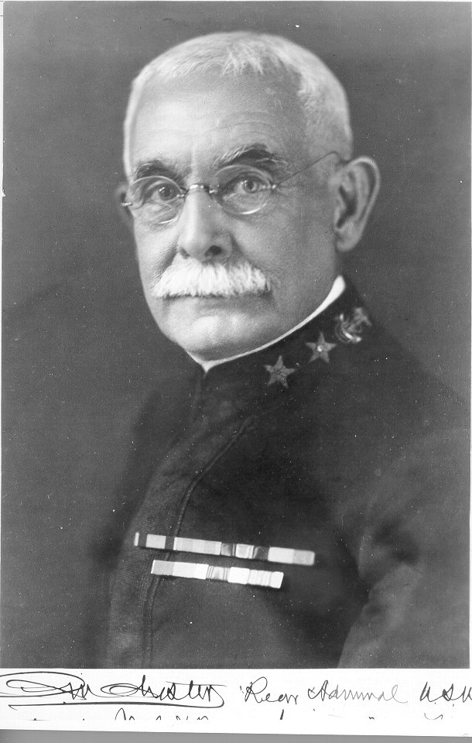
THIS DAY IN AVIATION
October 28
1907 — Admiral C. M. Chester urges anti-submarine airships and shipboard airplanes at the International Aeronautic Congress.

Slide 15
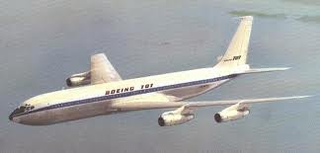
THIS DAY IN AVIATION
October 28
1957 - The Boeing Airplane Company rolls out its first production 707 jet transport which is expected to fly in December.

Slide 16
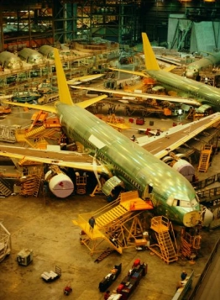
THIS DAY IN AVIATION
October 28
1957 — Total employment in the aircraft industry will drop from a peak of 909,100 in April 1957 to about 800,000 monthly average, according to the American Aviation DAILY survey.

Slide 17
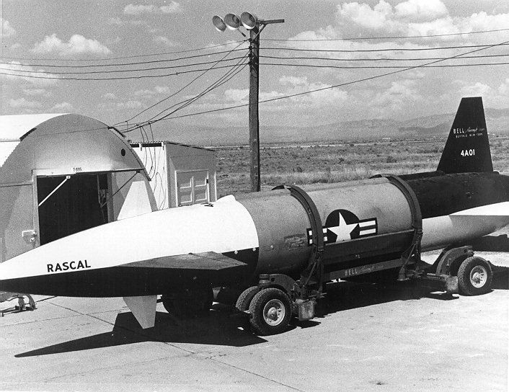
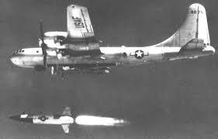
THIS DAY IN AVIATION
October 28
1957 — The United States Air Force announces that its Bell GAM-63 “Rascal” air-to-surface guided missile has hit three thousand-foot diameter target on last four launches.

Slide 18
Questions / Comments

Slide 19
October 2013
Sunday | Monday | Tuesday | Wednesday | Thursday | Friday | Saturday
6 | 7 Chapter 4 Forces of Flight | 8 | 9 Chapter 4 | 10 | 11 Chapter 4 Quiz FltLine Friday Flight Simulator | 12
13 | 14 | 15 Chapter 4 Lift/Drag Ratio | 16 | 17 Chapter 4 Lift and Weight | 18 | 19
20 | 21 Chapter 4 Quiz 1st Quarter Grades | 22 | 23 Chapter 4 Wingtip Vortices | 24 | 25 No School | 26
27 | 28 Chapter 4 Ground Effects | 29 | 30 | 31

Slide 20
Questions / Comments

Slide 21

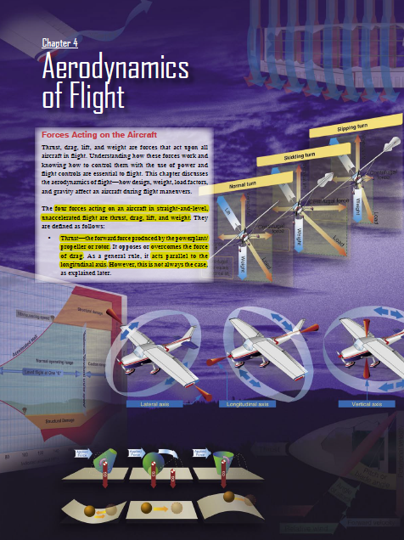
Chapter 4 – Aerodynamics of Flight
FAA – Pilot’s Handbook of Aeronautical Knowledge

Slide 22
Today’s Mission Requirements
Mission:
Identify in writing the forces acting on an aircraft in flight.
Describe how the forces of light work and how to control them with the use of power and flight controls essential to flight.
Describe the aerodynamics of flight.
Describe in writing how design, weight, load factors, and gravity affect an aircraft during flight maneuvers.
EQ:
  Describe the importance of Aeronautical Knowledge for the student pilot learning to fly.

Slide 23
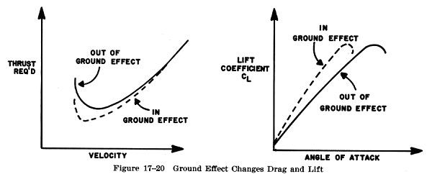
Ground Effect
It is possible to fly an aircraft at a slightly slower airspeed than that required to sustain level flight at higher altitudes.

Slide 24
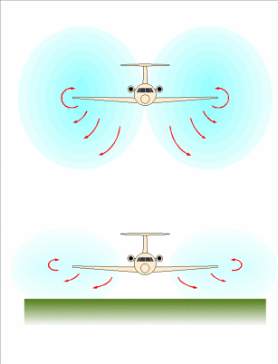
Ground Effect
When an aircraft in flight comes within several feet of the surface a change occurs in the three-dimensional flow pattern around the aircraft because the vertical component of the airflow around the wing is restricted by the surface.

Slide 25
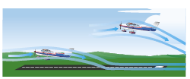
Ground Effect
Ground effect is due to the interference of the ground (or water) surface with the airflow patterns about the aircraft in flight.

Slide 26
Ground Effect
The reduction in induced flow due to ground effect causes a significant reduction in induced drag but causes no direct effect on parasite drag
the thrust required at low speeds will be reduced.

Slide 27
Ground Effect
Ground effect will cause an increase in the local pressure at the static source and produce a lower indication of airspeed and altitude.

Slide 28
Ground Effect
Thus, an aircraft may be airborne at an indicated airspeed less than that normally required.

Slide 29
Ground Effect
A large reduction in induced drag will take place only when the wing is very close to the ground.
Ground effect is most usually recognized during the liftoff for takeoff or just prior to touchdown when landing.

Slide 30
Ground Effect
The takeoff phase of flight, the aircraft leaving ground effect will:
  Require an increase in AOA to maintain the same CL.
  Experience an increase in induced drag and thrust required.
  Experience a decrease in stability and a nose-up change in moment.
  Experience a reduction in static source pressure and increase in indicated airspeed.

Slide 31
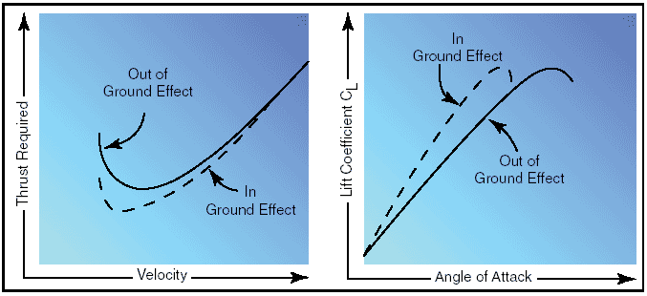
Ground Effect
A hazardous situation is possible because the recommended takeoff speed may not be achieved.
Due to the reduced drag in ground effect, the aircraft may seem capable of takeoff well below the recommended speed.

Slide 32
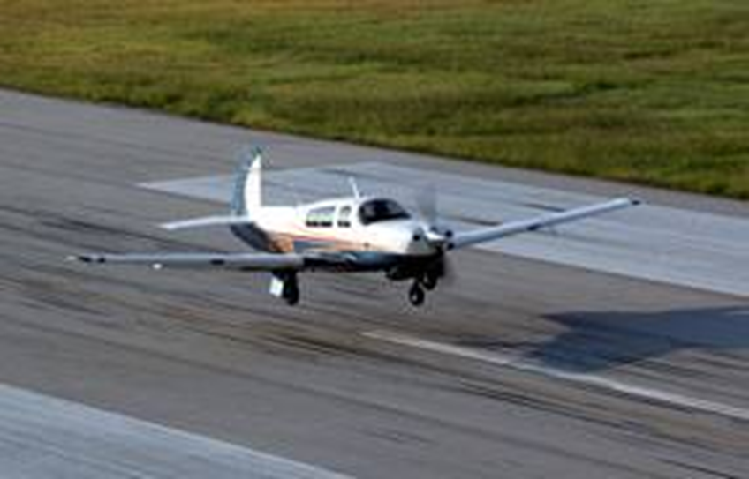
Ground Effect
In extreme conditions, such as high gross weight, high density altitude, and high temperature, a deficiency of airspeed during takeoff may permit the aircraft to become airborne but be incapable of sustaining flight out of ground effect.

Slide 33
Ground Effect
The manufacturer’s recommended takeoff speed is necessary to provide adequate initial climb performance.
It is important that a definite climb be established before a pilot retracts the landing gear or flaps.
Never retract the landing gear or flaps prior to establishing a positive rate of climb, and only after achieving a safe altitude.

Slide 34
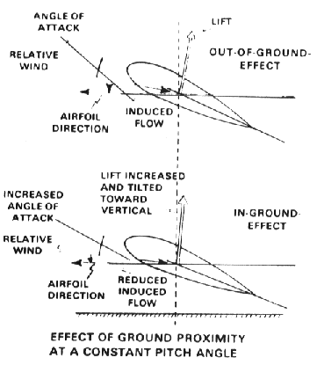
Ground Effect
During the landing phase of flight, the aircraft is brought into ground effect with a constant AOA, the aircraft experiences an increase in CL and a reduction in the thrust required, and a “floating” effect may occur.

Slide 35

Ground Effect
Any excess speed at the point of flare may incur a considerable “float” distance.
As the aircraft nears the ground, a reduced power setting is necessary or the reduced thrust required would allow the aircraft to climb.

Slide 36
Questions / Comments

Slide 37
Lesson Closure - 3 – 2 - 1
3. List 3 things you learned today.
2. List 2 things you have questions about today’s lesson.
1. Create (1) quiz question with answer about today’s lesson.

