Slide 1
Warm-Up – 10/27 – 10 minutes
Utilizing your notes and past knowledge answer the following questions:
Define static pressure.
Define dynamic pressure.

Slide 2

Questions / Comments

Slide 3
Warm-Up – 10/27 – 10 minutes
Utilizing your notes and past knowledge answer the following questions:
Define static pressure.
Define dynamic pressure.

Slide 4
Pitot-Static Flight Instruments
Impact Pressure Chamber and Lines
Static pressure, also known as ambient pressure, is always present whether an aircraft is moving or at rest.
It is simply the barometric pressure in the local area.

Slide 5
Warm-Up – 10/27 – 10 minutes
Utilizing your notes and past knowledge answer the following questions:
Define static pressure.
Define dynamic pressure.

Slide 6
Pitot-Static Flight Instruments
Impact Pressure Chamber and Lines
Dynamic pressure is present only when an aircraft is in motion; therefore, it can be thought of as a pressure due to motion

Slide 7
Questions / Comments

Slide 8

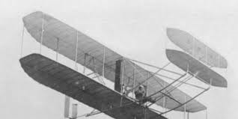
THIS DAY IN AVIATION
October 27
1909 — Mrs. Ralph van Deman flies for four minutes with Wilbur Wright at College Park, Maryland, becoming the United States' first female passenger.

Slide 9

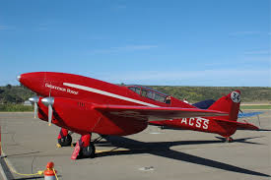
THIS DAY IN AVIATION
October 27 – 2 November
1934 — Lieut. Owen Cathcart-Jones and Kenneth H.F. Waller fly from Darwin, Australia, to Lympne, England, in 5 days 15 hours and 23 minutes, setting a new world record. (De Havilland Comet, two De Havilland Gipsy Six R engines.)

Slide 10

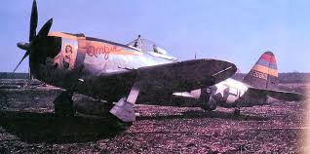
THIS DAY IN AVIATION
October 27
1944 — The 9th Fighter Squadron flew its first mission from the Philippines since 1942.

Slide 11


THIS DAY IN AVIATION
October 27
1957 — The United States Air Force reports sending a rocket at least 1,000 miles and perhaps 4,000 miles above the earth at Eniwetok Atoll in “Operation Far Side.”

Slide 12
Questions / Comments

Slide 13
October / November 2015
SUNDAY | MONDAY | TUESDAY | WEDNESDAY | THURSDAY | FRIDAY | SATURDAY
 | 26 Chapter 7 Flight Instruments | 27 Chapter 7 Flight Instruments Altimeter | 28 Chapter 7 Flight Instruments Vertical Speed Indicator | 29 Chapter 7 Flight Instruments Airspeed Indicator | 30 Chapter 7 QUIZ | 31
1 | 2 Chapter 7 Flight Instruments Gyro Systems | 3 Chapter 7 Flight Instruments Magnetic Compass | 4 Chapter 7 Flight Instruments Review and Test | 5 Chapter 8 Flight Manuals | 6 Chapter 8 Flight Manuals Review and Test | 7
8 | 9 Chapter 9 Weight and Balance | 10 Chapter 9 Weight and Balance | 11 HOLIDAY | 12 Chapter 10 Aircraft Performance | 13 Chapter 10 Aircraft Performance | 14
15 | 16 Chapter 10 Aircraft Performance | 17 Chapter 10 Aircraft Performance | 18 Chapter 10 Aircraft Performance | 19 Chapter 10 Aircraft Performance | 20 Chapter 10 Aircraft Performance TEST | 21

Slide 14
Questions / Comments

Slide 15
3rd Semester Requirements
(14 Class Meetings)
All students will complete the following:
  Take notes - All In class quizzes and tests
  Complete Flight Sim. Student Pilot Syllabus
    Lessons 1 – 7 (Straight & Level Flight through First Solo)
    Must pass written with 80%
    Successfully complete 3 times on small sim
    Successfully complete 1 time on Main sim
  Complete ERAU Aviation 101
    9 quizzes and 3 tests (Kut, Falcon, Not So Lonely & Relative Wind – only completers)
Student will receive zero points for all incomplete work

Slide 16
Questions / Comments

Slide 17

Chapter 7 – Flight Instruments
FAA – Pilot’s Handbook of Aeronautical Knowledge

Slide 18
Today’s Mission Requirements
Mission:
Identify in writing how to interpret and operate flight instruments.
Describe the pilot’s ability to recognize errors and malfunctions with flight instruments.
Describe the pitot-static system and associated instruments.
Describe the vacuum system and related instruments.
Describe the gyroscopic instruments and the magnetic compass.
EQ:
  Describe the importance of Aeronautical Knowledge for the student pilot learning to fly.

Slide 19
Pitot-Static Flight Instruments
Impact Pressure Chamber and Lines
Dynamic pressure is present only when an aircraft is in motion; therefore, it can be thought of as a pressure due to motion

Slide 20
Pitot-Static Flight Instruments
Impact Pressure Chamber and Lines
The pitot tube has a small opening at the front which allows the total pressure to enter the pressure chamber.

Slide 21
Pitot-Static Flight Instruments
Impact Pressure Chamber and Lines
The total pressure is made up of dynamic pressure plus static pressure.

Slide 22
Pitot-Static Flight Instruments
Impact Pressure Chamber and Lines
Both openings in the pitot tube need to be checked prior to flight to insure that neither is blocked.
This helps to keep bugs and other objects from becoming lodged in the opening of the pitot tube.

Slide 23
Pitot-Static Flight Instruments
Impact Pressure Chamber and Lines
The total pressure is transmitted to the Airspeed Indicator from the pitot tube’s pressure chamber via a small tube.

Slide 24
Pitot-Static Flight Instruments
Impact Pressure Chamber and Lines
The static pressure is also delivered to the opposite side of the ASI which serves to cancel out the two static pressures, thereby leaving the dynamic pressure to be indicated on the instrument.

Slide 25
Pitot-Static Flight Instruments
Impact Pressure Chamber and Lines
The two remaining instruments (altimeter and VSI) utilize only the static pressure which is derived from the static port.

Slide 26
Pitot-Static Flight Instruments
Static Pressure Chamber and Lines
The static chamber is vented through small holes to the free undisturbed air on the side(s) of the aircraft.

Slide 27
Pitot-Static Flight Instruments
Static Pressure Chamber and Lines
An alternate static source is provided in some aircraft to provide static pressure should the primary static source become blocked.
The alternate static source is normally found inside of the flight deck.

Slide 28
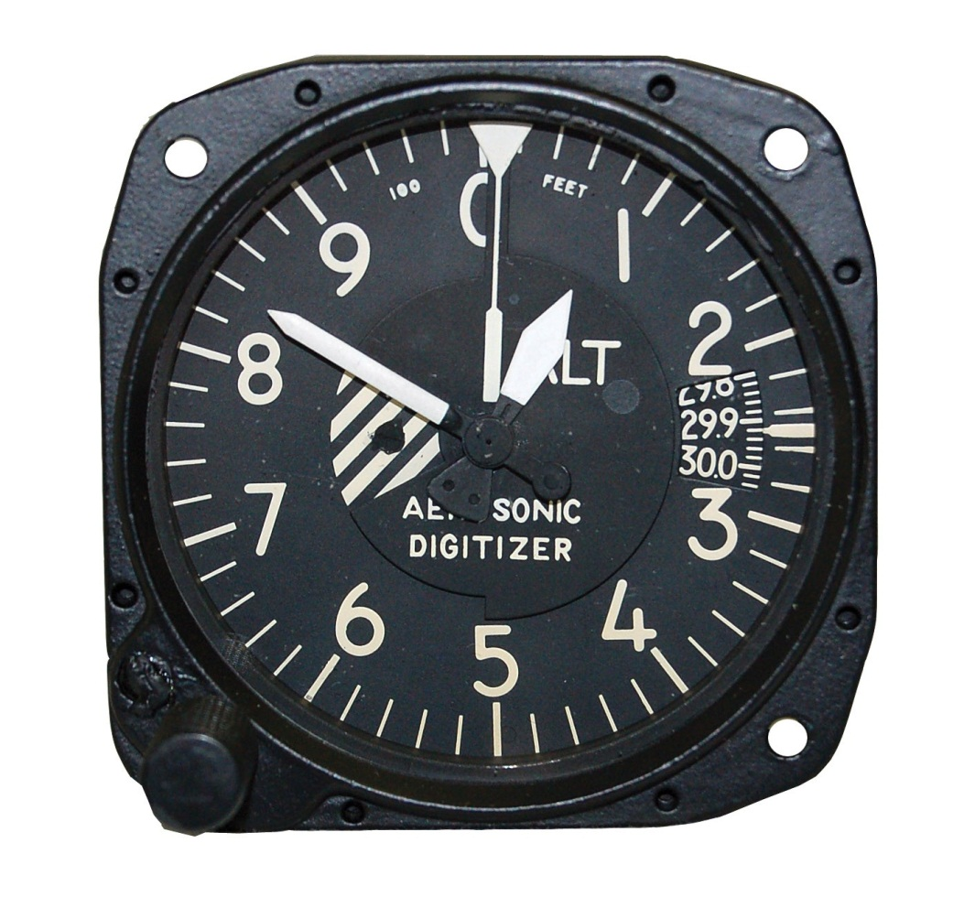
Altimeter
The altimeter is an instrument that measures the height of an aircraft above a given pressure level.
Since the altimeter is the only instrument that is capable of indicating altitude, this is one of the most vital instruments installed in the aircraft.

Slide 29
Principle of Operation
The pressure altimeter is an aneroid barometer that measures the pressure of the atmosphere at the level where the altimeter is located, and presents an altitude indication in feet.

Slide 30
Principle of Operation
The altimeter uses static pressure as its source of operation.

Slide 31
Principle of Operation
Air is denser at sea level than aloft—as altitude increases, atmospheric pressure decreases.
This difference in pressure at various levels causes the altimeter to indicate changes in altitude.

Slide 32
Principle of Operation
Adjustments for nonstandard pressures are accomplished by setting the corrected pressure into a barometric scale located on the face of the altimeter.

Slide 33
Principle of Operation
The barometric pressure window is sometimes referred to as the Kollsman window; only after the altimeter is set does it indicate the correct altitude.

Slide 34
Effects of Nonstandard Pressure
If altimeters could not be adjusted for nonstandard pressure, a hazardous situation could occur.

Slide 35
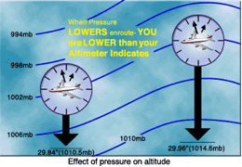
Effects of Nonstandard Pressure
For example, if an aircraft is flown from a high pressure area to a low pressure area without adjusting the altimeter, a constant altitude will be displayed, but the actual height of the aircraft above the ground would be lower then the indicated altitude.

Slide 36
Effects of Nonstandard Pressure
There is an old aviation axiom: “GOING FROM A HIGH TO A LOW, LOOK OUT BELOW.”

Slide 37
Effects of Nonstandard Pressure
Once in flight, it is important to frequently obtain current altimeter settings en route to ensure terrain and obstruction clearance.

Slide 38
Setting the Altimeter
Most altimeters are equipped with a barometric pressure setting window (or Kollsman window) providing a means to adjust the altimeter.

Slide 39
Setting the Altimeter
A knob is located at the bottom of the instrument for this adjustment.

Slide 40
Setting the Altimeter
To adjust the altimeter for variation in atmospheric pressure, the pressure scale in the altimeter setting window, calibrated in inches of mercury ("Hg) and/or millibars (mb), is adjusted to match the given altimeter setting.

Slide 41
Setting the Altimeter
An altimeter setting is accurate only in the vicinity of the reporting station.
Therefore, the altimeter must be adjusted as the flight progresses from one station to the next.

Slide 42
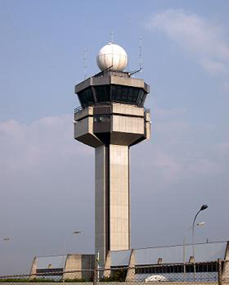
Setting the Altimeter
Air traffic control (ATC) will advise when updated altimeter settings are available.

Slide 43
Setting the Altimeter
If a pilot is not utilizing ATC assistance, local altimeter settings can be obtained by monitoring local automated weather observing system/automated surface observation system (AWOS/ASOS) or automatic terminal information service (ATIS) broadcasts.

Slide 44
Setting the Altimeter
The importance of properly setting the altimeter cannot be overemphasized.

Slide 45
Altimeter Operation
When the aircraft climbs or descends, changing pressure within the altimeter case expands or contracts the aneroid barometer.
A decrease in pressure causes the altimeter to indicate an increase in altitude, and an increase in pressure causes the altimeter to indicate a decrease in altitude.

Slide 46

Altimeter Operation
To clear obstructions, the pilot must constantly be aware of the altitude of the aircraft and the elevation of the surrounding terrain.
To reduce the possibility of a midair collision, it is essential to maintain altitude in accordance with air traffic rules.

Slide 47
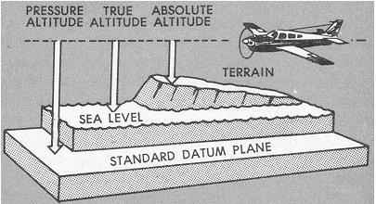
Types of Altitude
1. Indicated altitude—read directly from the altimeter (uncorrected) when it is set to the current altimeter setting.
2. True altitude—the vertical distance of the aircraft above sea level—the actual altitude.

Slide 48
Types of Altitude
3. Absolute altitude—the vertical distance of an aircraft above the terrain, or above ground level (AGL).
4. Pressure altitude—the altitude indicated when the altimeter setting window (barometric scale) is adjusted to 29.92 "Hg.

Slide 49
Types of Altitude
5. Density altitude—pressure altitude corrected for variations from standard temperature.
This is an important altitude because it is directly related to the aircraft’s performance.
The density of the air affects how much power a naturally aspirated engine produces, as well as how efficient the airfoils are.

Slide 50
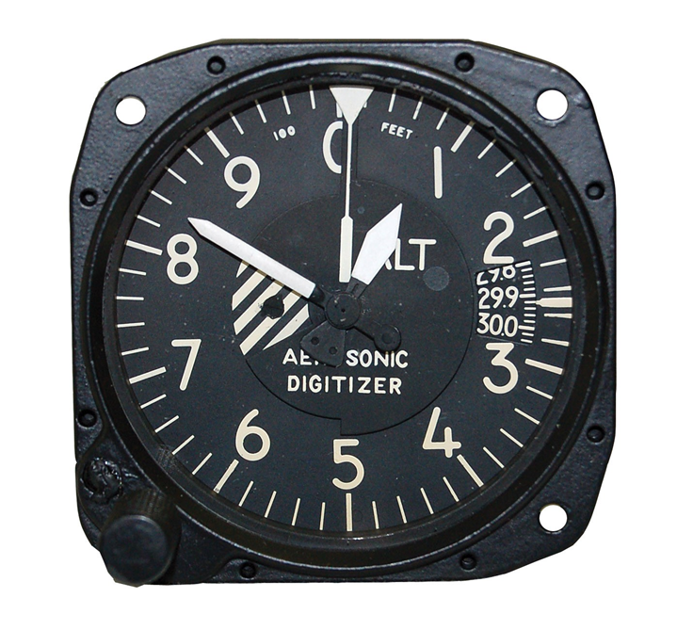
Instrument Check
Prior to each flight, a pilot should examine the altimeter for proper indications in order to verify its validity.
Set the barometric scale to the current reported altimeter setting.

Slide 51
Instrument Check
If the indication is off more than 75 feet from the surveyed field elevation, the instrument should be referred to a certificated instrument repair station.

Slide 52
Questions / Comments

