Slide 1
Warm-Up – 10/23 – 10 minutes
Utilizing your notes and past knowledge answer the following questions:
What is the point at which all weight is concentrated on an aircraft?
If lift becomes less than weight, happens to the aircraft?
If the velocity is increased what will happen to lift of the aircraft if the AOA is the same?
As velocity is increased, lift must be decreased – how would a pilot accomplish this?
In straight-and-level flight, cruising along at a constant altitude, altitude is maintained by adjusting lift to match, what __________?

Slide 2

Questions / Comments

Slide 3
Warm-Up – 10/23 – 10 minutes
Utilizing your notes and past knowledge answer the following questions:
What is the point at which all weight is concentrated on an aircraft?
If lift becomes less than weight, happens to the aircraft?
If the velocity is increased what will happen to lift of the aircraft if the AOA is the same?
As velocity is increased, lift must be decreased – how would a pilot accomplish this?
In straight-and-level flight, cruising along at a constant altitude, altitude is maintained by adjusting lift to match, what __________?

Slide 4
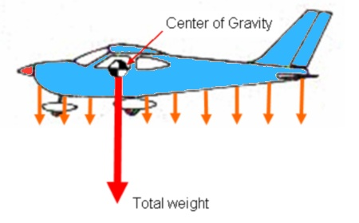
Weight (Gravity)
The CG may be considered as a point at which all the weight of the aircraft is concentrated.

Slide 5
Warm-Up – 10/23 – 10 minutes
Utilizing your notes and past knowledge answer the following questions:
What is the point at which all weight is concentrated on an aircraft?
If lift becomes less than weight, happens to the aircraft?
If the velocity is increased what will happen to lift of the aircraft if the AOA is the same?
As velocity is increased, lift must be decreased – how would a pilot accomplish this?
In straight-and-level flight, cruising along at a constant altitude, altitude is maintained by adjusting lift to match, what __________?

Slide 6
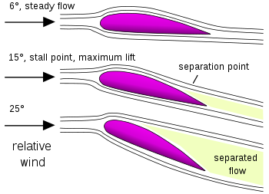
Weight (Gravity)
If lift becomes less than weight, the aircraft loses altitude.
When lift is greater than weight, the aircraft gains altitude.

Slide 7
Warm-Up – 10/23 – 10 minutes
Utilizing your notes and past knowledge answer the following questions:
What is the point at which all weight is concentrated on an aircraft?
If lift becomes less than weight, happens to the aircraft?
If the velocity is increased what will happen to lift of the aircraft if the AOA is the same?
As velocity is increased, lift must be decreased – how would a pilot accomplish this?
In straight-and-level flight, cruising along at a constant altitude, altitude is maintained by adjusting lift to match, what __________?

Slide 8
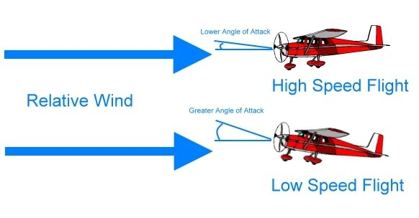
Lift
Actually, an aircraft could not continue to travel in level flight at a constant altitude and maintain the same AOA if the velocity is increased.
The lift would increase and the aircraft would climb.

Slide 9
Warm-Up – 10/23 – 10 minutes
Utilizing your notes and past knowledge answer the following questions:
What is the point at which all weight is concentrated on an aircraft?
If lift becomes less than weight, happens to the aircraft?
If the velocity is increased what will happen to lift of the aircraft if the AOA is the same?
As velocity is increased, lift must be decreased – how would a pilot accomplish this?
In straight-and-level flight, cruising along at a constant altitude, altitude is maintained by adjusting lift to match, what __________?

Slide 10
Lift
As velocity is increased, lift must be decreased.
This is normally accomplished by reducing the AOA by lowering the nose.

Slide 11
Warm-Up – 10/23 – 10 minutes
Utilizing your notes and past knowledge answer the following questions:
What is the point at which all weight is concentrated on an aircraft?
If lift becomes less than weight, happens to the aircraft?
If the velocity is increased what will happen to lift of the aircraft if the AOA is the same?
As velocity is increased, lift must be decreased – how would a pilot accomplish this?
In straight-and-level flight, cruising along at a constant altitude, altitude is maintained by adjusting lift to match, what __________?

Slide 12
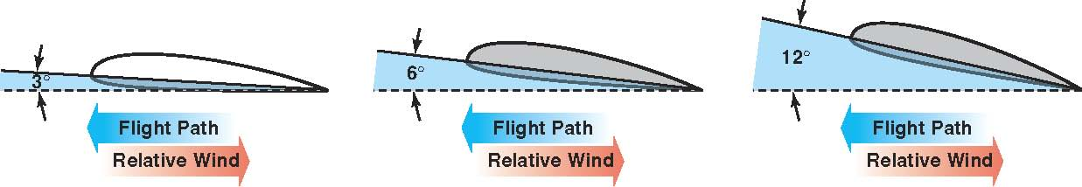
Lift
In straight-and-level flight, cruising along at a constant altitude, altitude is maintained by adjusting lift to match the aircraft’s velocity or cruise airspeed, while maintaining a state of equilibrium in which lift equals weight.

Slide 13
Questions / Comments

Slide 14
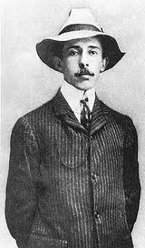
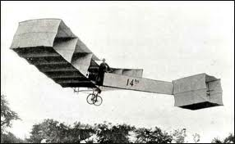
THIS DAY IN AVIATION
October 23
1906 — Brazilian aviator Alberto Santos Dumont makes the first sustained airplane flight in Europe in his own airplane, the N°14 bis.

Slide 15
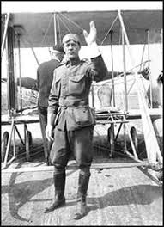
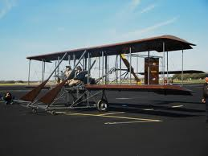
THIS DAY IN AVIATION
October 23
1909 — Lt. Benjamin D. Foulois took his first flying lesson from Wilbur Wright.

Slide 16
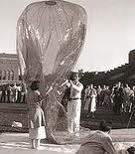
THIS DAY IN AVIATION
October 23
1934 — Dr. and Mrs. Jean Piccard ascending to a height of 57,979 feet and a stratosphere balloon, take off from Dearborn, Michigan, and land near Cadiz, Ohio.

Slide 17
Questions / Comments

Slide 18
October 2013
Sunday | Monday | Tuesday | Wednesday | Thursday | Friday | Saturday
 |  | 1 Chapter 3 Lift Theories Wingtip Vortices | 2 | 3 Chapter 3 Test Flight Simulator Syllabus | 4 | 5
6 | 7 Chapter 4 Forces of Flight | 8 | 9 Chapter 4 | 10 | 11 Chapter 4 Quiz FltLine Friday Flight Simulator | 12
13 | 14 | 15 Chapter 4 Lift/Drag Ratio | 16 | 17 Chapter 4 Lift and Weight | 18 | 19
20 | 21 Chapter 4 Quiz 1st Quarter Grades | 22 | 23 Chapter 4 Wingtip Vortices | 24 | 25 No School | 26
27 | 28 | 29 | 30 | 31

Slide 19
Questions / Comments

Slide 20

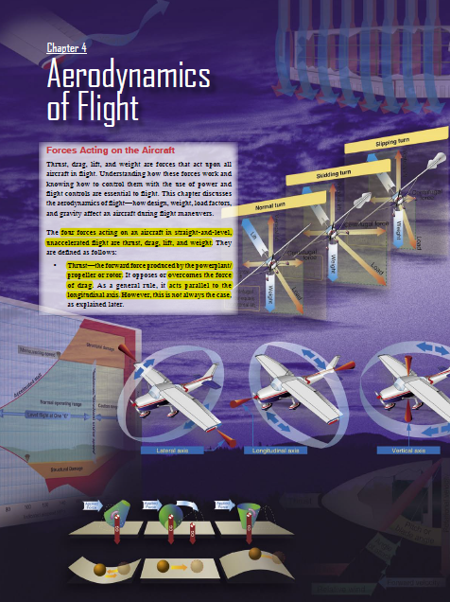
Chapter 4 – Aerodynamics of Flight
FAA – Pilot’s Handbook of Aeronautical Knowledge

Slide 21
Today’s Mission Requirements
Mission:
Identify in writing the forces acting on an aircraft in flight.
Describe how the forces of light work and how to control them with the use of power and flight controls essential to flight.
Describe the aerodynamics of flight.
Describe in writing how design, weight, load factors, and gravity affect an aircraft during flight maneuvers.
EQ:
  Describe the importance of Aeronautical Knowledge for the student pilot learning to fly.

Slide 22
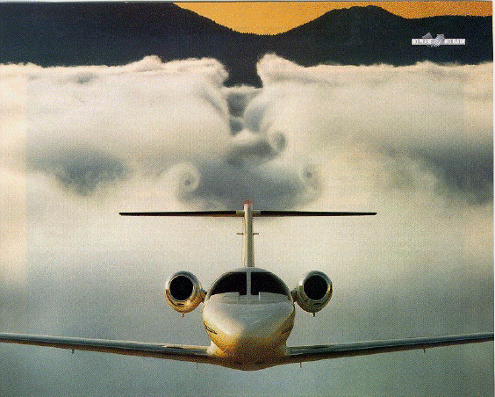
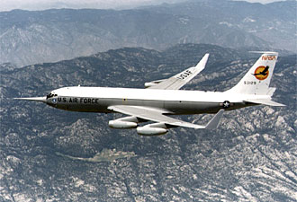
Wingtip Vortices
Air flows both upward and rearward, forming a vortex
Winglets are vertical airfoils that limit vortices and improve fuel efficiency
Notes:
More information about winglets is available from NASA at http://www.nasa.gov/centers/dryden/about/Organizations/Technology/Facts/TF-2004-15-DFRC.html
The aspect ratio is the square of the span, s, divided by the wing area, A. AR = s² / A
For a rectangular wing, this reduces to the ratio of the span to the chord, c. AR = s / c
Long, slender, high aspect ratio wings have lower induced drag than short, thick, low aspect ratio wings. Induced drag is a three dimensional effect related to the wing tips. The longer the wing, the farther the tips are from the main portion of the wing, and the lower the induced drag. Lifting line theory shows that the optimum (lowest) induced drag occurs for an elliptic distribution of lift from tip to tip. The efficiency factor, e, is equal to 1.0 for an elliptic distribution and is some value less than 1.0 for any other lift distribution.
The outstanding aerodynamic performance of the British Spitfire of World War II is partially attributable to its elliptical wing, which gave the aircraft a very low amount of induced drag. A more typical value of e = .7 exists for a rectangular wing. The total drag coefficient C_{d} is equal to the base drag coefficient at zero lift C_{d0} plus the induced drag coefficient C_{di}.

Slide 23
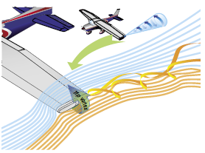
Induced Drag
The high-pressure area on the bottom of an airfoil pushes around the tip to the low-pressure area on the top.
This action creates a rotating flow called a tip vortex

Slide 24
Induced Drag
  These vortices circulate counterclockwise about the right tip and clockwise about the left tip.

Slide 25
A Third Dimension
The vortex flows behind the airfoil creating a downwash that extends back to the trailing edge of the airfoil.
This downwash results in an overall reduction in lift for the affected portion of the airfoil.

Slide 26
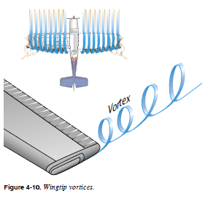
Wingtip Vortices
(Formation of Vortices)
The intensity or strength of the vortices is directly proportional to the weight of the aircraft and inversely proportional to the wingspan and speed of the aircraft

Slide 27
Wingtip Vortices
(Formation of Vortices)
The heavier and slower the aircraft, the greater the AOA and the stronger the wingtip vortices.
Like a boat through water

Slide 28
Wingtip Vortices
(Formation of Vortices)
Thus, an aircraft will create wingtip vortices with maximum strength occurring during the takeoff, climb, and landing phases of flight.

Slide 29
Wingtip Vortices
(Formation of Vortices)
These vortices lead to a particularly dangerous hazard to flight, wake turbulence.

Slide 30
Avoiding Wake Turbulence
This condition is most commonly encountered during approaches or departures because an aircraft’s AOA is at the highest to produce the lift necessary to land or take off.

Slide 31
Avoiding Wake Turbulence
Avoid flying through another aircraft’s flightpath.
Rotate prior to the point at which the preceding aircraft rotated, when taking off behind another aircraft.

Slide 32
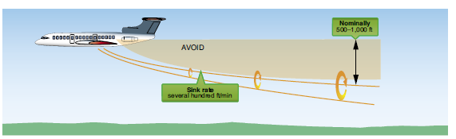
Avoiding Wake Turbulence
Avoid following another aircraft on a similar flightpath at an altitude within 1,000 feet.

Slide 33
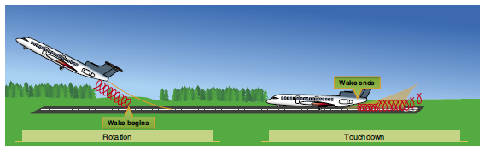
Avoiding Wake Turbulence
Approach the runway above a preceding aircraft’s path when landing behind another aircraft, and touch down after the point at which the other aircraft wheels contacted the runway.

Slide 34
Avoiding Wake Turbulence
Wind is important as wingtip vortices drift with the wind at the speed of the wind.

Slide 35
Avoiding Wake Turbulence
If a pilot is unsure of the other aircraft’s takeoff or landing point, approximately 3 minutes provides a margin of safety that allows wake turbulence dissipation

Slide 36
Questions / Comments

Slide 37
Lesson Closure - 3 – 2 - 1
3. List 3 things you learned today.
2. List 2 things you have questions about today’s lesson.
1. Create (1) quiz question with answer about today’s lesson.

