Slide 1
Warm-Up – 10/1 – 10 minutes
Utilizing your notes and past knowledge answer the following questions:
What are the instruments that are impacted by atmospheric pressure?
What standard are all instruments calibrated?
The density of air has significant effects on the aircraft’s performance because as air becomes less dense, identify three possible effects on an aircraft.
What is the approximate temperature decrease for every 1,000 feet of elevation in altitude?
Define angle of attack.

Slide 2
Questions / Comments

Slide 3
Warm-Up – 10/1 – 10 minutes
Utilizing your notes and past knowledge answer the following questions:
What are the instruments that are impacted by atmospheric pressure?
What standard are all instruments calibrated?
The density of air has significant effects on the aircraft’s performance because as air becomes less dense, identify three possible effects on an aircraft.
What is the approximate temperature decrease for every 1,000 feet of elevation in altitude?
Define angle of attack.

Slide 4
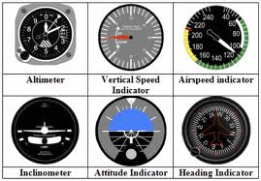
Atmospheric Pressure
These instruments are the altimeter, airspeed indicator, vertical speed indicator, and manifold pressure gauge.

Slide 5
Warm-Up – 10/1 – 10 minutes
Utilizing your notes and past knowledge answer the following questions:
What are the instruments that are impacted by atmospheric pressure?
What standard are all instruments calibrated?
The density of air has significant effects on the aircraft’s performance because as air becomes less dense, identify three possible effects on an aircraft.
What is the approximate temperature decrease for every 1,000 feet of elevation in altitude?
Define angle of attack.

Slide 6
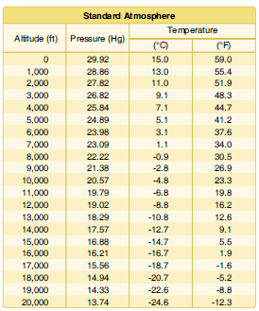
Atmospheric Pressure
Since aircraft performance is compared and evaluated with respect to the standard atmosphere, all aircraft instruments are calibrated for the standard atmosphere.

Slide 7
Warm-Up – 10/1 – 10 minutes
Utilizing your notes and past knowledge answer the following questions:
What are the instruments that are impacted by atmospheric pressure?
What standard are all instruments calibrated?
The density of air has significant effects on the aircraft’s performance because as air becomes less dense, identify three possible effects on an aircraft.
What is the approximate temperature decrease for every 1,000 feet of elevation in altitude?
Define angle of attack.

Slide 8
Density Altitude
The density of air has significant effects on the aircraft’s performance because as air becomes less dense, it reduces:
• Power because the engine takes in less air.
• Thrust because a propeller is less efficient in thin air.
• Lift because the thin air exerts less force on the airfoils.

Slide 9
Warm-Up – 10/1 – 10 minutes
Utilizing your notes and past knowledge answer the following questions:
What are the instruments that are impacted by atmospheric pressure?
What standard are all instruments calibrated?
The density of air has significant effects on the aircraft’s performance because as air becomes less dense, identify three possible effects on an aircraft.
What is the approximate temperature decrease for every 1,000 feet of elevation in altitude?
Define angle of attack.

Slide 10
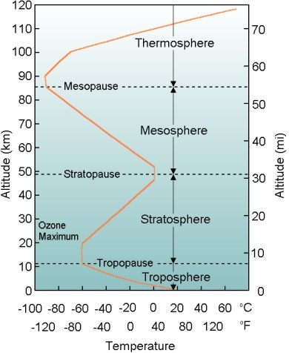
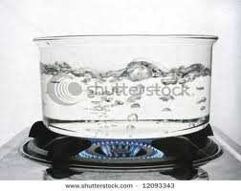
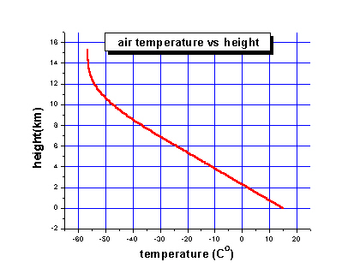
Temperature
Temperature is a measure of energy
The hotter the air, the more energy it has inside and the faster the molecules move around.
Temperature decreases approx 3 ½ degrees for every 1,000 ft increase in altitude
Decrease occurs up to about 38,000 ft

Slide 11
Warm-Up – 10/1 – 10 minutes
Utilizing your notes and past knowledge answer the following questions:
What are the instruments that are impacted by atmospheric pressure?
What standard are all instruments calibrated?
The density of air has significant effects on the aircraft’s performance because as air becomes less dense, identify three possible effects on an aircraft.
What is the approximate temperature decrease for every 1,000 feet of elevation in altitude?
Define angle of attack.

Slide 12
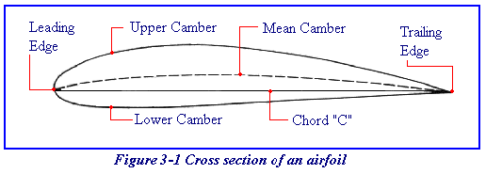
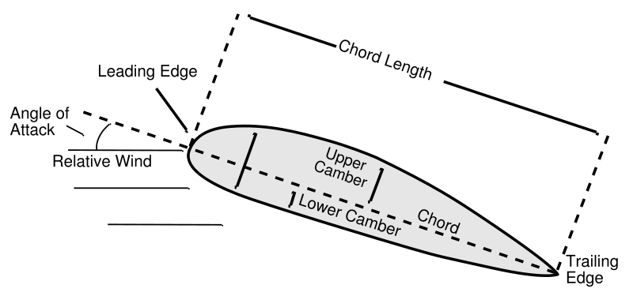
Airfoil – Designs that Capture the Energy of the Wind
Airfoil Design
Chord is an imaginary line that connects the leading with the trailing edge
The Relative Wind is opposite the flight path
Angle of Attack
Is the angle between the chord line and the oncoming relative wind

Slide 13
Questions / Comments

Slide 14
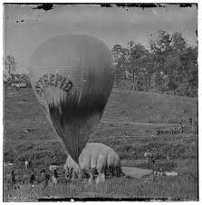
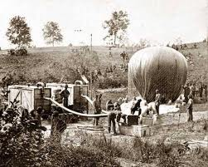
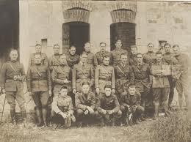
THIS DAY IN AVIATION
October 1
1861 — The United States Army Balloon Corps, consisting of five balloons and fifty men, is formed.

Slide 15
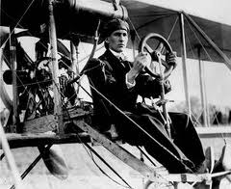
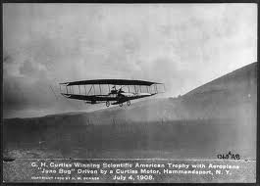
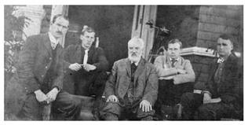
THIS DAY IN AVIATION
October 1
1907 — The Aerial Experiment Association is formed by Dr A. Graham Bell, F.W. Baldwin, J.A.D. McCurdy, Glenn H. Curtiss and Thomas E. Selfridge.

Slide 16
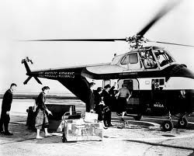
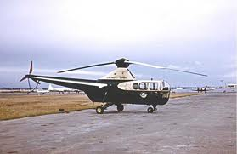
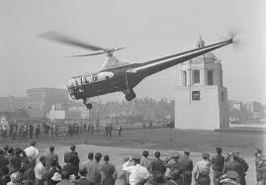
THIS DAY IN AVIATION
October 1
1947 — Los Angeles Airways opens the world's first regular airmail service by helicopter, using Sikorsky S-51 machines.

Slide 17
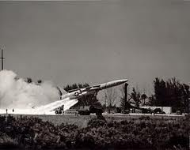
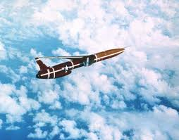
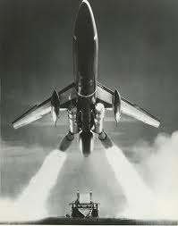
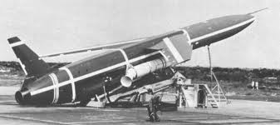
THIS DAY IN AVIATION
October 1
1957 — For the first time, USAF military personnel launch an intercontinental missile, a Northrop SM-62 “Snark.”

Slide 18
Questions / Comments

Slide 19
October 2013
Sunday | Monday | Tuesday | Wednesday | Thursday | Friday | Saturday
 |  | 1 Chapter 3 Lift Theories Wingtip Vortices | 2 | 3 Chapter 3 Test Flight Simulator Syllabus | 4 | 5
6 | 7 Chapter 4 | 8 | 9 Chapter 4 | 10 | 11 Chapter 4 Quiz FltLine Friday Flight Simulator | 12
13 | 14 | 15 Chapter 4 | 16 | 17 Chapter 4 | 18 | 19
20 | 21 Chapter 4 Quiz 1st Quarter Grades | 22 | 23 | 24 | 25 | 26
27 | 28 | 29 | 30 | 31

Slide 20
Questions / Comments

Slide 21
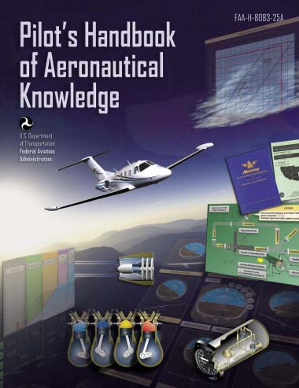
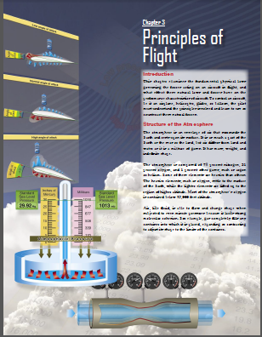
Chapter 3 – Principles of Flight
FAA – Pilot’s Handbook of Aeronautical Knowledge

Slide 22
Today’s Mission Requirements
Mission:
Identify in writing the fundamental physical laws governing the forces acting on an aircraft in flight.
Discuss the layers of the atmosphere, its composition and height.
Describe the atmospheric properties of pressure, temperature, and density
Describe in writing the effect these natural laws and forces have on the performance characteristics of an aircraft.
Describe in writing the means a pilot must understand the principles involved and learn to use or counteract these natural forces.
EQ:
Describe the importance of Aeronautical Knowledge for the student pilot learning to fly.

Slide 23
Questions / Comments

Slide 24
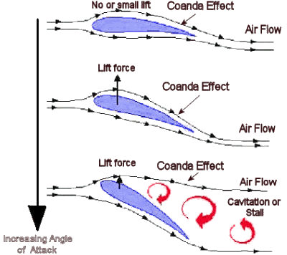
Coanda Effect

Slide 25
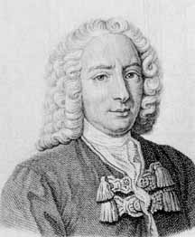
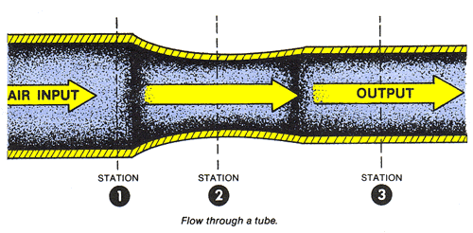
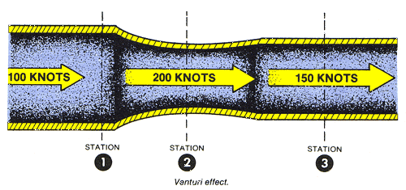
Who is Daniel Bernoulli?
Dutch-born physicist – born in 1738
Discovered a relationship between the pressure and speed of a fluid in motion
Specifically – as velocity of a fluid increases, the pressure decreases
Treat air as a fluid

Slide 26
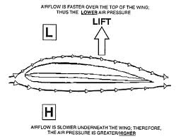
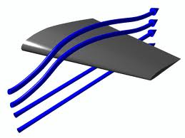
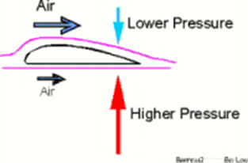
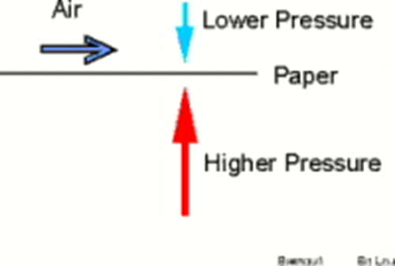
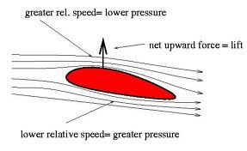
Who is Daniel Bernoulli?
For Lift to occur - The pressure on top of the airfoil must be less than the pressure below.
The airfoil has no choice but to move upward.

Slide 27
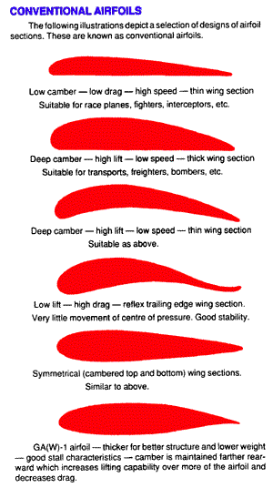
Who is Daniel Bernoulli?
Camber determines the amount of lift an airfoil will produce at a given speed
The thicker or more pronounced the camber – the more lift.
At low speeds its best to have a high-lift airfoil.

Slide 28
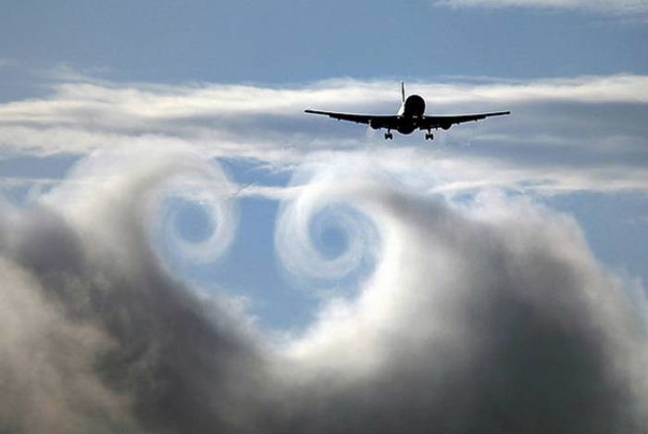
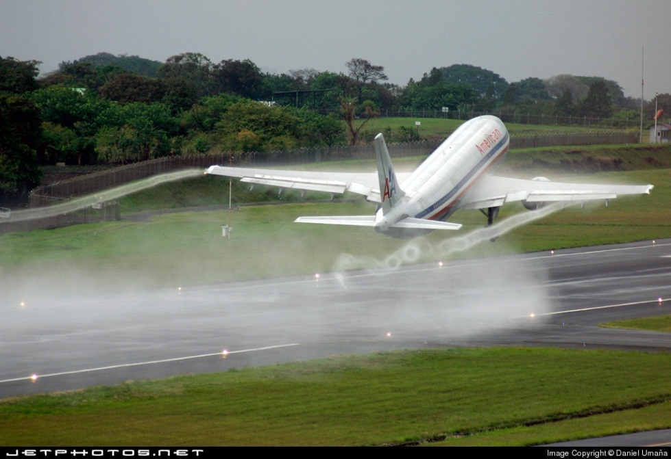
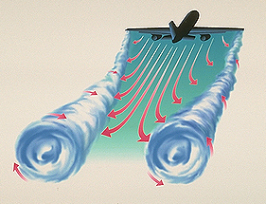
Vortices and Winglets

Slide 29
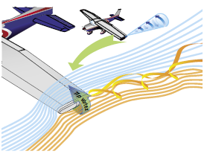
A Third Dimension
The high-pressure area on the bottom of an airfoil pushes around the tip to the low-pressure area on the top.
This action creates a rotating flow called a tip vortex

Slide 30
A Third Dimension
The vortex flows behind the airfoil creating a downwash that extends back to the trailing edge of the airfoil.
This downwash results in an overall reduction in lift for the affected portion of the airfoil.

Slide 31
A Third Dimension
To counteract this action.
Winglets can be added to the tip of an airfoil to reduce this flow.
The winglets act as a dam preventing the vortex from forming.
Winglets can be on the top or bottom of the airfoil.

Slide 32
A Third Dimension
Another method of countering the flow is to taper the airfoil tip, reducing the pressure differential and smoothing the airflow around the tip.

Slide 33
Summary
Modern general aviation aircraft have what may be considered high performance characteristics.
Therefore, it is increasingly necessary that pilots appreciate and understand the principles upon which the art of flying is based.

Slide 34
Questions / Comments

Slide 35
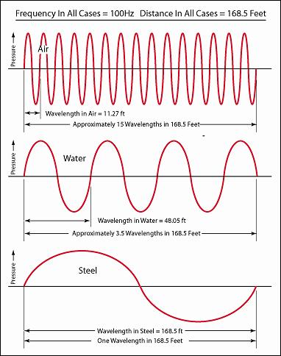
The Speed of Sound in Air
Sound waves travel like ripples in water.
Sound travels in all directions.

Slide 36
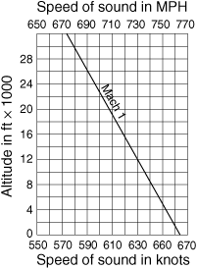
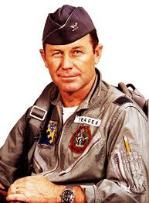
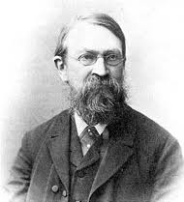
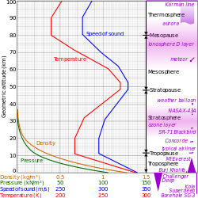
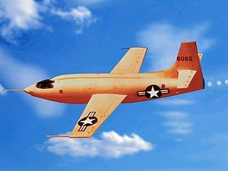
The Speed of Sound in Air
Austrian physicist Ernst Mach determined the mathematical value for the speed of sound
Speed of sound varies with altitude because temperature decreases with an increase in height
Chuck Yeager in the X-1 broke the speed of sound Oct 14, 1947

Slide 37
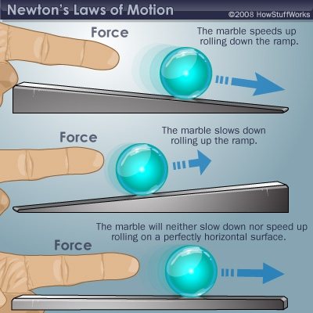
Newton’s Laws of Motion
Newton's three laws of motion are:
Inertia - A body at rest will remain at rest. and a body in motion will remain in motion at the same speed and direction until affected by some external force.
Nothing starts or stops without an outside force to bring about or prevent motion. Hence, the force with which a body offers resistance to change is called the force of inertia.

Slide 38
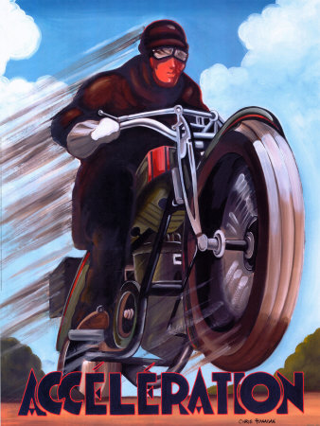
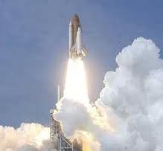
Newton’s Laws of Motion
Newton's three laws of motion are:
Acceleration - The force required to produce a change in motion of a body is directly proportional to its mass and the rate of change in its velocity.
Acceleration refers either to an increase or a decrease in velocity, although Deceleration is commonly used to indicate a decrease.

Slide 39
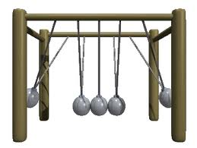
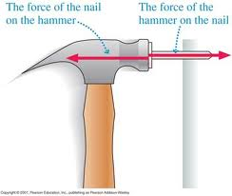
Newton’s Laws of Motion
Newton's three laws of motion are:
Action / Reaction - For every action there is an equal and opposite reaction.
If an interaction occurs between two bodies, equal forces in opposite directions will be imparted to each body.

