Slide 1
Warm-Up – 11/16 – 10 minutes
Utilizing your notes and past knowledge answer the following questions:
What region does the majority of aircraft flying take place?
Describe what is the gradient or slope of a runway.
Describe the affect on an aircraft with respect to takeoff distance, with a downsloping runway.
Describe the three concerns with a heavy aircraft during takeoff.
What is the concern of an aircraft taking off below the recommended speed?

Slide 2

Questions / Comments

Slide 3
Warm-Up – 11/16 – 10 minutes
Utilizing your notes and past knowledge answer the following questions:
What region does the majority of aircraft flying take place?
Describe what is the gradient or slope of a runway.
Describe the affect on an aircraft with respect to takeoff distance, with a downsloping runway.
Describe the three concerns with a heavy aircraft during takeoff.
What is the concern of an aircraft taking off below the recommended speed?

Slide 4
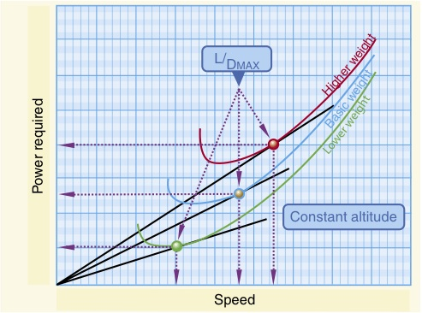
Region of Reversed Command
The majority of aircraft flying (climb, cruise, and maneuvers) is conducted in the region of normal command.

Slide 5
Warm-Up – 11/16 – 10 minutes
Utilizing your notes and past knowledge answer the following questions:
What region does the majority of aircraft flying take place?
Describe what is the gradient or slope of a runway.
Describe the affect on an aircraft with respect to takeoff distance, with a downsloping runway.
Describe the three concerns with a heavy aircraft during takeoff.
What is the concern of an aircraft taking off below the recommended speed?

Slide 6
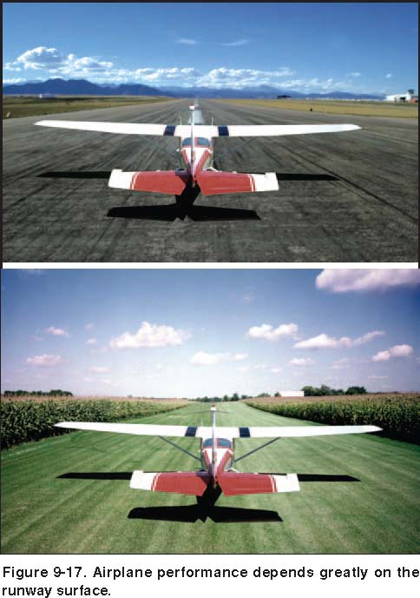
Runway Surface and Gradient
The gradient or slope of the runway is the amount of change in runway height over the length of the runway.
A positive gradient indicates the runway height increases, and a negative gradient indicates the runway decreases in height.

Slide 7
Warm-Up – 11/16 – 10 minutes
Utilizing your notes and past knowledge answer the following questions:
What region does the majority of aircraft flying take place?
Describe what is the gradient or slope of a runway.
Describe the affect on an aircraft with respect to takeoff distance, with a downsloping runway.
Describe the three concerns with a heavy aircraft during takeoff.
What is the concern of an aircraft taking off below the recommended speed?

Slide 8
Runway Surface and Gradient
A downsloping runway aids in acceleration on takeoff resulting in shorter takeoff distances.
The opposite is true when landing, as landing on a downsloping runway increases landing distances.

Slide 9
Warm-Up – 11/16 – 10 minutes
Utilizing your notes and past knowledge answer the following questions:
What region does the majority of aircraft flying take place?
Describe what is the gradient or slope of a runway.
Describe the affect on an aircraft with respect to takeoff distance, with a downsloping runway.
Describe the three concerns with a heavy aircraft during takeoff.
What is the concern of an aircraft taking off below the recommended speed?

Slide 10
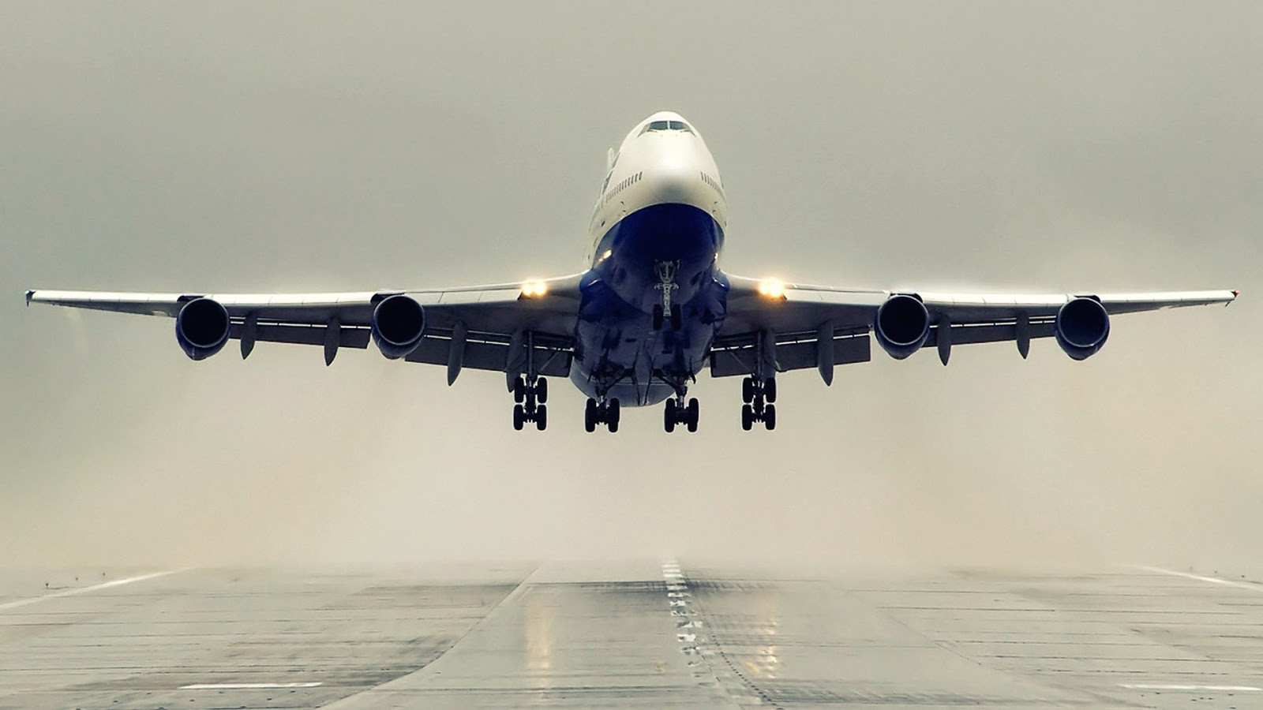
Takeoff Performance
1. Higher lift-off speed
2. Greater mass to accelerate
3. Increased retarding force (drag and ground friction)

Slide 11
Warm-Up – 11/16 – 10 minutes
Utilizing your notes and past knowledge answer the following questions:
What region does the majority of aircraft flying take place?
Describe what is the gradient or slope of a runway.
Describe the affect on an aircraft with respect to takeoff distance, with a downsloping runway.
Describe the three concerns with a heavy aircraft during takeoff.
What is the concern of an aircraft taking off below the recommended speed?

Slide 12

Takeoff Performance
Any attempt to take off below the recommended speed means:
  that the aircraft could stall
  be difficult to control
  or have a very low initial rate of climb.

Slide 13
Questions / Comments

Slide 14
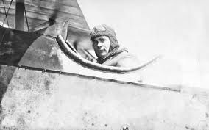
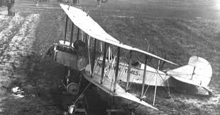
THIS DAY IN AVIATION
November 16
1915 — Victor Carlstrom becomes the first pilot to fly from Toronto to New York.
Carlstrom flies in a Curtiss R-2 biplane and was in the air for 6 hours and 40 minutes.

Slide 15
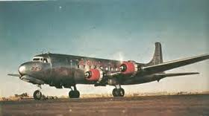
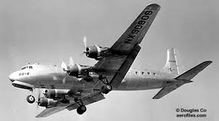
THIS DAY IN AVIATION
November 16
1949 — Douglas DC-6A prototype sets commercial San Francisco/Los Angeles record of 58 minutes 13 seconds with an average speed of 350 mph

Slide 16
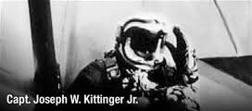
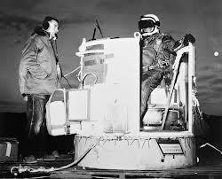
THIS DAY IN AVIATION
November 16
1959 — Capt. Joseph W. Kittinger, Jr. makes a record parachute jump from an open gondola at an altitude of 76,400 feet.

Slide 17
Questions / Comments

Slide 18
AVIATION ACES
4A
Pilots (A – 93 & above)
4A
Co-Pilots (B – 85 – 92)
Joker
Donald Duck
Krutch
Big Papi
Maverick
Big Daddy
Z
Rico
Smalls
Mr. Young
TJ
Eagle
Flash
Big Daddy Z
High Shooter (100)

Slide 19
October / November 2015
SUNDAY | MONDAY | TUESDAY | WEDNESDAY | THURSDAY | FRIDAY | SATURDAY
 | 26 Chapter 7 Flight Instruments | 27 Chapter 7 Flight Instruments Altimeter | 28 Chapter 7 Flight Instruments Vertical Speed Indicator | 29 Chapter 7 Flight Instruments Airspeed Indicator | 30 Chapter 7 QUIZ | 31
1 | 2 Chapter 7 Flight Instruments Gyro Systems | 3 Chapter 7 Flight Instruments Magnetic Compass | 4 Chapter 7 Flight Instruments Review and Test | 5 Chapter 8 Flight Manuals | 6 Chapter 8 Flight Manuals Review and Test | 7
8 | 9 Chapter 10 Aircraft Performance | 10 Chapter 10 Aircraft Performance | 11 HOLIDAY | 12 Chapter 10 Aircraft Performance | 13 Chapter 10 Aircraft Performance QUIZ | 14
15 | 16 Chapter 11 Weather Theory | 17 Chapter 11 Weather Theory | 18 Chapter 11 Weather Theory | 19 Chapter 11 Weather Theory | 20 Chapter 11 Weather Theory TEST | 21

Slide 20
Questions / Comments

Slide 21
2nd Quarter Requirements
(18 Class Meetings – Dec 14)
All students will complete the following:
  Take notes - All in class quizzes and tests
  Private Pilot Syllabus
    Lessons 1 – 6 (Taxiing through Air Traffic Control)
    Must pass written with 80%
    Successfully complete 3 times on small sim
    Successfully complete 1 time on Main sim
  Complete ERAU Aviation 101
    3 quizzes and 1 test
  Student will receive zero points for all incomplete work – NO make-up / extra credit
NOTE: All unfinished Student Pilot and ERAU must be complete prior to starting Private Pilot and last 3 quizzes and test for ERAU.

Slide 22
Questions / Comments

Slide 23

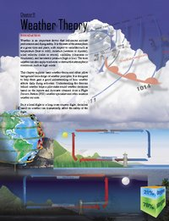
Chapter 11– Weather Theory
FAA – Pilot’s Handbook of Aeronautical Knowledge

Slide 24
Today’s Mission Requirements
Mission:
Describe basic weather theory and weather principles.
Describe how weather affects daily flying activities.
Describe the theories behind weather.
Describe the Flight Service Station (FSS) weather specialist and other aviation weather services.
EQ:
  Describe the importance of Aeronautical Knowledge for the student pilot learning to fly.

Slide 25

Introduction
Weather is an important factor that influences aircraft performance and flying safety.

Slide 26
Introduction
It is the state of the atmosphere at a given time and place, with respect to variables such as temperature (heat or cold), moisture (wetness or dryness), wind velocity (calm or storm), visibility (clearness or cloudiness), and barometric pressure (high or low).

Slide 27
Introduction
The term weather can also apply to adverse or destructive atmospheric conditions, such as high winds.

Slide 28
Introduction
Be it a local flight or a long cross-country flight, decisions based on weather can dramatically affect the safety of the flight.

Slide 29
Atmosphere
The atmosphere is a blanket of air made up of a mixture of gases that surrounds the Earth and reaches almost 350 miles from the surface of the Earth.
This mixture is in constant motion.

Slide 30
Measurement of Atmosphere Pressure
Atmospheric pressure is typically measured in inches of mercury ("Hg) by a mercurial barometer.
The barometer measures the height of a column of mercury inside a glass tube.

Slide 31
Measurement of Atmosphere Pressure
A section of the mercury is exposed to the pressure of the atmosphere, which exerts a force on the mercury.
An increase in pressure forces the mercury to rise inside the tube.
When the pressure drops, mercury drains out of the tube, decreasing the height of the column.

Slide 32
Measurement of Atmosphere Pressure
The International Standard Atmosphere (ISA) has been established standard sea level pressure is defined as 29.92 "Hg and a standard temperature of 59 °F (15 °C).

Slide 33
Measurement of Atmosphere Pressure
By tracking barometric pressure trends across a large area, weather forecasters can more accurately predict movement of pressure systems and the associated weather.
For example, tracking a pattern of rising pressure at a single weather station generally indicates the approach of fair weather.

Slide 34
Altitude and Atmospheric Pressure
As altitude increases, atmospheric pressure decreases.
As pressure decreases, the air becomes less dense or “thinner.”

Slide 35
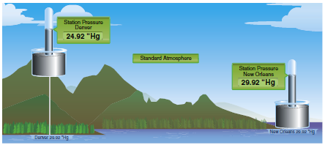
Altitude and Atmospheric Pressure
This is the equivalent of being at a higher altitude and is referred to as density altitude (DA).

Slide 36
Altitude and Atmospheric Pressure
As pressure decreases, DA increases and has a pronounced effect on aircraft performance.

Slide 37
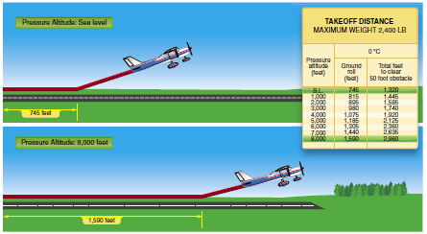
Altitude and Flight
When an aircraft takes off, lift must be developed by the flow of air around the wings.
If the air is thin, more speed is required to obtain enough lift for takeoff; therefore, the ground run is longer.
An aircraft that requires 745 feet of ground run at sea level requires more than double that at a pressure altitude of 8,000 feet.

Slide 38
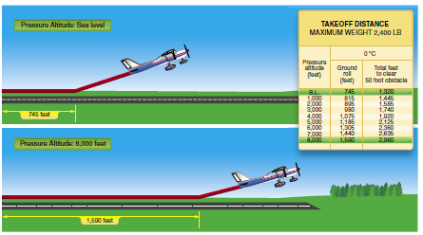

Slide 39
Altitude and Flight
It is also true that at higher altitudes, due to the decreased density of the air, aircraft engines and propellers are less efficient.
This leads to reduced rates of climb and a greater ground run for obstacle clearance.

Slide 40
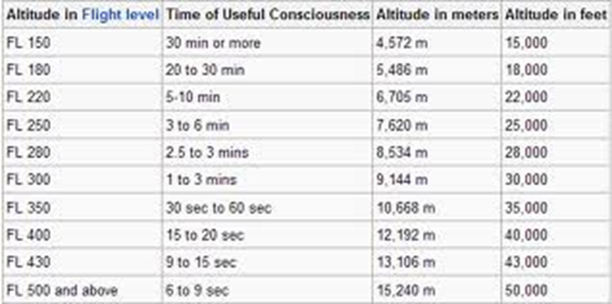
Altitude and the Human Body
At sea level, atmospheric pressure is great enough to support normal growth, activity, and life.
At 18,000 feet, the partial pressure of oxygen is reduced and adversely affects the normal activities and functions of the human body.

Slide 42
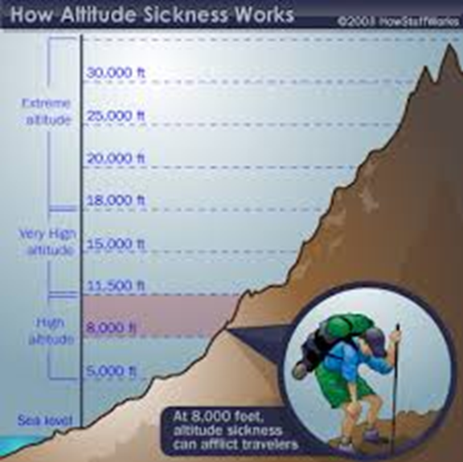
Altitude and the Human Body
The reactions of the average person become impaired at an altitude of about 10,000 feet, but for some people impairment can occur at an altitude as low as 5,000 feet.
The physiological reactions to hypoxia or oxygen deprivation are insidious and affect people in different ways.

Slide 43
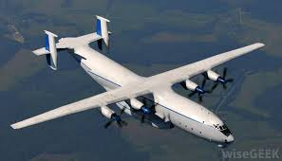
Altitude and the Human Body
These symptoms range from mild disorientation to total incapacitation, depending on body tolerance and altitude.
Supplemental oxygen or cabin pressurization systems help pilots fly at higher altitudes and overcome the effects of oxygen deprivation.

Slide 44
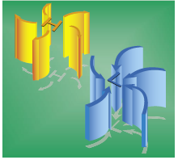
Wind and Currents
Air flows from areas of high pressure into areas of low pressure because air always seeks out lower pressure.

Slide 45
Wind Patterns
The flow of air from areas of high to low pressure is deflected to the right and produces a clockwise circulation around an area of high pressure.
The opposite is true of low-pressure areas; the air flows toward a low and is deflected to create a counterclockwise or cyclonic circulation.

Slide 46
Wind Patterns
High pressure systems are generally areas of dry, stable, descending air.
Good weather is typically associated with high pressure systems for this reason.
Conversely, air flows into a low pressure area to replace rising air.

Slide 47
Wind Patterns
This air tends to be unstable, and usually brings increasing cloudiness and precipitation.
Thus, bad weather is commonly associated with areas of low pressure.
A good understanding of high and low pressure wind patterns can be of great help when planning a flight, because a pilot can take advantage of beneficial tailwinds.

Slide 48
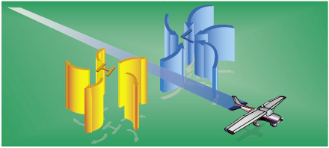
Wind Patterns
When planning a flight from west to east, favorable winds would be encountered along the northern side of a high pressure system or the southern side of a low pressure system.

Slide 49
Wind Patterns
On the return flight, the most favorable winds would be along the southern side of the same high pressure system or the northern side of a low pressure system.

Slide 50
Questions / Comments

Slide 51
2nd Quarter Requirements
(18 Class Meetings – Dec 14)
All students will complete the following:
  Take notes - All in class quizzes and tests
  Private Pilot Syllabus
    Lessons 1 – 6 (Taxiing through Air Traffic Control)
    Must pass written with 80%
    Successfully complete 3 times on small sim
    Successfully complete 1 time on Main sim
  Complete ERAU Aviation 101
    3 quizzes and 1 test
  Student will receive zero points for all incomplete work – NO make-up / extra credit
NOTE: All unfinished Student Pilot and ERAU must be complete prior to starting Private Pilot and last 3 quizzes and test for ERAU.

Slide 52
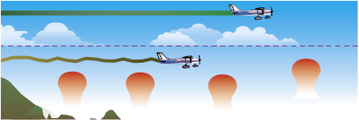
Convective Currents
Different surfaces radiate heat in varying amounts.

Slide 53
Convective Currents
Plowed ground, rocks, sand, and barren land give off a large amount of heat; water, trees, and other areas of vegetation tend to absorb and retain heat.

Slide 54
Convective Currents
The resulting uneven heating of the air creates small areas of local circulation called convective currents.

Slide 55
Convective Currents
Convective currents cause the bumpy, turbulent air sometimes experienced when flying at lower altitudes during warmer weather.

Slide 56
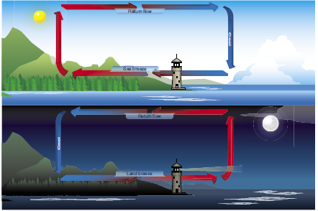
Convective Currents
Convective currents can occur anywhere there is an uneven heating of the Earth’s surface.

Slide 57
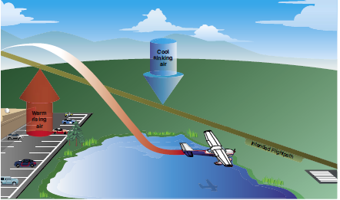
Convective Currents
Convective currents close to the ground can affect a pilot’s ability to control the aircraft.

Slide 58
Convective Currents
For example, on final approach, the rising air from terrain devoid of vegetation sometimes produces a ballooning effect that can cause a pilot to overshoot the intended landing spot.

Slide 59
Convective Currents
An approach over a large body of water or an area of thick vegetation tends to create a sinking effect that can cause an unwary pilot to land short of the intended landing spot.

Slide 60
Obstructions on Wind
Obstructions on the ground affect the flow of wind and can be an unseen danger.
Ground topography and large buildings can break up the flow of the wind and create wind gusts that change rapidly in direction and speed.

Slide 61
Obstructions on Wind
These obstructions range from manmade structures like hangars to large natural obstructions, such as mountains, bluffs, or canyons.
Tall trees can block the wind as well.

Slide 62
Low Level Wind Shear
Wind shear is a sudden, drastic change in wind speed and/or direction over a very small area.
Wind shear can subject an aircraft to violent updrafts and downdrafts, as well as abrupt changes to the horizontal movement of the aircraft.

Slide 63
Low Level Wind Shear
While wind shear can occur at any altitude, low-level wind shear is especially hazardous due to the proximity of an aircraft to the ground.
Low-level wind shear is commonly associated with passing frontal systems, thunderstorms, and temperature inversions with strong upper level winds (greater than 25 knots).

Slide 64
Low Level Wind Shear
It is important to remember that wind shear can affect any flight and any pilot at any altitude.
While wind shear may be reported, it often remains undetected and is a silent danger to aviation.
Always be alert to the possibility of wind shear, especially when flying in and around thunderstorms and frontal systems.

Slide 65
Temperature/Dew Point Relationship
When the temperature of the air is reduced to the dew point, the air is completely saturated and moisture begins to condense out of the air in the form of fog, dew, frost, clouds, rain, hail, or snow.

Slide 66
Methods by Which Air Reaches the Saturation Point
If air reaches the saturation point while temperature and dew point are close together, it is highly likely that fog, low clouds, and precipitation will form.

Slide 67
Fog
Fog is a cloud that begins within 50 feet of the surface.
It typically occurs when the temperature of air near the ground is cooled to the air’s dew point.
On clear nights, with relatively little to no wind present, radiation fog may develop.

Slide 68
Fog
As the sun rises and the temperature increases, radiation fog lifts and eventually burns off.
Any increase in wind also speeds the dissipation of radiation fog.

Slide 69
Fog
When a layer of warm, moist air moves over a cold surface, advection fog is likely to occur.
Unlike radiation fog, wind is required to form advection fog.

Slide 70
Fog
Advection fog is common in coastal areas where sea breezes can blow the air over cooler landmasses.

Slide 71
Clouds
Clouds are visible indicators and are often indicative of future weather.
Cloud type is determined by its height, shape, and behavior.

Slide 72
Clouds
Low clouds are those that form near the Earth’s surface and extend up to 6,500 feet AGL.
Low clouds are stratus, stratocumulus, and nimbostratus.

Slide 73
Clouds
Fog is also classified as a type of low cloud formation.
Clouds in this family create low ceilings, hamper visibility, and can change rapidly.

Slide 74
Clouds
Middle clouds form around 6,500 feet AGL and extend up to 20,000 feet AGL.
Typical middle-level clouds include altostratus and altocumulus.

Slide 75
Clouds
Altostratus clouds can produce turbulence and may contain moderate icing.
Altocumulus clouds, which usually form when altostratus clouds are breaking apart, also may contain light turbulence and icing.

Slide 76
Clouds
High clouds form above 20,000 feet AGL and usually form only in stable air.
High level clouds are cirrus, cirrostratus, and cirrocumulus.

Slide 77
Clouds
Clouds with extensive vertical development are cumulus clouds that build vertically into towering cumulus or cumulonimbus clouds.
The bases of these clouds form in the low to middle cloud base region but can extend into high altitude cloud levels.

Slide 78
Clouds
Towering cumulus clouds indicate areas of instability in the atmosphere, and the air around and inside them is turbulent.
These types of clouds often develop into cumulonimbus clouds or thunderstorms.

Slide 79
Clouds
Cumulonimbus clouds contain large amounts of moisture and unstable air, and usually produce hazardous weather phenomena, such as lightning, hail, tornadoes, gusty winds, and wind shear.

Slide 80
Clouds
These extensive vertical clouds can be obscured by other cloud formations and are not always visible from the ground or while in flight.
When this happens, these clouds are said to be embedded, hence the term, embedded thunderstorms.

Slide 81
Clouds
To pilots, the cumulonimbus cloud is perhaps the most dangerous cloud type.
Heating of the air near the Earth’s surface creates an air mass thunderstorm.
Cumulonimbus clouds that form in a continuous line are nonfrontal bands of thunderstorms or squall lines.

Slide 82
Clouds
Since rising air currents cause cumulonimbus clouds, they are extremely turbulent and pose a significant hazard to flight safety.
In addition, thunderstorms can produce large hailstones, damaging lightning, tornadoes, and large quantities of water, all of which are potentially hazardous to aircraft.

Slide 83
Clouds
A thunderstorm makes its way through three distinct stages before dissipating.
It begins with the cumulus stage, in which lifting action of the air begins.
If sufficient moisture and instability are present, the clouds continue to increase in vertical height.

Slide 84
Clouds
Continuous, strong updrafts prohibit moisture from falling.
The mature stage, which is the most violent time period of the thunderstorm’s life cycle.
At this point, drops of moisture, whether rain or ice, are too heavy for the cloud to support and begin falling in the form of rain or hail.

Slide 85
Clouds
Warm, rising air; cool, precipitation-induced descending air; and violent turbulence all exist within and near the cloud.
Below the cloud, the down-rushing air increases surface winds and decreases the temperature.

Slide 86
Clouds
Once the vertical motion near the top of the cloud slows down, the top of the cloud spreads out and takes on an anvil-like shape.
At this point, the storm enters the dissipating stage.
This is when the downdrafts spread out and replace the updrafts needed to sustain the storm.

Slide 87
Clouds
It is impossible to fly over thunderstorms in light aircraft.
A good rule of thumb is to circumnavigate thunderstorms identified as severe or giving an intense radar echo by at least 20 nautical miles (NM) since hail may fall for miles outside of the clouds.

Slide 88
Clouds
If flying around a thunderstorm is not an option, stay on the ground until it passes.

Slide 89
Ceiling
For aviation purposes, a ceiling is the lowest layer of clouds reported as being broken or overcast, as broken when five-eighths to seven-eighths of the sky is covered with clouds.
Overcast means the entire sky is covered with clouds.

Slide 90
Visibility
Visibility refers to the greatest horizontal distance at which prominent objects can be viewed with the naked eye.
Current visibility is also reported in METAR and other aviation weather reports, as well as by automated weather systems.

Slide 91
Precipitation
Precipitation refers to any type of water particles that form in the atmosphere and fall to the ground.
It has a profound impact on flight safety.
Depending on the form of precipitation, it can reduce visibility, create icing situations, and affect landing and takeoff performance of an aircraft.

Slide 92
Precipitation
Precipitation occurs because water or ice particles in clouds grow in size until the atmosphere can no longer support them.
Drizzle is very small water droplets.
Water droplets of larger size are referred to as rain.

Slide 93
Precipitation
In the case of hail, freezing water droplets are carried up and down by drafts inside clouds, growing larger in size as they come in contact with more moisture.
Once the updrafts can no longer hold the freezing water, it falls to the Earth in the form of hail.

Slide 94
Precipitation
Hail can be pea sized, or it can grow as large as five inches in diameter, larger than a softball.
Snow is precipitation in the form of ice crystals.

Slide 95
Precipitation
Precipitation in any form poses a threat to safety of flight.
Often, precipitation is accompanied by low ceilings and reduced visibility.

Slide 96
Precipitation
Aircraft that have ice, snow, or frost on their surfaces must be carefully cleaned prior to beginning a flight because of the possible airflow disruption and loss of lift.
Rain can contribute to water in the fuel tanks.

Slide 97

Chapter Summary
Knowledge of the atmosphere and the forces acting within it to create weather is essential to understand how weather affects a flight.
By understanding basic weather theories, a pilot can make sound decisions during flight planning after receiving weather briefings.

Slide 98
Questions / Comments

Slide 99
2nd Quarter Requirements
(18 Class Meetings – Dec 14)
All students will complete the following:
  Take notes - All in class quizzes and tests
  Private Pilot Syllabus
    Lessons 1 – 6 (Taxiing through Air Traffic Control)
    Must pass written with 80%
    Successfully complete 3 times on small sim
    Successfully complete 1 time on Main sim
  Complete ERAU Aviation 101
    3 quizzes and 1 test
  Student will receive zero points for all incomplete work – NO make-up / extra credit
NOTE: All unfinished Student Pilot and ERAU must be complete prior to starting Private Pilot and last 3 quizzes and test for ERAU.

Slide 100

May 2014
Sunday | Monday | Tuesday | Wednesday | Thursday | Friday | Saturday
 |  |  |  | 1 Chapter 10 Aircraft Performance | 2 | 3
4 | 5 Chapter 10 Aircraft Performance | 6 | 7 Chapter 10 Aircraft Performance | 8 | 9 Patriot’s Point Field Trip | 10
11 | 12 | 13 Chapter 11 | 14 | 15 Chapter 12/13 | 16 | 17
18 | 19 Chapter 14/15 | 20 | 21 Chapter 16/17 | 22 Seniors Last Day | 23 Flightline Friday | 24
25 | 26 Memorial Day NO SCHOOL | 27 | 28 | 29 | 30 | 31

