Slide 1
Warm-Up – 11/12 – 10 minutes
Utilizing your notes and past knowledge answer the following questions:
What is a major concern with water on runways with respect to aircraft operation?
What is the concern if an aircraft lands at higher speed when a runway is wet?
What is the norm for takeoff speeds of an aircraft?
Describe the three concerns with a heavy aircraft during takeoff.
What is required if there is an increase in weight in order for an aircraft to takeoff?

Slide 2
Questions / Comments

Slide 3
Warm-Up – 11/12 – 10 minutes
Utilizing your notes and past knowledge answer the following questions:
What is a major concern with water on runways with respect to aircraft operation?
What is the concern if an aircraft lands at higher speed when a runway is wet?
What is the norm for takeoff speeds of an aircraft?
Describe the three concerns with a heavy aircraft during takeoff.
What is required if there is an increase in weight in order for an aircraft to takeoff?

Slide 4
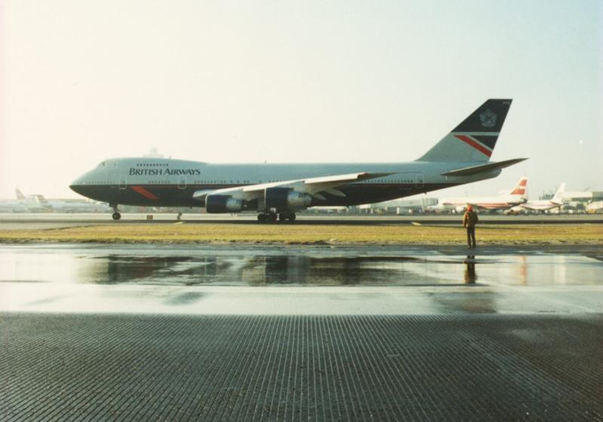
Water on the Runway and Dynamic Hydroplaning
Water on the runways reduces the friction between the tires and the ground, and can reduce braking effectiveness.
This is also true of braking effectiveness when runways are covered in ice.

Slide 5
Warm-Up – 11/12 – 10 minutes
Utilizing your notes and past knowledge answer the following questions:
What is a major concern with water on runways with respect to aircraft operation?
What is the concern if an aircraft lands at higher speed when a runway is wet?
What is the norm for takeoff speeds of an aircraft?
Describe the three concerns with a heavy aircraft during takeoff.
What is required if there is an increase in weight in order for an aircraft to takeoff?

Slide 6
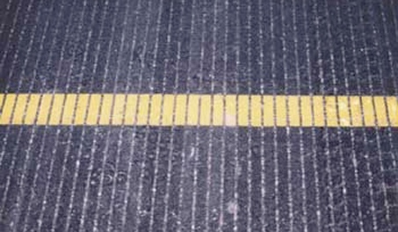
Water on the Runway and Dynamic Hydroplaning
Landing at higher than recommended touchdown speeds will expose the aircraft to a greater potential for hydroplaning.
And once hydroplaning starts, it can continue well below the minimum initial hydroplaning speed.

Slide 7
Warm-Up – 11/12 – 10 minutes
Utilizing your notes and past knowledge answer the following questions:
What is a major concern with water on runways with respect to aircraft operation?
What is the concern if an aircraft lands at higher speed when a runway is wet?
What is the norm for takeoff speeds of an aircraft?
Describe the three concerns with a heavy aircraft during takeoff.
What is required if there is an increase in weight in order for an aircraft to takeoff?

Slide 8
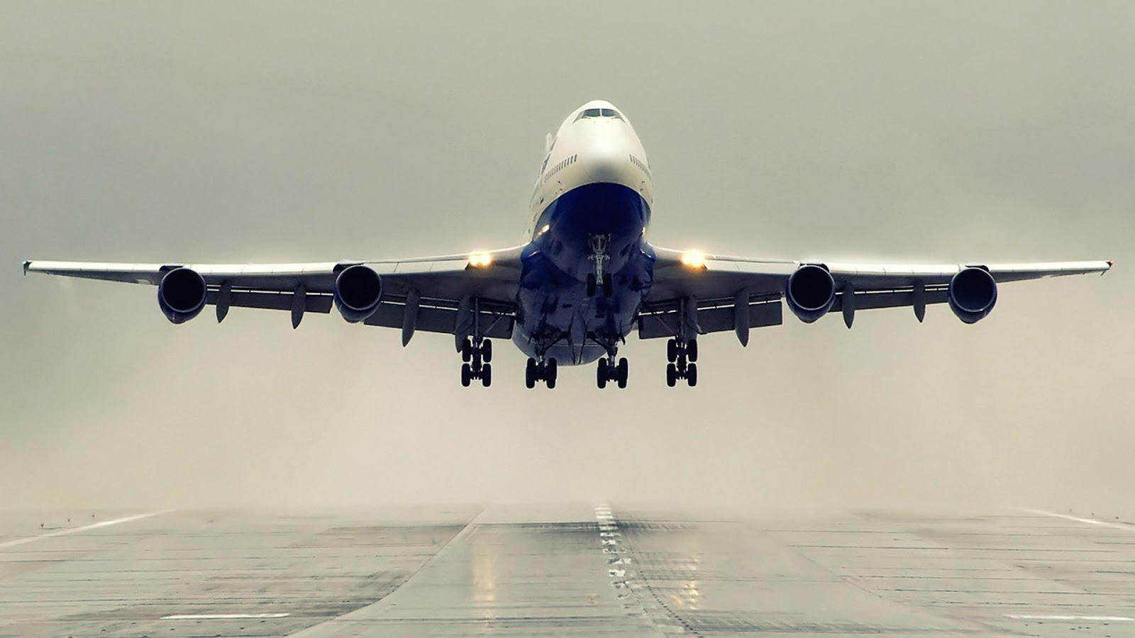
Takeoff Performance
Depending on the aircraft characteristics, the lift-off speed will be anywhere from 1.05 to 1.25 times the stall speed or minimum control speed.

Slide 9
Warm-Up – 11/12 – 10 minutes
Utilizing your notes and past knowledge answer the following questions:
What is a major concern with water on runways with respect to aircraft operation?
What is the concern if an aircraft lands at higher speed when a runway is wet?
What is the norm for takeoff speeds of an aircraft?
Describe the three concerns with a heavy aircraft during takeoff.
What is required if there is an increase in weight in order for an aircraft to takeoff?

Slide 10
Takeoff Performance
1. Higher lift-off speed
2. Greater mass to accelerate
3. Increased retarding force (drag and ground friction)

Slide 11
Warm-Up – 11/12 – 10 minutes
Utilizing your notes and past knowledge answer the following questions:
What is a major concern with water on runways with respect to aircraft operation?
What is the concern if an aircraft lands at higher speed when a runway is wet?
What is the norm for takeoff speeds of an aircraft?
Describe the three concerns with a heavy aircraft during takeoff.
What is required if there is an increase in weight in order for an aircraft to takeoff?

Slide 12
Takeoff Performance
If the gross weight increases, a greater speed is necessary to produce the greater lift necessary to get the aircraft airborne.

Slide 13
Questions / Comments

Slide 14
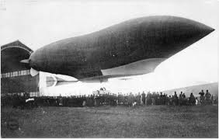
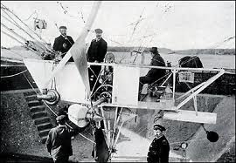
THIS DAY IN AVIATION
November 12
1903 — The first fully practical airship, the Lebaudy, makes a successful flight in Paris, France.
The 190-foot-long airship flies 38½ miles and achieves a speed of 25-mph.

Slide 15
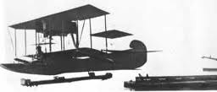
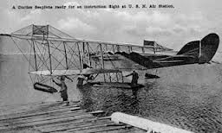
THIS DAY IN AVIATION
November 12
1912 — The first successful catapult launch of a seaplane is made at the Washington, D.C. Navy Yard.
Catapulted by a compressed air system from an anchored barge, the floatplane is a Curtiss A-1.

Slide 16
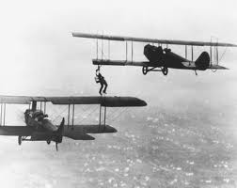
THIS DAY IN AVIATION
November 12
1921 — The first air-to-air refueling is made when American Wesley May steps from the wing of one aircraft to that of another carrying a five-gallon can of gasoline strapped to his back.

Slide 17
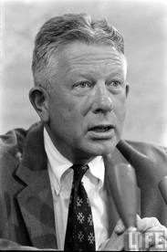
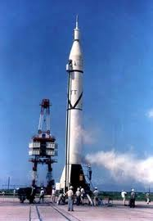
THIS DAY IN AVIATION
November 12
1957 — Defense Secretary Neil H. McElroy orders the United States Army to prepare to launch an Earth satellite.
A modified ”Jupiter-C” test vehicle will be used.

Slide 18
Questions / Comments

Slide 19
October / November 2015
SUNDAY | MONDAY | TUESDAY | WEDNESDAY | THURSDAY | FRIDAY | SATURDAY
 | 26 Chapter 7 Flight Instruments | 27 Chapter 7 Flight Instruments Altimeter | 28 Chapter 7 Flight Instruments Vertical Speed Indicator | 29 Chapter 7 Flight Instruments Airspeed Indicator | 30 Chapter 7 QUIZ | 31
1 | 2 Chapter 7 Flight Instruments Gyro Systems | 3 Chapter 7 Flight Instruments Magnetic Compass | 4 Chapter 7 Flight Instruments Review and Test | 5 Chapter 8 Flight Manuals | 6 Chapter 8 Flight Manuals Review and Test | 7
8 | 9 Chapter 10 Aircraft Performance | 10 Chapter 10 Aircraft Performance | 11 HOLIDAY | 12 Chapter 10 Aircraft Performance | 13 Chapter 10 Aircraft Performance QUIZ | 14
15 | 16 Chapter 10 Aircraft Performance | 17 Chapter 10 Aircraft Performance | 18 Chapter 10 Aircraft Performance | 19 Chapter 10 Aircraft Performance | 20 Chapter 10 Aircraft Performance TEST | 21

Slide 20
Questions / Comments

Slide 21
2nd Quarter Requirements (20 Class Meetings – Dec 14)
All students will complete the following:
Take notes - All in class quizzes and tests
Private Pilot Syllabus
Lessons 1 – 6 (Taxiing through Air Traffic Control)
Must pass written with 80%
Successfully complete 3 times on small sim
Successfully complete 1 time on Main sim
Complete ERAU Aviation 101
3 quizzes and 1 test
Student will receive zero points for all incomplete work – NO make-up / extra credit
NOTE: All unfinished Student Pilot and ERAU must be complete prior to starting Private Pilot and last 3 quizzes and test for ERAU.

Slide 22
Questions / Comments

Slide 23
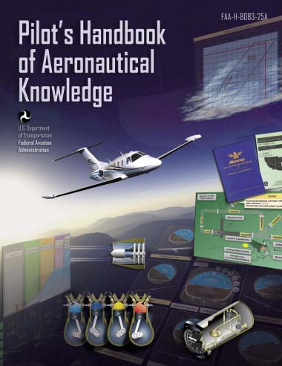
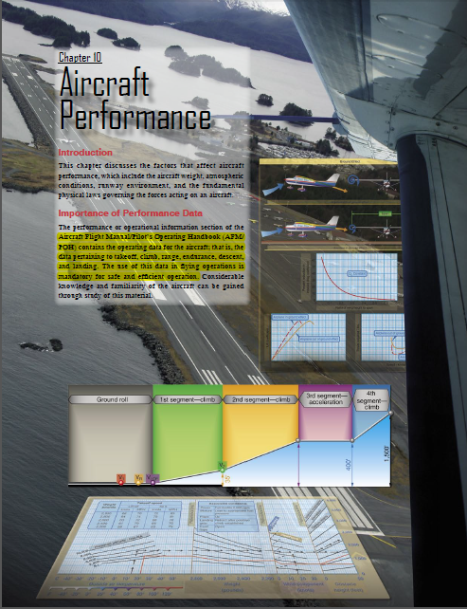
Chapter 10 – Aircraft Performance
FAA – Pilot’s Handbook of Aeronautical Knowledge

Slide 24
Today’s Mission Requirements
Mission:
Describe the factors that affect aircraft performance.
Identify how aircraft weight, atmospheric conditions, runway environment, and the fundamental physical laws governing the forces can affect aircraft performance.
EQ:
Describe the importance of Aeronautical Knowledge for the student pilot learning to fly.

Slide 25
Takeoff Performance
The effect of wind on takeoff distance is large.
The effect of a headwind is to allow the aircraft to reach the lift-off speed at a lower groundspeed while the effect of a tailwind is to require the aircraft to achieve a greater groundspeed to attain the lift-off speed.

Slide 26
Takeoff Performance
The effect of wind on landing distance is identical to its effect on takeoff distance.

Slide 27
Takeoff Performance
The effect of proper takeoff speed is especially important when runway lengths and takeoff distances are critical.
The takeoff speeds specified in the AFM/POH are generally the minimum safe speeds at which the aircraft can become airborne.

Slide 28
Takeoff Performance
Any attempt to take off below the recommended speed means that the aircraft could stall, be difficult to control, or have a very low initial rate of climb.

Slide 29
Takeoff Performance
Excessive airspeed at takeoff may improve the initial rate of climb and “feel” of the aircraft, but will produce an undesirable increase in takeoff distance.

Slide 30
Landing Performance
The effect of gross weight on landing distance is one of the principal items determining the landing distance.

Slide 31
Landing Performance
One effect of an increased gross weight is that a greater speed will be required to support the aircraft at the landing AOA and lift coefficient.

Slide 32
Landing Performance
The effect of wind on landing distance is large and deserves proper consideration when predicting landing distance.

Slide 33
Landing Performance
The principal effect of wind on landing distance is the change in the groundspeed at which the aircraft touches down.

Slide 34
Landing Performance
The landing speeds specified in the AFM/POH are generally the minimum safe speeds at which the aircraft can be landed.

Slide 35
Landing Performance
Any attempt to land at below the specified speed may mean that the aircraft may stall, be difficult to control, or develop high rates of descent.

Slide 36
Landing Performance
An excessive speed at landing may improve the controllability slightly (especially in crosswinds), but causes an undesirable increase in landing distance.

Slide 37
Landing Performance
The most critical conditions of landing performance are combinations of high gross weight, high density altitude, and unfavorable wind.

Slide 38
Questions / Comments

Slide 39
2nd Quarter Requirements (20 Class Meetings – Dec 14)
All students will complete the following:
Take notes - All in class quizzes and tests
Private Pilot Syllabus
Lessons 1 – 6 (Taxiing through Air Traffic Control)
Must pass written with 80%
Successfully complete 3 times on small sim
Successfully complete 1 time on Main sim
Complete ERAU Aviation 101
3 quizzes and 1 test
Student will receive zero points for all incomplete work – NO make-up / extra credit
NOTE: All unfinished Student Pilot and ERAU must be complete prior to starting Private Pilot and last 3 quizzes and test for ERAU.

