Slide 1
Warm-Up – 11/10 – 10 minutes
Utilizing your notes and past knowledge answer the following questions:
What region does the majority of aircraft flying take place?
Any surface that is not hard and smooth will increase the ground roll during takeoff. (True/False)
Describe what is the gradient or slope of a runway.
Describe the affect on an aircraft with respect to takeoff distance, with a downsloping runway.

Slide 2
Questions / Comments

Slide 3
Warm-Up – 11/10 – 10 minutes
Utilizing your notes and past knowledge answer the following questions:
What region does the majority of aircraft flying take place?
Any surface that is not hard and smooth will increase the ground roll during takeoff. (True/False)
Describe what is the gradient or slope of a runway.
Describe the affect on an aircraft with respect to takeoff distance, with a downsloping runway.

Slide 4
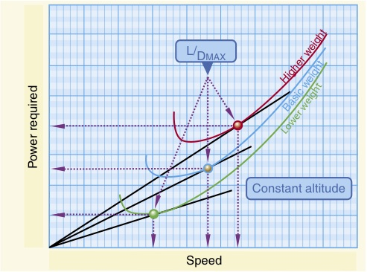
Region of Reversed Command
The majority of aircraft flying (climb, cruise, and maneuvers) is conducted in the region of normal command.

Slide 5
Warm-Up – 11/10 – 10 minutes
Utilizing your notes and past knowledge answer the following questions:
What region does the majority of aircraft flying take place?
Any surface that is not hard and smooth will increase the ground roll during takeoff. (True/False)
Describe what is the gradient or slope of a runway.
Describe the affect on an aircraft with respect to takeoff distance, with a downsloping runway.

Slide 6
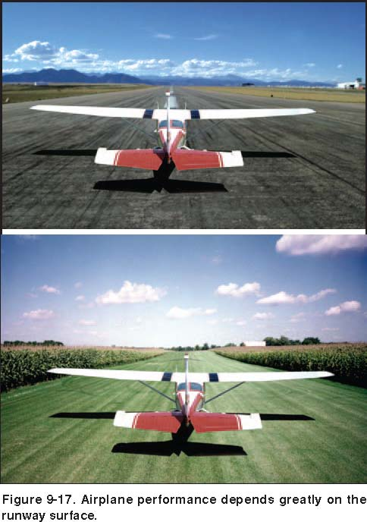
Runway Surface and Gradient
The runway surface encountered may be concrete, asphalt, gravel, dirt, or grass.
Any surface that is not hard and smooth will increase the ground roll during takeoff.

Slide 7
Warm-Up – 11/10 – 10 minutes
Utilizing your notes and past knowledge answer the following questions:
What region does the majority of aircraft flying take place?
Any surface that is not hard and smooth will increase the ground roll during takeoff. (True/False)
Describe what is the gradient or slope of a runway.
Describe the affect on an aircraft with respect to takeoff distance, with a downsloping runway.

Slide 8
Runway Surface and Gradient
The gradient or slope of the runway is the amount of change in runway height over the length of the runway.
A positive gradient indicates the runway height increases, and a negative gradient indicates the runway decreases in height.

Slide 9
Warm-Up – 11/10 – 10 minutes
Utilizing your notes and past knowledge answer the following questions:
What region does the majority of aircraft flying take place?
Any surface that is not hard and smooth will increase the ground roll during takeoff. (True/False)
Describe what is the gradient or slope of a runway.
Describe the affect on an aircraft with respect to takeoff distance, with a downsloping runway.

Slide 10
Runway Surface and Gradient
A downsloping runway aids in acceleration on takeoff resulting in shorter takeoff distances.
The opposite is true when landing, as landing on a downsloping runway increases landing distances.

Slide 11
Questions / Comments

Slide 12
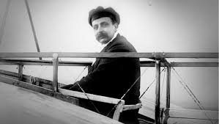
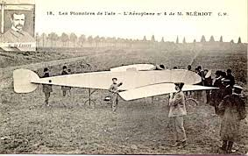
THIS DAY IN AVIATION
November 10
1907 — Louis Blériot introduces what will become the modern configuration of the airplane.
His Beliot VII has an enclosed or covered fuselage, a single set of wings, a tail unit, and a propeller in front of the engine.

Slide 13
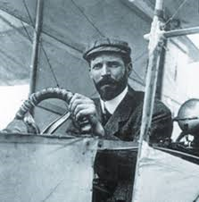
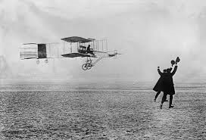
THIS DAY IN AVIATION
November 10
1907 — Henri Farman makes the first flight in Europe of over one minute in his Voisin-Farman I biplane in France.

Slide 14
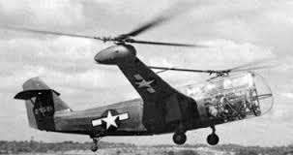
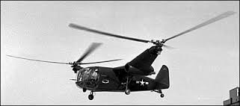
THIS DAY IN AVIATION
November 10
1949 — McDonnell Aircraft Corp. announces demonstration last week of its XHJD-1 “Whirlaway” twin-engine 20-rotor helicopter to the Air Force's Arctic Rescue Helicopter Evaluation Board at St. Louis, Missouri.

Slide 15
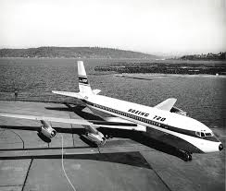
THIS DAY IN AVIATION
November 10
1959 — the first Boeing 720 is rolled out at Renton, Washington.

Slide 16
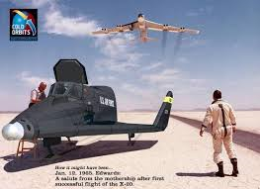
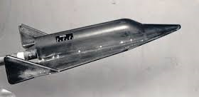
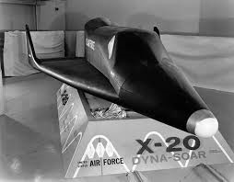
THIS DAY IN AVIATION
November 10
1959 — The United States Air Force gives responsibility for the Dyno-Soar project to Boeing and Martin.

Slide 17
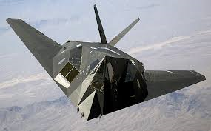
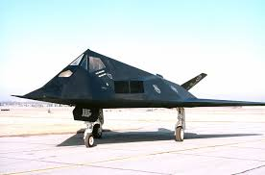
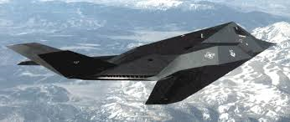
THIS DAY IN AVIATION
November 10
1988 — The United States Air Force reveals existence of the Lockheed F-117A “Nighthawk” stealth fighter.

Slide 18
Questions / Comments

Slide 19
October / November 2015
SUNDAY | MONDAY | TUESDAY | WEDNESDAY | THURSDAY | FRIDAY | SATURDAY
 | 26 Chapter 7 Flight Instruments | 27 Chapter 7 Flight Instruments Altimeter | 28 Chapter 7 Flight Instruments Vertical Speed Indicator | 29 Chapter 7 Flight Instruments Airspeed Indicator | 30 Chapter 7 QUIZ | 31
1 | 2 Chapter 7 Flight Instruments Gyro Systems | 3 Chapter 7 Flight Instruments Magnetic Compass | 4 Chapter 7 Flight Instruments Review and Test | 5 Chapter 8 Flight Manuals | 6 Chapter 8 Flight Manuals Review and Test | 7
8 | 9 Chapter 10 Aircraft Performance | 10 Chapter 10 Aircraft Performance | 11 HOLIDAY | 12 Chapter 10 Aircraft Performance | 13 Chapter 10 Aircraft Performance | 14
15 | 16 Chapter 10 Aircraft Performance | 17 Chapter 10 Aircraft Performance | 18 Chapter 10 Aircraft Performance | 19 Chapter 10 Aircraft Performance | 20 Chapter 10 Aircraft Performance TEST | 21

Slide 20
Questions / Comments

Slide 21
2nd Quarter Requirements (21 Class Meetings – Dec 14)
All students will complete the following:
Take notes - All in class quizzes and tests
Private Pilot Syllabus
Lessons 1 – 6 (Taxiing through Air Traffic Control)
Must pass written with 80%
Successfully complete 3 times on small sim
Successfully complete 1 time on Main sim
Complete ERAU Aviation 101
3 quizzes and 1 test
Student will receive zero points for all incomplete work – NO make-up / extra credit
NOTE: All unfinished Student Pilot and ERAU must be complete prior to starting Private Pilot and last 3 quizzes and test for ERAU.

Slide 22
Questions / Comments

Slide 23
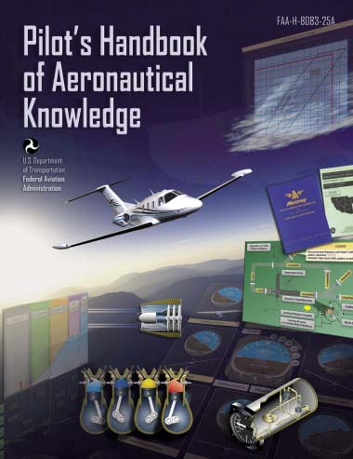
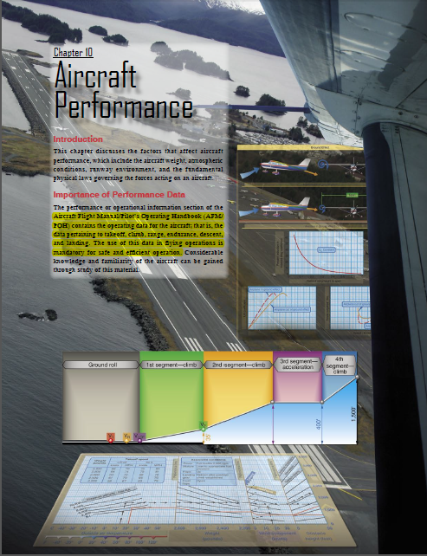
Chapter 10 – Aircraft Performance
FAA – Pilot’s Handbook of Aeronautical Knowledge

Slide 24
Today’s Mission Requirements
Mission:
Describe the factors that affect aircraft performance.
Identify how aircraft weight, atmospheric conditions, runway environment, and the fundamental physical laws governing the forces can affect aircraft performance.
EQ:
Describe the importance of Aeronautical Knowledge for the student pilot learning to fly.

Slide 25
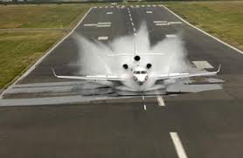
Water on the Runway and Dynamic Hydroplaning
Water on the runways reduces the friction between the tires and the ground, and can reduce braking effectiveness.
This is also true of braking effectiveness when runways are covered in ice.

Slide 26
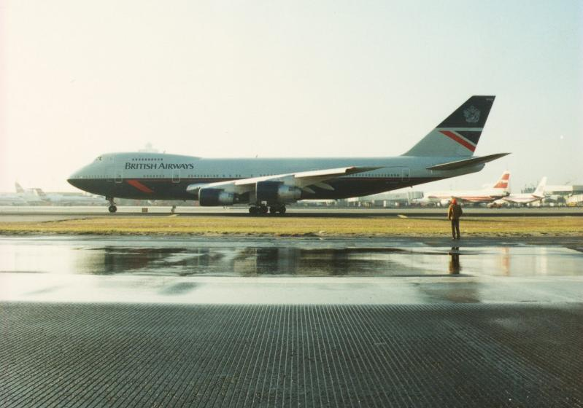
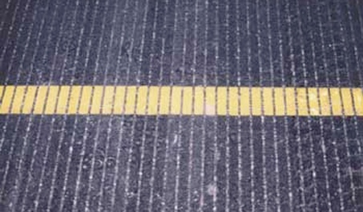
Water on the Runway and Dynamic Hydroplaning
To help minimize dynamic hydroplaning, some runways are grooved to help drain off water; most runways are not.

Slide 27
Water on the Runway and Dynamic Hydroplaning
Landing at higher than recommended touchdown speeds will expose the aircraft to a greater potential for hydroplaning.
And once hydroplaning starts, it can continue well below the minimum initial hydroplaning speed.

Slide 28
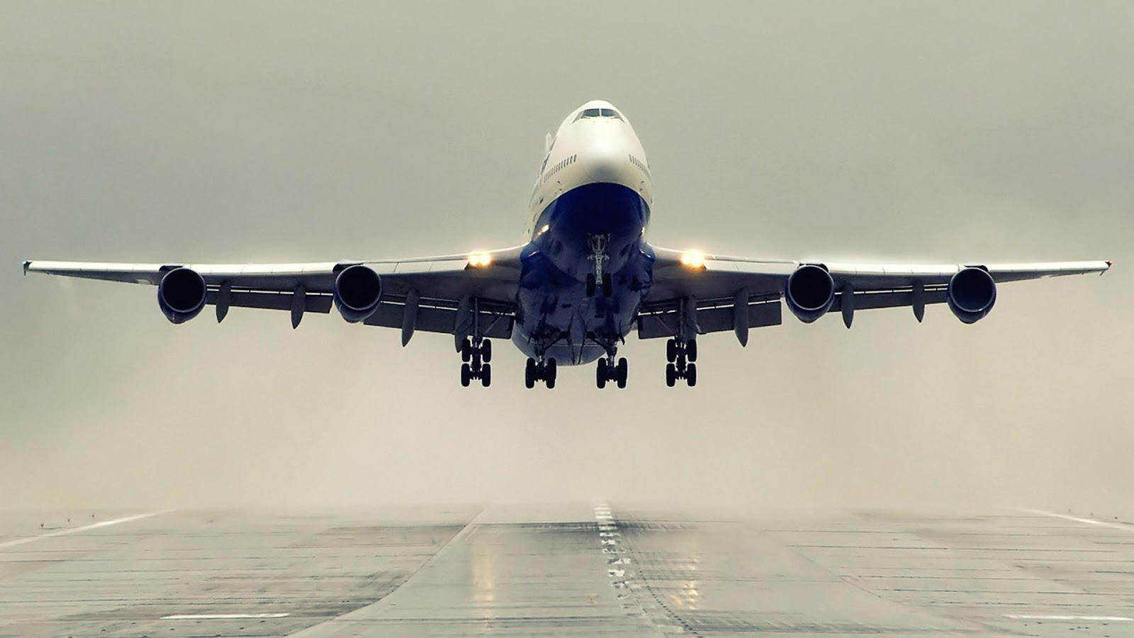
Takeoff Performance
The minimum takeoff distance is of primary interest in the operation of any aircraft.

Slide 29
Takeoff Performance
Depending on the aircraft characteristics, the lift-off speed will be anywhere from 1.05 to 1.25 times the stall speed or minimum control speed.

Slide 30
Takeoff Performance
The effect of gross weight on takeoff distance is significant and proper consideration of this item must be made in predicting the aircraft’s takeoff distance.

Slide 31
Takeoff Performance
1. Higher lift-off speed
2. Greater mass to accelerate
3. Increased retarding force (drag and ground friction)

Slide 32
Takeoff Performance
If the gross weight increases, a greater speed is necessary to produce the greater lift necessary to get the aircraft airborne.

Slide 33
Questions / Comments

Slide 34
2nd Quarter Requirements (21 Class Meetings – Dec 14)
All students will complete the following:
Take notes - All in class quizzes and tests
Private Pilot Syllabus
Lessons 1 – 6 (Taxiing through Air Traffic Control)
Must pass written with 80%
Successfully complete 3 times on small sim
Successfully complete 1 time on Main sim
Complete ERAU Aviation 101
3 quizzes and 1 test
Student will receive zero points for all incomplete work – NO make-up / extra credit
NOTE: All unfinished Student Pilot and ERAU must be complete prior to starting Private Pilot and last 3 quizzes and test for ERAU.

