Slide 1
Warm-Up – 5/19 – 10 minutes
Utilizing your notes and past knowledge answer the following questions:
Under what conditions does low-level wind shear normally occur?
Describe the effects weather event when a layer of warm, moist air moves over a cold surface.
Describe the type of clouds that can produce hazardous weather, such as lightning, hail, tornadoes, gusty winds, and wind shear.
Describe the good rule of thumb is for pilots with respect to flying when thunderstorms are present.
Describe the difference between broken ceiling cloud cover and overcast cloud cover.

Slide 2

Questions / Comments

Slide 3
Warm-Up – 5/19 – 10 minutes
Utilizing your notes and past knowledge answer the following questions:
Under what conditions does low-level wind shear normally occur?
Describe the effects weather event when a layer of warm, moist air moves over a cold surface.
Describe the type of clouds that can produce hazardous weather, such as lightning, hail, tornadoes, gusty winds, and wind shear.
Describe the good rule of thumb is for pilots with respect to flying when thunderstorms are present.
Describe the difference between broken ceiling cloud cover and overcast cloud cover.

Slide 4
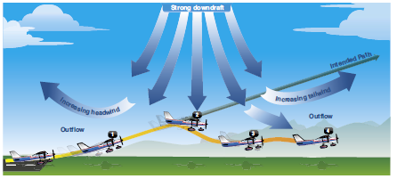
Low Level Wind Shear
While wind shear can occur at any altitude, low-level wind shear is especially hazardous due to the proximity of an aircraft to the ground.
Low-level wind shear is commonly associated with passing frontal systems, thunderstorms, and temperature inversions with strong upper level winds (greater than 25 knots).

Slide 5
Warm-Up – 5/19 – 10 minutes
Utilizing your notes and past knowledge answer the following questions:
Under what conditions does low-level wind shear normally occur?
Describe the effects weather event when a layer of warm, moist air moves over a cold surface.
Describe the type of clouds that can produce hazardous weather, such as lightning, hail, tornadoes, gusty winds, and wind shear.
Describe the good rule of thumb is for pilots with respect to flying when thunderstorms are present.
Describe the difference between broken ceiling cloud cover and overcast cloud cover.

Slide 6
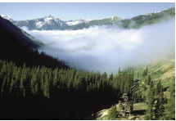
Fog
When a layer of warm, moist air moves over a cold surface, advection fog is likely to occur.
Unlike radiation fog, wind is required to form advection fog.

Slide 7
Warm-Up – 5/19 – 10 minutes
Utilizing your notes and past knowledge answer the following questions:
Under what conditions does low-level wind shear normally occur?
Describe the effects weather event when a layer of warm, moist air moves over a cold surface.
Describe the type of clouds that can produce hazardous weather, such as lightning, hail, tornadoes, gusty winds, and wind shear.
Describe the good rule of thumb is for pilots with respect to flying when thunderstorms are present.
Describe the difference between broken ceiling cloud cover and overcast cloud cover.

Slide 8
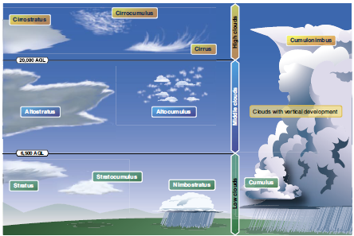
Clouds
Cumulonimbus clouds contain large amounts of moisture and unstable air, and usually produce hazardous weather phenomena, such as lightning, hail, tornadoes, gusty winds, and wind shear.

Slide 9
Warm-Up – 5/19 – 10 minutes
Utilizing your notes and past knowledge answer the following questions:
Under what conditions does low-level wind shear normally occur?
Describe the effects weather event when a layer of warm, moist air moves over a cold surface.
Describe the type of clouds that can produce hazardous weather, such as lightning, hail, tornadoes, gusty winds, and wind shear.
Describe the good rule of thumb is for pilots with respect to flying when thunderstorms are present.
Describe the difference between broken ceiling cloud cover and overcast cloud cover.

Slide 10
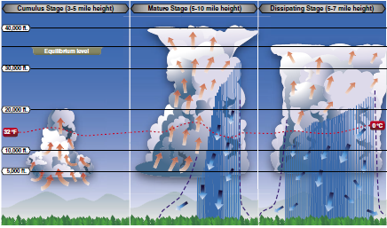
Clouds
It is impossible to fly over thunderstorms in light aircraft.
A good rule of thumb is to circumnavigate thunderstorms identified as severe or giving an intense radar echo by at least 20 nautical miles (NM) since hail may fall for miles outside of the clouds.

Slide 11
Warm-Up – 5/19 – 10 minutes
Utilizing your notes and past knowledge answer the following questions:
Under what conditions does low-level wind shear normally occur?
Describe the effects weather event when a layer of warm, moist air moves over a cold surface.
Describe the type of clouds that can produce hazardous weather, such as lightning, hail, tornadoes, gusty winds, and wind shear.
Describe the good rule of thumb is for pilots with respect to flying when thunderstorms are present.
Describe the difference between broken ceiling cloud cover and overcast cloud cover.

Slide 12

Ceiling
For aviation purposes, a ceiling is the lowest layer of clouds reported as being broken or overcast, as broken when five-eighths to seven-eighths of the sky is covered with clouds.
Overcast means the entire sky is covered with clouds.

Slide 13
Questions / Comments

Slide 14


THIS DAY IN AVIATION
May 19
1919 — M/Sgt R. W. Bottriell made first free back-type parachute jump.

Slide 15
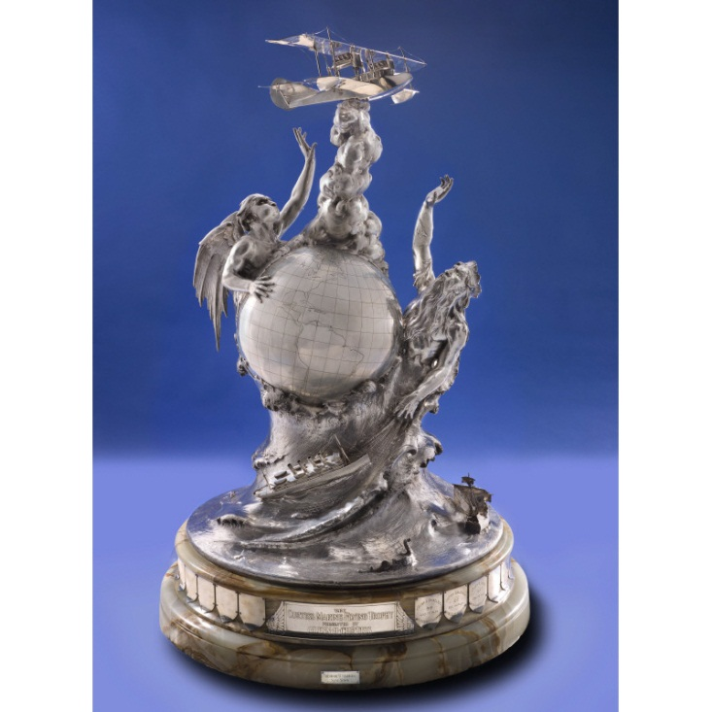
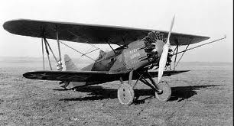
THIS DAY IN AVIATION
May 19
1928 — Major Charles A. Lutz wins the Curtiss Marine Trophy Race at Washington, D.C., flying Curtiss “Hawk,” Curtiss D-12 engine, over 100 mile course at 157.6 mph.

Slide 16
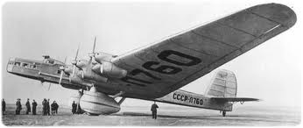
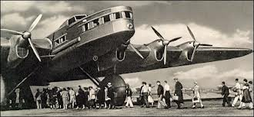
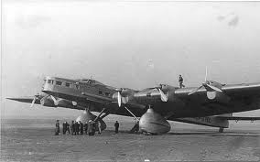
THIS DAY IN AVIATION
May 19
1934 — The first flight of the Russian Tupolev Ant-20 “Maxim Gorki,” at this time the largest aircraft in the world.
Powered by eight engines, capable of carrying 80 passengers, it is used mainly as a mobile propaganda office.

Slide 17
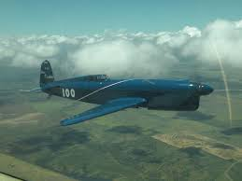
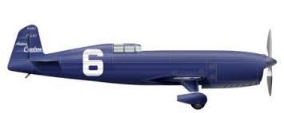
THIS DAY IN AVIATION
May 19
1935 — Third annual Deutsch de la Meurthe Cup Race won by Raymond Delmotte at 275.8 mph. (Caudron C.460, Renault engine.)

Slide 18
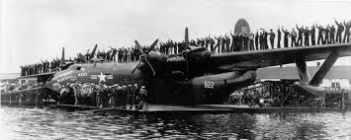
THIS DAY IN AVIATION
May 19
1949 — The United States Navy flying boat “Marshall Mars” lands after flying from Alameda, near San Francisco, with a record 301 passengers.

Slide 19
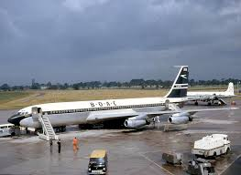
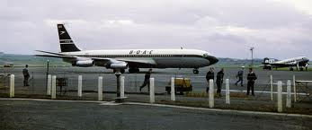
THIS DAY IN AVIATION
May 19
1959 — The first Boeing 707-436 “Intercontinental,” destined for British Overseas Airways Corporation (BOAC) makes its maiden flight, landing at Boeing Field, Seattle, after 1 hour, 11 minutes in the air.
BOAC ordered 15 “Intercontinentals” in 1956.

Slide 20
Questions / Comments

Slide 21

May 2014
Sunday | Monday | Tuesday | Wednesday | Thursday | Friday | Saturday
 |  |  |  | 1 Chapter 10 Aircraft Performance | 2 | 3
4 | 5 Chapter 10 Aircraft Performance | 6 | 7 Chapter 10 Aircraft Performance | 8 | 9 Patriot’s Point Field Trip | 10
11 | 12 | 13 Chapter 11 | 14 | 15 Chapter 11 | 16 | 17
18 | 19 Chapter 12 | 20 | 21 Chapter 14 | 22 Seniors Last Day | 23 Chapter 15 | 24
25 | 26 Memorial Day NO SCHOOL | 27 | 28 Chapter 16 | 29 | 30 | 31

Slide 22
Questions / Comments

Slide 23

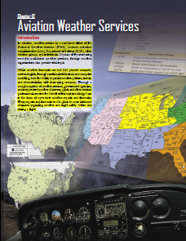
Chapter 12– Aviation Weather Services
FAA – Pilot’s Handbook of Aeronautical Knowledge

Slide 24
Today’s Mission Requirements
Mission:
Describe the combined effort associated with Aviation Weather Services.
Describe how meteorologists can predict weather patterns, trends and characteristics of weather systems.
Identify the various reports available and utilized by pilots.
Describe the basic information provided on reports that enable pilots to make informed decisions regarding weather safety before and during flight.
EQ:
  Describe the importance of Aeronautical Knowledge for the student pilot learning to fly.

Slide 25
Questions / Comments

Slide 26


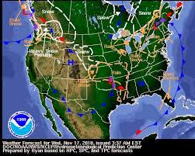

Introduction
In aviation, weather service is a combined effort of the National Weather Service (NWS), Federal Aviation Administration (FAA), Department of Defense (DOD), other aviation groups, and individuals.

Slide 27
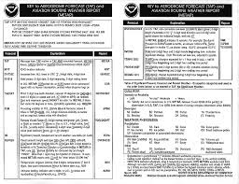
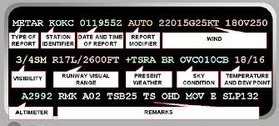
Introduction
Aviation weather services reports and forecasts enable pilots to make informed decisions regarding weather and flight safety before and during a flight.

Slide 28
Weather Briefings
Prior to every flight, pilots should gather all information vital to the nature of the flight.
This includes an appropriate weather briefing obtained from a specialist at a FSS, AFSS, or NWS.
Other helpful information is whether the flight is visual flight rules (VFR) or IFR, aircraft identification and type, departure point, estimated time of departure (ETD), flight altitude, route of flight, destination, and estimated time en route (ETE).

Slide 29
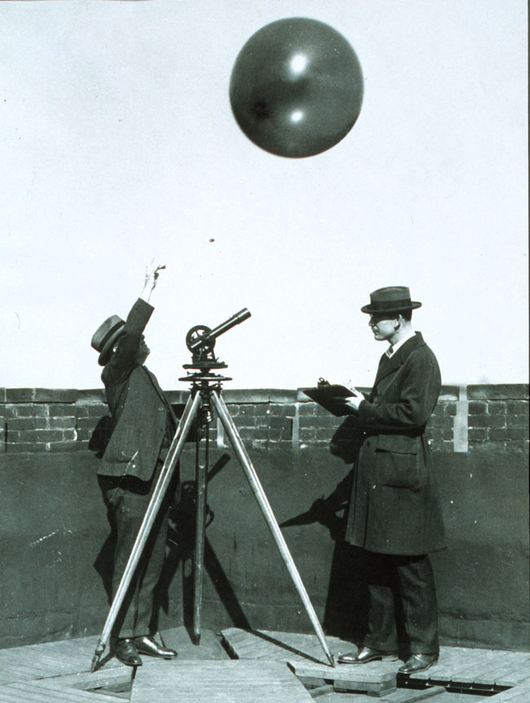
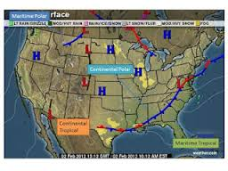
Observations
There are four types of weather observations: surface, upper air, radar, and satellite.

Slide 30
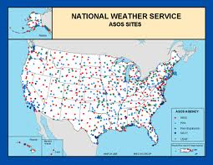
Surface Aviation Weather Observations
Surface aviation weather observations (METARs) are a compilation of elements of the current weather at individual ground stations across the United States.
Provide continuous up-to-date weather information.
Automated weather sources, such as the Automated Weather Observing Systems (AWOS), Automated Surface Observing Systems (ASOS).

Slide 31

Surface Aviation Weather Observations
Surface observations provide local weather conditions and other relevant information for a radius of five miles of a specific airport.

Slide 32
Surface Aviation Weather Observations
This information includes the type of report, station identifier, date and time, modifier (as required), wind, visibility, runway visual range (RVR), weather phenomena, sky condition, temperature/dew point, altimeter reading, and applicable remarks.

Slide 33
Surface Aviation Weather Observations
The information gathered for the surface observation may be from a person, an automated station, or an automated station that is updated or enhanced by a weather observer.

Slide 34
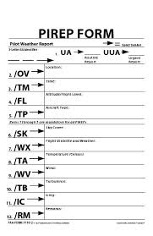
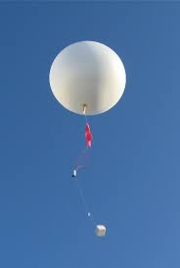
Upper Air Observations
Observations of upper air weather are more challenging than surface observations.
There are only two methods that upper air weather can be observed:
  radiosonde observations
  pilot weather reports (PIREPs).

Slide 35
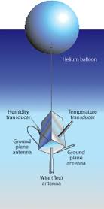
Upper Air Observations
A radiosonde is a small cubic instrumentation package which is suspended below a six foot hydrogen or helium filled balloon.

Slide 36
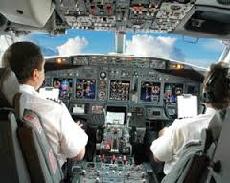
Upper Air Observations
Pilots also provide vital information regarding upper air weather observations and remain the only real-time source of information regarding turbulence, icing, and cloud heights.
This information is gathered and filed by pilots in flight.

Slide 37
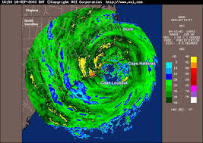
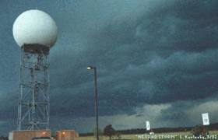
RADAR Observations
NEXRAD radar, commonly called Doppler radar, provides in-depth observations that inform surrounding communities of impending weather.
FAA terminal doppler weather radar (TDWR), installed at some major airports around the country, also aids in providing severe weather alerts and warnings to ATC.

Slide 38
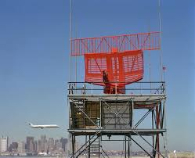
RADAR Observations
The third type of radar commonly used in the detection of precipitation is the FAA airport surveillance radar.
This radar is used to detect aircraft, but it also detects the location and intensity of precipitation which is used to route aircraft traffic around severe weather in an airport environment.

Slide 39

RADAR Observations
Airborne radar is equipment carried by aircraft to locate weather disturbances. permitting both penetration of heavy precipitation, required for determining the extent of thunderstorms.

Slide 40
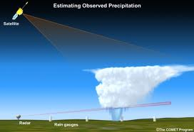
Satellite Observations
Satellite weather provides the pilot with a powerful resource for enhanced situational awareness at any time.
Due to continuous satellite broadcasts, pilots can obtain a weather briefing by looking at a display screen.

Slide 41
Significant Meteorological Information (SIGMET)
SIGMETs are weather advisories issued concerning weather significant to the safety of all aircraft.

Slide 42
Significant Meteorological Information (SIGMET)
SIGMET advisories can cover an area of at least 3,000 square miles and provide data regarding severe and extreme turbulence, severe icing, and widespread dust or sandstorms that reduce visibility to less than three miles.

Slide 43
Airmen’s Meteorological Information (AIRMET)
AIRMETs are weather advisories issued only to amend the area forecast concerning weather phenomena which are of operational interest to all aircraft and potentially hazardous to aircraft having limited capability because of lack of equipment, instrumentation, or pilot qualifications.

Slide 44
Airmen’s Meteorological Information (AIRMET)
AIRMETs concern weather of less severity than that covered by SIGMETs or convective SIGMETs.

Slide 45
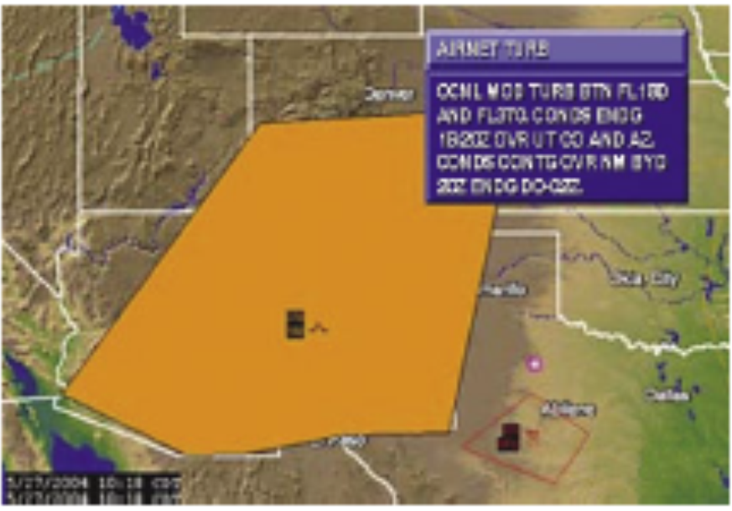
Airmen’s Meteorological Information (AIRMET)
Convective SIGMET's are issued for SEVERE WEATHER. Severe Thunderstorms, etc.
Pilot's DO NOT WANT TO FLY through areas of Convective SIGMET'S.

Slide 46
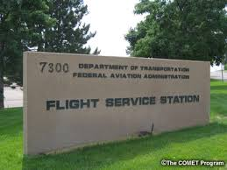

Automated Flight Service Station (AFSS)
A preflight weather briefing from an AFSS can be obtained 24 hours a day by calling 1-800-WX BRIEF from almost anywhere in the United States
The AFSS also provides inflight weather briefing services, as well as scheduled and unscheduled weather broadcasts.

Slide 47
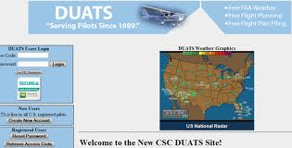
Direct User Access Terminal Service (DUATS)
The Direct User Access Terminal Service (DUATS), which is funded by the FAA, allows any pilot with a current medical certificate to access weather information and file a flight plan via computer.

Slide 48
Hazardous Inflight Weather Advisory (HIWAS)
Hazardous Inflight Weather Advisory (HIWAS) is a national program for broadcasting hazardous weather information continuously over selected navigation aids (NAVAIDs).
NAVAIDs that have HIWAS capability are depicted on sectional charts with an “H” in the upper right corner of the identification box.

Slide 49

Aviation Routine Weather Report (METAR)
A METAR is an observation of current surface weather reported in a standard international format.
METARS are issued hourly unless significant weather changes have occurred.

Slide 50
Aviation Routine Weather Report (METAR)
Example:
METAR KGGG 161753Z AUTO 14021G26 3/4SM
+TSRA BR BKN008 OVC012CB 18/17 A2970 RMK PRESFR
A typical METAR report contains the following information in sequential order:
1. Type of report—there are two types of METAR reports.
  routine transmitted every hour.
  special report given at any time to update
2. Station identifier —a four-letter code as established by the International Civil Aviation Organization (ICAO).

Slide 51
Aviation Routine Weather Report (METAR)
3. Date and time of report —depicted in a six-digit group (161753Z).
4. Modifier —denotes that the METAR came from an automated source or that the report was corrected. “COR” is used,
Wind — reported with six digits. The first three digits indicate the direction the true wind is blowing in tens of degrees. If the wind is variable, it is reported as “VRB.” The last two digits indicate the speed of the wind in knots winds are gusting, the letter “G” follows the wind speed (G26). After the letter “G,” the peak gust recorded is provided.

Slide 52
Aviation Routine Weather Report (METAR)
Visibility —the prevailing visibility (¾ SM) is reported in statute miles as denoted by the letters “SM.” It is reported in both miles and fractions of miles. At times, runway visual range (RVR) is the distance a pilot can see down the runway in a moving aircraft.
When RVR is reported as R17L/1400FT, it translates to a visual range of 1,400 feet on runway 17 left.
Weather —can be broken down into two different categories: qualifiers and weather phenomenon

Slide 53
Aviation Routine Weather Report (METAR)
Sky condition —a three-digit number in hundreds of feet AGL.
Temperature and dew point
Altimeter setting
Remarks—begins with the letters “RMK.”

Slide 54
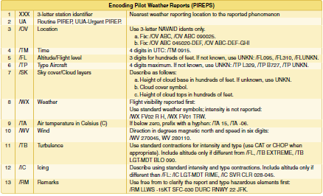
Pilot Weather Report (PIREPs)
PIREPs provide valuable information regarding the conditions as they actually exist in the air, which cannot be gathered from any other source.

Slide 55
Pilot Weather Report (PIREPs)
Pilots can confirm
  height of bases
  tops of clouds,
  locations of wind shear and turbulence
  location of inflight icing.
When unexpected weather conditions are encountered, pilots are encouraged to make a report to a FSS or ATC.

Slide 56
Terminal Aerodrome Forecasts (TAF)
A TAF is a report established for the five statute mile radius around an airport.
TAF reports are usually given for larger airports.
TAF is valid for a 30-hour time period, and is updated four times a day at 0000Z, 0600Z, 1200Z, and 1800Z.
The TAF utilizes the same descriptors and abbreviations as used in the METAR report.

Slide 57
Terminal Aerodrome Forecasts (TAF)
1. Type of report—
2. ICAO station identifier—
3. Date and time of origin—
4. Valid period date and time—
5. Forecast wind—
6. Forecast visibility—
7. Forecast significant weather—
8. Forecast sky condition—

Slide 58
Terminal Aerodrome Forecasts (TAF)
9. Forecast change group—from (FM), becoming (BECMG), and temporary (TEMPO). “FM” is used when a rapid and significant change, usually within an hour, is expected. “BECMG” is used when a gradual change in the weather is expected over a period of no more than 2 hours. “TEMPO” is used for temporary fluctuations of weather, expected to last less than one hour.
10. Probability forecast—

Slide 59
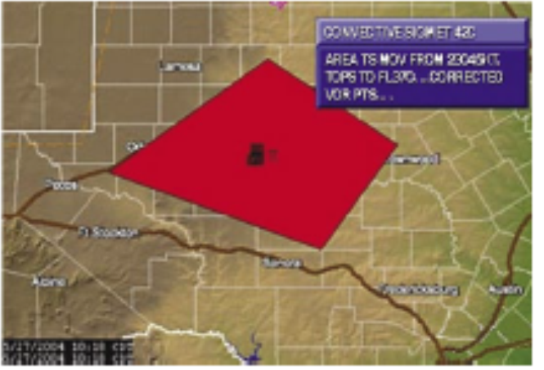
SIGMET
SIGMETs (WSs) are inflight advisories concerning non-convective weather that is potentially hazardous to all aircraft.

Slide 60
Convective Significant Meteorological Information (WST)
Convective SIGMETs are issued for severe thunderstorms with surface winds greater than 50 knots, hail at the surface greater than or equal to ¾ inch in diameter, or tornadoes.
They are also issued to advise pilots of embedded thunderstorms, lines of thunderstorms, or thunderstorms with heavy precipitation

Slide 61

Winds and Temperature Aloft Forecast (FD)
Winds and temperatures aloft forecasts (FD) provide wind and temperature forecasts for specific locations
Wind direction is always in reference to true north and wind speed is given in knots.

Slide 62
Winds and Temperature Aloft Forecast (FD)
The temperature is given in degrees Celsius.
When the forecast wind speed is calm or less than 5 knots, the data group is coded “9900,” which means light and variable.

Slide 63
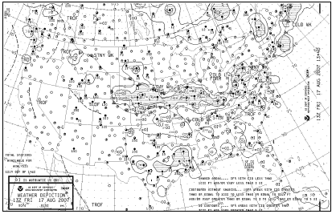
Weather Depiction Chart
A weather depiction chart details surface conditions as derived from METAR and other surface observations.

Slide 64
Weather Depiction Chart
Prepared and transmitted by computer every 3 hours beginning at 0100Z time, and is valid at the time of the plotted data.
It is designed to be used for flight planning by giving an overall picture of the weather across the United States.

Slide 65
Weather Depiction Chart
Provides a graphic display of IFR, VFR, and MVFR (marginal VFR) weather.
Areas of IFR conditions (ceilings less than 1,000 feet and visibility less than three miles) are shown by a hatched area outlined by a smooth line.

Slide 66
Weather Depiction Chart
MVFR regions (ceilings 1,000 to 3,000 feet, visibility 3 to 5 miles) are shown by a nonhatched area outlined by a smooth line.
Areas of VFR (no ceiling or ceiling greater than 3,000 feet and visibility greater than five miles) are not outlined.

Slide 67
Chapter Summary
While no weather forecast is guaranteed to be 100 percent accurate, pilots have access to a myriad of weather information on which to base flight decisions.

Slide 68
Chapter Summary
Weather products available for preflight planning to en route information received over the radio or via satellite link provide the pilot with the most accurate and up-to-date information available.
Each report provides a piece of the weather puzzle.

Slide 69
Chapter Summary
Pilots use several reports to get an overall picture and gain an understanding of the weather that will affect the safe completion of a flight.

Slide 70
Questions / Comments

