Slide 1
Warm-Up – 5/13 – 10 minutes
Utilizing your notes and past knowledge answer the following questions:
Describe the purpose of performance charts.
What does the takeoff chart take into consideration?
What a factor that needs to be taken into consideration with landing distance and weight of an aircraft?
Describe where we would find the maximum crosswind component.
Describe the two speeds which must be taken into account during landing.

Slide 2

Questions / Comments

Slide 3
Warm-Up – 5/13 – 10 minutes
Utilizing your notes and past knowledge answer the following questions:
Describe the purpose of performance charts.
What does the takeoff chart take into consideration?
What a factor that needs to be taken into consideration with landing distance and weight of an aircraft?
Describe where we would find the maximum crosswind component.
Describe the two speeds which must be taken into account during landing.

Slide 4
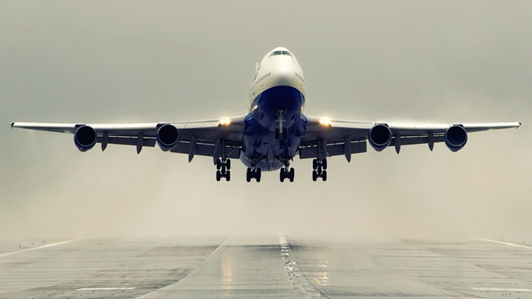
Performance Charts
Performance charts allow a pilot to predict the takeoff, climb, cruise, and landing performance of an aircraft.
These charts, provided by the manufacturer, are included in the AFM/POH.

Slide 5
Warm-Up – 5/13 – 10 minutes
Utilizing your notes and past knowledge answer the following questions:
Describe the purpose of performance charts.
What does the takeoff chart take into consideration?
What a factor that needs to be taken into consideration with landing distance and weight of an aircraft?
Describe where we would find the maximum crosswind component.
Describe the two speeds which must be taken into account during landing.

Slide 6
Takeoff Charts
This chart is an example of a combined takeoff distance graph. It takes into consideration pressure altitude, temperature, weight, wind, and obstacles all on one chart.
Sample Problem
Pressure Altitude........2,000 feet
OAT...............................22 °C
Takeoff Weight............2,600 lbs
Headwind....................6 knots
Obstacle Height.........50 ft obstacle

Slide 7
Warm-Up – 5/13 – 10 minutes
Utilizing your notes and past knowledge answer the following questions:
Describe the purpose of performance charts.
What does the takeoff chart take into consideration?
What a factor that needs to be taken into consideration with landing distance and weight of an aircraft?
Describe where we would find the maximum crosswind component.
Describe the two speeds which must be taken into account during landing.

Slide 8

Landing Charts
It is necessary to compensate for differences in density altitude, weight of the airplane, and headwinds.
Remember, when calculating landing distance that the landing weight will not be the same as the takeoff weight.
The weight must be recalculated to compensate for the fuel that was used during the flight.

Slide 9
Warm-Up – 5/13 – 10 minutes
Utilizing your notes and past knowledge answer the following questions:
Describe the purpose of performance charts.
What does the takeoff chart take into consideration?
What a factor that needs to be taken into consideration with landing distance and weight of an aircraft?
Describe where we would find the maximum crosswind component.
Describe the two speeds which must be taken into account during landing.

Slide 10
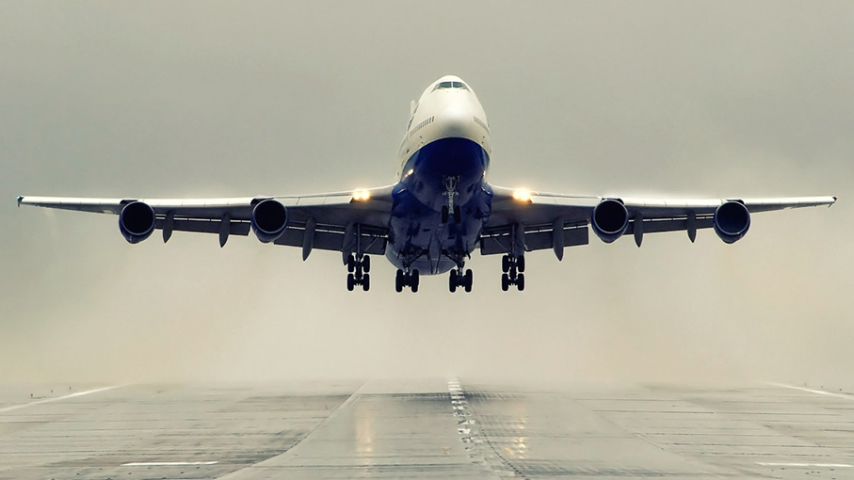
Crosswind and Headwind Component
The maximum demonstrated crosswind component is published in the AFM/POH.
The crosswind and headwind component chart allows for figuring the headwind and crosswind component for any given wind direction and velocity.

Slide 11
Warm-Up – 5/13 – 10 minutes
Utilizing your notes and past knowledge answer the following questions:
Describe the purpose of performance charts.
What does the takeoff chart take into consideration?
What a factor that needs to be taken into consideration with landing distance and weight of an aircraft?
Describe where we would find the maximum crosswind component.
Describe the two speeds which must be taken into account during landing.

Slide 12

Landing Performance
As in the takeoff planning, certain speeds must be considered during landing.
These speeds are shown below.
  VSO—stalling speed or the minimum steady flight speed in the landing configuration.
  VREF—1.3 times the stalling speed in the landing configuration.
  This is the required speed at the 50-foot height above the threshold end of the runway.

Slide 13
Questions / Comments

Slide 14
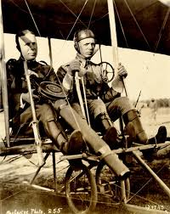
THIS DAY IN AVIATION
May 13
1911 — Lieutenants H. H. Arnold and T. D. Milling become first Wright School Army pilots.

Slide 15
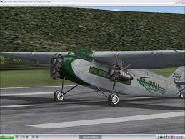
THIS DAY IN AVIATION
May 13
1927 — Colonial Air Transport offers a sightseeing trip from Teterboro, New Jersey, around New York City for just $8, less than the price of a similar trip in a taxi.

Slide 16
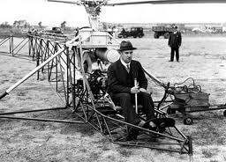
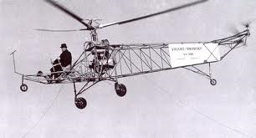
THIS DAY IN AVIATION
May 13
1940 — The first successful free flight of a true helicopter is made by Igor I. Sikorsky's single-rotor VS-300.

Slide 17
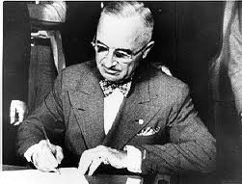
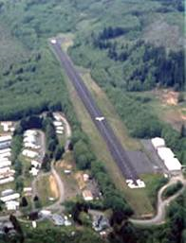
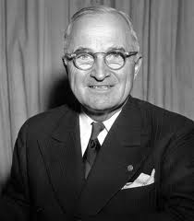
THIS DAY IN AVIATION
May 13
1946 — Federal Aid Airport Bill signed by President Truman.

Slide 18
Questions / Comments

Slide 19

May 2014
Sunday | Monday | Tuesday | Wednesday | Thursday | Friday | Saturday
 |  |  |  | 1 Chapter 10 Aircraft Performance | 2 | 3
4 | 5 Chapter 10 Aircraft Performance | 6 | 7 Chapter 10 Aircraft Performance | 8 | 9 Patriot’s Point Field Trip | 10
11 | 12 | 13 Chapter 11 | 14 | 15 Chapter 12/13 | 16 | 17
18 | 19 Chapter 14/15 | 20 | 21 Chapter 16/17 | 22 Seniors Last Day | 23 Flightline Friday | 24
25 | 26 Memorial Day NO SCHOOL | 27 | 28 | 29 | 30 | 31

Slide 20
Questions / Comments

Slide 21

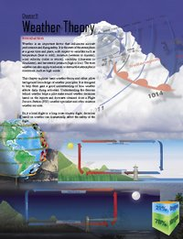
Chapter 11– Weather Theory
FAA – Pilot’s Handbook of Aeronautical Knowledge

Slide 22
Today’s Mission Requirements
Mission:
Describe basic weather theory and weather principles.
Describe how weather affects daily flying activities.
Describe the theories behind weather.
Describe the Flight Service Station (FSS) weather specialist and other aviation weather services.
EQ:
  Describe the importance of Aeronautical Knowledge for the student pilot learning to fly.

Slide 23
Introduction
Weather is an important factor that influences aircraft performance and flying safety.

Slide 24
Introduction
It is the state of the atmosphere at a given time and place, with respect to variables such as temperature (heat or cold), moisture (wetness or dryness), wind velocity (calm or storm), visibility (clearness or cloudiness), and barometric pressure (high or low).

Slide 25
Introduction
The term weather can also apply to adverse or destructive atmospheric conditions, such as high winds.

Slide 26
Introduction
Be it a local flight or a long cross-country flight, decisions based on weather can dramatically affect the safety of the flight.

Slide 27
Atmosphere
The atmosphere is a blanket of air made up of a mixture of gases that surrounds the Earth and reaches almost 350 miles from the surface of the Earth.
This mixture is in constant motion.

Slide 28
Measurement of Atmosphere Pressure
Atmospheric pressure is typically measured in inches of mercury ("Hg) by a mercurial barometer.
The barometer measures the height of a column of mercury inside a glass tube.

Slide 29
Measurement of Atmosphere Pressure
A section of the mercury is exposed to the pressure of the atmosphere, which exerts a force on the mercury.
An increase in pressure forces the mercury to rise inside the tube.
When the pressure drops, mercury drains out of the tube, decreasing the height of the column.

Slide 30
Measurement of Atmosphere Pressure
The International Standard Atmosphere (ISA) has been established standard sea level pressure is defined as 29.92 "Hg and a standard temperature of 59 °F (15 °C).

Slide 31
Measurement of Atmosphere Pressure
By tracking barometric pressure trends across a large area, weather forecasters can more accurately predict movement of pressure systems and the associated weather.
For example, tracking a pattern of rising pressure at a single weather station generally indicates the approach of fair weather.

Slide 32
Altitude and Atmospheric Pressure
As altitude increases, atmospheric pressure decreases.
As pressure decreases, the air becomes less dense or “thinner.”

Slide 33
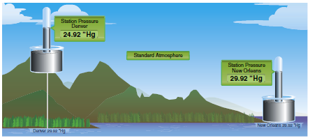
Altitude and Atmospheric Pressure
This is the equivalent of being at a higher altitude and is referred to as density altitude (DA).

Slide 34
Altitude and Atmospheric Pressure
As pressure decreases, DA increases and has a pronounced effect on aircraft performance.

Slide 35
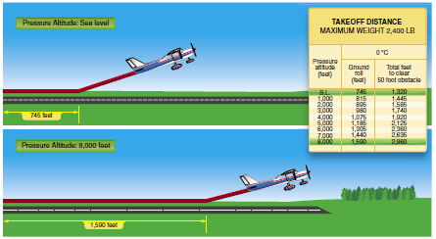
Altitude and Flight
When an aircraft takes off, lift must be developed by the flow of air around the wings.
If the air is thin, more speed is required to obtain enough lift for takeoff; therefore, the ground run is longer.
An aircraft that requires 745 feet of ground run at sea level requires more than double that at a pressure altitude of 8,000 feet.

Slide 36
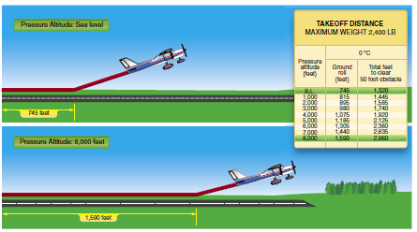

Slide 37
Altitude and Flight
It is also true that at higher altitudes, due to the decreased density of the air, aircraft engines and propellers are less efficient.
This leads to reduced rates of climb and a greater ground run for obstacle clearance.

Slide 38
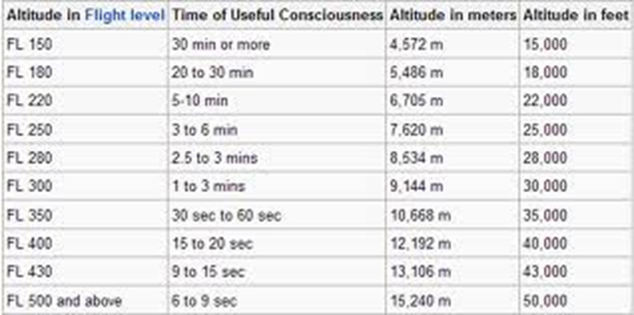
Altitude and the Human Body
At sea level, atmospheric pressure is great enough to support normal growth, activity, and life.
At 18,000 feet, the partial pressure of oxygen is reduced and adversely affects the normal activities and functions of the human body.

Slide 40
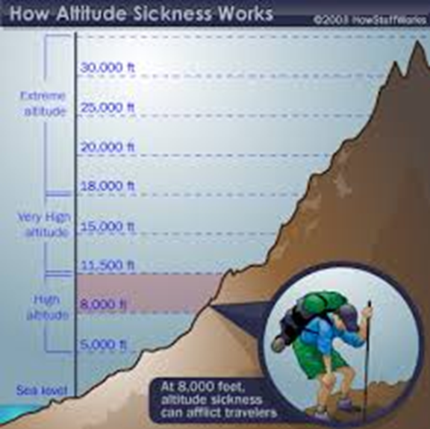
Altitude and the Human Body
The reactions of the average person become impaired at an altitude of about 10,000 feet, but for some people impairment can occur at an altitude as low as 5,000 feet.
The physiological reactions to hypoxia or oxygen deprivation are insidious and affect people in different ways.

Slide 41
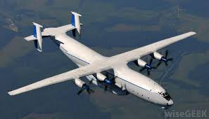
Altitude and the Human Body
These symptoms range from mild disorientation to total incapacitation, depending on body tolerance and altitude.
Supplemental oxygen or cabin pressurization systems help pilots fly at higher altitudes and overcome the effects of oxygen deprivation.

Slide 42
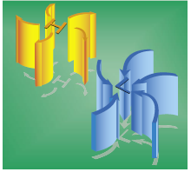
Wind and Currents
Air flows from areas of high pressure into areas of low pressure because air always seeks out lower pressure.

Slide 43
Wind Patterns
The flow of air from areas of high to low pressure is deflected to the right and produces a clockwise circulation around an area of high pressure.
The opposite is true of low-pressure areas; the air flows toward a low and is deflected to create a counterclockwise or cyclonic circulation.

Slide 44
Wind Patterns
High pressure systems are generally areas of dry, stable, descending air.
Good weather is typically associated with high pressure systems for this reason.
Conversely, air flows into a low pressure area to replace rising air.

Slide 45
Wind Patterns
This air tends to be unstable, and usually brings increasing cloudiness and precipitation.
Thus, bad weather is commonly associated with areas of low pressure.
A good understanding of high and low pressure wind patterns can be of great help when planning a flight, because a pilot can take advantage of beneficial tailwinds.

Slide 46
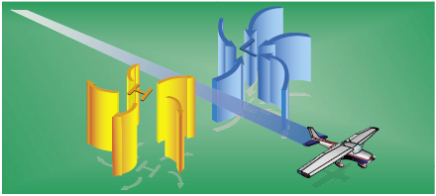
Wind Patterns
When planning a flight from west to east, favorable winds would be encountered along the northern side of a high pressure system or the southern side of a low pressure system.

Slide 47
Wind Patterns
On the return flight, the most favorable winds would be along the southern side of the same high pressure system or the northern side of a low pressure system.

Slide 48
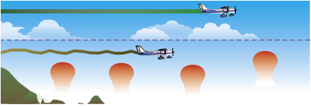
Convective Currents
Different surfaces radiate heat in varying amounts.

Slide 49
Convective Currents
Plowed ground, rocks, sand, and barren land give off a large amount of heat; water, trees, and other areas of vegetation tend to absorb and retain heat.

Slide 50
Convective Currents
The resulting uneven heating of the air creates small areas of local circulation called convective currents.

Slide 51
Convective Currents
Convective currents cause the bumpy, turbulent air sometimes experienced when flying at lower altitudes during warmer weather.

Slide 52
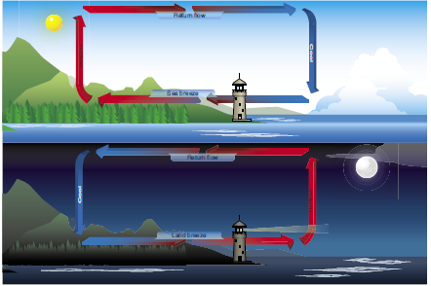
Convective Currents
Convective currents can occur anywhere there is an uneven heating of the Earth’s surface.

Slide 53
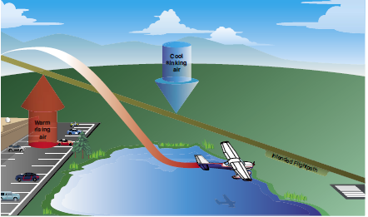
Convective Currents
Convective currents close to the ground can affect a pilot’s ability to control the aircraft.

Slide 54
Convective Currents
For example, on final approach, the rising air from terrain devoid of vegetation sometimes produces a ballooning effect that can cause a pilot to overshoot the intended landing spot.

Slide 55
Convective Currents
An approach over a large body of water or an area of thick vegetation tends to create a sinking effect that can cause an unwary pilot to land short of the intended landing spot.

Slide 56
Questions / Comments

Slide 57
Obstructions on Wind
Obstructions on the ground affect the flow of wind and can be an unseen danger.
Ground topography and large buildings can break up the flow of the wind and create wind gusts that change rapidly in direction and speed.

Slide 58
Obstructions on Wind
These obstructions range from manmade structures like hangars to large natural obstructions, such as mountains, bluffs, or canyons.
Tall trees can block the wind as well.

Slide 59
Low Level Wind Shear
Wind shear is a sudden, drastic change in wind speed and/or direction over a very small area.
Wind shear can subject an aircraft to violent updrafts and downdrafts, as well as abrupt changes to the horizontal movement of the aircraft.

Slide 60
Low Level Wind Shear
While wind shear can occur at any altitude, low-level wind shear is especially hazardous due to the proximity of an aircraft to the ground.
Low-level wind shear is commonly associated with passing frontal systems, thunderstorms, and temperature inversions with strong upper level winds (greater than 25 knots).

Slide 61
Low Level Wind Shear
It is important to remember that wind shear can affect any flight and any pilot at any altitude.
While wind shear may be reported, it often remains undetected and is a silent danger to aviation.
Always be alert to the possibility of wind shear, especially when flying in and around thunderstorms and frontal systems.

Slide 62
Temperature/Dew Point Relationship
When the temperature of the air is reduced to the dew point, the air is completely saturated and moisture begins to condense out of the air in the form of fog, dew, frost, clouds, rain, hail, or snow.

Slide 63
Methods by Which Air Reaches the Saturation Point
If air reaches the saturation point while temperature and dew point are close together, it is highly likely that fog, low clouds, and precipitation will form.

Slide 64
Fog
Fog is a cloud that begins within 50 feet of the surface.
It typically occurs when the temperature of air near the ground is cooled to the air’s dew point.
On clear nights, with relatively little to no wind present, radiation fog may develop.

Slide 65
Fog
As the sun rises and the temperature increases, radiation fog lifts and eventually burns off.
Any increase in wind also speeds the dissipation of radiation fog.

Slide 66
Fog
When a layer of warm, moist air moves over a cold surface, advection fog is likely to occur.
Unlike radiation fog, wind is required to form advection fog.

Slide 67
Fog
Advection fog is common in coastal areas where sea breezes can blow the air over cooler landmasses.

Slide 68
Clouds
Clouds are visible indicators and are often indicative of future weather.
Cloud type is determined by its height, shape, and behavior.

Slide 69
Clouds
Low clouds are those that form near the Earth’s surface and extend up to 6,500 feet AGL.
Low clouds are stratus, stratocumulus, and nimbostratus.

Slide 70
Clouds
Fog is also classified as a type of low cloud formation.
Clouds in this family create low ceilings, hamper visibility, and can change rapidly.

Slide 71
Clouds
Middle clouds form around 6,500 feet AGL and extend up to 20,000 feet AGL.
Typical middle-level clouds include altostratus and altocumulus.

Slide 72
Clouds
Altostratus clouds can produce turbulence and may contain moderate icing.
Altocumulus clouds, which usually form when altostratus clouds are breaking apart, also may contain light turbulence and icing.

Slide 73
Clouds
High clouds form above 20,000 feet AGL and usually form only in stable air.
High level clouds are cirrus, cirrostratus, and cirrocumulus.

Slide 74
Clouds
Clouds with extensive vertical development are cumulus clouds that build vertically into towering cumulus or cumulonimbus clouds.
The bases of these clouds form in the low to middle cloud base region but can extend into high altitude cloud levels.

Slide 75
Clouds
Towering cumulus clouds indicate areas of instability in the atmosphere, and the air around and inside them is turbulent.
These types of clouds often develop into cumulonimbus clouds or thunderstorms.

Slide 76
Clouds
Cumulonimbus clouds contain large amounts of moisture and unstable air, and usually produce hazardous weather phenomena, such as lightning, hail, tornadoes, gusty winds, and wind shear.

Slide 77
Clouds
These extensive vertical clouds can be obscured by other cloud formations and are not always visible from the ground or while in flight.
When this happens, these clouds are said to be embedded, hence the term, embedded thunderstorms.

Slide 78
Clouds
To pilots, the cumulonimbus cloud is perhaps the most dangerous cloud type.
Heating of the air near the Earth’s surface creates an air mass thunderstorm.
Cumulonimbus clouds that form in a continuous line are nonfrontal bands of thunderstorms or squall lines.

Slide 79
Clouds
Since rising air currents cause cumulonimbus clouds, they are extremely turbulent and pose a significant hazard to flight safety.
In addition, thunderstorms can produce large hailstones, damaging lightning, tornadoes, and large quantities of water, all of which are potentially hazardous to aircraft.

Slide 80
Clouds
A thunderstorm makes its way through three distinct stages before dissipating.
It begins with the cumulus stage, in which lifting action of the air begins.
If sufficient moisture and instability are present, the clouds continue to increase in vertical height.

Slide 81
Clouds
Continuous, strong updrafts prohibit moisture from falling.
The mature stage, which is the most violent time period of the thunderstorm’s life cycle.
At this point, drops of moisture, whether rain or ice, are too heavy for the cloud to support and begin falling in the form of rain or hail.

Slide 82
Clouds
Warm, rising air; cool, precipitation-induced descending air; and violent turbulence all exist within and near the cloud.
Below the cloud, the down-rushing air increases surface winds and decreases the temperature.

Slide 83
Clouds
Once the vertical motion near the top of the cloud slows down, the top of the cloud spreads out and takes on an anvil-like shape.
At this point, the storm enters the dissipating stage.
This is when the downdrafts spread out and replace the updrafts needed to sustain the storm.

Slide 84
Clouds
It is impossible to fly over thunderstorms in light aircraft.
A good rule of thumb is to circumnavigate thunderstorms identified as severe or giving an intense radar echo by at least 20 nautical miles (NM) since hail may fall for miles outside of the clouds.

Slide 85
Clouds
If flying around a thunderstorm is not an option, stay on the ground until it passes.

Slide 86
Ceiling
For aviation purposes, a ceiling is the lowest layer of clouds reported as being broken or overcast, as broken when five-eighths to seven-eighths of the sky is covered with clouds.
Overcast means the entire sky is covered with clouds.

Slide 87
Visibility
Visibility refers to the greatest horizontal distance at which prominent objects can be viewed with the naked eye.
Current visibility is also reported in METAR and other aviation weather reports, as well as by automated weather systems.

Slide 88
Precipitation
Precipitation refers to any type of water particles that form in the atmosphere and fall to the ground.
It has a profound impact on flight safety.
Depending on the form of precipitation, it can reduce visibility, create icing situations, and affect landing and takeoff performance of an aircraft.

Slide 89
Precipitation
Precipitation occurs because water or ice particles in clouds grow in size until the atmosphere can no longer support them.
Drizzle is very small water droplets.
Water droplets of larger size are referred to as rain.

Slide 90
Precipitation
In the case of hail, freezing water droplets are carried up and down by drafts inside clouds, growing larger in size as they come in contact with more moisture.
Once the updrafts can no longer hold the freezing water, it falls to the Earth in the form of hail.

Slide 91
Precipitation
Hail can be pea sized, or it can grow as large as five inches in diameter, larger than a softball.
Snow is precipitation in the form of ice crystals.

Slide 92
Precipitation
Precipitation in any form poses a threat to safety of flight.
Often, precipitation is accompanied by low ceilings and reduced visibility.

Slide 93
Precipitation
Aircraft that have ice, snow, or frost on their surfaces must be carefully cleaned prior to beginning a flight because of the possible airflow disruption and loss of lift.
Rain can contribute to water in the fuel tanks.

Slide 94

Chapter Summary
Knowledge of the atmosphere and the forces acting within it to create weather is essential to understand how weather affects a flight.
By understanding basic weather theories, a pilot can make sound decisions during flight planning after receiving weather briefings.

Slide 95
Questions / Comments

