Slide 1
Warm-Up – 3/28 – 10 minutes
Utilizing your notes and past knowledge answer the following questions:
What region does the majority of aircraft flying take place?
Any surface that is not hard and smooth will increase the ground roll during takeoff. (True/False)
Describe what is the gradient or slope of a runway.
Describe the affect on an aircraft with respect to takeoff distance, with a downsloping runway.

Slide 2
Questions / Comments

Slide 3
Warm-Up – 3/28 – 10 minutes
Utilizing your notes and past knowledge answer the following questions:
What region does the majority of aircraft flying take place?
Any surface that is not hard and smooth will increase the ground roll during takeoff. (True/False)
Describe what is the gradient or slope of a runway.
Describe the affect on an aircraft with respect to takeoff distance, with a downsloping runway.

Slide 4
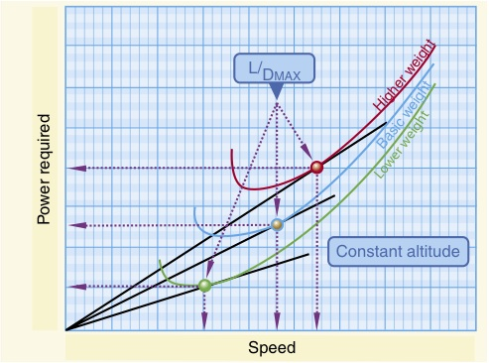
Region of Reversed Command
The majority of aircraft flying (climb, cruise, and maneuvers) is conducted in the region of normal command.

Slide 5
Warm-Up – 3/28 – 10 minutes
Utilizing your notes and past knowledge answer the following questions:
What region does the majority of aircraft flying take place?
Any surface that is not hard and smooth will increase the ground roll during takeoff. (True/False)
Describe what is the gradient or slope of a runway.
Describe the affect on an aircraft with respect to takeoff distance, with a downsloping runway.

Slide 6
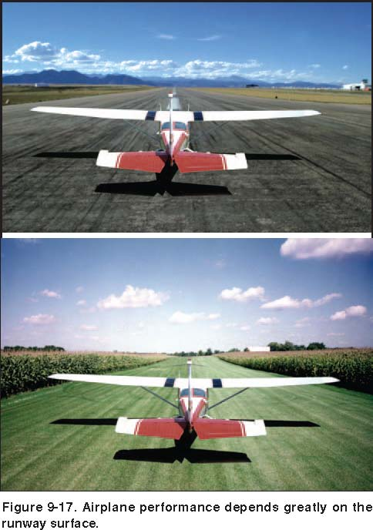
Runway Surface and Gradient
The runway surface encountered may be concrete, asphalt, gravel, dirt, or grass.
Any surface that is not hard and smooth will increase the ground roll during takeoff.

Slide 7
Warm-Up – 3/28 – 10 minutes
Utilizing your notes and past knowledge answer the following questions:
What region does the majority of aircraft flying take place?
Any surface that is not hard and smooth will increase the ground roll during takeoff. (True/False)
Describe what is the gradient or slope of a runway.
Describe the affect on an aircraft with respect to takeoff distance, with a downsloping runway.

Slide 8
Runway Surface and Gradient
The gradient or slope of the runway is the amount of change in runway height over the length of the runway.
A positive gradient indicates the runway height increases, and a negative gradient indicates the runway decreases in height.

Slide 9
Warm-Up – 3/28 – 10 minutes
Utilizing your notes and past knowledge answer the following questions:
What region does the majority of aircraft flying take place?
Any surface that is not hard and smooth will increase the ground roll during takeoff. (True/False)
Describe what is the gradient or slope of a runway.
Describe the affect on an aircraft with respect to takeoff distance, with a downsloping runway.

Slide 10
Runway Surface and Gradient
A downsloping runway aids in acceleration on takeoff resulting in shorter takeoff distances.
The opposite is true when landing, as landing on a downsloping runway increases landing distances.

Slide 11
Questions / Comments

Slide 12
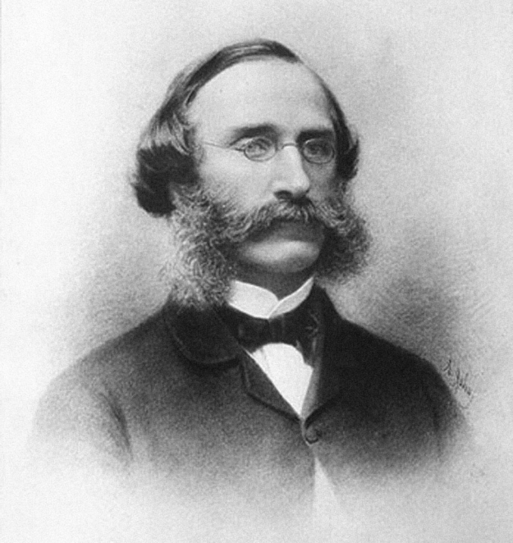
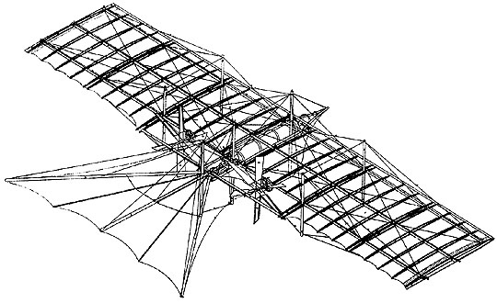
THIS DAY IN AVIATION
March 28
1843 — William Samuel Henson (1805-1888) receives the patent and publishes in London his design for an Aerial Steam Carriage.
This is the first reasoned, formulated, and detailed design for a propeller-driven aircraft.

Slide 13
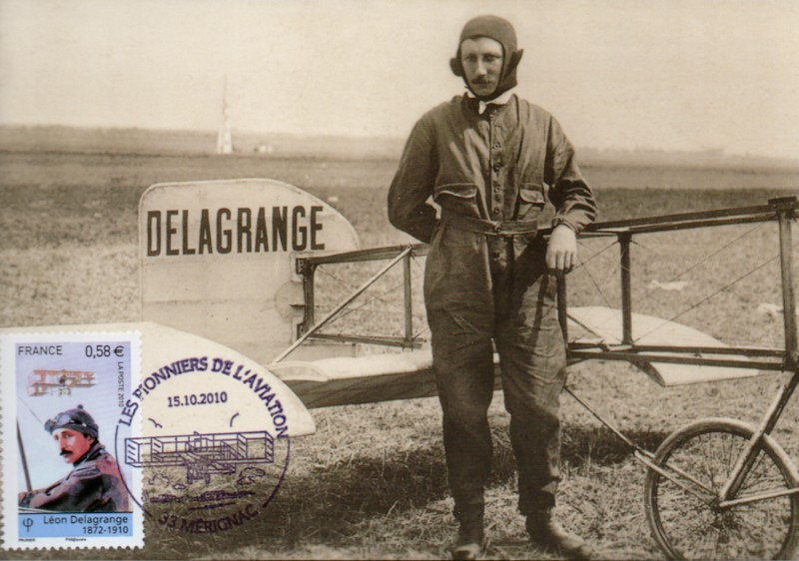
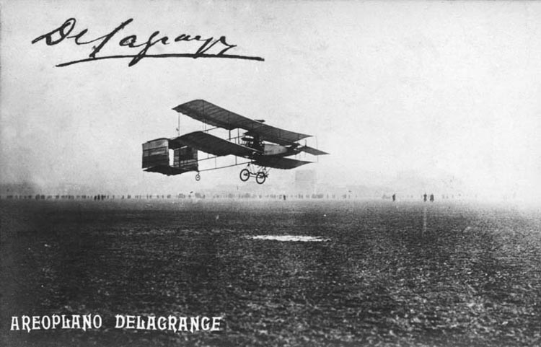
THIS DAY IN AVIATION
March 28
1908 — Leon Delagrange makes the first passenger flight, taking Farman aboard his Voisin biplane at Issy-les-Moulieaux.

Slide 14
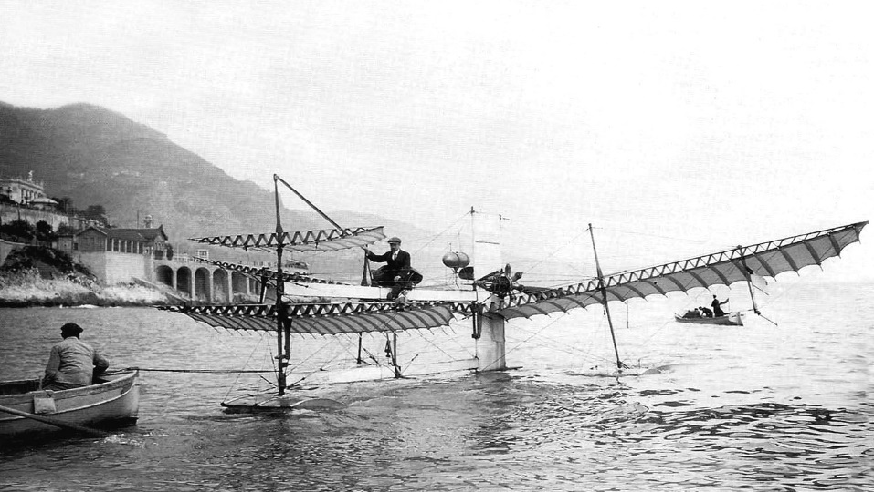
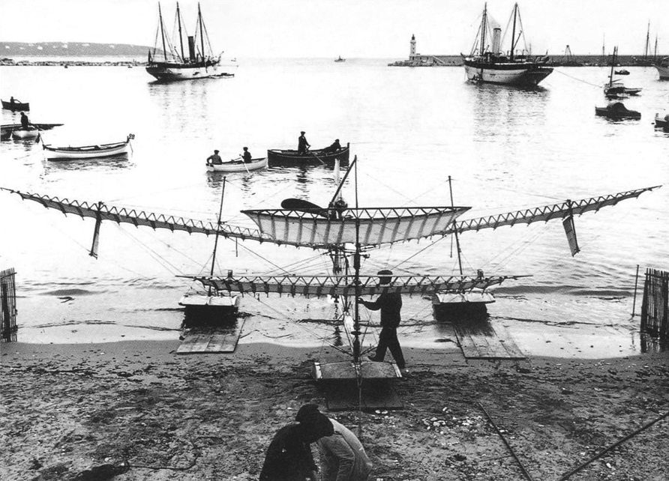
THIS DAY IN AVIATION
March 28
1910 — The first flight of Henri Fabre's Hydroavion, the first powered seaplane in the world, takes place at La Mède harbor, Martigues, France.
The hydroplane flies for about 1,600 ft. at the maximum height of 7 ft.

Slide 15
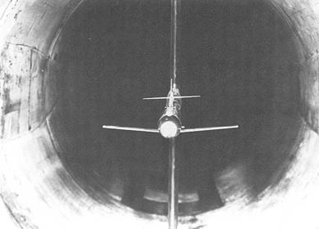
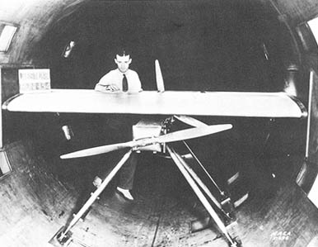
THIS DAY IN AVIATION
March 28
1936 — National Advisory Committee for Aeronautics (NACA) commences operational use of the newly constructed 8 foot high speed tunnel (8-Foot HST) at the Langley Memorial Aeronautical Laboratory, Langley, Virginia.
Built as a companion to the full scale tunnel capable of simulated speeds of up to 118 mph, the new facility can test models and components to 577 mph (Mach 0.75).

Slide 16
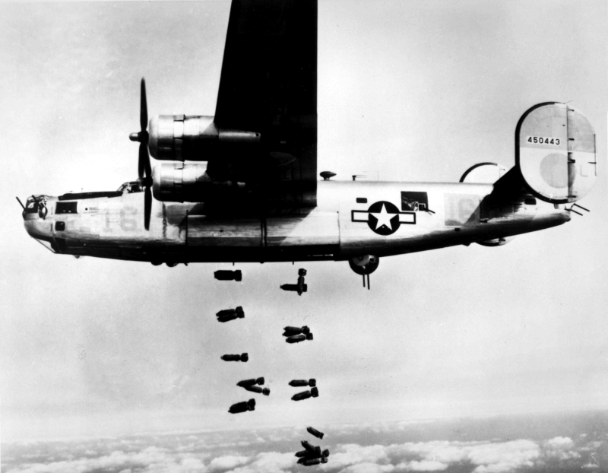
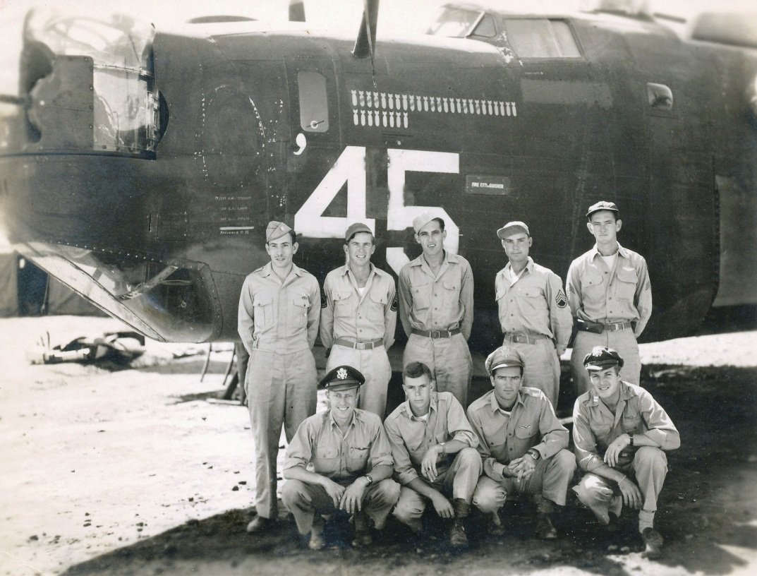
THIS DAY IN AVIATION
March 28
1944 — 15th Air Force flew its first "1000-ton raid" striking targets in Italy.

Slide 17
Questions / Comments

Slide 18
March / April 2017
Sunday | Monday | Tuesday | Wednesday | Thursday | Friday | Saturday
26 | 27 Chapter 10 Aircraft Performance | 28 Chapter 10 Aircraft Performance | 29 Chapter 10 Aircraft Performance | 30 Chap 10 Test | 31 Flight Line Friday | 1
2 | 3 Chapter 11 Weather Theory | 4 Chapter 11 Weather Theory | 5 Chapter 11 Weather Theory | 6 SCHOOL VISIT | 7 Flight Line Friday Chap 11 Test | 8
9 | 10 SCHOOL VACATION | 11 SCHOOL VACATION | 12 SCHOOL VACATION | 13 SCHOOL VACATION | 14 SCHOOL VACATION | 15
16 | 17 Chapter 12 Weather Services | 18 Chapter 12 Weather Services | 19 Chapter 12 Weather Services | 20 Chapter 12 Weather Services Review and Test | 21 Flight Line Friday | 22

Slide 19
2nd Quarter Requirements (8 weeks – May 24)
All students will complete the following:
Take notes - All in class quizzes and tests
Private Pilot Syllabus
Lessons 1 – 5 (Taxiing through Air Traffic Control)
Must pass written with 80%
Successfully complete 3 times on small sim
Successfully complete 1 time on Main sim
Complete ERAU Aviation 101
3 quizzes and 1 test
Student will receive zero points for all incomplete work – NO make-up / extra credit
NOTE: All unfinished Student Pilot and ERAU must be complete prior to starting Private Pilot and last 3 quizzes and test for ERAU.

Slide 20
Questions / Comments

Slide 21
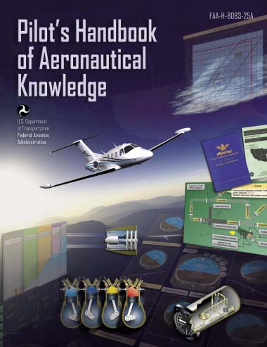
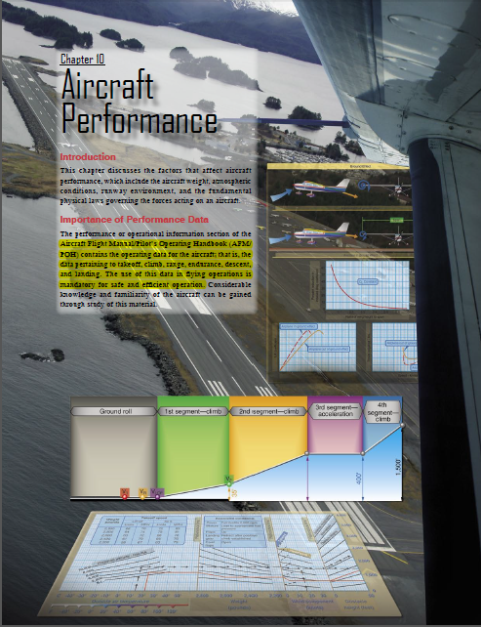
Chapter 10 – Aircraft Performance
FAA – Pilot’s Handbook of Aeronautical Knowledge

Slide 22
Today’s Mission Requirements
Mission:
Describe the factors that affect aircraft performance.
Identify how aircraft weight, atmospheric conditions, runway environment, and the fundamental physical laws governing the forces can affect aircraft performance.
EQ:
Describe the importance of Aeronautical Knowledge for the student pilot learning to fly.

Slide 23
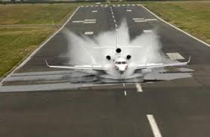
Water on the Runway and Dynamic Hydroplaning
Water on the runways reduces the friction between the tires and the ground, and can reduce braking effectiveness.
This is also true of braking effectiveness when runways are covered in ice.

Slide 24
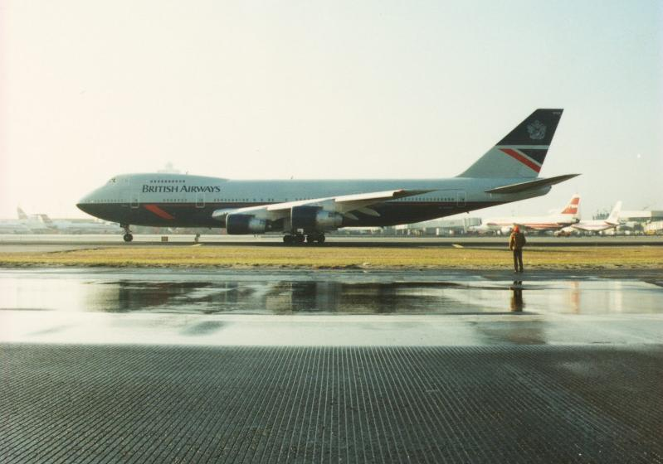
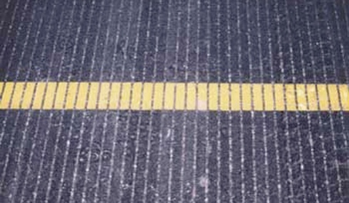
Water on the Runway and Dynamic Hydroplaning
To help minimize dynamic hydroplaning, some runways are grooved to help drain off water; most runways are not.

Slide 25
Water on the Runway and Dynamic Hydroplaning
Landing at higher than recommended touchdown speeds will expose the aircraft to a greater potential for hydroplaning.
And once hydroplaning starts, it can continue well below the minimum initial hydroplaning speed.

Slide 26
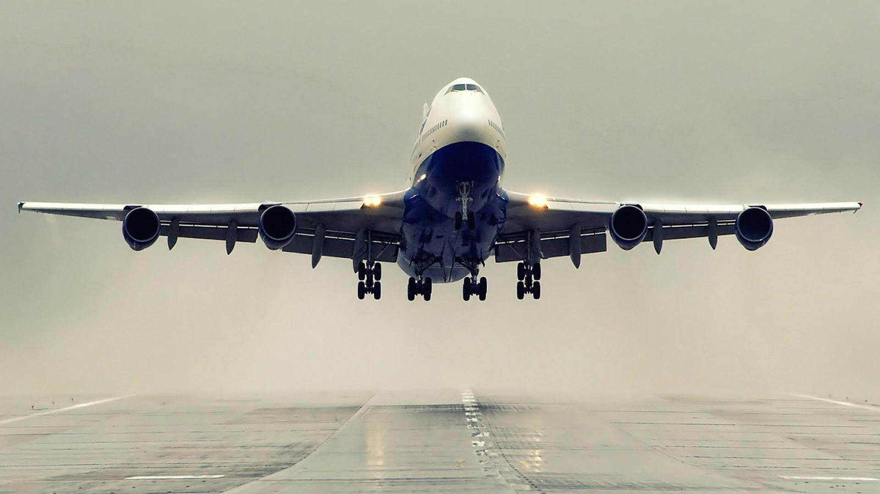
Takeoff Performance
The minimum takeoff distance is of primary interest in the operation of any aircraft.

Slide 27
Takeoff Performance
Depending on the aircraft characteristics, the lift-off speed will be anywhere from 1.05 to 1.25 times the stall speed or minimum control speed.

Slide 28
Takeoff Performance
The effect of gross weight on takeoff distance is significant and proper consideration of this item must be made in predicting the aircraft’s takeoff distance.

Slide 29
Takeoff Performance
1. Higher lift-off speed
2. Greater mass to accelerate
3. Increased retarding force (drag and ground friction)

Slide 30
Takeoff Performance
If the gross weight increases, a greater speed is necessary to produce the greater lift necessary to get the aircraft airborne.

Slide 31
Questions / Comments

Slide 32
2nd Quarter Requirements (8 weeks – May 24)
All students will complete the following:
Take notes - All in class quizzes and tests
Private Pilot Syllabus
Lessons 1 – 5 (Taxiing through Air Traffic Control)
Must pass written with 80%
Successfully complete 3 times on small sim
Successfully complete 1 time on Main sim
Complete ERAU Aviation 101
3 quizzes and 1 test
Student will receive zero points for all incomplete work – NO make-up / extra credit
NOTE: All unfinished Student Pilot and ERAU must be complete prior to starting Private Pilot and last 3 quizzes and test for ERAU.

