Slide 1
Warm-Up – 3/23 – 10 minutes
Utilizing your notes and past knowledge answer the following questions:
What instrument is required to be installed by 14CFR Part 91 during VFR and IFR flight operations?
What are the letters and numbers marked on the magnetic compass and how many degrees apart are they?
The long and short graduation marks are spaced how many degrees apart on a magnetic compass?
Describe what conditions may cause compass deviation.
What instrument/gauge provides the pilot with useful information about temperature lapse rate with altitude change?

Slide 2

Questions / Comments

Slide 3
Warm-Up – 3/23 – 10 minutes
Utilizing your notes and past knowledge answer the following questions:
What instrument is required to be installed by 14CFR Part 91 during VFR and IFR flight operations?
What are the letters and numbers marked on the magnetic compass and how many degrees apart are they?
The long and short graduation marks are spaced how many degrees apart on a magnetic compass?
Describe what conditions may cause compass deviation.
What instrument/gauge provides the pilot with useful information about temperature lapse rate with altitude change.

Slide 4
Magnetic Compass
One of the oldest and simplest instruments for indicating direction is the magnetic compass.
It is also one of the basic instruments required by Title 14 of the Code of Federal Regulations (14 CFR) part 91 for both VFR and IFR flight.

Slide 5
Warm-Up – 3/23 – 10 minutes
Utilizing your notes and past knowledge answer the following questions:
What instrument is required to be installed by 14CFR Part 91 during VFR and IFR flight operations?
What are the letters and numbers marked on the magnetic compass and how many degrees apart are they?
The long and short graduation marks are spaced how many degrees apart on a magnetic compass?
Describe what conditions may cause compass deviation.
What instrument/gauge provides the pilot with useful information about temperature lapse rate with altitude change.

Slide 6
Magnetic Compass
An aircraft magnetic compass is marked with letters representing the cardinal directions, north, east, south, and west, and a number for each 30° between these letters.
The final “0” is omitted from these directions.
For example, 3 = 30°, 6 = 60°, and 33 = 330°.

Slide 7
Warm-Up – 3/23 – 10 minutes
Utilizing your notes and past knowledge answer the following questions:
What instrument is required to be installed by 14CFR Part 91 during VFR and IFR flight operations?
What are the letters and numbers marked on the magnetic compass and how many degrees apart are they?
The long and short graduation marks are spaced how many degrees apart on a magnetic compass?
Describe what conditions may cause compass deviation.
What instrument/gauge provides the pilot with useful information about temperature lapse rate with altitude change.

Slide 8
Magnetic Compass
There are long and short graduation marks between the letters and numbers.
Each long mark representing 10° and each short mark representing 5°.

Slide 9
Warm-Up – 3/23 – 10 minutes
Utilizing your notes and past knowledge answer the following questions:
What instrument is required to be installed by 14CFR Part 91 during VFR and IFR flight operations?
What are the letters and numbers marked on the magnetic compass and how many degrees apart are they?
The long and short graduation marks are spaced how many degrees apart on a magnetic compass?
Describe what conditions may cause compass deviation.
What instrument/gauge provides the pilot with useful information about temperature lapse rate with altitude change.

Slide 10
Magnetic Compass
Deviation
Magnetic fields in an aircraft caused by electrical current flowing in the structure
Nearby wiring or any magnetized part of the structure
Conflict with the Earth’s magnetic field and cause a compass error called deviation.

Slide 11
Warm-Up – 3/23 – 10 minutes
Utilizing your notes and past knowledge answer the following questions:
What instrument is required to be installed by 14CFR Part 91 during VFR and IFR flight operations?
What are the letters and numbers marked on the magnetic compass and how many degrees apart are they?
The long and short graduation marks are spaced how many degrees apart on a magnetic compass?
Describe what conditions may cause compass deviation.
What instrument/gauge provides the pilot with useful information about temperature lapse rate with altitude change?

Slide 12
Outside Air Temperature (OAT) Gauge
OAT gauges are calibrated in degrees °C, °F, or both.
An accurate air temperature provides the pilot with useful information about temperature lapse rate with altitude change.

Slide 13
Questions / Comments

Slide 14
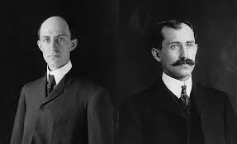
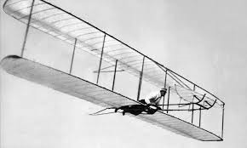
THIS DAY IN AVIATION
March 23
1903 — The Wright brothers file a patent request for a powered flying machine based on the second (modified) version of their 1902 glider successfully tested at Kill Devil Hill

Slide 15
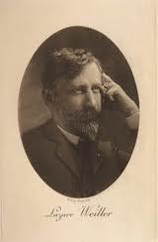

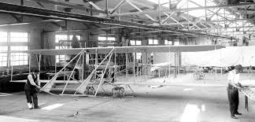
THIS DAY IN AVIATION
March 23
1908 — French industrialist Lazare Weiller signs a contract with the Wrights establishing a Wright airplane company in France, on condition that the brothers make two demonstration flights covering 50 km (31.1 miles) within a hour's flying time.
They will receive 500,000 francs and half the founders' share.

Slide 16
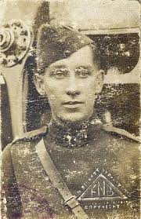
THIS DAY IN AVIATION
March 23
1921 — Lieutenant Arthur G. Hamilton sets a new world record when he jumps by parachute from 23,700 feet.

Slide 17
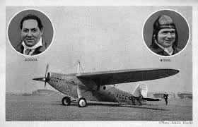
THIS DAY IN AVIATION
March 23
1932 — Flying a Blériot 110, French aviators Lucien Bossoutrot and Maurice Rossi take off for a record closed-circuit distance of 6,587.442 miles at Oran, Algeria

Slide 18
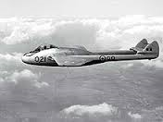
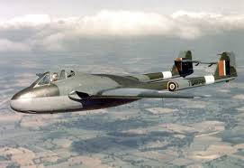
THIS DAY IN AVIATION
March 23
1948 — Test pilot Group Capt. John Cunningham sets a new Federal Aeronautique Internationale (FAI) ratified world altitude record of 18,118 m (59,446 ft.) during tests with the third production DH.100 “Vampire” (TG278).

Slide 19
Questions / Comments

Slide 20
February / March 2017
Sunday | Monday | Tuesday | Wednesday | Thursday | Friday | Saturday
26 | 27 Chapter 6 Flight Systems Powerplants | 28 Chapter 6 Flight Systems Propellers | 1 Chapter 6 Flight Systems Induction Carb Systems | 2 Chapter 6 Flight Systems Carb Icing and Heating | 3 Flight Line Friday QUIZ | 4
5 | 6 Chapter 6 Ignition Systems | 7 Chapter 6 Oil Systems | 8 Chapter 6 Fuel Systems | 9 Chapter 6 Fuel Systems | 10 HALF DAY Chap 6 Test | 11
12 | 13 Chapter 7 Flight Instruments | 14 Chapter 7 Flight Instruments Altimeter | 15 Chapter 7 Flight Instruments Vertical Speed Indicator | 16 Chapter 7 Flight Instruments Airspeed Indicator | 17 Flight Line Friday QUIZ | 18
19 | 20 Chapter 7 Flight Instruments Gyro Systems | 21 Chapter 7 Flight Instruments Magnetic Compass | 22 Chapter 7 Flight Instruments Review and Test | 23 Chapter 8 Flight Manuals | 24 Chapter 8 Flight Manuals Review and Test | 25

Slide 21
Questions / Comments

Slide 22
2nd Quarter Requirements
(9 weeks – May 24)
All students will complete the following:
  Take notes - All in class quizzes and tests
  Private Pilot Syllabus
    Lessons 1 – 6 (Taxiing through Air Traffic Control)
    Must pass written with 80%
    Successfully complete 3 times on small sim
    Successfully complete 1 time on Main sim
  Complete ERAU Aviation 101
    3 quizzes and 1 test
  Student will receive zero points for all incomplete work – NO make-up / extra credit
NOTE: All unfinished Student Pilot and ERAU must be complete prior to starting Private Pilot and last 3 quizzes and test for ERAU.

Slide 23
Questions / Comments

Slide 24
AVIATION ACES
1B
Pilots (A – 90 & above)
1B
Co-Pilots (B – 80 – 89)
Donald Duck
Joker
TJ
Eagle
Big Papi
Flash
Maverick
Z
Ski
Smalls
Mr. Young
Curly Fry
Krutch
Big Daddy
Andy
Rico
Big Daddy Z
High Shooter (100)

Slide 25
Questions / Comments

Slide 26

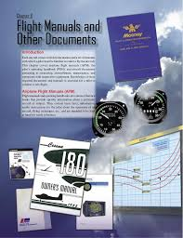
Chapter 8 – Flight Manuals
FAA – Pilot’s Handbook of Aeronautical Knowledge

Slide 27
Today’s Mission Requirements
Mission:
Describe in writing how AFM/POH and documents such as ADs help a pilot to have ready access to pertinent information needed to safely fly a particular aircraft.
Describe what information can be found in the AFM/POH to help a pilot make good flight decisions.
Identify what preventive maintenance is allowed on the aircraft, and how a pilot can maintain his or her aircraft in an airworthy condition.
Describe why flight manuals and aircraft documentation are essential tools used to reach the goal of safe flight.
EQ:
  Describe the importance of Aeronautical Knowledge for the student pilot learning to fly.

Slide 28
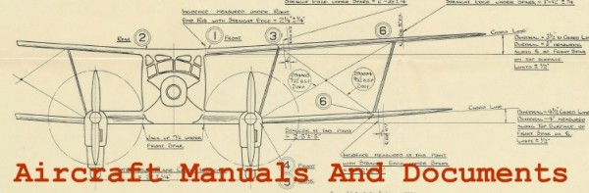
Introduction
This chapter covers airplane flight manuals (AFM), the pilot’s operating handbook (POH), and aircraft documents pertaining to ownership, airworthiness, maintenance, and operations with inoperative equipment.

Slide 29
Introduction
Knowledge of these required documents and manuals is essential for a pilot to conduct a safe flight.

Slide 30
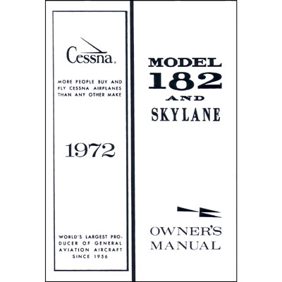
Pilots Operating Handbook
The POH is a document developed by the aircraft manufacturer and contains FAA approved Airplane Flight Manuals (AFM) information.
The POH for most light aircraft built after 1975 is also designated as the FAA-approved flight manual.

Slide 31
Pilots Operating Handbook / Airplane Flight Manual
The typical AFM/POH contains the following nine sections:
  General;
  Limitations;
  Emergency Procedures;
  Normal Procedures;
  Performance;
  Weight and Balance/Equipment List;
  Systems Description;
  Handling, Service, and Maintenance;
  Supplements.

Slide 32
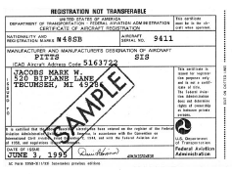
Aircraft Documents
Certificate of Aircraft Registration
Before an aircraft can be flown legally, it must be registered with the FAA Aircraft Registry.
The Certificate of Aircraft Registration, which is issued to the owner as evidence of the registration, must be carried in the aircraft at all times.

Slide 33
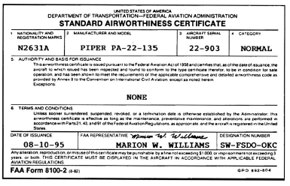
Airworthiness Certificate
An Airworthiness Certificate is issued by a representative of the FAA after the aircraft has been inspected, is found to meet the requirements of 14 CFR part 21, and is in condition for safe operation.

Slide 34
Airworthiness Certificate
The Airworthiness Certificate must be displayed in the aircraft so it is legible to the passengers and crew whenever it is operated.
The Airworthiness Certificate is transferred with the aircraft except when it is sold to a foreign purchaser.

Slide 35
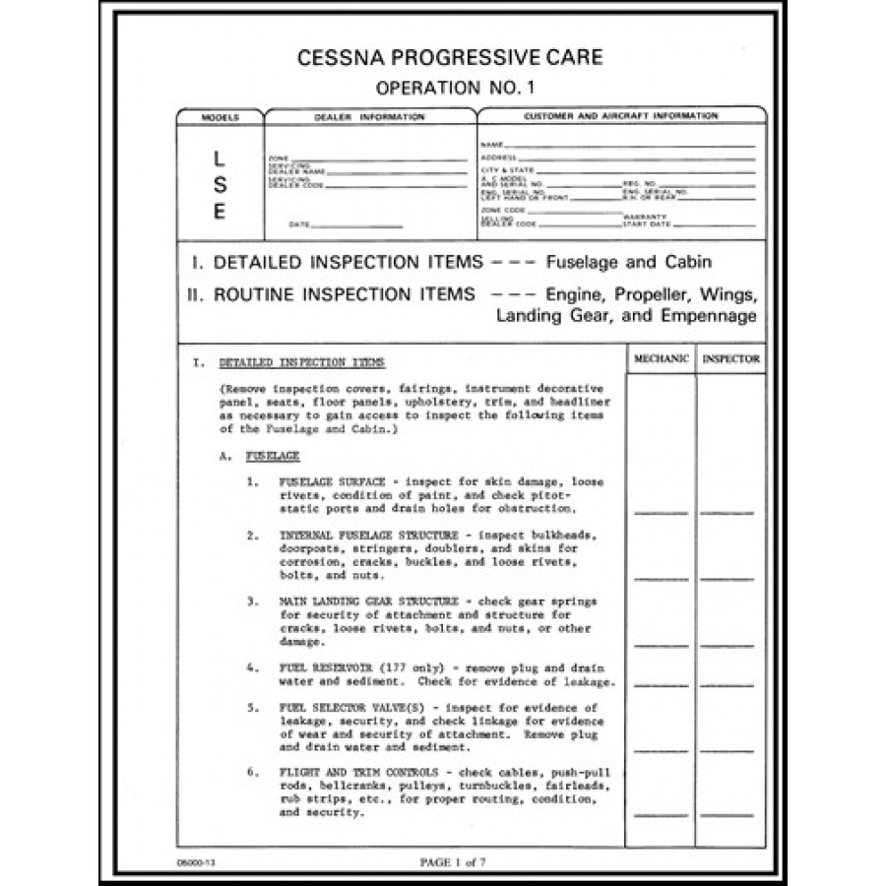
Airworthiness Inspections
14 CFR part 91, subpart E, requires the inspection of all civil aircraft at specific intervals to determine the overall condition.
The interval depends upon the type of operations in which the aircraft is engaged.

Slide 36
Airworthiness Inspections
All aircraft need to be inspected at least once each 12 calendar months, while inspection is required for others after each 100 hours of operation.

Slide 37
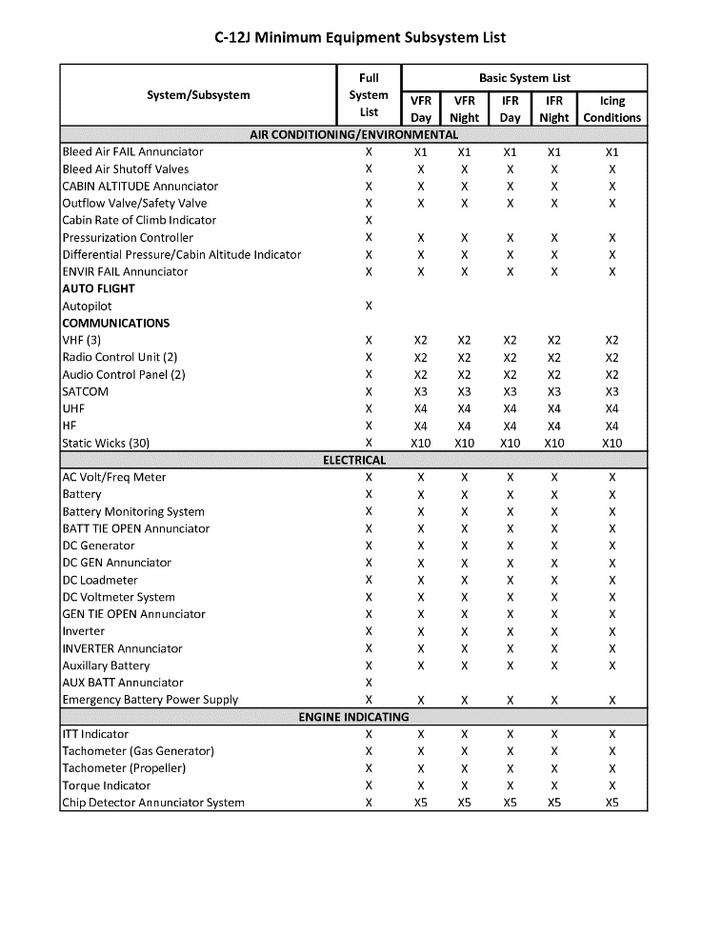
Minimum Equipment Lists (MEL)
14 CFR requires that all aircraft instruments and installed equipment be operative prior to each departure.

Slide 38
Minimum Equipment Lists (MEL)
When the FAA adopted the minimum equipment list (MEL) concept for 14 CFR part 91 operations, this allowed operations with inoperative equipment determined to be nonessential for safe flight.

Slide 39
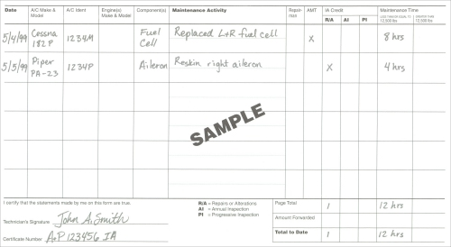
Maintenance Entries
All pilots who maintain or perform preventive maintenance must make an entry in the maintenance record of the aircraft.

Slide 40
Maintenance Entries
The entry must include:
  1. A description of the work, such as “changed oil (Shell Aero-50) at 2,345 hours.”
  2. The date of completion of the work performed.
  3. The entry of the pilot’s name, signature, certificate number, and type of certificate held.

Slide 41
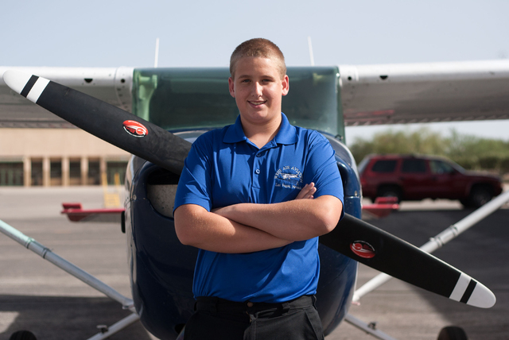
Aircraft Owner/Operator Responsibilities
The registered owner/operator of an aircraft is responsible for:
  Having a current Airworthiness Certificate
  Certificate of Aircraft Registration in the aircraft.

Slide 42
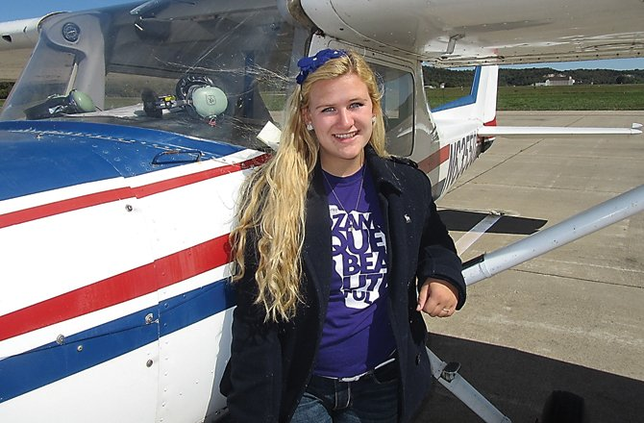
Aircraft Owner/Operator Responsibilities
Maintaining the aircraft in an airworthy condition, including compliance with all applicable ADs, and assuring that maintenance is properly recorded.
Keeping abreast of current regulations concerning the operation and maintenance of the aircraft.

Slide 43

Chapter Summary
The goal of every pilot is a safe flight; flight manuals and aircraft documentation are essential tools used to reach that goal.

Slide 44
Questions / Comments

Slide 45
2nd Quarter Requirements
(24 Class Meetings – Dec 14)
All students will complete the following:
  Take notes - All in class quizzes and tests
  Private Pilot Syllabus
    Lessons 1 – 6 (Taxiing through Air Traffic Control)
    Must pass written with 80%
    Successfully complete 3 times on small sim
    Successfully complete 1 time on Main sim
  Complete ERAU Aviation 101
    3 quizzes and 1 test
  Student will receive zero points for all incomplete work – NO make-up / extra credit
NOTE: All unfinished Student Pilot and ERAU must be complete prior to starting Private Pilot and last 3 quizzes and test for ERAU.

Slide 46
March 2015
Sunday | Monday | Tuesday | Wednesday | Thursday | Friday | Saturday
1 | 2 | 3 Chapter 8 Flight Manuals | 4 | 5 Chapter 8 Flight Manuals Review and Test | 6 | 7
8 | 9 Chapter 9 Weight and Balance | 10 | 11 Chapter 9 Weight and Balance Worksheets | 12 | 13 FltLine Friday Weight and Balance Worksheets | 14
15 | 16 | 17 Chapter 10 Aircraft Performance | 18 | 19 Chapter 10 Aircraft Performance | 20 NO SCHOOL | 21
22 | 23 | 24 Chapter 10 Aircraft Performance | 25 | 26 Chapter 10 Aircraft Performance | 27 | 28

Slide 47
3rd Semester Requirements
(8 Class Meetings)
All students will complete the following:
  Take notes - All In class quizzes and tests
  Complete Flight Sim. Student Pilot Syllabus
    Lessons 1 – 7 (Straight & Level Flight through First Solo)
    Must pass written with 80%
    Successfully complete 3 times on small sim
    Successfully complete 1 time on Main sim
  Complete ERAU Aviation 101
    9 quizzes and 3 tests
  Student will receive zero points for all incomplete work

Slide 48
Introduction
Each aircraft comes with documentation and a set of manuals with which a pilot must be familiar in order to fly that aircraft.

Slide 49
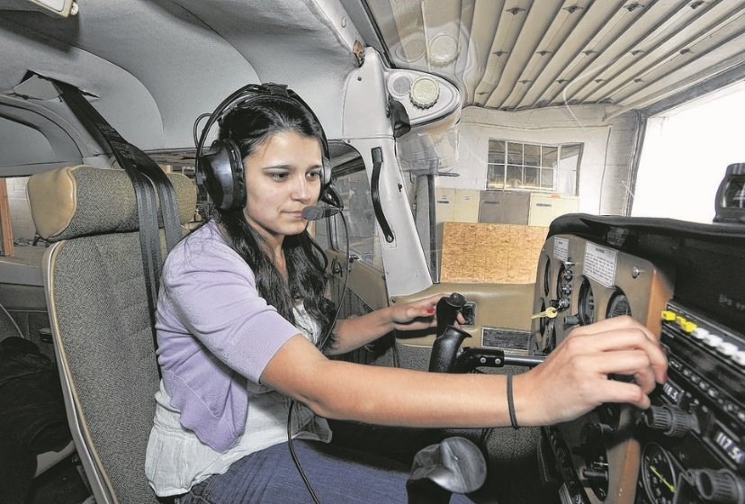
Aircraft Owner/Operator Responsibilities
Notifying the FAA Aircraft Registry immediately of any change of permanent mailing address, or of the sale or export of the aircraft, or of the loss of the eligibility to register an aircraft.

Slide 50
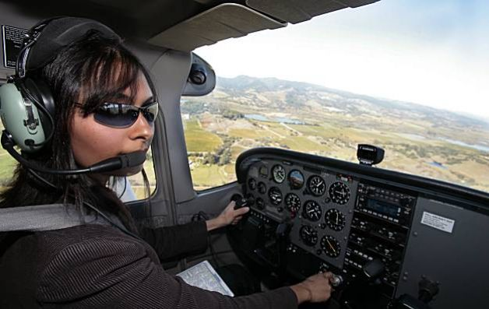
Aircraft Owner/Operator Responsibilities
Having a current Federal Communications Commission (FCC) radio station license if equipped with radios, including emergency locator transmitter

Slide 51
Chapter Summary
Knowledge of an aircraft’s AFM/POH and documents such as ADs help a pilot to have ready access to pertinent information needed to safely fly a particular aircraft.

Slide 52
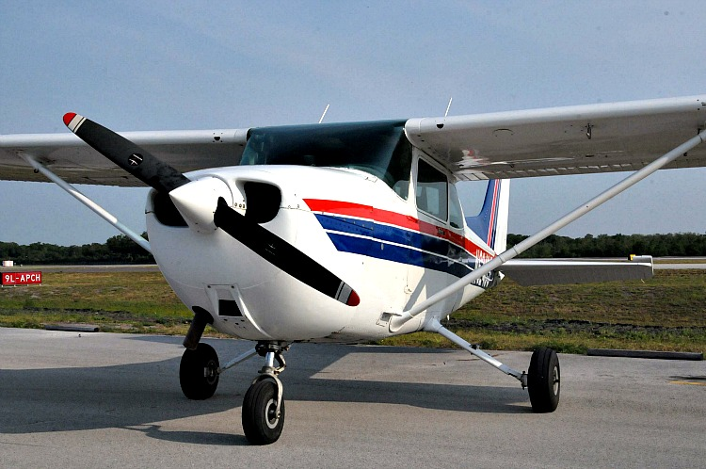
Chapter Summary
By understanding the operations, limitations, and performance characteristics of the aircraft, the pilot can make good flight decisions.
By learning what preventive maintenance is allowed on the aircraft, a pilot can maintain his or her aircraft in an airworthy condition.

