Slide 1
Warm-Up – 3/21 – 10 minutes
Utilizing your notes and past knowledge answer the following questions:
What are the most common instruments containing gyroscopes?
Describe the components of a typical vacuum and its operation.
Describe the turn coordinator and its operation.
What is often termed the most realistic instrument for use by a pilot?
What is the possible maximum error a heading indicator may have over an hour?

Slide 2

Questions / Comments

Slide 3
Warm-Up – 3/21 – 10 minutes
Utilizing your notes and past knowledge answer the following questions:
What are the most common instruments containing gyroscopes?
Describe the components of a typical vacuum and its operation.
Describe the turn coordinator and its operation.
What is often termed the most realistic instrument for use by a pilot?
What is the possible maximum error a heading indicator may have over an hour?

Slide 4
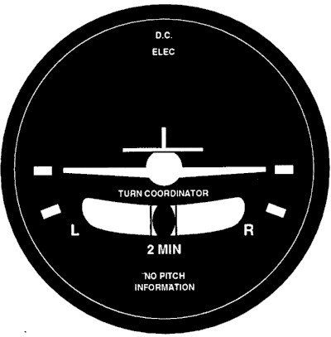
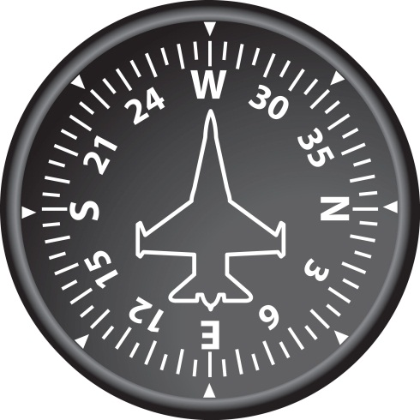
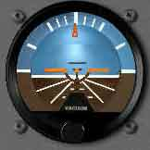
Gyroscopic Flight Instruments
Several flight instruments utilize the properties of a gyroscope for their operation.
The most common instruments containing gyroscopes are the turn coordinator, heading indicator, and the attitude indicator.

Slide 5
Warm-Up – 3/21 – 10 minutes
Utilizing your notes and past knowledge answer the following questions:
What are the most common instruments containing gyroscopes?
Describe the components of a typical vacuum and its operation.
Describe the turn coordinator and its operation.
What is often termed the most realistic instrument for use by a pilot?
What is the possible maximum error a heading indicator may have over an hour?

Slide 6
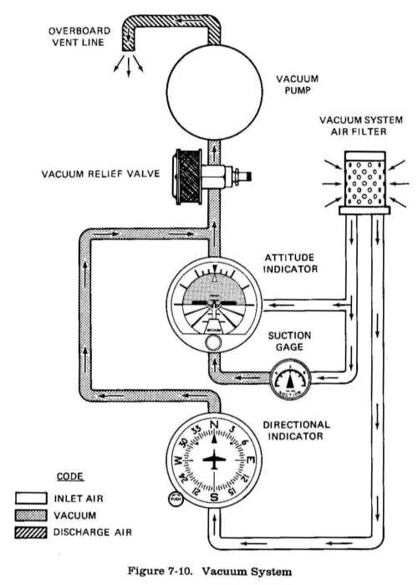
Gyroscopic Flight Instruments
Sources of Power
A typical vacuum system consists of an engine-driven vacuum pump, relief valve, air filter, gauge, and tubing necessary to complete the connections.

Slide 7
Gyroscopic Flight Instruments
Sources of Power
Air is drawn into the vacuum system by the engine-driven vacuum pump.
It first goes through a filter, which prevents foreign matter from entering the vacuum or pressure system.

Slide 8
Gyroscopic Flight Instruments
Sources of Power
The air then moves through the attitude and heading indicators, where it causes the gyros to spin.
A relief valve prevents the vacuum pressure, or suction, from exceeding prescribed limits.

Slide 9
Warm-Up – 3/21 – 10 minutes
Utilizing your notes and past knowledge answer the following questions:
What are the most common instruments containing gyroscopes?
Describe the components of a typical vacuum and its operation.
Describe the turn coordinator and its operation.
What is often termed the most realistic instrument for use by a pilot?
What is the possible maximum error a heading indicator may have over an hour?

Slide 10
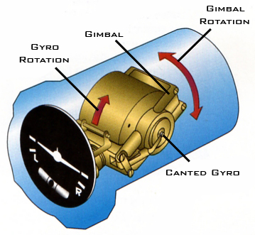
Turn Coordinator
The turn coordinator can be used to establish and maintain a standard-rate turn by aligning the wing of the miniature aircraft with the turn index.

Slide 11
Warm-Up – 3/21 – 10 minutes
Utilizing your notes and past knowledge answer the following questions:
What are the most common instruments containing gyroscopes?
Describe the components of a typical vacuum and its operation.
Describe the turn coordinator and its operation.
What is often termed the most realistic instrument for use by a pilot?
What is the possible maximum error a heading indicator may have over an hour?

Slide 12
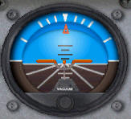
Attitude Indicator
The attitude indicator, with its miniature aircraft and horizon bar, displays a picture of the attitude of the aircraft.
The relationship of the miniature aircraft to the horizon bar is the same as the relationship of the real aircraft to the actual horizon.

Slide 13
Attitude Indicator
The instrument gives an instantaneous indication of even the smallest changes in attitude.
The horizon bar represents the true horizon.

Slide 14
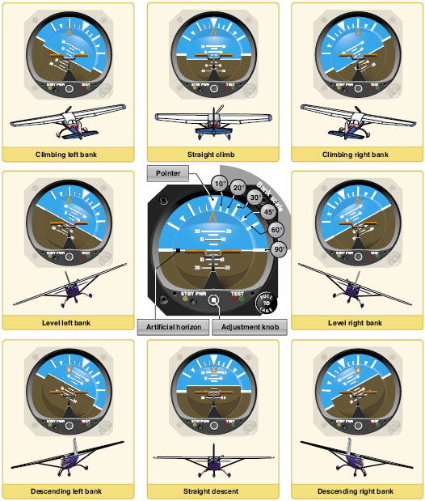
Attitude Indicator
The relationship of the miniature aircraft to the horizon bar should be used for an indication of the direction of bank.

Slide 15
Warm-Up – 3/21 – 10 minutes
Utilizing your notes and past knowledge answer the following questions:
What are the most common instruments containing gyroscopes?
Describe the components of a typical vacuum and its operation.
Describe the turn coordinator and its operation.
What is often termed the most realistic instrument for use by a pilot?
What is the possible maximum error a heading indicator may have over an hour?

Slide 16
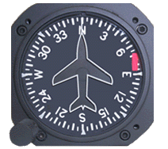
Heading Indicator
Another error in the heading indicator is caused by the fact that the gyro is oriented in space, and the Earth rotates in space at a rate of 15° in 1 hour.
The heading indicator may indicate as much as 15° error per every hour of operation.

Slide 17
Questions / Comments

Slide 18
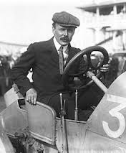
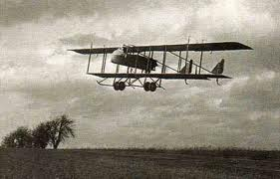
THIS DAY IN AVIATION
March 21
1877 — Maurice Farman (1877-1964), aviation pioneer and manufacturer, is born in Paris, France.
In 1908, he made the first circular flight of more than one mile (1,6 km) with his brother, Henri.

Slide 19
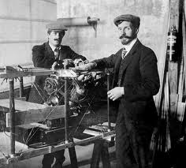
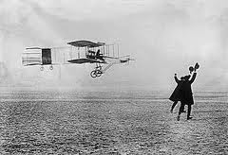
THIS DAY IN AVIATION
March 21
1908 — Henri Farman covers 6,275 feet in 3 minutes 47 seconds in his Voisin-Farman No.1 bis at Issy-les-Moulineaux.

Slide 20

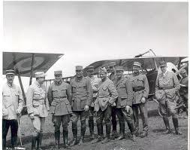
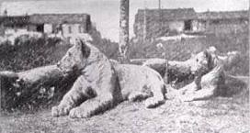
THIS DAY IN AVIATION
March 21
1916 — The French government authorizes the formation of the Escadrille Americaine (later Lafayette Escadrille) made up of American volunteer pilots.

Slide 21
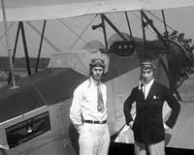
THIS DAY IN AVIATION
March 21
1933 — James L. Kinney makes the first cross-country test of blind flying and landing from College Park, Maryland to Newark, New Jersey.

Slide 22
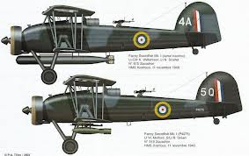
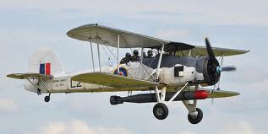
THIS DAY IN AVIATION
March 21
1933 — Fairey's TSR.1 torpedo spotter-reconnaissance airplane makes its first flight at Harmondsworth, Middlesex, England.

Slide 23
Questions / Comments

Slide 24
February / March 2017
Sunday | Monday | Tuesday | Wednesday | Thursday | Friday | Saturday
26 | 27 Chapter 6 Flight Systems Powerplants | 28 Chapter 6 Flight Systems Propellers | 1 Chapter 6 Flight Systems Induction Carb Systems | 2 Chapter 6 Flight Systems Carb Icing and Heating | 3 Flight Line Friday QUIZ | 4
5 | 6 Chapter 6 Ignition Systems | 7 Chapter 6 Oil Systems | 8 Chapter 6 Fuel Systems | 9 Chapter 6 Fuel Systems | 10 HALF DAY Chap 6 Test | 11
12 | 13 Chapter 7 Flight Instruments | 14 Chapter 7 Flight Instruments Altimeter | 15 Chapter 7 Flight Instruments Vertical Speed Indicator | 16 Chapter 7 Flight Instruments Airspeed Indicator | 17 Flight Line Friday QUIZ | 18
19 | 20 Chapter 7 Flight Instruments Gyro Systems | 21 Chapter 7 Flight Instruments Magnetic Compass | 22 Chapter 7 Flight Instruments Review and Test | 23 Chapter 8 Flight Manuals | 24 Chapter 8 Flight Manuals Review and Test | 25

Slide 25
Questions / Comments

Slide 26
2nd Quarter Requirements
(9 weeks – May 24)
All students will complete the following:
  Take notes - All in class quizzes and tests
  Private Pilot Syllabus
    Lessons 1 – 6 (Taxiing through Air Traffic Control)
    Must pass written with 80%
    Successfully complete 3 times on small sim
    Successfully complete 1 time on Main sim
  Complete ERAU Aviation 101
    3 quizzes and 1 test
  Student will receive zero points for all incomplete work – NO make-up / extra credit
NOTE: All unfinished Student Pilot and ERAU must be complete prior to starting Private Pilot and last 3 quizzes and test for ERAU.

Slide 27
Questions / Comments

Slide 28
AVIATION ACES
1B
Pilots (A – 90 & above)
1B
Co-Pilots (B – 80 – 89)
007
Jon Doe
Bulldog
Nimbus
DB n/a
Cincinnati
Chief
Jack in the Box
Goose
High Shooter (98)

Slide 29

Chapter 7 – Flight Instruments
FAA – Pilot’s Handbook of Aeronautical Knowledge

Slide 30
Today’s Mission Requirements
Mission:
Identify in writing how to interpret and operate flight instruments.
Describe the pilot’s ability to recognize errors and malfunctions with flight instruments.
Describe the pitot-static system and associated instruments.
Describe the vacuum system and related instruments.
Describe the gyroscopic instruments and the magnetic compass.
EQ:
  Describe the importance of Aeronautical Knowledge for the student pilot learning to fly.

Slide 31
Magnetic Compass
One of the oldest and simplest instruments for indicating direction is the magnetic compass.
It is also one of the basic instruments required by Title 14 of the Code of Federal Regulations (14 CFR) part 91 for both VFR and IFR flight.

Slide 32
Magnetic Compass
An aircraft magnetic compass is marked with letters representing the cardinal directions, north, east, south, and west, and a number for each 30° between these letters.
The final “0” is omitted from these directions.
For example, 3 = 30°, 6 = 60°, and 33 = 330°.

Slide 33
Magnetic Compass
There are long and short graduation marks between the letters and numbers.
Each long mark representing 10° and each short mark representing 5°.

Slide 34
Magnetic Compass
Induced Errors
The magnetic compass is the simplest instrument in the panel, but it is subject to a number of errors that must be considered.

Slide 35
Magnetic Compass
Induced Errors
Variation
  true directions
  magnetic directions
In aerial navigation, the difference between true and magnetic directions is called variation.

Slide 36
Magnetic Compass
Deviation
Magnetic fields in an aircraft caused by electrical current flowing in the structure
Nearby wiring or any magnetized part of the structure
Conflict with the Earth’s magnetic field and cause a compass error called deviation.

Slide 37
Magnetic Compass
Oscillation Error
Oscillation is a combination of all of the other errors
It results in the compass card swinging back and forth around the heading being flown.

Slide 38
Outside Air Temperature (OAT) Gauge
The outside air temperature (OAT) gauge is a simple and effective device mounted so that the sensing element is exposed to the outside air.

Slide 39
Outside Air Temperature (OAT) Gauge
OAT gauges are calibrated in degrees °C, °F, or both.
An accurate air temperature provides the pilot with useful information about temperature lapse rate with altitude change.

Slide 40
Questions / Comments

Slide 41
2nd Quarter Requirements
(26 Class Meetings – Dec 14)
All students will complete the following:
  Take notes - All in class quizzes and tests
  Private Pilot Syllabus
    Lessons 1 – 6 (Taxiing through Air Traffic Control)
    Must pass written with 80%
    Successfully complete 3 times on small sim
    Successfully complete 1 time on Main sim
  Complete ERAU Aviation 101
    3 quizzes and 1 test
  Student will receive zero points for all incomplete work – NO make-up / extra credit
NOTE: All unfinished Student Pilot and ERAU must be complete prior to starting Private Pilot and last 3 quizzes and test for ERAU.

