Slide 1
Warm-Up – 3/20 – 10 minutes
Utilizing your notes and past knowledge answer the following questions:
What are the most common instruments containing gyroscopes?
Describe the components of a typical vacuum and its operation.
Describe the turn coordinator and its operation.
What is often termed the most realistic instrument for use by a pilot?
What is the possible maximum error a heading indicator may have over an hour?

Slide 2

Questions / Comments

Slide 3
Warm-Up – 3/20 – 10 minutes
Utilizing your notes and past knowledge answer the following questions:
What are the most common instruments containing gyroscopes?
Describe the components of a typical vacuum and its operation.
Describe the turn coordinator and its operation.
What is often termed the most realistic instrument for use by a pilot?
What is the possible maximum error a heading indicator may have over an hour?

Slide 4
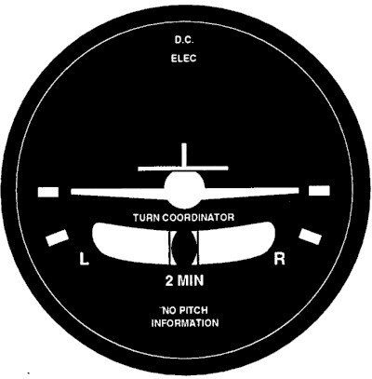
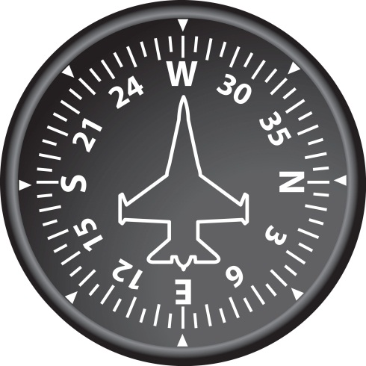
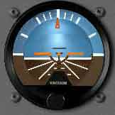
Gyroscopic Flight Instruments
Several flight instruments utilize the properties of a gyroscope for their operation.
The most common instruments containing gyroscopes are the turn coordinator, heading indicator, and the attitude indicator.

Slide 5
Warm-Up – 3/20 – 10 minutes
Utilizing your notes and past knowledge answer the following questions:
What are the most common instruments containing gyroscopes?
Describe the components of a typical vacuum and its operation.
Describe the turn coordinator and its operation.
What is often termed the most realistic instrument for use by a pilot?
What is the possible maximum error a heading indicator may have over an hour?

Slide 6
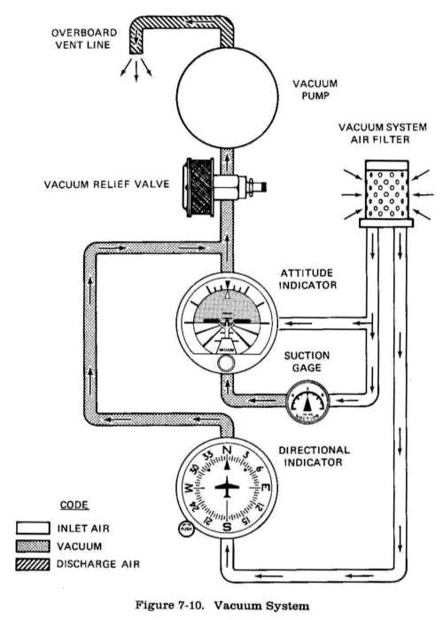
Gyroscopic Flight Instruments
Sources of Power
A typical vacuum system consists of an engine-driven vacuum pump, relief valve, air filter, gauge, and tubing necessary to complete the connections.

Slide 7
Gyroscopic Flight Instruments
Sources of Power
Air is drawn into the vacuum system by the engine-driven vacuum pump.
It first goes through a filter, which prevents foreign matter from entering the vacuum or pressure system.

Slide 8
Gyroscopic Flight Instruments
Sources of Power
The air then moves through the attitude and heading indicators, where it causes the gyros to spin.
A relief valve prevents the vacuum pressure, or suction, from exceeding prescribed limits.

Slide 9
Warm-Up – 3/20 – 10 minutes
Utilizing your notes and past knowledge answer the following questions:
What are the most common instruments containing gyroscopes?
Describe the components of a typical vacuum and its operation.
Describe the turn coordinator and its operation.
What is often termed the most realistic instrument for use by a pilot?
What is the possible maximum error a heading indicator may have over an hour?

Slide 10
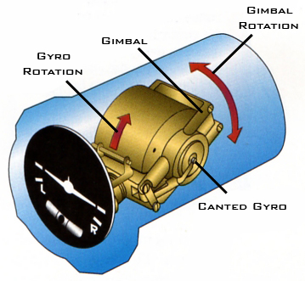
Turn Coordinator
The turn coordinator can be used to establish and maintain a standard-rate turn by aligning the wing of the miniature aircraft with the turn index.

Slide 11
Warm-Up – 3/20 – 10 minutes
Utilizing your notes and past knowledge answer the following questions:
What are the most common instruments containing gyroscopes?
Describe the components of a typical vacuum and its operation.
Describe the turn coordinator and its operation.
What is often termed the most realistic instrument for use by a pilot?
What is the possible maximum error a heading indicator may have over an hour?

Slide 12
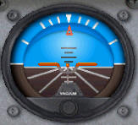
Attitude Indicator
The attitude indicator, with its miniature aircraft and horizon bar, displays a picture of the attitude of the aircraft.
The relationship of the miniature aircraft to the horizon bar is the same as the relationship of the real aircraft to the actual horizon.

Slide 13
Attitude Indicator
The instrument gives an instantaneous indication of even the smallest changes in attitude.
The horizon bar represents the true horizon.

Slide 14
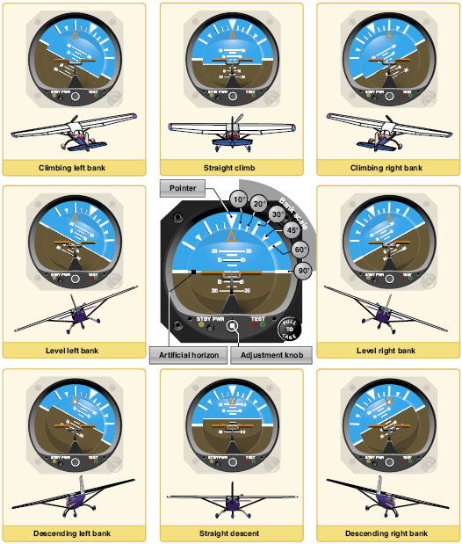
Attitude Indicator
The relationship of the miniature aircraft to the horizon bar should be used for an indication of the direction of bank.

Slide 15
Warm-Up – 3/20 – 10 minutes
Utilizing your notes and past knowledge answer the following questions:
What are the most common instruments containing gyroscopes?
Describe the components of a typical vacuum and its operation.
Describe the turn coordinator and its operation.
What is often termed the most realistic instrument for use by a pilot?
What is the possible maximum error a heading indicator may have over an hour?

Slide 16
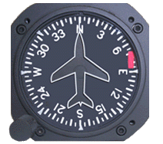
Heading Indicator
Another error in the heading indicator is caused by the fact that the gyro is oriented in space, and the Earth rotates in space at a rate of 15° in 1 hour.
The heading indicator may indicate as much as 15° error per every hour of operation.

Slide 17
Questions / Comments

Slide 18
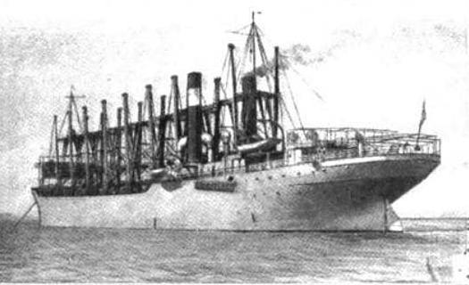
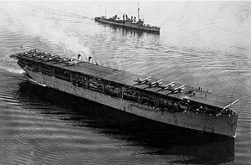
THIS DAY IN AVIATION
March 20
1922 — The USS Langley (CV-1), America's first aircraft carrier, is commissioned into the U. S. Navy at Norfolk, Virginia under the command of Comdr. Kenneth Whiting.

Slide 19
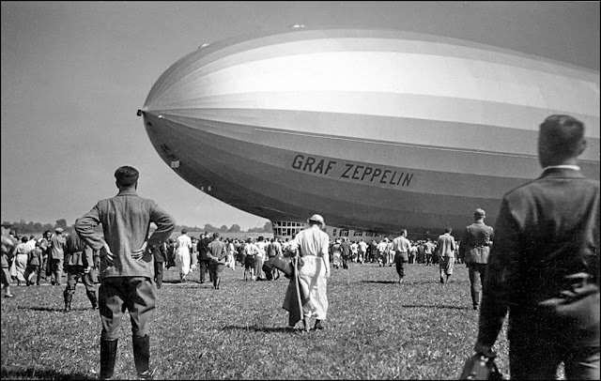
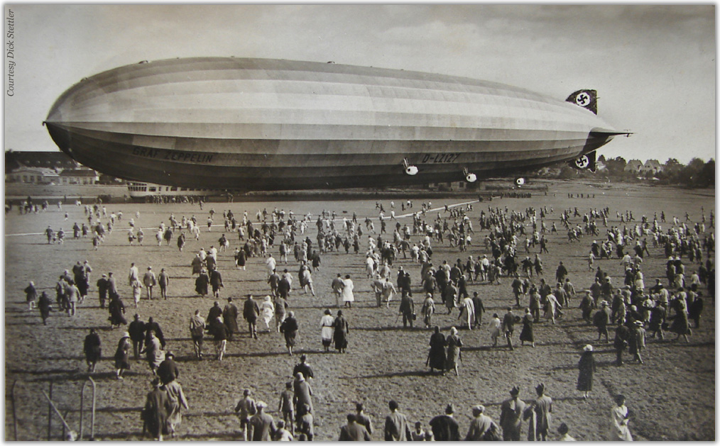
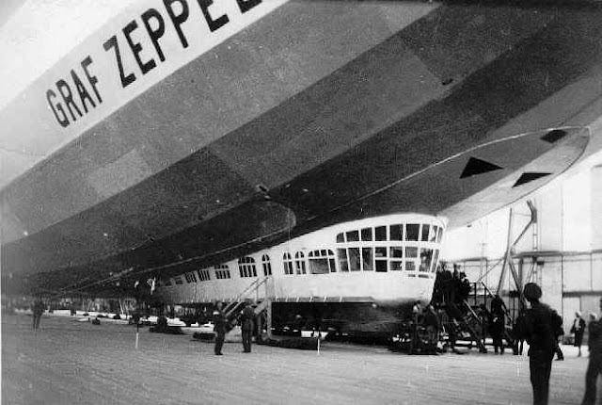
THIS DAY IN AVIATION
March 20
1932 — The airship “Graf Zeppelin” begins a series of flights between Germany and Brazil. Several round-trips are planned per year to Rio de Janeiro.

Slide 20
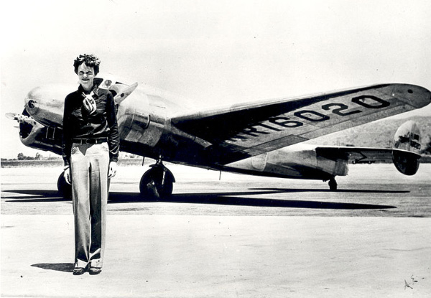
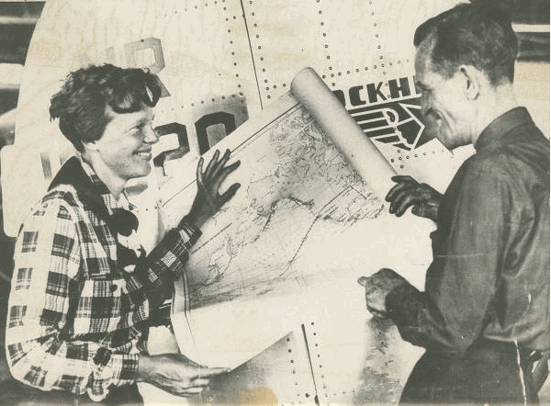
THIS DAY IN AVIATION
March 20
1937 — An attempted round-the-world flight by leading United States woman aviator Amelia Earhart ends dramatically when the starboard tire of her Lockheed “Electra” airliner bursts during take-off from Honolulu, Hawaii.
Because of the damage, the expedition is temporary abandoned.
The first leg from Oakland, California to Honolulu on March 17 was made in 16 hours, an east-west record.

Slide 21
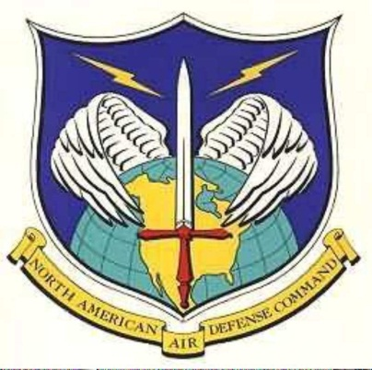
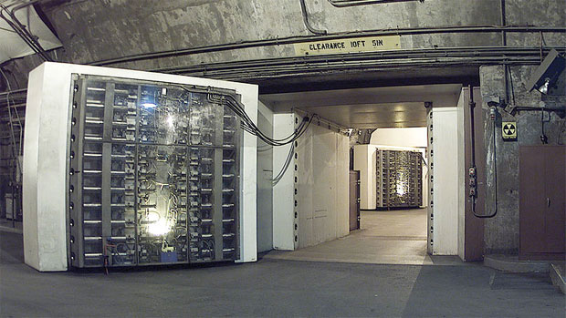

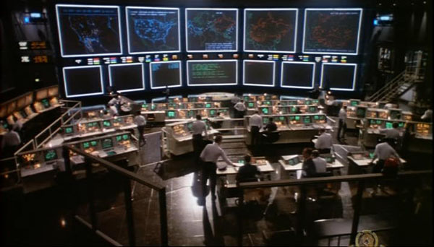
THIS DAY IN AVIATION
March 20
1959 — The site in Cheyenne Mountain, Colorado, is approved as the location for NORAD.

Slide 22
Questions / Comments

Slide 23
February / March 2018
Sunday | Monday | Tuesday | Wednesday | Thursday | Friday | Saturday
25 | 26 Chapter 6 Flight Systems Powerplants | 27 Chapter 6 Flight Systems Propellers | 28 Chapter 6 Flight Systems Induction Carb Systems | 1 Chapter 6 Flight Systems Carb Icing and Heating | 2 Flight Line Friday QUIZ | 3
4 | 5 Chapter 6 Ignition Systems | 6 Chapter 6 Oil Systems | 7 Chapter 6 Fuel Systems | 8 Chapter 6 Electrical Systems | 9 Mighty 8th Museum | 10
11 | 12 Chapter 7 Flight Instruments | 13 Chapter 7 Flight Instruments Altimeter | 14 Chapter 7 Flight Instruments Vertical Speed Indicator | 15 Chapter 7 Flight Instruments Airspeed Indicator | 16 Flight Line Friday QUIZ | 17
18 | 19 Chapter 7 Flight Instruments Gyro Systems | 20 Chapter 7 Flight Instruments Magnetic Compass | 21 Chapter 7 Flight Instruments Review and Test | 22 Chapter 8 Flight Manuals | 23 Chapter 8 Flight Manuals Review and Test | 24

Slide 24
2nd Quarter Requirements
(9 weeks – May 23)
All students will complete the following:
  Take notes - All in class quizzes and tests
  Private Pilot Syllabus
    Lessons 1 – 6 (Taxiing through Air Traffic Control)
    Must pass written with 80%
    Successfully complete 3 times on small sim
    Successfully complete 1 time on Main sim
  Complete ERAU Aviation 101
    3 quizzes and 1 test
  Student will receive zero points for all incomplete work – NO make-up / extra credit
NOTE: All unfinished Student Pilot and ERAU must be complete prior to starting Private Pilot and last 3 quizzes and test for ERAU.

Slide 25
Questions / Comments

Slide 26

Chapter 7 – Flight Instruments
FAA – Pilot’s Handbook of Aeronautical Knowledge

Slide 27
Today’s Mission Requirements
Mission:
Identify in writing how to interpret and operate flight instruments.
Describe the pilot’s ability to recognize errors and malfunctions with flight instruments.
Describe the pitot-static system and associated instruments.
Describe the vacuum system and related instruments.
Describe the gyroscopic instruments and the magnetic compass.
EQ:
  Describe the importance of Aeronautical Knowledge for the student pilot learning to fly.

Slide 28
Magnetic Compass
One of the oldest and simplest instruments for indicating direction is the magnetic compass.
It is also one of the basic instruments required by Title 14 of the Code of Federal Regulations (14 CFR) part 91 for both VFR and IFR flight.

Slide 29
Magnetic Compass
An aircraft magnetic compass is marked with letters representing the cardinal directions, north, east, south, and west, and a number for each 30° between these letters.
The final “0” is omitted from these directions.
For example, 3 = 30°, 6 = 60°, and 33 = 330°.

Slide 30
Magnetic Compass
There are long and short graduation marks between the letters and numbers.
Each long mark representing 10° and each short mark representing 5°.

Slide 31
Magnetic Compass
Induced Errors
The magnetic compass is the simplest instrument in the panel, but it is subject to a number of errors that must be considered.

Slide 32
Magnetic Compass
Induced Errors
Variation
  true directions
  magnetic directions
In aerial navigation, the difference between true and magnetic directions is called variation.

Slide 33
Magnetic Compass
Deviation
Magnetic fields in an aircraft caused by electrical current flowing in the structure
Nearby wiring or any magnetized part of the structure
Conflict with the Earth’s magnetic field and cause a compass error called deviation.

Slide 34
Magnetic Compass
Oscillation Error
Oscillation is a combination of all of the other errors
It results in the compass card swinging back and forth around the heading being flown.

Slide 35
Outside Air Temperature (OAT) Gauge
The outside air temperature (OAT) gauge is a simple and effective device mounted so that the sensing element is exposed to the outside air.

Slide 36
Outside Air Temperature (OAT) Gauge
OAT gauges are calibrated in degrees °C, °F, or both.
An accurate air temperature provides the pilot with useful information about temperature lapse rate with altitude change.

Slide 37
Questions / Comments

Slide 38
2nd Quarter Requirements
(9 weeks – May 23)
All students will complete the following:
  Take notes - All in class quizzes and tests
  Private Pilot Syllabus
    Lessons 1 – 6 (Taxiing through Air Traffic Control)
    Must pass written with 80%
    Successfully complete 3 times on small sim
    Successfully complete 1 time on Main sim
  Complete ERAU Aviation 101
    3 quizzes and 1 test
  Student will receive zero points for all incomplete work – NO make-up / extra credit
NOTE: All unfinished Student Pilot and ERAU must be complete prior to starting Private Pilot and last 3 quizzes and test for ERAU.

